Slide 1
Project 1: web API – Restaurant x
Michael Lai

Slide 2
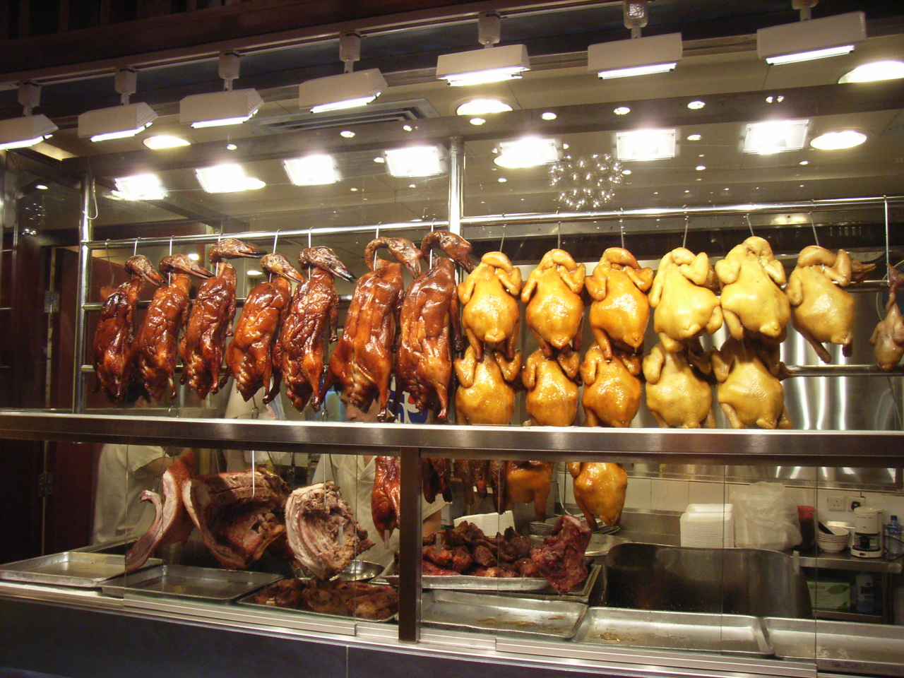
Introduction
I love Cantonese food, and I order quite often from various Cantonese restaurants nearby.
For this project, I want to create an API that is capable of handling customer orders and keep the records in a database for a restaurant.
Welcome to Restaurant X.

Slide 3

TECH STACK
Visual Studio 2022
Microsoft SQL server 2019
Microsoft SQL Server Management Studio
Swagger
Serilog
ADO.NET
ASP.NET CoRE
C#
SQL

Slide 4
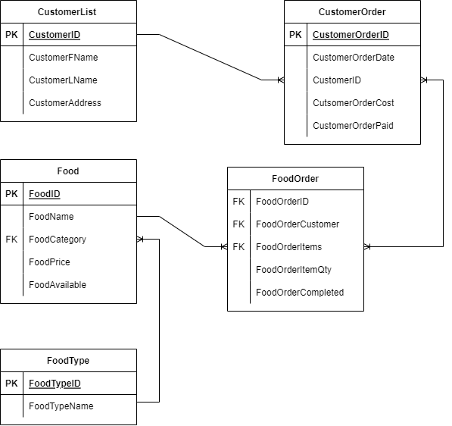
Entity-relation diagram

Slide 5
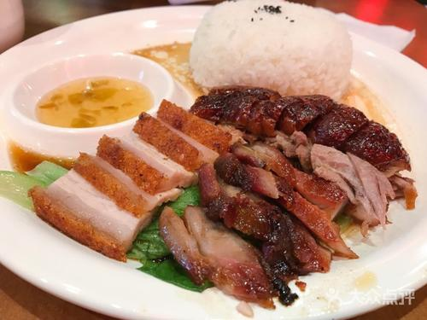
Current functionalities
Customer list: Create, Read/access, update, delete
Customer order: create, read/access, update, delete
Food item list for customer order: create, read/access, update, delete
Food menu : create, read/access, update, delete
Food type: create, read/access, update, delete
Logs – tracking system information and error occurred with above functionalities

Slide 6
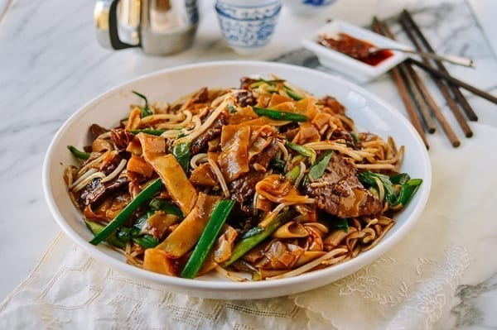
Functionalities to be added in the future
Extra food selection: BBQ Meat selection for food items
Customer order types (dine-in, pick-up, delivery)
Customer Payment methods (credit card info) and selection (cash, card)

Slide 7
Project Demonstration

