Slide 1

Chapter 13 – Recursion
Big Java by Cay Horstmann
Copyright © 2009 by John Wiley & Sons. All rights reserved.

Slide 2
Chapter Goals
To learn about the method of recursion
To understand the relationship between recursion and iteration
To analyze problems that are much easier to solve by recursion than by iteration
To learn to “think recursively”
To be able to use recursive helper methods
To understand when the use of recursion affects the efficiency of an algorithm

Slide 3
Triangle Numbers
Compute the area of a triangle of width n
Assume each [] square has an area of 1
Also called the n^{th} triangle number
The third triangle number is 6
  []
  [][]
  [][][]

Slide 4
Outline of Triangle Class
public class Triangle
{
private int width;
public Triangle(int aWidth)
{
width = aWidth;
}
public int getArea()
{
...
}
}

Slide 5
Handling Triangle of Width 1
The triangle consists of a single square
Its area is 1
Add the code to getArea method for width 1
  public int getArea()
  {
  if (width == 1) { return 1; }
  ...
  }

Slide 6
Handling the General Case
Assume we know the area of the smaller, colored triangle:
  []
  [][]
  [][][]
  [][][][]
Area of larger triangle can be calculated as:
  smallerArea + width
To get the area of the smaller triangle
  Make a smaller triangle and ask it for its area:
  Triangle smallerTriangle = new Triangle(width - 1);
  int smallerArea = smallerTriangle.getArea();

Slide 7
Completed getArea Method
public int getArea()
{
if (width == 1) { return 1; }
Triangle smallerTriangle = new Triangle(width - 1);
int smallerArea = smallerTriangle.getArea();
return smallerArea + width;
}

Slide 8
Computing the area of a triangle with width 4
getArea method makes a smaller triangle of width 3
It calls getArea on that triangle
  That method makes a smaller triangle of width 2
  It calls getArea on that triangle
    That method makes a smaller triangle of width 1
    It calls getArea on that triangle
      That method returns 1
    The method returns smallerArea + width = 1 + 2 = 3
  The method returns smallerArea + width = 3 + 3 = 6
The method returns smallerArea + width = 6 + 4 = 10

Slide 9
Recursion
A recursive computation solves a problem by using the solution of the same problem with simpler values
For recursion to terminate, there must be special cases for the simplest inputs
To complete our Triangle example, we must handle width <= 0:
  if (width <= 0) return 0;
Two key requirements for recursion success:
  Every recursive call must simplify the computation in some way
  There must be special cases to handle the simplest computations directly

Slide 10
Other Ways to Compute Triangle Numbers
The area of a triangle equals the sum:
  1 + 2 + 3 + ... + width
Using a simple loop:
  double area = 0;
  for (int i = 1; i <= width; i++)
  area = area + i;
Using math:
  1 + 2 + ... + n = n × (n + 1)/2
  => width * (width + 1) / 2

Slide 11
ch13/triangle/Triangle.java
1 /**
2 A triangular shape composed of stacked unit squares like this:
3 []
4 [][]
5 [][][]
6 . . .
7 */
8 public class Triangle
9 {
10 private int width;
11
12 /**
13 Constructs a triangular shape.
14 @param aWidth the width (and height) of the triangle
15 */
16 public Triangle(int aWidth)
17 {
18 width = aWidth;
19 }
20
Continued

Slide 12
ch13/triangle/Triangle.java (cont.)
21 /**
22 Computes the area of the triangle.
23 @return the area
24 */
25 public int getArea()
26 {
27 if (width <= 0) { return 0; }
28 if (width == 1) { return 1; }
29 Triangle smallerTriangle = new Triangle(width - 1);
30 int smallerArea = smallerTriangle.getArea();
31 return smallerArea + width;
32 }
33 }

Slide 13
ch13/triangle/TriangleTester.java
1 public class TriangleTester
2 {
3 public static void main(String[] args)
4 {
5 Triangle t = new Triangle(10);
6 int area = t.getArea();
7 System.out.println("Area: " + area);
8 System.out.println("Expected: 55");
9 }
10 }
Program Run:
  Enter width: 10
  Area: 55
  Expected: 55

Slide 14
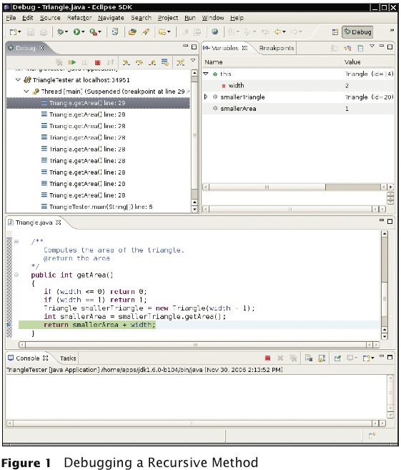
Tracing Through Recursive Methods

Slide 15
Thinking Recursively
Problem: Test whether a sentence is a palindrome
Palindrome: A string that is equal to itself when you reverse all characters
  A man, a plan, a canal – Panama!
  Go hang a salami, I’m a lasagna hog
  Madam, I’m Adam

Slide 16
Implement isPalindrome Method
public class Sentence
{
private String text;
/**
Constructs a sentence.
@param aText a string containing all characters of
the sentence
*/
public Sentence(String aText)
{
text = aText;
}
/**
Tests whether this sentence is a palindrome.
@return true if this sentence is a palindrome, false
otherwise
*/
Continued

Slide 17
Implement isPalindrome Method (cont.)
public boolean isPalindrome()
{
...
}
}

Slide 18
Thinking Recursively: Step-by-Step
Consider various ways to simplify inputs
Here are several possibilities:
  Remove the first character
  Remove the last character
  Remove both the first and last characters
  Remove a character from the middle
  Cut the string into two halves

Slide 19
Thinking Recursively: Step-by-Step
Combine solutions with simpler inputs into a solution of the original problem
  Most promising simplification: Remove first and last characters
  “adam, I’m Ada” is a palindrome too!
  Thus, a word is a palindrome if
    The first and last letters match, and
    Word obtained by removing the first and last letters is a palindrome
  What if first or last character is not a letter? Ignore it
    If the first and last characters are letters, check whether they match;
    if so, remove both and test shorter string
    If last character isn’t a letter, remove it and test shorter string
    If first character isn’t a letter, remove it and test shorter string

Slide 20
Thinking Recursively: Step-by-Step
Find solutions to the simplest inputs
  Strings with two characters
    No special case required; step two still applies
  Strings with a single character
    They are palindromes
  The empty string
    It is a palindrome

Slide 21
Thinking Recursively: Step-by-Step
Implement the solution by combining the simple cases and the reduction step
public boolean isPalindrome()
{
int length = text.length();
// Separate case for shortest strings.
if (length <= 1) { return true; }
// Get first and last characters, converted to
// lowercase.
char first = Character.toLowerCase(text.charAt(0));
char last = Character.toLowerCase(text.charAt(
length - 1));
if (Character.isLetter(first) &&
Character.isLetter(last))
{
// Both are letters.
if (first == last)
{
Continued

Slide 22
Thinking Recursively: Step-by-Step (cont.)
// Remove both first and last character.
Sentence shorter = new
Sentence(text.substring(1, length - 1));
return shorter.isPalindrome();
}
else
return false;
}
else if (!Character.isLetter(last))
{
// Remove last character.
Sentence shorter = new Sentence(text.substring(0,
length - 1));
return shorter.isPalindrome();
}
else
{
Continued

Slide 23
Thinking Recursively: Step-by-Step (cont.)
// Remove first character.
Sentence shorter = new
Sentence(text.substring(1));
return shorter.isPalindrome();
}
}

Slide 24
Recursive Helper Methods
Sometimes it is easier to find a recursive solution if you make a slight change to the original problem
Consider the palindrome test of previous slide
It is a bit inefficient to construct new Sentence objects in every step

Slide 25
Recursive Helper Methods
Rather than testing whether the sentence is a palindrome, check whether a substring is a palindrome:
/**
Tests whether a substring of the sentence is a
palindrome.
@param start the index of the first character of the
substring
@param end the index of the last character of the
substring
@return true if the substring is a palindrome
*/
public boolean isPalindrome(int start, int end)

Slide 26
Recursive Helper Methods
Then, simply call the helper method with positions that test the entire string:
  public boolean isPalindrome()
  {
  return isPalindrome(0, text.length() - 1);
  }

Slide 27
Recursive Helper Methods: isPalindrome
public boolean isPalindrome(int start, int end)
{
// Separate case for substrings of length 0 and 1.
if (start >= end) return true;
// Get first and last characters, converted to
// lowercase.
char first = Character.toLowerCase(text.charAt(start));
char last = Character.toLowerCase(text.charAt(end));
if (Character.isLetter(first) &&
Character.isLetter(last))
{
if (first == last)
{
// Test substring that doesn't contain the
// matching letters.
return isPalindrome(start + 1, end - 1);
}
else return false;
Continued

Slide 28
Recursive Helper Methods: isPalindrome (cont.)
}
else if (!Character.isLetter(last))
{
// Test substring that doesn't contain the last
// character.
return isPalindrome(start, end - 1);
}
else
{
// Test substring that doesn't contain the first
// character.
return isPalindrome(start + 1, end);
}
}

Slide 29
Fibonacci Sequence
Fibonacci sequence is a sequence of numbers defined by
f₁ = 1
f₂ = 1
f_{n} = f_{n-1} + f_{n-2}
First ten terms:
1, 1, 2, 3, 5, 8, 13, 21, 34, 55

Slide 30
ch13/fib/RecursiveFib.java
1 import java.util.Scanner;
2
3 /**
4 This program computes Fibonacci numbers using a recursive method.
5 */
6 public class RecursiveFib
7 {
8 public static void main(String[] args)
9 {
10 Scanner in = new Scanner(System.in);
11 System.out.print("Enter n: ");
12 int n = in.nextInt();
13
14 for (int i = 1; i <= n; i++)
15 {
16 long f = fib(i);
17 System.out.println("fib(" + i + ") = " + f);
18 }
19 }
20
Continued

Slide 31
ch13/fib/RecursiveFib.java (cont.)
21 /**
22 Computes a Fibonacci number.
23 @param n an integer
24 @return the nth Fibonacci number
25 */
26 public static long fib(int n)
27 {
28 if (n <= 2) { return 1; }
29 else return fib(n - 1) + fib(n - 2);
30 }
31 }
Program Run:
Enter n: 50
fib(1) = 1
fib(2) = 1
fib(3) = 2
fib(4) = 3
fib(5) = 5
fib(6) = 8
fib(7) = 13
...
fib(50) = 12586269025

Slide 32
The Efficiency of Recursion
Recursive implementation of fib is straightforward
Watch the output closely as you run the test program
First few calls to fib are quite fast
For larger values, the program pauses an amazingly long time between outputs
To find out the problem, let’s insert trace messages

Slide 33
ch13/fib/RecursiveFibTracer.java
1 import java.util.Scanner;
2
3 /**
4 This program prints trace messages that show how often the
5 recursive method for computing Fibonacci numbers calls itself.
6 */
7 public class RecursiveFibTracer
8 {
9 public static void main(String[] args)
10 {
11 Scanner in = new Scanner(System.in);
12 System.out.print("Enter n: ");
13 int n = in.nextInt();
14
15 long f = fib(n);
16
17 System.out.println("fib(" + n + ") = " + f);
18 }
19
Continued

Slide 34
ch13/fib/RecursiveFibTracer.java (cont.)
20 /**
21 Computes a Fibonacci number.
22 @param n an integer
23 @return the nth Fibonacci number
24 */
25 public static long fib(int n)
26 {
27 System.out.println("Entering fib: n = " + n);
28 long f;
29 if (n <= 2) { f = 1; }
30 else { f = fib(n - 1) + fib(n - 2); }
31 System.out.println("Exiting fib: n = " + n
32 + " return value = " + f);
33 return f;
34 }
35 }
Continued

Slide 35
ch13/fib/RecursiveFibTracer.java (cont.)
Program Run:
  Enter n: 6
  Entering fib: n = 6
  Entering fib: n = 5
  Entering fib: n = 4
  Entering fib: n = 3
  Entering fib: n = 2
  Exiting fib: n = 2 return value = 1
  Entering fib: n = 1
  Exiting fib: n = 1 return value = 1
  Exiting fib: n = 3 return value = 2
  Entering fib: n = 2
  Exiting fib: n = 2 return value = 1
  Exiting fib: n = 4 return value = 3
  Entering fib: n = 3
  Entering fib: n = 2
  Exiting fib: n = 2 return value = 1
  Entering fib: n = 1
  Exiting fib: n = 1 return value = 1
Continued

Slide 36
ch13/fib/RecursiveFibTracer.java (cont)
  Exiting fib: n = 1 return value = 1
  Exiting fib: n = 3 return value = 2
  Exiting fib: n = 5 return value = 5
  Entering fib: n = 4
  Entering fib: n = 3
  Entering fib: n = 2
  Exiting fib: n = 2 return value = 1
  Entering fib: n = 1
  Exiting fib: n = 1 return value = 1
  Exiting fib: n = 3 return value = 2
  Entering fib: n = 2
  Exiting fib: n = 2 return value = 1
  Exiting fib: n = 4 return value = 3
  Exiting fib: n = 6 return value = 8
  fib(6) = 8

Slide 37
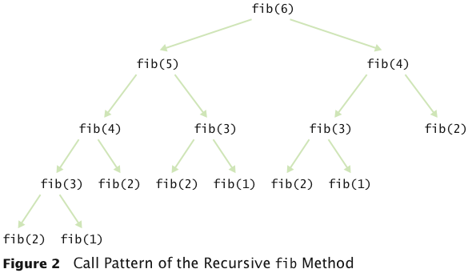
Call Tree for Computing fib(6)

Slide 38
The Efficiency of Recursion
Method takes so long because it computes the same values over and over
The computation of fib(6) calls fib(3) three times
Imitate the pencil-and-paper process to avoid computing the values more than once

Slide 39
ch13/fib/LoopFib.java
1 import java.util.Scanner;
2
3 /**
4 This program computes Fibonacci numbers using an iterative method.
5 */
6 public class LoopFib
7 {
8 public static void main(String[] args)
9 {
10 Scanner in = new Scanner(System.in);
11 System.out.print("Enter n: ");
12 int n = in.nextInt();
13
14 for (int i = 1; i <= n; i++)
15 {
16 long f = fib(i);
17 System.out.println("fib(" + i + ") = " + f);
18 }
19 }
20
Continued

Slide 40
ch13/fib/LoopFib.java (cont.)
21 /**
22 Computes a Fibonacci number.
23 @param n an integer
24 @return the nth Fibonacci number
25 */
26 public static long fib(int n)
27 {
28 if (n <= 2) { return 1; }
29 long olderValue = 1;
30 long oldValue = 1;
31 long newValue = 1;
32 for (int i = 3; i <= n; i++)
33 {
34 newValue = oldValue + olderValue;
35 olderValue = oldValue;
36 oldValue = newValue;
37 }
38 return newValue;
39 }
40 }
Continued

Slide 41
ch13/fib/LoopFib.java (cont.)
Program Run:
  Enter n: 50
  fib(1) = 1
  fib(2) = 1
  fib(3) = 2
  fib(4) = 3
  fib(5) = 5
  fib(6) = 8
  fib(7) = 13
  ...
  fib(50) = 12586269025

Slide 42
The Efficiency of Recursion
Occasionally, a recursive solution runs much slower than its iterative counterpart
In most cases, the recursive solution is only slightly slower
The iterative isPalindrome performs only slightly better than recursive solution
  Each recursive method call takes a certain amount of processor time
Smart compilers can avoid recursive method calls if they follow simple patterns
Most compilers don’t do that
In many cases, a recursive solution is easier to understand and implement correctly than an iterative solution
“To iterate is human, to recurse divine.” L. Peter Deutsch

Slide 43
Iterative isPalindrome Method
public boolean isPalindrome()
{
int start = 0;
int end = text.length() - 1;
while (start < end)
{
char first =
Character.toLowerCase(text.charAt(start));
char last = Character.toLowerCase(text.charAt(end);
if (Character.isLetter(first) &&
Character.isLetter(last))
{
// Both are letters.
if (first == last)
{
start++;
end--;
}
Continued

Slide 44
Iterative isPalindrome Method (cont.)
else
return false;
}
if (!Character.isLetter(last))
end--;
if (!Character.isLetter(first))
start++;
}
return true;
}

Slide 45
Permutations
Design a class that will list all permutations of a string
A permutation is a rearrangement of the letters
The string "eat" has six permutations:
  "eat"
  "eta"
  "aet"
  "tea"
  "tae"

Slide 46
Public Interface of PermutationGenerator
public class PermutationGenerator
{
public PermutationGenerator(String aWord) { ... }
ArrayList<String> getPermutations() { ... }
}

Slide 47
ch13/permute/PermutationGeneratorDemo.java
1 import java.util.ArrayList;
2
3 /**
4 This program demonstrates the permutation generator.
5 */
6 public class PermutationGeneratorDemo
7 {
8 public static void main(String[] args)
9 {
10 PermutationGenerator generator = new PermutationGenerator("eat");
11 ArrayList<String> permutations = generator.getPermutations();
12 for (String s : permutations)
13 {
14 System.out.println(s);
15 }
16 }
17 }
18
Continued

Slide 48
ch13/permute/PermutationGeneratorDemo.java (cont.)
Program Run:
  eat
  eta
  aet
  ate
  tea
  tae

Slide 49
To Generate All Permutations
Generate all permutations that start with 'e', then 'a', then 't'
To generate permutations starting with 'e', we need to find all permutations of "at"
This is the same problem with simpler inputs
Use recursion

Slide 50
To Generate All Permutations
getPermutations: Loop through all positions in the word to be permuted
For each position, compute the shorter word obtained by removing i^{th} letter:
String shorterWord = word.substring(0, i) +
word.substring(i + 1);
Construct a permutation generator to get permutations of the shorter word:
PermutationGenerator shorterPermutationGenerator
= new PermutationGenerator(shorterWord); ArrayList<String> shorterWordPermutations
= shorterPermutationGenerator.getPermutations();

Slide 51
To Generate All Permutations
Finally, add the removed letter to front of all permutations of the shorter word:
  for (String s : shorterWordPermutations)
  {
  result.add(word.charAt(i) + s);
  }
Special case: Simplest possible string is the empty string; single permutation, itself

Slide 52
ch13/permute/PermutationGenerator.java
1 import java.util.ArrayList;
2
3 /**
4 This class generates permutations of a word.
5 */
6 public class PermutationGenerator
7 {
8 private String word;
9
10 /**
11 Constructs a permutation generator.
12 @param aWord the word to permute
13 */
14 public PermutationGenerator(String aWord)
15 {
16 word = aWord;
17 }
18
Continued

Slide 53
ch13/permute/PermutationGenerator.java (cont.)
19 /**
20 Gets all permutations of a given word.
21 */
22 public ArrayList<String> getPermutations()
23 {
24 ArrayList<String> permutations = new ArrayList<String>();
25
26 // The empty string has a single permutation: itself
27 if (word.length() == 0)
28 {
29 permutations.add(word);
30 return permutations;
31 }
32
Continued

Slide 54
ch13/permute/PermutationGenerator.java (cont.)
33 // Loop through all character positions
34 for (int i = 0; i < word.length(); i++)
35 {
36 // Form a simpler word by removing the ith character
37 String shorterWord = word.substring(0, i)
38 + word.substring(i + 1);
39
40 // Generate all permutations of the simpler word
41 PermutationGenerator shorterPermutationGenerator
42 = new PermutationGenerator(shorterWord);
43 ArrayList<String> shorterWordPermutations
44 = shorterPermutationGenerator.getPermutations();
45
46 // Add the removed character to the front of
47 // each permutation of the simpler word,
48 for (String s : shorterWordPermutations)
49 {
50 permutations.add(word.charAt(i) + s);
51 }
52 }
53 // Return all permutations
54 return permutations;
55 }
56 }

Slide 55
Using Mutual Recursions
Problem: To compute the value of arithmetic expressions such as
  3 + 4 * 5
  (3 + 4) * 5
  1 - (2 - (3 - (4 - 5)))
Computing expression is complicated
  * and / bind more strongly than + and –
  Parentheses can be used to group subexpressions

Slide 56
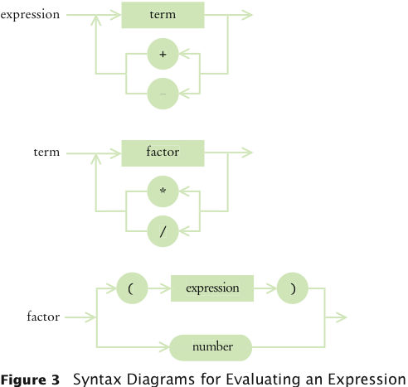
Syntax Diagrams for Evaluating an Expression

Slide 57
Using Mutual Recursions
An expression can broken down into a sequence of terms, separated by + or -
Each term is broken down into a sequence of factors, separated by * or /
Each factor is either a parenthesized expression or a number
The syntax trees represent which operations should be carried out first

Slide 58
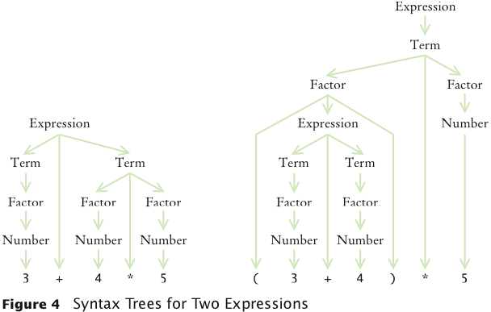
Syntax Tree for Two Expressions

Slide 59
Mutually Recursive Methods
In a mutual recursion, a set of cooperating methods calls each other repeatedly
To compute the value of an expression, implement 3 methods that call each other recursively:
  getExpressionValue
  getTermValue
  getFactorValue

