Slide 1
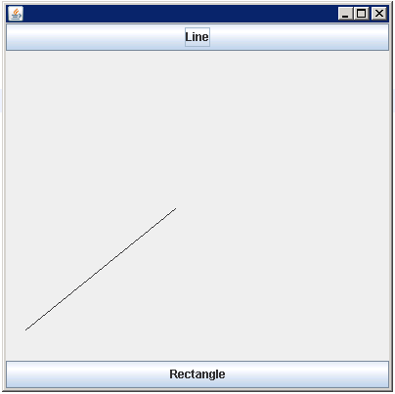
GUI Example 1
import javax.swing.JFrame;
public class Viewer1
{
public static void main(String[] args)
{
JFrame frame= new JFrame();
frame.setSize(400,400);
frame.setDefaultCloseOperation(JFrame.EXIT_ON_CLOSE);
twoshape t1=new twoshape();
frame.add(t1);
frame.setVisible(true);
}
}

Slide 2
import java.awt.BorderLayout;
import java.awt.Graphics;
import java.awt.Graphics2D;
import java.awt.Rectangle;
import java.awt.event.ActionEvent;
import java.awt.event.ActionListener;
import java.awt.geom.Line2D;
import java.util.Random;
import javax.swing.JButton;
import javax.swing.JComboBox;
import javax.swing.JPanel;
public class twoshape extends JPanel
{
private JButton Linebutton;
private JButton Rectbutton;
String shape="";
Random r1= new Random();
public twoshape()
{
Linebutton=new JButton("Line");
Rectbutton=new JButton("Rectangle");
this.setLayout(new BorderLayout());
lineListener l1=new lineListener();
RectListener rec=new RectListener();
Linebutton.addActionListener(l1);
Rectbutton.addActionListener(rec);
this.add(Linebutton,BorderLayout.NORTH);
this.add(Rectbutton,BorderLayout.SOUTH);;
}

Slide 3
public void paintComponent(Graphics g)
{
super.paintComponent(g);
Graphics2D g2=(Graphics2D)g;
if(shape.equals("Line"))
{
g2.draw(new Line2D.Double(r1.nextInt(300),r1.nextInt(300),r1.nextInt(400),r1.nextInt(400)));
}
else
g2.draw(new Rectangle(r1.nextInt(300),r1.nextInt(300),r1.nextInt(400),r1.nextInt(400)));
}
public class lineListener implements ActionListener
{
public void actionPerformed(ActionEvent arg0)
{
shape="Line";
repaint();
}
}

Slide 4
public class RectListener implements ActionListener
{
public void actionPerformed(ActionEvent e)
{
shape="Rectangle";
repaint();
}
}
}

Slide 5

Chapter 9 – Interfaces and Polymorphism
Big Java by Cay Horstmann
Copyright © 2009 by John Wiley & Sons. All rights reserved.

Slide 6
Chapter Goals
To be able to declare and use interface types
To understand the concept of polymorphism
To appreciate how interfaces can be used to decouple classes
To learn how to implement helper classes as inner classes
G To implement event listeners in graphical applications

Slide 7
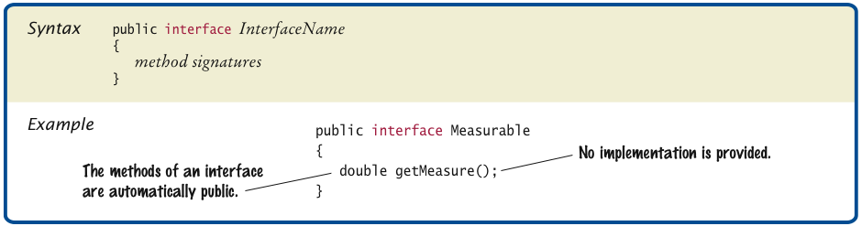
Syntax 9.1 Declaring an Interface

Slide 8
Interfaces vs. Classes
An interface type is similar to a class, but there are several important differences:
All methods in an interface type are abstract; they don’t have an implementation
All methods in an interface type are automatically public
An interface type does not have instance fields

Slide 9
Generic DataSet for Measurable Objects
public class DataSet {
private double sum; private Measurable maximum; private int count; ... public void add(Measurable x) { sum = sum + x.getMeasure(); if (count == 0 || maximum.getMeasure() < x.getMeasure()) maximum = x; count++; } public Measurable getMaximum() { return maximum; } }

Slide 10
Implementing an Interface Type
Use implements reserved word to indicate that a class implements an interface type:
public class BankAccount implements Measurable { public double getMeasure() {
... return balance; } }
A class can implement more than one interface type
Class must declare all the methods that are required by all the interfaces it implements

Slide 11
Implementing an Interface Type
Another example:
public class Coin implements Measurable
{
public double getMeasure()
{
return value;
}
...
}

Slide 12
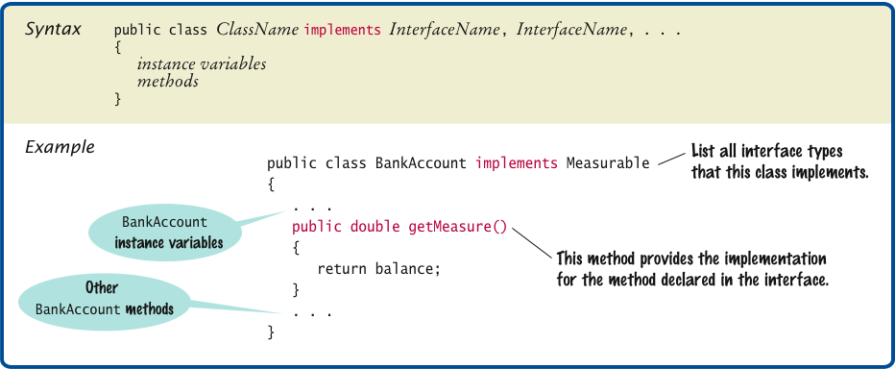
Syntax 9.2 Implementing an Interface

Slide 13
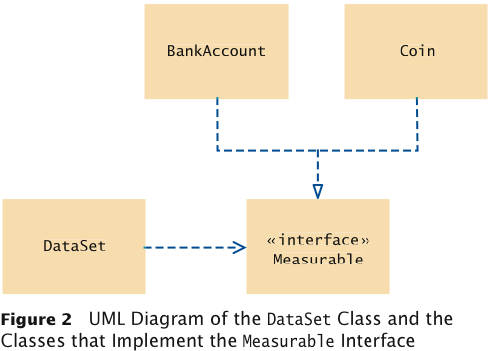
UML Diagram of DataSet and Related Classes
Interfaces can reduce the coupling between classes
UML notation:
Interfaces are tagged with a “stereotype” indicator «interface»
A dotted arrow with a triangular tip denotes the “is-a” relationship between a class and an interface
A dotted line with an open v-shaped arrow tip denotes the “uses” relationship or dependency
Note that DataSet is decoupled from BankAccount and Coin

Slide 14
ch09/measure1/DataSetTester.java
1 /**
2 This program tests the DataSet class.
3 */
4 public class DataSetTester
5 {
6 public static void main(String[] args)
7 {
8 DataSet bankData = new DataSet();
9
10 bankData.add(new BankAccount(0));
11 bankData.add(new BankAccount(10000));
12 bankData.add(new BankAccount(2000));
13
14 System.out.println("Average balance: " + bankData.getAverage());
15 System.out.println("Expected: 4000");
16 Measurable max = bankData.getMaximum();
17 System.out.println("Highest balance: " + max.getMeasure());
18 System.out.println("Expected: 10000");
19
20 DataSet coinData = new DataSet();
21
Continued

Slide 15
ch09/measure1/DataSetTester.java (cont.)
22 coinData.add(new Coin(0.25, "quarter"));
23 coinData.add(new Coin(0.1, "dime"));
24 coinData.add(new Coin(0.05, "nickel"));
25
26 System.out.println("Average coin value: " + coinData.getAverage());
27 System.out.println("Expected: 0.133");
28 max = coinData.getMaximum();
29 System.out.println("Highest coin value: " + max.getMeasure());
30 System.out.println("Expected: 0.25");
31 }
32 }

Slide 16
ch09/measure1/DataSetTester.java (cont.)
Program Run:
Average balance: 4000.0 Expected: 4000 Highest balance: 10000.0 Expected: 10000 Average coin value: 0.13333333333333333 Expected: 0.133 Highest coin value: 0.25 Expected: 0.25

Slide 17
Converting Between Class and Interface Types
You can convert from a class type to an interface type, provided the class implements the interface
BankAccount account = new BankAccount(10000); Measurable x = account; // OK
Coin dime = new Coin(0.1, "dime"); Measurable x = dime; // Also OK
Cannot convert between unrelated types:
Measurable x = new Rectangle(5, 10, 20, 30); // ERROR
Because Rectangle doesn’t implement Measurable

Slide 18
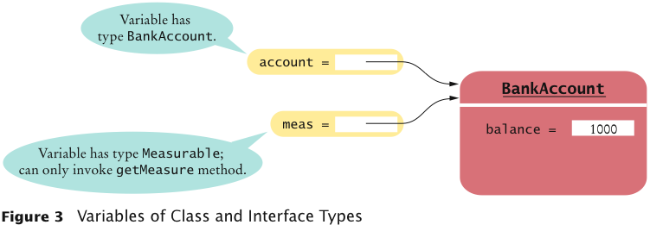
Variables of Class and Interface Types

Slide 19
Casts
Add Coin objects to DataSet:
DataSet coinData = new DataSet(); coinData.add(new Coin(0.25, "quarter")); coinData.add(new Coin(0.1, "dime")); coinData.add(new Coin(0.05, ”nickel")); Measurable max = coinData.getMaximum(); // Get the largest coin
What can you do with max? It’s not of type Coin:
String name = max.getName(); // ERROR
You need a cast to convert from an interface type to a class type
You know it’s a Coin, but the compiler doesn’t. Apply a cast:
Coin maxCoin = (Coin) max; String name = maxCoin.getName();

Slide 20
Casts
If you are wrong and max isn’t a coin, the program throws an exception and terminates
Difference with casting numbers:
When casting number types you agree to the information loss
When casting object types you agree to that risk of causing an exception

Slide 21
Polymorphism
An interface variable holds a reference to object of a class that implements the interface:
Measurable meas; meas = new BankAccount(10000); meas = new Coin(0.1, "dime");
Note that the object to which meas refers doesn’t have type Measurable; the type of the object is some class that implements the Measurable interface
You can call any of the interface methods:
double m = meas.getMeasure();
Which method is called?

Slide 22
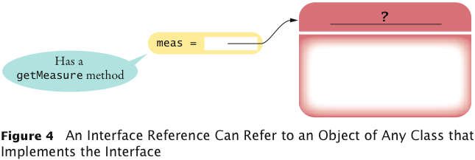
Interface Reference

Slide 23
Polymorphism
When the virtual machine calls an instance method, it locates the method of the implicit parameter's class — called dynamic method lookup
If meas refers to a BankAccount object, then meas.getMeasure() calls the BankAccount.getMeasure method
If meas refers to a Coin object, then method Coin.getMeasure is called
Polymorphism (many shapes) denotes the ability to treat objects with differences in behavior in a uniform way

Slide 24
Using Interfaces for Callbacks
Limitations of Measurable interface:
Can add Measurable interface only to classes under your control
Can measure an object in only one way
E.g., cannot analyze a set of savings accounts both by bank balance and by interest rate
Callback: a mechanism for specifying code that is executed at a later time
In previous DataSet implementation, responsibility of measuring lies with the added objects themselves

Slide 25
Using Interfaces for Callbacks
Alternative: Hand the object to be measured to a method of an interface:
public interface Measurer { double measure(Object anObject); }
Object is the “lowest common denominator” of all classes

Slide 26
Using Interfaces for Callbacks
The code that makes the call to the callback receives an object of class that implements this interface:
public DataSet(Measurer aMeasurer)
{
sum = 0;
count = 0;
maximum = null;
measurer = aMeasurer; // Measurer instance variable
}
The measurer instance variable carries out the measurements:
public void add(Object x)
{
sum = sum + measurer.measure(x);
if (count == 0 || measurer.measure(maximum) < measurer.measure(x))
maximum = x;
count++;
}

Slide 27
Using Interfaces for Callbacks
A specific callback is obtained by implementing the Measurer interface:
public class RectangleMeasurer implements Measurer { public double measure(Object anObject) { Rectangle aRectangle = (Rectangle) anObject; double area = aRectangle.getWidth() * aRectangle.getHeight(); return area; } }
Must cast from Object to Rectangle:
Rectangle aRectangle = (Rectangle) anObject;

Slide 28
Using Interfaces for Callbacks
Pass measurer to data set constructor:
Measurer m = new RectangleMeasurer(); DataSet data = new DataSet(m); data.add(new Rectangle(5, 10, 20, 30)); data.add(new Rectangle(10, 20, 30, 40));
...

Slide 29
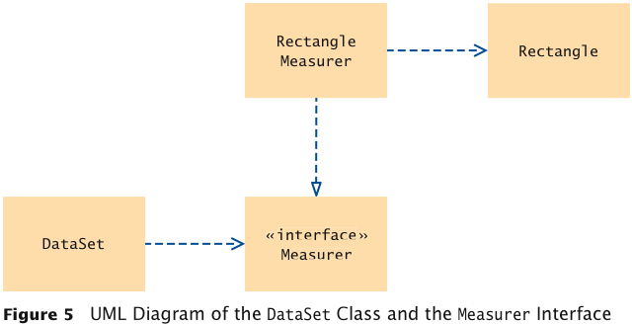
UML Diagram of Measurer Interface and Related Classes
Note that the Rectangle class is decoupled from the Measurer interface

Slide 30
ch09/measure2/Measurer.java
1 /**
2 Describes any class whose objects can measure other objects.
3 */
4 public interface Measurer
5 {
6 /**
7 Computes the measure of an object.
8 @param anObject the object to be measured
9 @return the measure
10 */
11 double measure(Object anObject);
12 }

Slide 31
ch09/measure2/RectangleMeasurer.java
1 import java.awt.Rectangle;
2
3 /**
4 Objects of this class measure rectangles by area.
5 */
6 public class RectangleMeasurer implements Measurer
7 {
8 public double measure(Object anObject)
9 {
10 Rectangle aRectangle = (Rectangle) anObject;
11 double area = aRectangle.getWidth() * aRectangle.getHeight();
12 return area;
13 }
14 }

Slide 32
ch09/measure2/DataSet.java
1 /**
2 Computes the average of a set of data values.
3 */
4 public class DataSet
5 {
6 private double sum;
7 private Object maximum;
8 private int count;
9 private Measurer measurer;
10
11 /**
12 Constructs an empty data set with a given measurer.
13 @param aMeasurer the measurer that is used to measure data values
14 */
15 public DataSet(Measurer aMeasurer)
16 {
17 sum = 0;
18 count = 0;
19 maximum = null;
20 measurer = aMeasurer;
21 }
22
Continued

Slide 33
ch09/measure2/DataSet.java (cont.)
23 /**
24 Adds a data value to the data set.
25 @param x a data value
26 */
27 public void add(Object x)
28 {
29 sum = sum + measurer.measure(x);
30 if (count == 0 || measurer.measure(maximum) < measurer.measure(x))
31 maximum = x;
32 count++;
33 }
34
35 /**
36 Gets the average of the added data.
37 @return the average or 0 if no data has been added
38 */
39 public double getAverage()
40 {
41 if (count == 0) return 0;
42 else return sum / count;
43 }
44
Continued

Slide 34
ch09/measure2/DataSet.java (cont.)
45 /**
46 Gets the largest of the added data.
47 @return the maximum or 0 if no data has been added
48 */
49 public Object getMaximum()
50 {
51 return maximum;
52 }
53 }

Slide 35
ch09/measure2/DataSetTester2.java
1 import java.awt.Rectangle;
2
3 /**
4 This program demonstrates the use of a Measurer.
5 */
6 public class DataSetTester2
7 {
8 public static void main(String[] args)
9 {
10 Measurer m = new RectangleMeasurer();
11
12 DataSet data = new DataSet(m);
13
14 data.add(new Rectangle(5, 10, 20, 30));
15 data.add(new Rectangle(10, 20, 30, 40));
16 data.add(new Rectangle(20, 30, 5, 15));
17
18 System.out.println("Average area: " + data.getAverage());
19 System.out.println("Expected: 625");
20
Continued

Slide 36
ch09/measure2/DataSetTester2.java (cont.)
21 Rectangle max = (Rectangle) data.getMaximum();
22 System.out.println("Maximum area rectangle: " + max);
23 System.out.println("Expected: "
24 + "java.awt.Rectangle[x=10,y=20,width=30,height=40]");
25 }
26 }
Program Run:
Average area: 625 Expected: 625 Maximum area rectangle:java.awt.Rectangle[x=10,y=20,width=30,height=40] Expected: java.awt.Rectangle[x=10,y=20,width=30,height=40]

Slide 37
Inner Classes
Trivial class can be declared inside a method:
public class DataSetTester3
{
public static void main(String[] args)
{
class RectangleMeasurer implements Measurer
{
...
}
Measurer m = new RectangleMeasurer();
DataSet data = new DataSet(m);
...
}
}

Slide 38
Inner Classes
If inner class is declared inside an enclosing class, but outside its methods, it is available to all methods of enclosing class:
public class DataSetTester3
{
class RectangleMeasurer implements Measurer
{
. . .
}
public static void main(String[] args)
{
Measurer m = new RectangleMeasurer();
DataSet data = new DataSet(m);
. . .
}
}

Slide 39
Inner Classes
Compiler turns an inner class into a regular class file:
DataSetTester$1$RectangleMeasurer.class

Slide 40
ch09/measure3/DataSetTester3.java
1 import java.awt.Rectangle;
2
3 /**
4 This program demonstrates the use of an inner class.
5 */
6 public class DataSetTester3
7 {
8 public static void main(String[] args)
9 {
10 class RectangleMeasurer implements Measurer
11 {
12 public double measure(Object anObject)
13 {
14 Rectangle aRectangle = (Rectangle) anObject;
15 double area
16 = aRectangle.getWidth() * aRectangle.getHeight();
17 return area;
18 }
19 }
20
21 Measurer m = new RectangleMeasurer();
22
23 DataSet data = new DataSet(m);
24
Continued

Slide 41
ch09/measure3/DataSetTester3.java (cont.)
25 data.add(new Rectangle(5, 10, 20, 30));
26 data.add(new Rectangle(10, 20, 30, 40));
27 data.add(new Rectangle(20, 30, 5, 15));
28
29 System.out.println("Average area: " + data.getAverage());
30 System.out.println("Expected: 625");
31
32 Rectangle max = (Rectangle) data.getMaximum();
33 System.out.println("Maximum area rectangle: " + max);
34 System.out.println("Expected: "
35 + "java.awt.Rectangle[x=10,y=20,width=30,height=40]");
36 }
37 }

Slide 42
Mock Objects
Want to test a class before the entire program has been completed
A mock object provides the same services as another object, but in a simplified manner
Example: a grade book application, GradingProgram, manages quiz scores using class GradeBook with methods:
public void addScore(int studentId, double score)
public double getAverageScore(int studentId)
public void save(String filename)
Want to test GradingProgram without having a fully functional GradeBook class

Slide 43
Mock Objects
Declare an interface type with the same methods that the GradeBook class provides
Convention: use the letter I as a prefix for the interface name:
public interface IGradeBook
{
void addScore(int studentId, double score);
double getAverageScore(int studentId);
void save(String filename);
. . .
}
The GradingProgram class should only use this interface, never the GradeBook class which implements this interface

Slide 44
Mock Objects
Meanwhile, provide a simplified mock implementation, restricted to the case of one student and without saving functionality:
public class MockGradeBook implements IGradeBook
{
private ArrayList<Double> scores;
public void addScore(int studentId, double score)
{
// Ignore studentId
scores.add(score);
}
double getAverageScore(int studentId)
{
double total = 0;
for (double x : scores) { total = total + x; }
return total / scores.size();
}
void save(String filename)
{
// Do nothing
}
. . .
}

Slide 45
Mock Objects
Now construct an instance of MockGradeBook and use it immediately to test the GradingProgram class
When you are ready to test the actual class, simply use a GradeBook instance instead
Don’t erase the mock class — it will still come in handy for regression testing

Slide 46
Events, Event Sources, and Event Listeners
User interface events include key presses, mouse moves, button clicks, and so on
Most programs don’t want to be flooded by boring events
A program can indicate that it only cares about certain specific events

Slide 47
Events, Event Sources, and Event Listeners
Event listener:
Notified when event happens
Belongs to a class that is provided by the application programmer
Its methods describe the actions to be taken when an event occurs
A program indicates which events it needs to receive by installing event listener objects
Event source:
User interface component that generates a particular event
Add an event listener object to the appropriate event source
When an event occurs, the event source notifies all event listeners

Slide 48
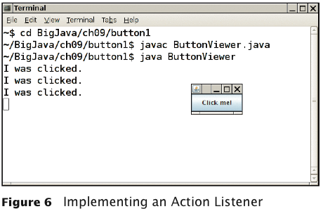
Events, Event Sources, and Event Listeners
Example: A program that prints a message whenever a button is clicked:

Slide 49
Events, Event Sources, and Event Listeners
Use JButton components for buttons; attach an ActionListener to each button
ActionListener interface:
public interface ActionListener { void actionPerformed(ActionEvent event); }
Need to supply a class whose actionPerformed method contains instructions to be executed when button is clicked
event parameter contains details about the event, such as the time at which it occurred

Slide 50
Events, Event Sources, and Event Listeners
Construct an object of the listener and add it to the button:
ActionListener listener = new ClickListener(); button.addActionListener(listener);

Slide 51
ch09/button1/ClickListener.java
1 import java.awt.event.ActionEvent;
2 import java.awt.event.ActionListener;
3
4 /**
5 An action listener that prints a message.
6 */
7 public class ClickListener implements ActionListener
8 {
9 public void actionPerformed(ActionEvent event)
10 {
11 System.out.println("I was clicked.");
12 }
13 }

Slide 52
ch09/button1/ButtonViewer.java
1 import java.awt.event.ActionListener;
2 import javax.swing.JButton;
3 import javax.swing.JFrame;
4
5 /**
6 This program demonstrates how to install an action listener.
7 */
8 public class ButtonViewer
9 {
10 private static final int FRAME_WIDTH = 100;
11 private static final int FRAME_HEIGHT = 60;
12
13 public static void main(String[] args)
14 {
15 JFrame frame = new JFrame();
16 JButton button = new JButton("Click me!");
17 frame.add(button);
18
19 ActionListener listener = new ClickListener();
20 button.addActionListener(listener);
21
Continued

Slide 53
ch09/button1/ButtonViewer.java (cont.)
22 frame.setSize(FRAME_WIDTH, FRAME_HEIGHT);
23 frame.setDefaultCloseOperation(JFrame.EXIT_ON_CLOSE);
24 frame.setVisible(true);
25 }
26 }

Slide 54
Using Inner Classes for Listeners
Implement simple listener classes as inner classes like this:
JButton button = new JButton("..."); // This inner class is declared in the same method as the // button variable
class MyListener implements ActionListener { ... }; ActionListener listener = new MyListener(); button.addActionListener(listener);
This places the trivial listener class exactly where it is needed, without cluttering up the remainder of the project

Slide 55
Using Inner Classes for Listeners
Methods of an inner class can access the variables from the enclosing scope
Local variables that are accessed by an inner class method must be declared as final
Example: Add interest to a bank account whenever a button is clicked:

Slide 56
Using Inner Classes for Listeners
JButton button = new JButton("Add Interest");
final BankAccount account =
new BankAccount(INITIAL_BALANCE);
// This inner class is declared in the same method as
// the account and button variables.
class AddInterestListener implements ActionListener
{
public void actionPerformed(ActionEvent event)
{
// The listener method accesses the account
// variable from the surrounding block
double interest = account.getBalance()
* INTEREST_RATE / 100;
account.deposit(interest);
}
};
ActionListener listener = new AddInterestListener();
button.addActionListener(listener);

Slide 57
ch09/button2/InvestmentViewer1.java
1 import java.awt.event.ActionEvent;
2 import java.awt.event.ActionListener;
3 import javax.swing.JButton;
4 import javax.swing.JFrame;
5
6 /**
7 This program demonstrates how an action listener can access
8 a variable from a surrounding block.
9 */
10 public class InvestmentViewer1
11 {
12 private static final int FRAME_WIDTH = 120;
13 private static final int FRAME_HEIGHT = 60;
14
15 private static final double INTEREST_RATE = 10;
16 private static final double INITIAL_BALANCE = 1000;
17
18 public static void main(String[] args)
19 {
20 JFrame frame = new JFrame();
21
Continued

Slide 58
ch09/button2/InvestmentViewer1.java (cont.)
22 // The button to trigger the calculation
23 JButton button = new JButton("Add Interest");
24 frame.add(button);
25
26 // The application adds interest to this bank account
27 final BankAccount account = new BankAccount(INITIAL_BALANCE);
28
29 class AddInterestListener implements ActionListener
30 {
31 public void actionPerformed(ActionEvent event)
32 {
33 // The listener method accesses the account variable
34 // from the surrounding block
35 double interest = account.getBalance() * INTEREST_RATE / 100;
36 account.deposit(interest);
37 System.out.println("balance: " + account.getBalance());
38 }
39 }
40
Continued

Slide 59
ch09/button2/InvestmentViewer1.java (cont.)
41 ActionListener listener = new AddInterestListener();
42 button.addActionListener(listener);
43
44 frame.setSize(FRAME_WIDTH, FRAME_HEIGHT);
45 frame.setDefaultCloseOperation(JFrame.EXIT_ON_CLOSE);
46 frame.setVisible(true);
47 }
48 }
Program Run:
balance: 1100.0
balance: 1210.0
balance: 1331.0
balance: 1464.1

Slide 60
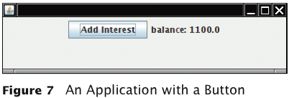
Building Applications with Buttons
Example: Investment viewer program; whenever button is clicked, interest is added, and new balance is displayed:

Slide 61
Building Applications with Buttons
Construct an object of the JButton class:
JButton button = new JButton("Add Interest");
We need a user interface component that displays a message:
JLabel label = new JLabel("balance: ”
+ account.getBalance());
Use a JPanel container to group multiple user interface components together:
JPanel panel = new JPanel();
panel.add(button);
panel.add(label);
frame.add(panel);

Slide 62
Building Applications with Buttons
Listener class adds interest and displays the new balance:
class AddInterestListener implements ActionListener { public void actionPerformed(ActionEvent event) { double interest = account.getBalance() * INTEREST_RATE / 100; account.deposit(interest); label.setText("balance=" + account.getBalance()); } }
Add AddInterestListener as inner class so it can have access to surrounding final variables (account and label)

Slide 63
ch09/button3/InvestmentViewer2.java
1 import java.awt.event.ActionEvent;
2 import java.awt.event.ActionListener;
3 import javax.swing.JButton;
4 import javax.swing.JFrame;
5 import javax.swing.JLabel;
6 import javax.swing.JPanel;
7 import javax.swing.JTextField;
8
9 /**
10 This program displays the growth of an investment.
11 */
12 public class InvestmentViewer2
13 {
14 private static final int FRAME_WIDTH = 400;
15 private static final int FRAME_HEIGHT = 100;
16
17 private static final double INTEREST_RATE = 10;
18 private static final double INITIAL_BALANCE = 1000;
19
20 public static void main(String[] args)
21 {
22 JFrame frame = new JFrame();
23
Continued

Slide 64
ch09/button3/InvestmentViewer2.java (cont.)
24 // The button to trigger the calculation
25 JButton button = new JButton("Add Interest");
26
27 // The application adds interest to this bank account
28 final BankAccount account = new BankAccount(INITIAL_BALANCE);
29
30 // The label for displaying the results
31 final JLabel label = new JLabel("balance: " + account.getBalance());
32
33 // The panel that holds the user interface components
34 JPanel panel = new JPanel();
35 panel.add(button);
36 panel.add(label);
37 frame.add(panel);
38
Continued

Slide 65
ch09/button3/InvestmentViewer2.java (cont.)
39 class AddInterestListener implements ActionListener
40 {
41 public void actionPerformed(ActionEvent event)
42 {
43 double interest = account.getBalance() * INTEREST_RATE / 100;
44 account.deposit(interest);
45 label.setText("balance: " + account.getBalance());
46 }
47 }
48
49 ActionListener listener = new AddInterestListener();
50 button.addActionListener(listener);
51
52 frame.setSize(FRAME_WIDTH, FRAME_HEIGHT);
53 frame.setDefaultCloseOperation(JFrame.EXIT_ON_CLOSE);
54 frame.setVisible(true);
55 }
56 }

Slide 66
Processing Timer Events
javax.swing.Timer generates equally spaced timer events, sending events to installed action listeners
Useful whenever you want to have an object updated in regular intervals

Slide 67
Processing Timer Events
Declare a class that implements the ActionListener interface:
class MyListener implements ActionListener { void actionPerformed(ActionEvent event) { Listener action (executed at each timer event) } }
Add listener to timer and start timer:
MyListener listener = new MyListener(); Timer t = new Timer(interval, listener); t.start();

Slide 68
ch09/timer/RectangleComponent.java
Displays a rectangle that can be moved
The repaint method causes a component to repaint itself. Call this method whenever you modify the shapes that the paintComponent method draws
1 import java.awt.Graphics;
2 import java.awt.Graphics2D;
3 import java.awt.Rectangle;
4 import javax.swing.JComponent;
5
6 /**
7 This component displays a rectangle that can be moved.
8 */
9 public class RectangleComponent extends JComponent
10 {
11 private static final int BOX_X = 100;
12 private static final int BOX_Y = 100;
13 private static final int BOX_WIDTH = 20;
14 private static final int BOX_HEIGHT = 30;
15
Continued

Slide 69
ch09/timer/RectangleComponent.java (cont.)
16 private Rectangle box;
17
18 public RectangleComponent()
19 {
20 // The rectangle that the paintComponent method draws
21 box = new Rectangle(BOX_X, BOX_Y, BOX_WIDTH, BOX_HEIGHT);
22 }
23
24 public void paintComponent(Graphics g)
25 {
26 Graphics2D g2 = (Graphics2D) g;
27
28 g2.draw(box);
29 }
30
Continued

Slide 70
ch09/timer/RectangleComponent.java (cont.)
31 /**
32 Moves the rectangle by a given amount.
33 @param x the amount to move in the x-direction
34 @param y the amount to move in the y-direction
35 */
36 public void moveBy(int dx, int dy)
37 {
38 box.translate(dx, dy);
39 repaint();
40 }
41 }
Big Java by Cay Horstmann
Copyright © 2009 by John Wiley & Sons. All rights reserved.

Slide 71
ch09/timer/RectangleMover.java
1 import java.awt.event.ActionEvent;
2 import java.awt.event.ActionListener;
3 import javax.swing.JFrame;
4 import javax.swing.Timer;
5
6 /**
7 This program moves the rectangle.
8 */
9 public class RectangleMover
10 {
11 private static final int FRAME_WIDTH = 300;
12 private static final int FRAME_HEIGHT = 400;
13
14 public static void main(String[] args)
15 {
16 JFrame frame = new JFrame();
17
18 frame.setSize(FRAME_WIDTH, FRAME_HEIGHT);
19 frame.setTitle("An animated rectangle");
20 frame.setDefaultCloseOperation(JFrame.EXIT_ON_CLOSE);
21
Continued

Slide 72
ch09/timer/RectangleMover.java (cont.)
22 final RectangleComponent component = new RectangleComponent();
23 frame.add(component);
24
25 frame.setVisible(true);
26
27 class TimerListener implements ActionListener
28 {
29 public void actionPerformed(ActionEvent event)
30 {
31 component.moveBy(1, 1);
32 }
33 }
34
35 ActionListener listener = new TimerListener();
36
37 final int DELAY = 100; // Milliseconds between timer ticks
38 Timer t = new Timer(DELAY, listener);
39 t.start();
40 }
41 }

Slide 73
Mouse Events
Use a mouse listener to capture mouse events
Implement the MouseListener interface:
public interface MouseListener { void mousePressed(MouseEvent event); // Called when a mouse button has been pressed on a // component void mouseReleased(MouseEvent event); // Called when a mouse button has been released on a // component void mouseClicked(MouseEvent event); // Called when the mouse has been clicked on a component void mouseEntered(MouseEvent event); // Called when the mouse enters a component
void mouseExited(MouseEvent event); // Called when the mouse exits a component
}

Slide 74
Mouse Events
mousePressed, mouseReleased: Called when a mouse button is pressed or released
mouseClicked: If button is pressed and released in quick succession, and mouse hasn’t moved
mouseEntered, mouseExited: Mouse has entered or exited the component’s area

Slide 75
Mouse Events
Add a mouse listener to a component by calling the addMouseListener method:
public class MyMouseListener implements MouseListener { // Implements five methods } MouseListener listener = new MyMouseListener(); component.addMouseListener(listener);
Sample program: enhance RectangleComponent — when user clicks on rectangle component, move the rectangle

Slide 76
ch09/mouse/RectangleComponent.java
1 import java.awt.Graphics;
2 import java.awt.Graphics2D;
3 import java.awt.Rectangle;
4 import javax.swing.JComponent;
5
6 /**
7 This component displays a rectangle that can be moved.
8 */
9 public class RectangleComponent extends JComponent
10 {
11 private static final int BOX_X = 100;
12 private static final int BOX_Y = 100;
13 private static final int BOX_WIDTH = 20;
14 private static final int BOX_HEIGHT = 30;
15
16 private Rectangle box;
17
18 public RectangleComponent()
19 {
20 // The rectangle that the paintComponent method draws
21 box = new Rectangle(BOX_X, BOX_Y, BOX_WIDTH, BOX_HEIGHT);
22 }
23
Continued

Slide 77
ch09/mouse/RectangleComponent.java (cont.)
24 public void paintComponent(Graphics g)
25 {
26 Graphics2D g2 = (Graphics2D) g;
27
28 g2.draw(box);
29 }
30
31 /**
32 Moves the rectangle to the given location.
33 @param x the x-position of the new location
34 @param y the y-position of the new location
35 */
36 public void moveTo(int x, int y)
37 {
38 box.setLocation(x, y);
39 repaint();
40 }
41 }

Slide 78
Mouse Events
Call repaint when you modify the shapes that paintComponent draws:
box.setLocation(x, y);
repaint();

Slide 79
Mouse Events
Mouse listener: if the mouse is pressed, listener moves the rectangle to the mouse location:
class MousePressListener implements MouseListener { public void mousePressed(MouseEvent event) { int x = event.getX(); int y = event.getY(); component.moveTo(x, y);
}
// Do-nothing methods public void mouseReleased(MouseEvent event) {} public void mouseClicked(MouseEvent event) {} public void mouseEntered(MouseEvent event) {} public void mouseExited(MouseEvent event) {} }
All five methods of the interface must be implemented; unused methods can be empty

Slide 80
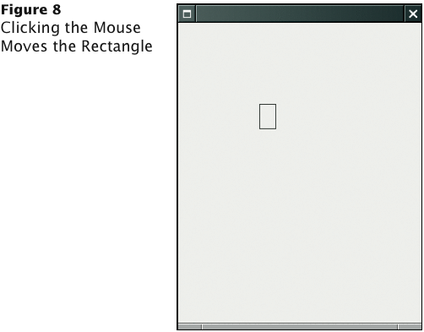
RectangleComponentViewer Program Run

Slide 81
ch09/mouse/RectangleComponentViewer.java
1 import java.awt.event.MouseListener;
2 import java.awt.event.MouseEvent;
3 import javax.swing.JFrame;
4
5 /**
6 This program displays a RectangleComponent.
7 */
8 public class RectangleComponentViewer
9 {
10 private static final int FRAME_WIDTH = 300;
11 private static final int FRAME_HEIGHT = 400;
12
13 public static void main(String[] args)
14 {
15 final RectangleComponent component = new RectangleComponent();
16
Continued

Slide 82
ch09/mouse/RectangleComponentViewer.java (cont.)
17 // Add mouse press listener
18
19 class MousePressListener implements MouseListener
20 {
21 public void mousePressed(MouseEvent event)
22 {
23 int x = event.getX();
24 int y = event.getY();
25 component.moveTo(x, y);
26 }
27
28 // Do-nothing methods
29 public void mouseReleased(MouseEvent event) {}
30 public void mouseClicked(MouseEvent event) {}
31 public void mouseEntered(MouseEvent event) {}
32 public void mouseExited(MouseEvent event) {}
33 }
34
35 MouseListener listener = new MousePressListener();
36 component.addMouseListener(listener);
37
Continued

Slide 83
ch09/mouse/RectangleComponentViewer.java (cont.)
38 JFrame frame = new JFrame();
39 frame.add(component);
40
41 frame.setSize(FRAME_WIDTH, FRAME_HEIGHT);
42 frame.setDefaultCloseOperation(JFrame.EXIT_ON_CLOSE);
43 frame.setVisible(true);
44 }
45 }

