Slide 1

Chapter 10 – Inheritance

Slide 2
Chapter Goals
To learn about inheritance
To understand how to inherit and override superclass methods
To be able to invoke superclass constructors
To learn about protected and package access control
To understand the common superclass Object and to override its toString and equals methods
G To use inheritance for customizing user interfaces

Slide 3

Inheritance Hierarchies
Often categorize concepts into hierarchies:

Slide 4
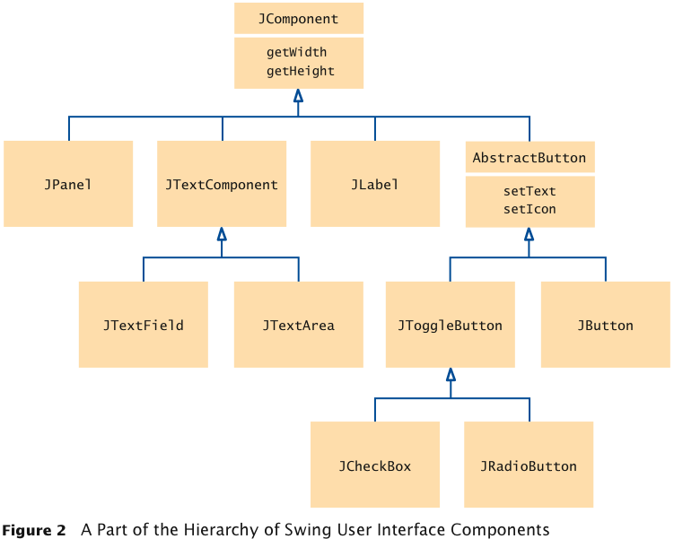
Inheritance Hierarchies
Set of classes can form an inheritance hierarchy
Classes representing the most general concepts are near the root, more specialized classes towards the branches:

Slide 5
Inheritance Hierarchies
Superclass: more general class
Subclass: more specialized class that inherits from the superclass
Example: JPanel is a subclass of JComponent

Slide 6
Inheritance Hierarchies
Example: Different account types:
Checking account:
No interest
Small number of free transactions per month
Charges transaction fee for additional transactions
Savings account:
Earns interest that compounds monthly
Superclass: BankAccount
Subclasses: CheckingAccount & SavingsAccount

Slide 7
Inheritance Hierarchies
Behavior of account classes:
All support getBalance method
Also support deposit and withdraw methods, but implementation details differ
Checking account needs a method deductFees to deduct the monthly fees and to reset the transaction counter
Checking account must override deposit and withdraw methods to count the transactions

Slide 8
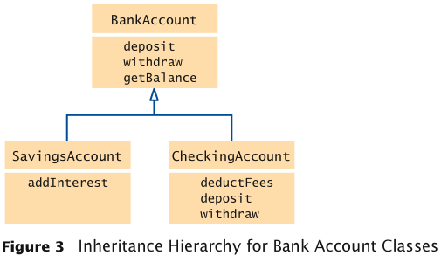
Inheritance Hierarchies

Slide 9
Inheritance Hierarchies
Inheritance is a mechanism for extending existing classes by adding instance variables and methods:
class SavingsAccount extends BankAccount
{
added instance variables
new methods
}
A subclass inherits the methods of its superclass:
SavingsAccount collegeFund = new SavingsAccount(10);
// Savings account with 10% interest
collegeFund.deposit(500);
// OK to use BankAccount method with SavingsAccount object

Slide 10
Inheritance Hierarchies
In subclass, specify added instance variables, added methods, and changed or overridden methods:
public class SavingsAccount extends BankAccount
{
private double interestRate;
public SavingsAccount(double rate)
{
Constructor implementation
}
public void addInterest()
{
Method implementation
}
}

Slide 11
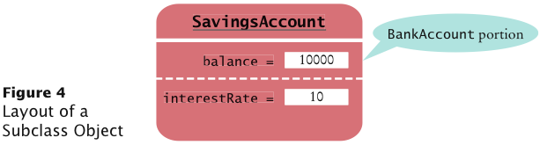
Inheritance Hierarchies
Instance variables declared in the superclass are present in subclass objects
SavingsAccount object inherits the balance instance variable from BankAccount, and gains one additional instance variable, interestRate:

Slide 12
Inheritance Hierarchies
Implement the new addInterest method:
public class SavingsAccount extends BankAccount
{
private double interestRate;
public SavingsAccount(double rate)
{
interestRate = rate;
}
public void addInterest()
{
double interest = getBalance() * interestRate / 100;
deposit(interest);
}
}

Slide 13
Inheritance Hierarchies
A subclass has no access to private instance variables of its superclass
Encapsulation: addInterest calls getBalance rather than updating the balance variable of the superclass (variable is private)
Note that addInterest calls getBalance without specifying an implicit parameter (the calls apply to the same object)
Inheriting from a class differs from implementing an interface: the subclass inherits behavior from the superclass

Slide 14
ch10/accounts/SavingsAccount.java
1 /**
2 An account that earns interest at a fixed rate.
3 */
4 public class SavingsAccount extends BankAccount
5 {
6 private double interestRate;
7
8 /**
9 Constructs a bank account with a given interest rate.
10 @param rate the interest rate
11 */
12 public SavingsAccount(double rate)
13 {
14 interestRate = rate;
15 }
16
Continued

Slide 15
ch10/accounts/SavingsAccount.java (cont.)
17 /**
18 Adds the earned interest to the account balance.
19 */
20 public void addInterest()
21 {
22 double interest = getBalance() * interestRate / 100;
23 deposit(interest);
24 }
25 }

Slide 16
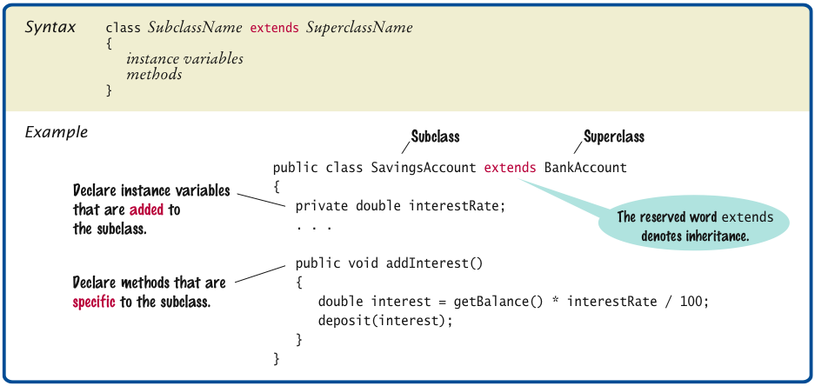
Syntax 10.1 Inheritance

Slide 17
Common Error: Shadowing Instance Variables
A subclass has no access to the private instance variables of the superclass:
public class SavingsAccount extends BankAccount
{
public void addInterest()
{
double interest = getBalance() * interestRate / 100;
balance = balance + interest; // Error
}
. . .
}

Slide 18
Common Error: Shadowing Instance Variables
Beginner’s error: “solve” this problem by adding another instance variable with same name:
public class SavingsAccount extends BankAccount
{
private double balance; // Don’t
public void addInterest()
{
double interest = getBalance() * interestRate / 100;
balance = balance + interest; // Compiles but doesn’t
// update the correct balance
}
. . .
}

Slide 19
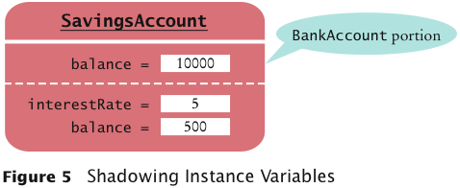
Common Error: Shadowing Instance Variables
Now the addInterest method compiles, but it doesn’t update the correct balance!

Slide 20
Overriding Methods
A subclass method overrides a superclass method if it has the same name and parameter types as a superclass method
When such a method is applied to a subclass object, the overriding method is executed

Slide 21
Overriding Methods
Example: deposit and withdraw methods of the CheckingAccount class override the deposit and withdraw methods of the BankAccount class to handle transaction fees:
public class BankAccount
{
. . .
public void deposit(double amount) { . . . }
public void withdraw(double amount) { . . . }
public double getBalance() { . . . }
}
public class CheckingAccount extends BankAccount
{
. . .
public void deposit(double amount) { . . . }
public void withdraw(double amount) { . . . }
public void deductFees() { . . . }
}

Slide 22
Overriding Methods
Problem: Overriding method deposit can't simply add amount to balance:
public class CheckingAccount extends BankAccount
{
. . .
public void deposit(double amount)
{
transactionCount++;
// Now add amount to balance
balance = balance + amount; // Error
}
}
If you want to modify a private superclass instance variable, you must use a public method of the superclass
deposit method of CheckingAccount must invoke the deposit method of BankAccount

Slide 23
Overriding Methods
Idea:
public class CheckingAccount extends BankAccount
{
public void deposit(double amount)
{
transactionCount++;
// Now add amount to balance
deposit; // Not complete
}
}
Won't work because compiler interprets
deposit(amount);
as
this.deposit(amount);
which calls the method we are currently writing ⇒ infinite recursion

Slide 24
Overriding Methods
Use the super reserved word to call a method of the superclass:
public class CheckingAccount extends BankAccount
{
public void deposit(double amount)
{
transactionCount++;
// Now add amount to balance
super.deposit
}
}

Slide 25
Overriding Methods
Remaining methods of CheckingAccount also invoke a superclass method:
public class CheckingAccount extends BankAccount
{
private static final int FREE_TRANSACTIONS = 3;
private static final double TRANSACTION_FEE = 2.0;
private int transactionCount;
. . .
public void withdraw(double amount
{
transactionCount++;
// Now subtract amount from balance
super.withdraw(amount);
}
Continued

Slide 26
Overriding Methods (cont.)
public void deductFees()
{
if (transactionCount > FREE_TRANSACTIONS)
{
double fees = TRANSACTION_FEE *
(transactionCount - FREE_TRANSACTIONS);
super.withdraw(fees);
}
transactionCount = 0;
}
. . .
}

Slide 27
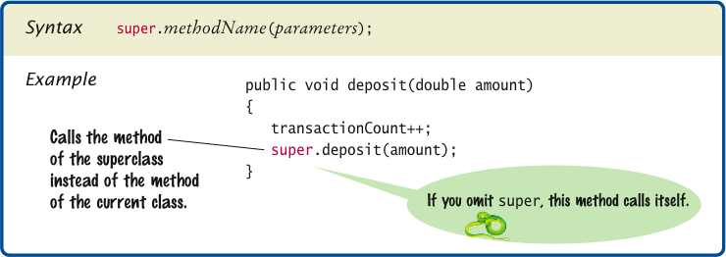
Syntax 10.2 Calling a Superclass Method

Slide 28
Subclass Construction
To call the superclass constructor, use the super reserved word in the first statement of the subclass constructor:
public class CheckingAccount extends BankAccount
{
public CheckingAccount(double initialBalance)
{
// Construct superclass
super(initialBalance);
// Initialize transaction count
transactionCount = 0;
}
...
}

Slide 29
Subclass Construction
When subclass constructor doesn't call superclass constructor, the superclass must have a constructor with no parameters
If, however, all constructors of the superclass require parameters, then the compiler reports an error

Slide 30
ch10/accounts/CheckingAccount.java
1 /**
2 A checking account that charges transaction fees.
3 */
4 public class CheckingAccount extends BankAccount
5 {
6 private static final int FREE_TRANSACTIONS = 3;
7 private static final double TRANSACTION_FEE = 2.0;
8
9 private int transactionCount;
10
11 /**
12 Constructs a checking account with a given balance.
13 @param initialBalance the initial balance
14 */
15 public CheckingAccount(double initialBalance)
16 {
17 // Construct superclass
18 super(initialBalance);
19
20 // Initialize transaction count
21 transactionCount = 0;
22 }
23
Continued

Slide 31
ch10/accounts/CheckingAccount.java (cont.)
24 public void deposit(double amount)
25 {
26 transactionCount++;
27 // Now add amount to balance
28 super.deposit(amount);
29 }
30
31 public void withdraw(double amount)
32 {
33 transactionCount++;
34 // Now subtract amount from balance
35 super.withdraw(amount);
36 }
37
Continued

Slide 32
ch10/accounts/CheckingAccount.java (cont.)
38 /**
39 Deducts the accumulated fees and resets the
40 transaction count.
41 */
42 public void deductFees()
43 {
44 if (transactionCount > FREE_TRANSACTIONS)
45 {
46 double fees = TRANSACTION_FEE *
47 (transactionCount - FREE_TRANSACTIONS);
48 super.withdraw(fees);
49 }
50 transactionCount = 0;
51 }
52 }

Slide 33
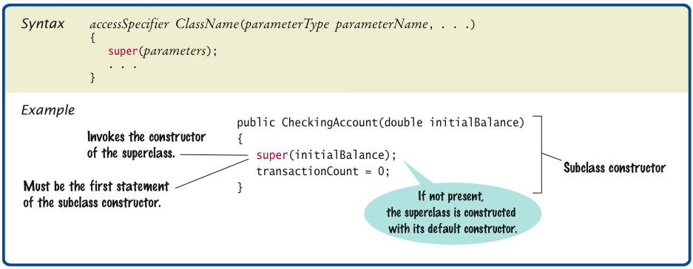
Syntax 10.3 Calling a Superclass Constructor

Slide 34
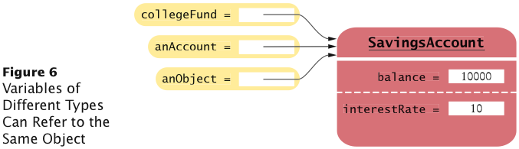
Converting Between Subclass and Superclass Types
OK to convert subclass reference to superclass reference:
SavingsAccount collegeFund = new SavingsAccount(10);
BankAccount anAccount = collegeFund;
Object anObject = collegeFund;
The three object references stored in collegeFund, anAccount, and anObject all refer to the same object of type SavingsAccount

Slide 35
Converting Between Subclass and Superclass Types
Superclass references don’t know the full story:
anAccount.deposit(1000); // OK
anAccount.addInterest();
// No--not a method of the class to which anAccount
// belongs
Why would anyone want to know less about an object?
Reuse code that knows about the superclass but not the subclass:
public void transfer(double amount, BankAccount other)
{
withdraw(amount);
other.deposit(amount);
}
Can be used to transfer money from any type of BankAccount

Slide 36
Converting Between Subclass and Superclass Types
Occasionally you need to convert from a superclass reference to a subclass reference:
BankAccount anAccount = (BankAccount) anObject;
This cast is dangerous: If you are wrong, an exception is thrown
Solution: Use the instanceof operator
instanceof: Tests whether an object belongs to a particular type:
if (anObject instanceof BankAccount)
{
BankAccount anAccount = (BankAccount) anObject;
...
}

Slide 37
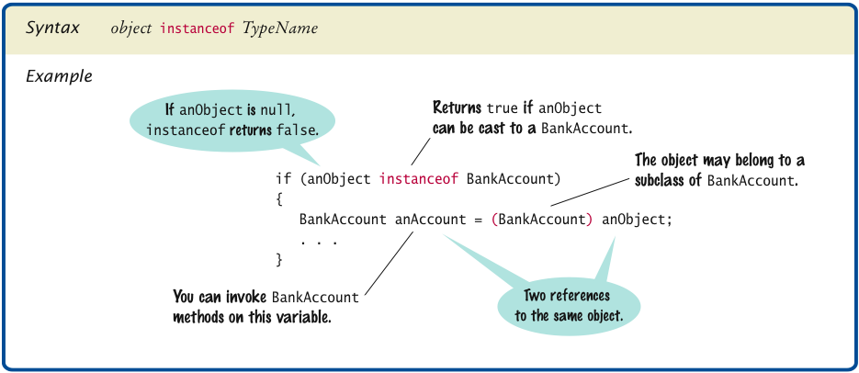
Syntax 10.4 The instanceof Operator

Slide 38
Polymorphism and Inheritance
Type of a variable doesn’t completely determine type of object to which it refers:
BankAccount aBankAccount = new SavingsAccount(1000);
// aBankAccount holds a reference to a SavingsAccount
BankAccount anAccount = new CheckingAccount();
anAccount.deposit(1000);
Which deposit method is called?
Dynamic method lookup: When the virtual machine calls an instance method, it locates the method of the implicit parameter's class

Slide 39
Polymorphism and Inheritance
Example:
public void transfer(double amount, BankAccount other)
{
withdraw(amount);
other.deposit(amount);
}
When you call
anAccount.transfer(1000, anotherAccount);
two method calls result:
anAccount.withdraw(1000);
anotherAccount.deposit(1000);

Slide 40
Polymorphism and Inheritance
Polymorphism: Ability to treat objects with differences in behavior in a uniform way
The first method call
withdraw(amount);
is a shortcut for
this.withdraw(amount);
this can refer to a BankAccount or a subclass object

Slide 41
ch10/accounts/AccountTester.java
1 /**
2 This program tests the BankAccount class and
3 its subclasses.
4 */
5 public class AccountTester
6 {
7 public static void main(String[] args)
8 {
9 SavingsAccount momsSavings = new SavingsAccount(0.5);
10
11 CheckingAccount harrysChecking = new CheckingAccount(100);
12
13 momsSavings.deposit(10000);
14
15 momsSavings.transfer(2000, harrysChecking);
16 harrysChecking.withdraw(1500);
17 harrysChecking.withdraw(80);
18
19 momsSavings.transfer(1000, harrysChecking);
20 harrysChecking.withdraw(400);
21
Continued

Slide 42
ch10/accounts/AccountTester.java (cont.)
22 // Simulate end of month
23 momsSavings.addInterest();
24 harrysChecking.deductFees();
25
26 System.out.println("Mom’s savings balance: "
27 + momsSavings.getBalance());
28 System.out.println("Expected: 7035");
29
30 System.out.println("Harry’s checking balance: "
31 + harrysChecking.getBalance());
32 System.out.println("Expected: 1116");
33 }
34 }
Program Run:
Mom's savings balance: 7035.0 Expected: 7035 Harry's checking balance: 1116.0 Expected: 1116

Slide 43
Protected Access
Protected features can be accessed by all subclasses and by all classes in the same package
Solves the problem that CheckingAccount methods need access to the balance instance variable of the superclass BankAccount:
public class BankAccount
{
. . .
protected double balance;
}

Slide 44
Protected Access
The designer of the superclass has no control over the authors of subclasses:
Any of the subclass methods can corrupt the superclass data
Classes with protected instance variables are hard to modify — the protected variables cannot be changed, because someone somewhere out there might have written a subclass whose code depends on them
Protected data can be accessed by all methods of classes in the same package
It is best to leave all data private and provide accessor methods for the data

Slide 45
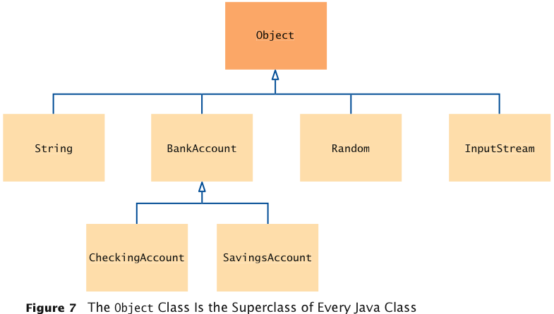
Object: The Cosmic Superclass
All classes defined without an explicit extends clause automatically extend Object:

Slide 46
Object: The Cosmic Superclass
Most useful methods:
String toString()
boolean equals(Object otherObject)
Object clone()
Good idea to override these methods in your classes

Slide 47
Overriding the toString Method
Returns a string representation of the object
Useful for debugging:
Rectangle box = new Rectangle(5, 10, 20, 30);
String s = box.toString();
// Sets s to "java.awt.Rectangle[x=5,y=10,width=20, // height=30]"
toString is called whenever you concatenate a string with an object:
"box=" + box;
// Result: "box=java.awt.Rectangle[x=5,y=10,width=20, // height=30]"

Slide 48
Overriding the toString Method
Object.toString prints class name and the hash code of the object:
BankAccount momsSavings = new BankAccount(5000);
String s = momsSavings.toString();
// Sets s to something like "BankAccount@d24606bf"

Slide 49
Overriding the toString Method
To provide a nicer representation of an object, override toString:
public String toString()
{
return "BankAccount[balance=" + balance + "]";
}
This works better:
BankAccount momsSavings = new BankAccount(5000);
String s = momsSavings.toString();
// Sets s to "BankAccount[balance=5000]"

Slide 50
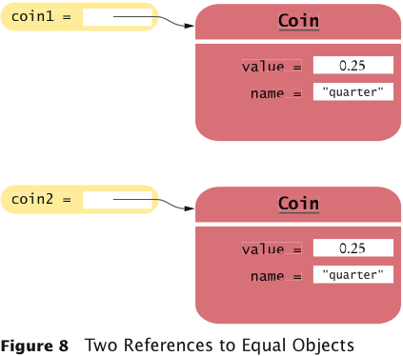
Overriding the equals Method
equals tests for same contents:
if (coin1.equals(coin2)) . . .
// Contents are the same

Slide 51
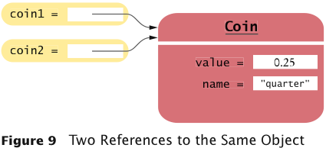
Overriding the equals Method
== tests for references to the same object:
if (coin1 == (coin2)) . . .
// Objects are the same

Slide 52
Overriding the equals Method
Need to override the equals method of the Object class:
public class Coin
{
...
public boolean equals(Object otherObject)
{
...
}
...
}

Slide 53
Overriding the equals Method
Cannot change parameter type; use a cast instead:
public class Coin
{
...
public boolean equals(Object otherObject)
{
Coin other = (Coin) otherObject;
return name.equals(other.name) && value ==
other.value;
}
...
}
You should also override the hashCode method so that equal objects have the same hash code

Slide 54
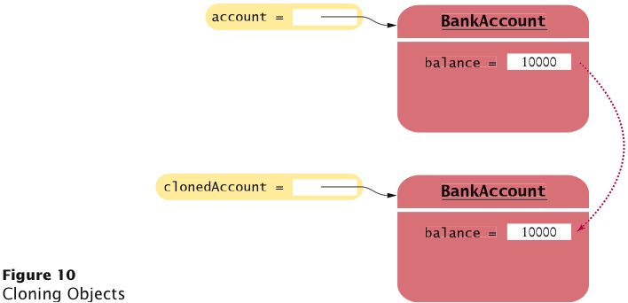
The clone Method
Copying an object reference gives two references to same object:
BankAccount account = newBankAccount(1000);
BankAccount account2 = account;
account2.deposit(500); // Now both account and account2
// refer to a bank account with a balance of 1500
Sometimes, need to make a copy of the object:

Slide 55
The clone Method
Implement clone method to make a new object with the same state as an existing object
Use clone:
BankAccount clonedAccount =
(BankAccount) account.clone();
Must cast return value because return type is Object

Slide 56
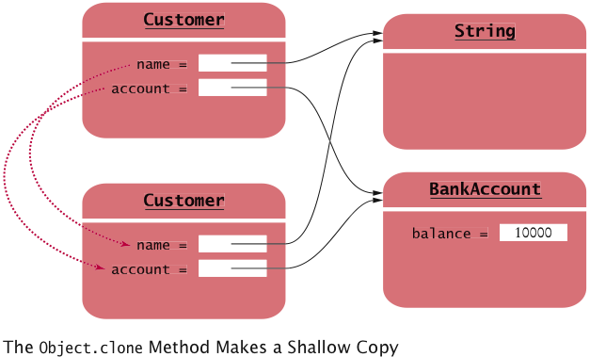
The Object.clone Method
Creates shallow copies:

Slide 57
The Object.clone Method
Does not systematically clone all subobjects
Must be used with caution
It is declared as protected; prevents from accidentally calling x.clone() if the class to which x belongs hasn’t redefined clone to be public
You should override the clone method with care (see Special Topic 10.6)

Slide 58
Using Inheritance to Customize Frames
Use inheritance for complex frames to make programs easier to understand
Design a subclass of JFrame
Store the components as instance variables
Initialize them in the constructor of your subclass
If initialization code gets complex, simply add some helper methods

Slide 59
ch10/frame/InvestmentFrame.java
1 import java.awt.event.ActionEvent;
2 import java.awt.event.ActionListener;
3 import javax.swing.JButton;
4 import javax.swing.JFrame;
5 import javax.swing.JLabel;
6 import javax.swing.JPanel;
7 import javax.swing.JTextField;
8
9 public class InvestmentFrame extends JFrame
10 {
11 private JButton button;
12 private JLabel label;
13 private JPanel panel;
14 private BankAccount account;
15
16 private static final int FRAME_WIDTH = 400;
17 private static final int FRAME_HEIGHT = 100;
18
19 private static final double INTEREST_RATE = 10;
20 private static final double INITIAL_BALANCE = 1000;
21
Continued

Slide 60
ch10/frame/InvestmentFrame.java
22 public InvestmentFrame()
23 {
24 account = new BankAccount(INITIAL_BALANCE);
25
26 // Use instance variables for components
27 label = new JLabel("balance: " + account.getBalance());
28
29 // Use helper methods
30 createButton();
31 createPanel();
32
33 setSize(FRAME_WIDTH, FRAME_HEIGHT);
34 }
35
36 private void createButton()
37 {
38 button = new JButton("Add Interest");
39 ActionListener listener = new AddInterestListener();
40 button.addActionListener(listener);
41 }
42
Continued

Slide 61
Example: Investment Viewer Program (cont.)
43 private void createPanel()
44 {
45 panel = new JPanel();
46 panel.add(button);
47 panel.add(label);
48 add(panel);
49 }
50
51 class AddInterestListener implements ActionListener
52 {
53 public void actionPerformed(ActionEvent event)
54 {
55 double interest = account.getBalance() * INTEREST_RATE / 100;
56 account.deposit(interest);
57 label.setText("balance: " + account.getBalance());
58 }
59 }
60 }

Slide 62
Example: Investment Viewer Program
Of course, we still need a class with a main method:
1 import javax.swing.JFrame;
2
3 /**
4 This program displays the growth of an investment.
5 */
6 public class InvestmentViewer2
7 {
8 public static void main(String[] args)
9 {
10 JFrame frame = new InvestmentFrame();
11 frame.setDefaultCloseOperation(JFrame.EXIT_ON_CLOSE);
12 frame.setVisible(true);
13 }
14 }

