Slide 1
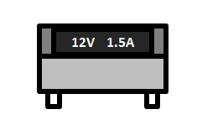
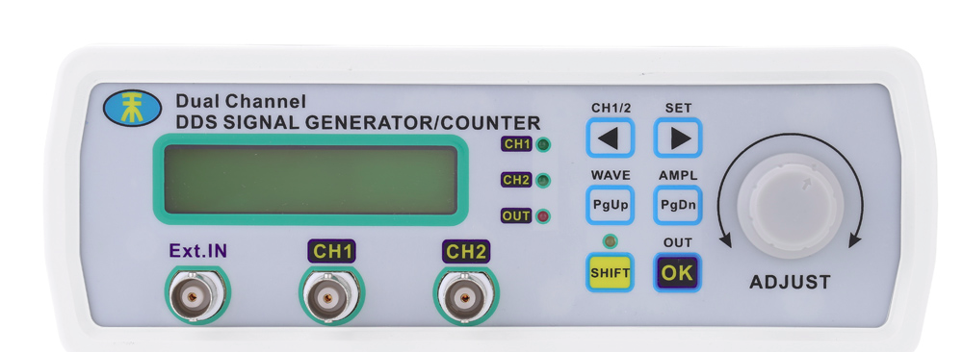

Esquemático da jiga de testes ADC
Power Supply
AFC
slot 2
FMC_ADC
A
FMC in slot 2 must run:
slot2_relayoff.sh
slot2_relayon.sh
FPGA
B
FMC_ADC
C
D
A
FMC in slot 1 must run:
slot1_relayoff.sh
slot1_relayon.sh
slot 1
FMC_ADC
B
C
D
Low scale
current
Resistors
USB Jtag

