Slide 1
Podcast Feed
Vamsidhar Allampati, Jonathan Holmes, Uzair Shamim

Slide 2
Our Project
Program that allows a user to keep up with their favorite podcasts via streaming
Program remembers what podcasts a user adds and what they have already listened to
RSS Podcast Feed
------------------------------------------------------------------
Pause/Resume | 20:30/50:10 | Episode 3
Podcast 1
Podcast 2
Podcast 3
Podcast 4
Episode 1
Episode 2
Episode 3
Episode 4
Play Podcast
Episode 3
On Todays
Podcast We
Talk about...

Slide 3
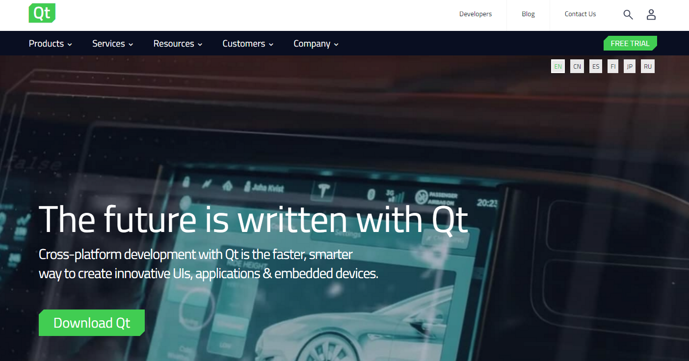
Qt
Used Qt to develop GUI components
Qt also provides networking, XML and JSON parsing capabilities

Slide 4
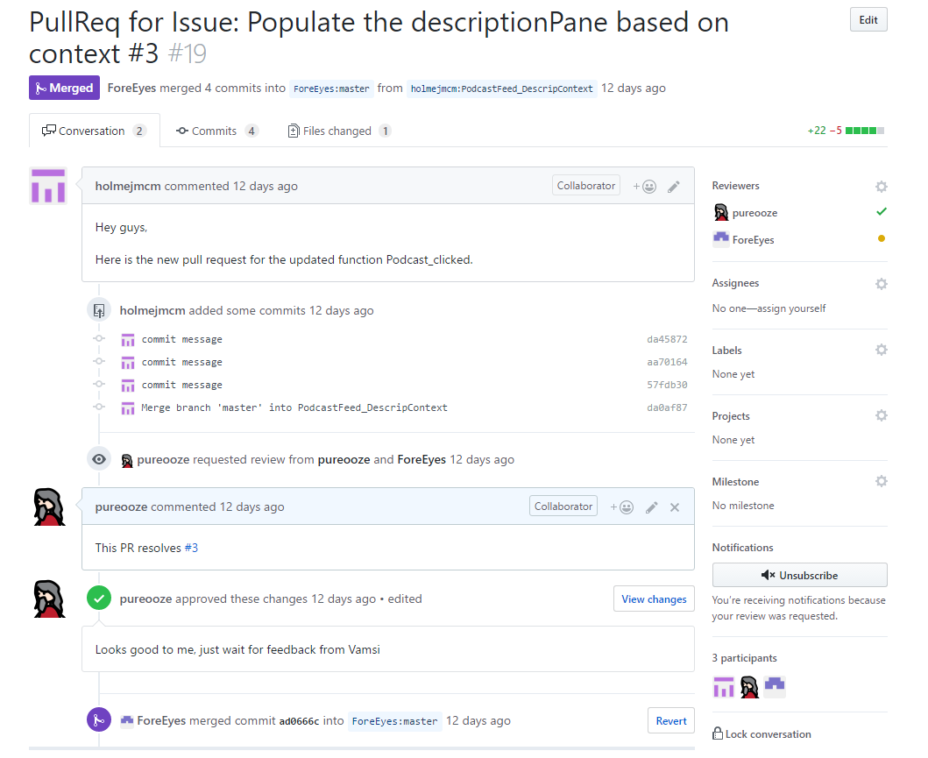
Github

Slide 5
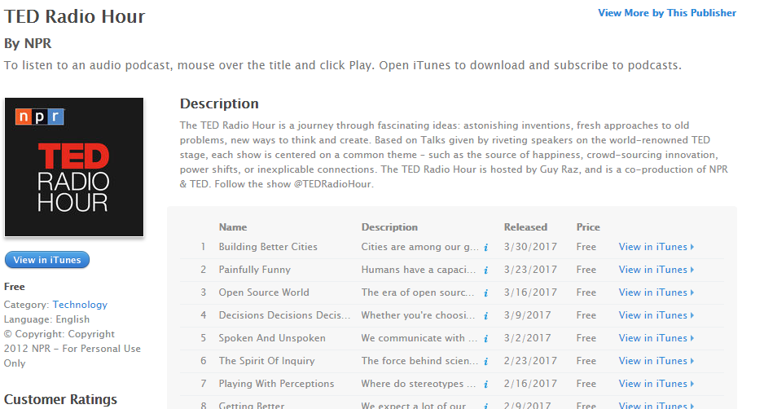
How It Works

Slide 6
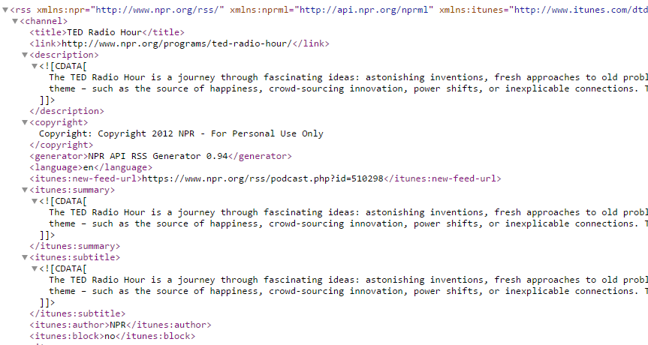
How It Works (cont.)

Slide 7
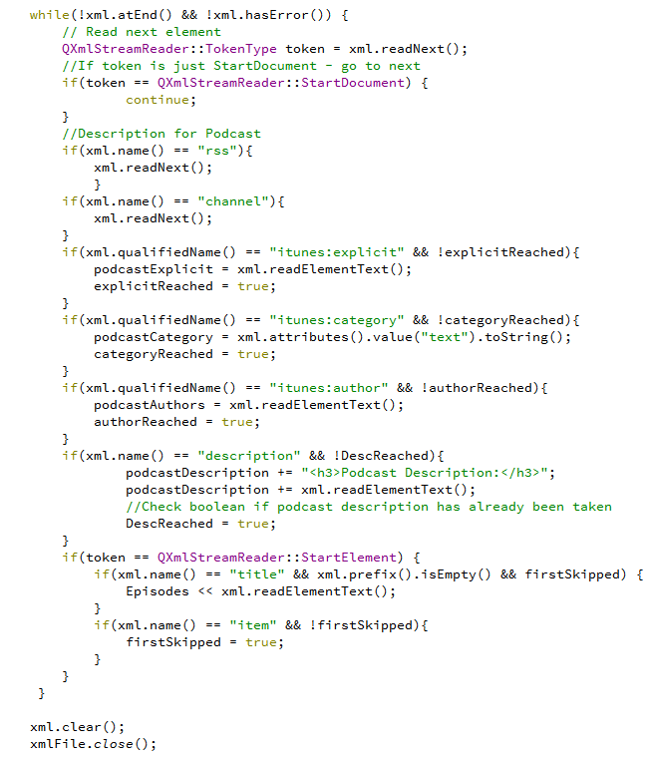
How It Works (cont.)

Slide 8
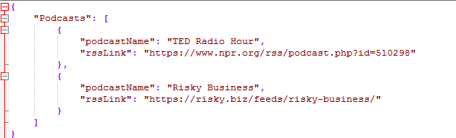
How It Works (cont.)

Slide 9
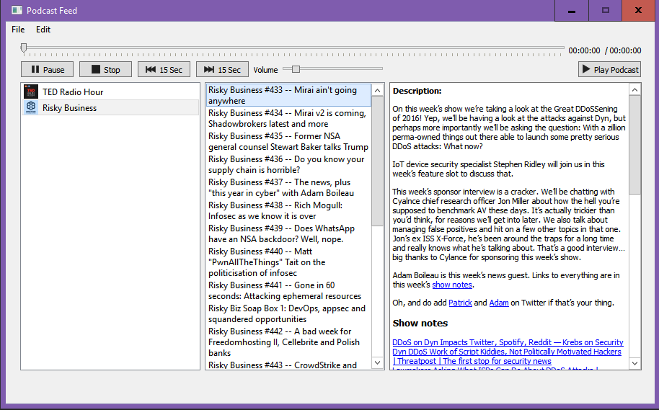
The Application

