Slide 1
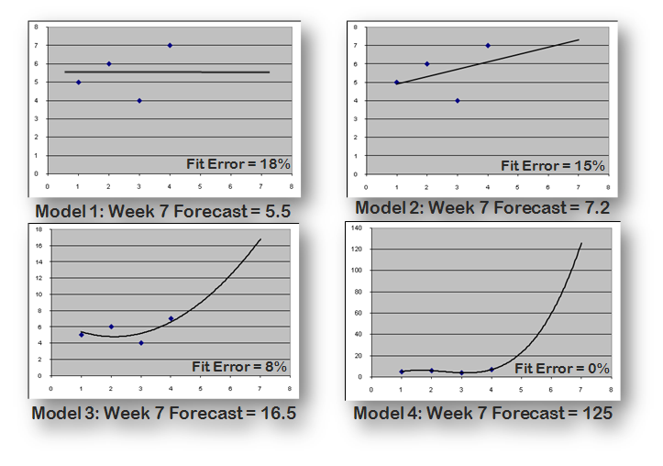
“Best Fit to History” Model Selection
Worst Practice: Confusing “fit to history” with “appropriateness for forecasting”
Notes:
I mentioned the “Best fit” or “pick best” functionality common in forecasting packages, and here’s why it can be a problem.
Suppose we have four weeks of sales: 5, 6, 4, and 7 units. What should we forecast three weeks out?
It makes sense to start with a simple model, just taking the average of the four historical data points. The error in our fit to history is 18%.
We can fit the history slightly better, with a 15% error, by using a linear trend. Can we do better?
If we move up to a quadratic model, we cut the fit error in half, to 8%, and now our week 7 forecast has gone up quite a bit. Can we do better?
In fact it is always possible to create a model that fits the history perfectly, in this case a cubic model. So our fit error is 0%, but our week 7 forecast is now 125 units, which common sense suggests is wildly inappropriate.
Unless there is other information to suggest otherwise, our first two models, the ones that fit history the poorest, are probably the most appropriate models for forecasting the future.
So while fit to history is a relevant consideration in forecasting, it should not be the sole consideration for choosing a model. And if you use fit to history as your sole criterion for model selection, you can expect to generate some wildly inappropriate forecasts.

