Slide 1
Profit from Your Forecasting Software
Paul Goodwin

Slide 2
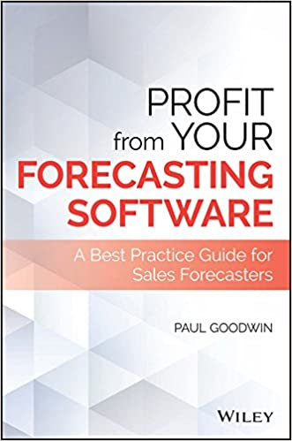
Many sales forecasters in companies find themselves in a job for which they have received no training.
As a result, they often resort to basing forecasts on judgment, when statistical methods would be more accurate.
Alternatively, they find themselves using forecasting software with little understanding of the statistical methods or algorithms that it embodies.
This book is intended to help people like these to make the best use of available commercial forecasting software.

Slide 3
The tone of the book is therefore :
Non-mathematical;
Evaluative -it documents the strengths and limitations of different forecasting methods and accuracy measures;
Advisory -for example it advises you when judgmental overrides to the software’s forecasts are likely to be beneficial or whether you should allow software to choose a forecasting method;
Practical –there is an emphasis on applying methods embodied in software rather than the theory that underpins them.

Slide 4
Accurate sales, or demand, forecasts can be crucial. They can effect decisions in areas such as:
- inventory planning
- logistic planning
- production scheduling
- purchasing
- human resource planning.

Slide 5
One estimate is that avoidable forecast errors add between 2% and 4% to production costs (Source: catchbull.com)
Another estimate – a company with $1 billion turnover could make savings of $5 to $10 million by using accurate forecasts to reduce inventory levels (Source: Triple Point Technology)
Yet in one survey, 40% of respondents admitted they were “not leveraging the advantages of statistical modelling in their demand planning operations’ levels” (Source: Triple Point Technology).

Slide 6
What is a forecast?
Problems can arise in companies because of confusion over what a forecast is.
Definition:
“A forecast is an honest statement of what we can expect to happen at a future date, based on information available at the time the forecast was made.”

Slide 7
A forecast is not:
- what we hope will happen;
- a target to make people increase their efforts;
- what we would intend to happen if we could control future events (i.e., a
plan);
- a number that will please the boss or give us a political advantage;
- a decision (e.g. deciding how much stock to hold is not the same as a
forecast of what demand will be).

Slide 8
Ways of presenting forecasts
X% Prediction interval
Point forecast

Slide 9
Forecasting in practice is dominated by point forecasts, but these provide no information on the level of uncertainty associated with future demand,
e.g. they can’t be used to determine safety stock levels.
Prediction intervals do give some indication of the level of uncertainty, but in practice they are usually too narrow. Yet when they are wide managers are likely to disregard them.
Currently, most commercial software products don’t display density forecasts, despite their potential usefulness.

Slide 10
The advantages of using dedicated forecasting software
48% of forecasters used spreadsheets in one survey. Only 11% used dedicated software.
Using spreadsheets can:
- lead to idiosyncratic forecasting systems no one else understands;
- lead to methods that lack a theoretical rationale;
- involve methods that haven’t been tested on lots of data sets or compared with other
methods;
- involve using algorithms that contain errors;
- lead to dangers of cutting & pasting errors or mistakes in cell referencing.
One study found that those using dedicated software achieved errors about 7% lower than those using spreadsheets.

Slide 11
The advantages of using dedicated forecasting software
They provide a wide range of methods and accuracy & bias metrics;
Designed to support tasks specific to demand forecasting such as hierarchical forecasting or determination of safety stock levels;
Allow forecasting to be automated -important when you have to make frequent forecasts for thousands of products;
Support collaboration between different departments and individuals -in too many companies there are ‘islands of analysis’ where people produce separate forecasts and don’t share information;
Allow judgmental interventions to be made when these are justified.

Slide 12
Why prefer software-based forecasts over management judgment?
Psychological biases
-people tend to see imaginary patterns in noise;
-they tend to underestimate trends;
-they give undue weight to recent observations and events;
-they give undue weight to anecdotal evidence relative to
statistics;
-they can suffer from optimism bias.

Slide 13
Why prefer software-based forecasts over management judgment?
Motivational biases
-forecasts made for political reasons;
-herding – making your forecast the same as others so you are
not singled out if it has a large error;
-contrarianism -deliberately making your forecast different to
others so you will stand out if the forecasts is accurate.

Slide 14
Data Cleansing
Trading day adjustments
Monthly and weekly sales can be affected by the number of trading days
-weekends, holidays and different lengths of months can all contribute to
variation in sales
Most software products can adjust for this if they are supplied with calendar information.
We need to be careful if trading days are not equally important.
e.g. if Tuesday is usually busier than Monday then the adjustment should
take into account the number of Mondays and Tuesdays in a month
when trading took place.

Slide 15
How software uses patterns in past data
Software-based forecasts are usually based on the assumption of constancy.
i.e. past systematic patterns or relationships will continue into the
future.
The patterns may relate just to the past sales (or demand) history.
Or they may refer to relationships between sales and other factors such as advertising expenditure and price.

Slide 16
Components of sales histories
Ideally, the algorithm should filter-out randomness so only the systematic components are extrapolated

Slide 17
Examples of trend types
Damped
Changing linear
Product lifecycle
Exponential

Slide 18
Seasonal patterns
Additive
Multiplicative

Slide 19
Noise or randomness
Point forecasts should be estimates of what sales will be if there is no noise
i.e. they are estimates of what would happen on average if the future could be replayed many times over.
They are not intended to exactly predict an individual outcome
-hence we can never say that an individual forecast is wrong;
-the term ‘forecast error’ can therefore be misleading;
-senior managers have been known to question why forecasts are not 100% accurate!
Nevertheless, we need to measure the variation in sales caused by noise to estimate uncertainty and safety stock levels.

Slide 20
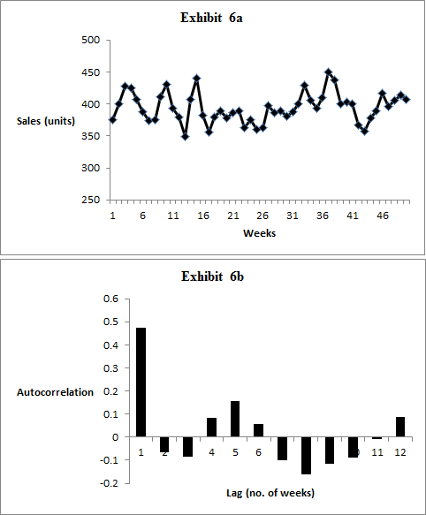
Autocorrelation
E.g. higher than average sales in one week may be associated with higher than average sales in the following week or vice versa.
Never trust your judgment to identify autocorrelation. Humans are prone to seeing autocorrelation in purely random series.
(Reimers & Harvey, 2011).

Slide 21
Intermittent Demand

Slide 22
Outliers
Outliers caused by exceptional events or data entry errors can distort forecasts.
Some software products have facilities for detecting outliers
-the sensitivity of the detection method
can be adjusted`;
-outlier can be replaced by a ‘more
typical’ value.
Correcting the odd extreme outlier may improve your forecasts
-correcting too may may cause uncertainty
to be underestimated.

Slide 23
Outliers (continued)
Alternative is to use an event index where an outlier occurs.
Where special events are repeated (e.g. promotions) event index can be used to forecast its effect.
Commonly managers use judgmental adjustments to forecast special events
-but these can be subject to biases (Fildes et al., 2009).

Slide 24
Correlation
Useful in identifying factors driving sales.
r = +0.84

Slide 25
It’s always advisable to produce a scattergraph to avoid being misled by correlation…
r = -0.05
r = +0.65

Slide 26
Missing values
Missing values can occur as a result of data entry errors
Can replace missing value with an estimate, previous or subsequent
sales, average of previous and subsequent sales, etc.
Do not replace with a zero unless no sales were actually made –otherwise forecasts will biased.
If correlation is being calculated the missing value and the value of the associated variable can be removed and correlation calculated on reduced data set.

Slide 27
Conclusions
Forecasting software is more efficient than judgmental forecasters at extracting systematic patterns from noisy data and projecting these into the future.
Dedicated forecasting software has advantages over the use of spreadsheets.
No matter how sophisticated your software is, it’s wise to examine graphs of your data to avoid being mislead by outliers, (over) influential observations and non-linearity.

