Slide 1
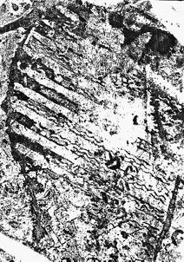
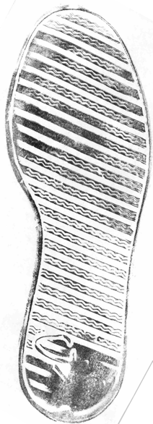
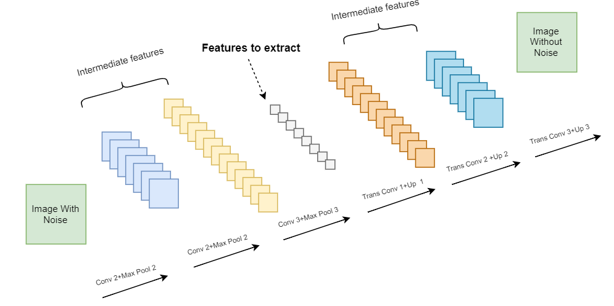
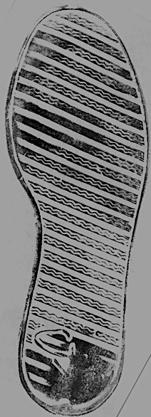
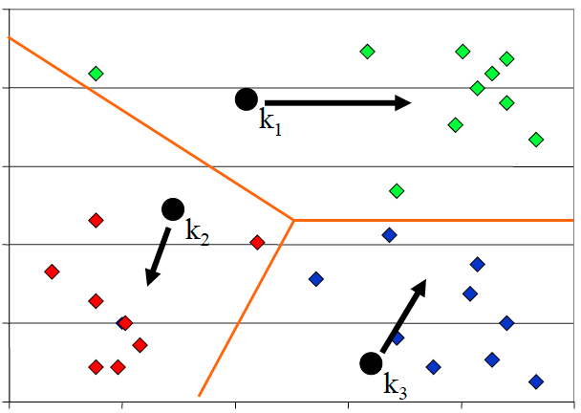
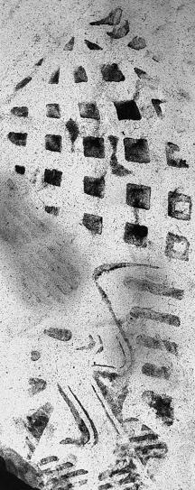
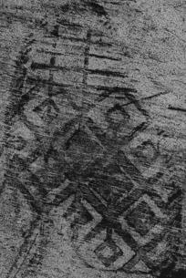

Adj. Forensic Investigation via XYZ
Tong Lin, Tianlong Yu, Di Deng
Carnegie Mellon University
Problem
Forensic investigation task
Challenge 1: Incomplete evidence
Challenge 2: Noisy background
associate
Footwear impression
at the crime scene
Reference impression
in records
Crop
Rotate
Flip
Brightness
Structured background noise that are not relevant to footprint impression
Our solution: Autoencoder and XYZ classifier
Idea 1: Data augmentation
Idea 2: Autoencoder to reduce noise
System Overview
Images with noise
Images without noise
Crop
Gaussian
Noise
Data augmentation
Autoencoder
Rotate
Training
KNN
Testing
Flip
Images with noise
Images without noise
Footwear impressions
at the crime scene
Identified footwear impressions
Brightness
Autoencoder is trained to filter out noise
Evaluation
PCA as comparison

