Slide 1
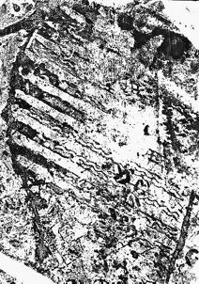
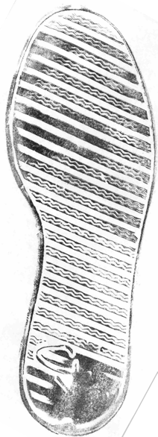
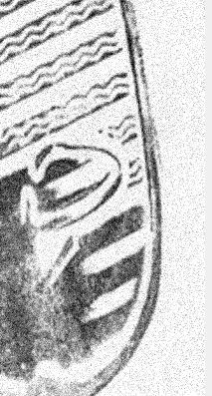
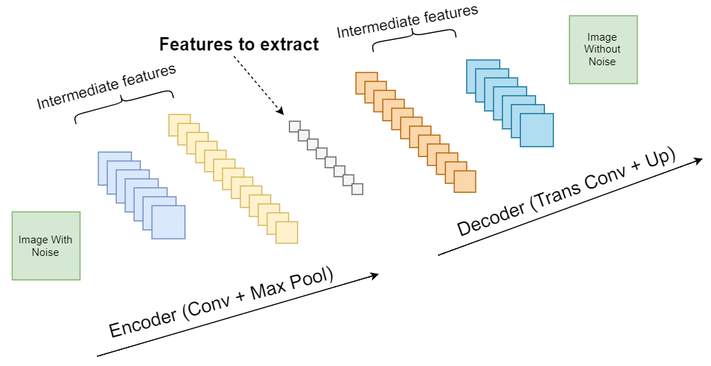
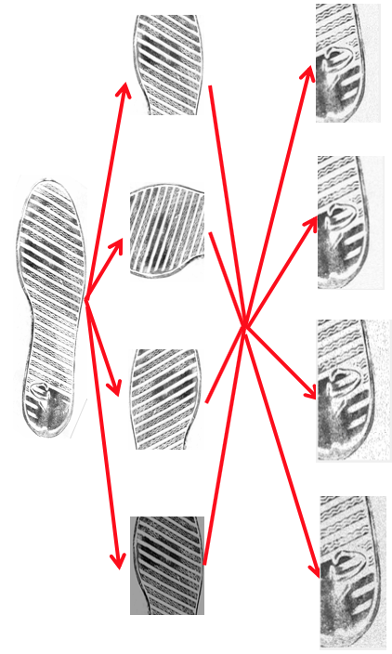
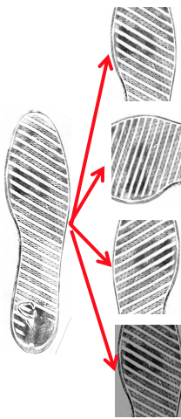

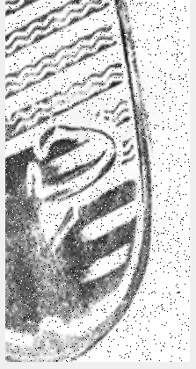
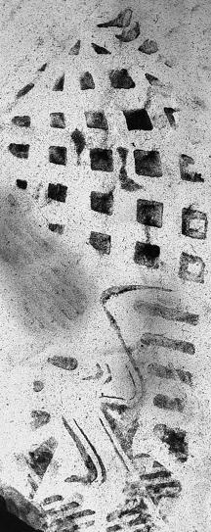
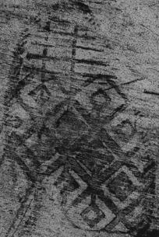
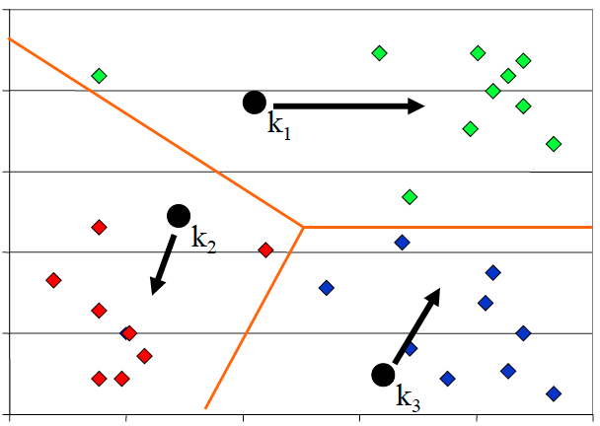
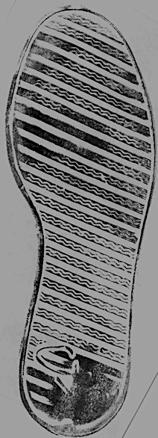

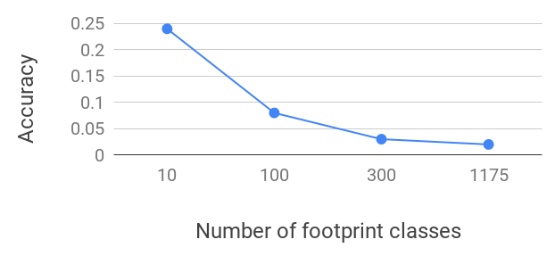
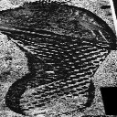
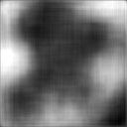
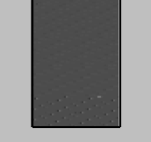
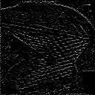


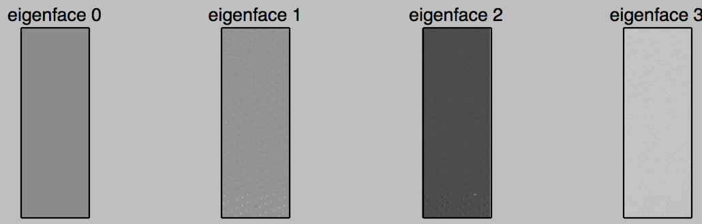




Forensic Investigation via Autoencoder and KNN
Tong Lin, Tianlong Yu, Di Deng
Carnegie Mellon University
Problem: Forensic investigation
Forensic investigation task
Challenge 1: Incomplete evidence
Challenge 2: Noisy background
associate
Footwear impression
at the crime scene
Reference impression
in records
Crop
Rotate
Flip
Brightness
Structured background noise that are not relevant to footprint impression
Our solution: Data augmentation and autoencoder
Idea 1: Data augmentation
Idea 2: Autoencoder to reduce noise
System Overview
Images with noise
Images without noise
Crop
Gaussian
Data augmentation
Autoencoder
Rotate
Poisson
Training
KNN
Testing
Flip
Salt & Pepper
Autoencoder is trained to filter out noise
Footwear impressions
at the crime scene
Identified footwear impressions
Brightness
Speckle
Evaluation
Comparison: PCA (Eigenface)
Eigenface results
Autoencoder and KNN classifier results
X
=
U
SV^{T}
Learnt some useful proper filters
Some features are not useful
Sparse encoding
Poor reconstruction leads to poor KNN classification (1% to 5%）
Significant
?
Input
Features: 64 X 64
Noise
Noise
Significant
Several issues for applying PCA:
Low accuracy: <0.1 (300 classes)
Possible reason: not robust
Requires centered footprints
Requires same size
Sensitive to angles
Cannot scale to 1175 classes
Augmented images:
117500
100 eigen-footprints
Features
Reconstruction
10-701 Machine Learning
Final Encoding

