Slide 1
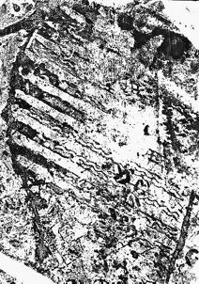
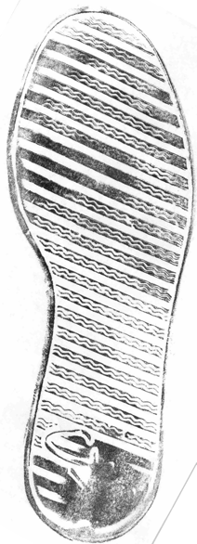
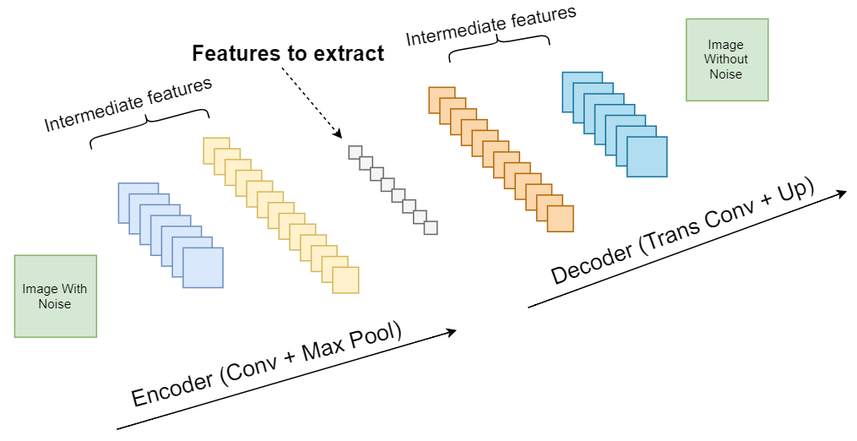
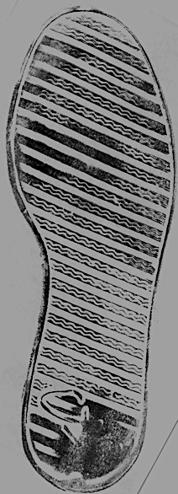
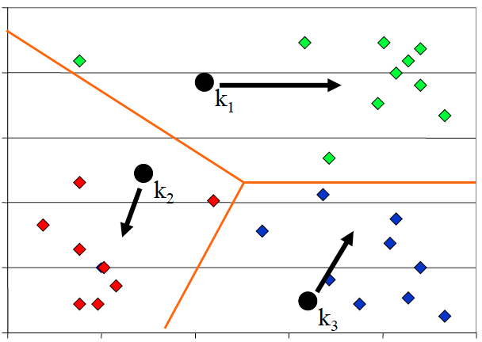
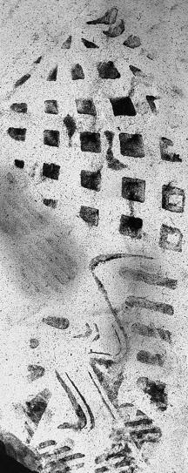
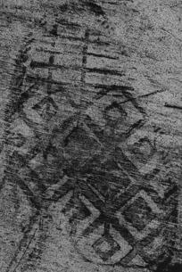

Adj. Forensic Investigation via XYZ
Tong Lin, Tianlong Yu, Di Deng
Carnegie Mellon University
Problem
Forensic investigation task
Challenge 1: Incomplete evidence
Challenge 2: Noisy background
associate
Footwear impression
at the crime scene
Reference impression
in records
Crop
Rotate
Flip
Brightness
Structured background noise that are not relevant to footprint impression
Our solution: Autoencoder and XYZ classifier
Idea 1: Data augmentation
Idea 2: Autoencoder to reduce noise
System Overview
Images with noise
Images without noise
Crop
Data augmentation
Autoencoder
Rotate
Training
KNN
Testing
Noise:
Gaussian
Poisson
Salt & Pepper
Speckle
Flip
Autoencoder is trained to filter out noise
Footwear impressions
at the crime scene
Identified footwear impressions
Brightness
Evaluation
PCA as comparison

