Slide 1
EE382N.1: Computer Architecture Fall 2018: Lecture 1
Dam Sunwoo
The University of Texas at Austin
Arm Research
Action items:
Lab 0 (and get LRC account)
HW1 (tell us about yourself)
Sign up for Piazza
Go to discussion section

Slide 2
Who Are We?
Instructor: Dam Sunwoo (dam.sunwoo@arm.com)
Principal Research Engineer in Arm Research (Austin, TX)
Working on next generation Arm architectures and CPUs
UT ECE Ph.D (2010)
Advisor: Prof. Derek Chiou (Now at Microsoft)
Office hours MW 6:30-7:30pm or by appointment
TA: Pritesh Vinod Chhajed (pritesh_chhajed@utexas.edu)
Really cares about you learning the material and succeeding
Has done very well in this course
Use Piazza to communicate unless personal
Don’t waste time: check/search previous posts before posting

Slide 3
Where to find stuff
https://lph.ece.utexas.edu/class/Fa18EE382N1
General info
Labs
Various course materials
Piazza (through Canvas) for all communication
Only place for all announcements
Only place for Q&A
Except personal issues
Canvas and Gradescope
Surveys mostly live under Quizzes section
Homework probably mostly Gradescope
Announcements incomplete! See Piazza
Submit labs through grader.ece.utexas.edu
Get an LRC account ASAP

Slide 4
Outline: Class Introduction
Introduction
What are you supposed to learn in this class?
What is architecture?
How am I going to teach?
What do I expect from you?
Policies
Action items:
Lab 0 (and get LRC account)
HW1 (tell us about yourself)
Sign up for Piazza
Go to discussion session

Slide 5
What Is “Classic” Architecture?
Designing a structure that meets specific requirements
Functional requirements (office building, house, apartment, etc.)
Cost requirements
Durability requirements
Codes requirements
Construction ease requirements
Aesthetic requirements
“Form follows function” Louis Sullivan

Slide 6
What Is Computer Architecture?
Designing a computer that meets user needs and specifications
Always requires making a series of tradeoffs between characteristics
Some characteristics
Electrical power
Development (Non-recoverable engineering) costs
Per part cost
Executing a specific instruction set architecture
Complexity
Implementation effort
Verification effort
Performance
Technology
Correctness
Reliability
Form follows function

Slide 7

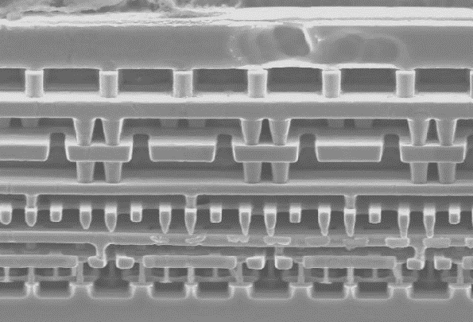
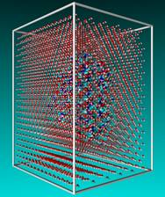
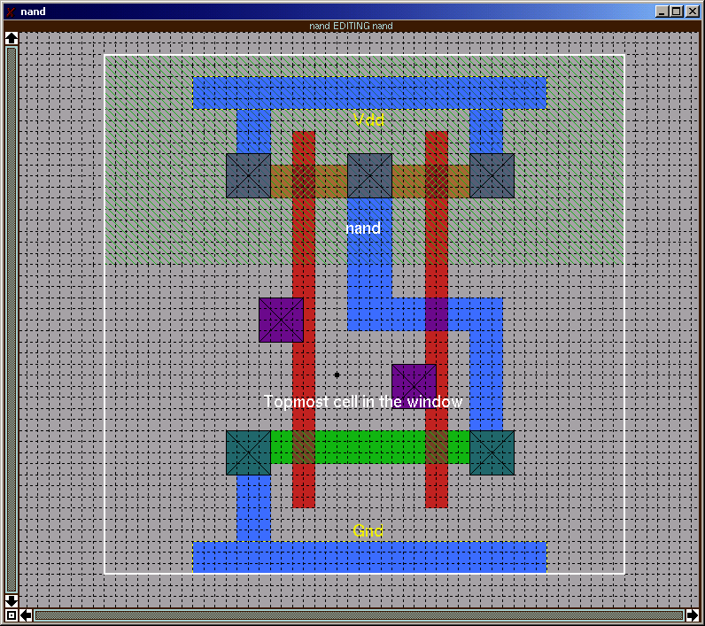
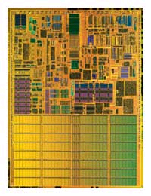
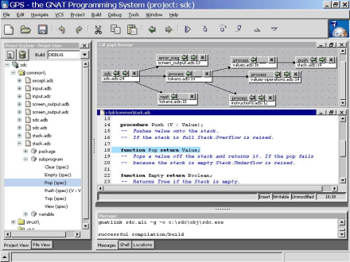
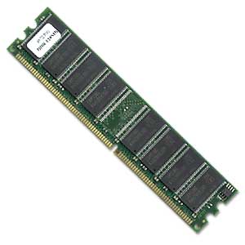

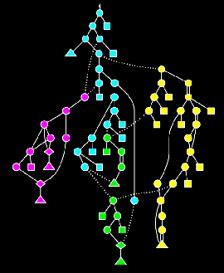
Computer Architects Match Hardware Technology with User Requirements
algorithm
circuits
programming language
processor
compiler
OS +HW system

Slide 8
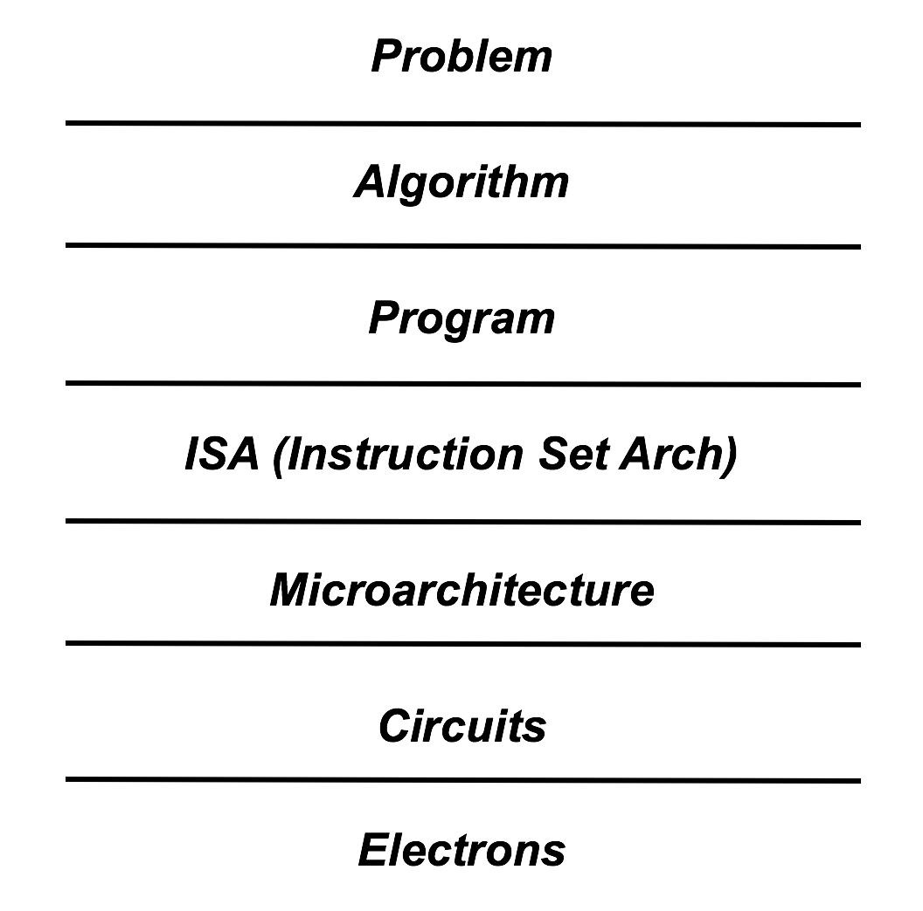
Prof. Patt’s Layers

Slide 9
Where Does Computer Architecture Fit?
Need
Scientific, business
Application
Matlab, Oracle
Algorithm
Bubble sort, quick sort, heap sort
Language
C, C++, C#, Java, Visual Basic
Instruction Set Architecture (ISA)
IA32, Itanium, PowerPC, Alpha
Microarchitecture
386, 486, Pentium, Pentium Pro, Pentium II, Pentium III, Pentium 4, Pentium M, Core, Core 2, Opteron, Athlon, Transmeta, VIA/Centaur, SimICS, bochs
Implementation
RTL, schematic capture, full custom, C
Technology
Silicon, GaAs, Quantum computers

Slide 10
Architecture vs Microarchitecture
Architecture
Contract between compiler/assembly language programmer and microarchitecture
ISA and what is visible to the ISA
Microarchitecture
Specific implementation of ISA
Not visible to the ISA
Car versus engine, transmission, brakes, …
Test for architecture/microarchitecture
If time and resources cannot be measured, user cannot tell the difference between microarchitectures but can tell the difference between architectures

Slide 11
Architecture
Instruction Set
Load/Store memory
Opcodes, Address Modes, Data Types
Condition codes
Format
Memory
Address space
Addressability
Alignment
Priority/Privilege
Interrupt/Exception Handling
Arithmetic
I/O
Multi-threading support
Multiprocessor support

Slide 12
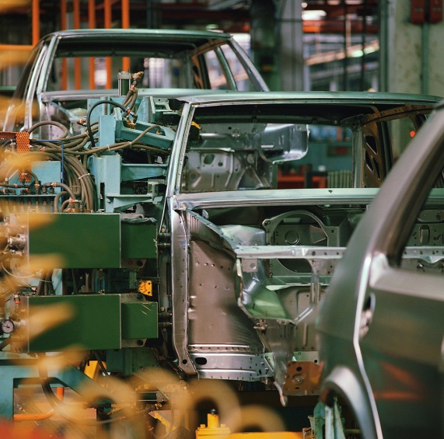
Microarchitecture
Often tradeoff characteristics
Improving performance
Concurrency
Von-Neumann versus Harvard
Multiple instruction issue
pipelining
Branch prediction
Locality
Caches
Registers
Clock rate
Critical path design
Improving power
Clock gating to unused components
Amdahl’s Law
Attacking bottlenecks

Slide 13
Rate of Change
Architectures change slowly
Features added
New features can improve performance, leverage technology
SISD, MMX, 64b extensions
But can become a liability in the future
SPARC register windows, MIPS delayed branch
Removing features almost never happens
8088 code still runs on latest Intel Xeon
Some code probably depends on every instruction
Therefore, add carefully because removing very painful
Microarchitectures change very quickly
Every couple of years (at most)
Different companies implement same ISA with different microarchitectures (Intel/AMD/Transmeta/VIA-Centaur)
Enables performance, power, cost, … improvements

Slide 14
Incorrect Class Name?
Should be “Computer Microarchitecture, Architecture and a Little Implementation”
Computer architecture often means computer microarchitecture
Most computer architects should really be called microarchitects

Slide 15
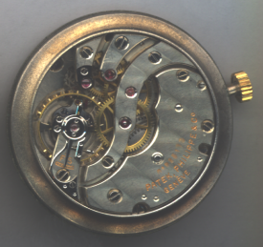

Tradeoffs
A clever design can sometimes be better on all metrics
Seiko Kinetic vs automatic watch
Almost everything, however, comes at a cost
Performance/Efficiency (tank engine, hybrid engine)
Efficiency/Technology-Cost-Implementability (hybrid, classic)
Efficiency/Speed (larger car is generally slower)
Tradeoffs everywhere
Important to understand implementation and technology to be able to truly evaluate tradeoffs
E.g., faster is not always better
Shrink in technology at full speed comes at a factor of 5-10 increase in leakage current

Slide 16
Tradeoffs Change Over Time
Technologies, abilities and concerns change
Early computers
Number of devices
Vacuum tubes expensive, unreliable, big, power hungry
Mainframes/Mini-Computers
Code compatibility
Number of devices
System efficiency
Multi-tasking operating systems
Reliability
Personal Computers
Code compatibility
Cost
Size
Power
Is number of devices/system efficiency as important???

Slide 17
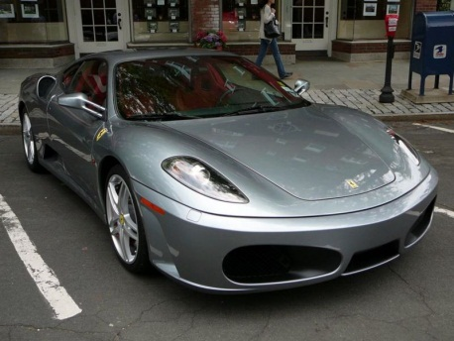
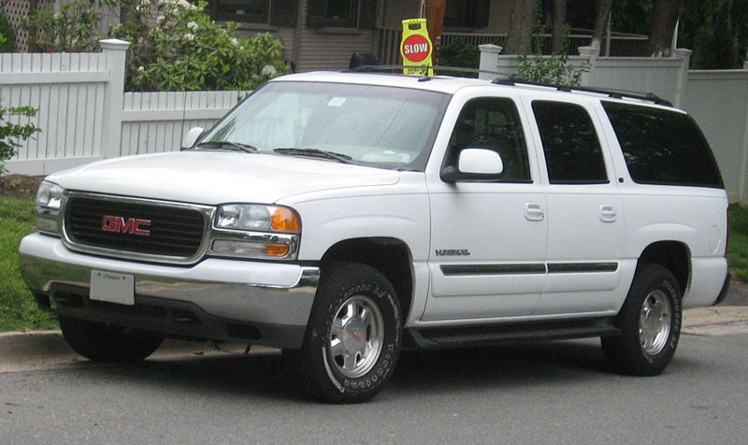


Evaluating Tradeoffs
Performance often inconsistent and hard to determine
Better for one application may be worse for another
Ferrari versus Suburban
Even within the same category, differences
CART versus Formula 1
Different parameters result in different optimal points
Needs
Algorithms
Implementations
Technologies
Right answer usually: “it depends”
Trick is figuring out what on
Need to quantify

Slide 18
Job of (Computer) Architect Includes
Review: Premises/successes of prior art
Know: The Environment for which it will be used
Project: Direction of that Environment
Evaluate: Research what is going on
Understand: User requirements and business considerations
Appreciate: Technology limitations
In other words, look beyond
But also up, down, and sideways

Slide 19
EE382N.1 – Computer Architecture
Used to be offered as EE460N (undergrad) and EE382N.1 (grad) combined
This is the first time splitting the two courses
This will allow us to go faster and deeper into certain topics
This course is heavily based on the course that Prof. Yale Patt created
Course material is heavily based on previous versions taught by Profs. Yale Patt, Derek Chiou, and Mattan Erez
This is the first time I am teaching this course
I TA-ed this course twice in 2003-2004
There will be weak spots and errors for sure, but I’ll do my best to correct them

Slide 20
What Will You Learn?
You will learn about all major architectural and micro-architectural components of all microprocessors up to circa Pentium Pro (or so)
And 80%-90% of pretty much any modern processor
You should be able to architect a processor implementing some arbitrary reasonable instruction set
Expect that you will learn how to be comfortable in Linux and brush up on your C as well
Goal is to learn as efficiently as possible, need your feedback to achieve that
Will have regular surveys, but please don’t wait for those!

Slide 21

What Will You Learn?

Slide 22
What Will You Learn
Architecture concepts
Interaction with software and how to partition functionality
Why instructions and how to choose them
When to specialize and how much to specialize (briefly)
Interfaces between system components
Memory components
How to safely share a system
Systems with multiple processors
Microarchitecture concepts (for improving performance mostly)
Microcoding
Concurrency through pipelining
Concurrency through parallelism
Locality through portioning
Locality through caching
Speculation
Throw more resources at a problem

Slide 23
Discussion Sections
Th 5:00-6:30pm, F 3:00-4:30pm
Do we need all of them?
You are free to attend any/both of the discussion sections
Provided there is space – priority to those registered
Format is subject to change
Discuss labs, requirements, tips, …
Review/answer questions about lectures
Discussion sections start this week!
Expectations and such + Linux basics (you’ll be doing your labs on Linux) and perhaps a brief review of C
If you feel nervous about either, you are strongly encouraged to attend

Slide 24
What Do I Expect From You?
Learn the material
Do the work
If you’re going to come to class, come on time
I do not take attendance and you will not be graded on it
However, all of the top students from previous years regularly attended class
Big believer in communicating
Probably the most important thing to know
Speak up, ask questions, participate in class
There will be a minimum standard to pass the class
This class will definitely be tough
This is a graduate-level class
No preset grade distribution

Slide 25
How Will You Be Evaluated?
Problems sets, 10% total
Intended to reinforce what you learned in class
Clear deadlines on Canvas
Online submission – typed or scanned – must be super-legible or not graded (seriously)
No late problems accepted
Can always hand in early
Sample graded – randomly select one problem to grade per week
6 Programming labs, 5% each = 30%
This is where you really learn
1 grad lab, 4%
gives you an idea of how computer architecture research is done
2 midterm exams, 14% each = 28%
1 comprehensive final exam, 24%
My subjective evaluation, 4%
How much you contribute to class
General interest
Impression of seriousness, …
DO HW 1
DO LAB 0

Slide 26
Exams
Exams are hard in this class
I target a 50% average
Goal is to have a good dynamic range
I hope at least one of you scores over 90% on each test
Assess what everyone understands rather than “good enough”
Questions have simple answers but often require coming up with and evaluating multiple options
“I don’t know” is given 15% partial credit
You need to decide if guessing is worthwhile
Saves grading time
You have to write “I don’t know” and cross out /erase anything else to get credit
A blank answer doesn’t count
All exams are open book (means your book won’t help)
+ I trust you

Slide 27
Policies
Check syllabus and labs to figure out when they are due (there is a date and a time specified)
Slack days – 5 slack days
Collaboration is encouraged, but only on problem sets, discussion, and first 2 labs. All exams and labs 3 – 6 must be your own work
Only 1 submission per group for problem sets
Make-up exams very, very rare and only in extreme circumstances. Make-up exams, if any, will likely take a different form, i.e., will likely be an oral exam.
Again, no extra credit

Slide 28
Textbook
Our own scribed course notes
http://users.ece.utexas.edu/~derek/360NScribeNotes/360NScribedNotes.html
Free, you will be helping to improve them
Some recommended (but not required) textbooks
Hennessey & Patterson, “A Quantitative Approach to Computer Architecture”
General reference
Patterson & Hennesy, “Computer Organization and Design”
Useful for more basic material
Harvey G. Cragon, Computer Architecture and Implementation, Cambridge University Press, 2000, ISBN 0521651689, 0521657059
Carl Hamacher, Zvonko Vranesic, Safwat Zaky, Computer Organization, 5th Edition, McGraw Hill, 2001, ISBN 0072320869
Andrew Tanenbaum, Structured Computer Organization, 5th Edition, Prentice Hall, 2005, ISBN 0131485210

Slide 29
Labs
Labs take time
Thinking/design time
Programming time
Test design + debug (and repeat)
We will regrade Labs 3 and 4
These are tricky
Lab 4 depends on Lab3, Lab 5 depends on Lab 4
After 2 slack days, you’ll be able to retest until you get it right
Final lab grade = max(orig, 0.6*orig+0.4*regrade)
No other labs will be regraded!
You need to write your own set of comprehensive tests!
Tests are an important part of architecture (that’s when you know you really understand)
Tests are integral to any engineering project
Sharing tests is cheating

Slide 30
Programming Environment
Develop code (or at least test it) on the LRC Linux boxes (mario, luigi, or princess)
Microsoft Visual Studio is nice, but it’s not what we use
The lack of Unix knowledge is a major problem according to my industry contacts
We only accept ANSI-C C99 that can be compiled by the default GCC on the LRC Linux boxes

Slide 31
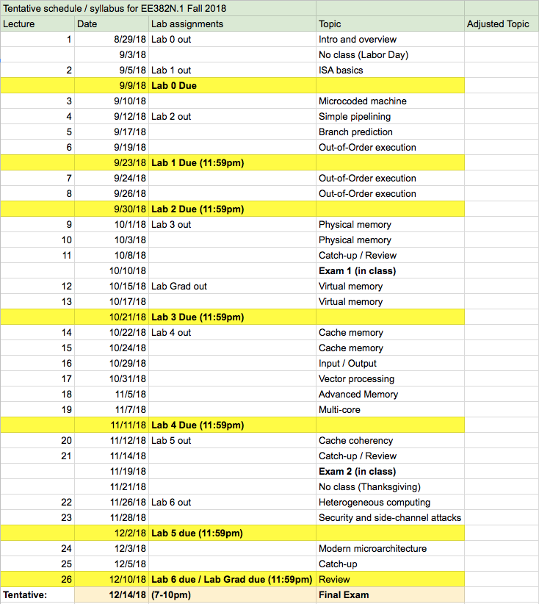
Tentative Course Schedule (on webpage)

Slide 32
Cheating
Collaborate only on homeworks and first two labs (and grad lab)
Strongly encouraged to do homework together in a group (~4 per)
Indicate who you worked with on each homework
On everything else, any collaboration is considered cheating
Do not discuss, leave your solutions unprotected, etc.
Consulting any source, whether from someone they know or found on web / repo is cheating
Penalties are extremely severe
Immediately drop one letter grade for final grade + 0 on assignment
Designed to make cheating not worthwhile
Risk-adjusted return is negative
Much better to not hand in lab or take exam
You are (or are almost) engineers – ethics are everything
Trust yourselves and police yourselves (we’ll help ☹ )
This is really important and may not have been emphasized enough
Impossible for us to block all cheating
Cheating hurts everyone

Slide 33
Where to find stuff
https://lph.ece.utexas.edu/class/Fa18EE382N1
General info
Labs
Various course materials
Opportunities and “ads”
Piazza (through Canvas) for all communication
Only place for all announcements
Only place for Q&A
Except personal issues
Canvas for homeworks, surveys, and most grades
Surveys mostly live under Quizzes section
Announcements incomplete! See Piazza
Submit HW on Canvas
Submit labs through grader.ece.utexas.edu

Slide 34
Emergency Information
Test every first Wednesday 11:50am
Outdoor warning systems and sirens
https://utdirect.utexas.edu/apps/csas/text/
https://www.utexas.edu/emergency/
Lockdown, shelter-in-place, or evacuate
Lockdown
Secure entrances and lock if safe
Leave if you can and hide otherwise
Don’t call people in locked-down buildings
Engage as last resort
Evacuate
Leave orderly and quickly (and turn everything off)
Go and stay 300’ from building
Don’t enter locked/evacuated buildings
Tell me about any concerns

Slide 35
What Did We Learn?
Lab 0 (and get LRC account)
HW1 (tell us about yourself)
Sign up for Piazza
Go to discussion section
Detailed syllabus and requirements
Computer architecture is organization and tradeoffs
Doing the best with the limitations and requirements at hand
Architecture/Micro-architecture partition
Architecture is a contract that should rarely change
Microarchitecture is the implementation and changes often

