Slide 1
382N.1: Computer Architecture Fall 2018: Lecture 11
Dam Sunwoo
University of Texas at Austin
Arm Research

Slide 2
Announcements
Exam #1 on Wednesday (in class)
PS #3 posted

Slide 3
Recap
Finished Out-of-Order execution
Tomasulo algorithm
Register renaming
Reservation stations
ROB
Went through some modern examples of putting everything together

Slide 4
Solution 1
Other
Stuff
Completed?
dest
reg
phy
reg
Committed?
Committed
Tag
Uncommitted
Tag
Valid?
000
R1
P7
F
001
R1
P8
T
R0
P0
P4
C
T
010
R3
P1
T
R1
P17
P18
U
F
011
R1
P18
F
R2
P3
P30
C
T
100
101
R3
P2
P1
U
T
110
RAT
111
ROB
As instruction retires,
previously committed phys reg can be reclaimed
Requires read/modify/write of committed entry in rename table
Notes:
Looking at R1, P17 is committed. Instruction 000, 001 and 011 reused R1, renaming to P7, P8 and P18 respectively. Upon commit of 000, would need to write P7 into the Committed field of R1.

Slide 5
Solution 1a
Other
Stuff
Completed?
arch
reg
new
phy
reg
old
phy
reg
000
Correction:
I incorrectly said we keep the old “committed” phys reg
It should be the most recent phys reg (regardless of committed or uncommitted)
001
010
011
100
101
110
111
Keep old physical register name in ROB
Can reclaim as instruction retired
Avoid read/modify/write in rename table

Slide 6
Anything to review before Exam?

Slide 7
Outline
Physical memory in LC3b
Physical memory constraints and tradeoffs
Cache hierarchies to balance tradeoffs better

Slide 8
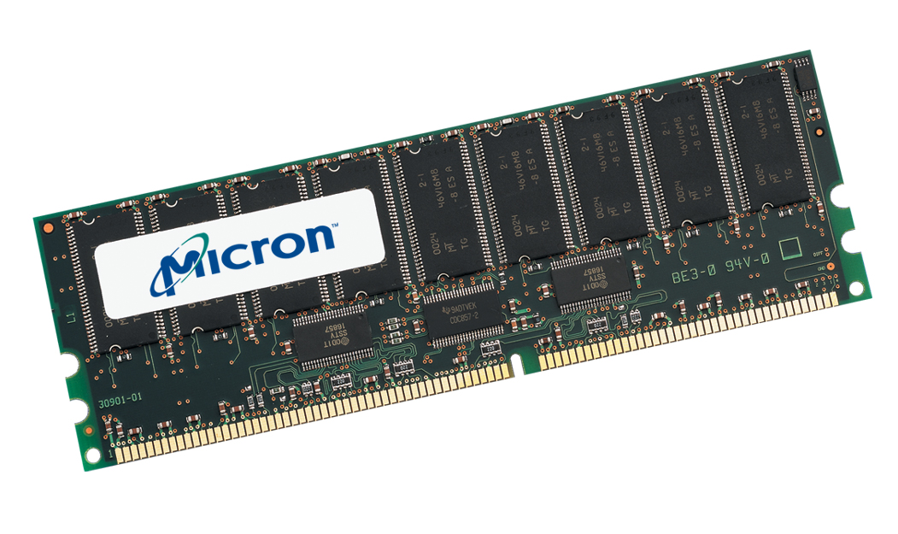
What Is Memory?
Component that remembers one or more values
Registers
SRAM (Static RAM)
DRAM (Dynamic RAM)
Non-volatile RAM (typically abbreviated NVM)
Disk
CAM
Our systems are mostly memory
Exciting times
Packaging changes
Device changes
Interface changes
8
Notes:
8

Slide 9
What Is Memory in this Picture?
uPC
Logic
IR
n
p
z
S
A
B
MAR
MDR
shift
ALU
Regs
Memory
9
Notes:
9

Slide 10
What Is Memory Used For?
Persistent data
How much is in your bank account?
Code
Your application
Operating system, etc.
Intermediate computation
A = B + C
D = A * 4
10
Notes:
10

Slide 11
Accessing Memory
Access by address
UT Austin, 201 E 24th St., POB 6.248, Austin, TX, 78712
Computers use binary addresses
Easy to represent and operate on
Access by content
Screaming down the hall “who’s got the scissors”
Google “I feel lucky”
Your own memory
CAM (Content-Addressable Memory)
Both methods useful
Address: when you know where what you want is
Content: when you know what you want but not sure where it is
Notes:
11

Slide 12
Abstract View of Memory
CE (Chip Enable)
Address
n
WE (Write Enable)
k
Content
How large?
<= (2^{n} * k) bits
Notes:
12

Slide 13
How Much Memory?
As much as you need and no more (expensive)
How much do you need?
How big is your OS?
Windows/OS-X 512MiB+ (need >2GiB)
Seems to be growing with time
How big is your data?
Tools / Simulators that need tens to hundreds of GiBs
There are analytics tools that need many TiBs
Scientific computing needs PiB of memory
How much can I get?
Cost?
Available capacities
System capability
13
Notes:
13

Slide 14
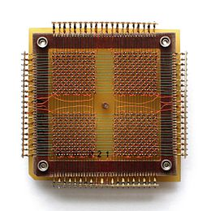
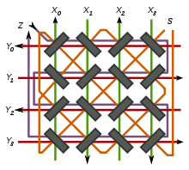
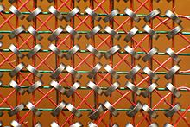
Early days SRAM → Magnetic Core Memory
Magnetic Core memory
A set of memory planes of ferromagnetic rings
Each ring can have magnetic flux circulating one way or the other
Enough current through the ring can flip polarity
Write: passing half that current through both a single X and Y wire …
Read: try to write 0 and see if any pulse on Sense line
Destructive reads! Read flips to 0, so have to rewrite any 1s
Only single bit accessed per plane

Slide 15
How much memory can fit in a chip?
Common chip size is order of 100 mm²
Core memory:
Density ~1 bit per mm²
So can have ~100 bits per “chip” in today’s wolrd!
SRAM
.0588 um² per bit in 14nm process technology
So can have >1 billion bits
Is 1 billion bits a lot?
Just ~128MiB, not enough for even just Windows
Denser memories needed

Slide 16
Memory Layout Across One Chip
16b
3b address
8
16
Notes:
16

Slide 17
Memory Layout Across Two Chips
16b
High
Low
3b address
8
8
8
Notes:
17

Slide 18
Memory Layout Across Two Chips
16b
3b address
8
8
8
Notes:
18

Slide 19
Multiple Memory Chips
15:1
MAR
0
logic
CE
X8
high
WE
CE
X8
low
WE
8
8
MDR
16
Notes:
19

Slide 20
Issue
LC-3b, like many machines, is byte-addressable
However, LC-3b word is 16b (2 bytes)
What does this imply?
8b
0
A
1
B
2
C
3
D
4
5
6
7

Slide 21
A Specific Memory does not always contain the “High” or “Low” byte
1
x8
0
x8
3
2
5
4
7
6
9
8
11
10
13
12
15
14
*((uint16_t)0)
*((uint16_t)3)
Note: LC3b doesn’t have unaligned memory operations
It is byte addressable but LDW and STW are word aligned!

Slide 22
Methods For Dealing with Alignment
ISA
Don’t allow unaligned accesses (Alpha)
Software deals with it
Issues?
Hardware
Processor-centric
Memory sub-system centric
Notes:
ISA needs to read multiple words and insert the correct bits into the correct parts of the words
painful certainly. Common?

Slide 23
Hardware Alignment

Slide 24
Memory Layout Across Four Chips
16b
[15:
12]
[11:8]
[7:4]
[3:0]
3b address
8
4
Notes:
24

Slide 25
Memories of Specific Generation Typically Store Same Number of Bits (tech dependent)
As RAM output gets wider, RAM height gets shorter
Same number of bits per RAM!
32M
16M
8M
x8
x16
x4
Notes:
25

Slide 26
Narrower RAMs Enable Greater Capacity Given Constant Total Width
32M x 4
32M x 4
32M x 4
32M x 4
8M x 16
Notes:
26

Slide 27
More Memory
MAR
0
logic
CE
x8
WE
CE
x8
WE
CE
x8
WE
CE
x8
WE
addr
8
8
8
8
Any Problems?
Notes:
27

Slide 28
Separate CE (two “ranks”)
MAR
1
0
logic
CE
x8
WE
CE
x8
WE
CE
x8
WE
CE
x8
WE
addr
8
8
8
8
16
Notes:
28

Slide 29
What makes a good memory?
Is it just capacity and cost?
What else could it be?

Slide 30
What’s a memory cell anyway?

Slide 31
Small-capacity memories just use logic
SR flip-flop / latch
D flip-flop / latch
How big (how many transistors)?

Slide 32
Small-capacity memories just use logic
SRAM
Static RAM (holds value while power is on)
Densest logic-only memory
6 carefully laid-out transistors
word line
=

Slide 33
Example memory: SRAM Array
b0
b0
b1
b1
b2
b2
b3
b3
word line 0
word line 1
Word decoder
word line 2
word line 3
Sense Amplifiers

Slide 34
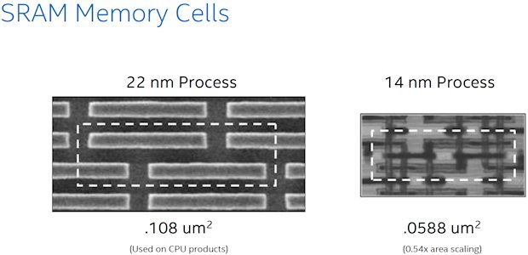
Example memory: SRAM
From Intel:
200 – 300 f² per cell for high-performance
f² is a unit of area – feature-size squared
Limited by transistors and wires
Can go down to ~120 – 150 f² for high density
What does cell size have to do with performance?
Small transistor drive less current – switch lines more slowly

Slide 35
Important SRAM notes
SRAMs are very carefully laid out – amortize costs over many bits (8Kb or more usually)
In large arrays, the latency of access is dominated by the latency of the wires!
Therefore, the larger the memory, the slower it is (generally)
Things are more complex in reality

Slide 36
When logic is too expensive, use different physics
Early days – magnetic core memory
Smaller than vacuum tube logic
Not small by today’s standards

Slide 37
DRAM uses transistors and capacitors

Slide 38


DRAM uses transistors and capacitors
What happens when you read?
38
Notes:
38

Slide 39
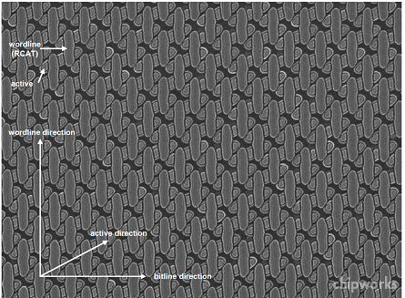
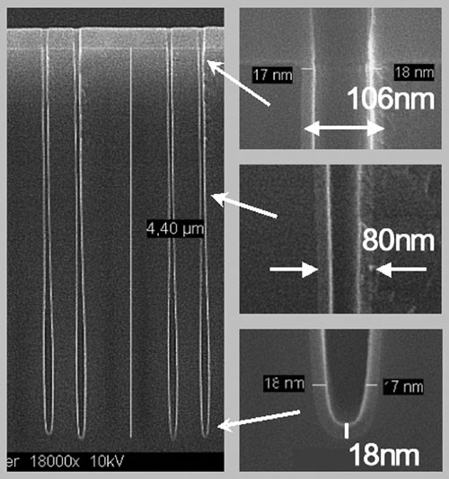
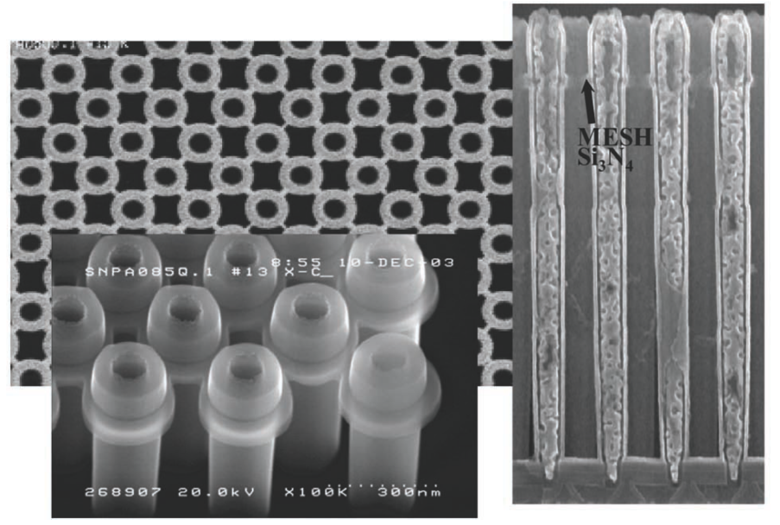
DRAM uses transistors and capacitors
What happens when you read?
Infineon 80nm
39
Notes:
39

Slide 40
DRAM Refresh
Capacitor holding value leaks, eventually you will lose information (everything turns to 0)
How do you maintain the values in DRAM?
40
Notes:
40

Slide 41
Simplified DRAM Internal Structure
Will discuss details of DRAM architecture in another lecture!
Row
RAS
Addr
Column
CAS
41
Notes:
41

Slide 42
DRAM is still kind of big
Current DRAM cell is 6f², and f is around 20nm
So, 416Mb per mm²
In reality, a lot of area is “lost” to supporting (peripheral) circuits
But DRAM scaling is challenging
More problems as dimensions shrink – 10nm will be 4x density, but really hard to achieve
How can we do better?
Use even denser memories
Reduce peripheral circuits
Go vertical – store in 3D

Slide 43
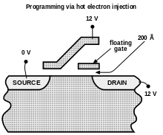
FLASH Memory
Relies on quantum tunneling!
A floating (insulated) second gate (~4f² today)
Learning to count electrons
Multi-level cells

Slide 44
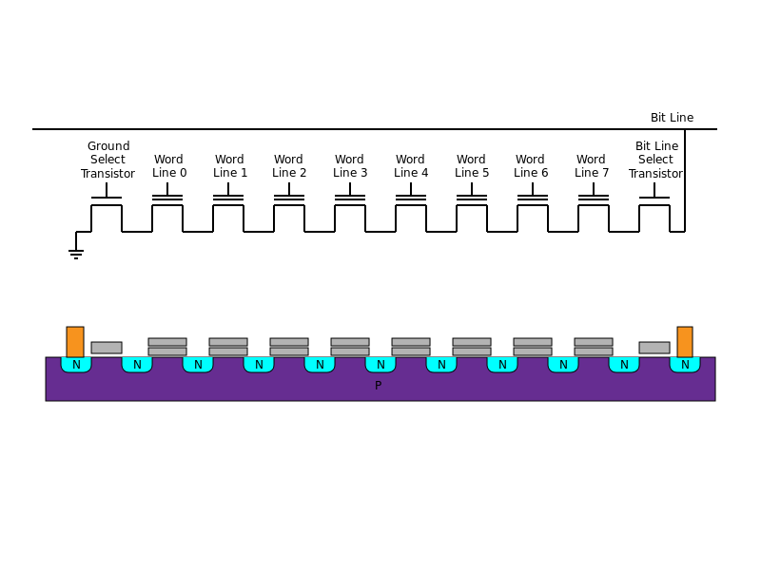
NAND FLASH (reduce wires and periphery)
Access entire page at a time
But, only allow one to possibly affect the read
Have to program and erase together

Slide 45
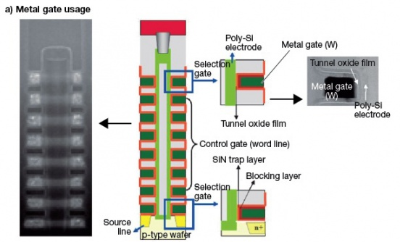
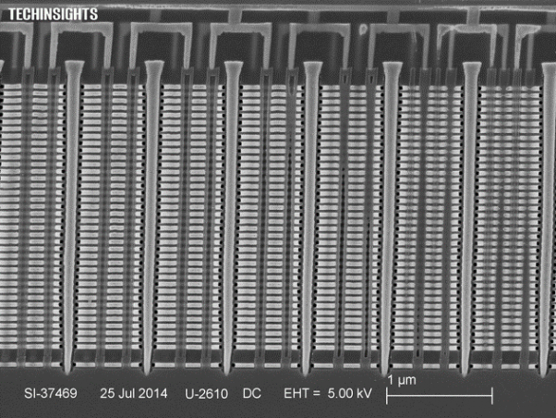
Go vertical

Slide 46
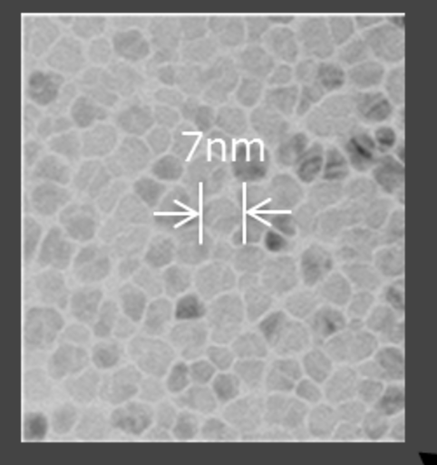
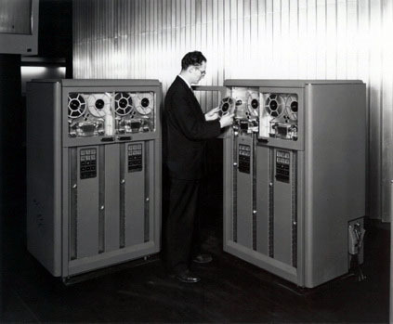
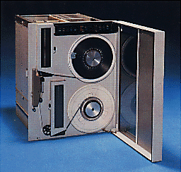
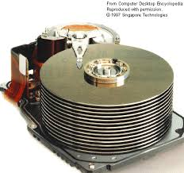
Even that’s not densest
Magnetic disks and tapes win that right now
~100nm² per cell (< “1f²” today)
Stack multiple platters in disks
Tape is thin and wrapped

Slide 47
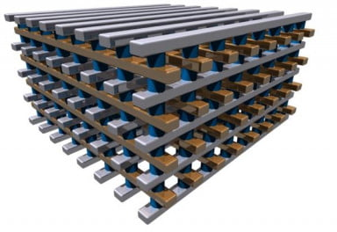
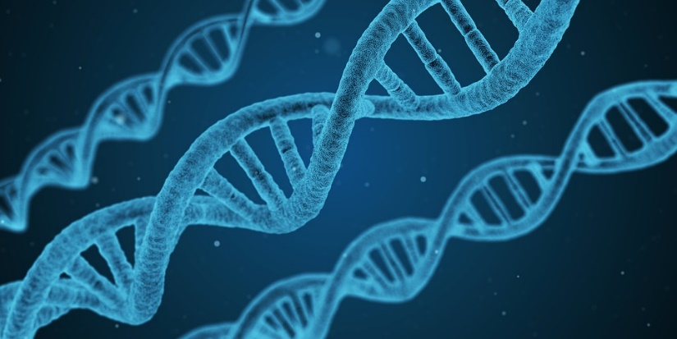
And even that may not be densest
3D crossbar memories
Resistive storage
Sense the current
No access transistors!
But, really dense still in research
Periphery is large
Reliability is a problem
DNA storage
Science stage
May never be good for computing
Why?
Holograms
...

Slide 48
Bottom line -- tradeoffs
Can’t get the cost/capacity we want at the latency we want
So use multiple technologies at once
Memory
Cheap
Efficient
Dense (high capacity)
Fast
Reliable

