Slide 1
382N.1: Computer Architecture Fall 2018: Lecture 15
Dam Sunwoo
University of Texas at Austin
Arm Research

Slide 2
Announcements
Lab 4 posted
Will cover Interrupts and Exceptions today to help with the lab

Slide 3
Last time: Virtual Memory
Virtual memory gives the illusion of isolated “infinite” memory
Address translation + protection provides isolation
Address translation + demand paging enables “infinite” memory
Address translation
Segments (base + bound)
Pages are lots of smallish, fixed-size segments
Page table per process allows linear virtual address translated to physical frame + offset (in hardware)
OS maintains page table and notifies HW where to find it
Only page table pointer updated on context switch
VAX vs. x86
Privileges
Can’t have regular processes messing with pages tables or segment registers/values
Demand paging

Slide 4
Interrupts

Slide 5
Definitions
Our definitions
Interrupt: an event external to the processor that alters the normal flow of instructions
Disk, network, keyboard
Exception: an event internal to the processor that alters the normal flow of instructions
Page fault, arithmetic exception
Note: these definitions are not universally accepted
Notes:
5

Slide 6
Others’ Definitions
Intel (http://www.intel.com/cd/ids/developer/asmo-na/eng/microprocessors/ia32/xeon/19250.htm?page=2)
Interrupt: An exception that comes from outside of the processor. There are two kinds of exceptions: local and external. A local exception is generated from a program. External exceptions are usually generated by external I/O devices and received at exception pins.
PowerPC Architecture
Interrupts “allow the processor to change state as a result of external signals, errors, or unusual conditions arising in the execution of instructions”
PowerPC 604
Everything is an exception
68K
Everything is an exception
VAX
Interrupts: device, software, urgent
Exceptions: faults, traps, aborts
Notes:
6

Slide 7
Terms
Synchronous vs. Asynchronous
Synchronous: event happens in same place in instruction stream every time (assuming same data)
Basically synonymous with exceptions
Asynchronous: event can happen at any point
Basically synonymous with interrupts
Maskable vs. Unmaskable
Interrupts/exceptions can be individually masked
E.g., misaligned access causes an exception or not?
User requested
Users can call TRAP instructions that are handled by the exception handling mechanisms
Notes:
7

Slide 8
Why?
Don’t want to waste time waiting for rare events
There are a lot of things to do
Special hardware to do those things?
Expensive, infrequent -> antithesis of “optimize the common case”
Software?
Cost-effective, how to do it?
Can switch program being run
When to switch?
How to switch?
Notes:
8

Slide 9
When Do You Call the Handler? Where Do You Restart?
Interrupts
Instruction is allowed to complete before interrupt handler executed (why?)
Interrupt handler returns to the following instruction
Exceptions
Instruction causing exception cannot complete without help
Must call handler before instruction completes
Exception handler returns to the instruction that caused the exception
Notes:
9

Slide 10
Interrupts in a Processor
Processor
Chipset
PCI
disk
keyboard
network
Notes:
10

Slide 11
What Happens After An Interrupt/Exception Occurs?
Call handler
What if there are multiple interrupts/exceptions?
How many handlers?
Can you have just one?
What does it need to do?
Poll state to determine which interrupt/exception occurred
Poll in priority order
How can you determine which handler to go to more efficiently?
Vector to appropriate handler as specified by the specific interrupt/exception
Notes:
11

Slide 12
Vectoring To Interrupt/Exception Handlers
Temporarily disable new interrupts
Enter supervisor mode at jump to handler
Needed to fix problems
But, priority for exception handling generally inherited from the original program
Interrupt/Exception saves PC of interrupted stream into special register
Other appropriate state may be saved
Constructs index into interrupt/exception vector
Uses interrupt/exception number as index
Jumps to that location in the interrupt/exception vector
Often another jump right afterwards to the interrupt/exception handling code
Re-enable new interrupts
Notes:
12

Slide 13
Handlers
DSI/ISI (Data/Instruction Storage Interrupt) handler
Page fault handler
Allocate page frame, read data from disk (if necessary), swap page back, update page table
External Interrupt
Poll all possible causes
Keyboard, disk, network
Copy into appropriate memory/buffer
Decrementer (timer)
Switch to new process
Do LRU bit flipping for page reclamation
Etc.
Program
TRAPs: debugger may replace instructions with TRAPs
Use saved PC to figure out where you are
How do you resume?
Notes:
13

Slide 14
Nested Exceptions
One interrupt/exception occurs when another is already active
Priority maintained
Can fundamentally do it
Subroutine calls within subroutine calls
Handlers need to save appropriate state
Notes:
14

Slide 15
Interrupts vs. Exceptions Summary
Interrupts |  | Exceptions
External | CAUSE | Internal to running program (process)
Usually, when convenient | WHEN HANDLED | Usually, when detected
Depends on event | PRIORITY | Same as running process
System | CONTEXT | Process
Usually | MASKABLE | Usually not

Slide 16
CACHES

Slide 17
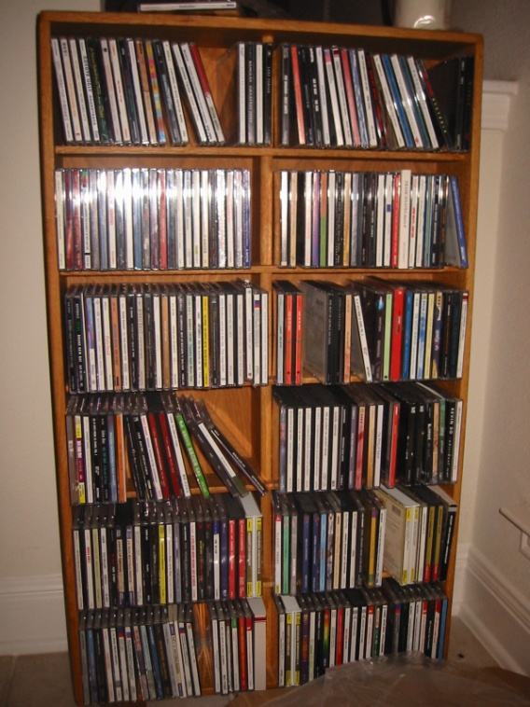
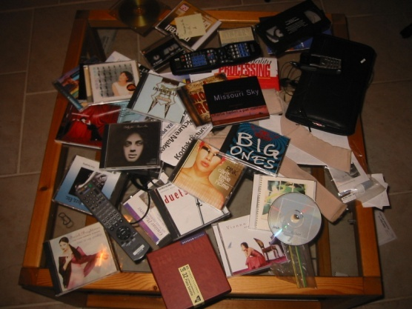
Memory, Cache, Processor
Living Room
17
Notes:
17

Slide 18
An Early Word on Memory Hierarchy
“4.1. Ideally one would desire an indefinitely large memory capacity … We are therefore forced to recognize the possibility of constructing a hierarchy of memories, each of which has greater capacity than the preceding but which is less quickly accessible.”
Burks, Goldstine, and von Neumann, "Preliminary discussion of the logical design of an electronic computing instrument," 1946
.

Slide 19
Cray-1 Solution: Register File Hierarchy
Only 8 vector, 8 scalar, 8 address registers
Electrical/address space considerations
Working set is often larger for scalar/address
vector operations could be “chained”
pipelined: while later part of vector read, beginning can be operated on
Have additional explicitly-addressed RAMs further away than registers
19
Notes:
19

Slide 20
Cray-1: More Registers
Single-
Ported
Memory
(320 MW/
sec)
64 (78?)
T-Registers
Scalar
FU’s
S registers
64 (78?)
B-Registers
Address
FU’s
A registers
Provide operations to explicitly move
data between S/T and A/B registers
20
Notes:
20

Slide 21
DSPs and Stream Processors: Explicit Memory Hierarchy
DRAM and local SRAM use different addresses (and/or instructions)
under explicit SW control. Often hard/impossible to get right
DRAM
Local
SRAM
ALUs
Registers
DSPs: Scratchpad memory
GPUs: “Shared memory”
Sony Cell Broadband Engine (PS3): Local store
Stream Processors: Stream register file (SRF)

Slide 22
Want Automatic Management
Backing registers or scratchpad nice, but
explicit management is painful
often cannot tell statically what will be reused
register files got larger
backing registers needed to get correspondingly larger
code portability suffers too
Caches
Cray never believed in them (“Caches are for wimps!”)
22
Notes:
22

Slide 23
Caches: Automatic Management of Fast Storage
CPU
Cache
$
Memory
Assumptions:
Memory access (~100ns) >> cache access (~1ns)
Cache is smaller, faster, and more expensive than memory
Programs exhibit temporal locality
If an item is referenced, it will tend to be referenced again soon
Can you do this between memory and disk???
Memory hierarchy gets deep
Today, 3 levels of on-chip caches are common
Also between memory and disk/SSD
23
Notes:
23

Slide 24
How Things Have Progressed
Disk/SSD
CPU
Cache
$
Memory
1995 low-mid range Hennessy & Patterson, Computer Arch., 1996 | 200B 5ns | 64KB 10ns | 32MB 100ns | 2GB 5ms
2009 low-mid range www.dell.com, $449 including 17” LCD flat panel | ~200B 0.33ns | 8MB 0.33ns | 4GB <100ns | 750GB 4ms
2015 mid range | ~200B 0.33ns | 8MB 0.33ns | 16GB <100ns | 256GB 20-100us
Notes:
24

Slide 25
Basic Cache Issues
Naming
What do you call things?
Placement
Where in the cache is data placed?
Or, how can I find my data?
Replacement
Given more than one place to place, where is data placed?
Or, what to kick out?
Write Operations
When should memory be updated?

Slide 26
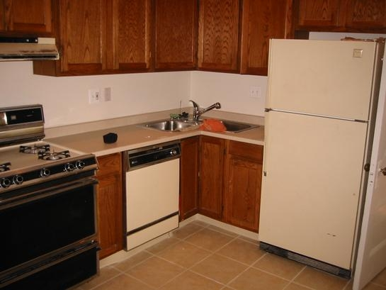
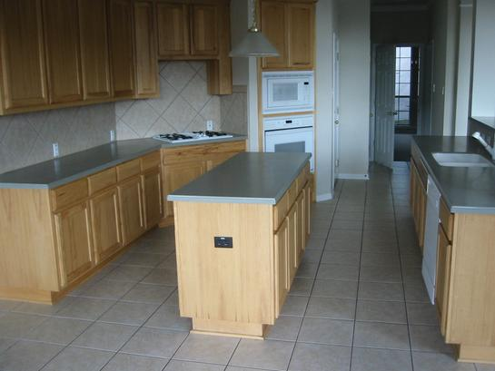
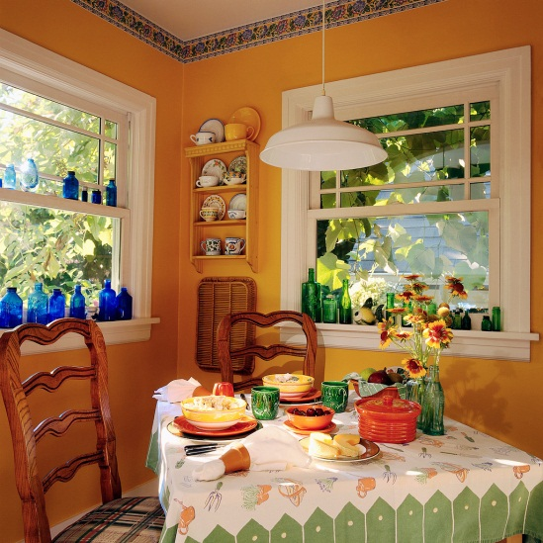
Examples
What do you call things (Naming)
Computers use addresses
Grocery store based on categories
Alphabetize?
Where do you put something (placement)?
Lots of space: “Everything has its place”
Grocery store
“Not everything has its place”
Counter space
Where do you put things?
Place anywhere? Ok, if small kitchen
Place in specific locations (larger kitchen)
Easier to find, can run out of space faster
What do you do when you run out of space (replacement)?
What do you move?
Where do you put what you move?
Meat
Veg
Starch

Slide 27
How much does a cache help?
Model!
Program with n loads
Speedup_{B-over-A} = T_{A} / T_{B}
T_{A} = 100 * n
T_{B} = (HR * 1 + (1 – HR) * (100 + 1) ) * n
HR (Hit Rate) = (# of accesses found in cache) / (total # of accesses)
Miss Rate = 1 - HR
CPU
100 cycles
Mem
A:
CPU
1 cyc
$
100 cycles
Mem
B:
HR | T_A | T_B | Speedup
1 | 100 | 1 | 100.00
0.99 | 100 | 2 | 50.00
0.9 | 100 | 11 | 9.09
0.5 | 100 | 51 | 1.96
0.1 | 100 | 91 | 1.10
0.01 | 100 | 100 | 1.00
0 | 100 | 101 | 0.99

Slide 28
Basic Cache Issues
Naming
What do you call things?
Placement
Where in the cache is data placed?
Or, how can I find my data?
Replacement
Given more than one place to place, where is data placed?
Or, what to kick out?
Write Operations
When should memory be updated?

Slide 29
Baseline Cache & Memory
4 cache locations
Data + address tag
Also called cache-line
16 memory locations
For now, assume cache location size == memory location size
Cache is smaller than memory (obviously)
Thus, not all memory locations can be cached at the same time
Assume each memory location can only reside in one cache-line
Cache
Memory
0000
0001
0010
0011
a
0100
00
0101
01
0110
10
0111
11
1000
1001
1010
1011
1100
1101
1110
1111

Slide 30
Cache Placement, Part 1
Use memory address as a name
Apply a function to the name to generate a cache address to access
What are reasonable functions?
Cache
Memory
0000
0001
0010
0011
a
0100
00
0101
01
0110
10
0111
11
1000
1001
1010
1011
1100
cache
func
1101
1110
1111
addr

Slide 31
Function to Address Cache
Cache expensive; use it efficiently
For “normal” access patterns use as much of the cache as possible
Simplest function is a subset of address bits
CA = ADDR[3],ADDR[2]
CA = ADDR[3],ADDR[1]
CA = ADDR[3],ADDR[0]
CA = ADDR[2],ADDR[1]
CA = ADDR[2],ADDR[0]
CA = ADDR[1],ADDR[0]
Any other functions?
Cache
Memory
0000
0001
0010
0011
a
0100
00
0101
01
0110
10
0111
11
1000
1001
1010
1011
1100
cache
func
1101
1110
1111
addr

Slide 32
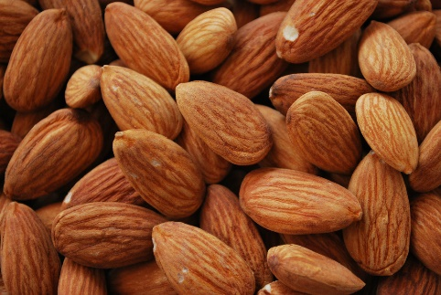
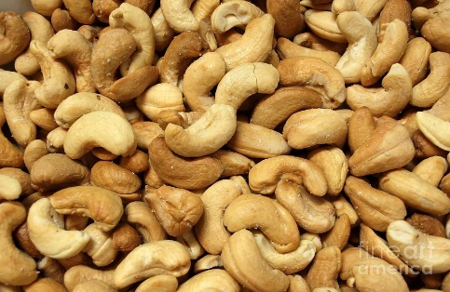
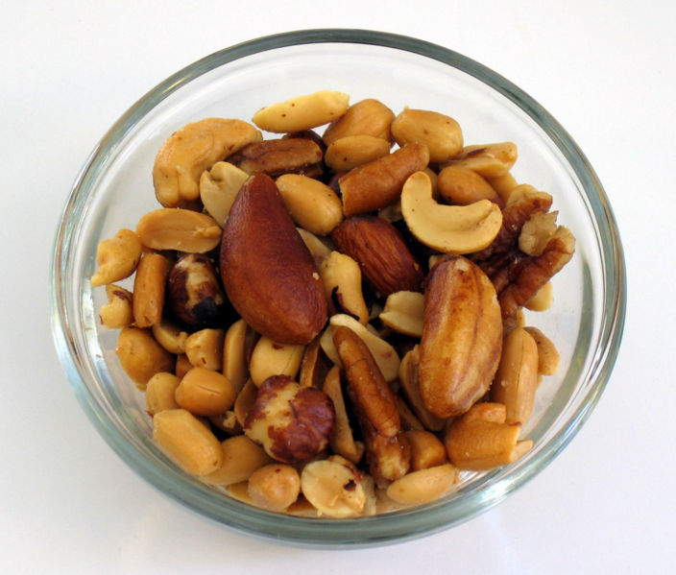
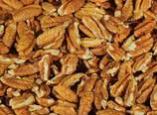
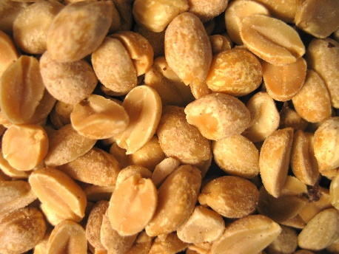
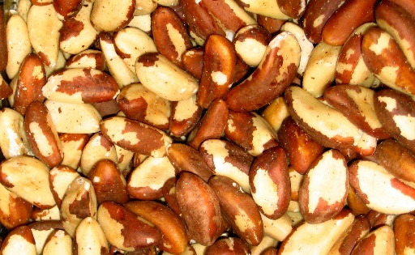
Direct-Mapped Cache
Address cache with lowest order address bits
Very simple
Only one place to look

Slide 33
Example: Direct-Mapped Cache
For (i = 0; i < 4; ++i) {
A += mem[i];
}
For (i = 0; i < 4; ++i) {
B *= (mem[i] + A);
}
Assume mem == 0b1000
ldb R_{a}, 0b1000
ldb R_{t}, 0b1001; add R_{a} , R_{a} , R_{t}
ldb R_{t}, 0b1010; add R_{a} , R_{a} , R_{t}
ldb R_{t}, 0b1011; add R_{a} , R_{a} , R_{t}
ldb R_{b}, 0b1000; cache hit?
Cache
Memory
0000
0001
0010
0011
a
0100
00
1000
a
0101
01
1001
b
0110
10
1010
c
0111
11
1011
d
1000
a
1001
b
1010
c
1011
d
1100
Addr[1:0]
=
1101
1110
1111
addr
Hit?

Slide 34
Do We Need All Those Address Tag Bits?
Cache
Memory
0000
0001
0010
0011
a
0100
00
1000
a
0101
01
1001
b
0110
10
1010
c
0111
11
1011
d
1000
a
1001
b
1010
c
1011
d
1100
Addr[1:0]
=
1101
1110
1111
[3:2]
addr
Hit?

Slide 35
Do We Need All Those Address Tag Bits?
Cache
Memory
0000
0001
0010
0011
a
0100
00
1000
10
a
0101
01
1001
10
b
0110
10
1010
10
c
0111
11
1011
10
d
1000
a
1001
b
1010
c
1011
d
1100
Addr[1:0]
=
1101
1110
1111
[3:2]
addr
Hit?

Slide 36
Reminder: Abstract View of Memory
CE
Address
n
WE
k
Content

Slide 37
One Possible Direct-Mapped Cache Implementation
Cache state is RAM!
Implement cache as a single SRAM
Need appropriate comparators
Memory is implemented as a DRAM
Cache
Memory
0000
0001
0010
0011
a
a
0100
00
0101
01
0110
10
0111
11
1000
1001
1010
1011
1100
1101
1110
1111

Slide 38
One Possible Direct-Mapped Cache Implementation
Cache state is RAM!
Implement cache as a single SRAM
Need appropriate comparators
Memory is implemented as a DRAM
Cache
Memory
0000
Mem
(DRAM)
0001
0010
0011
a
a
0100
00
Cache
SRAM
0101
01
0110
10
2
0111
11
1000
4
1001
1010
addr_tag + valid + data
1011
1100
1101
1110
1111
data

Slide 39
Conflicts
What if our access pattern is mostly contiguous but not completely?
For (I = 0; I < 3; ++I) {
A += mem[i];
}
A += mem[5];
Assume mem == 0b1000
ldw R_{a}, 0b1000
ldw R_{t}, 0b1001; add R_{a} , R_{a} , R_{t}
ldw R_{t}, 0b1010; add R_{a} , R_{a} , R_{t}
ldw R_{t}, 0b1101; add R_{a} , R_{a} , R_{t}
…….
ldw R_{b}, 0b1001; cache hit?
Cache
Memory
0000
0001
0010
0011
a
0100
00
10
a
0101
01
10
10
11
b
b
d
0110
10
10
c
0111
11
1000
a
1001
b
1010
c
1011
1100
Addr[1:0]
1101
d
1110
1111
addr

Slide 40
Sets
Each cacheable memory location is mapped to a set of cache locations
A set is one or more cache locations
Generally (but not always) set size is a power of 2
Total number of cache-lines is divisible by number of sets
Otherwise, waste some cache-lines
Thus, for this example, expect set sizes of 1, 2, 4
Direct mapped is set size == 1!
Cache
Memory
0000
0001
0010
0011
0100
00
0101
01
0110
10
0111
11
1000
1001
1010
1011
1100
1101
1110
1111

Slide 41
Sets
Each cacheable memory location is mapped to a set of cache locations
A set is one or more cache locations
Generally (but not always) set size is a power of 2
Total number of cache-lines is divisible by number of sets
Otherwise, waste some cache-lines
Thus, for this example, expect set sizes of 1, 2, 4
Direct mapped is set size == 1!
Cache
Memory
0000
0001
0010
0011
0100
00
0101
01
0110
10
0111
11
1000
1001
1010
1011
1100
1101
1110
1111

Slide 42
2-Way Set-Associative
Each set is 2 entries big
Which addr bits select set?
Either entry can store any cache-line that maps to that set
For (I = 0; I < 3; ++I) {
A += mem[i];
}
A += mem[5];
Assume mem == 0b1000
ldw R_{a}, 0b1000
ldw R_{t}, 0b1001; add R_{a} , R_{a} , R_{t}
ldw R_{t}, 0b1010; add R_{a} , R_{a} , R_{t}
ldw R_{t}, 0b1101; add R_{a} , R_{a} , R_{t}
ldw R_{b}, 0b1001; cache hit?
0
Set 0
1000
1010
1
Set 1
1001
1101

Slide 43
Can Same Structure Implement a 2-Way Set-Associative Cache?
Cache
Memory
0000
Mem
(DRAM)
0001
0010
0011
a
a
Finding the right tag?
0100
00
Cache
SRAM
0101
01
0110
2
10
0111
11
4
1000
1001
1010
addr_tag + valid + data
1011
1100
1101
1110
1111
data

Slide 44
One Possible 2-Way Set-Associative Cache Implementation
Cache is simply RAM
Implement 2-way set-associative cache as a two SRAMs
Similar to Banked Memory
But use same address for both
Double bandwidth
Cache
0
Cache
SRAM
0
Cache
SRAM
1
1
addr_tag + v + data
addr_tag + v + data

Slide 45
4-Way Set-Associative (Fully Associative for a 4-entry cache)
0
0000
0100
1000
1100
Each Set 4 entries big
Every entry can store any cache-line that maps to that set
ldw R_{a}, 0b0000
ldw R_{t}, 0b0100
ldw R_{t}, 0b1000
ldw R_{t}, 0b1100
ldw R_{b}, 0b1000; cache hit?
Tags?

Slide 46
Set-Associative vs. Direct Mapped
What are the tradeoffs?
Set-Associative Pros
Generally higher hit rate
Better utilization of cache resources
Direct-Mapped Pros
Simpler
Faster

Slide 47
Locality again
So far: temporal locality
What about spatial?

Slide 48
Example: Block Size (Cache-Line Size) of 2 (Direct Mapped Cache)
Cache
Memory
ldb Ra, 1000
ldb Rb, 1001
ldb Rc, 1010
ldb Rd, 1011
0000
0001
0010
0011
a
0100
00
a:b
0101
01
c:d
0110
10
0111
11
1000
a
1001
b
What is total cache size?
Which addr bits used?
1010
c
1011
d
1100
Addr[2:1]
=
1101
1110
[3]
1111
addr
Hit?

Slide 49
Cache Naming and Placement
Cache namespace is the same as the memory namespace
Cache placement will be as below for:
b bits in a memory address
2^{n}-way set-associative cache
S sets (s = log₂S)
L bytes of data in a cache line (l = log₂L)
Cache size?
b-1
l+s
l
0
tag
index
offset

Slide 50
Terms: Types of Misses
Compulsory
First access
Conflict
Cache is not associative enough
Capacity
Cache is not big enough, forced to make room
50
Notes:
50

Slide 51
What To Do On Miss?
Put into cache or not?
Any reason not to put into cache?
Difference between loads and stores?
51
Notes:
51

Slide 52
Replacement Policy
Which block should be replaced?
Direct mapped?
Associative caches?
Replacement Policy
least-recently-used (LRU)
difficult to implement perfect LRU
Random
FIFO (uncommon)
LIFO (uncommon)
52
Notes:
52

