Slide 1
382N.1: Computer Architecture Fall 2018: Lecture 17
Dam Sunwoo
University of Texas at Austin
Arm Research

Slide 2
Last time
Grad Lab
We will look into LRC resources
Perhaps get started with Virtual Machines in the meantime?
Caches
Set-associative caches

Slide 3
Terms: Types of Misses
Compulsory
First access
Conflict
Cache is not associative enough
Capacity
Cache is not big enough, forced to make room
How to determine miss type:
Compulsory
no choice (first time seen or coherence invalidation)
Capacity
Simulate fully-associate cache with capacity, line size, and alloc/replacement policy; is miss – capacity miss
Conflict
Simulate given cache, if miss but not capacity miss, then conflict
3
Notes:
3

Slide 4
What To Do On Miss?
Put into cache or not?
Any reason not to put into cache?
Difference between loads and stores?
4
Notes:
4

Slide 5
Replacement Policy
Which block should be replaced?
Direct mapped?
Associative caches?
Replacement Policy
Least Recently Used (LRU)
difficult to implement perfect LRU
Need log₂(n!) bits to represent state for n-way set-associative structure
Least Frequently Used (LFU)
Random
FIFO (uncommon)
LIFO (uncommon)
Optimal?
Belady’s algorithm: Replace most distant reuse in the future
[IBM Journal, 1966]
5
Notes:
5

Slide 6
One Implementation of Hardware LRU
k
0 1 2 3
3 0 0 0 0
2 0 0 0 0
1 0 0 0 0
0 0 1 1 1
4-way set
j
when the i’th block is referenced
row i is set to 1
column i is set to 0
the row containing all 0’s is the LRU block
example: b0, b1, b2, b3, b0, b2
6
Notes:
6

Slide 7
One Implementation of Hardware LRU
k
0 1 2 3
3 0 0 0 0
2 0 0 0 0
1 1 0 1 1
0 0 0 1 1
4-way set
j
when the i’th block is referenced
row i is set to 1
column i is set to 0
the row containing all 0’s is the LRU block
example: b0, b1, b2, b3, b0, b2
7
Notes:
7

Slide 8
One Implementation of Hardware LRU
k
0 1 2 3
3 0 0 0 0
2 1 1 0 1
1 1 0 0 1
0 0 0 0 1
4-way set
j
when the i’th block is referenced
row i is set to 1
column i is set to 0
the row containing all 0’s is the LRU block
example: b0, b1, b2, b3, b0, b2
8
Notes:
8

Slide 9
One Implementation of Hardware LRU
k
0 1 2 3
3 1 1 1 0
2 1 1 0 0
1 1 0 0 0
0 0 0 0 0
4-way set
j
when the i’th block is referenced
row i is set to 1
column i is set to 0
the row containing all 0’s is the LRU block
example: b0, b1, b2, b3, b0, b2
9
Notes:
9

Slide 10
One Implementation of Hardware LRU
k
0 1 2 3
3 0 1 1 0
2 0 1 0 0
1 0 0 0 0
0 0 1 1 1
4-way set
j
when the i’th block is referenced
row i is set to 1
column i is set to 0
the row containing all 0’s is the LRU block
example: b0, b1, b2, b3, b0, b2
10
Notes:
10

Slide 11
One Implementation of Hardware LRU
k
0 1 2 3
3 0 1 0 0
2 1 1 0 1
1 0 0 0 0
0 0 1 0 1
4-way set
j
when the i’th block is referenced
row i is set to 1
column i is set to 0
the row containing all 0’s is the LRU block
example: b0, b1, b2, b3, b0, b2
11
Notes:
11

Slide 12
One Implementation of Hardware LRU
k
0 1 2 3
3 0 1 0 0
2 1 1 0 1
1 0 0 0 0
0 0 1 0 1
4-way set
j
Row with lowest binary value is LRU!
when the i’th block is referenced
row i is set to 1
column i is set to 0
the row containing all 0’s is the LRU block
example: b0, b1, b2, b3, b0, b2
12
Notes:
12

Slide 13
Pseudo-LRU
Achieve close to LRU performance with far simpler policy and fewer state to track
Tree-based Pseudo-LRU
(n-1) bits organized as tree for n-ways
Bits point to path to victim (left or right)
Upon cache access, ensure bits along path are pointing “the other way”
Not Recently Used (NRU)
1 bit per cache line
Set bit to 0 on cache hit
Set all bits to 1 when all bits are 0
Replace line with 1

Slide 14
Tree-based Pseudo-LRU Example (4-way)
0
1
0
0
0
1
0
1
1
A
A
B
1
0
1
0
1
0
0
1
0
A
C
B
A
C
B
D
E
C
B
D

Slide 15
General Rule: Bigger == Slower
CPU
Cache
$
Level 1
(L1 $)
Cache
$
Level 2 (L2 $)
Memory
How big should the cache be?
Too small and too much memory traffic
Too large and cache slows down execution (high latency)
Make multiple levels of cache
Small L1 backed up by larger L2
Today’s processors typically have 3 cache levels
15
Notes:
15

Slide 16
How much does a cache hierarchy help?
CPU
Cache
$
L1 $
1 cycle
Cache
$
L2 $
10 cycle
Memory
100 cycles
n load instructions
Total time T: Add up fraction of instructions at particular level multiplied by access latency at that level
T = ( h₁*1 + (1-h₁)*h₂*(1+10) + (1-h₁)*(1-h₂)*(1+10+100) ) * n
h₁: hit rate at L1$
h₂: hit rate at L2$

Slide 17
Inclusive Caches vs. Exclusive Caches
Inclusive Caches
Every block in a level also exists in the next level
When fetching a block, place it in all cache levels
(-) Duplication of data in hierarchy
(-) more effort to maintain inclusion
(+) cache coherence in multiprocessors easier
Only track in last-level cache
Exclusive Caches
Blocks contained in cache levels are mutually exclusive
(+) More efficient utilization of cache space
(+) More flexibility in replacement / placement
(-) More blocks/levels to keep trace of for cache coherence
Non-Inclusive Non-Exclusive cache
No guarantees for inclusion or exclusion

Slide 18
Virtual or Physical Addresses for Caches?
TLB look up takes time
For both instructions and data addresses
CPU
Virtual
Cache
VA
Memory
VA
TLB
PA
CPU
PA
Physical
Cache
PA
Memory
VA
TLB

Slide 19
Issues with Virtual Caches
Synonym: a word that means the same as another word
Virtual cache can have two copies of same physical data
Homonym: words with same spelling but different meaning
One virtual page maps to two physical page
Solutions: Add ASID with tag, use physical tags, flush on context switch
VA₁
PA
VA₂
PA₁
VA
PA₂

Slide 20
Virtually-Indexed Physically Tagged (VIPT) Caches
Best of both worlds!
VA
VPN
Page Offset
Tag
Index
Offset
Cache
TLB
PFN
=
(phys) Tag
Data

Slide 21
VIPT Cache
Can concurrently look up TLB and cache using VA bits
Compare tag (physical) against TLB output later
Cache Index bits need to fit in Page Offset
Page offset same in VA and PA!
Constraints on cache configuration
Cache size <= Page size * Associativity
If Cache size larger than (page size * assoc), can cause synonyms
Solutions?
Ensure mapping of overlapping bits are the same in S/W (early SPARC)

Slide 22
Virtual or Physical Caches
VIVT: Fastest, but can have synonyms and homonyms
VIPT: Fast, no homonyms
Mostly used in L1 caches
PIVT: ?
PIPT: Slower, but no synonyms or homonyms
Used in lower level caches

Slide 23
Other cache optimizations
Latency
Anything other than levels?
Hit rate
Reduce misses
Conflict misses
Associativity tradeoffs
Victim cache
Compulsory misses
Cache line size
Prefetch
Capacity misses
Replacement policies

Slide 24
Critical Word First
Memory bus is generally one or two words wide
Pentium 4 is 64b wide, 32b words
Cache-line fills require multiple words over bus
A simple cache-fill would always start on word 0
If you have an 8 word cache-line, and you miss on the 5th word, with a 1 word bus, you need to wait for the 5th word
Why not start on the 5th word?
Design logic to do so

Slide 25
Caches can be specialized for data and instructions
Memory is read for every instruction
Lots of spatial locality
instructions tend to follow one another
Lots of temporal locality
Programs have loops
Programs are often not that big
Can have a special cache just for instructions
Reduce conflicts with data
Perhaps longer cache lines
Can have very high hit rate if data doesn’t evict instructions
All processors today (almost) have separate ICache and DCache

Slide 26
Prefetching
Issue loads that will miss early (before demand)
Done by
User (prefetch instructions)
Compiler (prefetch instructions)
Hardware (look for patterns)
Huge amount of research
Still on-going
Will cover some examples in later lectures (if time permits)

Slide 27
Victim Caches
Associative caches expensive
Sometimes associativity necessary to get reasonable hit rate
Some memory access patterns need associativity
But perhaps on a small number
Combine a large direct-mapped cache with a small fully-associative cache
Fill fully-associative with conflicts from direct-mapped cache
[Jouppi, ISCA 1990]

Slide 28
Placement/replacement optimizations
Dead block prediction
LRU-stack location
Blend LRU and LFU
Inter-reference intervals
…

Slide 29
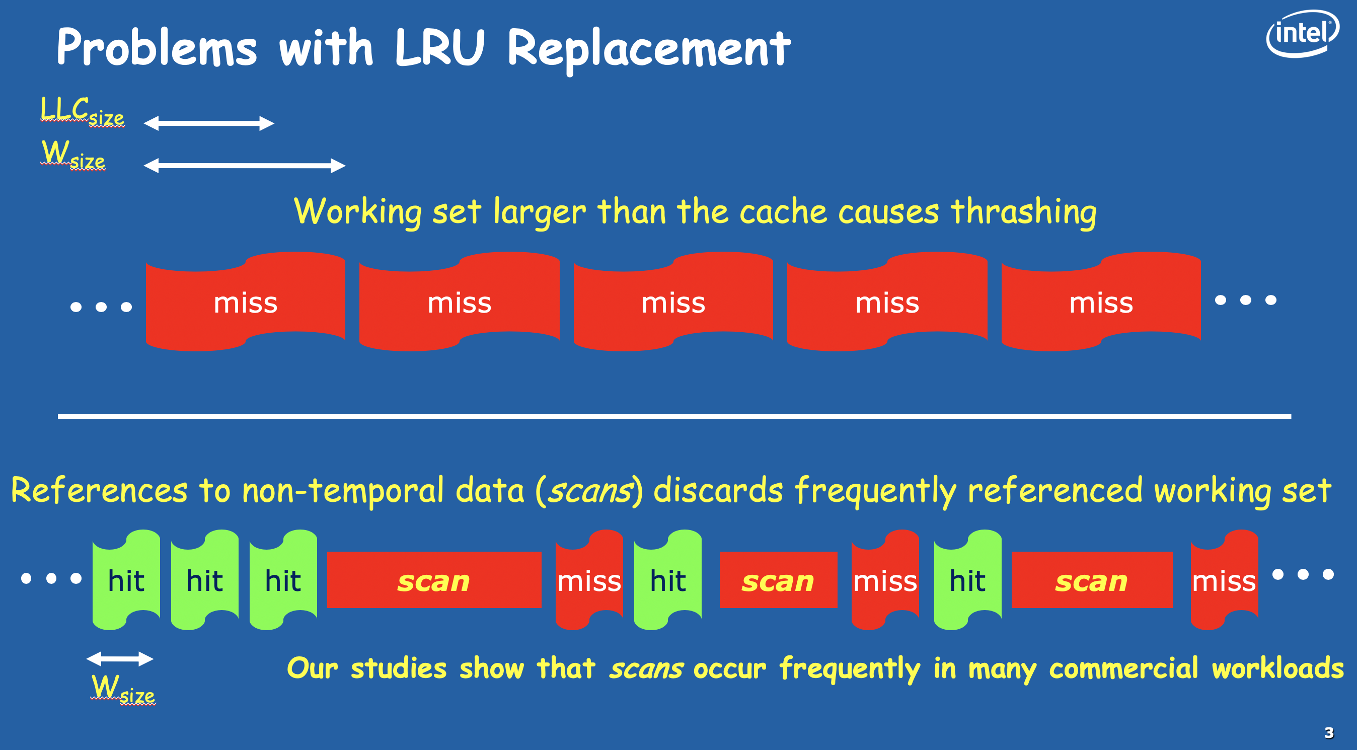
Re-Reference Interval Prediction (RRIP)
[Jaleel+, ISCA 2010]

Slide 30
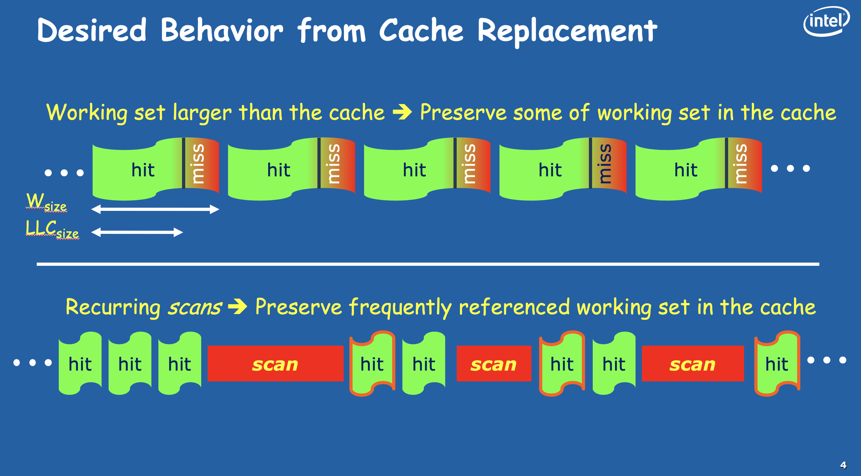
Re-Reference Interval Prediction (RRIP)
[Jaleel+, ISCA 2010]

Slide 31
Re-Reference Interval Prediction (RRIP)
Insert into “long” re-reference interval and promote on hit
[Jaleel+, ISCA 2010]

Slide 32
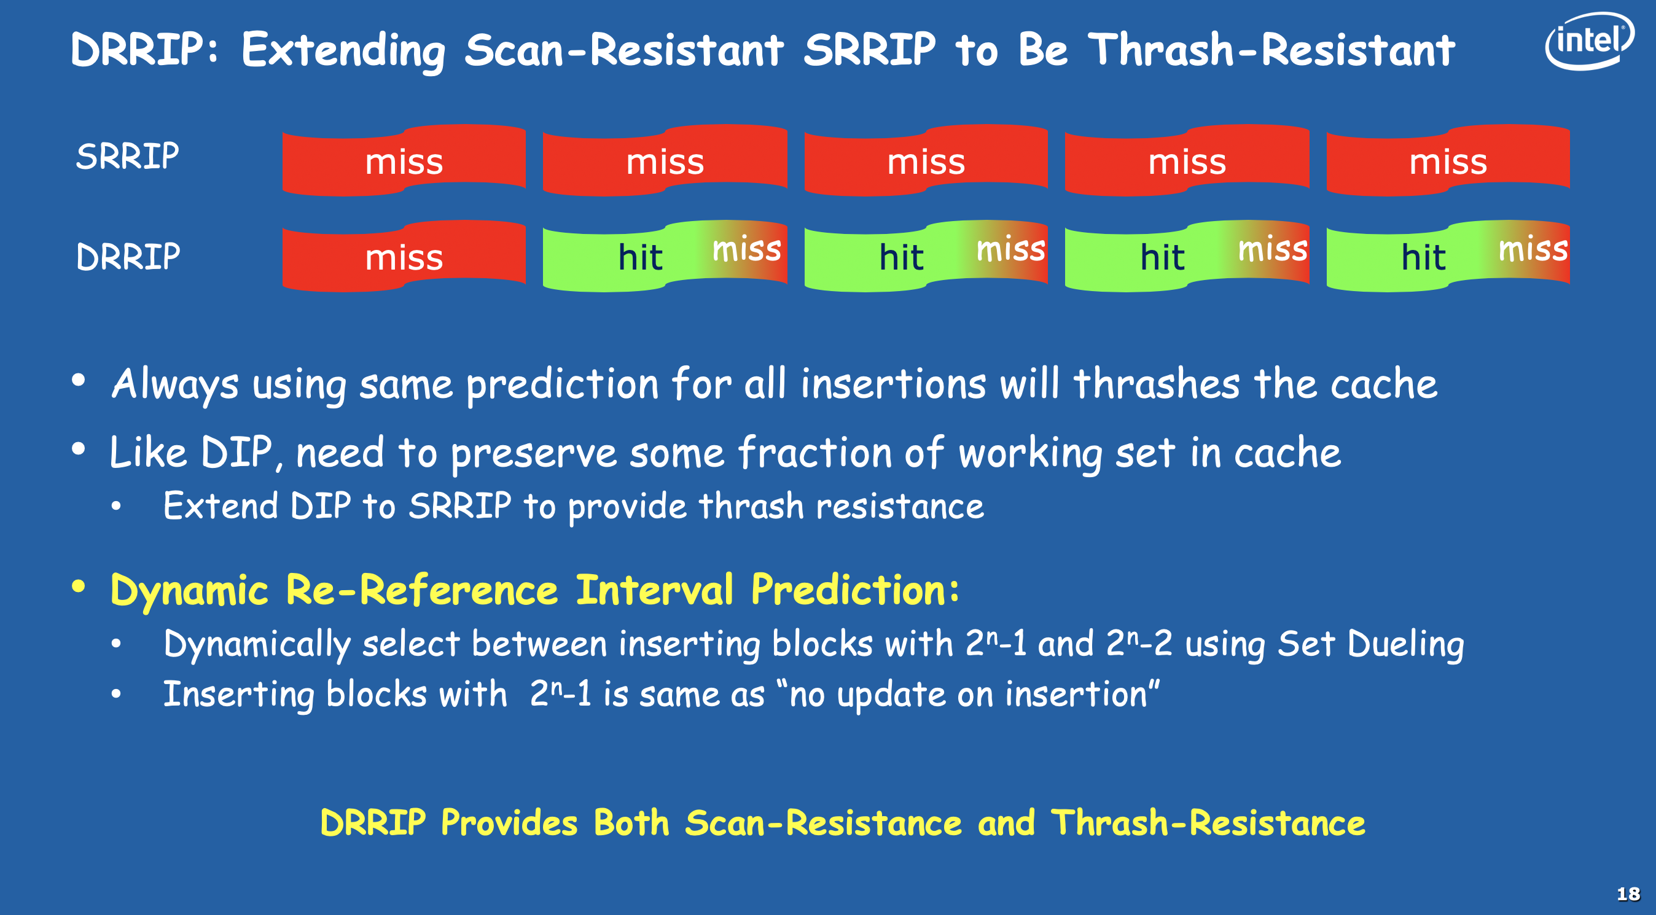
Re-Reference Interval Prediction (RRIP)
[Jaleel+, ISCA 2010]

Slide 33
Cut down on tag lookup?
Predict where the data is
E.g., way prediction
[Powell+, MICRO 2001]
Predict way; only 1 tag comparison performed that cycle
If miss:
Check other ways in set
Go to next level if not found

Slide 34
Cache Control Instructions
Enable control over placement and replacement
PowerPC example:
dcbt: data cache block touch
dcbtst: data cache block touch for store
dcbz: data cache block zero
dcbst: data cache block store
Stores dirty data back to memory
dcbf: data cache block flush

Slide 35
Does SW care about cache (is it microarch)?
Recall: If architectural state changes are unaffected → uarch
So, despite cache control instructions and prefetch a cache (for now) is uarch
We’ll revisit when we talk about parallelism

Slide 36
What did we learn? Caches: Automatic Management of Fast Storage
CPU
Cache
$
Memory
Assumptions:
memory access (~100ns) >> cache access (~1ns)
Cache is smaller, faster, more expensive than memory
Programs exhibit temporal locality
If an item is referenced, it will tend to be referenced again soon
Programs exhibit spatial locality
If an item is referenced, the next item in memory is likely to be accessed soon
36
Notes:
36

