Slide 1
EE 382N.1: Computer Architecture Fall 2018: Lecture 2
Dam Sunwoo
University of Texas at Austin
Arm Research

Slide 2
Announcements
Dam’s office hours:
MW 6:30-7:30pm (after class) in classroom or EER 0.814D
Or, by appointment
Don’t forget Lab #0
set up environment and test submission
Survey #1 – Tell us about yourself (through Canvas)
Lab #1 is out
Pair up if you wish
Problem Set #1 is out
Check Canvas / Piazza for announcements
You can search for teammates on Piazza

Slide 3
Review
What is architecture?
Match requirements with technology under constraints
Define system components and how they interface/interact
Tradeoffs, tradeoffs, tradeoffs
Know what they are and know how to decide
Realize that tradeoffs change over time
Creative solutions can avoid tough choices
Arch/microarch?
Arch is always SW visible, microarch can be ignored by SW
Ideal test: If can’t tell difference between two systems without measuring time or resources, then only differences are μarch
Class policies
Do the homework (small groups), 6 + 1 labs (yourself), take the 2 mid-terms (in class) and the final, contribute to class
Don’t cheat

Slide 4
Outline
What is an ISA
Why ISA?
Creating ISAs
Implementing ISAs
Evaluating tradeoffs
Amdahl’s Law

Slide 5
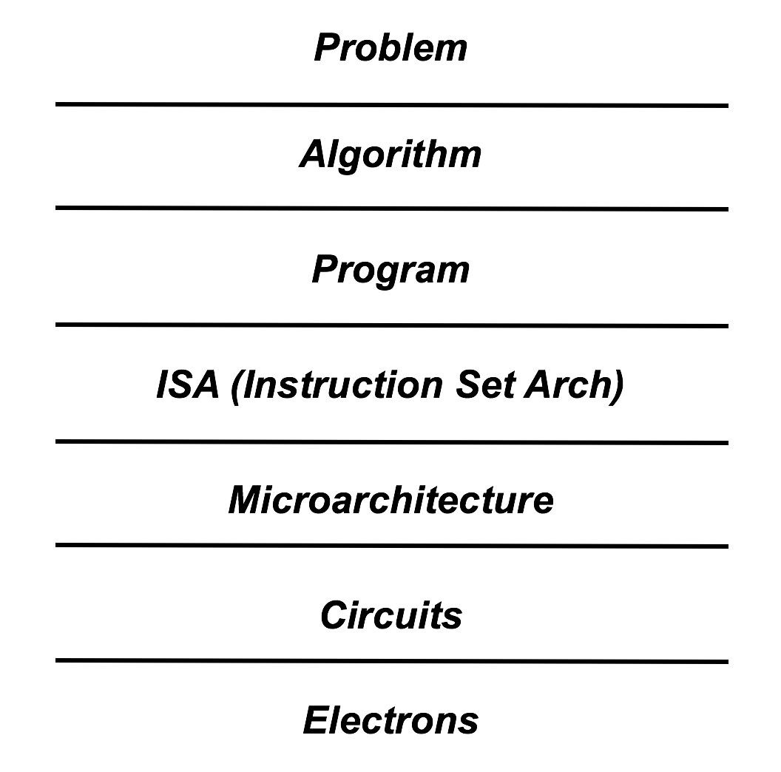
Prof. Patt’s Layers (Recap)

Slide 6
What is an ISA?
And why are there many?

Slide 7
Instruction Set Architecture (Recap)
Instruction Set
Load/Store memory
Opcodes, Address Modes, Data Types
Condition codes
Format
Memory
Address space
Addressability
Alignment
Priority/Privilege
Interrupt/Exception Handling
Arithmetic
I/O
Multi-threading support
Multiprocessor support

Slide 8
What are instructions for?

Slide 9
Why have instructions?
And what are the alternatives to having instructions?

Slide 10
Why Have Instructions?
Alternatives
Special purpose hardware
Reconfigurable hardware (FPGAs)
Minimize everything as much as possible?
Simplifies interface
Software knows what is available
Hardware knows what needs to be implemented
Abstraction protects software and hardware
Software can run on new machines
Hardware can run old software

Slide 11
So what instructions should we have?

Slide 12
Early Machines
Very limited resources
Hundreds or thousands of words of memory
A few thousand vacuum tubes
Huge cost (millions back then)
Minimize everything as much as possible
Instruction size
Amount of memory/registers
Size of ALU
Number of ALU functions
Parallelism

Slide 13
Modern Machines
Some resources limited, others abundant
Billions/Trillions of words of memory
Billions of transistors
Cost limitations
Power limitations
Minimize cost, maximize usability

Slide 14
Language/Application-Directed Architecture
ISA/Microarchitecture originally optimized for language/application
Examples include
LISP: Symbolics 3600, TI Explorer
Tags for GC, linked-list support, etc.
C: auto-increment memory index registers
*X++ = Y;
Other ways to implement language constructs
Simpler ISA, map language onto ISA with compiler
How should performance be taken into account?
Debate was settled for a while, but perhaps being revisited?

Slide 15
Characteristics of a Good ISA
Unambiguous
Expressive
Easily describes all the algorithms that will run on this platform
Instructions are used
Very complex instructions might not be used often
(Relatively) easy to compile
(Relatively) easy to implement well
Implementation provides good performance, cost, etc.
ISAs often highly reliant on microarchitecture and vice-versa
Some ISAs easy to implement on some microarchitectures
Some microarchitectures make some instructions easy to implement

Slide 16
What’s in a computer?
Discussion (summarized later)
Computer building blocks

Slide 17
Computer Building Blocks
Memory (storage)
E.g., registers
E.g., RAM
E.g., disk
Computation
Functional units in general
ALUs
Control (when do things happen)
E.g., decoder
E.g., instruction sequencer
Communication
E.g., bus
Notes:
17

Slide 18
What tradeoffs are there related to an ISA?

Slide 19
Tradeoffs
Fewer instructions
Pros?
Cons?
There are 1 instruction ISAs
subleq a, b, c ;
Mem[b] = Mem[b] - Mem[a] ;if (Mem[b] ≤ 0) goto c
Number of registers per instruction
Number of bits per instruction
Number of registers to implement
Zero, One, Two, Three, Four, …
Fixed verses Variable Length instructions
Notes:
19

Slide 20
Number of Registers Per Instruction (Implied or Explicit): C = A + B
Zero
Stack machine (HP calculators): implied addresses
PUSH AddrA; PUSH AddrB; ADD; POP AddrC
One (implied)
Accumulator-based machine
LOAD AddrA; ADD AddrB; STORE AddrC
Two (same register, src and dest)
One source is destination
LOAD R1, AddrA; LOAD R2, AddrB;
ADD R1, R2; STORE R1, AddrC
Three
Current (D = S1 OP S2)
LOAD R1, AddrA; LOAD R2, AddrB;
ADD R3, R1, R2; STORE R3, AddrC
Four and above
Notes:
Don’t spend too much time on this slide, will discuss later

Slide 21
Tradeoffs Change Over Time
Technologies, abilities and concerns change
Early computers
Number of devices
Vacuum tubes expensive, unreliable, big, power hungry
Mainframes/Mini-Computers
Code compatibility
Number of devices
System efficiency
Multi-tasking operating systems
Reliability
Personal Computers
Code compatibility
Cost
Size
Power
Is number of devices/system efficiency as important???

Slide 22
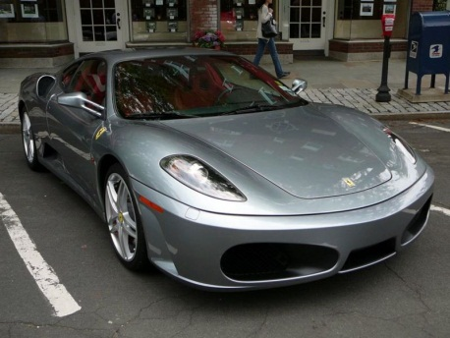
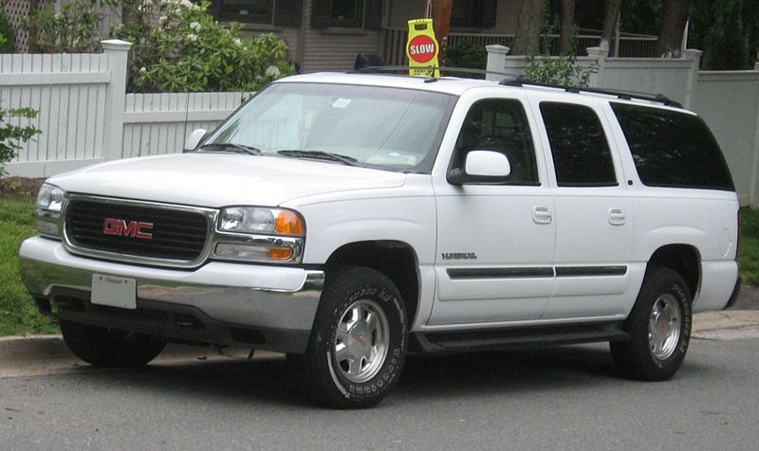
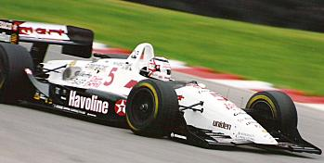

Evaluating Tradeoffs
Performance often inconsistent and hard to determine
Better for one application may be worse for another
Ferrari versus Suburban
Even within the same category, differences
CART versus Formula 1
Different parameters result in different optimal points
Needs
Algorithms
Implementations
Technologies

Slide 23
Evaluating tradeoffs requires measurement
“If you can’t measure it, you can’t improve it” –P. Drucker
Also, you can’t objectively compare if you do not measure
So, what should we measure?
Performance
Execution time
Instructions per Cycle (IPC)
Cost: chip area
Power / Energy
Complexity
Affects design time, validation time

Slide 24
How much improvement is worthwhile?
Where should we target our improvement?

Slide 25
Amdahl’s Law (performance example)
Unchanged time
Fraction sped up

Slide 26
Example of Amdahl’s Law
New feature doubles floating point performance. What sort of overall performance boost?
What is fraction of floating point operations?
100%: Speedup = (1/0.5) = 2.
50%: Speedup = 1/((1-0.5)+0.5/2) = 1/(0.5 + 0.25) = 1/0.75 = 1.33

Slide 27
Amdahl’s Law
Lesson: big performance boost of one area does not necessarily lead to overall performance boost
Diminishing returns
Applies to more than just performance:
Power, cost, reliability …

Slide 28
What Did We Learn?
ISAs
Slowly changing definition of architecture
Flexible and concise way of expressing programs
Amenable to automatic tools
Critical aspect of architecture
Along with other aspects, ISAs define contract between HW and SW
Abstraction protects both SW and HW
Influenced by uarch and technology
Tradeoffs
Depends on requirements and context
Always attack the bottleneck
Amdahl’s Law
Remember: Survey #1, Lab #0, Lab #1, Problem Set #1!

