Slide 1
382N.1: Computer Architecture Fall 2018: Lecture 9
Dam Sunwoo
University of Texas at Austin
Arm Research

Slide 2
Announcements
Survey #2 results
26 students responded (26/32 = 81% response rate)
Thank you for providing honest feedback!

Slide 3
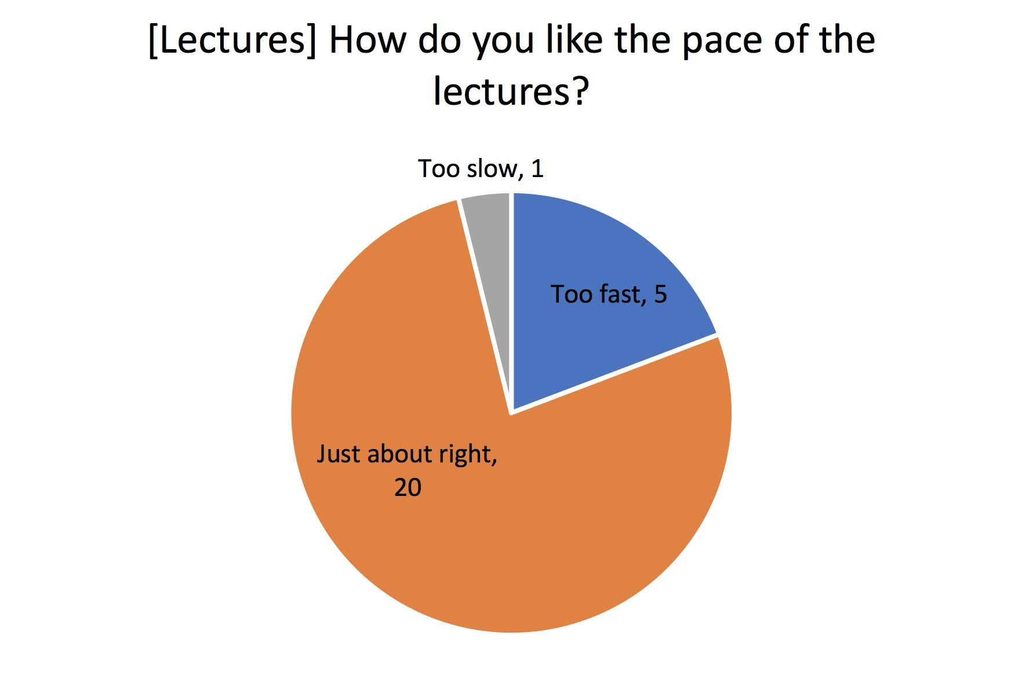
Survey #2: How are we doing?

Slide 4
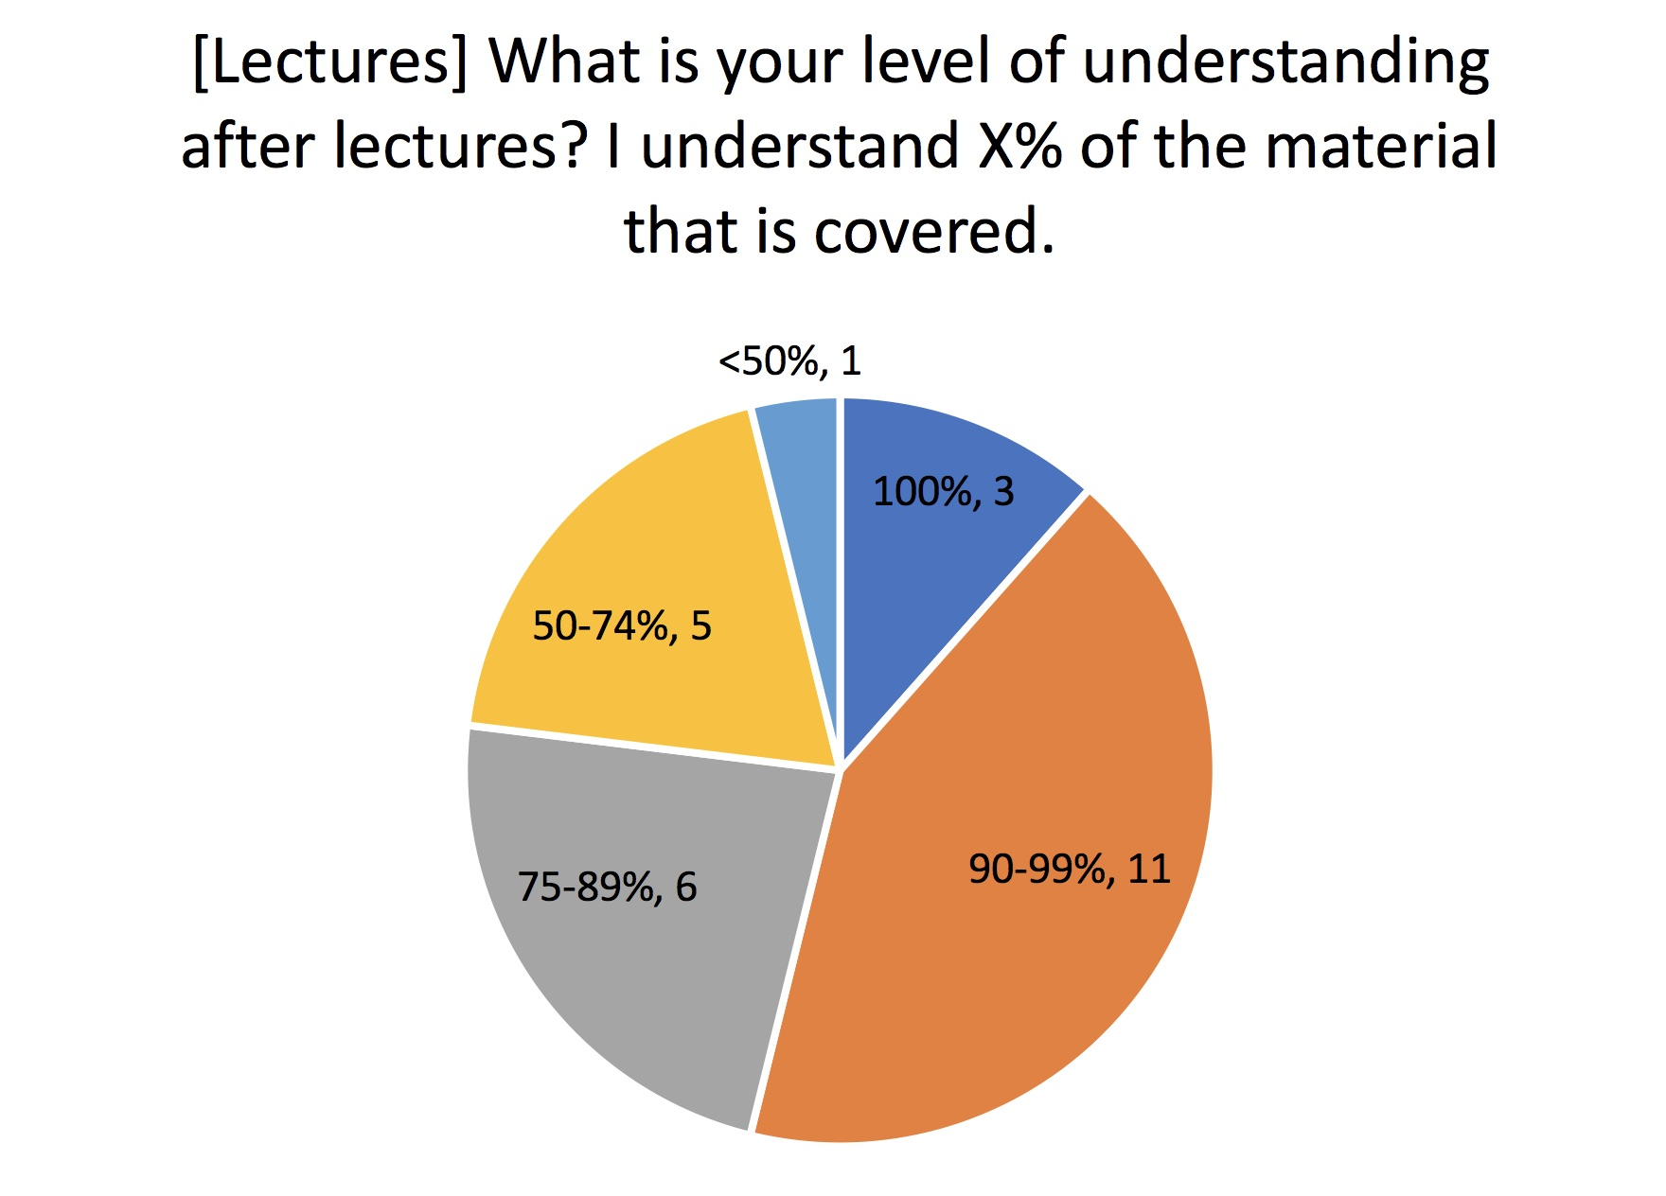
Survey #2: How are we doing?

Slide 5

Survey #2: How are we doing?

Slide 6

Survey #2: How are we doing?

Slide 7
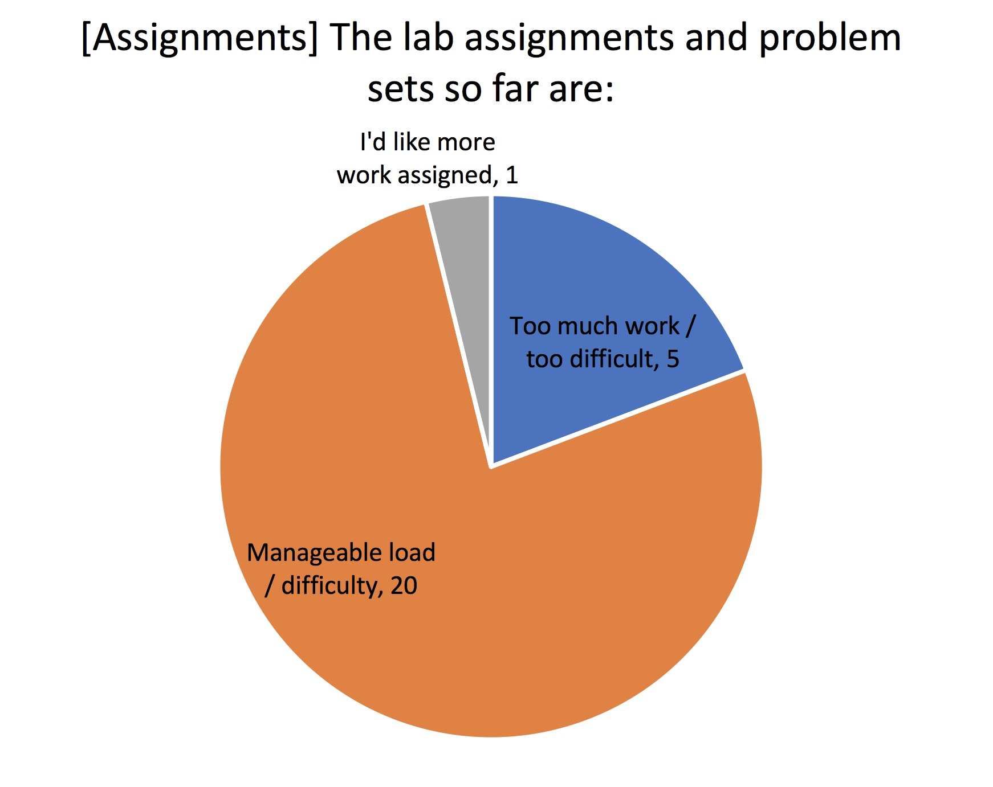
Survey #2: How are we doing?

Slide 8
Survey #2: How are we doing?
What other topics would you like covered?
Real-world examples
Recent architectural changes and contributions
Breaking down an SoC
Different generations of Intel processors
TAGE branch predictors and other latest branch predictors
GPU
Non-von-Neumann architecture
Machine Learning related topics
Formal verification, Bluespec, RISC-V

Slide 9
Survey #2: How are we doing?
Other comments (Most responses paraphrased. Removed compliments)
“I worry that people who haven’t taken this class before are at a disadvantage”
Lectures
“Sometimes the lectures feel like the slide is simply being read rather than a story is being told.”
Order of lectures sometimes feel out-of-order
Want more details in slides
Want some problem set type examples in class
Assignments
Want feedback on lab and assignments
For labs, want more than one chance for testing our code
“I don’t have a good C background which is making homework and labs quite difficult”
Discussion Sections
Want new content instead of recitation

Slide 10
Scoreboarding Review
Allows instructions to execute out-of-order when necessary resources are available and there are no data dependencies
Stalls front of pipeline if
functional unit busy (deals with FU hazard)
destination register busy (deals with WAW hazard)
Reads registers immediately before execution
May need more register read ports
Every register writeback is performed
If pending reads of previous value of register, writeback stalled
Otherwise, potential for WAR hazard

Slide 11
Tomasulo’s Algorithm Review
More distributed than scoreboarding
Decisions can be made in distributed reservation stations
Address WAW hazards without stalling
Register Renaming
Today:
More details on Tomasulo
Handling In-order Retirement (ROB)

Slide 12
Review: Simplified Tomasulo Pipeline
FU1
Fetch
Decode
Reg
Read
FU2
FU3

Slide 13
Register File
FU1
Reg
Read
FU2
Each register has a presence bit indicating whether its value is present (valid) or not present (invalid)
If data invalid, value is being computed
Tag is used as a placeholder for the value until it is computed
When is presence bit set to invalid?
Register file read returns either valid data or a tag
FU3
tag
value
valid?
R0
R1
R2
R3

Slide 14
Register File Valid?
Set to invalid the moment dispatched as destination
At that point no following instructions should read the old value
Set to valid during writeback/complete iff tag matches instructions and register file location
Every instruction must maintain its original destination architectural register name
Every instruction must maintain its tag

Slide 15
More Registers without More Registers?
Rename registers effectively increase number of usable registers without increasing number of bits in instruction
not quite as good. why?
Need some way to “reclaim” registers
Potential performance hit?
Why can’t the compiler just use different registers?

Slide 16
Renaming and Hazards
Do WAW/WAR hazards occur after rename?
No!
New name (tag) for every register written
Dependence based on tag, not register name
Rename eliminates all hazards by renaming all destination registers and using new names for real dependencies
What if you run out of rename names?
Standard solution (stall)

Slide 17
Tomasulo Register Renaming Algorithm Intentional Error!
Dispatch in order
Dispatch (to RS) has a register rename table
One entry per architectural register
RenameTable[0..MAX_REG-1]
At dispatch do the following
Rename every destination register with a tag
Tag allocated, stored in rename table
RenameTable[register] = tag
IF value available, read value from reg file ELSE
Use tag instead of register names for source registers
Tag = RenameTable[register]

Slide 18
Tomasulo Register Renaming Algorithm: Corrected
Dispatch in order
Dispatch (to RS) has a register rename table
One entry per architectural register
RenameTable[0..MAX_REG-1]
At dispatch do the following
IF value available read value from reg file ELSE
Use tag instead of register names for source registers
Tag = RenameTable[register]
Rename every destination register with a tag
Tag allocated, stored in rename table
RenameTable[register] = tag

Slide 19
New Pipeline?
Fetch
Decode
Dispatch+Rename
Execute/Mem
WB
How do we decouple IF/ID from EX/WB

Slide 20
Common Data Bus in 360/91 (floating point path)
FP registers
from memory
from instruction unit
load
buffers
store buffers
operation bus
reservation
stations
to memory
FP FU
FP FU

Slide 21
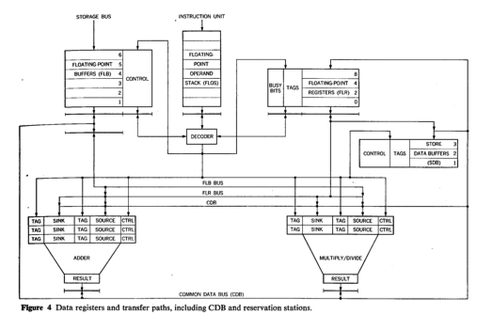
Figure from Original Paper

Slide 22
Reservation station entry: May be more than one per FU
FU1
Reg
Read
FU2
FU3
Data_valid
Data_valid
tag
data
tag
data
Op
1
0
Src1
Src2
Renamed instruction sent to reservation station and stored until all arguments are valid
Op is operation (+, -, *, /)
Valid bit indicates whether data or tag is valid
Tag is sent with data from functional units
RS matches tags sent with data against valid tags to determine who needs data
Maybe more than one RS entry needs data (why?)

Slide 23
Reservation Station Design Options
RS can be distributed or centralized
Distributed RS (separate RS per FU)
Can only contain fields pertaining to specific functional unit (branch, store, ..)
Simpler control and routing
Number of ports can be low
Centralized RS (shared RS for all FUs)
RS entries not statically partitioned
Can adapt better to different instruction mixes
FU1
Reg
Read
FU2
FU3
FU1
Reg
Read
FU2
FU3

Slide 24
Tomasulo Dispatch/Issue/Execute/Complete
If reservation station available before renaming
Instruction + renamed operands (source value/tag) to reservation station
Only rename if reservation station is available
Else????
When waiting for operand (implying tag in RS, not value)
Watch common data bus (CDB) for tag
When tag seen, grab value
When both operands available, instruction ready to be issued
Issue instruction to FU
After instruction finishes in FU
Arbitrate for CDB
Put tagged value onto CDB
Register file on CDB
Register contains 1 tag indicating latest value
If latest value of register seen, write to register (and set valid bit)
Reclaim rename tag
no valid copy of tag in system!

Slide 25
Nonblocking Caches
Needed to allow “memory parallelism”
Concurrent requests to memory so that OOO isn’t blocked
Concurrent requests to utilize throughput optimizations in mem
Miss Status Holding(Handling) Registers (MSHRs)
Track each outstanding memory operation
Fixed number of outstanding misses at each level
Multiple requests can potentially be serviced by same entry
Implies data returns out of order – need an ID and buffers at all levels where non-blocking allowed
CPU
L1$
L2$
Mem
MSHR

Slide 26
Out-of-Order Completion
Does it matter?
During normal program run, it doesn’t matter if instructions get out-of-order!
When does it matter?
Precise exceptions
What if operation faults (divide by zero, page fault)?
traditionally, kill instructions behind, let instructions ahead go
fix problem in software
resume faulting instruction or one after
Out-of-order means following instructions may have already completed
26
Notes:
26

Slide 27
Out-of-Order Completion => In-Order Retirement
What do we need to do?
Provide appearance that instructions write-back (retire) to architectural state in dispatch order
Real registers
Memory
Must provide way to use non-retired state
Tomasulo already supports that
But, does Tomasulo allow us to “uncomplete” a completed instruction?
Need two things
Track what is oldest instruction and newest write to a reg
Provide ability to “rollback” to a specific un-retired instruction
27
Notes:
27

Slide 28
Determining Order Reorder Buffer == Completion Buffer
Reorder buffer tracks all outstanding instructions in issue order
Determines when instruction becomes oldest
Retires oldest instruction(s) by copying pending value to architectural register file
If need to rollback to oldest instruction, throw away
Bread crumbs to determine state of each instruction
Similar to scoreboard
28
Notes:
28

Slide 29
Out-of-Order Execution => In-Order State Update
One possible strategy
Architectural registers
Consistent with in-order execution
AND separate rename registers
Hold non-completed values
value
valid
A
10
F
B
11
T
C
12
F
Value
Tag
committed
D
13
F
R0
0
T
E
15
F
R1
1
T
F
18
F
R2
2
B
F
G
25
F
R3
3
A
F
“RAT”
Register Alias Table
What registers are architectural registers?
Can R3’s value be read? If so, what is it?
Can R0’s value be read? If so, what is it?
Can R2’s value be read? If so, what is it?
How many rename registers required?
29
Notes:
29

Slide 30
Possible Reorder Buffer – Implemented as Circular Buffer
Valid
Issued
Done
Inst address
Arch Reg
Rename
Reg
head
1
1
0
0x0100
---
---
1
0
0
0x0200
R3
B
1
1
1
0x0204
R5
A
tail
0
0
0
0
0
0
0
When can an instruction retire?
What do you do?
How do you read a register that hasn’t committed to arch state?
30
Notes:
30

Slide 31
Possible Reorder Buffer – Implemented as Circular Buffer
Valid
Issued
Done
Inst address
Arch Reg
Actual
Physical
head
1
1
0
0x0100
---
---
1
0
0
0x0200
R3
Value
1
1
1
0x0204
R5
Value
tail
0
0
0
0
0
0
0
When can an instruction retire?
What do you do?
How do you read a register that hasn’t committed to arch state?
31
Notes:
31

Slide 32
Shadow Memory Buffers/Store Buffers
Uncommitted executed memory writes are blocked to a write buffer until instruction is committed
Loads must be short-circuited from buffer
When instruction is oldest, writes either
Allowed to proceed to be written to memory or
Canceled
Store buffers are essentially renamed registers for memory locations
Any issues?
Also known as the Load/Store Queue (LSQ)
Also known as Memory Ordering Buffer (MOB)

Slide 33
Shadow Memory Buffers/Store Buffers
Store → Load is potential RAW! True data flow
Store → Store is potential WAW
What about WAR?
Don’t want to stall on every memory operation
Rules for “memory disambiguation”
Loads (most relaxed)
Load can bypass any store known to not be to overlapping location
Careful about word size
Typically need to know addresses of load and all prior stores, unless:
Load can immediately “execute” when closest store to same address has a value (in store buffer)
Stores (most relaxed)
Store can write to memory when all older store addresses known

Slide 34
Where is the Reorder Buffer?
Fetch
Decode
Rename/ROB/ MOB/RS
RS/Schedule
Execute/Mem
WB
Retire
Retire stage also known as commit or gradute

Slide 35
Alternative: Explicit Register Renaming
Commited?
Committed
Tag
Uncommitted
Tag
Valid?
R0
P0
P4
C
T
No architectural registers, only physical registers
Use more physical registers than ISA supports
Supports in-order view of register values
Single register file, simpler
Used in MIPS R10000, Alpha 21264, and with many modern processors
Architectural register mapping is a lookup table
Committed or uncommitted
Valid or not
Can committed be invalid?
R1
P7
P1
U
F
R2
P3
P5
C
T
R3
P2
P6
U
T
value
P0
P1
P2
P3
P4
P5
P6
P7

Slide 36
Tradeoffs of Explicit Register Renaming (Physical Register Files)
Pros:
Register file can be smaller than ROB
Not all instructions write to registers
Data values not duplicated
Otherwise, data can be in RS, Arch reg file, ROB, rename table, etc.
Simpler register file design
Only one read and write path for register data
Cons:
Always need to look up PRF to access value
Indirection implies higher latency

Slide 37
Reorder Buffer with Explicit Register Renaming
Other
Stuff
Completed?
dest
reg
phy
reg
000
001
010
011
100
101
110
111
Tag points to physical register
When instruction commits, binding between arch register and physical register is committed
In register rename table
Notes:
If registers read at dispatch, then deallocate physical register when the corresponding arch register is overwritten. If read right before issue, then cannot deallocate until all pending reads to that physical register have completed.

Slide 38
When Are Explicit Rename Registers Deallocated?
Assume want to support precise exceptions
Darn precise exceptions, always complicating things
Cannot deallocate every register
Some are the architectural registers
Only deallocate register if not going to be used again
How do you know when it won’t be used again?

Slide 39
Solution 1
Other
Stuff
Completed?
dest
reg
phy
reg
Commited?
Committed
Tag
Uncommitted
Tag
Valid?
000
R1
P7
F
001
R1
P8
T
R0
P0
P4
C
T
010
R3
P1
T
R1
P17
P18
U
F
011
R1
P18
F
R2
P3
P30
C
T
100
101
R3
P2
P1
U
T
110
RAT
111
ROB
As instruction retires,
previously committed phys reg can be reclaimed
Requires read/modify/write of committed entry in rename table
Notes:
Looking at R1, P17 is committed. Instruction 000, 001 and 011 reused R1, renaming to P7, P8 and P18 respectively. Upon commit of 000, would need to write P7 into the Committed field of R0.

Slide 40
Solution 1a
Other
Stuff
Completed?
arch
reg
new
phy
reg
old
phy
reg
000
001
010
011
100
101
110
111
Keep old physical register name in ROB
Can reclaim as instruction retired
Avoid read/modify/write in rename table

Slide 41
Where is the Reorder Buffer?
Fetch
Decode
Rename/ROB/ MOB
Dispatch possibly separate from Rename/ROB. But then need to check physical register at dispatch again.
Dispatch
RS/Schedule
Execute/Mem
WB
Retire
Retire stage also known as commit or graduate

Slide 42
Putting it all together
Fetch
RAT
Decode
Rename
ROB
Physical Registers
RS
Execute/Mem
WB
LSQ
Retire
Reservation stations
Architectural
registers

Slide 43
Putting it all together (one option)
Fetch
Decode
Rename
RAT
Arch registers
ROB
Physical registers
LSQ
RS
Reservation stations
Execute/Mem
WB
Retire

Slide 44
Putting it all together (one option)
Fetch
Decode
Rename
RAT
Arch registers
ROB
Physical registers
LSQ
RS
Reservation stations
Execute/Mem
WB
Retire

Slide 45
Putting it all together (one option)
Fetch
Decode
Rename
RAT
Arch registers
ROB
Physical registers
LSQ
RS
Reservation stations
Execute/Mem
WB
Retire

Slide 46
Putting it all together (one option)
Fetch
Decode
Rename
RAT
Arch registers
ROB
Physical registers
LSQ
RS
Reservation stations
Execute/Mem
WB
Retire

Slide 47
Putting it all together (one option)
Fetch
Decode
Rename
RAT
Arch registers
ROB
Physical registers
LSQ
RS
Reservation stations
Execute/Mem
WB
Retire

Slide 48
Putting it all together (one option)
Fetch
Decode
Rename
RAT
Arch registers
ROB
Physical registers
LSQ
RS
Reservation stations
Execute/Mem
WB
Retire

Slide 49
Putting it all together (one option)
Fetch
Decode
Rename
RAT
Arch registers
ROB
Physical registers
LSQ
RS
Reservation stations
Execute/Mem
WB
Retire

Slide 50
Putting it all together (one option)
Fetch
Decode
Rename
RAT
Arch registers
ROB
Physical registers
LSQ
RS
Reservation stations
Execute/Mem
WB
Retire

Slide 51
Putting it all together (one option)
Fetch
Decode
Rename
RAT
Arch registers
ROB
Physical registers
LSQ
RS
Reservation stations
Execute/Mem
WB
Retire

Slide 52
Putting it all together (one option)
Fetch
Decode
Rename
RAT
Arch registers
ROB
Physical registers
LSQ
RS
Reservation stations
Execute/Mem
WB
Retire

Slide 53
Putting it all together (one option)
Fetch
Decode
Rename
RAT
Arch registers
ROB
Physical registers
LSQ
RS
Reservation stations
Execute/Mem
WB
Retire

Slide 54
Putting it all together (one option)
Fetch
Decode
Rename
RAT
Arch registers
ROB
Physical registers
LSQ
RS
Reservation stations
Execute/Mem
WB
Retire

Slide 55
Putting it all together (one option)
Fetch
Decode
Rename
RAT
Arch registers
ROB
Physical registers
LSQ
RS
Reservation stations
Execute/Mem
WB
Retire

Slide 56
Putting it all together (one option)
Fetch
Decode
Rename
RAT
Arch registers
ROB
Physical registers
LSQ
RS
Reservation stations
Execute/Mem
WB
Retire

Slide 57
Putting it all together (one option)
Fetch
Decode
Rename
RAT
Arch registers
ROB
Physical registers
LSQ
RS
Reservation stations
Execute/Mem
WB
Retire

