Slide 1


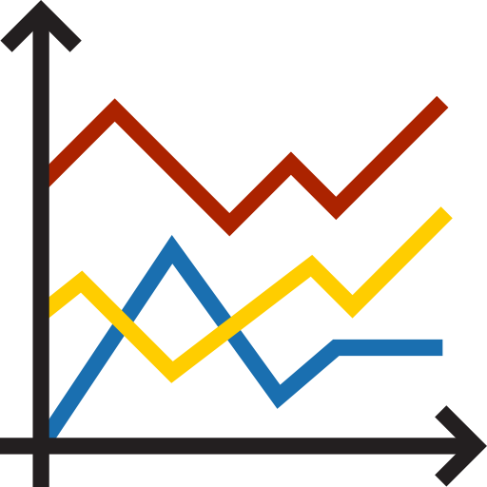












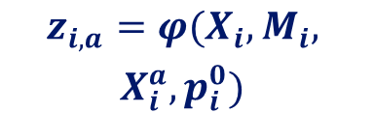

































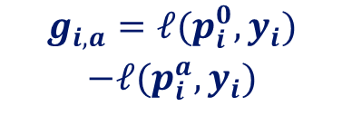









1
Historical Full-Action Replay
Training History
Incomplete Context
Admissible Actions
Action Inputs
Frozen
Model
Output
Realized Utility
Replay Bank
$$x_{1}$$
$$x_{1}$$
$$\begin{aligned} \\ \text{Keep} \\ a_{0}\end{aligned}$$
$$\begin{aligned} \\ \text{FFill} \\ a_{1}\end{aligned}$$
$$\begin{aligned} \\ \text{SAITS} \\ a_{2}\end{aligned}$$
$$X_{i}^{a}=T_{a}(X_{i},M_{i})$$
$$\begin{aligned}g_{i,a}=ℓ(p_{i}^{0},y_{i}) \\ −ℓ(p_{i}^{a},y_{i})\end{aligned}$$
$$p_{i}^{0}$$
$$x_{2}$$
$$x_{2}$$
$$X_{i}^{a_{0}}$$
Offline
$$F$$
$$p_{i}^{a_{1}}$$
Action State
$$x_{3}$$
$$x_{C}$$
$$X_{i}^{a_{1}}$$
$$\begin{aligned}B=\{(z_{i,a},a, \\ g_{i,a})\}\end{aligned}$$
$$x_{C}$$
$$t$$
$$\begin{aligned}\text{Multi} \\ \text{TS−ICL} \\ a_{3}\end{aligned}$$
$$\begin{aligned}\text{Ctx.} \\ \text{Ridge} \\ a_{4}\end{aligned}$$
$$\begin{aligned}\text{Single} \\ \text{TS−ICL} \\ a_{5}\end{aligned}$$
$$\begin{aligned}z_{i,a}=φ(X_{i},M_{i}, \\ X_{i}^{a},p_{i}^{0})\end{aligned}$$
$$t$$
$$X_{i}^{a_{5}}$$
$$p_{i}^{a_{5}}$$
$$X_{i}∈ℝ^{C×L}$$
$$\text{Mask }M_{i}$$
Read-Only
Shared Feature-Space Retrieval
2
Action-Conditioned State
3
Local Utility Estimation
4
Act Or Keep
Incoming Request
Keep Reference
Same-Action Neighbors
Conservative Score
$$x_{1}$$
$$X^{a_{0}}=T_{a_{0}}(X,M)$$
$$\begin{aligned}\text{Query} \\ z_{a}\end{aligned}$$
Bank
Read-Only
$$\begin{aligned}\text{Matches} \\ N_{a}\end{aligned}$$
$$S_{a}={\hat{μ}}_{a}−β\frac{{\hat{σ}}_{a}}{\sqrt{n_{eff,a}}},a∈A^{+}$$
$$x_{2}$$
$$F$$
$$x_{C}$$
$$p_{0}$$
Decision Rule
Online
$$t$$
$$\max_{a∈A^{+}} S_{a}>0⇒a^{∗}=\underset{a∈A^{+}}{argmax} S_{a}$$
$$\begin{aligned}X∈ℝ^{C×L} \\ \text{Mask }M\end{aligned}$$
Similarity Weights
Cached Forecast
$$\text{Otherwise: }a^{∗}=a_{0}$$
Action State
$$\begin{aligned}w_{j}=exp(−d_{j}/τ) \\ τ=\underset{j∈N_{a}}{median} d_{j}+ε\end{aligned}$$
Candidate Inputs
Selected Action
Keep Reference
$$X^{a_{1}}$$
$$X^{a_{2}}$$
$$X^{a_{3}}$$
$$z_{a}=φ(X,M,X^{a},p_{0})$$
$$X^{a^{∗}}=T_{a^{∗}}(X,M)$$
Cached Forecast
22 State Features
Weighted Statistics
$$F$$
$$p_{a^{∗}}$$
$$p_{0}$$
$$\begin{aligned}{\hat{μ}}_{a} \\ \text{Mean}\end{aligned}$$
$$\begin{aligned}{\hat{σ}}_{a} \\ \text{Std. Dev.}\end{aligned}$$
$$\begin{aligned}n_{eff,a} \\ \text{Eff. Count}\end{aligned}$$
$$F$$
$$X^{a_{4}}$$
$$X^{a_{5}}$$
Mask 6
Context 6
Change 5
Forecast 5
Forecast
No Extra Call
1–2 Backbone Calls Per Request
Notes:
Visual reference: user-provided codex-clipboard-33b627d0-781c-4d8a-8638-5ab093326a63.png. Scientific reference: latex/IntroActTS_20260919_v47_revised.tex, Sections 3.1–3.5 and action/state feature appendices. Notation follows C × L, reference-minus-action loss, and a frozen bank. All curves are schematic, not measured data. The conservative score is heuristic, not a calibrated bound. A+ excludes Keep a0. Neighbor j retains its action index: (z_j,a, g_j,a). Input Change denotes the five intervention-state features. Every expression is a single native Office Math object; multi-line labels and equations use one equation array in one textbox. Candidate forecasts are evaluated offline; only the reference and selected action forecasts are computed online.

