Slide 1
Development of Range Resonance Genetic Algorithm
Yan Forestas (Savoie Mont Blanc University)
So Fukuhara (Kagawa University)
Masao Arakawa (Kagawa University)

Slide 2
Contents
Research Background
Proposed Method
Verification
Conclusion

Slide 3
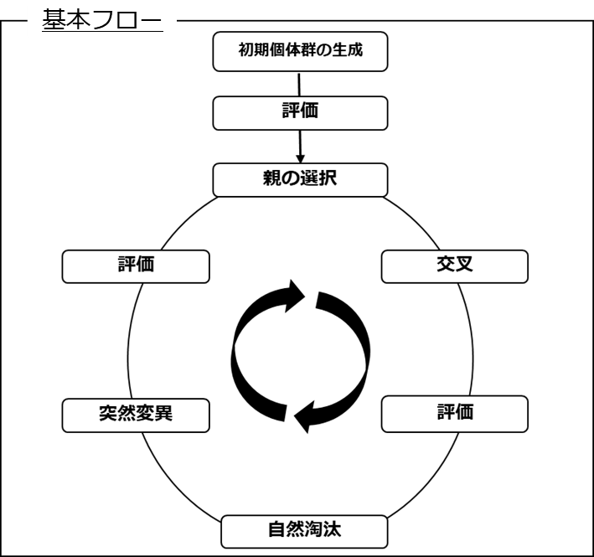
Research Background
●GA: Genetic Algorithm
heuristic optimization method
modeled the principles of biological evolution
Basic Flow
Initialize
Evaluation
Select Parents
Evaluation
Crossover
Mutation
Evaluation
Natural Select

Slide 4
Research Background
●Issue: conventional heuristic optimization methods
Effective:
Continuous variable problem
Discrete variable problem
Mixed variable problem
About general purpose optimization software
increase Behavioral and design variables: deal with Large number problem
Not using objective function trait
Searching multiple point at the same time
Schema theory (Building Block)

Slide 5
Research Background
● Issue: conventional heuristic optimization methods
Perform a search for all variables at the same time
（ Assuming dependencies between all variables ）
→ Expanding the size of the searching space unnecessary
→ Performance for large variable problems：low
Efficiency
performance of conventional heuristic optimization methods：Rosenbrock function (10000 generations)
Simple GA (8bit)
No. of variables
degradation
Degrade performance suddenly for large number problem (more than 16 variables)

Slide 6
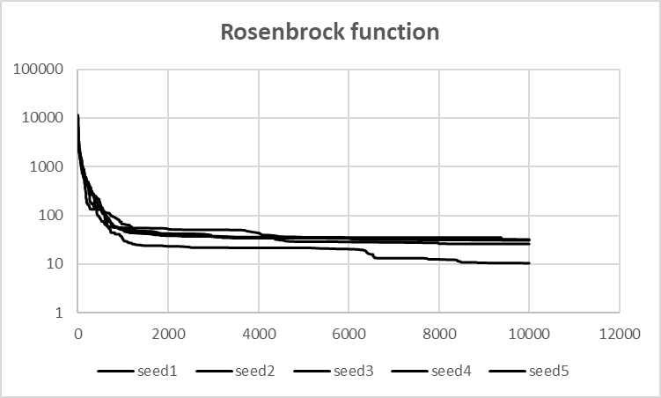
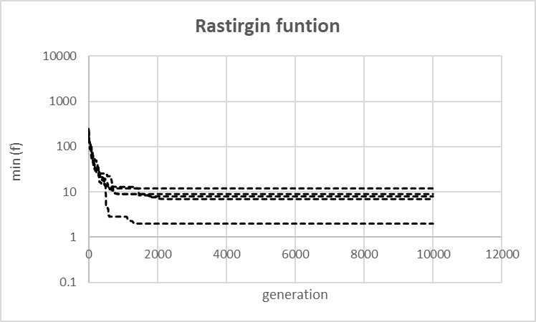
Research Background
● Issue: conventional heuristic optimization methods
Fall into the state of no improvement during local convergence
→ generate redundant function calls
Efficiency
REGA：Rosenbrock funtion(16 variables)
REGA：Rasrigin function(16 variables)

Slide 7
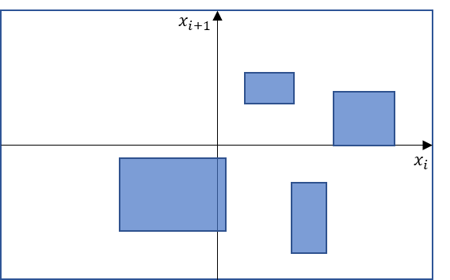
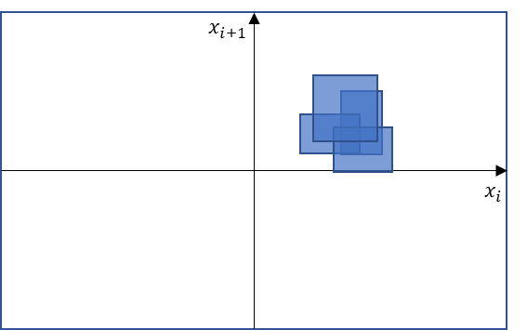
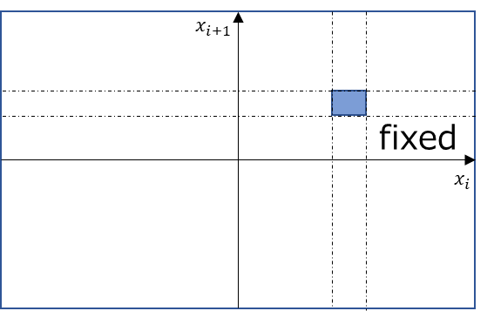
Research Background
Large number problem
Redundant function calls
Estimate dependency
Estimate convergence
Dimensionality reduction (stacking all search ranges)
Range resonance Genetic Algorithm

Slide 8
Proposed Method

Slide 9
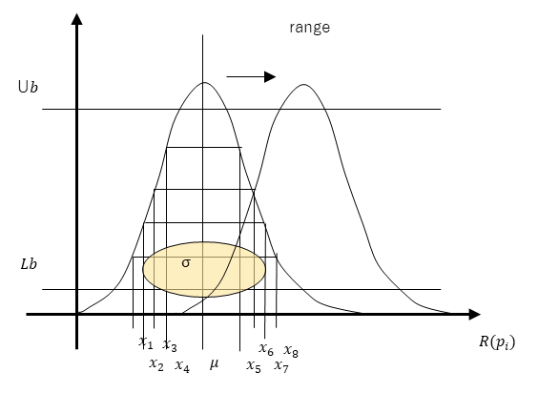
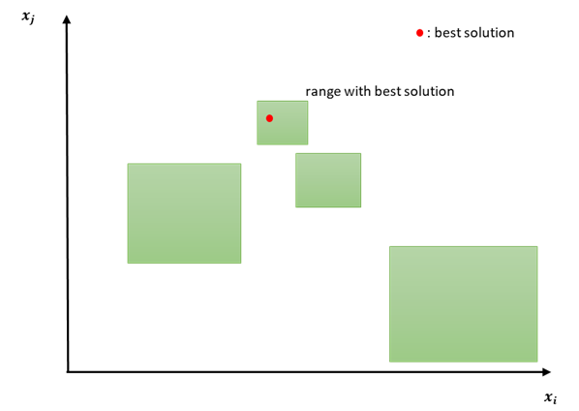
Proposed Method
●Range Resonance Genetic Algorithm (RRGA)
Basic flow: Range Exploring Genetic Algorithm (REGA)
flow
Gaussian function
Generation of the initial individuals
Select
Death and Regeneration of ranges
Cross over
search ranges
Pinning and Updating ranges
Phased out
Mutate

Slide 10
Proposed Method
Large number problem
Redundant function calls
Estimate dependency
Estimate convergence
Dimensionality reduction (stacking all search ranges)
Define new type genes

Slide 11
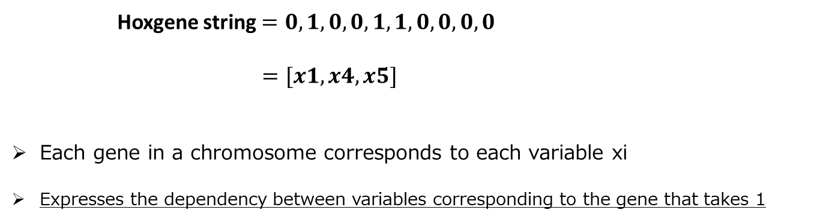

Proposed Method
●new gene：Hoxgene
Representing variable pairs in optimization problems（Binary）
Evolution with conventional solution search
Finally, Hoxgenes that represent pairs with dependencies survive
design variables
$$x0 x1 x2 x3 x4 x5 x6 x7 x8 x9$$
Hoxgene string$=0, 1, 0, 0, 1, 1, 0, 0, 0, 0$
$=[x1, x4, x5]$
Each gene in a chromosome corresponds to each variable xi
Expresses the dependency between variables corresponding to the gene that takes 1
(String length : No. of variables)
Variable pair

Slide 12
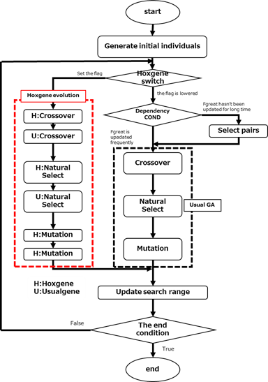
Proposed Method
●Evolution of Hoxgenes
Arrange the period of evolving Hoxgenes every several generations (red frame)
Hoxgenes evolve in such a way that those that represent variable pairs with dependencies survive
Crossover
Natural Select
Mutation
Evaluation Method
Evolution Phase

Slide 13
Proposed Method
●H:Crossover
Crossover
Generate 4 children from 2 parents
cp
Hoxgene $p1 0, 1, 1, 0, 1, 0, 0, 0, 1,$ $0$
Hoxgene $p2 0, 0, 1, 0, 1, 0, 0, 1, 1,$ $0$
cp
Hoxgene $c1 0, 1, 1, 0, 0, 0, 0, 0, 0,$ $0$
Hoxgene $c2 0, 0, 0, 0, 1, 0, 0, 0, 1,$ $0$
Hoxgene $c3 0, 0, 1, 0, 1, 0, 0, 0, 0,$ $0$
Hoxgene $c4 0, 0, 0, 0, 0, 0, 0, 1, 1,$ $0$

Slide 14
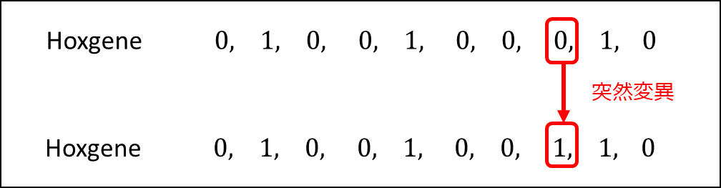
Proposed Method
●H:Mutation
Mutation
Replace one or two gene loci with alleles
Mutation

Slide 15
Proposed Method
●H:Natural Select
Roulette Selection
Each Hoxgene is selected with a probability proportional to its degree of adaptation

Slide 16
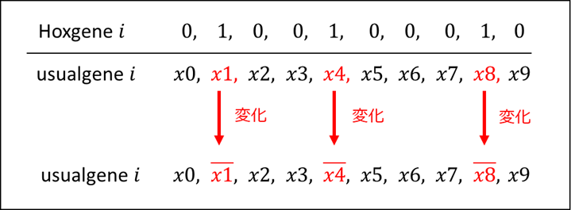
Proposed Method
●Evaluation of Hoxgene
Change in the Usualgene crossover scheme in Hoxgene evolutionary period
Only the variable corresponding to the gene that takes 1 in the Hoxgene is changed
Change
Change
Change

Slide 17
Proposed Method
●Evaluation of Hoxgene
Evaluation value：improvement ratio of F-value
We can calculate improvement ratio of F-value with changing the variable pair value
Searching for variable pairs that have a dependency relationship with each other tends to improve the F-value.
F-value does not improve easily for changes in convergent variable pairs
Improvement ratio
Before
changing
変化前：$f(x0, x1, x2, x3, x4, x5, x6, x7, x8,$ $x9)$
改善率
After
changing
変化後：$f(x0, \overline{x1}, x2, x3, \overline{x4}, x5, x6, x7, \overline{x8},$ $x9)$
Hoxgenes representing variable pairs that are not converged and have dependencies can be highly evaluated with high probability

Slide 18
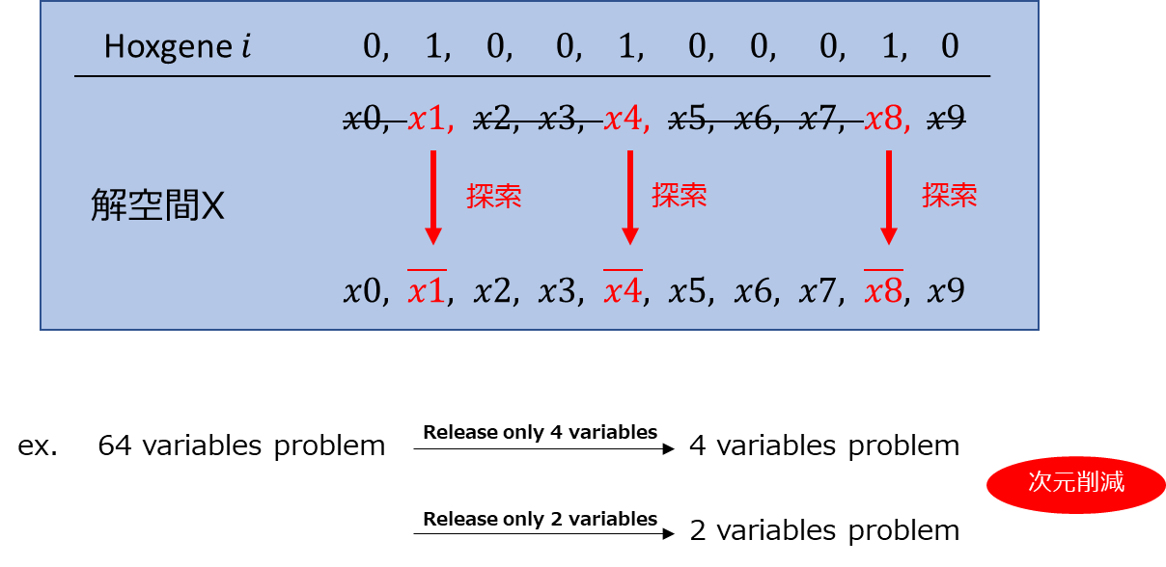
Proposed Method
●the search considering the dependency between variables
The search based on Hoxgenes with high evaluation value
Solution Space
search
search
search
Dimensionality reduction

Slide 19
Verification

Slide 20
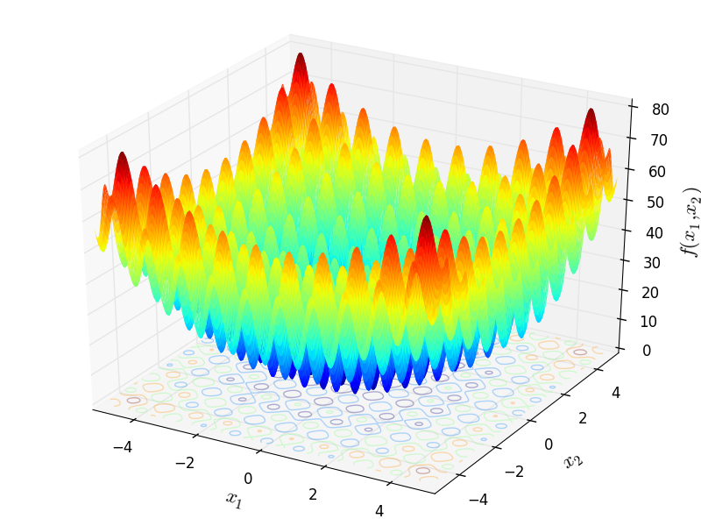
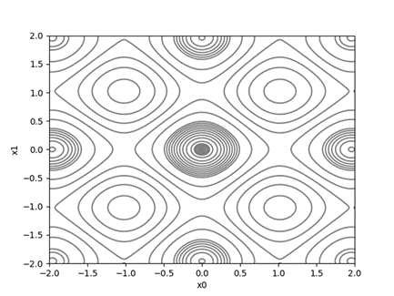
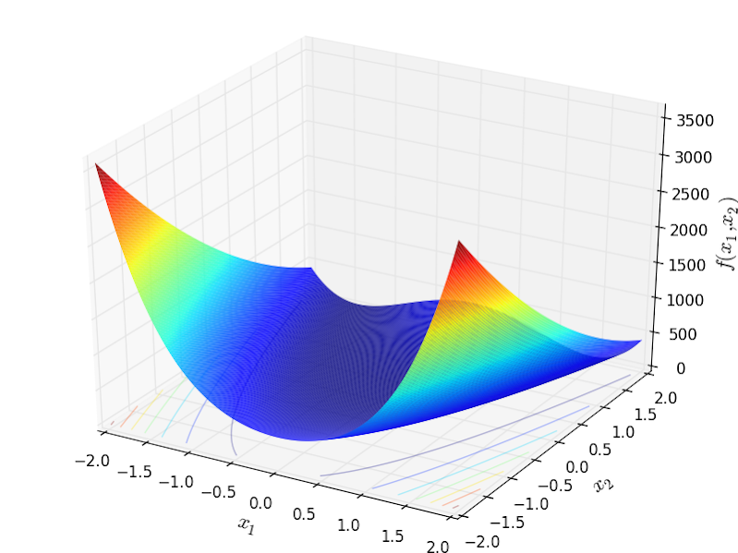
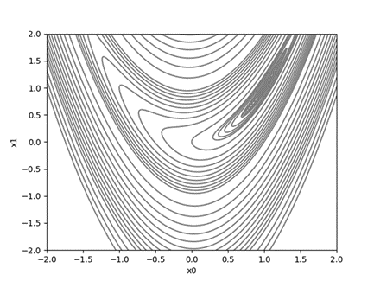
Verification Problem
●Verification: Effectiveness of Searching based on estimation information
What to verify:
With Hoxgene vs. Without Hoxgene（convergence of function value）
Accuracy of estimation dependency
Benchmark functions
Rastrigin function：multimodal, no dependency between variables
Rosenbrock function：unimodal, dependencies between 2 adjacent variables

Slide 21
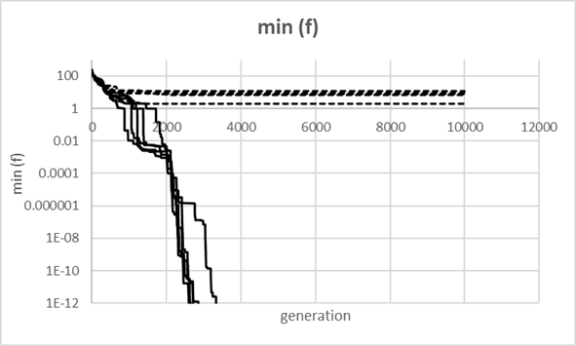

Result: Rastrigin function
16 variables
With Hoxgene vs. Without Hoxgene

Slide 22
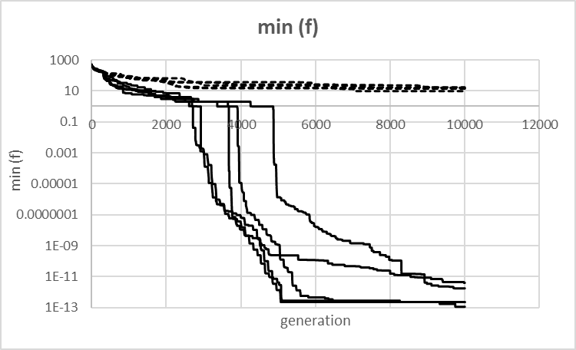
Result: Rastrigin function
32 variables
With Hoxgene vs. Without Hoxgene

Slide 23
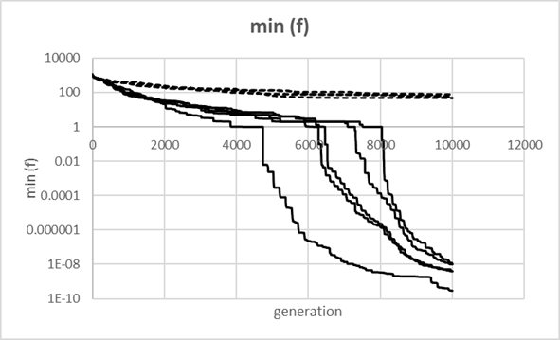
Result: Rastrigin function
64 variables
With Hoxgene vs. Without Hoxgene

Slide 24
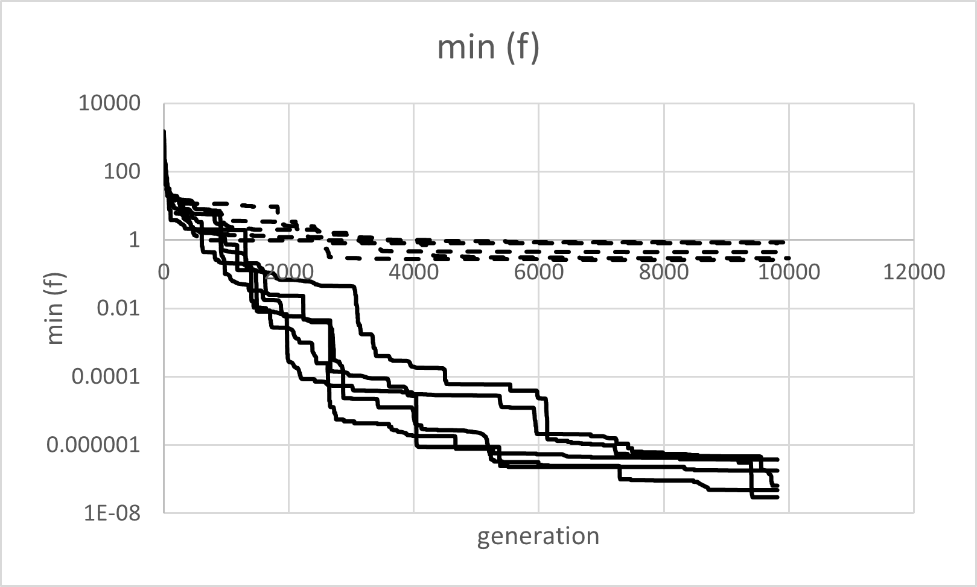
Result: Rosenbrock function
16 variables
With Hoxgene vs. Without Hoxgene

Slide 25
Result: Rosenbrock function
16 variables
Estimation accuracy
 | seed1 | seed2 | seed3 | seed4 | seed5 | AVE
選択数[回] | 26 | 34 | 23 | 32 | 21 | 27.2
総探索回数[回] | 28 | 34 | 23 | 32 | 21 | 27.6
成功率[%] | 92.85714286 | 100 | 100 | 100 | 100 | 99
No. of selection
No. of search
Success rate[%]
Estimation accuracy

Slide 26
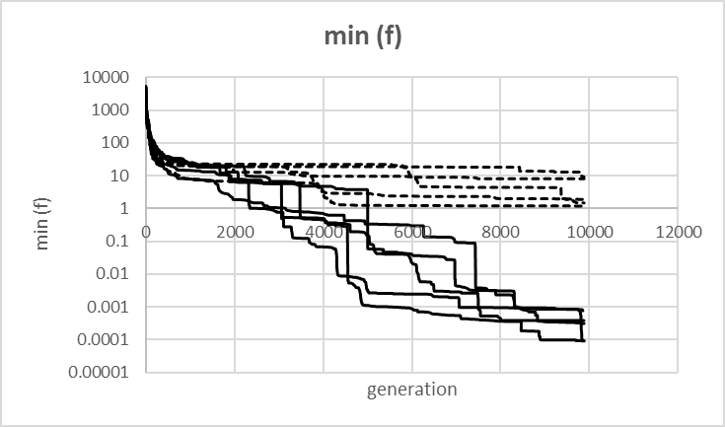
Result: Rosenbrock function
32 variables
With Hoxgene vs. Without Hoxgene

Slide 27
Result: Rosenbrock function
32 variables
Estimation accuracy
 | seed1 | seed2 | seed3 | seed4 | seed5 | AVE
選択回数[回] | 22 | 24 | 24 | 24 | 22 | 23.2
総探索回数[回] | 22 | 26 | 24 | 25 | 22 | 23.8
成功率[%] | 100 | 92 | 100 | 96 | 100 | 98
No. of selection
No. of search
Success rate[%]
Estimation accuracy

Slide 28
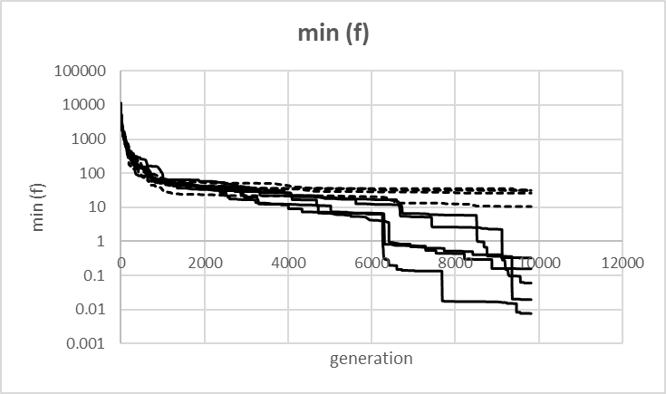
Result: Rosenbrock function
64 variables
With Hoxgene vs. Without Hoxgene

Slide 29
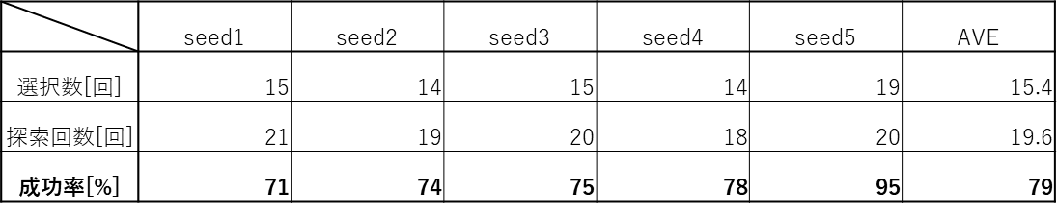
Result: Rosenbrock function
64 variables
Estimation accuracy
No. of selection
No. of search
Success rate[%]
Estimation accuracy

Slide 30
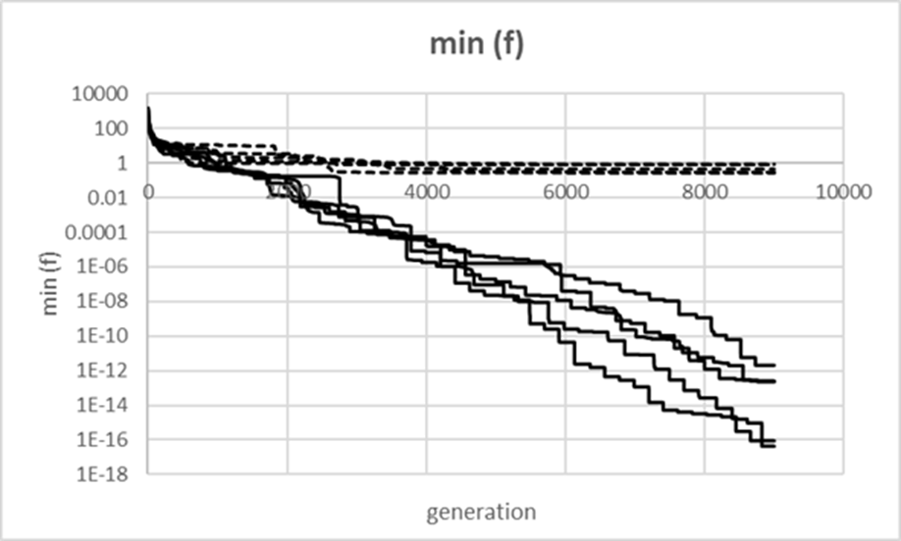
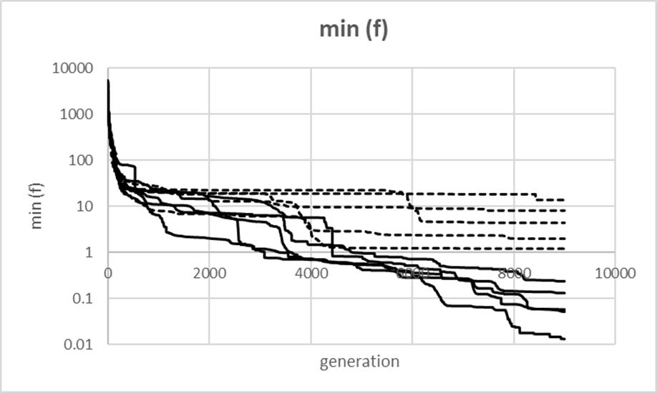
Conclusion
●Conclusion
Developed GA installed search with considering dependency and verified effectiveness
→ escape from the state of no improvement rapidly
→ improve search efficiency（possible: large number problem）
Verified estimation accuracy
→ accuracy: High
→ increase No. of variables: Decline
●Future Plan
Develop strategy for executing search considering dependencies
(adjust some parameters such as immigrant ratio)
→ improve search efficiency
Improve estimation accuracy for large number problem
Evaluate benchmark problem similar to real problems

Slide 31
Thank you for listening

