Slide 1



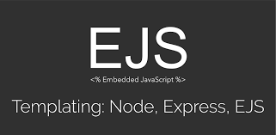


Express
Server-side Programming using Node.js

Slide 2
Node.js HTTP Server
Outcomes
Getting Started with Express
Working with Static Files
Configuring Routes
Extracting Data from the URL
Working with a Request Body

Slide 3
Getting Started With Express
Express is a Web Framework used to configure Node's HTTP module
Fast
Un-opinionated
Minimalist
Express is distributed via an NPM package
Express should be installed locally to each project, not globally

Slide 4
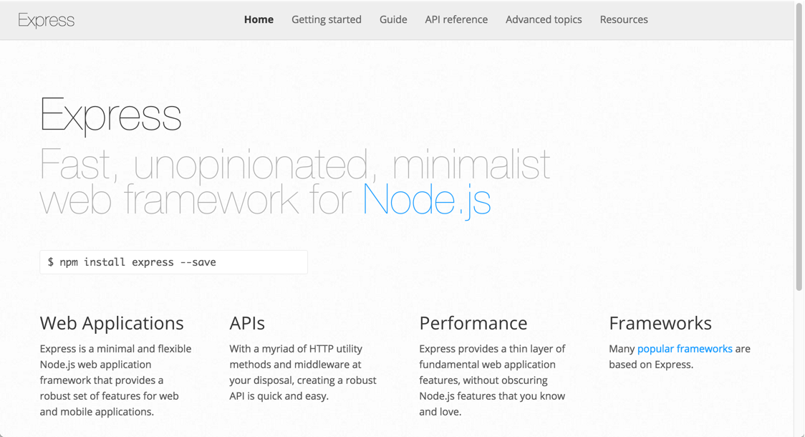
Express.js

Slide 5
Express.js
Express has no out-of-the-box object relational mapping or templating engine.
Express isn't built around specific components, having "no opinion" regarding what technologies you plug into it.
It strives to put control in the developer's hands and make Web application development for Node.js easier.
This freedom, coupled with lightning fast setup and the pure JavaScript environment of Node, makes Express a strong candidate for quick development and rapid prototyping.

Slide 6
Express.js

Slide 7
Getting Started With Express
Installing express ( and saving it with dependencies)
npm install express --save
Hello Express
const express = require('express')
const app = express()
const port = 3000
app.get('/', (req, res) => {
res.send('Hello World!')
})
app.listen(port, () => {
console.log(`Example app listening at http://localhost:${port}`)
})

Slide 8
Exercise: Hello Express (20 Minutes)

Slide 9
Getting Started With Express (Challenge Accepted?)
Aside: Express Generator
Use the application generator tool, express-generator, to quickly create an application skeleton.
You can run the application generator with the npx command (available in Node.js 8.2.0).
npx express-generator
For earlier Node versions, install the application generator as a global npm package and then launch it.
npm install -g express-generator
express
Explore additional options that are available for expess-generator

Slide 10
Exercise: Install express (with save) and write Hello Express app

Slide 11
Express Server: Working with Static Files
Serving Files with Express
There are two ways to serve static files using Express:
Serving a single file by configuring a path to the resource
Setting a public directory in which all files are accessible
We'll go over each of these methods in the next two sections.

Slide 12
Express Server: Working with Static Files
Serving Files with Express: Serving a Single File
Consider a scenario when we want to create a simple landing page that consists of 3 HTML documents (home.html, contact.html, and about.html), and we want to serve these files to the user.
Let's assume that the user visits the root path (http://localhost:3000). In that case, we want to serve the home.html file. Similarly, if the user visits the /contacts or /about paths, we want to serve the contact.html and about.html files, respectively.
To implement this, let's create a landing-page.js file and import the Express library:
const express = require('express');
Then, we'll create the Express app:
const app = express();
Then let's define the port on which our server will be running, which we'll use later when we actually run the server:
const port = 3000;

Slide 13
Express Server: Working with Static Files
Serving Files with Express: Serving a Single File
Since we are sending a single file, we won't include links to any CSS or script files within those HTML files unless they are hosted in a different location, like a CDN, for example.
We'll handle serving these files together in the next section, so for now, let's stick with three very simple, bare-bone HTML files:
home.html:
Contact.html:
about.html:
<body> <h1>Home</h1> </body>
<body> <h1>Contact</h1> </body>
<body> <h1>About Us</h1> </body>

Slide 14
Express Server: Working with Static Files
Serving Files with Express: Serving a Single File
Now let's go back and edit our landing-page.js file to send files corresponding to the paths the user visits, such as sending the home.html file when the user visits the root path.
We can use the res.sendFile() method to serve a file within a response:
app.get('/', (req, res) => {
res.sendFile('./landing-page/home.html',
{ root: __dirname });
} );
For security reasons, it's best to use a static path for res.sendFile(), as shown above. If you're ever taking user input that affects the file path, be very careful to prevent the user from being able to manipulate the file path and thus allowing them to retrieve private files.
In our case, we're setting the root for where the relative path is from by passing the root parameter to the method. Note that, we have passed __dirname, which is a Node.js global variable to the path of currently running file.

Slide 15
Express Server: Working with Static Files
Serving Files with Express: Serving a Single File
We can use the same method to serve our other files, contact.html and about.html, as well:
app.get('/about', (req, res) => {
res.sendFile('./landing-page/about.html', { root: __dirname });
});
app.get('/contact', (req, res) => {
res.sendFile('./landing-page/contact.html',
{ root: __dirname });
});
Now that our application is ready to go, let's start the server and listen to the port we set earlier:
app.listen(port, () => console.log(`listening on port ${port}!`));
And run our app by executing:
node landing-page.js

Slide 16
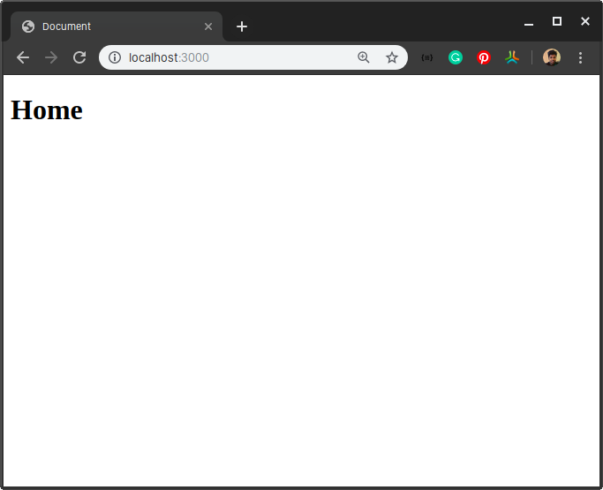
Express Server: Working with Static Files
Serving Files with Express: Serving a Single File
Open your browser and visit any of the mapped paths and you should be greeted with the HTML file(s):

Slide 17
Exercise: Serve different pages using Express

Slide 18
Express Server: Setting up a Public Directory
The second method of serving static files is to set up a public directory. Unlike sending a file through the HTTP response, where only a single file can be served, all files inside our specified folder will be available for users.
Let's create another file, called server.js, and set the folder with our three HTML documents to be a public directory:
const express = require('express');
const app = express();
const port = 3000; // Setting up the public directory
app.use(express.static('landing-page'));
app.listen(port, () => console.log(`listening on port ${port}!`));
Making a directory public is as easy as using the app.use() and express.static() methods. Let's run our app again and verify that it's working:
node server.js
Open your browser and visit any of the mapped paths and you should be greeted with the HTML files, just like last time. Keep in mind that this time, the root path is not mapped to the home.html file, but rather the http://localhost:3000/home.html:

Slide 19
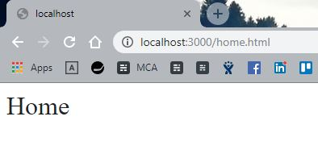
Express Server: Working with Static Files
Also, you can set a prefix to the path to access your public directory by passing the prefix as the first parameter:
app.use('/public', express.static('landing-page'));x

Slide 20
Express Server: Working with Static Files
Outcomes
Getting Started with Express
Working with Static Files
Configuring Routes
Extracting Data from the URL
Working with a Request Body

