Slide 1


Mastech Digital + Salesforce®
Solutions for the Manufacturing Industry INDUSTRIAL | BRAND SOLUTIONS | PHARMACEUTICALS

Slide 2



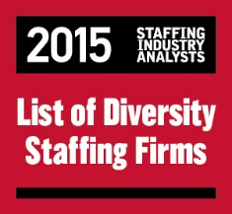
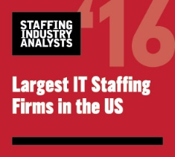




Credible & Consistent
To ensure you optimize your Salesforce® success, Mastech Digital can help pair you with the right solution to get the most out of a Salesforce® investment. Our tailored engagement offerings eliminate the most common technology roadblocks, helping many customers devote their time to growing their business.
Experienced in Digital Transformation IT Services such as Data Management & Analytics
Backed by a team of more than 20 certified consultants, we’ve been helping companies implement CRM applications
We’ve empowered leading companies in a wide range of industries from financial services and healthcare, to manufacturing
2

Slide 3





Our Focus Areas
Sales Cloud®
Revenue maximization through sales automation
Service Cloud®
Greater customer satisfaction through personalization
Jitterbit, Informatica ETL, Informatica CC360, SAP HANA, SAP ECC, G Suite, AWS Integration
Platform & Apps
Platform-as-a-Service (PaaS) development framework
Salesforce Lightning
Modern enterprise apps made quickly and easily
Community Cloud
Increased efficiency through stakeholder integration
3

Slide 4






Overcoming Challenges
Eliminating swivel-chair interfaces
Reducing response time to customers
Providing visibility into divisional sales data
4

Slide 5



Proven Success
Harmonized processes under one umbrella
Branded a full-cycle, customized sales process
Unified global Salesforce reporting across orgs.
5

Slide 6




Creating Opportunities
Our practice understands how the Sales Cloud can change the way Manufacturing does business. Our expertize creates robust Data Integrity from Integration to Automation. From Salesforce Connect to Salesforce Einstein, we deliver harmonized applications with enriched data.
Salesforce® Connect
Salesforce® Lightning
Apps
on Salesforce®
Partner Communities
Salesforce® Sales Cloud Einstein
6

Slide 7



Use Case |
MYLAN PHARMACEUTICALS
INDUSTRY: Pharmaceuticals
SEGMENT: Generic Drug Manufacturing CLOUDS:
Sales Cloud
Service Cloud
CHALLENGE
SOLUTION
RESULTS
Disparate source systems with no unified solution for global needs
Cloud-enabled solution with standardized business process implementation
Improved market share by creating opportunities directly from product launches, and reduced response time to customers, which garnered a lot of goodwill
7

Slide 8



Offerings
Assessment & Roadmap
Holistic assessment of an existing application landscape
Enablement of benefits from next-gen solutions
Implementation & Integration
Implementation of scalable solutions with high importance on data integrity
Integration of ERP, databases, or homegrown applications, to get rid of swivel-chair interfaces
User Adoption & Change Management
Creating a powerful advantage by making every user a power user
Customized change management program for better adoption and greater success
8

Slide 9

Working with Mastech Digital
Shirish Ashwat SALESFORCE PRACTICE DIRECTOR
EMAIL: Shirish.Ashwat@mastechdigital.com WORK: +1 412.490.7946 MOBILE: +1 412.498.4160
9

Slide 10
Thank You

