Slide 1

Out-of-distribution Detection with Boundary Aware Learning
Sen Pei^{1,3}, Xin Zhang^{1,3}, Bin Fan⁴, and Gaofeng Meng^{1,2,3}
¹UCAS,
²CAIR, HKISI, CAS,
³NLPR, Institute of Automation, CAS,
⁴University of Science and Technology Beijing

Slide 2
Outline
Background
Analysis
Our Solution
Experiments
Visualization

Slide 3
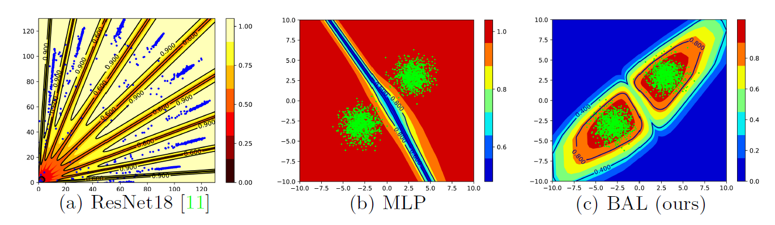
Background
Conventional discriminative models suffer from over-confidence issue.
(a) demonstrates the decision boundary of MNIST dataset with a ResNet18
(b) shows the decision boundary of two gaussian distribution
(c) is the ideal boundary that assigns lower scores to the place where no ID data distributes.

Slide 4
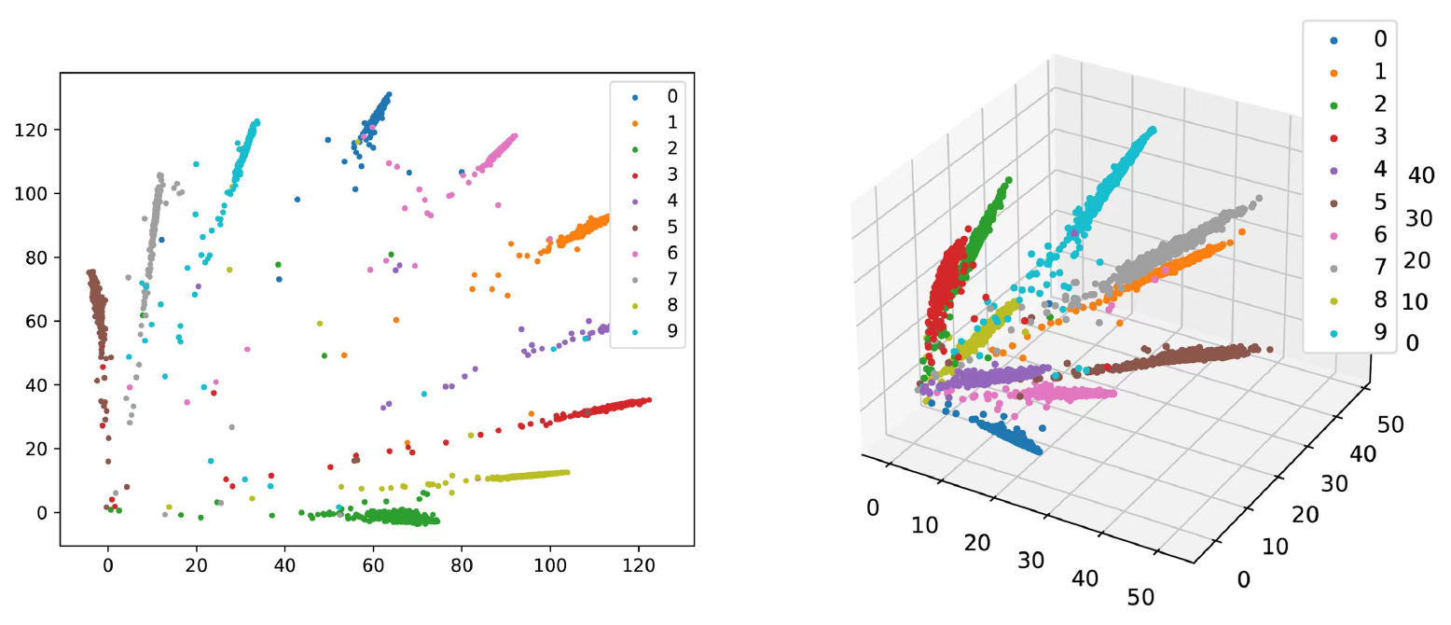
Analysis
The out-of-distribution feature space gets high confidence due to the lack of supervision.
We set the penultimate layer of classification head to have two or three neuros, following GCPL (Yang et al. , 2018).
Left: The figure demonstrates feature distribution of MNIST in 2-dimension space
Right: The figure shows feature distribution of MNIST in 3-dimension space

Slide 5
Analysis
The out-of-distribution feature space gets high confidence due to the lack of supervision.
We set the penultimate layer of classification head to have two or three neuros, following GCPL (Yang et al. , 2018).
Conclusion:
The in-distribution data distribute densely and narrowly in feature space.
The feature space is almost filled with the out-of-distribution data.

Slide 6
Solution
Boundary Aware Learning: Make the classifier know the boundary of in-distribution data.
Schemes:
The trivial OOD feature: we can sample data in feature space uniformly.
The hard OOD feature:
(a) We train a generator which can give us ID feature in high-quality first.
(b) We use FGSM (Goodfellow et al., 2015) to push the synthetic feature close to the boundary of ID and OOD.

Slide 7
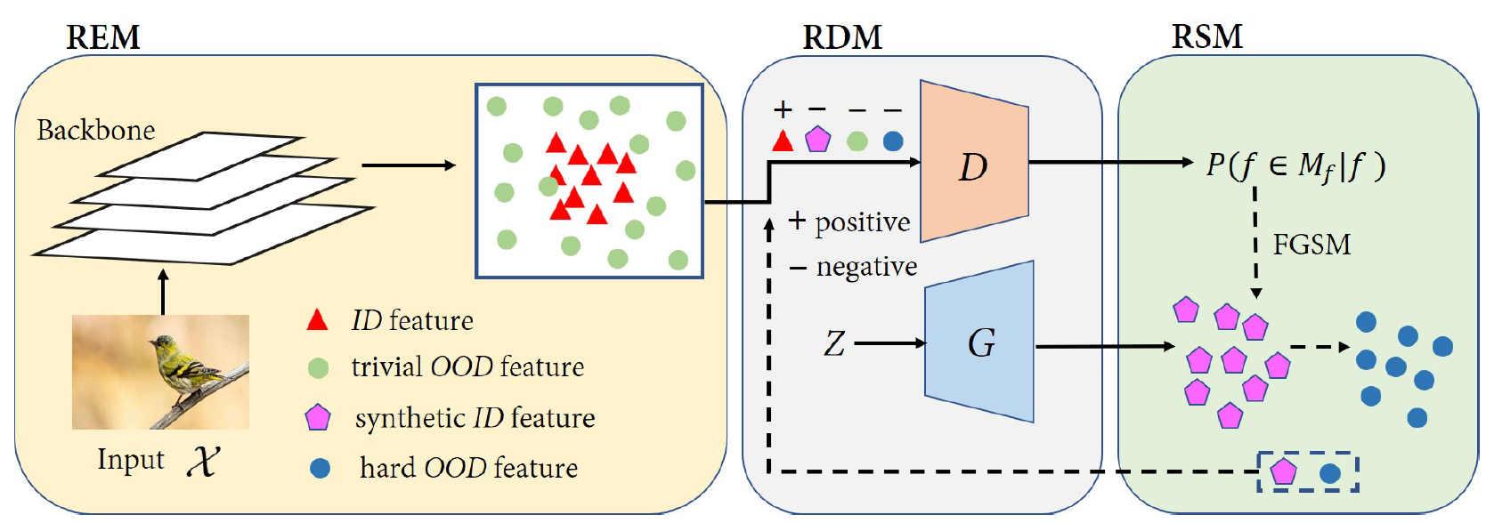
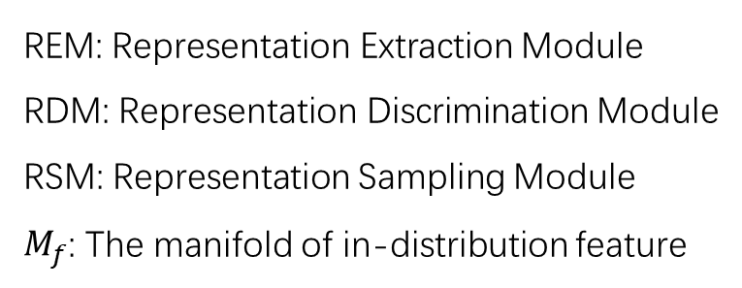
Solution
REM: Representation Extraction Module
RDM: Representation Discrimination Module
RSM: Representation Sampling Module
$M_{f}$: The manifold of in-distribution feature

Slide 8
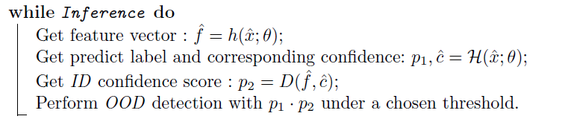
Solution

Slide 9
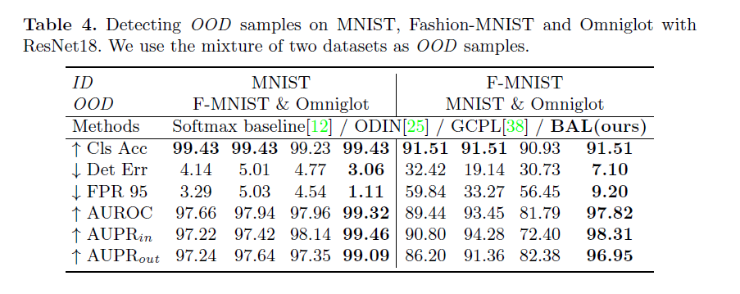
Experiments
Mixed Out-of-distribution detection

Slide 10
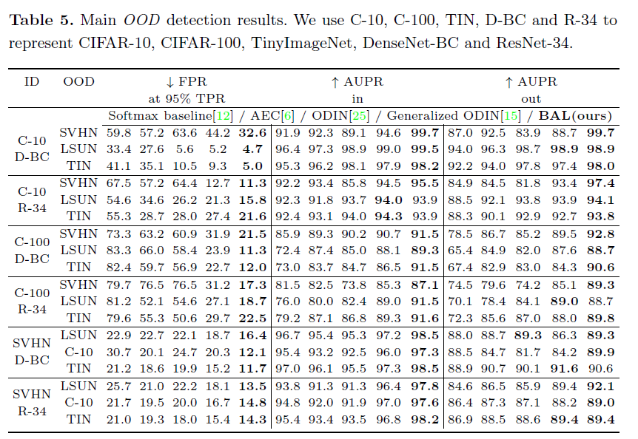
Experiments
Common benchmarks

Slide 11
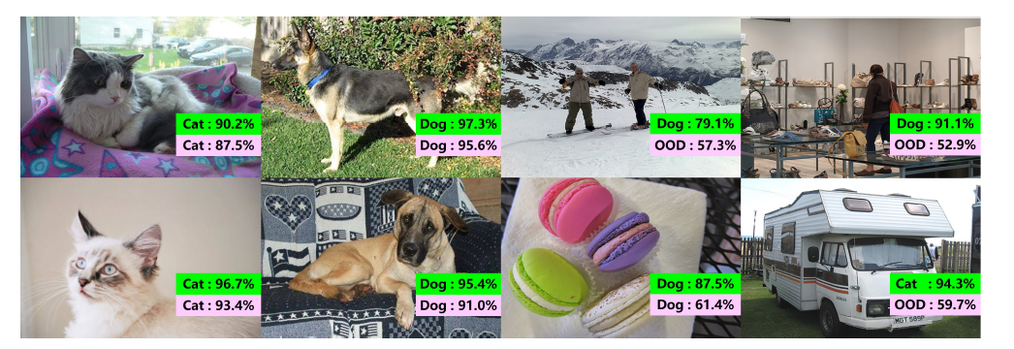
Visualization
Kaggle Challenge: Dog vs. Cats
In-distribution: Dog vs. Cats dataset
Out-of-distribution: ImageNet
Pink: conventional ResNet
Green (ours): ResNet with BAL
Thanks

