Slide 1








Latch
Ömer Metehan İzal
Prototype · 17 Oct 2026
Latch demo
foreveranka
0xmetee
Notes:
Latch pre-hackathon prototype. Built 17 October 2026. Live: https://latch-bch.vercel.app. This deck adapts the official BCH BLAZE Widget Factory template: https://docs.google.com/presentation/d/1Yfuk9CJkf4U9M_WukcELhumWgj3Ak6345Ewy8hSp-Hk/edit .

Slide 2
Latch
BCH payments with a refund path
for funds that stay unclaimed
github.com/Foreveranka/latch-bch
Notes:
Code: https://github.com/Foreveranka/latch-bch. Original proof is pre-event and must be disclosed. Do not claim the prototype was built during the November hackathon.

Slide 3
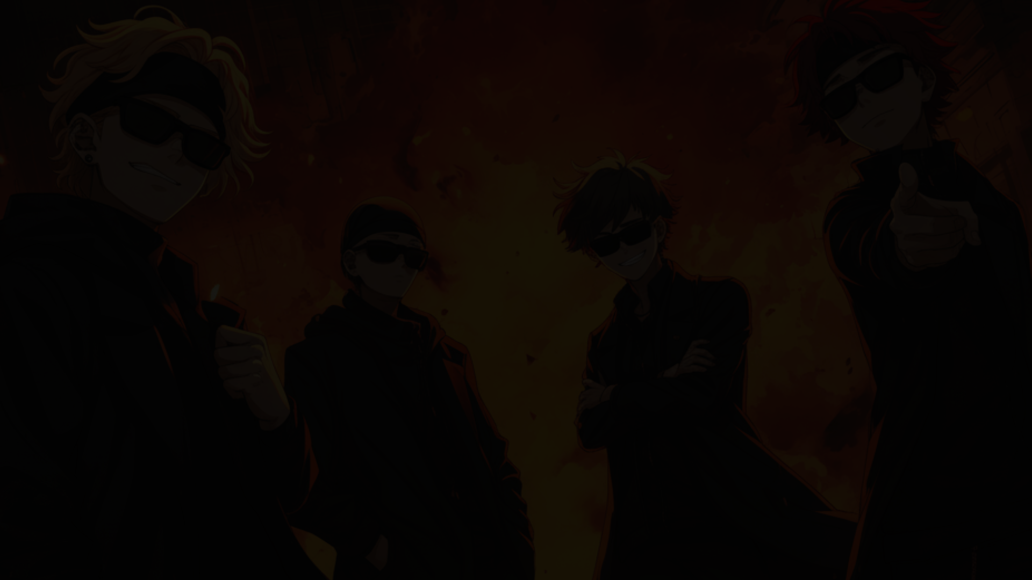


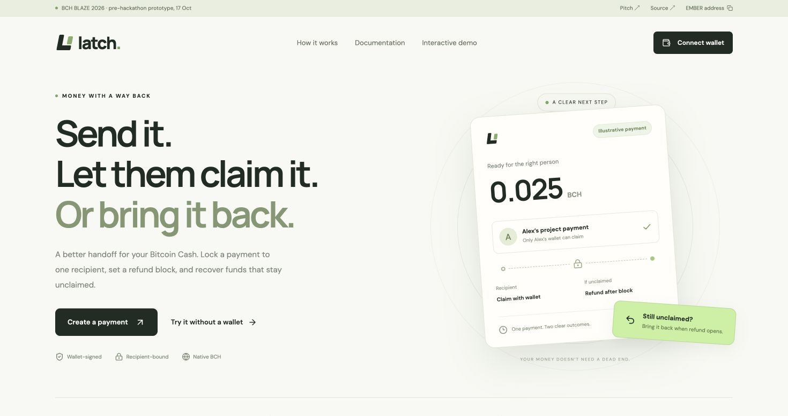

The payment handoff
A sender needs to pay one specific wallet.
The recipient may not claim it immediately.
Latch locks BCH for that recipient and gives the sender a refund path after a known block.
A shared link cannot redirect the funds.
bchblaze.com
Notes:
Product hypothesis: delayed contractor/community payouts need recipient binding and a recovery path. No traction or market-size claims. Actual product screenshot.

Slide 4
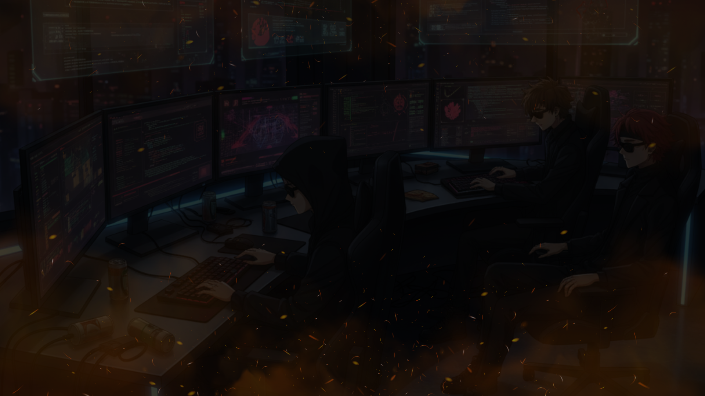
Payment
controls
Only the named wallet claims
  Sender refund after maturity
  No platform custody key
Exportable recovery record
800-satoshi settlement fee
  Local VM demo without a wallet
Notes:
One input, one output. Fixed payout script. Contract caps fee at 1000 satoshis, app uses 800. No token inputs. Check contracts/Latch.cash and tests/core.test.ts.

Slide 5
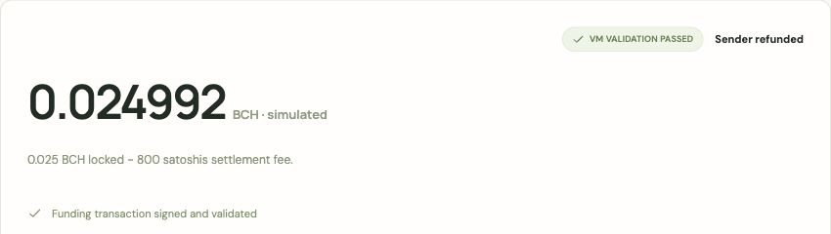
BCH contract
CashScript fixes the destination and caps the fee.
WizardConnect keeps signing in your wallet.
18 automated tests pass. Mainnet proof is pending.
Notes:
Primary technical sources: https://cashscript.org/docs/sdk/transaction-builder and https://docs.riftenlabs.com/wizardconnect/dapp/ . The demo uses MockNetworkProvider and actual local BCH VM signature validation, not a mainnet receipt. Funded mainnet and real external wallet end-to-end tests pending.

Slide 6
Next
steps
Pilot has no platform fee
  Future paid team tracking
  Live wallet and mainnet tests
Substantial November upgrades
Prototype predates the event
Refund maturity does not cancel a recipient claim
Notes:
Business model is proposed. No existing revenue claims. After refund maturity recipient claim remains valid until spent. Competing claim/refund transactions can race. In-event improvements, mainnet evidence, preparation-stream roll call, Telegram confirmation and submission opening are pending.

Slide 7






TRY LATCH
latch-bch.vercel.app
Notes:
Website: https://latch-bch.vercel.app . Demo: https://latch-bch.vercel.app/demo . Telegram user-supplied handle foreveranka. Source: https://github.com/Foreveranka/latch-bch .

