Slide 1

Fitness 4 You
Gym and Fitness Center
Providing membership packages for fitness classes and personal training.

Slide 2
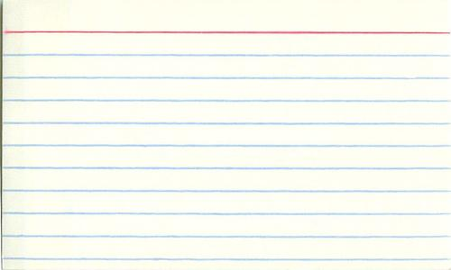
Members
Fred Brown 555-123-9281
123 Main Street
Class: Spin
Bronze Membership
Training: Strength
Melanie Smith 555-509-3936
75 Lokey Avenue
Class: Spin, Zumba, Boot Camp
Gold Membership
Training: Strength, Toning, Weight Targeting
Jennifer Walters 555-282-2820
15 Stone Lane
Class: Boot Camp
Bronze Membership
Training: Weight Targeting
Jeff Smith 555-338-2820
7355 Oak Mountain Drive
Class: Zumba, Boot Camp
Silver Membership
Training: Weight Targeting, Strength
Tamara Rohly 555-838-3830
900 Friendship Loop
Class: Zumba
Bronze Membership
Training: None
Fred Brown 555-822-8809
88 Grand Pinen Dr
Class: Boot Camp, Spin
Silver Membership
Training: Strength, Toning

Slide 3
Membership Levels
Bronze Members
1 class/week
1 trainer/month
Pool - 2 days/month
Silver Members
2 classes/week
2 trainers/month
Pool – 4 days/month
Gold Members
3 classes/week
3 trainers/month
Unlimited access to pool

Slide 4
Classes and Training
Classes
Spin
Zumba
Boot Camp
Personal Training Available
Strength
Toning
Weight Targeting
Class Schedule
Spin – Monday, Wednesday, Saturday
Zumba – Tuesday, Thursday, Friday
Boot Camp – Monday, Tuesday, Friday
Class Instructors
Spin – Molly, James, Von
Zumba – Amelia, Kevin
Boot Camp – Sasha, Brian, Jon
Personal Trainers
Strength – Hogan, Stark, Thor
Toning – Craig, Natalie, Julie
Weight Targeting – Dwayne, Larry

