Slide 1
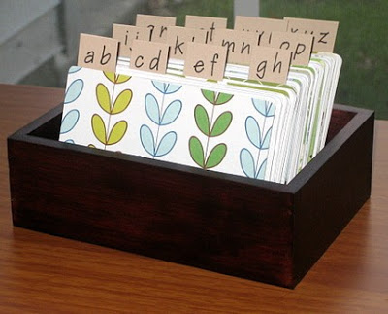
Example Scenario
A vet’s office is currently collecting new client information on simple paper cards they hand to each new client.
The client fills in the information requested, and these cards are stored and referenced alphabetically by client last name.
This card box represents a data store but not a true database.
Consider some of the issues with this system of recordkeeping.
Why is a relational database better?

Slide 2
Conceptual ERD
Choosing entities
Identifying relationships

Slide 3
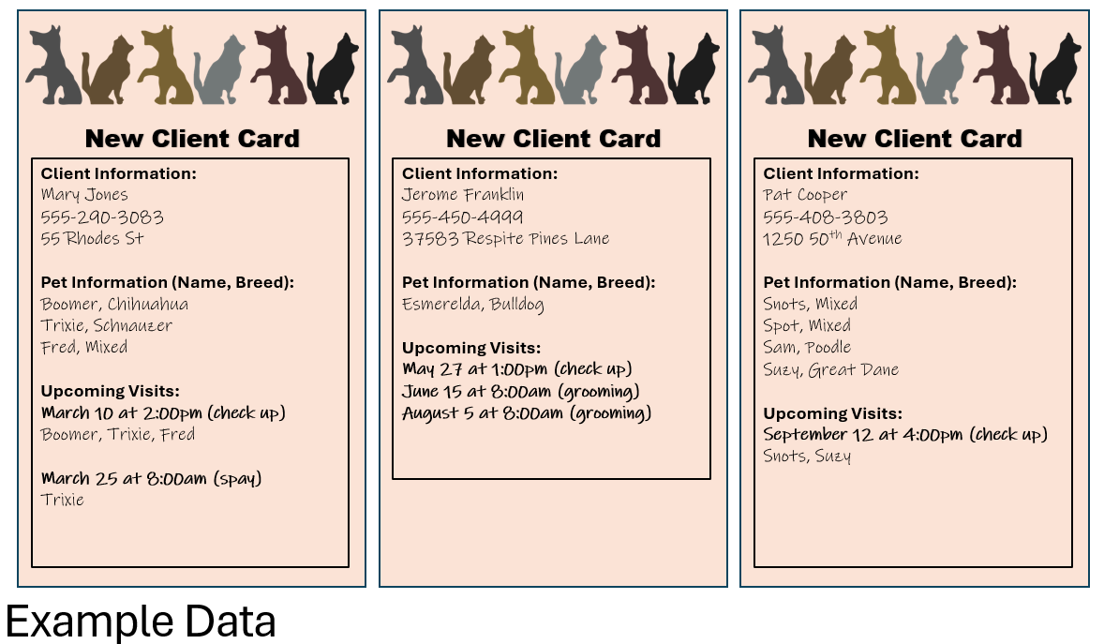
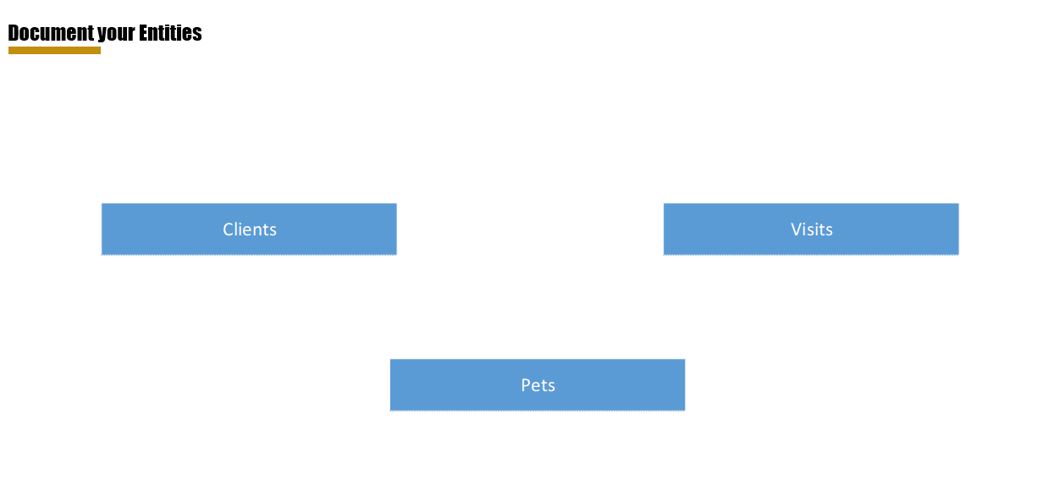
Conceptual ERD Entities
Looking at the data set we can see we need to create tables to store all data. This data includes:
client first and last name
client phone number
client address
pet name
pet breed
upcoming visit date
upcoming visit time
To determine the entities needed, we identify categories of data that will account for all of the above data and create an entity for each:
Clients
This accounts for the client’s first and last name, phone number, and address data
Pets
This accounts for the pet name and pet breed data
Visits
This accounts for the upcoming visit date and time data

Slide 4
Conceptual ERD Entity Relationships
Now that we have our entities to account for all data, we need to relate the entities to each other.
Relationships can be one-to-one, one-to-many, or many-to-many.
Decide which entities are related to each and then determine the cardinality.
Thinking about the data logically, we know:
Each client must have a pet, (otherwise they would not be a client of a vet clinic), so we know Clients and Pets are related.
Each Client must attend a visit, (pets cannot take themselves to the clinic), so we know Clients and Visits are related.
Each Pet must attend a visit, (without a pet, there is no reason for a visit to the clinic), so we know Pets and Visits are related.

Slide 5
Conceptual ERD Entity Relationships
Now that we have determined which entities have a relationship, we assign cardinality.
Clients to Visits
Clients can attend multiple visits
1 client > many visits
Each visit is for one client only (remember the client is the human)
1 visit > 1 client
This tells us there is a one-to-many relationship from clients to visits
One client to many visits
Clients to Pets
Clients can have multiple pets
1 client > many pets
Each pet has one client
1 pet > 1 client
This tells us there is a one-to-many relationship from clients to pets
One client to many pets
Pets to Visits
Pets can have many visits
1 pet > many visits
Visits can include many pets
1 visit > many pets
This tells us there is a many-to-many relationship from pets to visits
Many pets to many visits

Slide 6
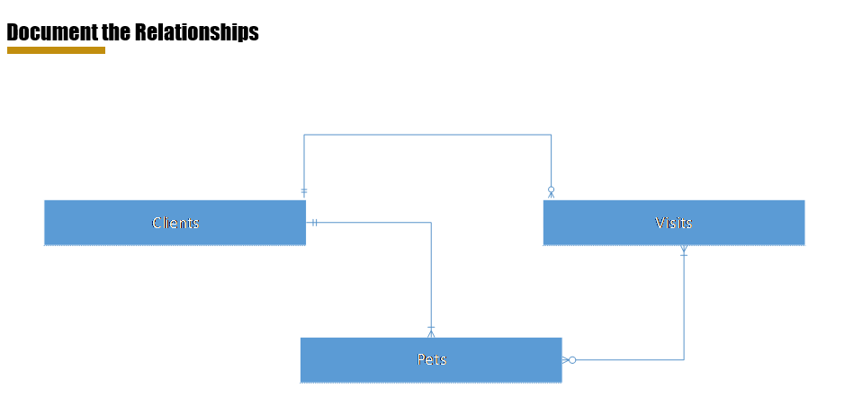
Conceptual ERD
Now we model these relationships in Visio
One client to many visits
One client to many Pets
Many pets to many visits

