Slide 1
SMART BINUSING ARDUINO

Slide 2
Smart BIN Using Arduino
Group: -7 Section : I
Md.Forhadul islam id :20-42091-1
Nabila Chowdhury Joya id: 20-42268-1
ANANNA RASHID KUMKUM id: 20-43589-1

Slide 3

introduction
• Smart dustbin as its name represents ,it works smartlyor we can say that it is an automatic dustbin •Smart dustbin is automated dustbin intended to reducehuman efforts and improve cleanliness •It is a decent gadget and make your home clean andattractiv

Slide 4
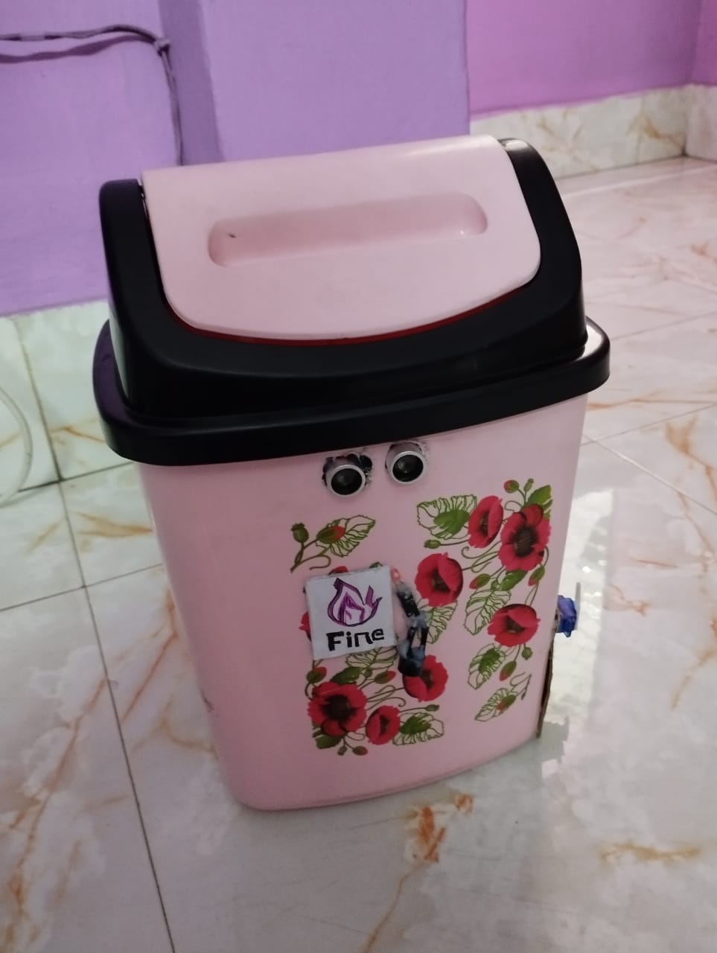
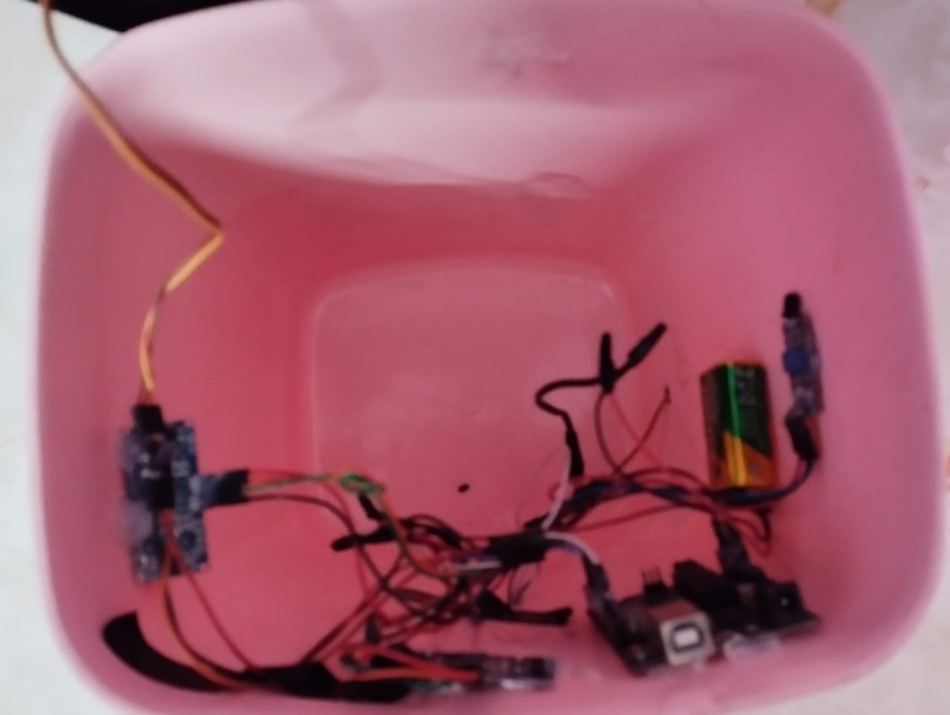
Picture of the smart bin

Slide 5
OBJECTIVES: Automatic open-close Detect the level of the trash inside the dustbin No contact touch between dustbin and person so,prevent from germs and diseases also added automatic fire alarm system. Keep our environment clean and eco friendly

Slide 6
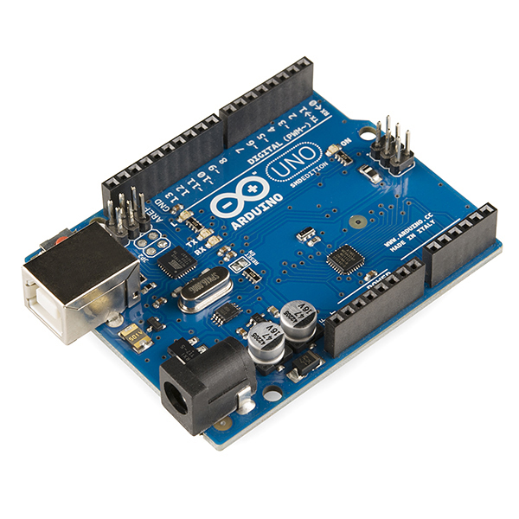
SOFTWARE REQUIRED
its is used to write and uploadprogrammes to Arduino compatibleboards, but also with the help of thirdparty cores, other vendor developmentboards

Slide 7
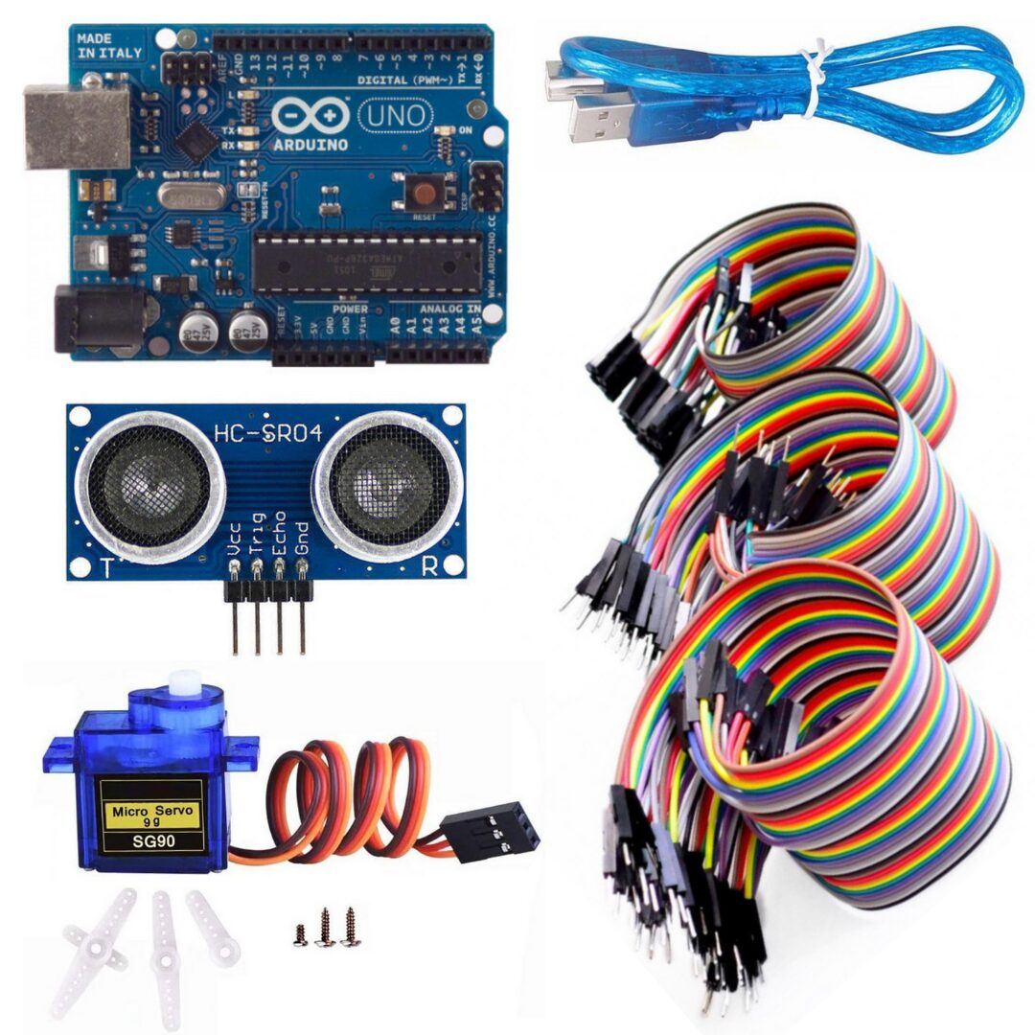
HARDWARE REQUIREMENTS
▪ Arduino uno ▪ Servo motor ▪ HC-SR04 ultrasonic senso ▪ Jumper wire ▪ Male Female wire ▪ Flame sensor ▪6V Battery

Slide 8
Working procedure of flame sensor
The flame sensor is positioned in a location where it can detect the presence of a flame. This is usually in the path of the burner flame.
When a flame is present, the infrared radiation emitted by the flame is absorbed by the sensor.
The sensor converts the infrared radiation into an electrical signal, which is sent to the control board of the heating system.
The control board analyzes the signal and determines whether a reliable flame is present.
If a reliable flame is present, the control board allows the heating system to continue operating. If a flame is not detected, the control board will shut down the system to prevent any potential hazards.

Slide 9

summary
The Smart Bin with Fire Alarm System project is an innovative and practical solution for waste management in public areas. The project involves the development of a smart bin that uses ultrasonic sensors to detect when it's full and then compacts the trash using a motorized system to make room for more waste. The bin also features a fire alarm system that uses a flame sensor to detect the presence of a fire and alerts nearby authorities.

Slide 10
thank you

