Slide 1
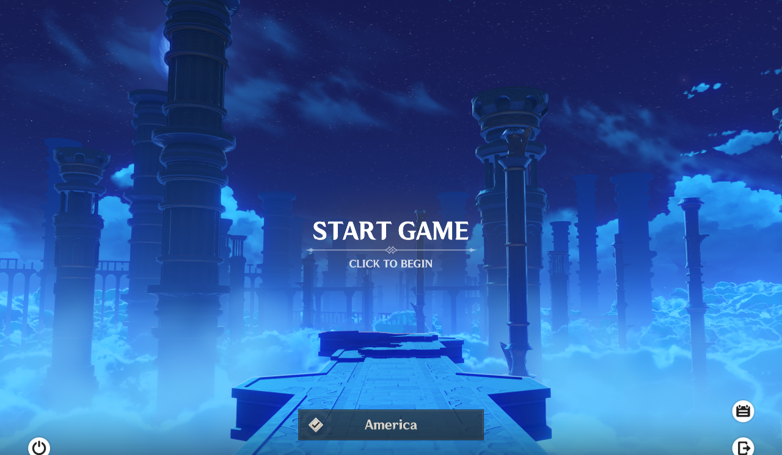

GENSHIN IMPACT CRASH COURSE

Slide 2
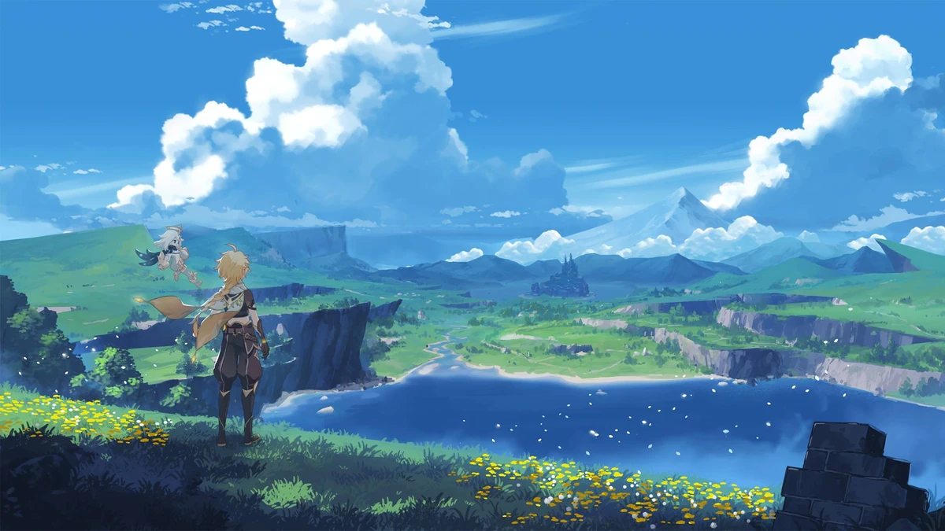
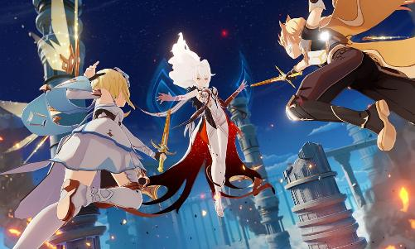
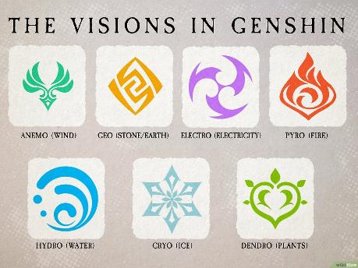
General Overview
Celestia: the floating island and higher power ruling over Teyvat
Leads the Archons (gods of each nation) and grants Visions (elemental power)
Took the Traveler’s (our) twin, which is why we’re searching for them
Notes:
Celestia is the floating island above Teyvat and the higher power that rules over it. It’s led by a being called the Heavenly Principles, who sits above even the Archons. The Archons, the gods of each nation, won their positions in a war among gods, and Celestia backed them by giving them Gnoses, which are tied to their power. Celestia is also the source of Visions, which are given to people with strong ambition and let them use elemental energy. But Celestia keeps watch over everything, and it’s very controlling: it doesn’t want anyone interfering with its plans. That’s why it matters to our story. When my twin and I arrived in this world, a god from Celestia took them from me. So now I’m traveling through the nations of Teyvat, meeting the Archons and looking for them.

Slide 3
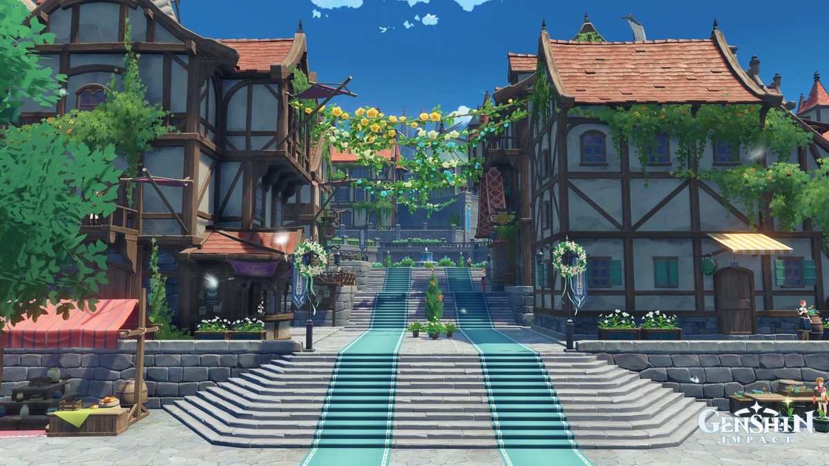
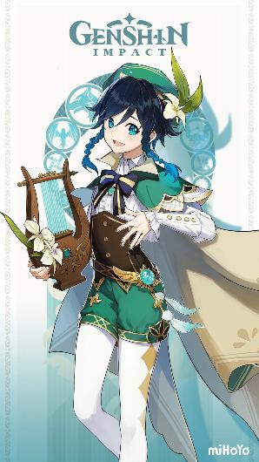
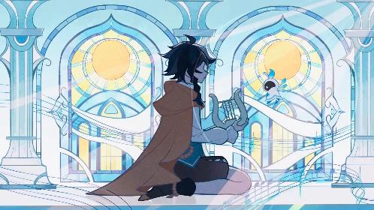
Mondstadt
The Land of Freedom
“What is freedom, when demanded of you by a god?”
Mondstadt: the city of freedom, ruled by the Anemo Archon, Barbatos
Protected by the Knights of Favonius
Dvalin (Stormterror): a dragon attacking the city, corrupted by the Abyss Order
Venti, the bard, is revealed to be Barbatos in disguise
The Traveler cleanses Dvalin of the corruption and saves the city
Notes:
Mondstadt is the city of freedom, located in the northwest of Teyvat. It is ruled by the Anemo Archon, Barbatos, who freed its people from a tyrant long ago, and today the city is protected by an organization called the Knights of Favonius. When the Traveler and their companion Paimon arrive, the city is in trouble. A massive dragon called Dvalin, also known as Stormterror, is attacking Mondstadt and surrounding it with storms. The Traveler teams up with the Knights, including acting Grand Master Jean, and with a bard named Venti to find out why. They learn that Dvalin is not evil. He is suffering from poison and corruption from the Abyss Order, which is driving him to attack. Venti then reveals that he is actually Barbatos, the Anemo Archon, in disguise. With his help, the Traveler fights Dvalin, cleanses the corruption, and frees the dragon. Mondstadt is saved, and the Traveler continues the journey to find their lost twin.

Slide 4
Mondstadt
The Land of Freedom
“What does freedom really mean, when demanded of you by a god?
Notes:
If a god commands people to be free, they are still just following orders, so it isn’t real freedom. Freedom only counts when people choose it and build it themselves.
He seems like a slacker god who doesn’t do anything. But really, it’s because he believes humanity should be free to make its own choices and learn from its mistkaes. He still does help when it matters.

Slide 5
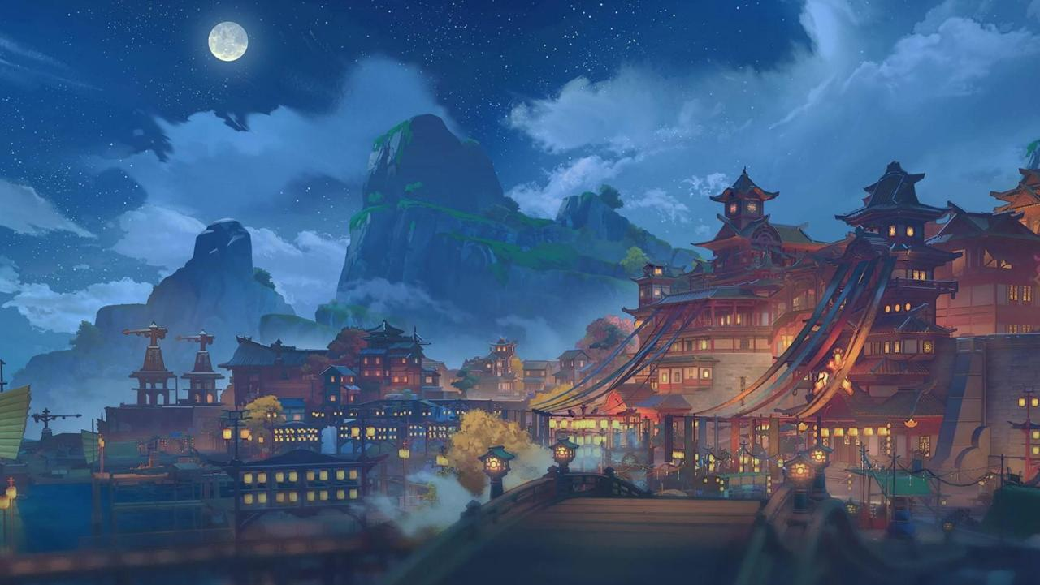
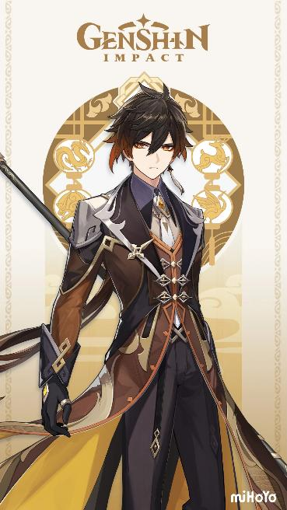
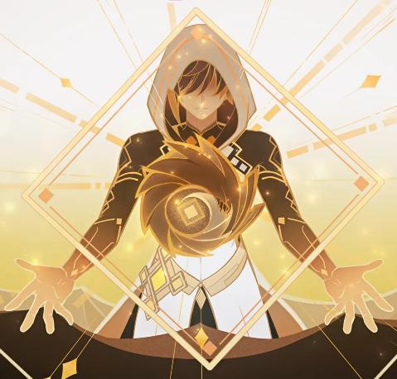
Liyue
The Land of Contracts
Liyue: the nation of contracts, ruled by the Geo Archon, Rex Lapis
Governed by the Qixing and protected by the Adepti
The Fatui plot to steal the Archon’s Gnosis during the Rite of Descension
Their scheme awakens Osial, an ancient sea creature
Zhongli is revealed to be Rex Lapis, who faked his death to give Liyue to its people
Liyue is left to govern itself, and the Traveler moves on
Notes:
Liyue is the nation of contracts, located in the east of Teyvat and ruled by the Geo Archon, Rex Lapis. Its capital, Liyue Harbor, is a major trading port where agreements and business are held sacred. The city is run by a council of merchants called the Qixing, with Ningguang and Keqing among its leading figures, and it is protected by the Millelith and by the Adepti, ancient mythical beasts who serve Rex Lapis. When the Traveler arrives, Liyue is preparing for the Rite of Descension, a ceremony honoring its god. During this time, the Fatui, led by the Harbinger Childe, plot to steal the Geo Archon’s Gnosis. The Traveler meets Zhongli, a knowledgeable consultant from the Wangsheng Funeral Parlor, and together they work to stop the Fatui’s plan. Their scheming awakens the ancient sea creature Osial, and a god-sized threat sweeps over the city. Liyue’s people and the Adepti fight back, and the Traveler helps drive the creature away. Then comes the biggest twist: Rex Lapis is killed at the Rite of Descension. Afterward, it is revealed that Zhongli is Rex Lapis himself, who faked his death to hand the nation over to its own people. He willingly gave up his Gnosis, which the Fatui take, and lives on as a mortal. Liyue is left to govern itself, and the Traveler continues on the journey to find their lost twin.

Slide 6
Liyue
“Trade relies on both contracts and fairness. There is one thing you must never forget when making and abiding by a contract: if fairness is lost, then the contract shall become proof of one's deception.”
Notes:
For thousands of years, Zhongli ruled Liyue as Rex Lapis, the Geo Archon and God of Contracts. Over that time he came to believe that a nation led forever by a god would never truly stand on its own. Liyue’s people were prosperous and capable, but they had grown used to relying on him for every major decision. So Zhongli chose to step back. He staged his own death at the Rite of Descension, giving up his role as Archon and his Gnosis, and he gave the nation to its people. Afterward he lived quietly as a mortal consultant at the Wangsheng Funeral Parlor, watching Liyue govern itself. For him, humanity should take control of its own future, and a god’s greatest act of trust is knowing when to let go.

Slide 7
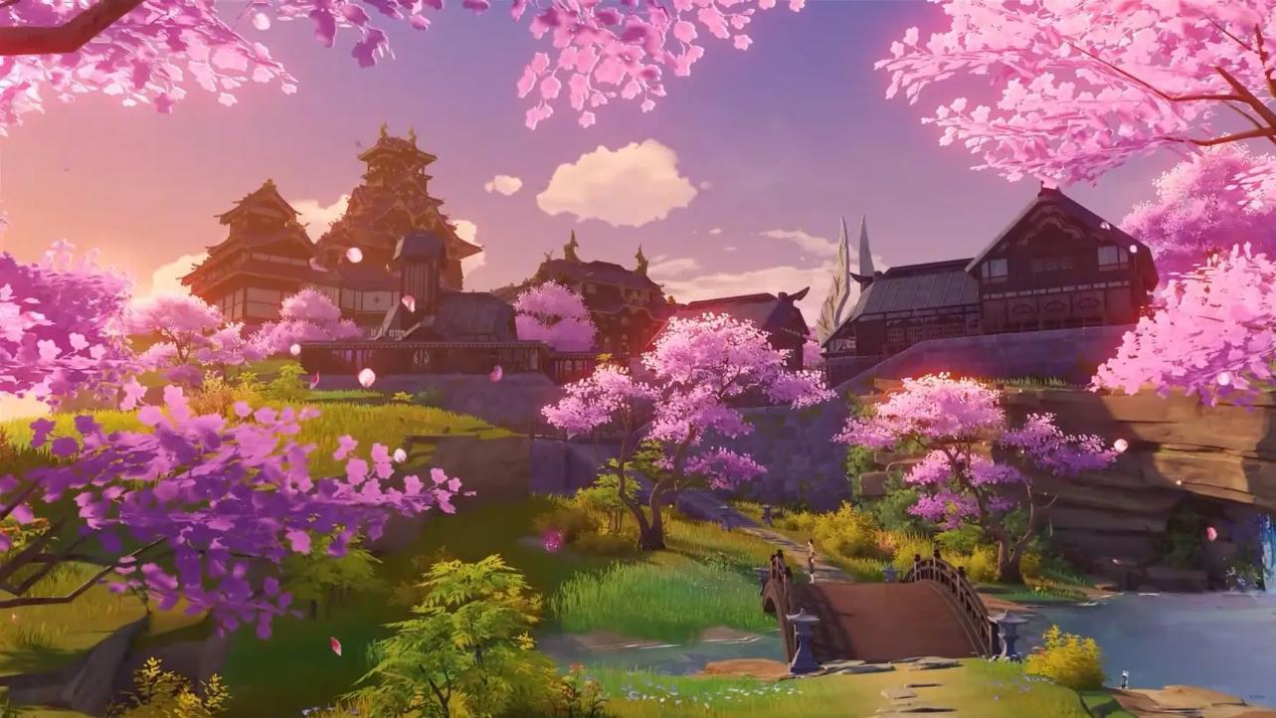
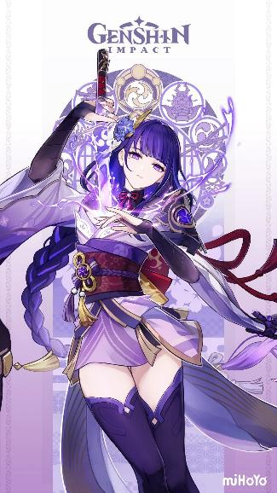

Inazuma
The Land of Eternity
Inazuma: the nation of eternity, ruled by the Electro Archon, Raiden Shogun
The Vision Hunt Decree orders the confiscation of Visions and isolates the nation
The Resistance, led by Kokomi, opposes the decree
The Shogun is revealed to be a puppet, and the real Archon, Ei, is hidden in the Plane of Euthymia
Ei sought eternity to avoid loss after her twin’s death
The Traveler convinces her to end the decree and lead Inazuma openly
Notes:
Inazuma is the nation of eternity, a chain of islands in the east of Teyvat, ruled by the Electro Archon, Raiden Shogun. The nation is closed off from the rest of the world under a sakoku decree, and the Shogun has also issued a Vision Hunt Decree, which orders the confiscation of Visions from the people. When the Traveler arrives, they are caught up in this conflict and meet Kamisato Ayaka and Thoma of the Kamisato Clan, who help them navigate the tense situation. The Traveler also meets the Resistance on Watatsumi Island, led by Sangonomiya Kokomi, who oppose the decree, and Yae Miko, the head priestess of the Grand Narukami Shrine, who works behind the scenes. The Traveler is eventually drawn into a confrontation with the Shogun. It is revealed that the Shogun ruling Inazuma is actually a puppet, while the real Archon, Ei, remains in a hidden realm called the Plane of Euthymia. Ei lost her twin sister Makoto long ago and, in her grief, sought to preserve Inazuma in a state of eternity, free from change and loss. The Traveler fights her and convinces her to reconsider. In the end, Ei ends the Vision Hunt Decree and the isolation of Inazuma, and decides to lead the nation herself, in a more open way. The story also includes the Fatui’s Scaramouche, who takes the Gnosis and betrays the group, and the Traveler continues the journey to find their lost twin.

Slide 8
Inazuma
“Individual ambition is inherently incompatible with eternity. What you might not realize is that all too often... people have far more to lose by chasing their dreams. Consider this — no one will lose their life on account of having their Vision taken away... Rather, those who have lost their lives are the ones who insisted on pursuing their own aspirations, are they not?”
Notes:
For most of Inazuma’s history, Ei defined eternity as keeping everything exactly as it was. After losing her twin sister Makoto and watching friends and allies fall in the Archon War, she concluded that change is what causes loss. In her view, human progress, development, and modernization would only lead to more of it. So she shut Inazuma off from the world, issued the Vision Hunt Decree, and tried to freeze the nation in place, protecting it by stopping it from changing at all. By the end of the Archon Quest, she has come to see this differently. She realizes that preserving a people by stopping their growth is not protection, and that impermanence is part of what gives life its meaning. She now embraces transience, accepting that people will change, grow, and eventually pass on, and that this is not something to be feared. Eternity no longer means keeping things unchanged. It means carrying forward what matters, like her memories and the bonds she has shared, while letting the future move ahead on its own.

Slide 9
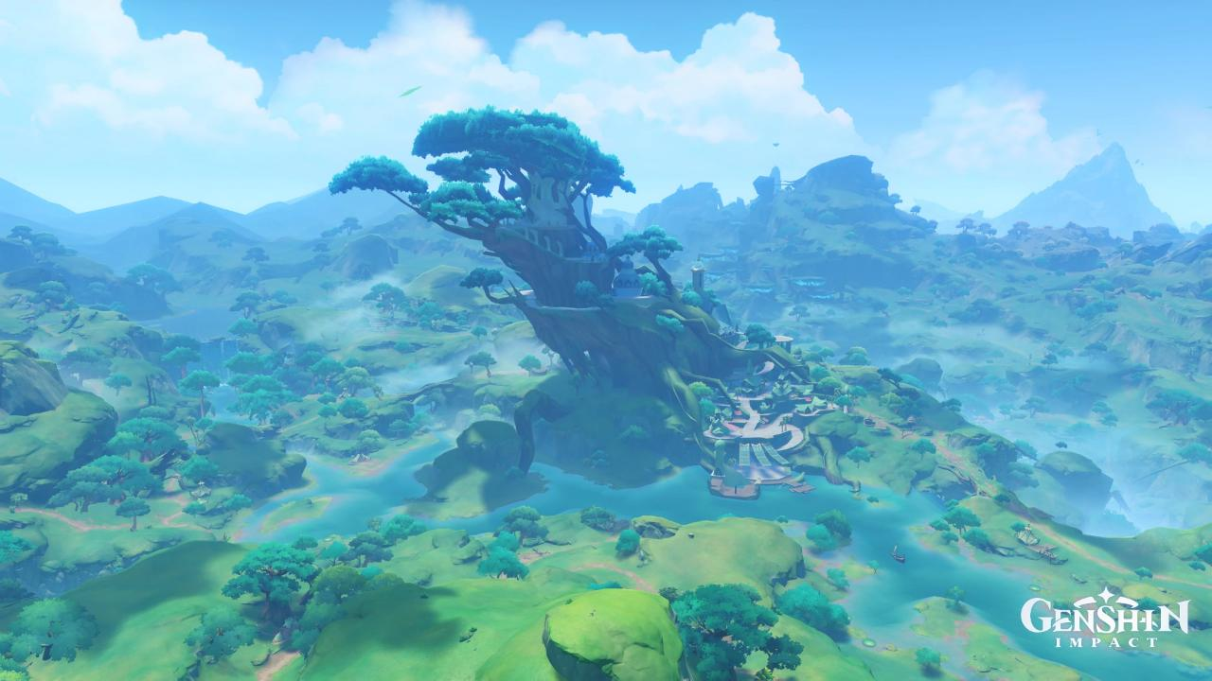

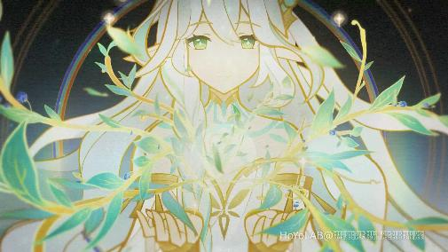
Sumeru
The Land of Wisdom
Sumeru: the nation of wisdom, ruled by the Dendro Archon, Nahida
The Akademiya and its Sages run the nation’s scholarship and have confined Nahida
Akasha is a knowledge system meant to replace the Archon’s guidance
The Traveler frees Nahida and uncovers a plot involving the Fatui
Nahida takes back her role and leads Sumeru directly
Notes:
Sumeru is the nation of wisdom, a land of rainforests and deserts in the southwest of Teyvat, ruled by the Dendro Archon, Nahida, also known as Lesser Lord Kusanali. Its center of learning is the Akademiya, a scholarly institution led by a group of Sages under Grand Sage Azar. The story starts with her predecessor, the Greater Lord Rukkhadevata, who set up the Akademiya to help govern Sumeru and created the Akasha, a system that moves knowledge through dreams. After Rukkhadevata was gone, Nahida was born as the new Archon, but the Sages did not trust her and considered her inferior to her predecessor. They confined her to the Sanctuary of Surasthana, forced her to keep the Akasha running, and deliberately reduced her public presence. To the people of Sumeru, she was barely a god at all, and the Akademiya ran the nation in her place. Their real plan was to replace her. The Sages wanted to turn Scaramouche, now known as the Wanderer, into a new god, one made by the Akademiya instead of born as an Archon. To speed that plan up, they harvested the dreams of Sumeru’s people through the Akasha, trapping them in an endless loop. This is why the Sabzeruz Festival keeps repeating when the Traveler arrives. It looks like a time loop, but it is not. Everyone’s memory is erased each day, so they wrongly believe time is stuck on the festival. Nahida, still locked in the sanctuary, reaches out to the Traveler through dreams and helps them escape the repeating dream. With allies like Tighnari, Cyno, Nilou, Dehya, and Alhaitham, the Traveler works to free her and uncovers the Fatui’s role in the plot, including the Harbinger Dottore. In the end, the Traveler and Nahida’s allies free her and defeat the false god the Sages created, and Nahida takes her place as the true leader of Sumeru.

Slide 10
Sumeru
Life has always been the end, while it is wisdom that shall be the means.
There is no single answer to wisdom because disagreement and divergence form its foundation. Views differ, and without these differences, wisdom cannot exist.

Slide 11
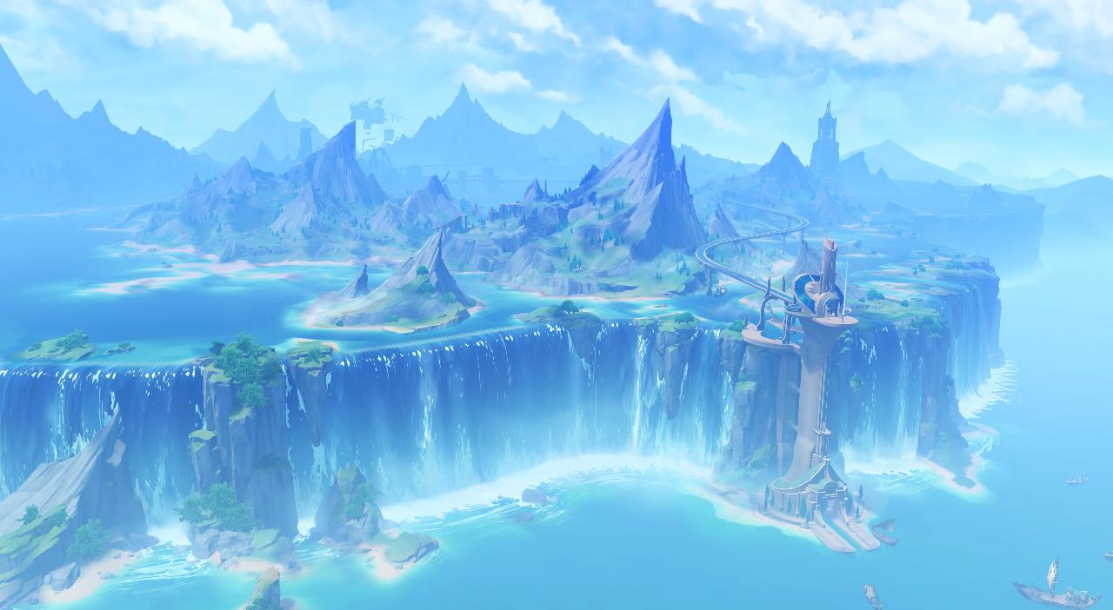
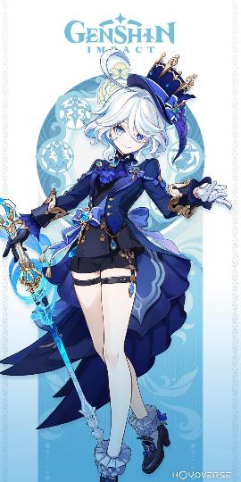
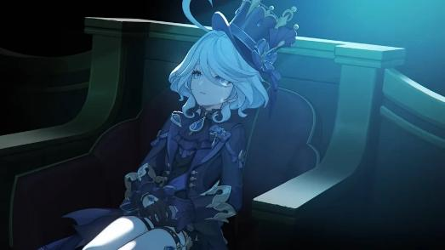
Fontaine
The Land of Justice
Notes:
Fontaine is the nation of justice, a land of water and courts in the northwest of Teyvat, where trials are a major part of public life. It is led by the Hydro Archon, Furina, who is famous for her dramatic personality and the grand trials she presides over, alongside the Iudex, Neuvillette. Fontaine also lives under an ancient prophecy that its people will dissolve into the Primordial Sea. When the Traveler arrives, young women across the nation are disappearing, and the Traveler is drawn into the case. The truth is disturbing. The people of Fontaine can dissolve, and a man named Vacher was dissolving women to find a way to bring his dissolved wife back. The case reveals that Primordial Seawater can dissolve Fontaine’s people, which makes the prophecy feel real. It also leads to the biggest secret in the story. Furina is not the real Hydro Archon. The true Archon is Focalors, who separated her divinity and humanity around 500 years before the events of the game, leaving Furina as her human half in order to outsmart the Heavenly Principles. Focalors then tasked Furina with pretending to be the god for 500 years. Furina had no real power, but she had to act like an all-knowing Archon in front of the whole nation, with no one to tell the truth to. In the end, Focalors sacrifices herself, her power passes to Neuvillette, and Furina is freed to live as an ordinary person.

Slide 12
Fontaine
If there were scales, with all the people of Fontaine on one side, and my pain on the other... Is it not obvious where the scales should tilt?
The scales of justice should not weigh heavy in the hands of its god.
Notes:
The line says justice shouldn’t depend on the will or authority of a god. The “scales of justice” are the fair weighing of evidence, and if a god’s power tips them, they stop being fair. Justice works best when it belongs to the people and rests on evidence and reason. A god’s judgment shouldn’t weigh more than anyone else’s.
The Traveler and Paimon find Furina in Poisson, where she's distressed about the prophecy and the people who have died.
The Traveler convinces her to open up privately, saying they're an outsider to Teyvat and can act as a neutral "witness."
Furina begins to lower her guard and considers revealing what she's been hiding.
Suddenly, the house collapses and reveals itself to be an elaborate stage setup inside the Opera Epiclese!
The Traveler, Navia, Lyney, and the others have orchestrated the entire situation to bring Furina before a public trial.
The Traveler even gives Furina one last opportunity to confess privately before the trial begins. But she refuses.
The Traveler then accuses her of being a fraud who isn't actually the Hydro Archon.

Slide 13
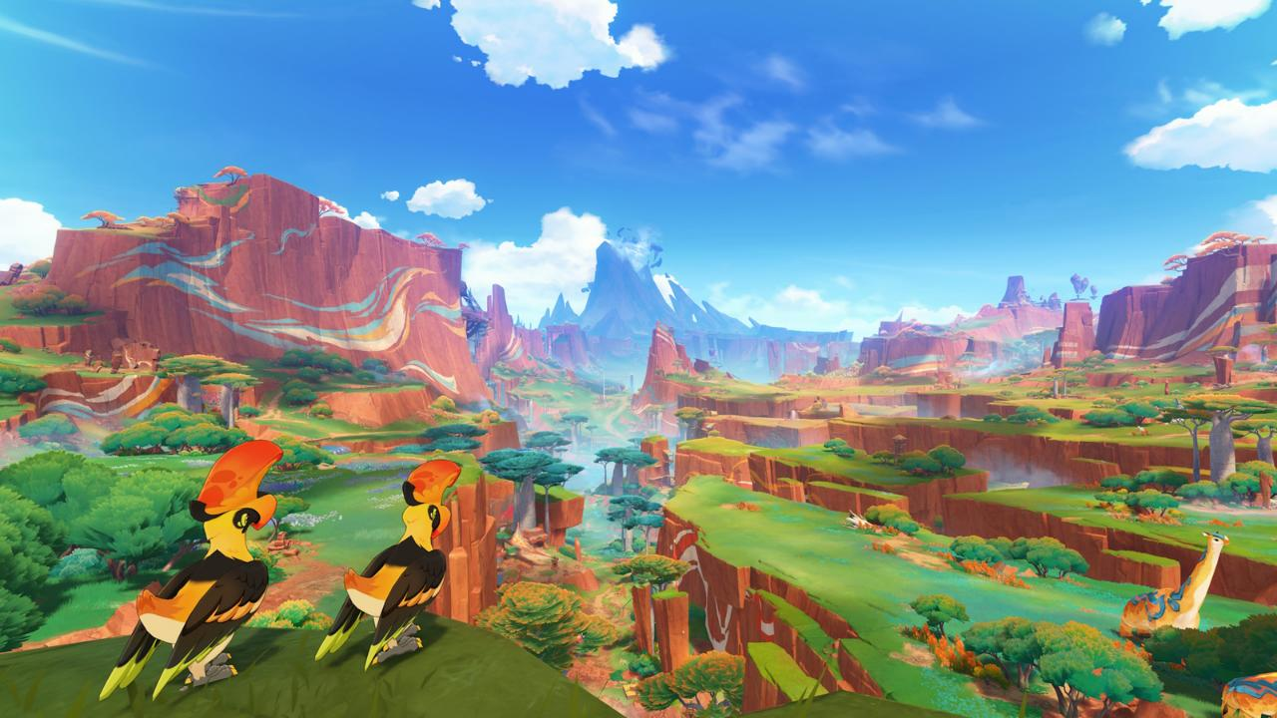
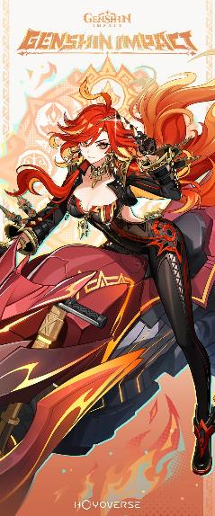
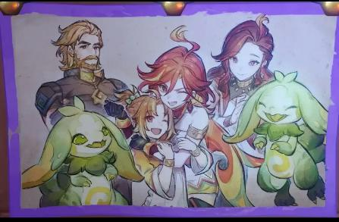
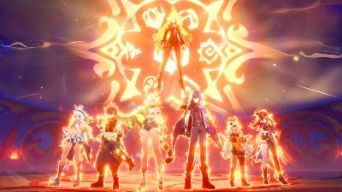
Natlan
The Nation of War
Natlan: the nation of war, heavily contaminated by the Abyss and facing destruction
Ruled by the Pyro Archon, Mavuika, who was actually born 500 years ago
She sacrificed her life to the Sacred Flame to be reborn when the crisis peaked
Her plan: gather heroes from the tribes and defeat the Abyss for good
The Traveler and Mavuika defeat it in the Night Kingdom
Notes:
Natlan is the nation of war, a land of fire and volcanic terrain inspired by Mesoamerican cultures, made up of several tribes. It is ruled by the Pyro Archon, Mavuika. When the Traveler arrives, Natlan is heavily contaminated by the Abyss and is on the brink of complete destruction. Its tribes keep their fighting spirit alive through the Pilgrimage, a series of contests, but the Abyss is still eroding the nation underneath. Mavuika then reveals her secret: she was born 500 years ago. She served as Pyro Archon during the ancient Cataclysm, fighting the Abyss Order alongside Natlan’s original heroes. She realized that Natlan could not win a prolonged war in her own era. Even if they defeated the Abyss on the surface, Natlan would be destroyed 500 years later by the Abyss taking over the Night Kingdom. So she made a plan. She sacrificed her life by entering the Sacred Flame, and 500 years later she was resurrected and continued her plan. The goal was to return when the crisis would reach its peak, gather heroes from the tribes, and finally defeat the Abyss for good. The Traveler helps her unite the tribes, while the Fatui, led by Capitano, also become involved. The story ends in the Night Kingdom, where the Traveler and Mavuika face the Heart of the Abyss, Gosoythoth. During the final fight, the Traveler unlocks their Pyro resonance. The Abyss is defeated, and the Traveler continues the search for their lost twin.

Slide 14
Natlan
The future is not something we wait for. It is something we fight for.
Even if the future ends in destruction, that's still no reason to give up on the here and now. And it's precisely because we humans cannot know our fate that we will never give up on our struggle.

Slide 15
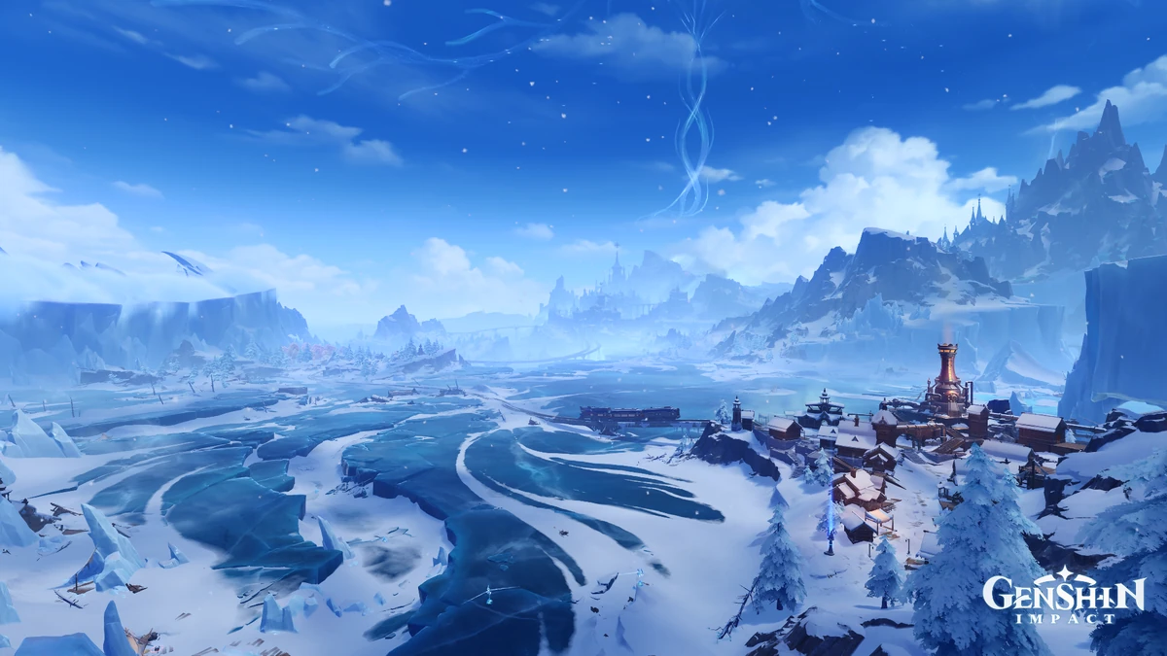

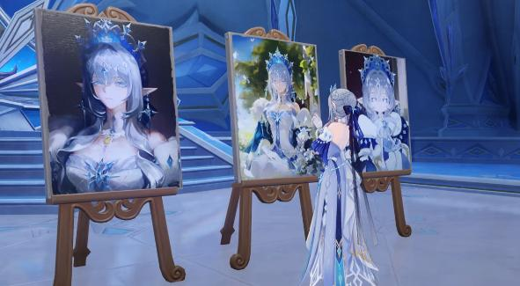
Snezhnaya
The Land of Love
World is ending in 42 days!!! :D
Archons were cursed with a love for humanity, but she doesn’t believe it’s true love because she is only allowed to love those Celestia deems worthy
Snezhnaya: the frozen nation of the Cryo Archon, the Tsaritsa, home of the Fatui
She once served the Belyi Tsar, the original Cryo Archon
The Heavenly Principles erased her existence, then revived her without her memories of the Third Descender
She calls divine love a curse imposed from above
Her Fatui collect the Gnoses to challenge the Heavenly Principles (Celestia)
Notes:
Snezhnaya is the frozen nation in the far north of Teyvat, ruled by the Cryo Archon, the Tsaritsa, whose name is Anastasya. It is the home of the Fatui, who have opposed the Traveler since the first nation. For most of the story, the Tsaritsa stays out of sight, collecting the Gnoses of the other Archons through her Harbingers. When the Traveler finally meets her, they learn the reason behind her plan, and it begins with her past. Before she became Archon, she served the Belyi Tsar, the original Cryo Archon. According to Rhinedottir’s account, the Tsar incited her and a figure called the Third Descender to open the gates of the Abyss. This caused thousands of years of disaster, and the Heavenly Principles punished her by erasing her existence. The Tsar fled to the Shadow Realm and was never pursued. The Third Descender ascended to Celestia and offered his own life to bring her back, on the condition that his descendants, later known as Khaenri’ahns, would never be harmed. The Tsaritsa was revived, but the Heavenly Principles erased only the Third Descender and every memory of him. This explains much of her story. She is shown to distrust the love that gods are supposed to feel for humanity, calling it a curse laid down by the Heavenly Principles. It also explains her war. The Fatui, under her orders, are working to challenge the divine hierarchy of the Heavenly Principles. The story is ongoing, and what the Tsaritsa will do with the Gnoses is still being revealed.

Slide 16
Snezhnaya
And then… the Heavenly Principles spoiled our love. I almost doubt whether it was ever true at all. One should not throw fragile driftwood to a drowning person nor give the illusion of warmth to those freezing to death. Death is not the enemy of love. The real enemy is the blessings given by deluded gods.
By your design, Love is a force that dispels curses afflicting the world and maintains Teyvat's stability. Yet this power lies under strict limitations. I can only remove such curses as you did not beget. I must turn a blind eye to those you impose. Yet this power lies under strict limitations. Love itself is one such curse. You force me to forget its true nature. Instead, I may love only those whom you require. And yet, you would have me submit my interpretation of true Love, based solely on the love for humanity that you bestow upon me ...What sense could ever be made of this? (...) Then let us examine this so-called trial critically. You have inflicted the Holy Soil phenomenon upon Teyvat, releasing the wrath of the ancient fae. "If she still wields authority over love, she will surely dispel this wrath." What a means to prove one's love... First to inflict suffering, and then to seek its relief... Utterly absurd. Clearly, even you do not know what love is, Phanes. You hold the lives of all humanity ransom, and their homelands, and admire our desperate struggle to survive, all to test whether or not we will still obey... This is a desecration of love. You who have spoiled its meaning have no right to judge us in its name.
She declared war against the whole world only because she dreams of peace.

Slide 17
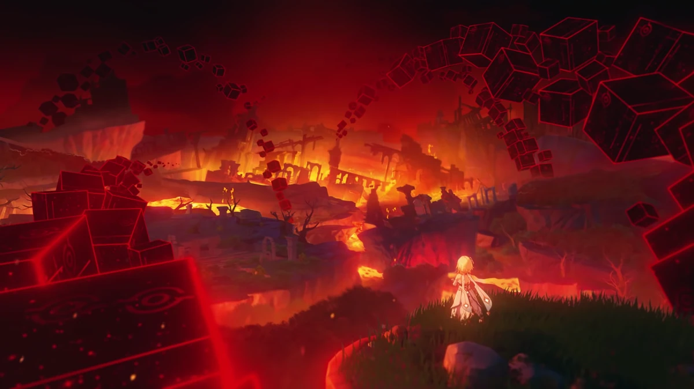
Conclusion
World is ending in 42 days!!!
Notes:
Celestia is the floating island above Teyvat and the higher power that rules over it. It’s led by a being called the Heavenly Principles, who sits above even the Archons. The Archons, the gods of each nation, won their positions in a war among gods, and Celestia backed them by giving them Gnoses, which are tied to their power. Celestia is also the source of Visions, which are given to people with strong ambition and let them use elemental energy. But Celestia keeps watch over everything, and it’s very controlling: it doesn’t want anyone interfering with its plans. That’s why it matters to our story. When my twin and I arrived in this world, a god from Celestia took them from me. So now I’m traveling through the nations of Teyvat, meeting the Archons and looking for them.

