Slide 1
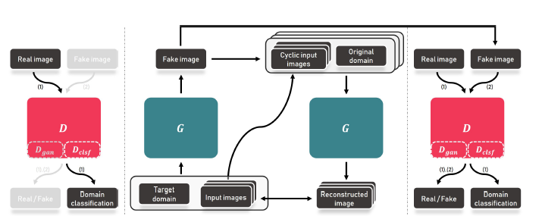
Structural Similarity Index loss
adversarial loss
domain classification loss
Multiple cycle consistency loss
Discriminator Loss

