Slide 1
Conventional Semantic Approaches
Grigore Rosu
CS522 – Programming Language Semantics

Slide 2
Conventional Semantic Approaches
A language designer should understand the existing design approaches, techniques and tools, to know what is possible and how, or to come up with better ones. This part of the course will cover the major PL semantic approaches, such as:
Big-step structural operational semantics (Big-step SOS)
Small-step structural operational semantics (Small-step SOS)
Denotational semantics
Modular structural operational semantics (Modular SOS)
Reduction semantics with evaluation contexts
Abstract Machines
The chemical abstract machine
Axiomatic semantics

Slide 3
IMP
A simple imperative language

Slide 4
IMP – A Simple Imperative Language
We will exemplify the conventional semantic approaches by means of IMP, a very simple non-procedural imperative language, with
Arithmetic expressions
Boolean expressions
Assignment statements
Conditional statements
While loop statements
Blocks

Slide 5
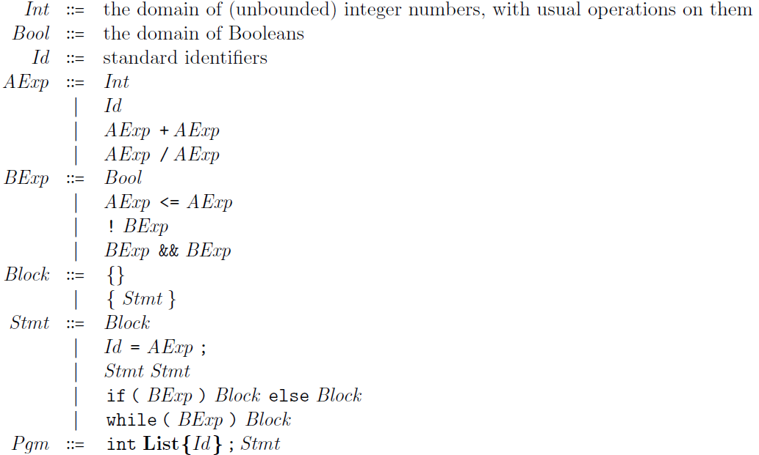
IMP Syntax
Suppose that, for demonstration
purposes, we want “+” and “/”
to be non-deterministically strict,
“<=“ to be sequentially strict,
and “&&” to be short-circuited
Comma-separated list of identifiers

Slide 6



IMP State
Most semantics need some notion of state. A state holds all the semantic ingredients to fully define the meaning of a given program or fragment of program.
For IMP, a state is a partial finite-domain function from identifiers to integers (i.e., a function defined only on a finite subset of identifiers and undefined on the rest), written using a half-arrow:
We let State denote the set of such functions, and may write it
or

Slide 7



Lookup, Update and Initialization
We may write states by enumerating each identifier binding. For example, the following state binds x to 8 and y to 0:
Typical state operations are lookup, update and initialization
Lookup
Update
Initialization
σ =

Slide 8
Big-Step SOS
Big-step structural operational semantics

Slide 9







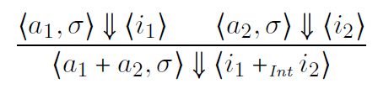
Big-Step Structural Operational Semantics (Big-Step SOS)
Gilles Kahn (1987), under the name natural semantics. Also known as relational semantics, or evaluation semantics. We can regard a big-step SOS as a recursive interpreter, telling for a fragment of code and state what it evaluates to.
Configuration: tuple containing code and semantic ingredients
E.g.,
Sequent: Pair of configurations, to be derived or proved
E.g.,
Rule: Tells how to derive a sequent from others
E.g.,
Read “evaluates to”
Premises
May omit line when no premises
Conclusion

Slide 10



Big-Step SOS of IMP - Arithmetic
State lookup
Read: “provided that a₁ evaluates to i₁ in σ and a₂ evaluates to i₂ in σ , then a₁ + a₂ evaluates to the integer sum of i₁ and i₂ in σ
Side condition ensures rule will never apply when a₂ evaluates to 0

Slide 11
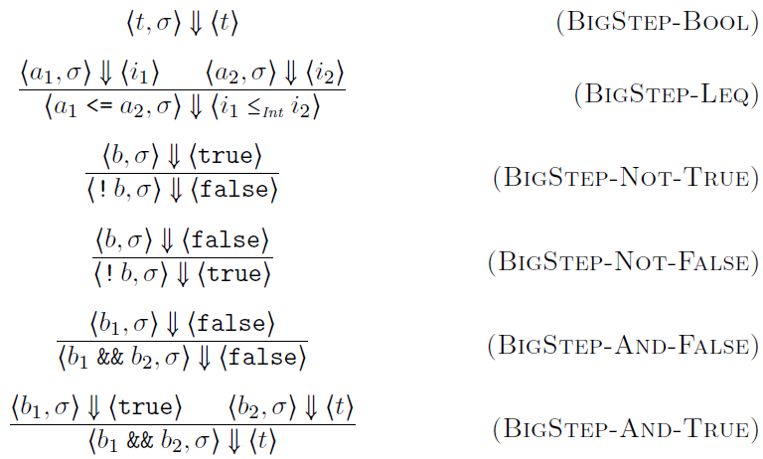
Big-Step SOS of IMP - Boolean

Slide 12
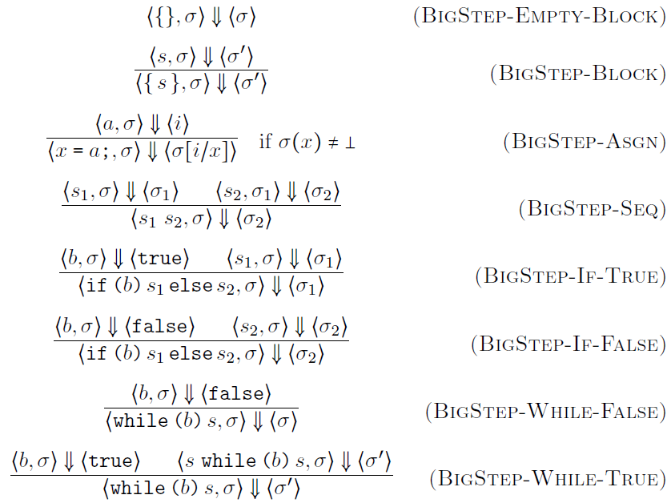
Big-Step SOS of IMP - Statements
State update

Slide 13

Big-Step SOS of IMP - Programs
State initialization

Slide 14



Big-Step Rule Instances
Rules are schemas, allowing recursively enumerable many instances; side conditions filter out instances
E.g., these are correct instances of the rule for division
The second may look suspicious, but it is not. Normally, one should never be able to apply it, because one cannot prove its hypotheses
However, the following is not a correct instance (no matter what ? is):

Slide 15

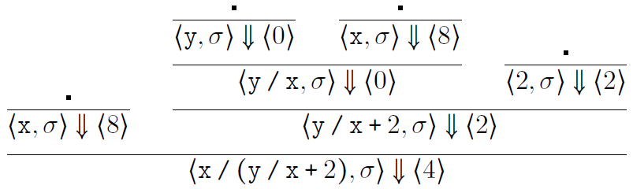

Big-Step SOS Derivation
The following is a valid proof derivation, or proof tree, using the
big-step SOS proof system of IMP above.
Suppose that x and y are identifiers and σ (x) = 8 and σ (y) = 0.

Slide 16


Big-Step SOS for Type Systems
Big-Step SOS is routinely used to define type systems for programming languages
The idea is that a fragment of code c, in a given type environment Γ, can be assigned a certain type τ. We typically write
instead of
Since all variables in IMP have integer type, Γ can be replaced by a list of untyped variables in our case. In general, however, a type environment Γ contains typed variables, that is, pairs “x :τ”.

Slide 17
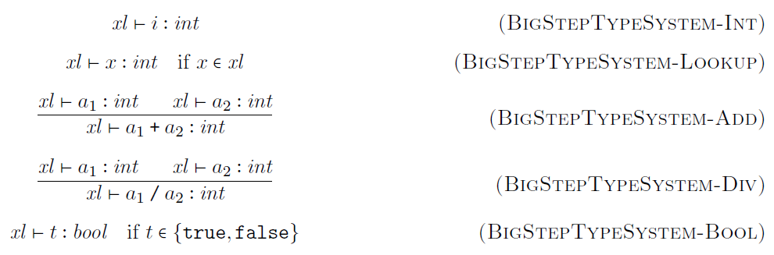
Typing Arithmetic Expressions

Slide 18
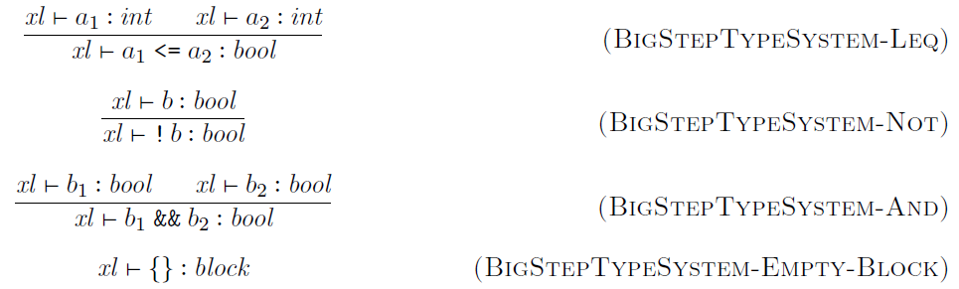
Typing Boolean Expressions

Slide 19
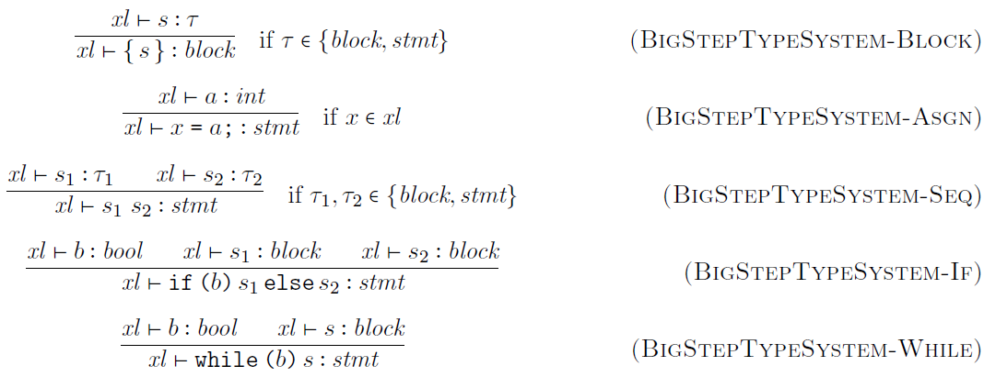
Typing Statements
The type of s can be either block or stmt

Slide 20
Typing Programs

Slide 21
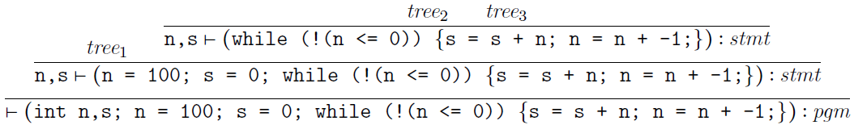
Big-Step SOS Type Derivation
Like the big-step rules for the concrete semantics of IMP, the ones for its type system are also rule schemas. We next show a proof derivation for the well-typed-ness of an IMP program that adds all the numbers from 1 to 100:
where

Slide 22
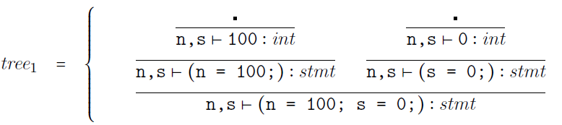
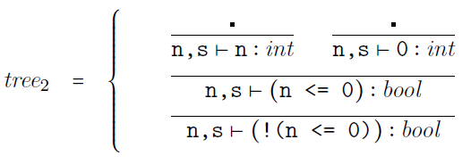
Big-Step SOS Type Derivation

Slide 23
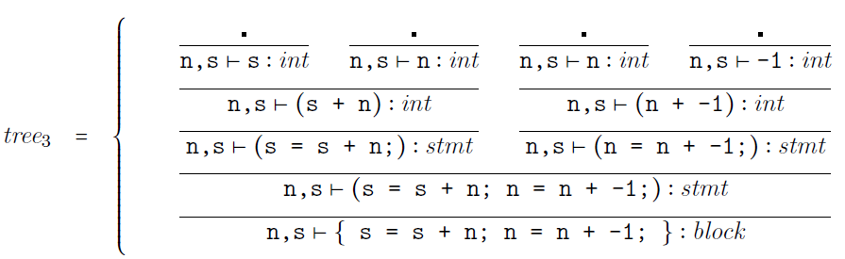
Big-Step SOS Type Derivation

Slide 24
small-Step SOS
Small-step structural operational semantics

Slide 25







Small-Step Structural Operational Semantics (Small-Step SOS)
Gordon Plotkin (1981)
Also known as transitional semantics, or reduction semantics
One can regard a small-step SOS as a device capable of executing a program step-by-step
Configuration: tuple containing code and semantic ingredients
E.g.,
Sequent (transition): Pair of configurations, to be derived (proved)
E.g.,
Rule: Tells how to derive a sequent from others
E.g.,

Slide 26
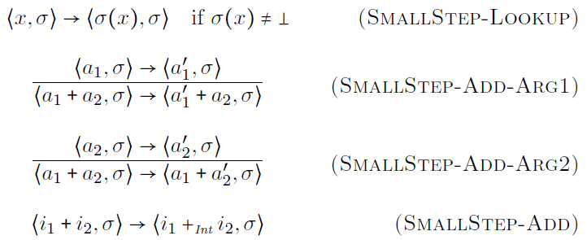
Small-Step SOS of IMP - Arithmetic
State lookup
+ is non-deterministic (its arguments can evaluate in any order, and interleaved

Slide 27
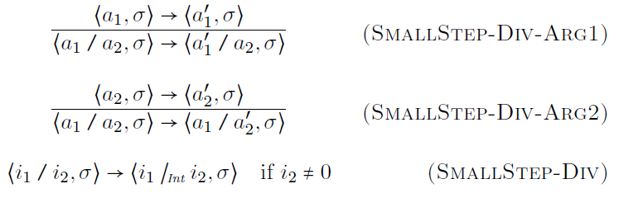
Small-Step SOS of IMP - Arithmetic
Side condition ensures rule will never apply when denominator is 0
/ is also non-deterministic

Slide 28
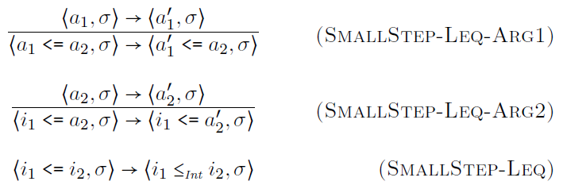
Small-Step SOS of IMP - Boolean
Ensures sequential strictness

Slide 29
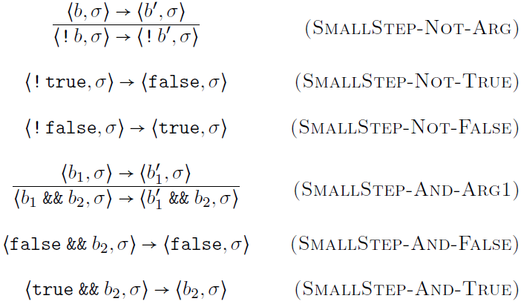
Small-Step SOS of IMP - Boolean
Short-circuit
semantics

Slide 30
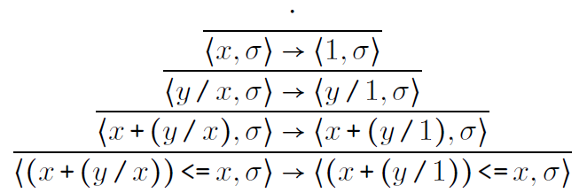

Small-Step SOS Derivation
The following is a valid proof derivation, or proof tree, using the
small-step SOS proof system for expressions of IMP above.
Suppose that x and y are identifiers and σ(x)=1.

Slide 31
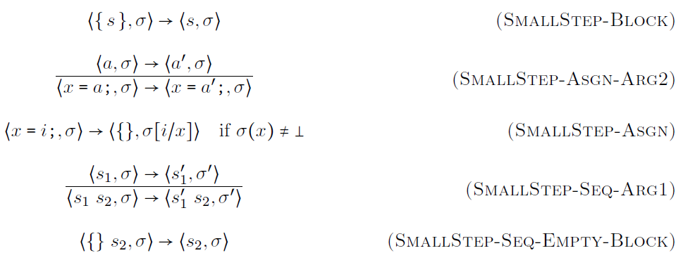
Small-Step SOS of IMP - Statements
State update

Slide 32
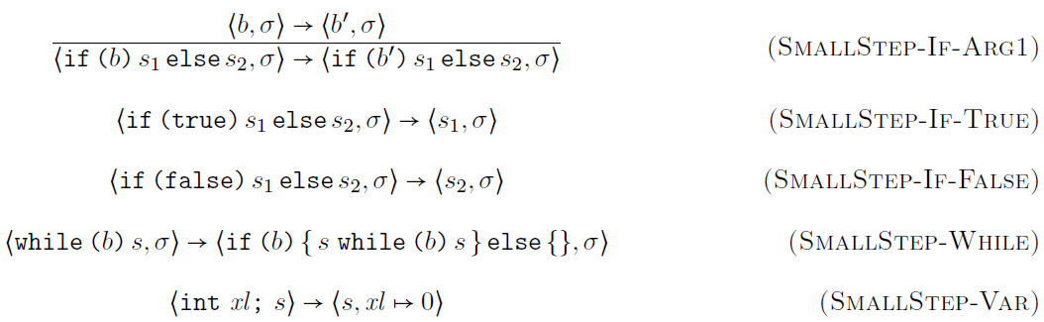
Small-Step SOS of IMP - Statements
State initialization

Slide 33
Small-Step SOS in Rewriting Logic
Any small-step SOS can be associated a rewrite logic theory (or, equivalently, a Maude module)
The idea is to associate to each small-step SOS rule
a rewrite rule
(the circle means “ready for one step”)

Slide 34
Denotational
Denotational or fixed-point semantics

Slide 35

Denotational Semantics
Christopher Strachey and Dana Scott (1970)
Associate denotation, or meaning, to (fragments of) programs into mathematical domains; for example,
The denotation of an arithmetic expression in IMP is a partial function from states to integer numbers
The denotation of a statement in IMP is a partial function from states to states

Slide 36
Denotational Semantics
Partial because some expressions may be undefined in some states (e.g., division by zero)
Partial because some expressions may be undefined in some states (e.g., division by zero)
Partial because some statements in some states may use undefined expressions, or may not terminate
Partial because some statements in some states may use undefined expressions, or may not terminate
Christopher Strachey and Dana Scott (1970)
Associate denotation, or meaning, to (fragments of) programs into mathematical domains; for example,
The denotation of an arithmetic expression in IMP is a partial function from states to integer numbers
The denotation of a statement in IMP is a partial function from states to states

Slide 37
Denotational Semantics - Terminology
Denotation
(function)
Denotation
(function)
Fragment of program
Fragment of program
Mathematical domain
Mathematical domain

Slide 38


Denotational Semantics - Compositional
Once the right mathematical domains are chosen, giving a denotational semantics to a language should be a straightforward and compositional process; e.g.
The hardest part is to give semantics to recursion. This is done using fixed-points.

Slide 39
Mathematical Domains
Mathematical domains can be anything; it is common though that they are organized as complete partial orders with bottom element
The partial order structure captures the intuition of informativeness: a ≤ b means a is less informative than b. E.g., as a loop is executed, we get more and more information about its semantics
Completeness means that chains of more and more informative elements have a limit
The bottom element, written ⊥, stands for undefined, or no information at all

Slide 40








Partial Orders
Partial order is set and binary rel. which is
Reflexive:
Transitive:
Anti-symmetric:
Total order = partial order with
Important example: domains of partial functions
iff defined everywhere is defined and
whenever is defined

Slide 41






(Least) Upper Bounds
An upper bound (u.b.) of is any element such that for any
The least upper bound (l.u.b.) of , written , is an upper bound with for any u.b.
When they exist, least upper bounds are unique
The domains of partial functions, , admit upper bounds and least upper bounds if and only if all the partial functions in the considered set are compatible: any two agree on any element in which both are defined

Slide 42





Complete Partial Orders (CPO)
A chain in is an infinite sequence
also written
Partial order is a complete partial order (CPO) iff any of its chains admits a least upper bound
is a bottomed CPO (BCPO) iff ⊥ is a minimal element of , also called its bottom
The domain of partial functions is a BCPO, where ⊥ is the partial function undefined everywhere

Slide 43







Monotone and Continuous Functions
monotone iff
implies
Monotone functions preserve chains:
chain implies chain
However, they do not always preserve l.u.b. of chains
continuous iff monotone and preserves l.u.b. of chains:
, the domain of continuous functions between two BCPOs, is itself a BCPO

Slide 44





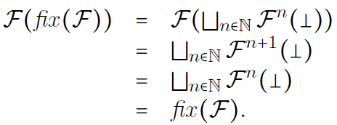
Fixed-Point Theorem
Let be a BCPO and
be a continuous function. Then the l.u.b. of the chain
is the least fixed-point of
Typically written
Proof sketch:

Slide 45
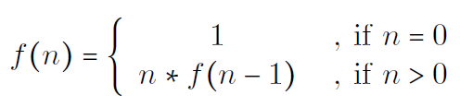

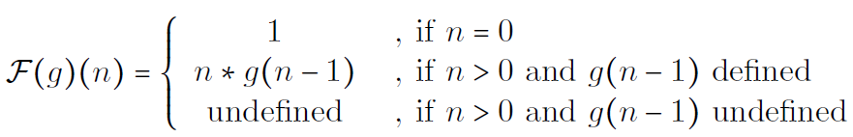
Applications of Fixed-Point Theorem
Consider the following “definition” of the factorial:
This is a recursive definition
Is it well-defined? Why?
Yes. Because it is the least fixed-point of the following continuous (prove it!) function from to itself

Slide 46
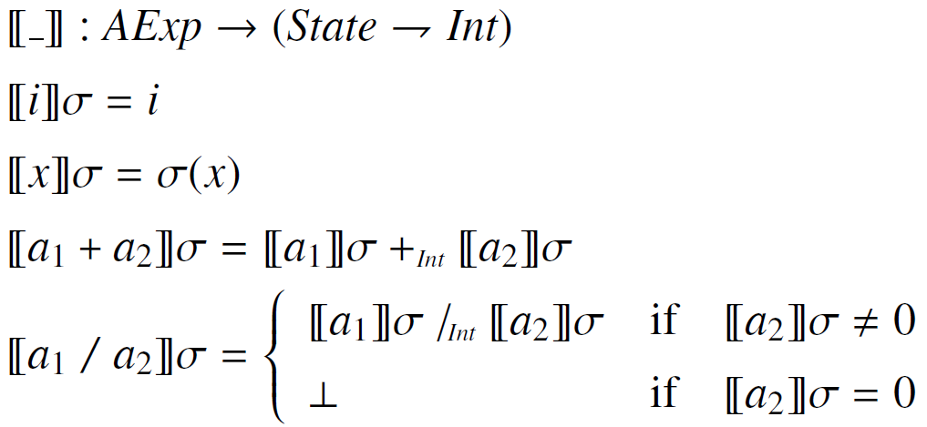
Denotational Semantics of IMP Arithmetic Expressions

Slide 47
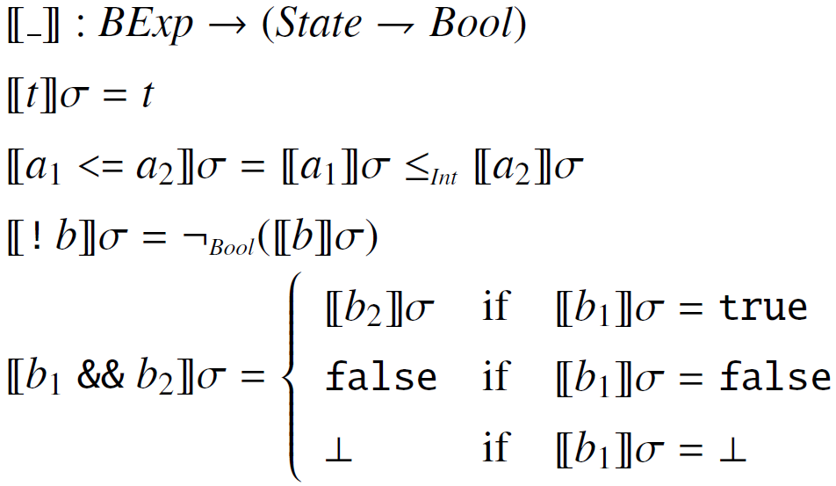
Denotational Semantics of IMP Boolean Expressions

Slide 48
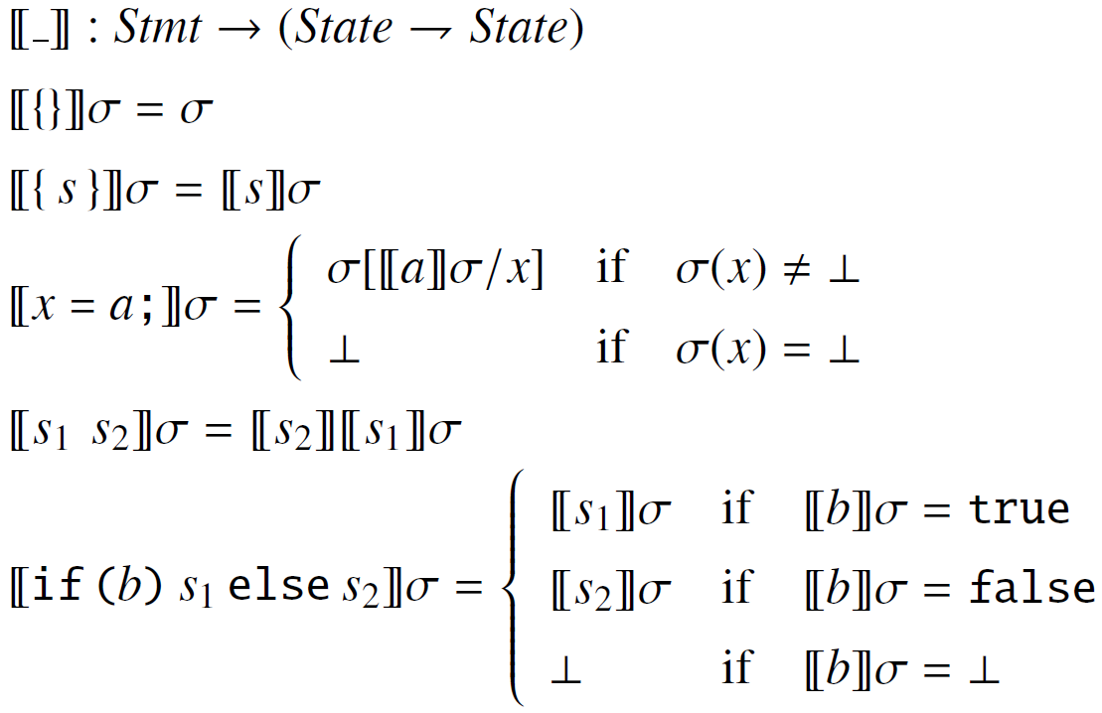
Denotational Semantics of IMP Statements (without loops)

Slide 49
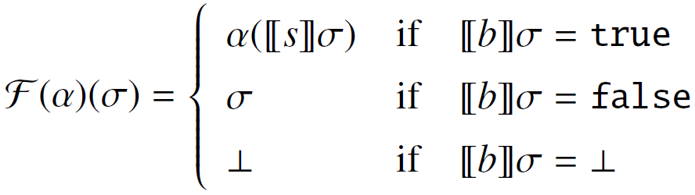

Denotational Semantics of IMP While
We first define a continuous function as follows
Then we define the denotational semantics of while

Slide 50
MSOS
Modular structural operational semantics

Slide 51
Modular Structural Operational Semantics (Modular SOS, or MSOS)
Peter Mosses (1999)
Addresses the non-modularity aspects of SOS
A definitional framework is non-modular when, in order to add a new feature to an existing language, one needs to revisit and change some of the already defined, unrelated language features
The non-modularity of SOS becomes clear when we define IMP++
Why modularity is important
Modifying existing rules when new rules are added is error prone
When experimenting with language design, one needs to make changes quickly; having to do unrelated changes slows us down
Rapid language development, e.g., domain-specific languages

Slide 52
Philosophy of MSOS
Separate the syntax from configurations and treat it differently
Transitions go from syntax to syntax, hiding the other configuration components into transition labels
Labels encode all the non-syntactic configuration changes
Specialized notation in transition labels, to
Say that certain configuration components stay unchanged
Say that certain configuration changes are propagated from the premise to the conclusion of a rule

Slide 53

MSOS Transitions
An MSOS transition has the form
P and P’ are programs or fragments of program
Δ is a label describing the changes in the configuration components, defined as a record; primed fields stay for “after” the transition
Example:
This rule can be automatically “desugared” into the SOS rule
But also into (if the configuration contains more components, like in IMP++)

Slide 54
MSOS Labels
Labels are field assignments, or records, and can use “…” for “and so on”, called record comprehension
Fields can be primed or not.
Unprimed = configuration component before the transition is applied
Primed = configuration component after the transition is applied
Some fields appear both unprimed and primed (called read-write), while others appear only primed (called write-only) or only unprimed (called read-only)

Slide 55

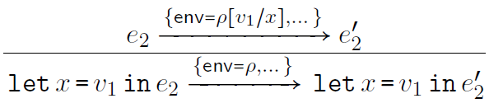
MSOS Labels
Field types
Read/write = fields which appear both unprimed and unprimed
Write-only = fields which appear only primed
Read –only = fields which appear only unprimed

Slide 56
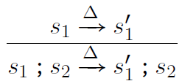

MSOS Rules
Like in SOS, but using MSOS transitions as sequents
Same labels or parts of them can be used multiple times in a rule
Example:
Same Δ means that changes propagate from premise to conclusion
The author of MSOS now promotes a simplifying notation
If the premise and the conclusion repeat the same label or part of it, simply drop that label or part of it. For example:

Slide 57
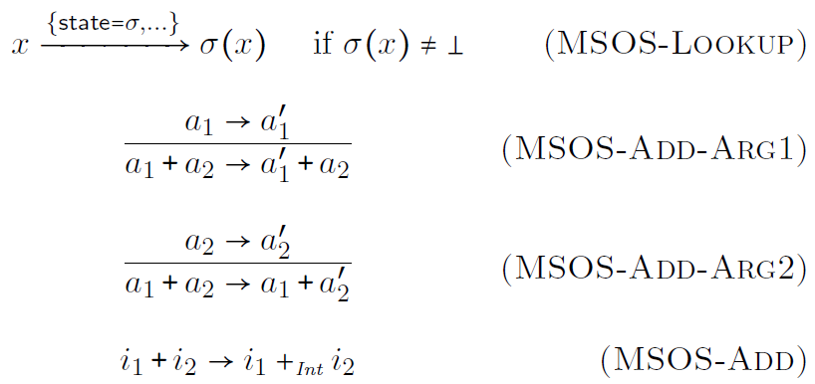
MSOS of IMP - Arithmetic
State
lookup

Slide 58
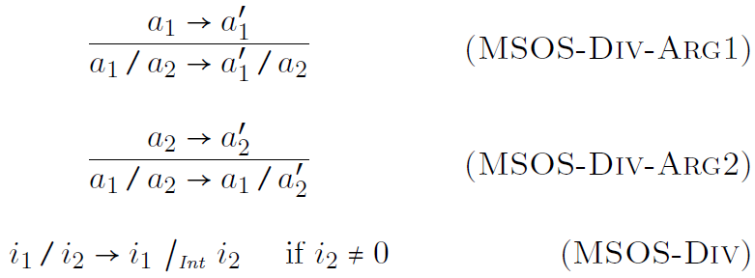
MSOS of IMP - Arithmetic

Slide 59
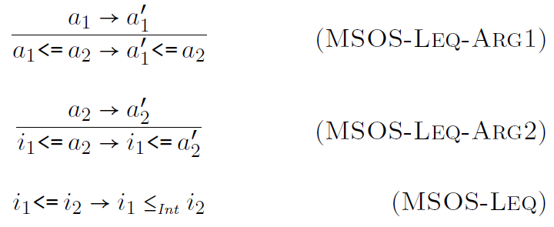
MSOS of IMP - Boolean

Slide 60
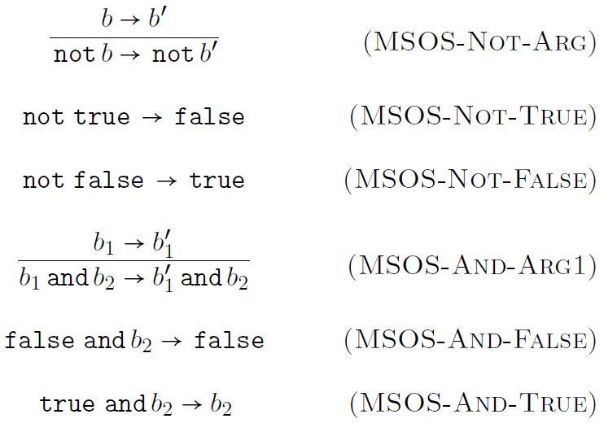
MSOS of IMP - Boolean

Slide 61
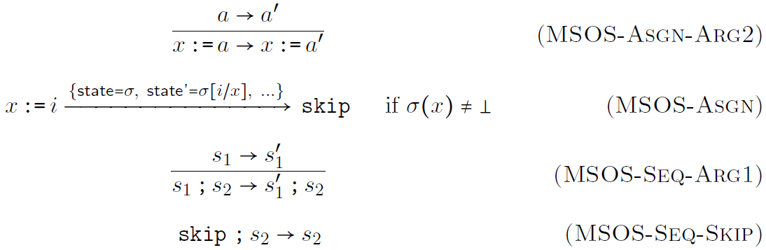
MSOS of IMP - Statements

Slide 62
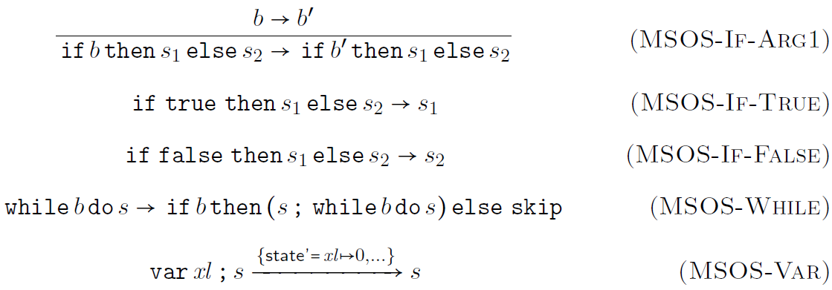
MSOS of IMP - Statements

Slide 63
RSEC
Reduction semantics with evaluation contexts

Slide 64
Reduction Semantics with Evaluation Contexts (RSEC)
Matthias Felleisen and collaborators (1992)
Previous operational approaches encoded the program execution context as a proof context, by means of rule conditions or premises
This has a series of advantages, but makes it hard to define control intensive features, such as abrupt termination, exceptions, call/cc, etc.
We would like to have the execution context explicit, so that we can easily save it, change it, or even delete it
Reduction semantics with evaluation contexts does precisely that
It allows to formally define evaluation contexts
Rules become mostly unconditional
Reductions can only happen “in context”

Slide 65
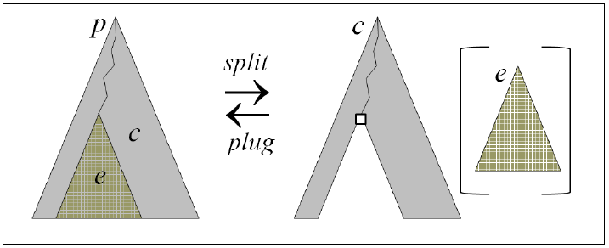

Splitting and Plugging
RSEC relies on reversible implicit mechanisms to
Split syntax into an evaluation context and a redex
Plug a redex into an evaluation contexts and obtain syntax again

Slide 66
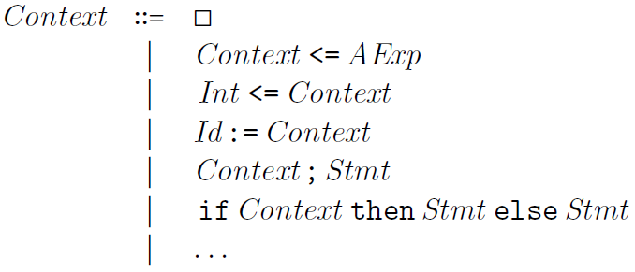
Evaluation Contexts
Evaluation contexts are typically defined by the same means that we use to define the language syntax, that is, grammars
The hole  represents the place where redex is to be plugged
Example:

Slide 67
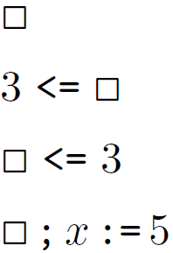

Correct Evaluation Contexts

Slide 68
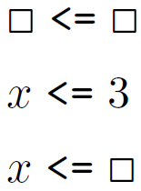


Wrong Evaluation Contexts

Slide 69




Splitting/Plugging of Syntax

Slide 70
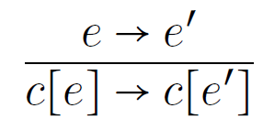
Characteristic Rule of RSEC
The characteristic rule of RSEC allows us to only define semantic rules stating how redexes are reduced
This significantly reduces the number of rules
The semantic rules are mostly unconditional (no premises)
The overall result is a semantics which is compact and easy to read and understand

Slide 71
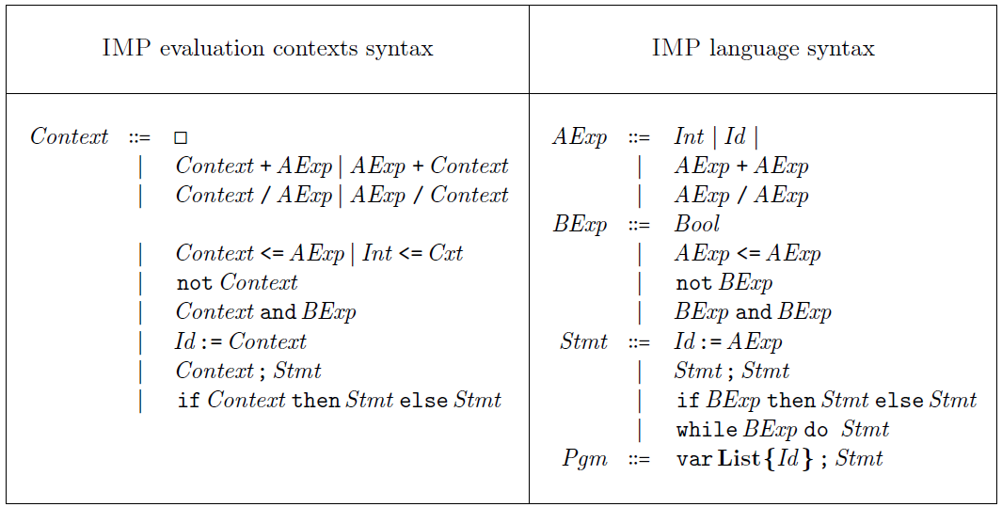
RSEC of IMP – Evaluation Contexts

Slide 72
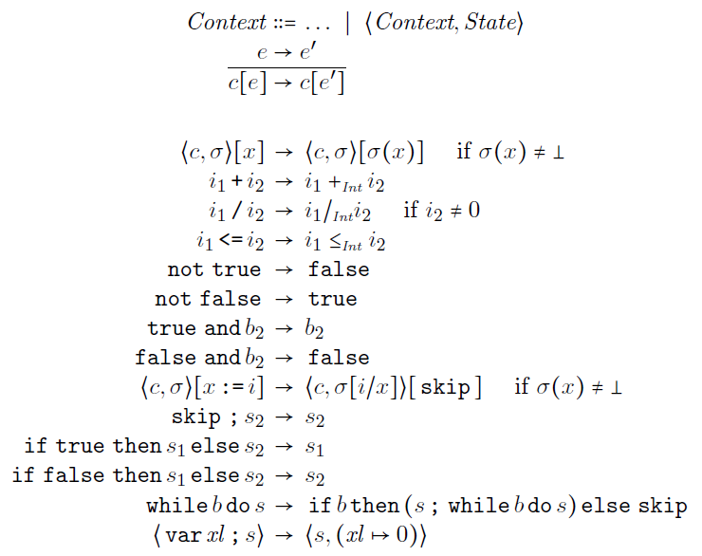
RSEC of IMP – Rules

Slide 73
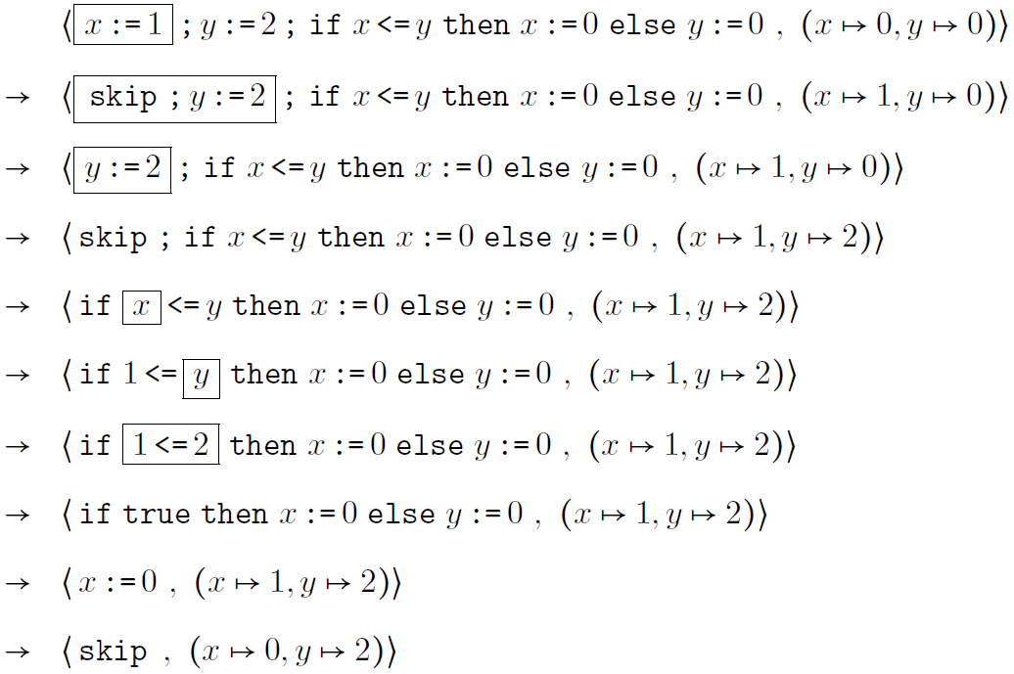
RSEC Derivation

Slide 74
CHAM
The chemical abstract machine

Slide 75

The Chemical Abstract Machine (CHAM)
Berry and Boudol (1992)
Both a model of concurrency and a specific semantic style
Chemical metaphor
States regarded as chemical solutions containing floating molecules
Molecules can interact with each other by means of reactions
Reactions take place concurrently, unrestricted by context
Solutions are encapsulated within new molecules, using membranes
The following is a solution containing k molecules:

Slide 76


CHAM Syntax and Rules
Airlock

Slide 77

CHAM Rules
Ordinary rewrite rules between solution terms:
Rewriting takes place only within solutions
Three (metaphoric) kinds of rules
Heating rules using : structurally rearrange solution
Cooling rules using : clean up solution after reactions
Reaction rules using : change solution irreversibly

Slide 78

CHAM Airlock
Allows to extract molecules from encapsulated solutions
Governed by two rules coming in a heating/cooling pair:

Slide 79

CHAM Molecule Configuration for IMP
A top-level solution containing two subsolution molecules
One for holding the syntax
Another for holding the state
Example:
Syntax
State

Slide 80
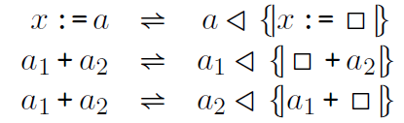


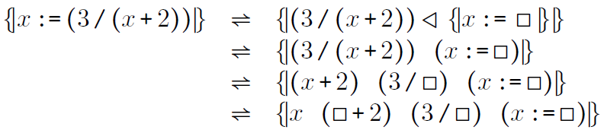
Airlock can be Problematic
Airlock cannot be used to encode evaluation strategies; heating/cooling rules of the form
are problematic, because they yield ambiguity, e.g.,

Slide 81



Correct Representation of Syntax
Other attempts fail, too (see the lecture notes)
We need some mechanism which is not based on airlocks
We borrow the representation approach of K
Term represented as
Can be achieved using heating/cooling rules of the form

Slide 82
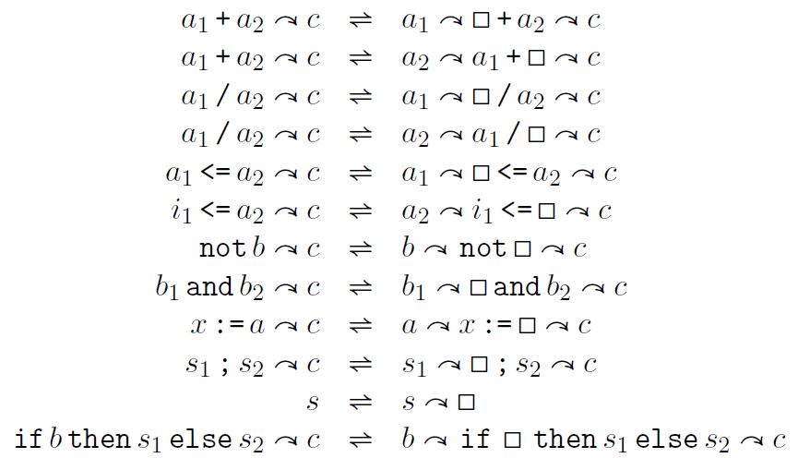
CHAM Heating-Cooling Rules for IMP

Slide 83



Examples of Syntax Heating/Cooling
The following is correct heating/cooling of syntax:
The following is incorrect heating/cooling of syntax:

Slide 84
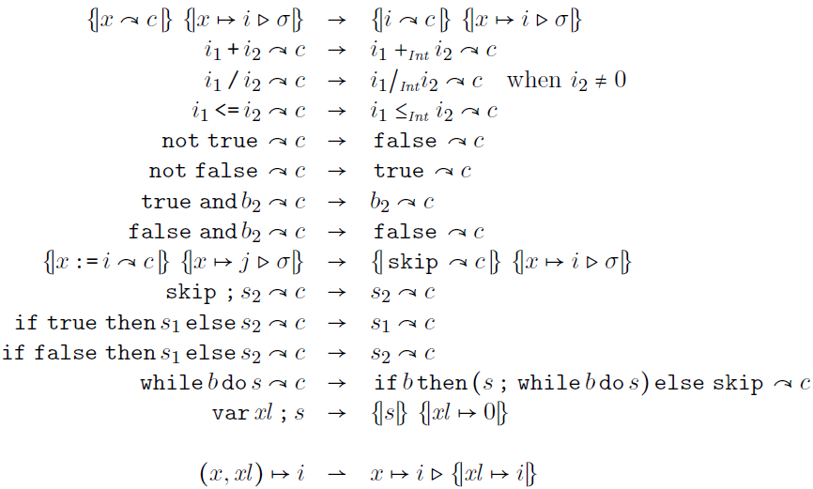
CHAM Reaction Rules for IMP

Slide 85
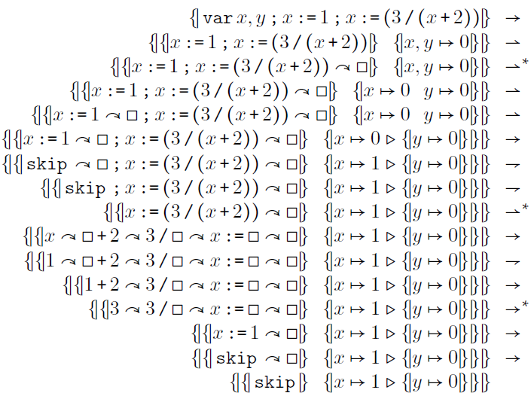
Sample CHAM Rewriting

Slide 86
Comparing Conventional executable semantics
How good are the various semantic approaches?

Slide 87
IMP++: A Language Design Experiment
We next discuss the conventional executable semantics approaches in depth, aiming at understanding their pros and cons
Our approach is to extend each semantics of IMP with various common features (we call the resulting language IMP++)
Variable increment – this will add side effects to expressions
Input/Output – this will require changes in the configuration
Abrupt termination – this requires explicit handling of control
Dynamic threads – this requires handling concurrency and sharing
Local variables – this requires handling environments
We will first treat each extension of IMP independently, i.e., we do not pro-actively take semantic decisions when defining a feature that will help the definition of other features later on. Then, we will put all features together into our IMP++ final language.

Slide 88

IMP++ Variable Increment
Syntax:
Variable increment is very common (C, C++, Java, etc.)
We only consider pre-increment (first increment, then return value)
The problem with increment in some semantic approaches is that it adds side effects to expressions. Therefore, if one did not pro-actively account for that then one needs to change many existing and unrelated semantics rules, if not all.

Slide 89




IMP++ Variable Increment Big-Step SOS
Previous big-step SOS rules had the form:
Big-step SOS is the most affected by side effects
Needs to change its sequents from to
And all the existing rules accordingly, e.g.:

Slide 90
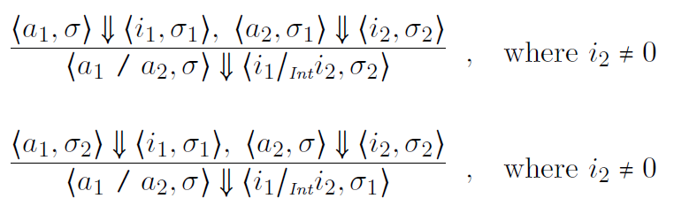
IMP++ Variable Increment Big-Step SOS
Recall IMP operators like / were non-deterministically strict. Here is an attempt to achieve that with big-step SOS
All we got is “non-deterministic choice” strictness: choose an order, then evaluate the arguments in that order
Some behaviors are thus lost, but this is relatively acceptable in practice since programmers should not rely on those behaviors in their programs anyway (the loss of behaviors when we add threads is going to be much worse)

Slide 91

IMP++ Variable Increment Big-Step SOS
We are now ready to add the big-step SOS for variable increment (this is easy now, the hard part was to get here):
Example:
How many values can the following expression possibly evaluate to under the big-step SOS of IMP++ above (assume x is initially 1)?
Can it evaluate to 0 or even be undefined under a fully non-deterministic evaluation strategy?

Slide 92


IMP++ Variable Increment Small-Step SOS
Previous small-step SOS rules had the form:
Small-step SOS less affected than big-step SOS, but still requires many rule changes to account for the side effects:

Slide 93
IMP++ Variable Increment Small-Step SOS
Since small-step SOS “gets back to the top” at each step, it actually does not lose any non-deterministic behaviors
We get fully non-deterministic evaluation strategies for all the IMP constructs instead of “non-deterministic choice” ones
The semantics of variable increment almost the same as in big-step SOS (indeed, variable increment is an atomic operation):

Slide 94


IMP++ Variable Increment MSOS
Previous MSOS rules had the form:
All semantic changes are hidden within labels, which are implicitly propagated through the general MSOS mechanism
Consequently, the MSOS of IMP only needs the following rule to accommodate variable updates; nothing else changes!

Slide 95




IMP++ Variable Increment Reduction Semantics with Eval. Contexts
Previous RSEC evaluation contexts and rules had the form:
Evaluation contexts, together with the characteristic rule of RSEC, allows for compact unconditional rules, mentioning only what is needed from the entire configuration
Consequently, the RSED of IMP only needs the following rule to accommodate variable updates; nothing else changes!

Slide 96

IMP++ Variable Increment CHAM
Previous CHAM heating/cooling/reaction rules had the form:
Since the heating/cooling rules achieve the role of the evaluation contexts and since one can only mention the necessary molecules in each rule, one does not need to change anything either!
All one needs to do is to add the following rule:

Slide 97
Where is the rest?
We discussed the remaining features in class, using the whiteboard and colors.
The lecture notes contain the complete information, even more than we discussed in class.

