Slide 1
Conventional Semantic Approaches
Grigore Rosu
CS522 – Programming Language Semantics

Slide 2
Conventional Semantic Approaches
A language designer should understand the existing design approaches, techniques and tools, to know what is possible and how, or to come up with better ones. This part of the course will cover the major PL semantic approaches, such as:
Big-step structural operational semantics (Big-step SOS)
Small-step structural operational semantics (Small-step SOS)
Denotational semantics
Modular structural operational semantics (Modular SOS)
Reduction semantics with evaluation contexts
Abstract Machines
The chemical abstract machine
Axiomatic semantics

Slide 3
IMP
A simple imperative language

Slide 4
IMP – A Simple Imperative Language
We will exemplify the conventional semantic approaches by means of IMP, a very simple non-procedural imperative language, with
Arithmetic expressions
Boolean expressions
Assignment statements
Conditional statements
While loop statements
Blocks

Slide 5
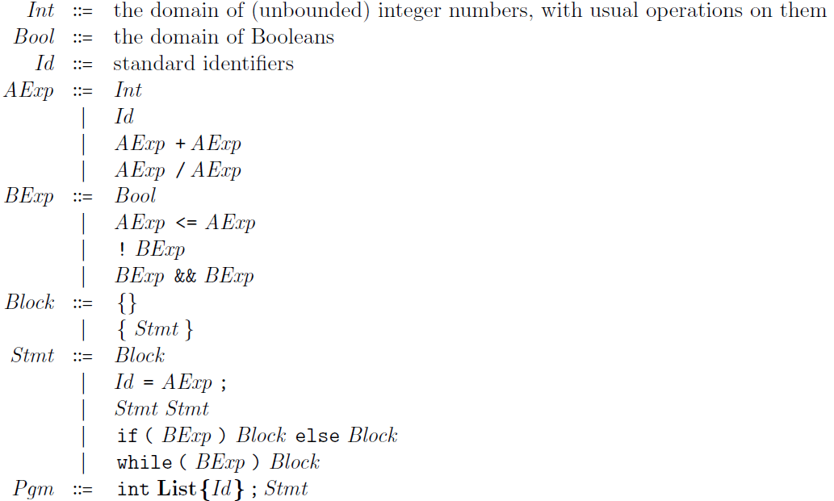
IMP Syntax
Suppose that, for demonstration
purposes, we want “+” and “/”
to be non-deterministically strict,
“<=“ to be sequentially strict,
and “&&” to be short-circuited
Comma-separated list of identifiers

Slide 6
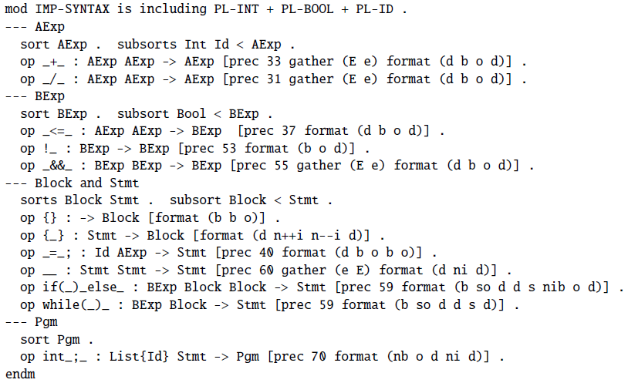
IMP Syntax in Maude

Slide 7



IMP State
Most semantics need some notion of state. A state holds all the semantic ingredients to fully define the meaning of a given program or fragment of program.
For IMP, a state is a partial finite-domain function from identifiers to integers (i.e., a function defined only on a finite subset of identifiers and undefined on the rest), written using a half-arrow:
We let State denote the set of such functions, and may write it
or

Slide 8



Lookup, Update and Initialization
We may write states by enumerating each identifier binding. For example, the following state binds x to 8 and y to 0:
Typical state operations are lookup, update and initialization
Lookup
Update
Initialization
σ =

Slide 9
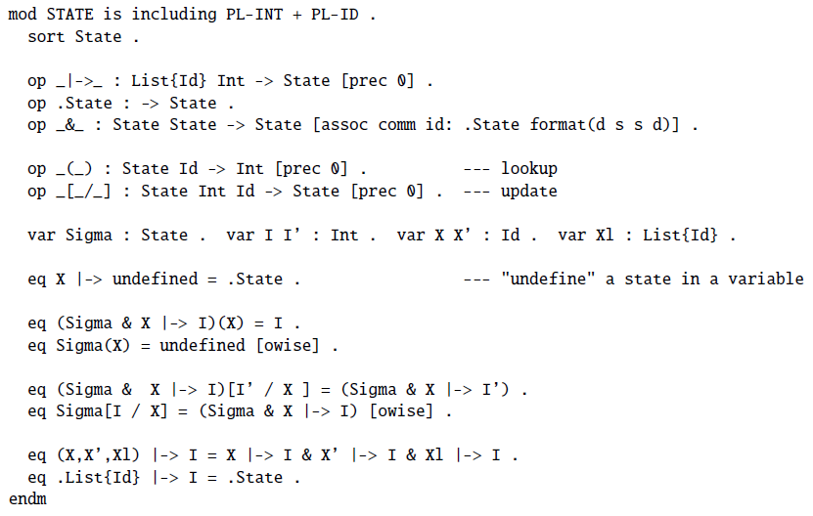
IMP State in Maude

Slide 10
Big-Step SOS
Big-step structural operational semantics

Slide 11







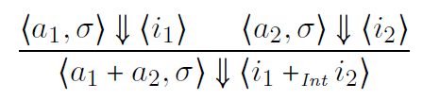
Big-Step Structural Operational Semantics (Big-Step SOS)
Gilles Kahn (1987), under the name natural semantics. Also known as relational semantics, or evaluation semantics. We can regard a big-step SOS as a recursive interpreter, telling for a fragment of code and state what it evaluates to.
Configuration: tuple containing code and semantic ingredients
E.g.,
Sequent: Pair of configurations, to be derived or proved
E.g.,
Rule: Tells how to derive a sequent from others
E.g.,
Read “evaluates to”
Premises
May omit line when no premises
Conclusion

Slide 12



Big-Step SOS of IMP - Arithmetic
State lookup
Read: “provided that a₁ evaluates to i₁ in σ and a₂ evaluates to i₂ in σ , then a₁ + a₂ evaluates to the integer sum of i₁ and i₂ in σ
Side condition ensures rule will never apply when a₂ evaluates to 0

Slide 13
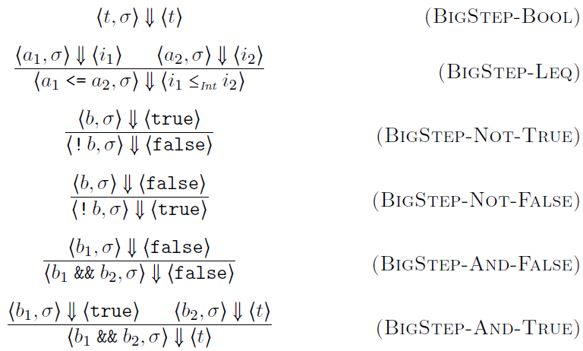
Big-Step SOS of IMP - Boolean

Slide 14
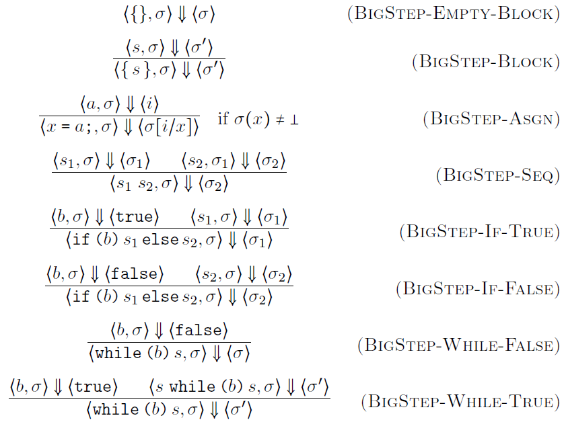
Big-Step SOS of IMP - Statements
State update

Slide 15

Big-Step SOS of IMP - Programs
State initialization

Slide 16



Big-Step Rule Instances
Rules are schemas, allowing recursively enumerable many instances; side conditions filter out instances
E.g., these are correct instances of the rule for division
The second may look suspicious, but it is not. Normally, one should never be able to apply it, because one cannot prove its hypotheses
However, the following is not a correct instance (no matter what ? is):

Slide 17

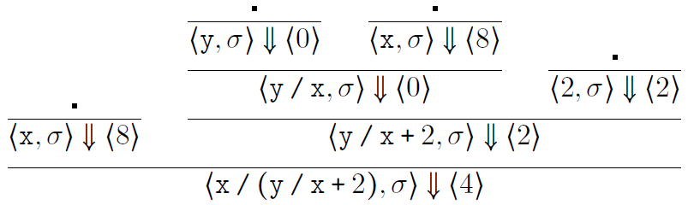

Big-Step SOS Derivation
The following is a valid proof derivation, or proof tree, using the
big-step SOS proof system of IMP above.
Suppose that x and y are identifiers and σ (x) = 8 and σ (y) = 0.

Slide 18


Big-Step SOS for Type Systems
Big-Step SOS is routinely used to define type systems for programming languages
The idea is that a fragment of code c, in a given type environment Γ, can be assigned a certain type τ. We typically write
instead of
Since all variables in IMP have integer type, Γ can be replaced by a list of untyped variables in our case. In general, however, a type environment Γ contains typed variables, that is, pairs “x :τ”.

Slide 19
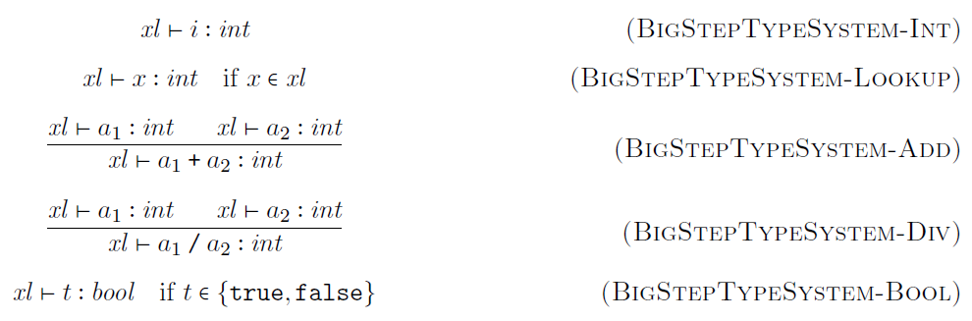
Typing Arithmetic Expressions

Slide 20
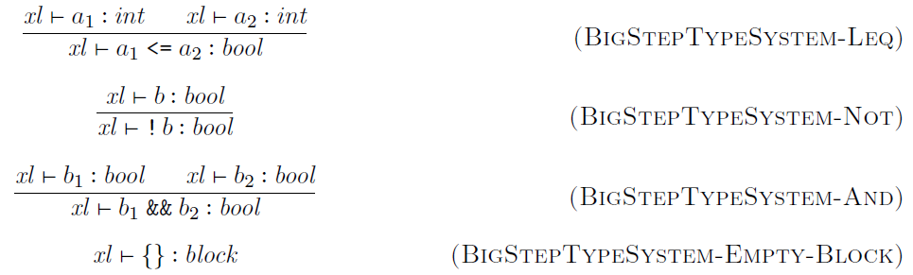
Typing Boolean Expressions

Slide 21
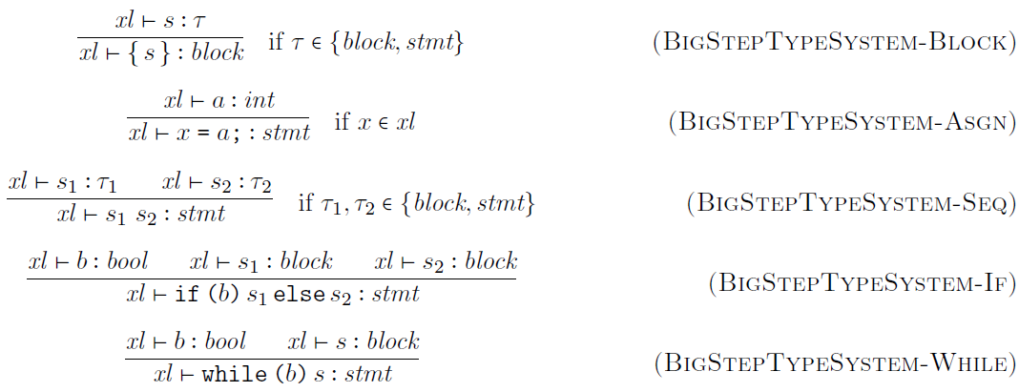
Typing Statements
The type of s can be either block or stmt

Slide 22
Typing Programs

Slide 23
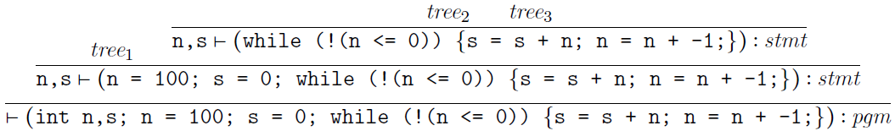
Big-Step SOS Type Derivation
Like the big-step rules for the concrete semantics of IMP, the ones for its type system are also rule schemas. We next show a proof derivation for the well-typed-ness of an IMP program that adds all the numbers from 1 to 100:
where

Slide 24
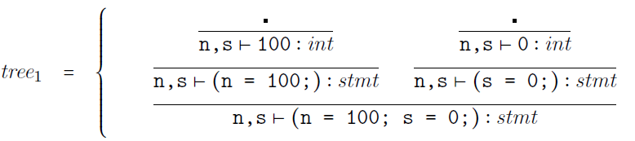
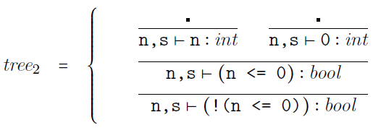
Big-Step SOS Type Derivation

Slide 25
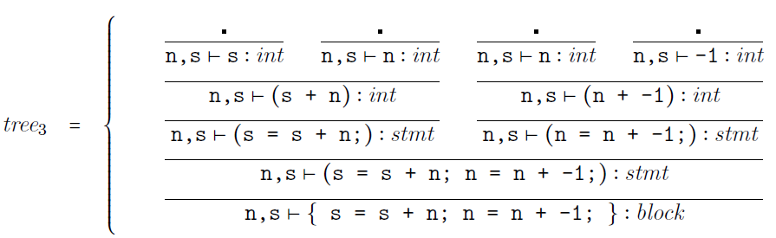
Big-Step SOS Type Derivation

Slide 26

Big-Step SOS in Rewriting Logic
Any big-step SOS can be associated a rewrite logic theory (or, equivalently, a Maude module)
The idea is to associate to each big-step SOS rule
a rewrite rule
(over-lining means “algebraization”)

Slide 27
small-Step SOS
Small-step structural operational semantics

Slide 28







Small-Step Structural Operational Semantics (Small-Step SOS)
Gordon Plotkin (1981)
Also known as transitional semantics, or reduction semantics
One can regard a small-step SOS as a device capable of executing a program step-by-step
Configuration: tuple containing code and semantic ingredients
E.g.,
Sequent (transition): Pair of configurations, to be derived (proved)
E.g.,
Rule: Tells how to derive a sequent from others
E.g.,

Slide 29
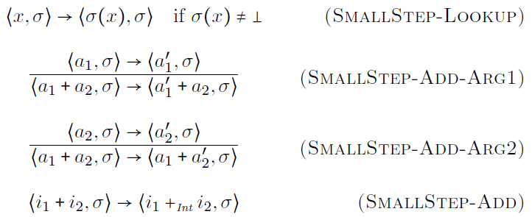
Small-Step SOS of IMP - Arithmetic
State lookup
+ is non-deterministic (its arguments can evaluate in any order, and interleaved

Slide 30
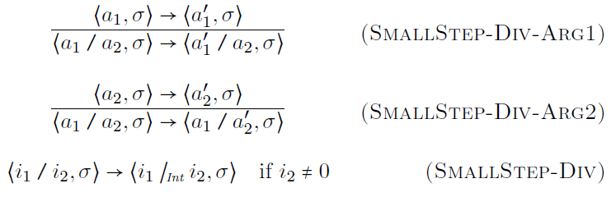
Small-Step SOS of IMP - Arithmetic
Side condition ensures rule will never apply when denominator is 0
/ is also non-deterministic

Slide 31
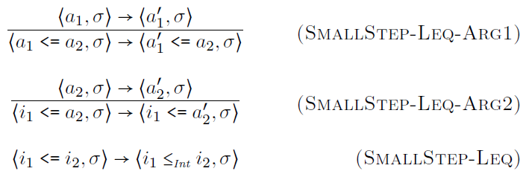
Small-Step SOS of IMP - Boolean
Ensures sequential strictness

Slide 32
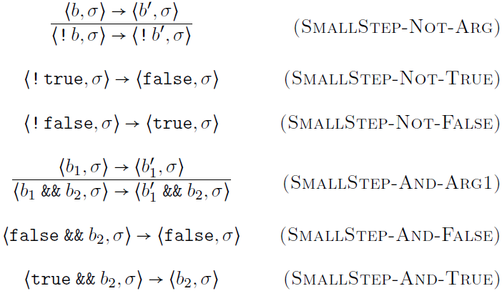
Small-Step SOS of IMP - Boolean
Short-circuit
semantics

Slide 33
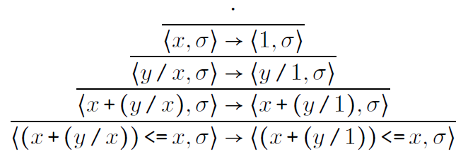

Small-Step SOS Derivation
The following is a valid proof derivation, or proof tree, using the
small-step SOS proof system for expressions of IMP above.
Suppose that x and y are identifiers and σ(x)=1.

Slide 34
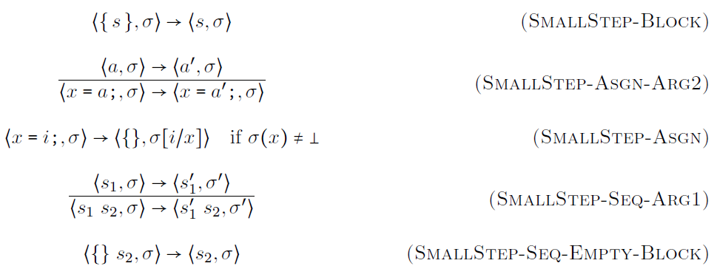
Small-Step SOS of IMP - Statements
State update

Slide 35
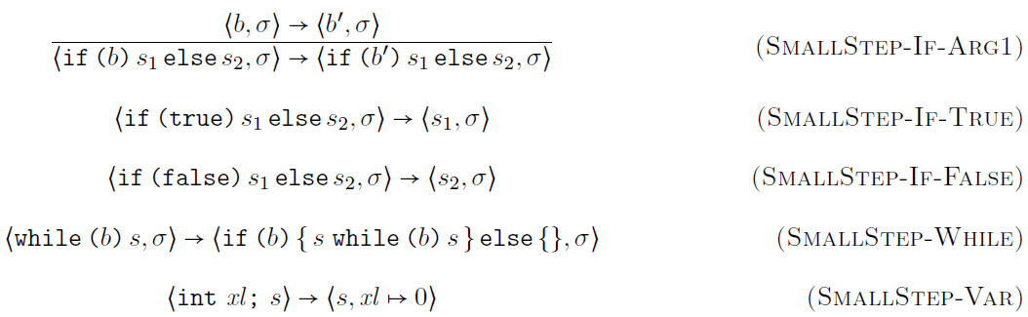
Small-Step SOS of IMP - Statements
State initialization

Slide 36
Small-Step SOS in Rewriting Logic
Any small-step SOS can be associated a rewrite logic theory (or, equivalently, a Maude module)
The idea is to associate to each small-step SOS rule
a rewrite rule
(the circle means “ready for one step”)

Slide 37
Denotational
Denotational or fixed-point semantics

Slide 38

Denotational Semantics
Christopher Strachey and Dana Scott (1970)
Associate denotation, or meaning, to (fragments of) programs into mathematical domains; for example,
The denotation of an arithmetic expression in IMP is a partial function from states to integer numbers
The denotation of a statement in IMP is a partial function from states to states

Slide 39
Denotational Semantics
Partial because some expressions may be undefined in some states (e.g., division by zero)
Partial because some expressions may be undefined in some states (e.g., division by zero)
Partial because some statements in some states may use undefined expressions, or may not terminate
Partial because some statements in some states may use undefined expressions, or may not terminate
Christopher Strachey and Dana Scott (1970)
Associate denotation, or meaning, to (fragments of) programs into mathematical domains; for example,
The denotation of an arithmetic expression in IMP is a partial function from states to integer numbers
The denotation of a statement in IMP is a partial function from states to states

Slide 40
Denotational Semantics - Terminology
Denotation
(function)
Denotation
(function)
Fragment of program
Fragment of program
Mathematical domain
Mathematical domain

Slide 41


Denotational Semantics - Compositional
Once the right mathematical domains are chosen, giving a denotational semantics to a language should be a straightforward and compositional process; e.g.
The hardest part is to give semantics to recursion. This is done using fixed-points.

Slide 42
Mathematical Domains
Mathematical domains can be anything; it is common though that they are organized as complete partial orders with bottom element
The partial order structure captures the intuition of informativeness: a ≤ b means a is less informative than b. E.g., as a loop is executed, we get more and more information about its semantics
Completeness means that chains of more and more informative elements have a limit
The bottom element, written ⊥, stands for undefined, or no information at all

Slide 43








Partial Orders
Partial order is set and binary rel. which is
Reflexive:
Transitive:
Anti-symmetric:
Total order = partial order with
Important example: domains of partial functions
iff defined everywhere is defined and
whenever is defined

Slide 44






(Least) Upper Bounds
An upper bound (u.b.) of is any element such that for any
The least upper bound (l.u.b.) of , written , is an upper bound with for any u.b.
When they exist, least upper bounds are unique
The domains of partial functions, , admit upper bounds and least upper bounds if and only if all the partial functions in the considered set are compatible: any two agree on any element in which both are defined

Slide 45





Complete Partial Orders (CPO)
A chain in is an infinite sequence
also written
Partial order is a complete partial order (CPO) iff any of its chains admits a least upper bound
is a bottomed CPO (BCPO) iff ⊥ is a minimal element of , also called its bottom
The domain of partial functions is a BCPO, where ⊥ is the partial function undefined everywhere

Slide 46







Monotone and Continuous Functions
monotone iff
implies
Monotone functions preserve chains:
chain implies chain
However, they do not always preserve l.u.b. of chains
continuous iff monotone and preserves l.u.b. of chains:
, the domain of continuous functions between two BCPOs, is itself a BCPO

Slide 47





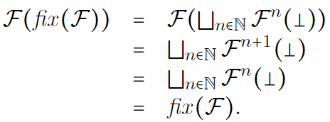
Fixed-Point Theorem
Let be a BCPO and
be a continuous function. Then the l.u.b. of the chain
is the least fixed-point of
Typically written
Proof sketch:

Slide 48
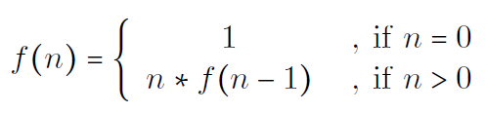

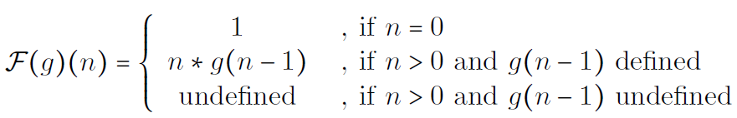
Applications of Fixed-Point Theorem
Consider the following “definition” of the factorial:
This is a recursive definition
Is it well-defined? Why?
Yes. Because it is the least fixed-point of the following continuous (prove it!) function from to itself

Slide 49
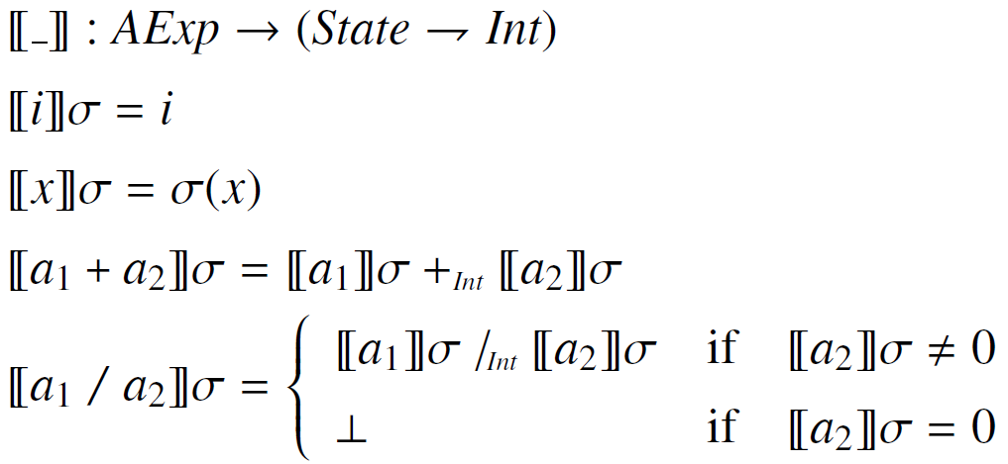
Denotational Semantics of IMP Arithmetic Expressions

Slide 50
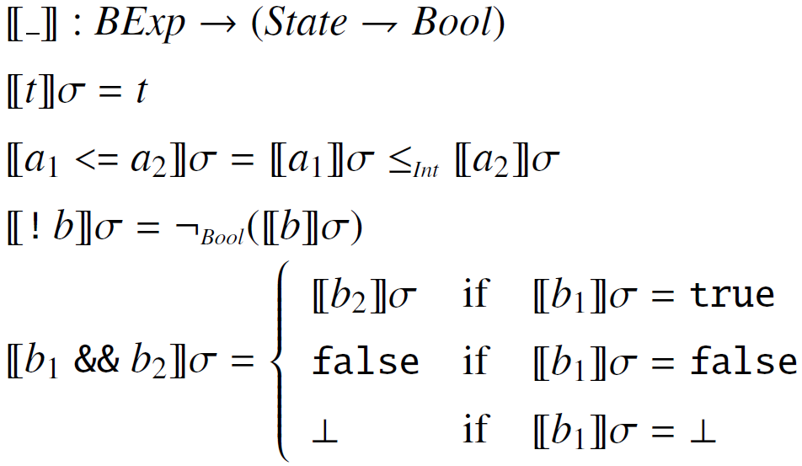
Denotational Semantics of IMP Boolean Expressions

Slide 51
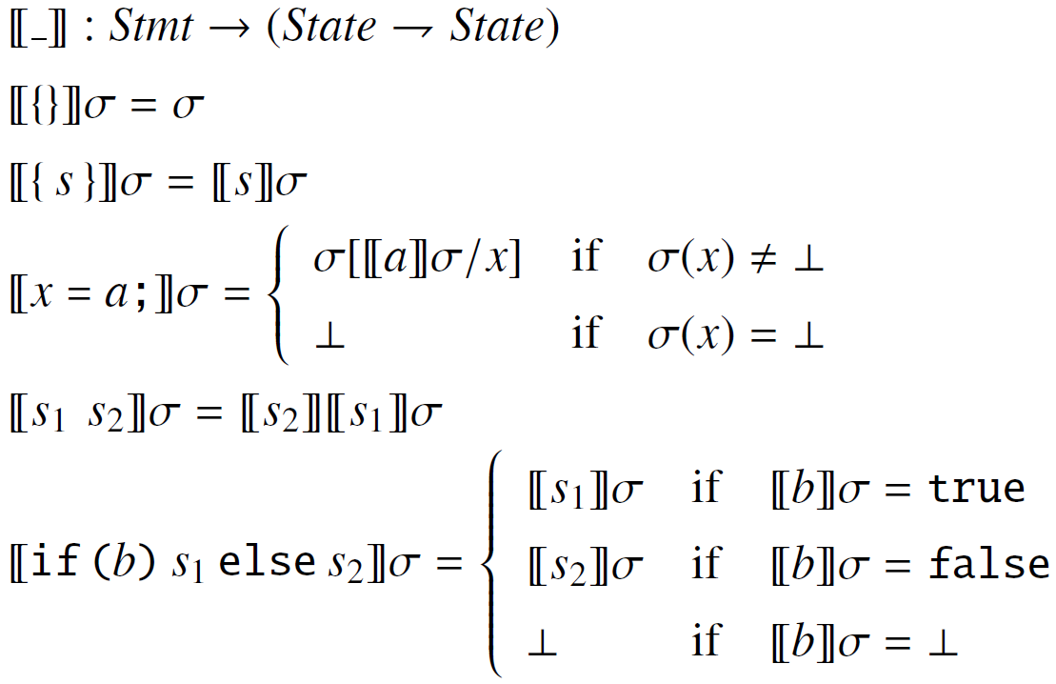
Denotational Semantics of IMP Statements (without loops)

Slide 52
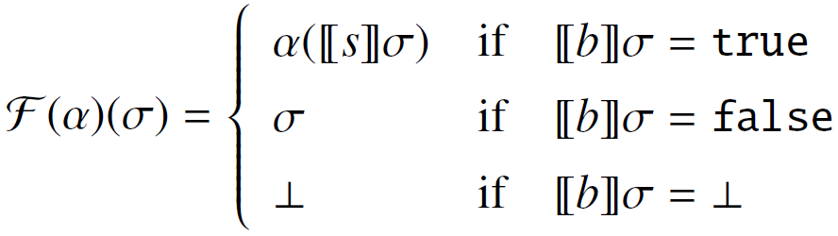

Denotational Semantics of IMP While
We first define a continuous function as follows
Then we define the denotational semantics of while

Slide 53
Formalizing Denotational Semantics
A denotational semantics is like a “compiler” of the defined programming language into mathematics
Formalizing denotational semantics in RL reduces to formalizing the needed mathematical domains:
Integers, Booleans, etc.
Functions (with cases) and function applications
Fixed-points
Such mathematics is already available in functional programming languages, which makes them excellent candidates for denotational semantics!

Slide 54
Denotational Semantics in Rewriting Logic
Rewriting/equational logics do not have builtin functions and fixed-points, so they need be defined
They are, however, easy to define using rewriting
In fact, we do not need rewrite rules, all we need is equations to define these simple domains
See next slide

Slide 55
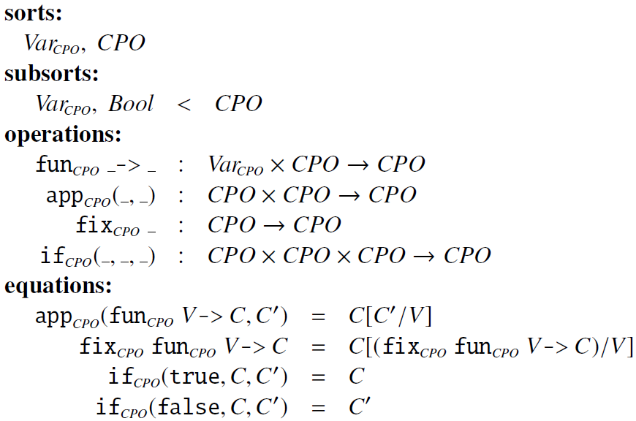
Functional CPO Domain

Slide 56
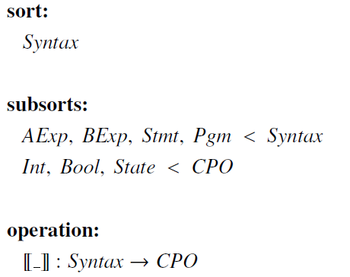
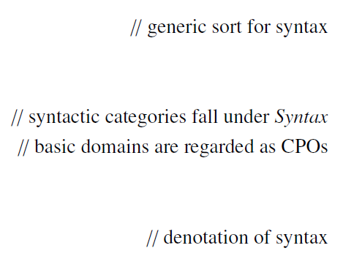
Denotational Semantics of IMP in RL Signature

Slide 57
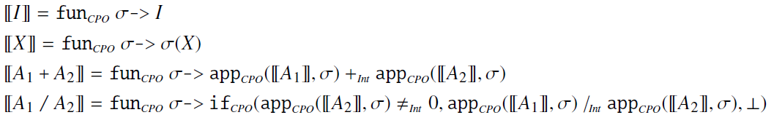
Denotational Semantics of IMP in RL Arithmetic Expressions

Slide 58
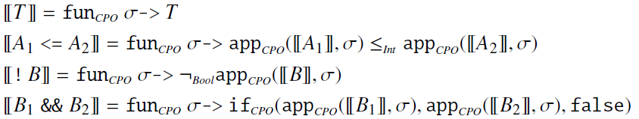
Denotational Semantics of IMP in RL Boolean Expressions

Slide 59
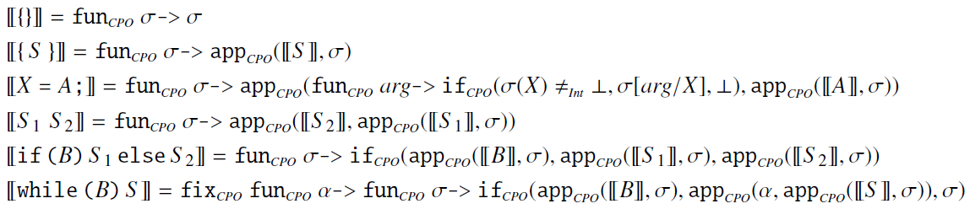
Denotational Semantics of IMP in RL Statements and Programs

Slide 60
MSOS
Modular structural operational semantics

Slide 61
Modular Structural Operational Semantics (Modular SOS, or MSOS)
Peter Mosses (1999)
Addresses the non-modularity aspects of SOS
A definitional framework is non-modular when, in order to add a new feature to an existing language, one needs to revisit and change some of the already defined, unrelated language features
The non-modularity of SOS becomes clear when we define IMP++
Why modularity is important
Modifying existing rules when new rules are added is error prone
When experimenting with language design, one needs to make changes quickly; having to do unrelated changes slows us down
Rapid language development, e.g., domain-specific languages

Slide 62
Philosophy of MSOS
Separate the syntax from configurations and treat it differently
Transitions go from syntax to syntax, hiding the other configuration components into transition labels
Labels encode all the non-syntactic configuration changes
Specialized notation in transition labels, to
Say that certain configuration components stay unchanged
Say that certain configuration changes are propagated from the premise to the conclusion of a rule

Slide 63

MSOS Transitions
An MSOS transition has the form
P and P’ are programs or fragments of program
Δ is a label describing the changes in the configuration components, defined as a record; primed fields stay for “after” the transition
Example:
This rule can be automatically “desugared” into the SOS rule
But also into (if the configuration contains more components, like in IMP++)

Slide 64
MSOS Labels
Labels are field assignments, or records, and can use “…” for “and so on”, called record comprehension
Fields can be primed or not.
Unprimed = configuration component before the transition is applied
Primed = configuration component after the transition is applied
Some fields appear both unprimed and primed (called read-write), while others appear only primed (called write-only) or only unprimed (called read-only)

Slide 65

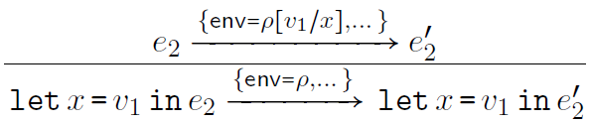
MSOS Labels
Field types
Read/write = fields which appear both unprimed and unprimed
Write-only = fields which appear only primed
Read –only = fields which appear only unprimed

Slide 66
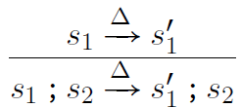

MSOS Rules
Like in SOS, but using MSOS transitions as sequents
Same labels or parts of them can be used multiple times in a rule
Example:
Same Δ means that changes propagate from premise to conclusion
The author of MSOS now promotes a simplifying notation
If the premise and the conclusion repeat the same label or part of it, simply drop that label or part of it. For example:

Slide 67
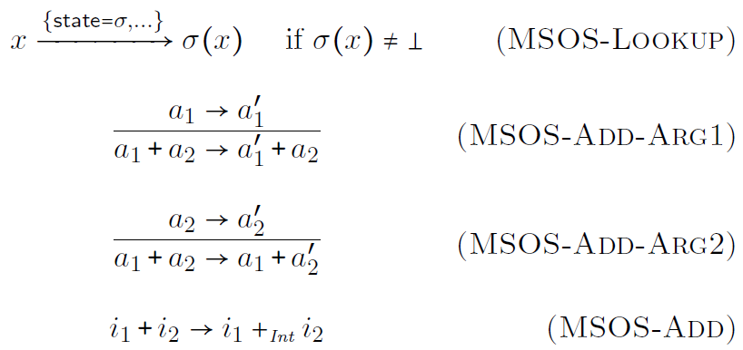
MSOS of IMP - Arithmetic
State
lookup

Slide 68
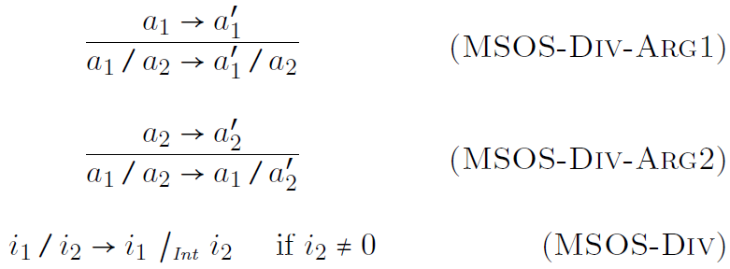
MSOS of IMP - Arithmetic

Slide 69
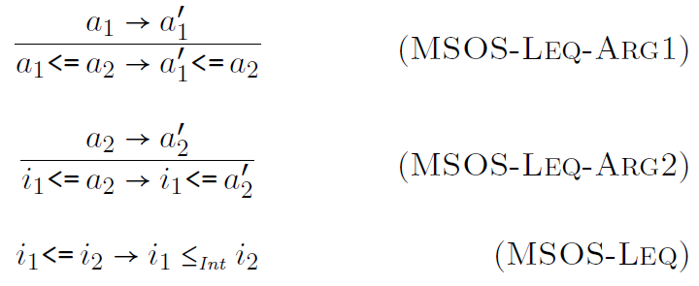
MSOS of IMP - Boolean

Slide 70
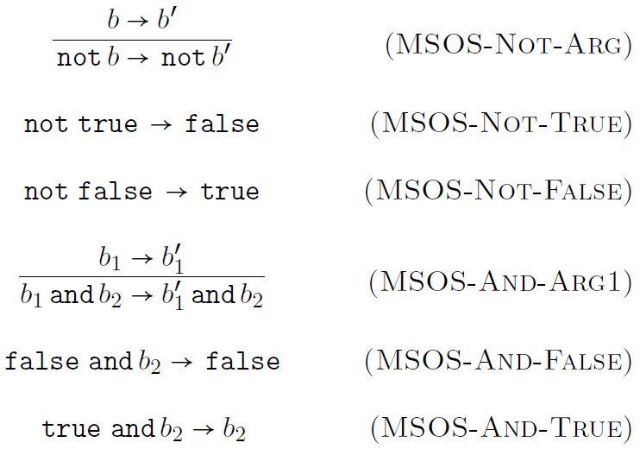
MSOS of IMP - Boolean

Slide 71
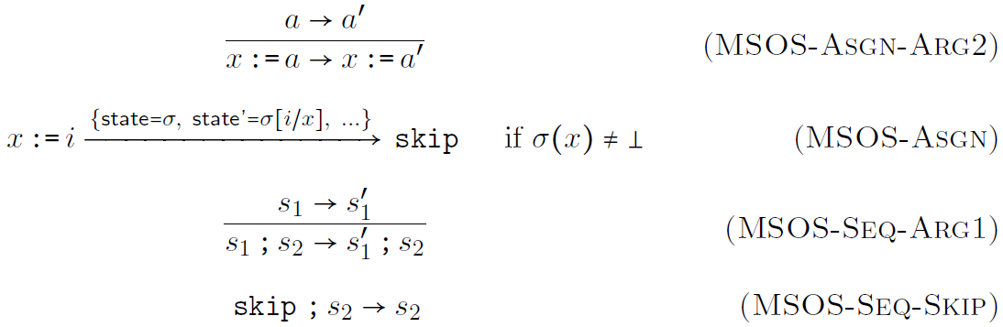
MSOS of IMP - Statements

Slide 72
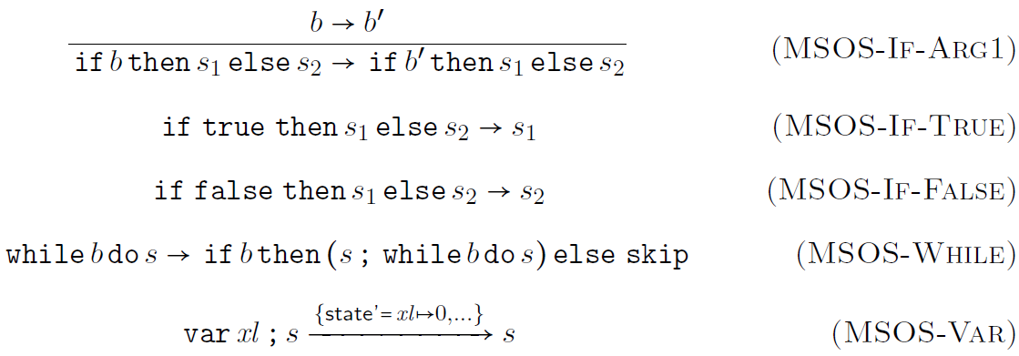
MSOS of IMP - Statements

Slide 73
MSOS in Rewriting Logic
Any MSOS can be associated a rewrite logic theory (or, equivalently, a Maude module)
Idea:
Desugar MSOS into SOS
Apply the SOS-to-rewriting-logic representation, but
Hold the non-syntactic configuration components in an ACI-data-structure, so that we can use ACI matching to retrieve only the fields of interest (which need to be read or written to)

Slide 74
MSOS of IMP in Maude
See file
imp-semantics-msos.maude

Slide 75
RSEC
Reduction semantics with evaluation contexts

Slide 76
Reduction Semantics with Evaluation Contexts (RSEC)
Matthias Felleisen and collaborators (1992)
Previous operational approaches encoded the program execution context as a proof context, by means of rule conditions or premises
This has a series of advantages, but makes it hard to define control intensive features, such as abrupt termination, exceptions, call/cc, etc.
We would like to have the execution context explicit, so that we can easily save it, change it, or even delete it
Reduction semantics with evaluation contexts does precisely that
It allows to formally define evaluation contexts
Rules become mostly unconditional
Reductions can only happen “in context”

Slide 77
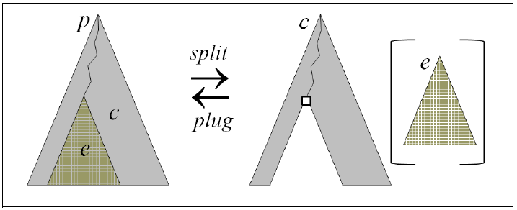

Splitting and Plugging
RSEC relies on reversible implicit mechanisms to
Split syntax into an evaluation context and a redex
Plug a redex into an evaluation contexts and obtain syntax again

Slide 78
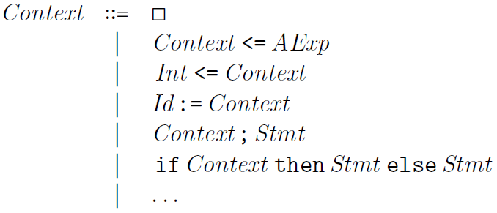
Evaluation Contexts
Evaluation contexts are typically defined by the same means that we use to define the language syntax, that is, grammars
The hole  represents the place where redex is to be plugged
Example:

Slide 79
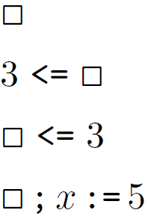

Correct Evaluation Contexts

Slide 80
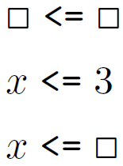


Wrong Evaluation Contexts

Slide 81




Splitting/Plugging of Syntax

Slide 82
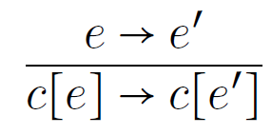
Characteristic Rule of RSEC
The characteristic rule of RSEC allows us to only define semantic rules stating how redexes are reduced
This significantly reduces the number of rules
The semantic rules are mostly unconditional (no premises)
The overall result is a semantics which is compact and easy to read and understand

Slide 83
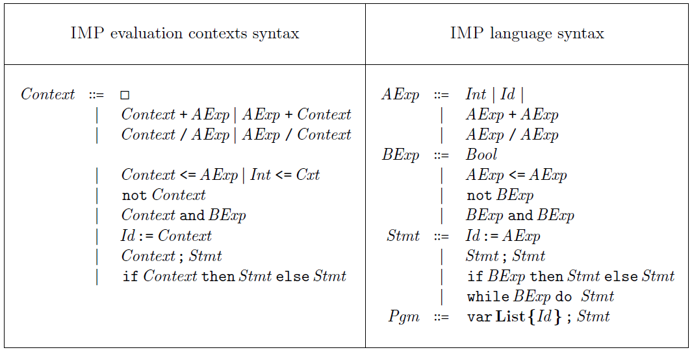
RSEC of IMP – Evaluation Contexts

Slide 84
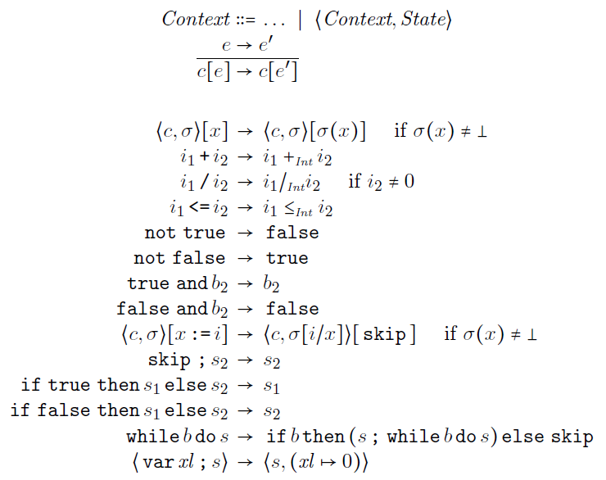
RSEC of IMP – Rules

Slide 85
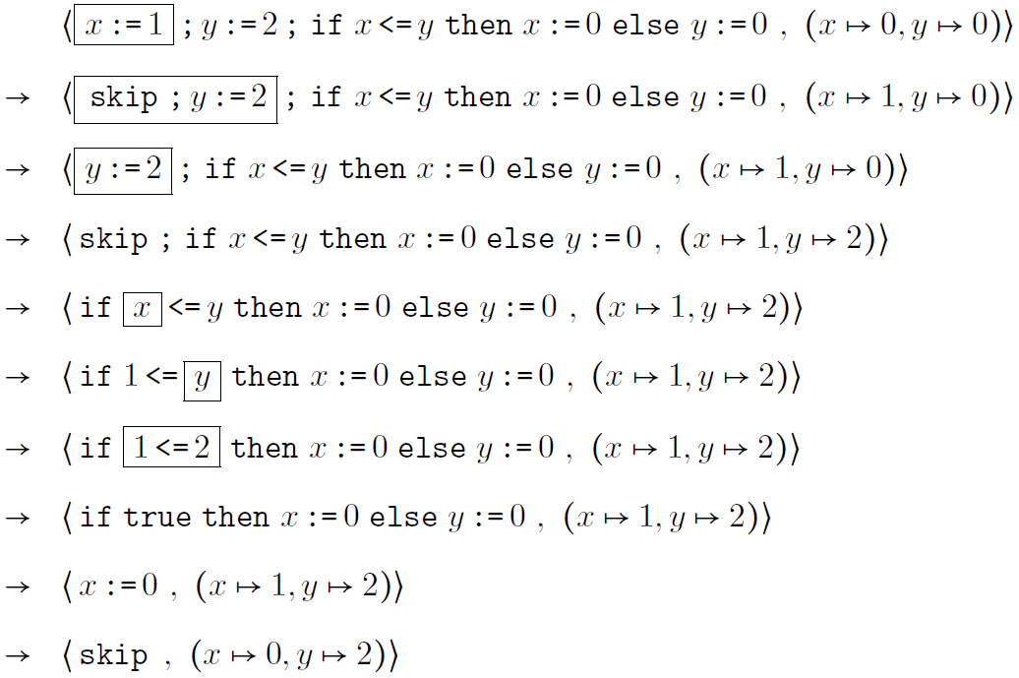
RSEC Derivation

Slide 86
RSEC in Rewriting Logic
Like with the other styles, RSEC can also be faithfully represented in rewriting logic and, implicitly, in Maude
However, RSEC is context sensitive, while rewriting logic is not (rewriting logic allows rewriting strategies, but one can still not match and modify the context, as we can do in RSEC)
We therefore need
A mechanism to achieve context sensitivity (the splitting/plugging) in rewriting logic
Use that mechanism to represent the characteristic rule of RSEC

Slide 87

Evaluation Contexts in Rewriting Logic
An evaluation context CFG production in RSEC has the form
Associate to each such production one rule and one equation:
Plus, we add one generic rule and one generic equation:

Slide 88


IMP Examples:
For productions
we add the following rewrite logic rules and equations:

Slide 89

RSEC Reduction Rules in Rewriting Logic

Slide 90

IMP Examples
One rule of first kind
No need for equations of second kind
Characteristic rule of RSEC:
The remaining rules are as natural as can be:

Slide 91
RSEC of IMP in Maude
See file
imp-split-plug.maude
See files
imp-semantics-evaluation-contexts-1.maude
imp-semantics-evaluation-contexts-2.maude
imp-semantics-evaluation-contexts-3.maude

Slide 92
CHAM
The chemical abstract machine

Slide 93

The Chemical Abstract Machine (CHAM)
Berry and Boudol (1992)
Both a model of concurrency and a specific semantic style
Chemical metaphor
States regarded as chemical solutions containing floating molecules
Molecules can interact with each other by means of reactions
Reactions take place concurrently, unrestricted by context
Solutions are encapsulated within new molecules, using membranes
The following is a solution containing k molecules:

Slide 94


CHAM Syntax and Rules
Airlock

Slide 95

CHAM Rules
Ordinary rewrite rules between solution terms:
Rewriting takes place only within solutions
Three (metaphoric) kinds of rules
Heating rules using : structurally rearrange solution
Cooling rules using : clean up solution after reactions
Reaction rules using : change solution irreversibly

Slide 96

CHAM Airlock
Allows to extract molecules from encapsulated solutions
Governed by two rules coming in a heating/cooling pair:

Slide 97

CHAM Molecule Configuration for IMP
A top-level solution containing two subsolution molecules
One for holding the syntax
Another for holding the state
Example:
Syntax
State

Slide 98




Airlock can be Problematic
Airlock cannot be used to encode evaluation strategies; heating/cooling rules of the form
are problematic, because they yield ambiguity, e.g.,

Slide 99



Correct Representation of Syntax
Other attempts fail, too (see the lecture notes)
We need some mechanism which is not based on airlocks
We borrow the representation approach of K
Term represented as
Can be achieved using heating/cooling rules of the form

Slide 100

CHAM Heating-Cooling Rules for IMP

Slide 101



Examples of Syntax Heating/Cooling
The following is correct heating/cooling of syntax:
The following is incorrect heating/cooling of syntax:

Slide 102

CHAM Reaction Rules for IMP

Slide 103

Sample CHAM Rewriting

Slide 104
CHAM in Rewriting Logic
CHAM rules cannot be used unchanged as rewrite rules
They need to only apply in solutions, not anywhere they match
We represent each CHAM rule
into a rewrite logic rule
where Ms is a fresh bag-of-molecule variable and the overlined
molecules are the algebraic variants of the original ones,
replacing in particular their meta-variables by variables

Slide 105
CHAM of IMP in Maude
See file
imp-heating-cooling.maude
See file
imp-semantics-cham.maude

Slide 106
Comparing Conventional executable semantics
How good are the various semantic approaches?

Slide 107
IMP++: A Language Design Experiment
We next discuss the conventional executable semantics approaches in depth, aiming at understanding their pros and cons
Our approach is to extend each semantics of IMP with various common features (we call the resulting language IMP++)
Variable increment – this will add side effects to expressions
Input/Output – this will require changes in the configuration
Abrupt termination – this requires explicit handling of control
Dynamic threads – this requires handling concurrency and sharing
Local variables – this requires handling environments
We will first treat each extension of IMP independently, i.e., we do not pro-actively take semantic decisions when defining a feature that will help the definition of other features later on. Then, we will put all features together into our IMP++ final language.

Slide 108

IMP++ Variable Increment
Syntax:
Variable increment is very common (C, C++, Java, etc.)
We only consider pre-increment (first increment, then return value)
The problem with increment in some semantic approaches is that it adds side effects to expressions. Therefore, if one did not pro-actively account for that then one needs to change many existing and unrelated semantics rules, if not all.

Slide 109




IMP++ Variable Increment Big-Step SOS
Previous big-step SOS rules had the form:
Big-step SOS is the most affected by side effects
Needs to change its sequents from to
And all the existing rules accordingly, e.g.:

Slide 110

IMP++ Variable Increment Big-Step SOS
Recall IMP operators like / were non-deterministically strict. Here is an attempt to achieve that with big-step SOS
All we got is “non-deterministic choice” strictness: choose an order, then evaluate the arguments in that order
Some behaviors are thus lost, but this is relatively acceptable in practice since programmers should not rely on those behaviors in their programs anyway (the loss of behaviors when we add threads is going to be much worse)

Slide 111

IMP++ Variable Increment Big-Step SOS
We are now ready to add the big-step SOS for variable increment (this is easy now, the hard part was to get here):
Example:
How many values can the following expression possibly evaluate to under the big-step SOS of IMP++ above (assume x is initially 1)?
Can it evaluate to 0 or even be undefined under a fully non-deterministic evaluation strategy?

Slide 112


IMP++ Variable Increment Small-Step SOS
Previous small-step SOS rules had the form:
Small-step SOS less affected than big-step SOS, but still requires many rule changes to account for the side effects:

Slide 113
IMP++ Variable Increment Small-Step SOS
Since small-step SOS “gets back to the top” at each step, it actually does not lose any non-deterministic behaviors
We get fully non-deterministic evaluation strategies for all the IMP constructs instead of “non-deterministic choice” ones
The semantics of variable increment almost the same as in big-step SOS (indeed, variable increment is an atomic operation):

Slide 114


IMP++ Variable Increment MSOS
Previous MSOS rules had the form:
All semantic changes are hidden within labels, which are implicitly propagated through the general MSOS mechanism
Consequently, the MSOS of IMP only needs the following rule to accommodate variable updates; nothing else changes!

Slide 115




IMP++ Variable Increment Reduction Semantics with Eval. Contexts
Previous RSEC evaluation contexts and rules had the form:
Evaluation contexts, together with the characteristic rule of RSEC, allows for compact unconditional rules, mentioning only what is needed from the entire configuration
Consequently, the RSED of IMP only needs the following rule to accommodate variable updates; nothing else changes!

Slide 116

IMP++ Variable Increment CHAM
Previous CHAM heating/cooling/reaction rules had the form:
Since the heating/cooling rules achieve the role of the evaluation contexts and since one can only mention the necessary molecules in each rule, one does not need to change anything either!
All one needs to do is to add the following rule:

Slide 117
Where is the rest?
We discussed the remaining features in class, using the whiteboard and colors.
The lecture notes contain the complete information, even more than we discussed in class.

