Slide 1
Requirements in the software lifecycle
Bertrand Meyer
Notes:
1

Slide 2
The waterfall model (a pedagogical device)
Feasibility study
Requirements
Specification
Global design
Detailed design
Implemen- tation
Verification
Deployment

Slide 3
Merging of middle activities
Feasibility study
Requirements
Specification
Global design
Detailed design
Implemen- tation
Verification
Deployment

Slide 4
Arguments for the waterfall
Source: Boehm 81
(After B.W. Boehm: Software engineering economics)
The activities are necessary
(But: merging of middle activities)
The order is the right one.

Slide 5
Problems with the waterfall
Late appearance of actual code
Lack of support for requirements change — and more generally for extendibility and reusability
Lack of support for the maintenance activity
Division of labor hampering total quality management
Impedance mismatches
Purely synchronous model

Slide 6
Problems with the waterfall: division of labor
RequirementsAnalysts, consultants
Designers
Implementers
Testers
Customers

Slide 7
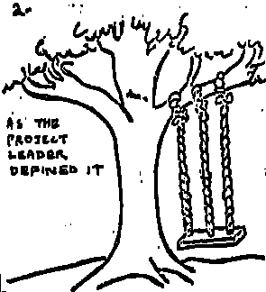
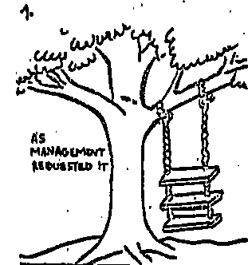
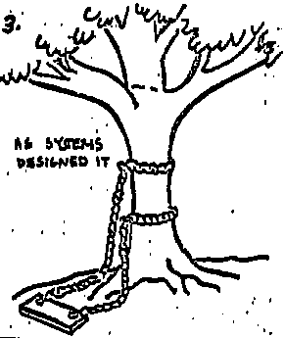
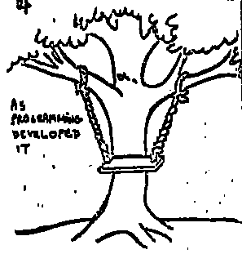
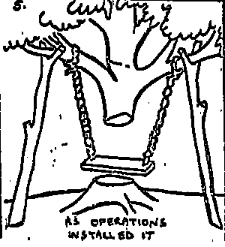
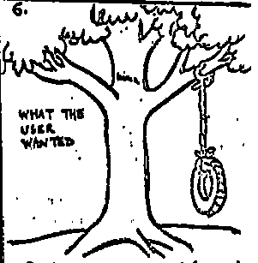
Lifecycle: “impedance mismatches”
1. As Management requested it
2. As the Project Leader defined it
3. As Systems designed it
4. As Programming developed it
5. As Operations installed it
6. What the user wanted
(Pre-1970 cartoon; source unknown)

Slide 8
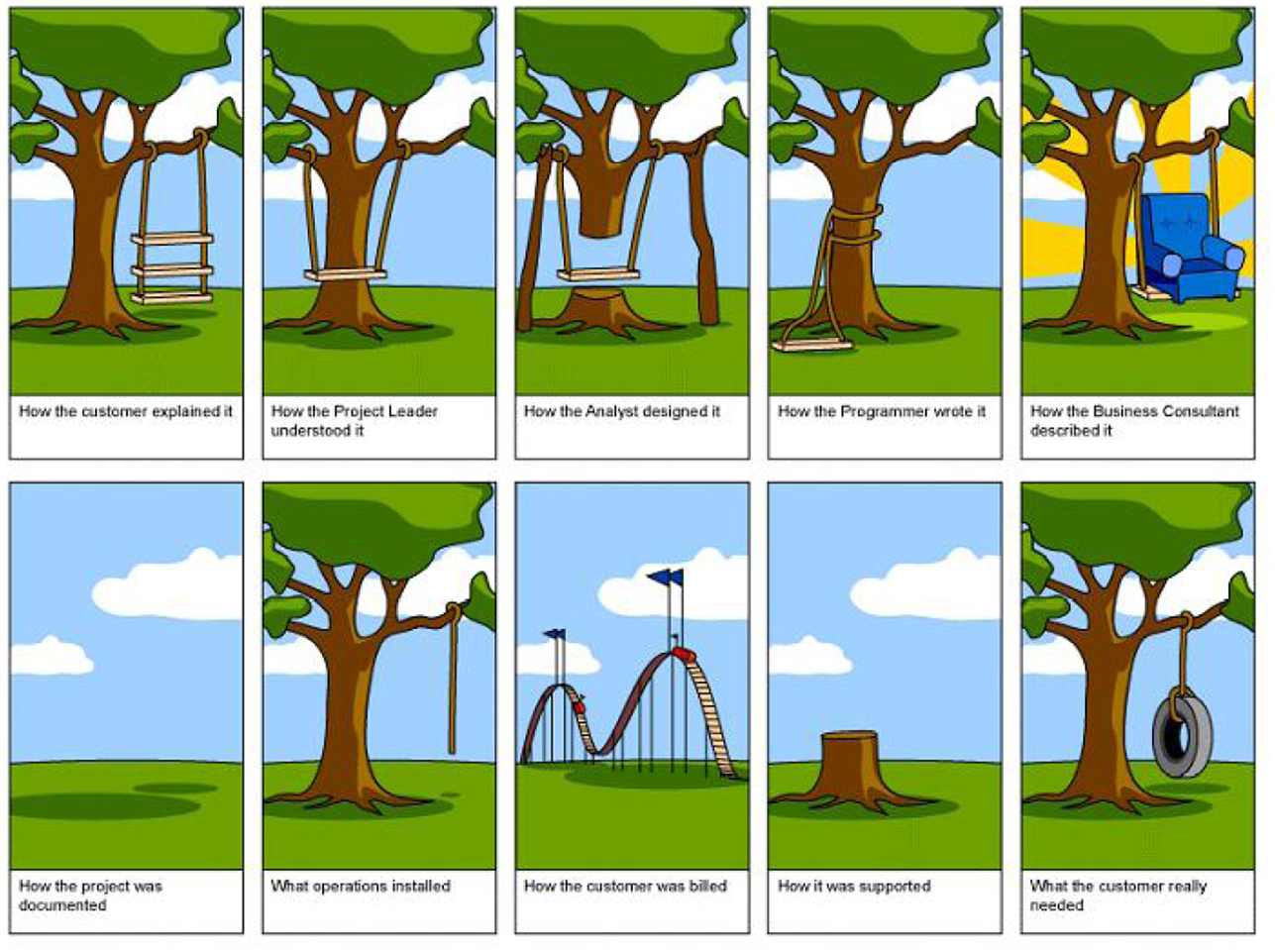
Problems with the waterfall: impedance mismatches

Slide 9
The spiral model
Iteration 3
Iteration 1
Iteration 2

Slide 10
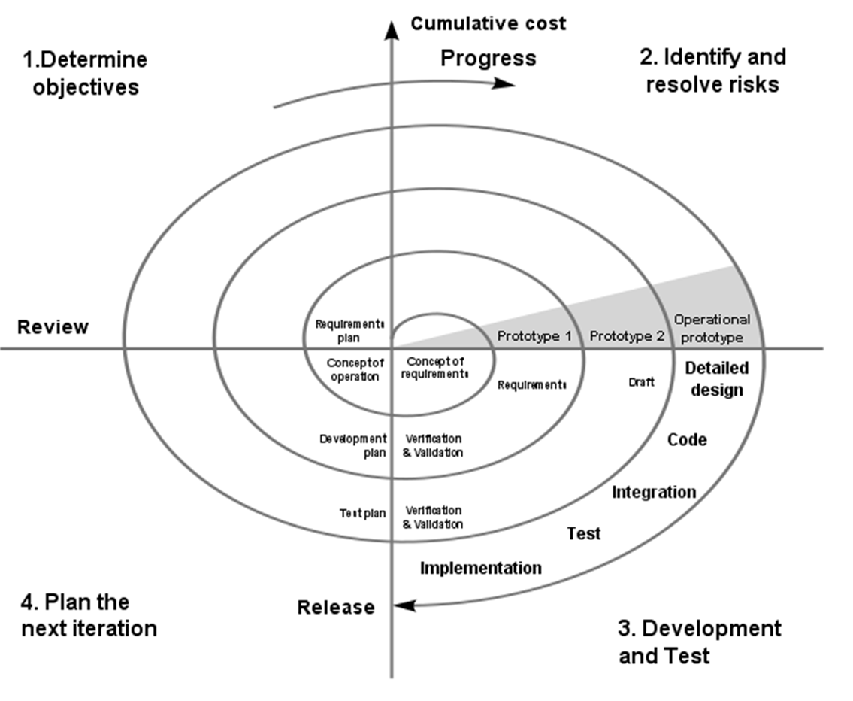
The spiral model
Apply a waterfall-like approach to successive prototypes

Slide 11

“Prototyping” in software
The term is used in one of the following meanings:
1. Experimentation:
Requirements capture
Try specific techniques: GUI, implementation (“buying information”)
2. Pilot project
3. Incremental development
4. Throw-away development
(Fred Brooks, The Mythical Man-Month, 1975: “Plan to throw one away, you will anyhow”).

Slide 12
The problem with throw-away development
Software development is hard because of the need to reconcile conflicting criteria, e.g. portability and efficiency
A prototype typically sacrifices some of these criteria
Risk of shipping the prototype
In the 20th-anniversary edition of his book (1995), Brooks admitted that “plan to throw one away” is bad advice

Slide 13
Seamless, incremental development
Seamless development:
Single set of notation, tools, concepts, principles throughout
Continuous, incremental development
Keep model, implementation and documentation consistent
Reversibility: can go back and forth
These are in particular some of the ideas behind the Eiffel method

Slide 14
Seamless development
Single concepts, principles, notation, tools
Continuous, incremental development
Keep model, implementation, documentation consistent
Requirements
ACCOUNT, TRANSACTION…
Design
STATE, COMMAND…
Implementation
COUNTER…
Verification
TEST_DRIVER…
Generalization
TABLE…
Example classes

Slide 15
Seamless development
Single concepts, principles, notation, tools
Continuous, incremental development
Keep model, implementation, documentation consistent
Support reversibility
Requirements
ACCOUNT, TRANSACTION…
Design
STATE, COMMAND…
Implementation
COUNTER…
Verification
TEST_DRIVER…
Generalization
TABLE…
Example classes

Slide 16
Generalization
G
R
D
I
V
Prepare for reuse. For example:
Remove built-in limits
Remove dependencies on specifics of project
Improve documentation, contracts...
Abstract
Extract commonalities and revamp inheritance hierarchy
Few companies have the guts to provide the budget for this
A*
B
X
Y
Z

Slide 17
Seamless development
Single concepts, principles, notation, tools
Continuous, incremental development
Keep model, implementation, documentation consistent
Requirements
ACCOUNT, TRANSACTION…
Design
STATE, COMMAND…
Implementation
COUNTER…
Verification
TEST_DRIVER…
Generalization
TABLE…
Example classes

Slide 18
Seamless, reversible development
Single concepts, principles, notation, tools
Continuous, incremental development
Keep model, implementation, documentation consistent
Correct earlier steps as needed (reversibility)
Requirements
Design
Implementation
Verification
Generalization

Slide 19
The cluster model
Cluster 1
Cluster 2
R
D
R
Cluster n
I
D
V
I
R
V
D
G
I
G
V
G

Slide 20
Extremes
“Trickle”
“Clusterfall”
R
D
Cluster 1
R
R
R
I
V
D
D
D
G
I
I
I
R
V
V
V
D
Cluster 2
I
V
G
G
G
G
R
D
Cluster 1
Cluster 2
I
V
G

Slide 21
Dynamic rearrangement
Cluster 1
R
D
I
Cluster 2
R
V
D
G
I
Cluster 3
V
R
G
D
Cluster 4
I
R
V
D
G
I
V
G

Slide 22
Bottom-up order of cluster development
R
D
Cluster 1
Cluster 2
Cluster n
Specialized functions
I
R
R
V
D
D
V
D
I
I
I
G
V
V
V
G
G
G
V
Start with most fundamental functionalities, end with user interface
D
I
V
Time
R
D
G
I
Base technology
V
G

Slide 23
Seamless development with EiffelStudio
Diagram Tool
System diagrams can be produced automatically from software text
Works both ways: update diagrams or update text – other view immediately updated
No need for separate UML tool
Metrics Tool
Profiler Tool
Documentation generation tool
...

Slide 24
Consequences of this discussion
Requirements are generally viewed as a step, but are better understood as an activity, normally carried out at the beginning but possibly needing to be taken up again later
Requirements will change
The lifecycle model should support requirements and their continuous adaptation

Slide 25
Practical advice
Make sure your lifecycle model integrates change & maintenance

Slide 26
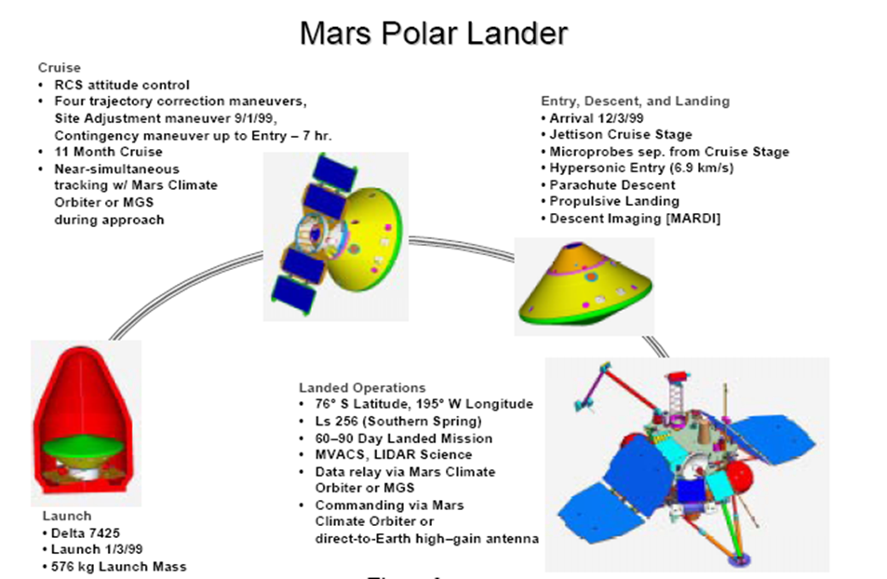
On the other hand…
“The peer review … indicates that one team used English units (e.g., inches, feet and pounds) while the other used metric units… This information was critical to the maneuvers to place the spacecraft in the proper Mars orbit. “

Slide 27
Use Cases (scenarios)
One of the UML diagram types
A use case describes how to achieve a single business goal or task through the interactions between external actors and the system
A good use case must:
Describe a business task
Not be implementation-specific
Provide appropriate level of detail
Be short enough to implement by one developer in one release

Slide 28
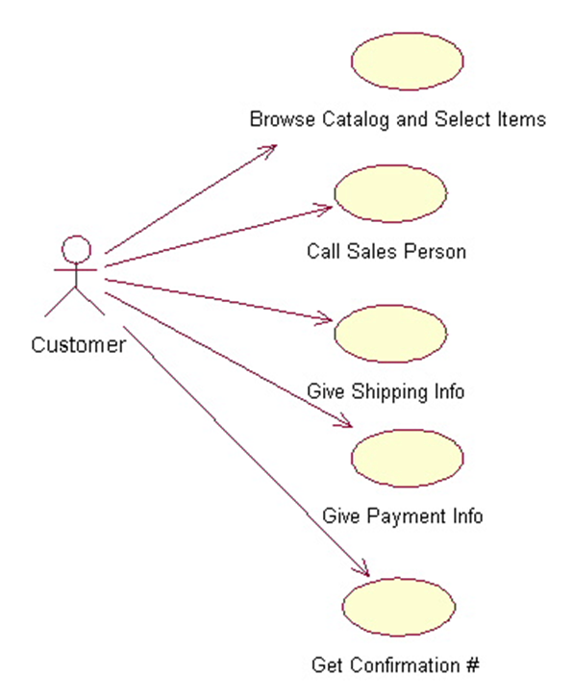
Use case example
Place an order:
Browse catalog & select items
Call sales representative
Supply shipping information
Supply payment information
Receive conformation number from salesperson
May have precondition, postcondition, invariant

Slide 29
Another example: ordering through Amazon
Rank Supplier
Search Product
«extend»
«include»
View Product Details
Write Review
After page generation
Navigate Deals
«include»
«extend»
Add to cart
«extend»
Checkout
«include»
«extend»
user is not
a member
Login
Register
Handle Order Status
«include»
Source: Eran Toch
Notes:
Important points: Note that weak relations between use-cases are not mentioned. For instance, add to cart provides products to checkout, but the relation is not modeled. Also, the hierarchy between use-cases originates from the user perspective: Even though “View Product Details” is the central component from the programmers point of view, the user wants to search products or to see deals, and that the top use-case.
Use extend when:
You want to leave the important UC as simple as possible
For flexibility: we want to be able to add more features to important UCses.
When the extending UC is rare, it does not always happen.

Slide 30
Agile requirements
Source: Leffingwell 11
No “Big Upfront Requirements” but “user stories”
A user story is a brief statement of intent that describes something system needs to do for the user
Example user story:
“As a consumer, I want to be able to see my daily energy usage so that I can lower my energy costs and usage”.

Slide 31
Requirements under agile methods
Under XP: requirements are taken into account as defined at the particular time considered
Requirements are largely embedded in test cases
Benefits:
Test plan will be directly available
Customer involvement
Risks:
Change may be difficult (refactoring)
Structure may not be right
Test only cover the foreseen cases

Slide 32
My view
Use cases and user stories help requirement elicitation but not a fundamental requirement technique. They cannot define the requirements:
Not abstract enough
Too specific
Describe current processes
Do not support evolution
Use cases are to requirements what tests are to software specification and design
Major application: for validating requirements

Slide 33
User stories
X f (x)
0
0
1
1
2
4
3
9
4
16
...
...

Slide 34
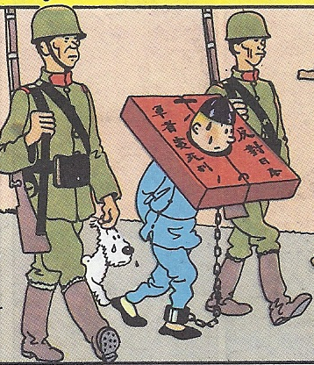
Use cases as requirements

Slide 35
What use cases (and user stories) are good for
They are ways to validate the user requirements
Use cases are to requirements (specifications) what tests are to programs
The task of requirements is to abstract from user stories

Slide 36
Practical advice
Apply use cases for validating the requirements and deriving the test plan

Slide 37
Literate Programming
First version called “WEB” developed by Knuth for TeX word processing system
Key characteristics:
Regards programming as the transformation of a document into code.
Natural language text and code are unified into one document. Automatic tools are used to extract the code and generate the program.
During development, parts can be left unspecified.
Opens the “Analyse, Design, Implement”-Triatlon

Slide 38
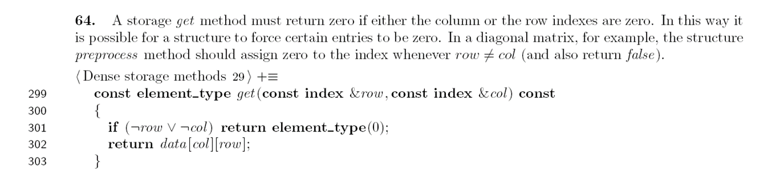
Literate Programming (cont.)

Slide 39
Practical advice
Retain the best agile practices, such as frequent iterations, customer involvement, centrality of code & testing.
Disregard those that contradict proven software engineering principles.

Slide 40
Tasks of Requirements Management tools
Extract
Capture
Store
Collaborate
Version
Identify
Categorize
Trace
Merge
Present

Slide 41
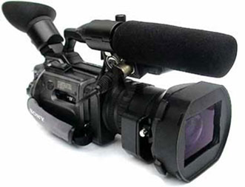
Extract
Sources for requirements come in different forms:
Microsoft Word Documents
PDF Documents
Diagrams
Photos
E-Mails
Video, Audio
Requirements must be extracted from these documents
Any extracted requirement should be linked to its source

Slide 42
Capture
Are requirements always plain text?
“A picture can say more than a thousand words.”
Technical applications are often specified with mathematical equations.
Same problem as requirement sources: video, audio, photos, etc.

Slide 43
Store
From “requirements document” to requirements database
For large and long-term projects, the database can become very large.
Fast retrieval of data ?
Query mechanisms or languages ?

Slide 44
Collaborate
If there are many people working on the same requirement data:
How can they all access the data ?
How is tracked “Who changes what ?”
Collision detection

Slide 45
Versioning
Software Development is a process that happens over time
Requirements are a moving target
Documents are constantly changed
Certain versions of the documents form the basis for contractual agreements

Slide 46
Identify
Every requirement needs an identification
This identification has to be unique and stable over time and space
The identification should be human-readable to facilitate communication between developers and stakeholders

Slide 47
Tasks of a requirements management tool
Extract
Capture
Store
Collaborate
Version
Identify
Categorize
Trace
Merge
Present
Tasks of Software Configuration Management

Slide 48
Categorize
Standard techniques:
Hierarchical structure
Tags (labels)
Numbering
Development of a good categorization structure is critical
Categorizations can be reused between projects
Categorization schemas depend on:
Doftware development methodology.
Problem domain.

Slide 49
Trace
Requirements do not stand alone
During the requirements process we identify:
Requirements that complement other requirements
Requirements that contradict other requirements
Requirements derived from other requirements
A tools has to:
Record connections
Present connections
Allow a “What if?” analysis of a possible change.

Slide 50
Example of a trace
Customer: Access to the server should be available at any time.
Manager: The system has to have a 99.999% availability.
Hardware Maintainer: The software must run in a distributed environment with a seamless failover functionality and no single point of fail.

Slide 51
Merge
Many sources for requirements
At least one for every stakeholder
A single document should be produced
A tool can support this process:
Showing differences between documents.
Identifying similarities between documents.

Slide 52
Present
The final requirements document has to
Form the contractual basis between client and supplier.
Be well-structured and understandable
The tools should be able to generate a current version of the requirements document automatically at any time.

Slide 53
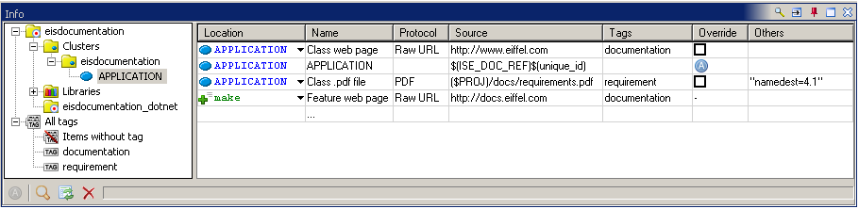
EIS: Outgoing link
Example outgoing link:
note
EIS: "name=Project Requirement",
"src=$(PROJ)/docs/requirements.pdf",
"protocol=PDF",
"nameddest=4.1", "tag=requirement“
Information tool:

Slide 54
EIS: incoming link
New form of URI; examples:
eiffel:?class=STRING_8&feature=is_equal
eiffel:?cluster=elks&class=STRING_8&feature=is_equal
eiffel:?target=base&cluster=elks&class=STRING_8&feature=is_equal
eiffel:?class=STRING_8
eiffel:?cluster=elks
Search for “EIS” at http://docs.eiffel.com

Slide 55
- 5 -
Object-Oriented Requirements Analysis & Abstract Data Types
- 1 – Overview of the requirements task

Slide 56
Analysis classes
deferred class VAT
inherit
TANK
feature
in_valve, out_valve: VALVE
fill -- Fill the vat.
require in_valve.open
out_valve.closed
deferred ensure in_valve.closed
out_valve.closed
is_full
end
empty, is_full, is_empty, gauge, maximum, ... [Other features] ...
invariant
is_full = (gauge >= 0.97 * maximum) and (gauge <= 1.03 * maximum)
end

Slide 57
What is object-oriented analysis?
Classes around object types (not just physical objects but also important concepts of the application domain)
Abstract Data Types approach
Deferred classes and features
Inter-component relations: “client” and inheritance
Distinction between reference and expanded clients
Inheritance — single, multiple and repeated for classification.
Contracts to capture the semantics of systems: properties other than structural.
Libraries of reusable classes

Slide 58
Analysis classes
deferred class VAT
inherit
TANK
feature
in_valve, out_valve: VALVE
fill -- Fill the vat.
require in_valve.open
out_valve.closed
deferred ensure in_valve.closed
out_valve.closed
is_full
end
empty, is_full, is_empty, gauge, maximum, ... [Other features] ...
invariant
is_full = (gauge >= 0.97 * maximum) and (gauge <= 1.03 * maximum)
end
Precondition
Specified, not implemented
Postcondition
Class invariant

Slide 59
What O-O requirements analysis is not
Use cases
(Not appropriate as requirements statement mechanism)
Use cases are to requirements what tests are to specification and design

Slide 60
The mathematical basis: abstract data types
A formal way of describing object structures
Benefits:
Modular, precise description of a wide range of problems
Enables proofs
Basis for object technology
Basis for object-oriented requirements

Slide 61
What are object-oriented requirements?
Classes around object types (not just physical objects but also important concepts of the application domain)
Abstract Data Types approach
Deferred classes and features
Inter-component relations: “client” and inheritance
Distinction between reference and expanded clients
Inheritance — single, multiple and repeated for classification.
Contracts to capture the semantics of systems: properties other than structural.
Libraries of reusable classes

Slide 62
O-O analysis
Same benefits as O-O programming, in particular extendibility and reusability
Direct modeling of the problem domain
Seamlessness and reversibility with the continuation of the project (design, implementation, maintenance)
To be continued: we need abstract data types before continuing the discussion of O-O analysis. See lecture 3.

Slide 63
Analysis classes
deferred class VAT
inherit
TANK
feature
in_valve, out_valve: VALVE
fill is -- Fill the vat.
require in_valve.open
out_valve.closed
deferred ensure in_valve.closed
out_valve.closed
is_full
end
empty, is_full, is_empty, gauge, maximum, ... [Other features] ...
invariant
is_full = (gauge >= 0.97 * maximum) and (gauge <= 1.03 * maximum)
end
Precondition
Specified, not implemented
Postcondition
Class invariant

Slide 64
Television station example
Source: OOSC
class SCHEDULE feature
segments: LIST [SEGMENT]
end

Slide 65
Schedules
note
description : “ 24-hour TV schedules”
deferred class SCHEDULE feature
segments: LIST [SEGMENT ]
-- Successive segments
deferred end
air_time : DATE -- 24-hour period -- for this schedule deferred end
set_air_time (t : DATE)
-- Assign schedule to -- be broadcast at time t.
require
t.in_future
deferred
ensure
air_time = t
end
print
-- Produce paper version.
deferred
end
end

Slide 66
Contracts
Feature precondition: condition imposed on the rest of the world
Feature postcondition: condition guaranteed to the rest of the world
Class invariant: Consistency constraint maintained throughout on all instances of the class

Slide 67
Why contracts
Specify semantics, but abstractly!
(Remember basic dilemma of requirements:
Committing too early to an implementation Overspecification!
Missing parts of the problem Underspecification!
)

Slide 68
Segment
note
description : “TV program component "
deferred class SEGMENT feature
schedule : SCHEDULE deferred end -- Schedule to which -- segment belongs
index: INTEGER deferred end -- Position of segment in -- its schedule
starting_time, ending_time : INTEGER deferred end -- Beginning and end of -- scheduled air time
next: SEGMENT deferred end -- Segment to be played -- next, if any
sponsor : COMPANY deferred end -- Segment’s principal sponsor
rating : INTEGER deferred end -- Segment’s rating (for -- children’s viewing etc.)
… Commands change_next, set_sponsor, set_rating omitted …
Minimum_duration : INTEGER = 30 -- Minimum length of segments, -- in seconds
Maximum_interval : INTEGER = 2 -- Maximum time between two -- successive segments, in seconds

Slide 69
Segment (continued)
invariant
in_list: (1 <= index) and (index <= schedule.segments.count)
in_schedule: schedule.segments [index] = Current
next_in_list: (next /= Void ) implies schedule.segments [index + 1] = next
no_next_iff_last: (next = Void) = (index = schedule.segments.count)
non_negative_rating: rating >= 0
positive_times: (starting_time > 0 ) and (ending_time > 0)
sufficient_duration: ending_time – starting_time >= Minimum_duration
decent_interval : (next.starting_time) - ending_time <= Maximum_interval
end

Slide 70
Commercial
note
description: "Advertizing segment "
deferred class COMMERCIAL inherit
SEGMENT
rename sponsor as advertiser end
feature
primary: PROGRAM deferred -- Program to which this -- commercial is attached
primary_index: INTEGER deferred -- Index of primary
set_primary (p : PROGRAM)
-- Attach commercial to p.
require
program_exists: p /= Void
same_schedule: p,schedule = schedule
before: p.starting_time <= starting_time
deferred
ensure
index_updated: primary_index = p.index
primary_updated: primary = p
end
invariant
meaningful_primary_index: primary_index = primary.index
primary_before: primary.starting_time <= starting_time
acceptable_sponsor: advertizer.compatible (primary.sponsor)
acceptable_rating: rating <= primary.rating
end

Slide 71
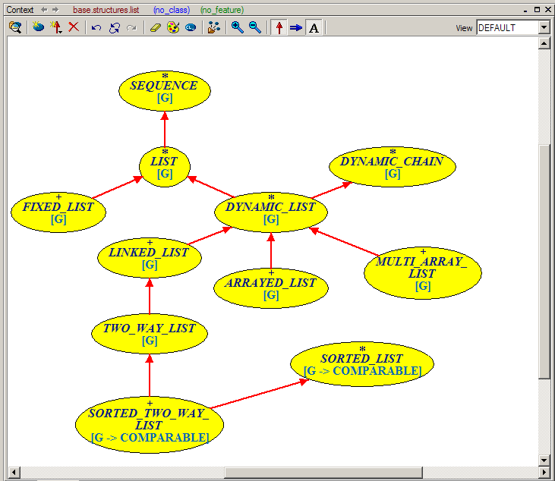
Diagrams: UML, BON
Text-Graphics Equivalence

Slide 72
O-O analysis process
Identify abstractions
New
Reused
Describe abstractions through interfaces, with contracts
Look for more specific cases: use inheritance
Look for more general cases: use inheritance, simplify
Iterate on suppliers
At all stages keep structure simple and look for applicable contracts

Slide 73
Practical advice
Write ADT specifications for delicate parts of the system requirements

Slide 74
The four PEGS
Environment
Goals
Project
System

Slide 75
References between the four PEGS
Environment
Goals
Project
System
May reference

Slide 76
Verification obligations between the four PEGS
Environment
Goals
Project
System
Must satisfy

Slide 77
The requirements process
loop
loop
state_goals || analyze_environment
plan_project || define_clusters
verify
end
select_clusters
across selected as s loop
loop
sìanalyze; sìdesign; sìimplement; sìverify; sìgeneralize
end
end
verify
end

Slide 78
The lifecycle model
Define goals
Analyze environment
Sprint definition
Plan project
Define clusters
Verify
Select clusters
Sprint implementation
Verify

Slide 79
In what notation do we state elements?
For goals: mostly English
Everything else: Eiffel whenever possible, English otherwise (or other notations, e.g. graphics)
Connections/dependencies are recorded:
Automatically for Eiffel texts
Semi-automatically for Eiffel to something else
Manually (in our RSS) otherwise

