Slide 1
Patient-conditioned ECG forecasting
PTB-XL small-data pilot
0.6 s observed · 0.3 s forecast · 12 leads · 70 figures
Persistence MAE 0.141546 mV · best neural MAE 0.150113 mV

Slide 2
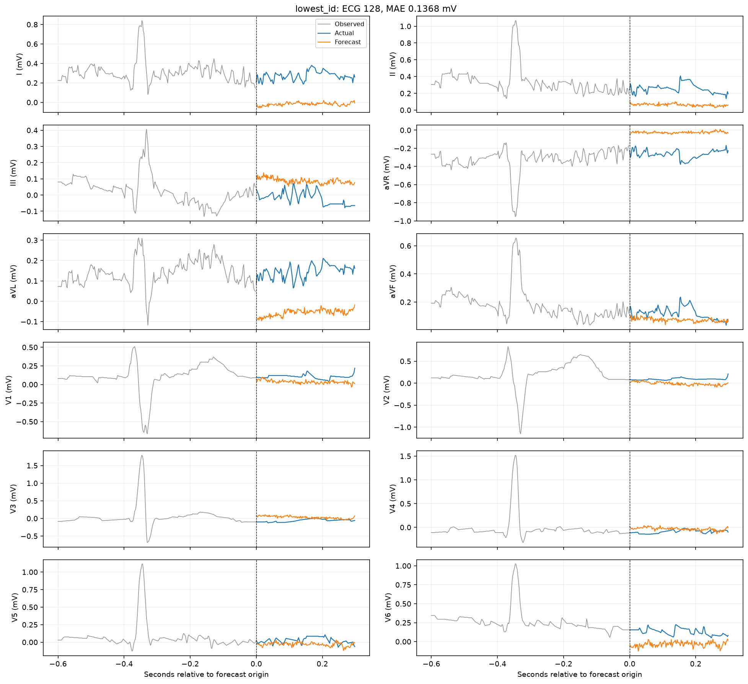
Lowest-ID test forecast
CNN-LSTM / demographics
02

Slide 3
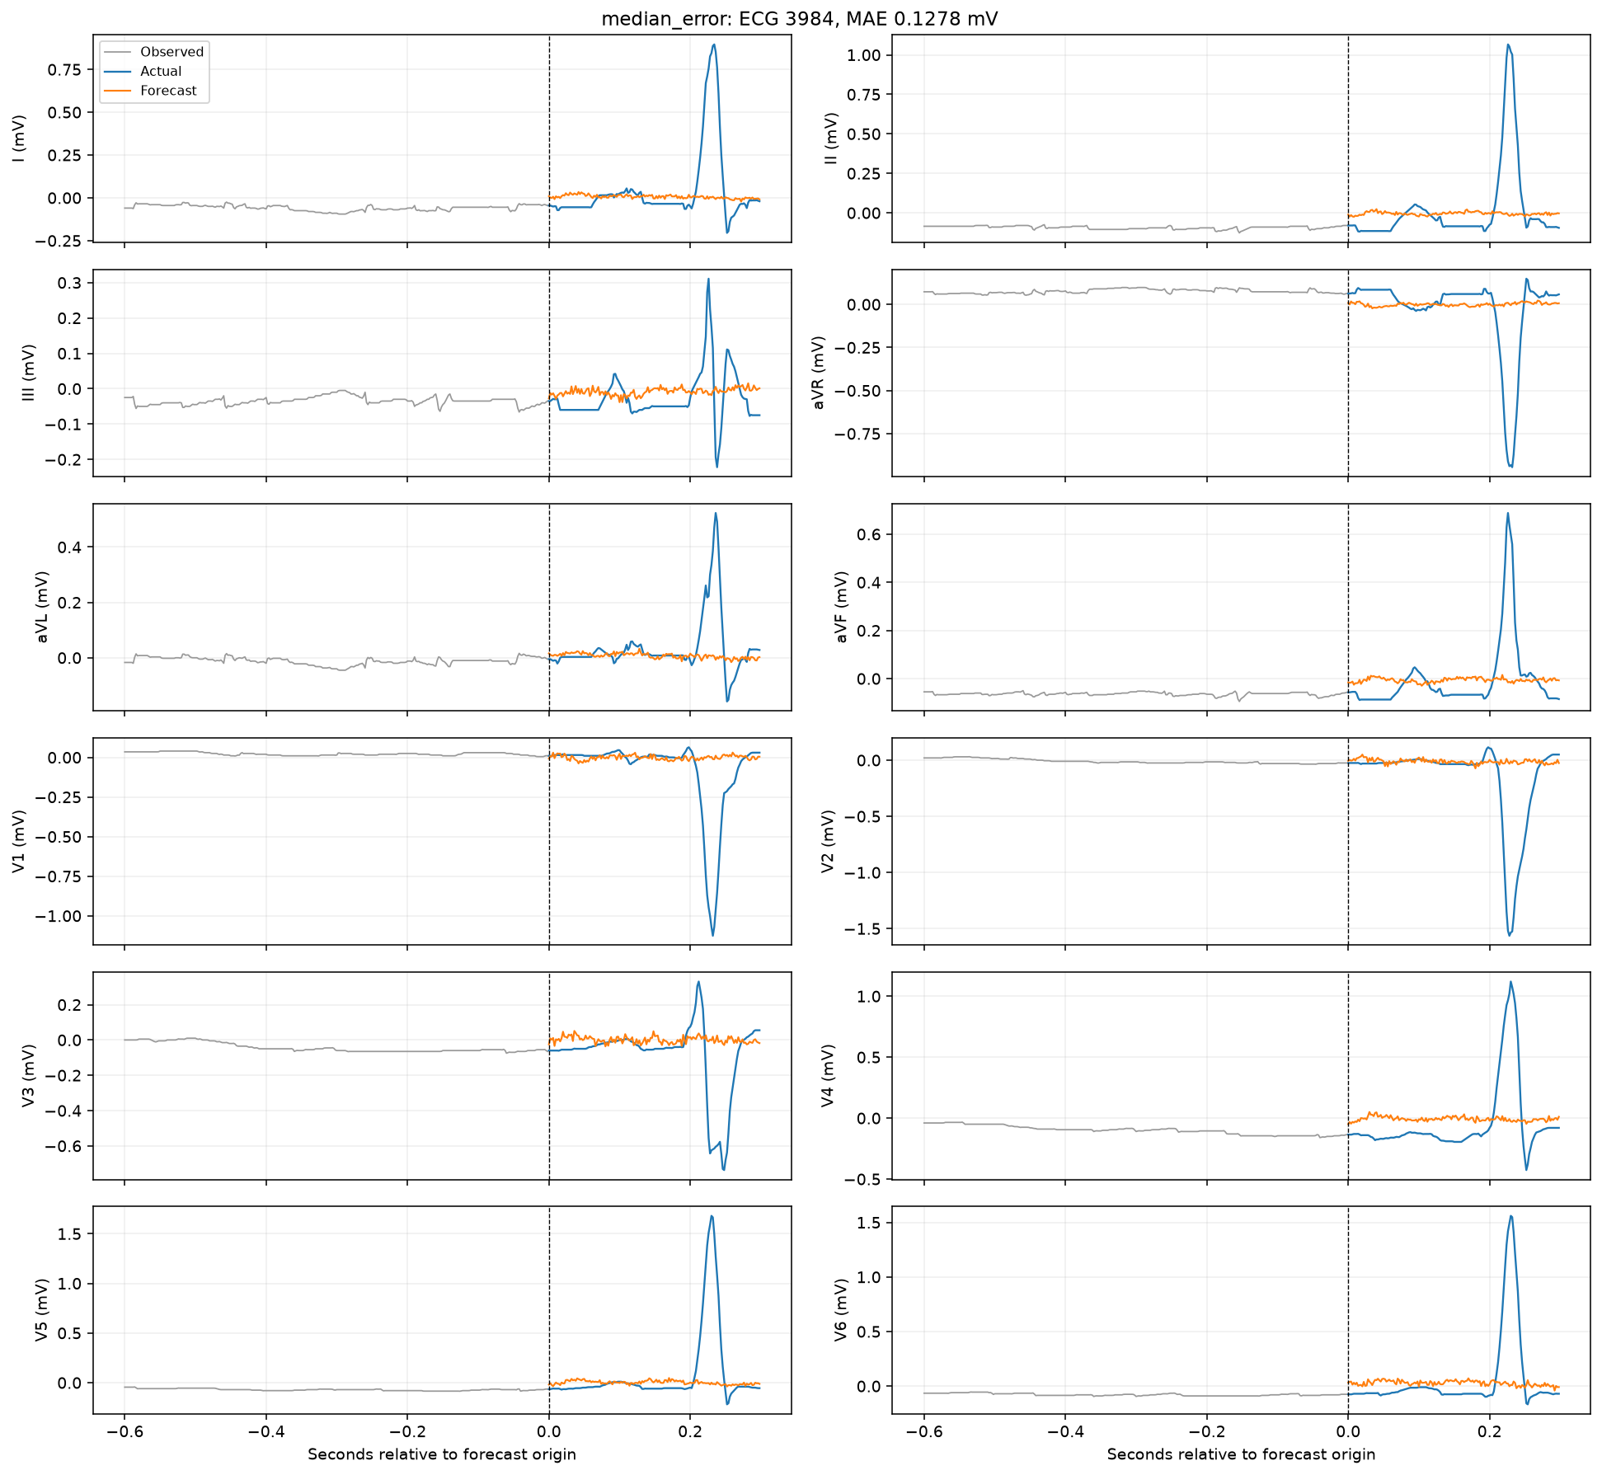
Median-error test forecast
CNN-LSTM / demographics
03

Slide 4
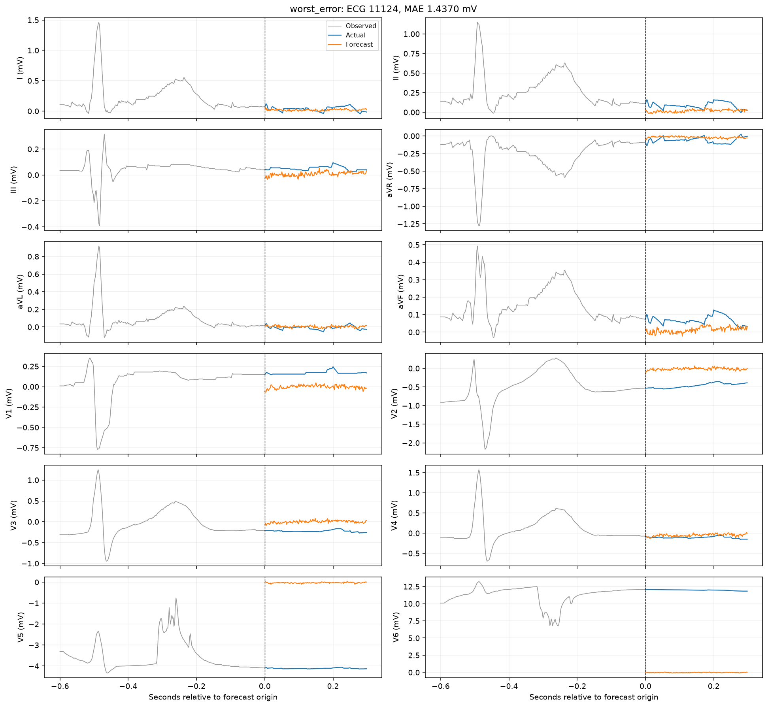
Worst-error test forecast
CNN-LSTM / demographics
04

Slide 5
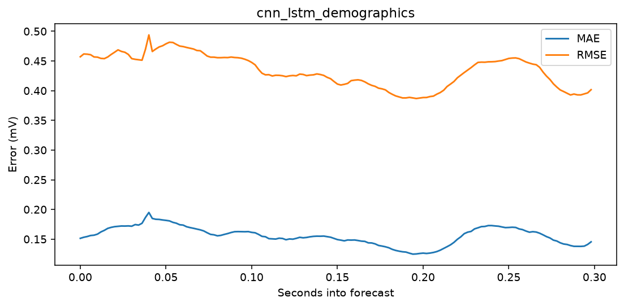
Forecast-horizon error
CNN-LSTM / demographics
05

Slide 6
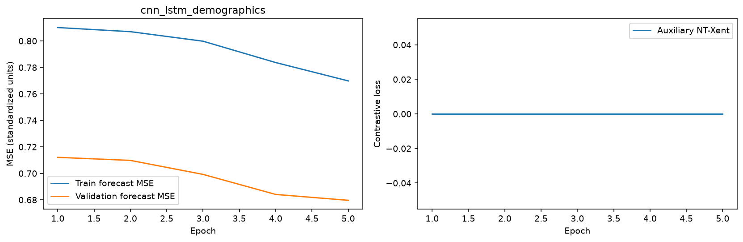
Learning curves
CNN-LSTM / demographics
06

Slide 7
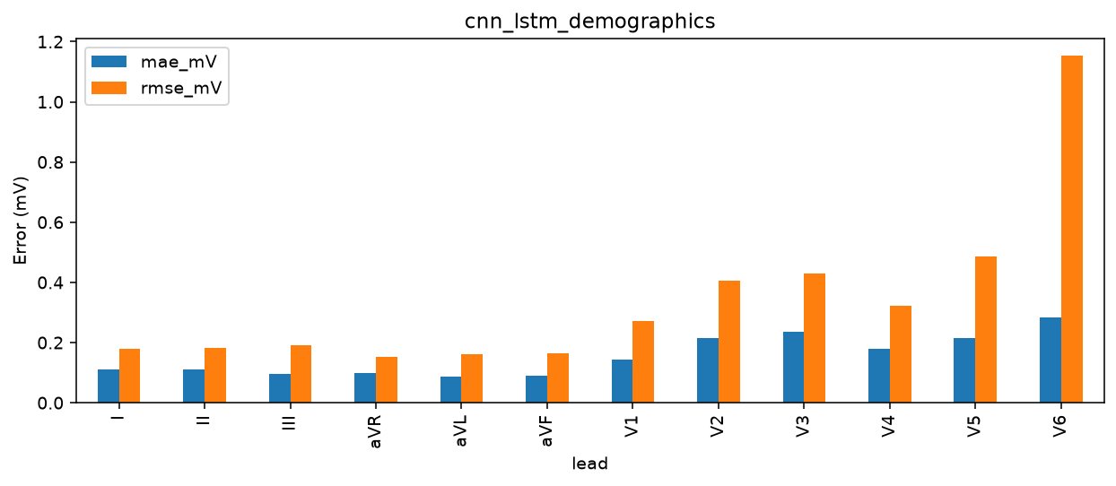
Per-lead errors
CNN-LSTM / demographics
07

Slide 8
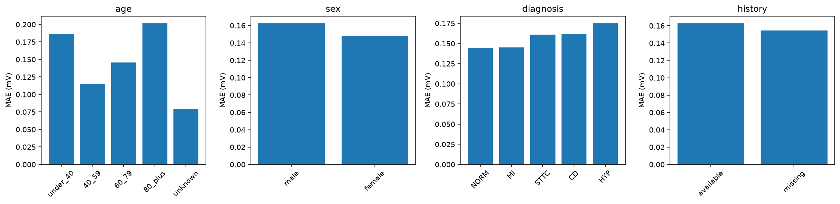
Patient subgroup errors
CNN-LSTM / demographics
08

Slide 9
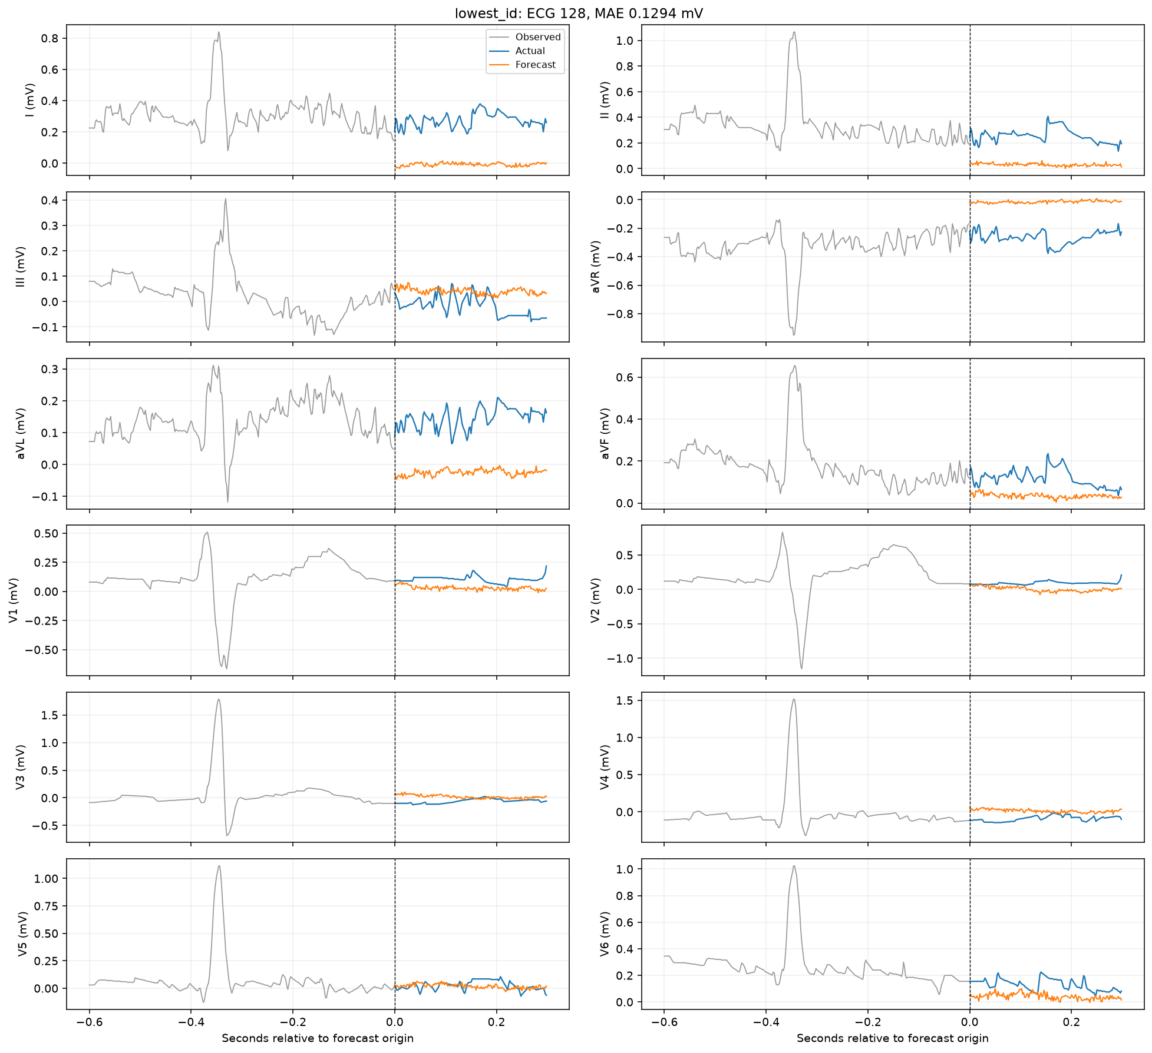
Lowest-ID test forecast
CNN-LSTM / ECG only
09

Slide 10
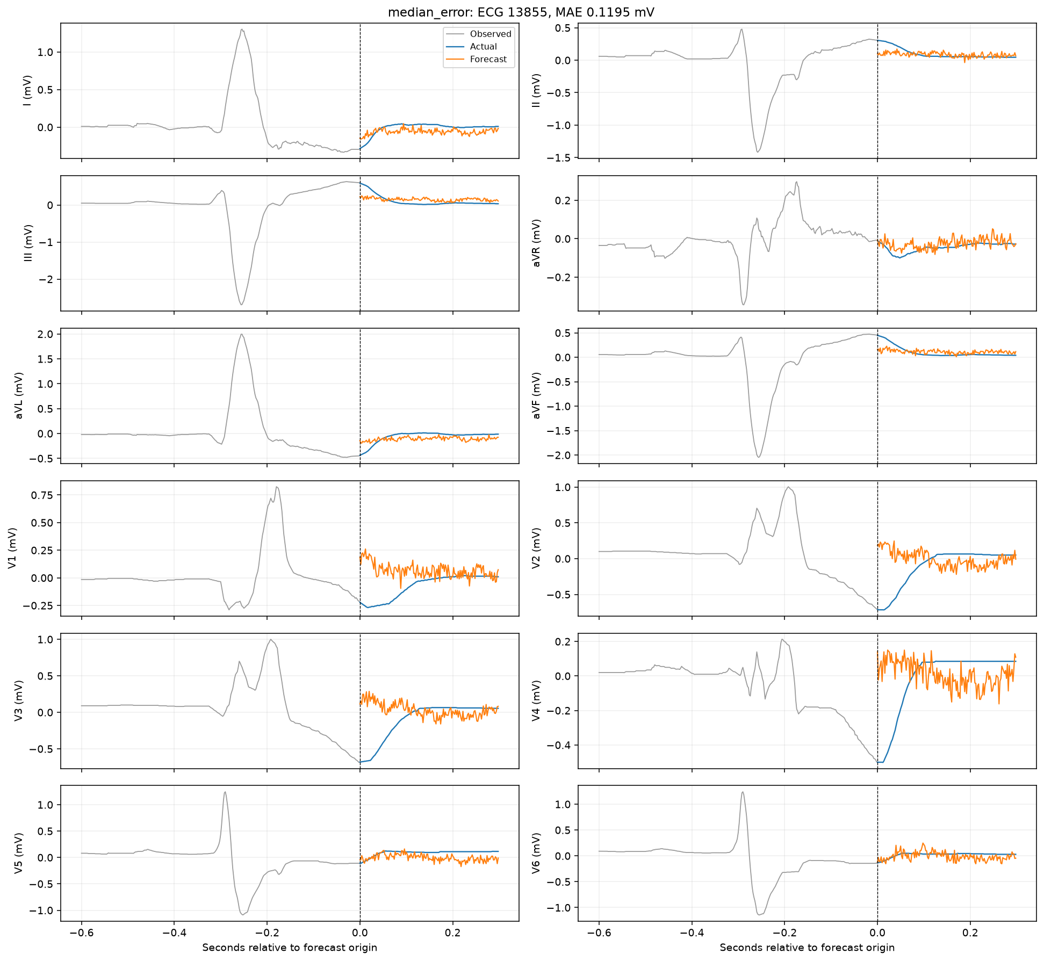
Median-error test forecast
CNN-LSTM / ECG only
10

Slide 11
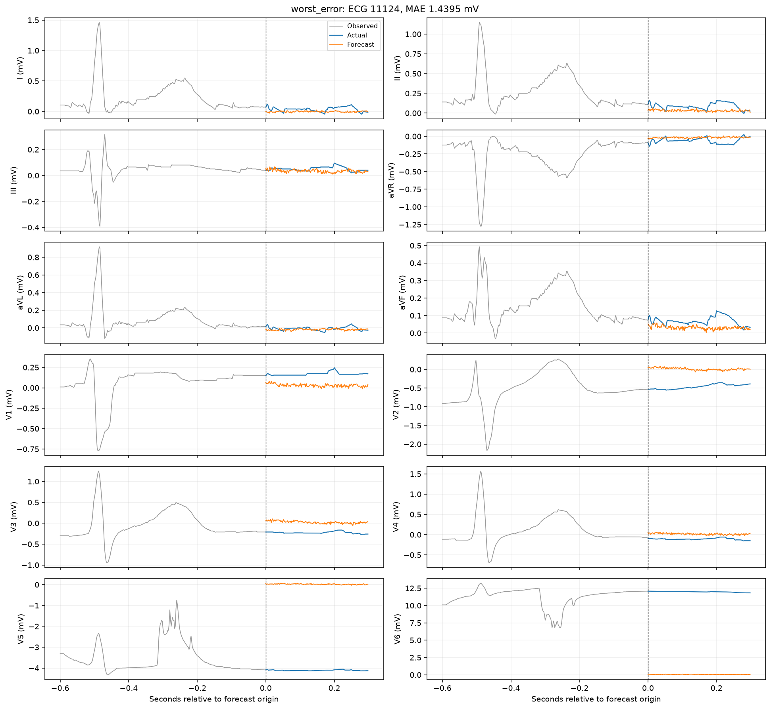
Worst-error test forecast
CNN-LSTM / ECG only
11

Slide 12
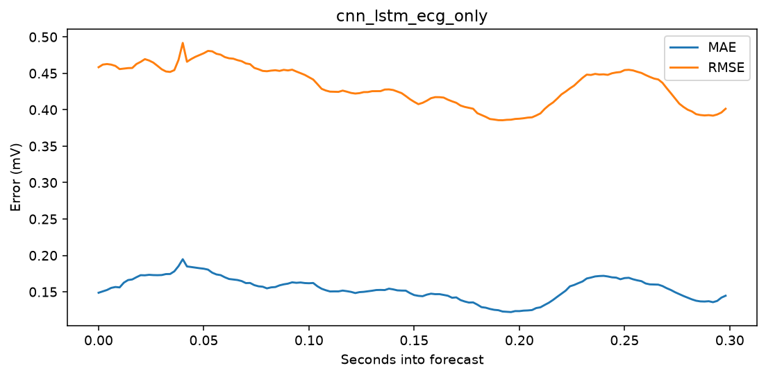
Forecast-horizon error
CNN-LSTM / ECG only
12

Slide 13
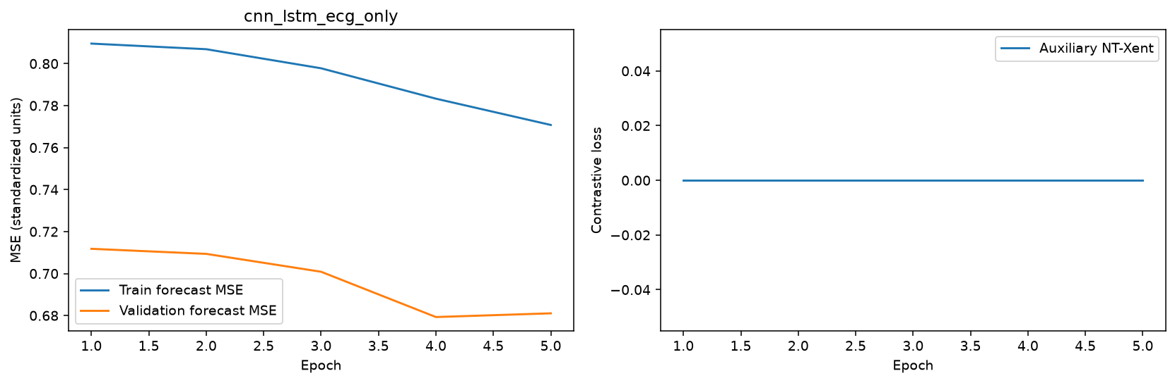
Learning curves
CNN-LSTM / ECG only
13

Slide 14

Per-lead errors
CNN-LSTM / ECG only
14

Slide 15
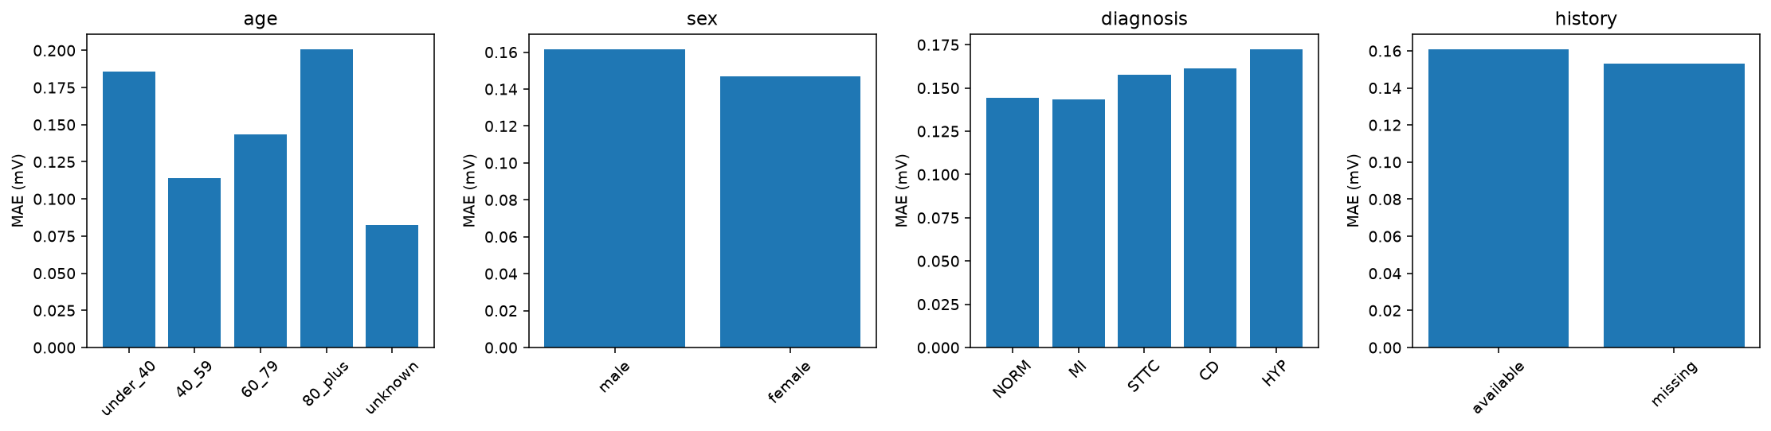
Patient subgroup errors
CNN-LSTM / ECG only
15

Slide 16
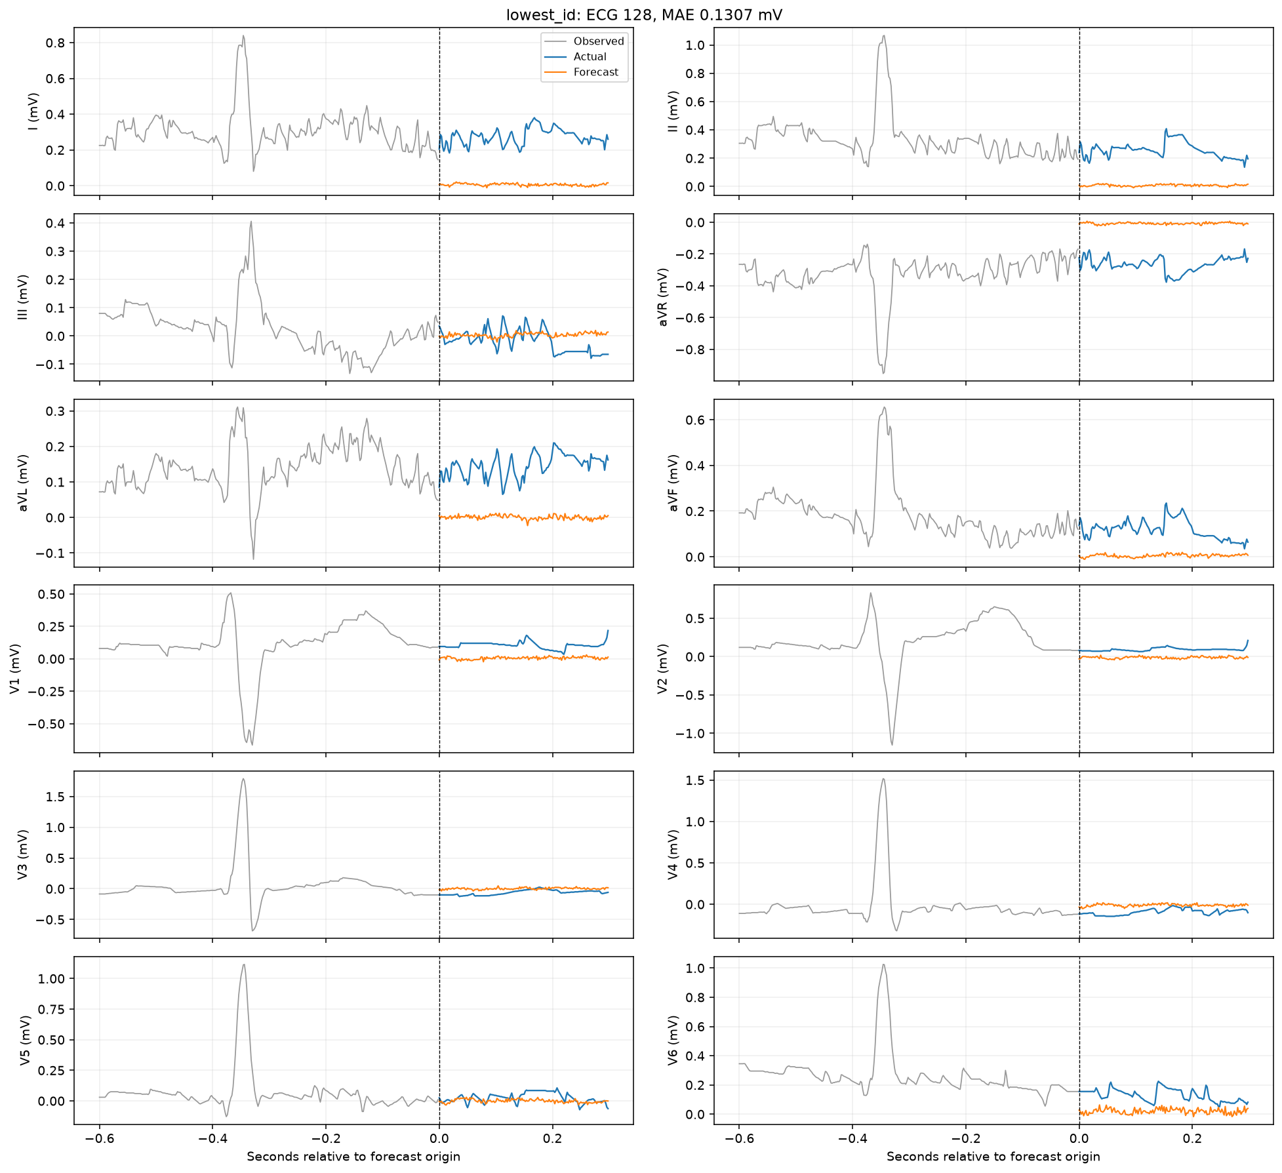
Lowest-ID test forecast
CNN-LSTM / patient history
16

Slide 17
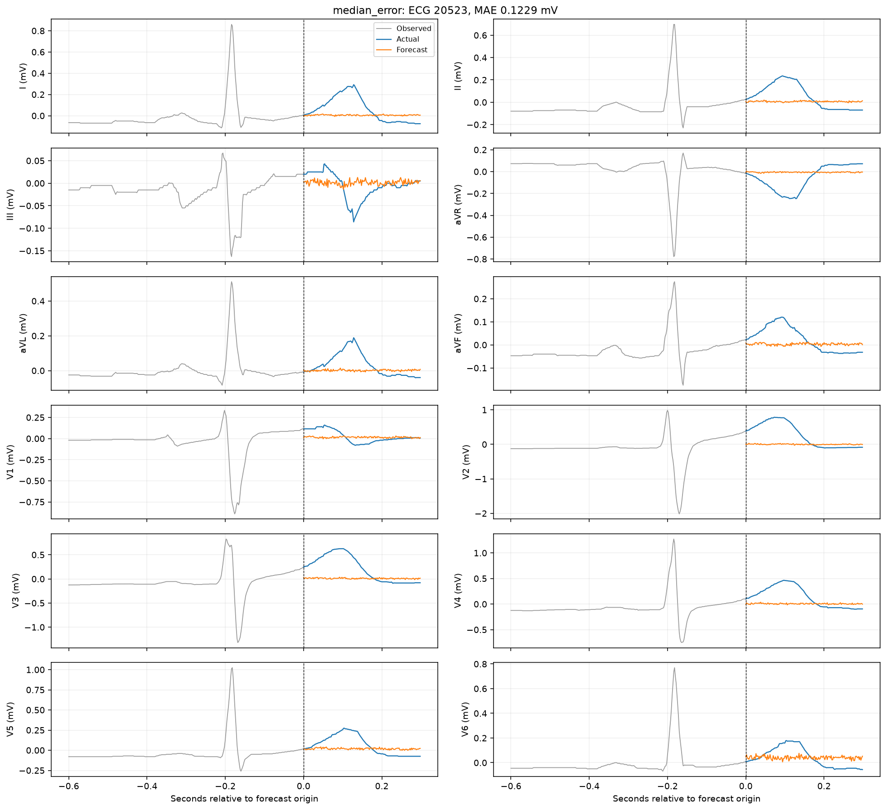
Median-error test forecast
CNN-LSTM / patient history
17

Slide 18
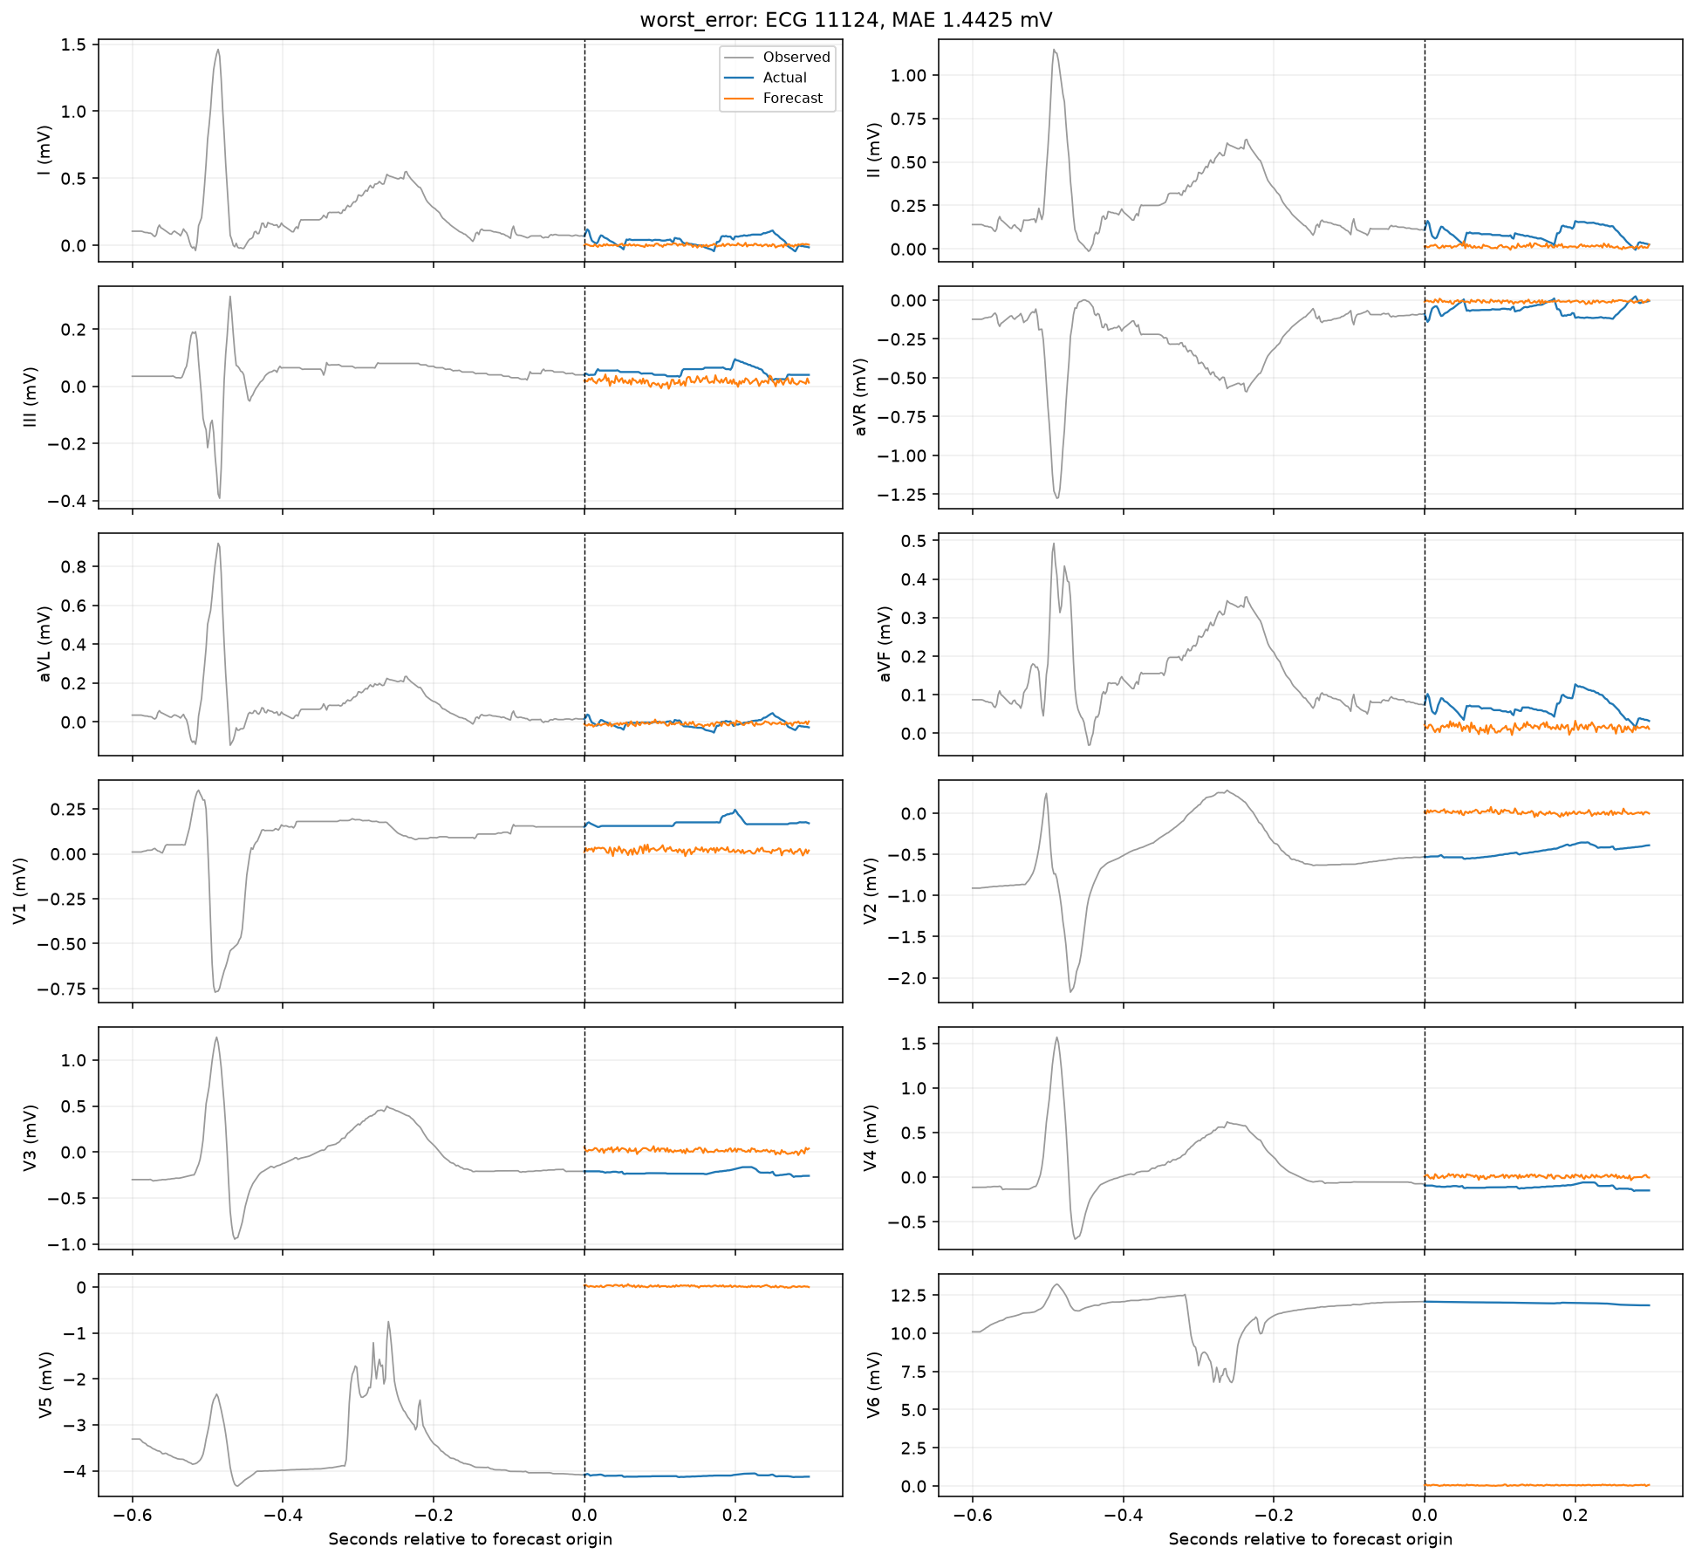
Worst-error test forecast
CNN-LSTM / patient history
18

Slide 19
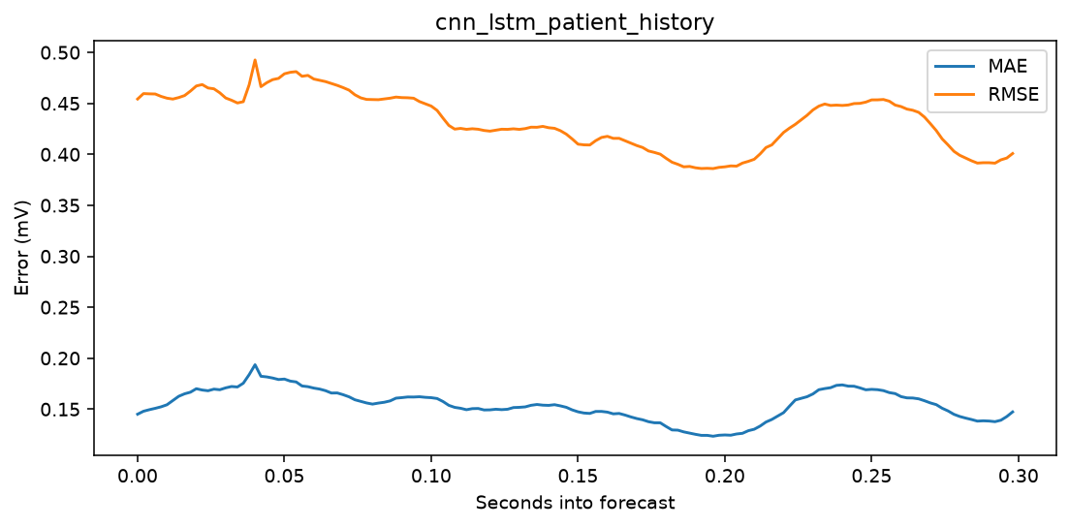
Forecast-horizon error
CNN-LSTM / patient history
19

Slide 20

Learning curves
CNN-LSTM / patient history
20

Slide 21
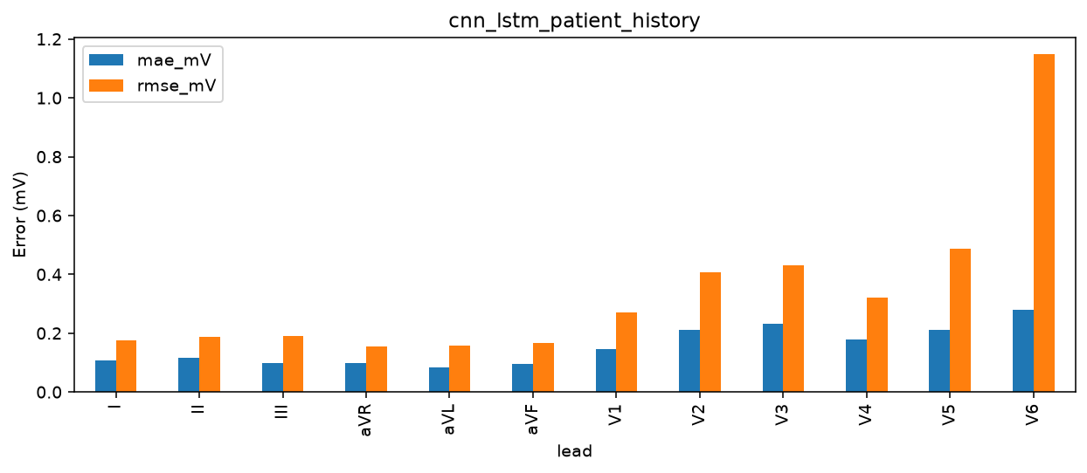
Per-lead errors
CNN-LSTM / patient history
21

Slide 22
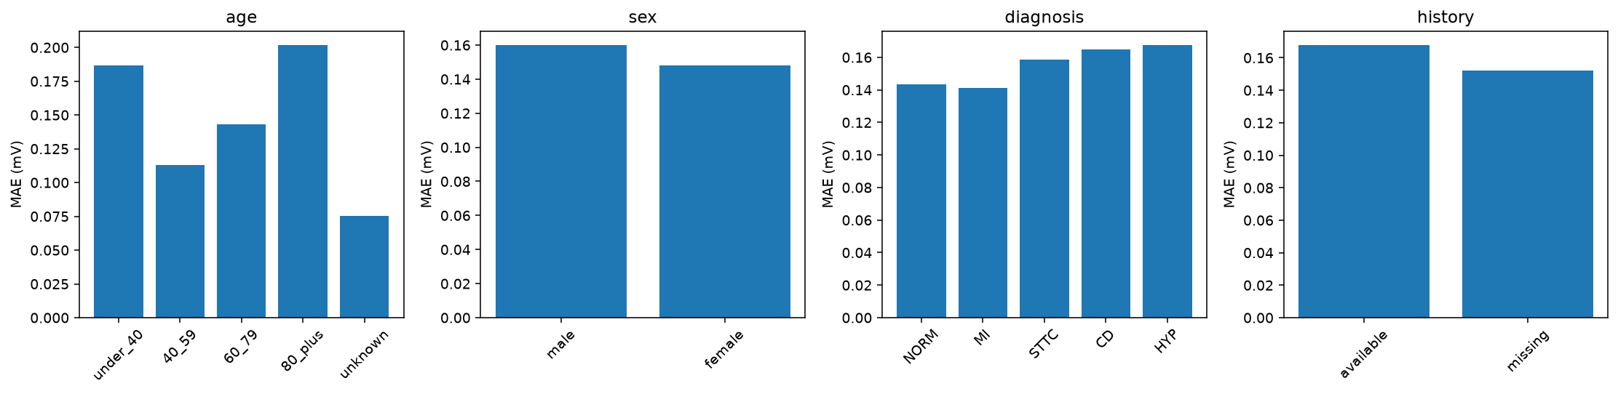
Patient subgroup errors
CNN-LSTM / patient history
22

Slide 23
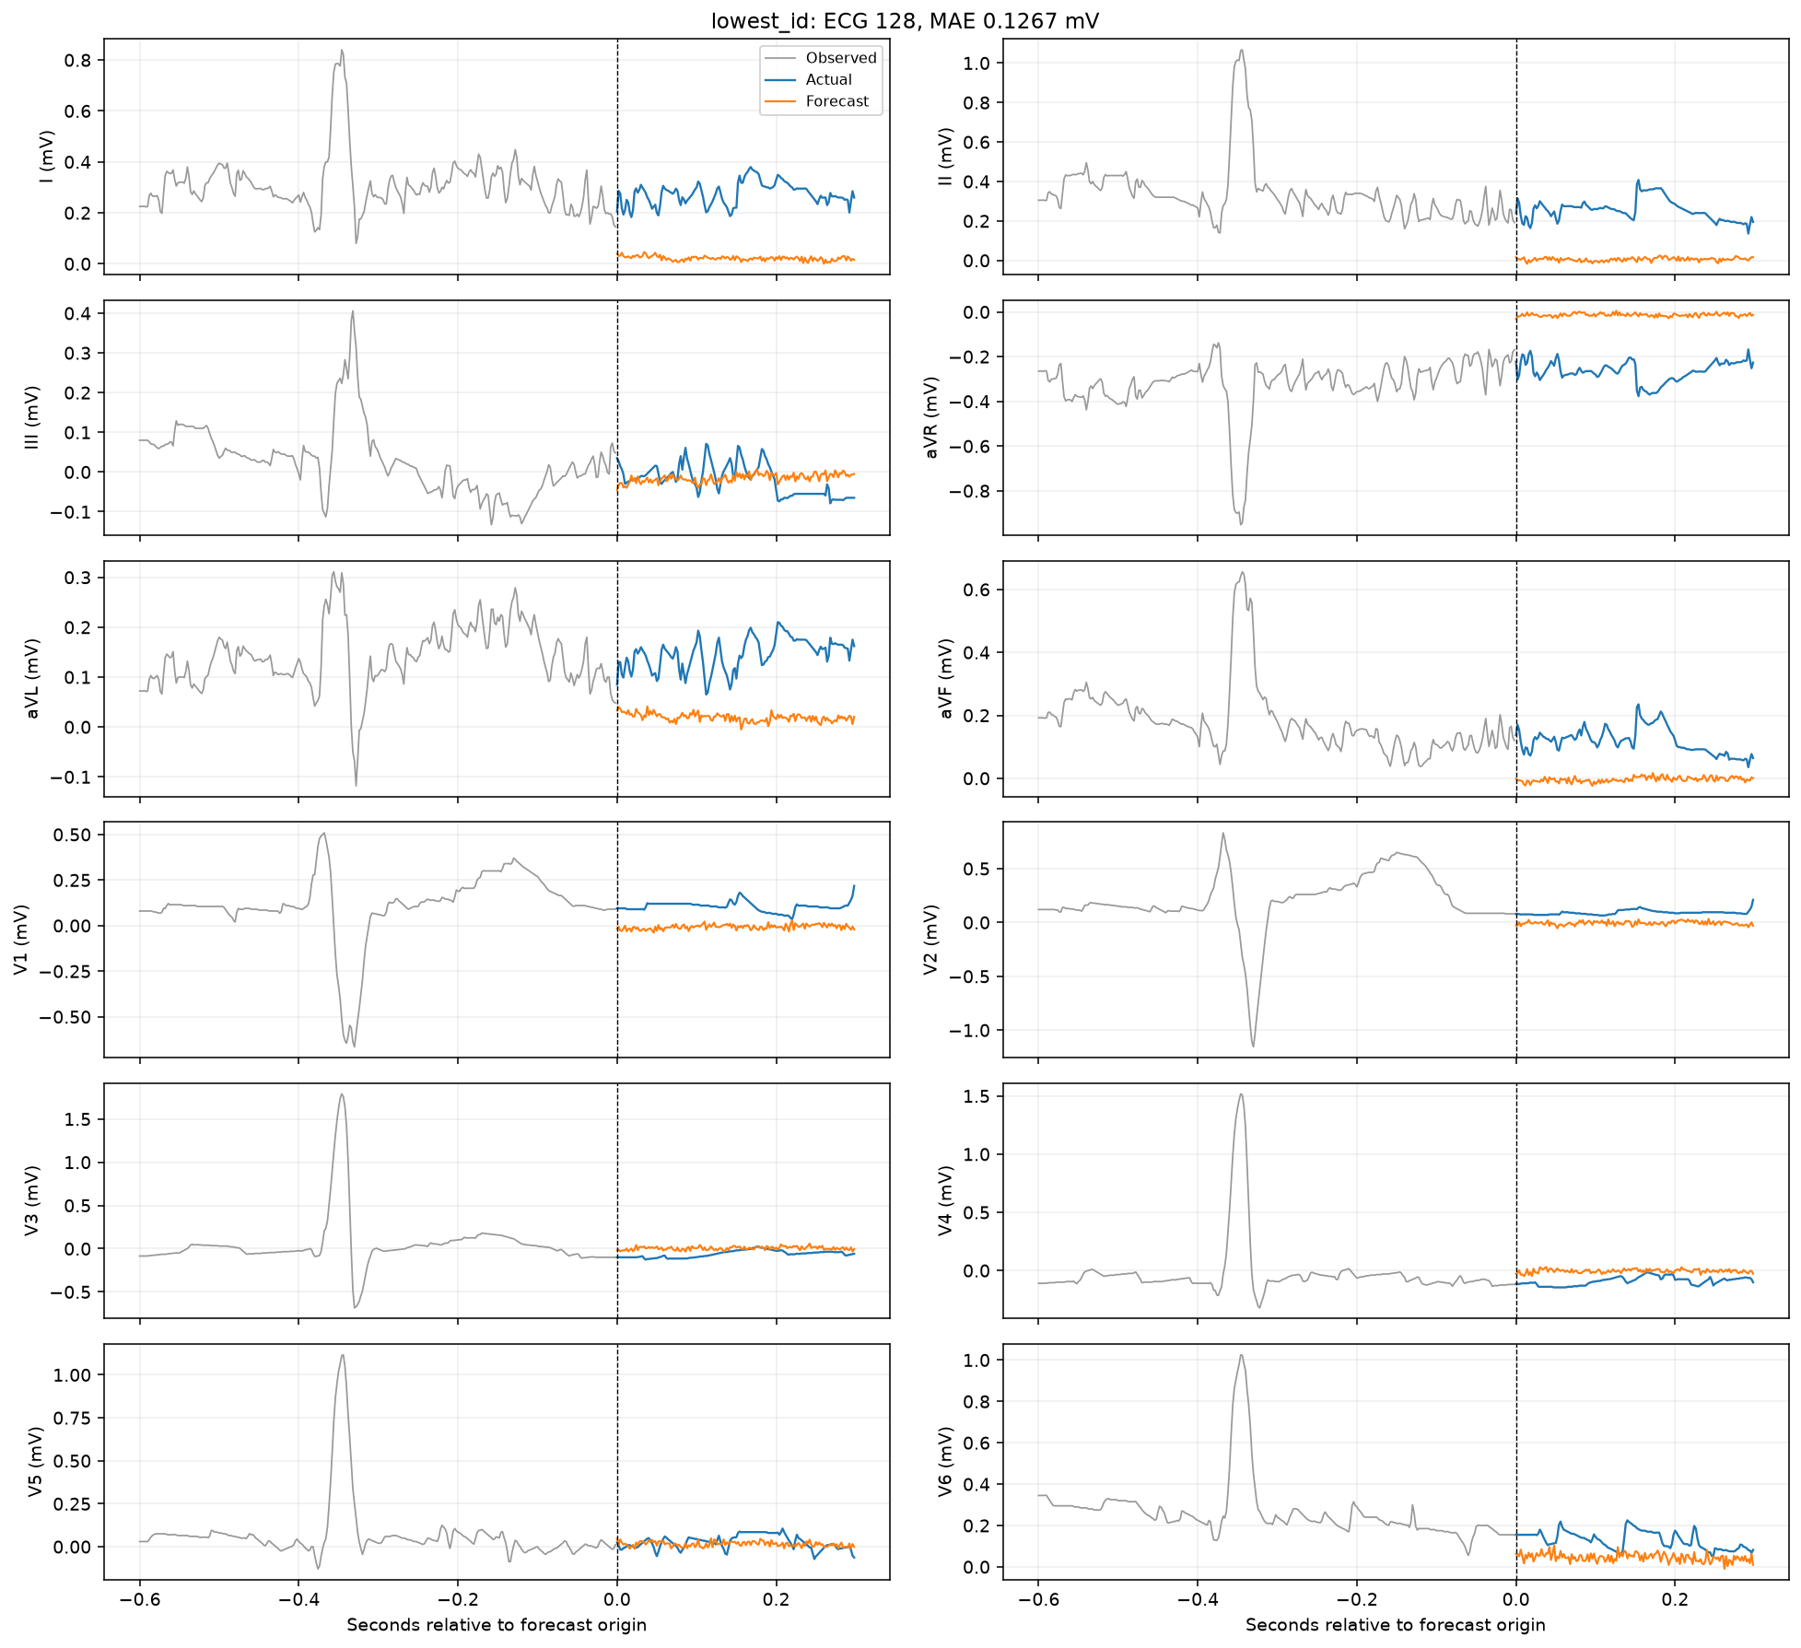
Lowest-ID test forecast
CNN-LSTM / patient history + contrastive
23

Slide 24
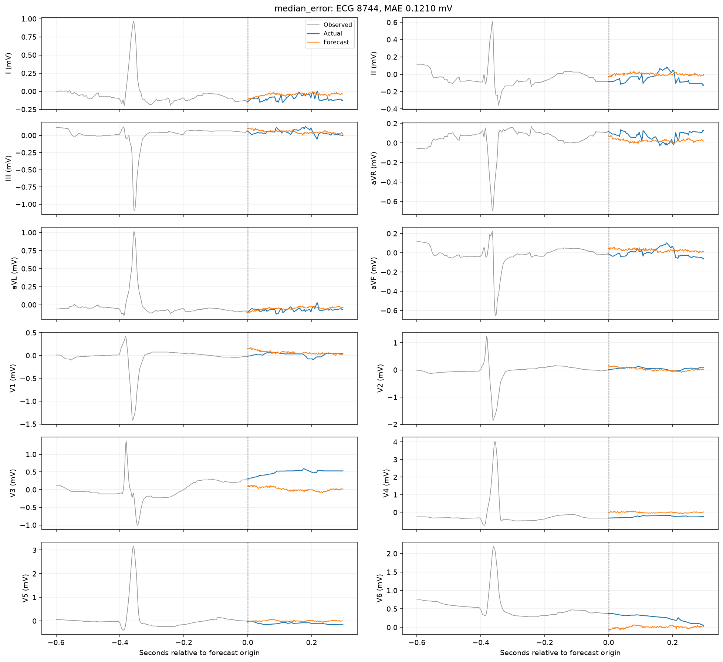
Median-error test forecast
CNN-LSTM / patient history + contrastive
24

Slide 25
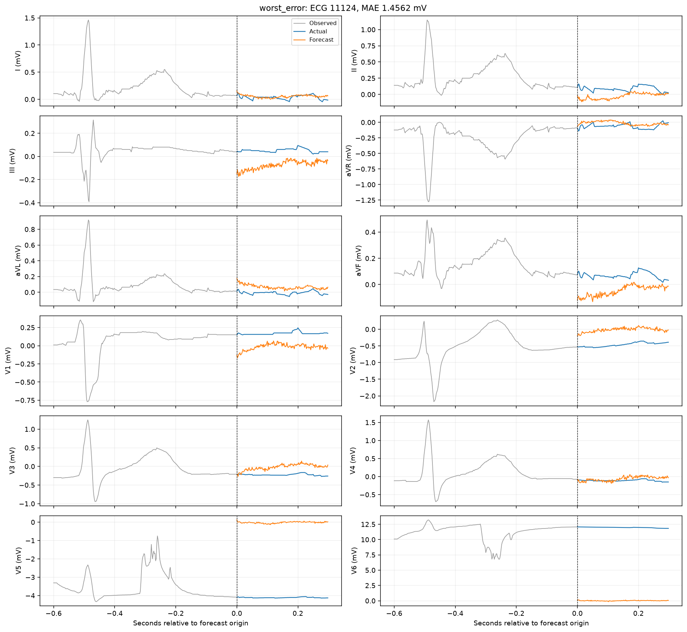
Worst-error test forecast
CNN-LSTM / patient history + contrastive
25

Slide 26
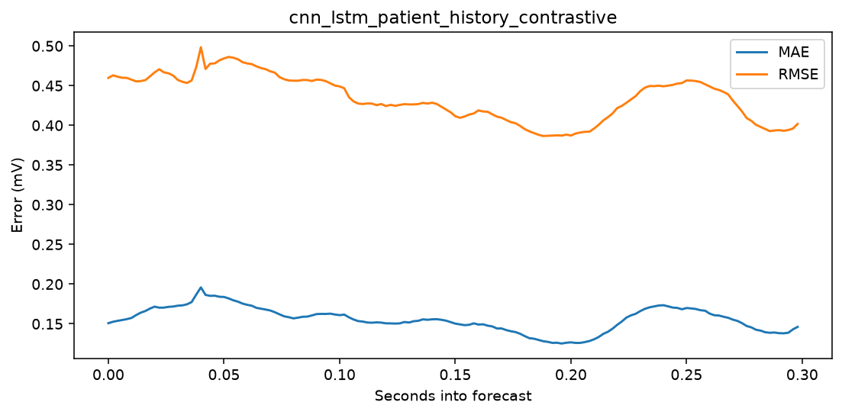
Forecast-horizon error
CNN-LSTM / patient history + contrastive
26

Slide 27
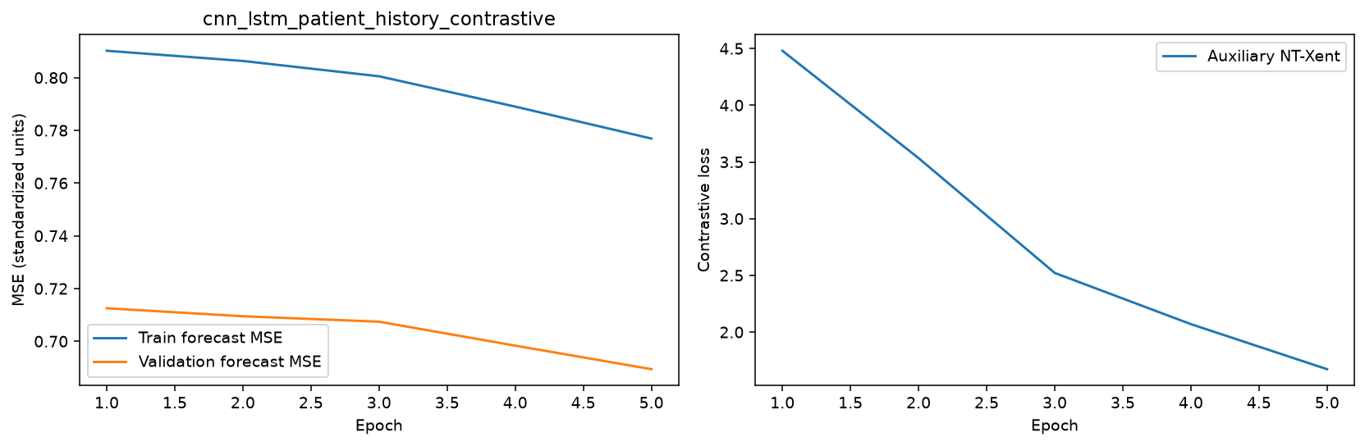
Learning curves
CNN-LSTM / patient history + contrastive
27

Slide 28
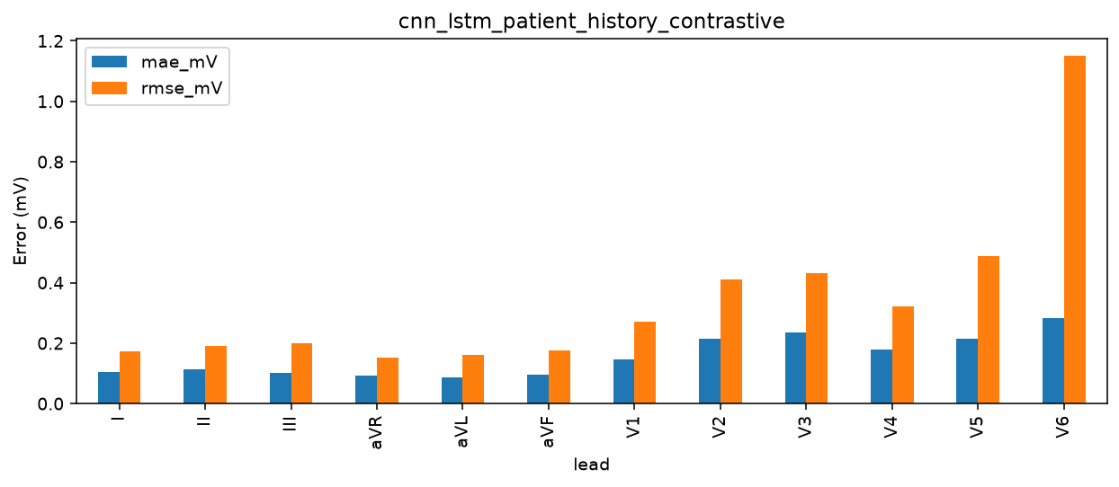
Per-lead errors
CNN-LSTM / patient history + contrastive
28

Slide 29
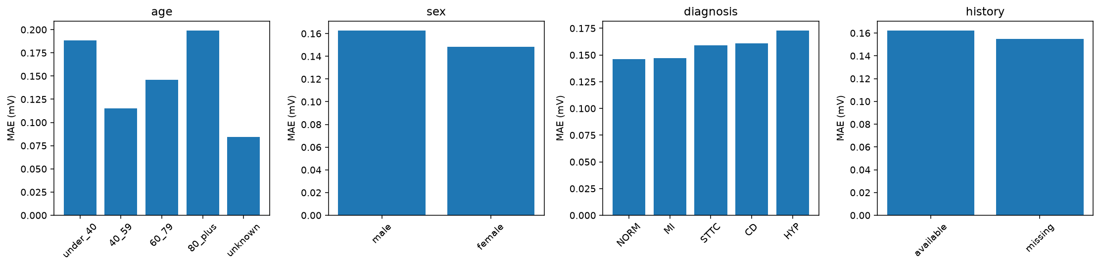
Patient subgroup errors
CNN-LSTM / patient history + contrastive
29

Slide 30
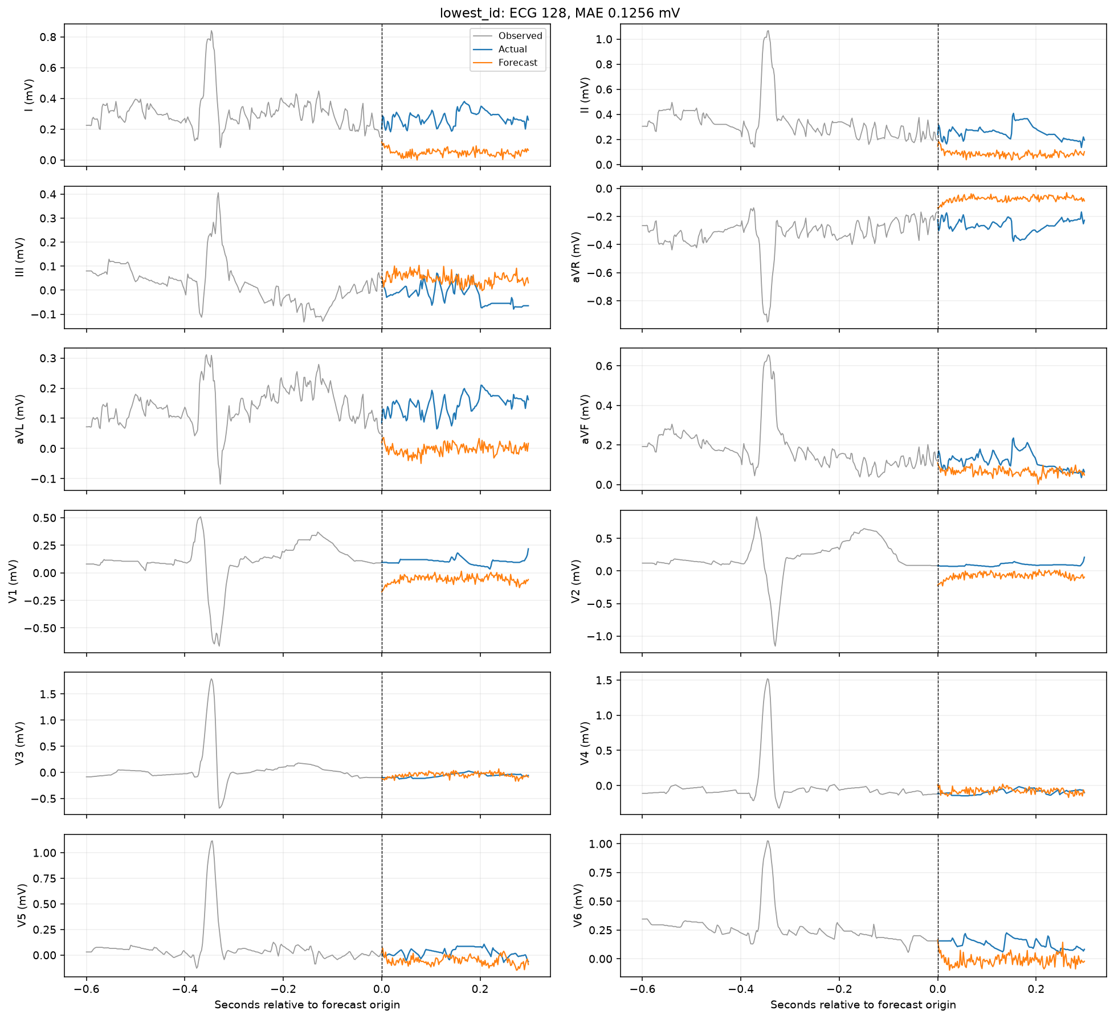
Lowest-ID test forecast
LSTM / demographics
30

Slide 31
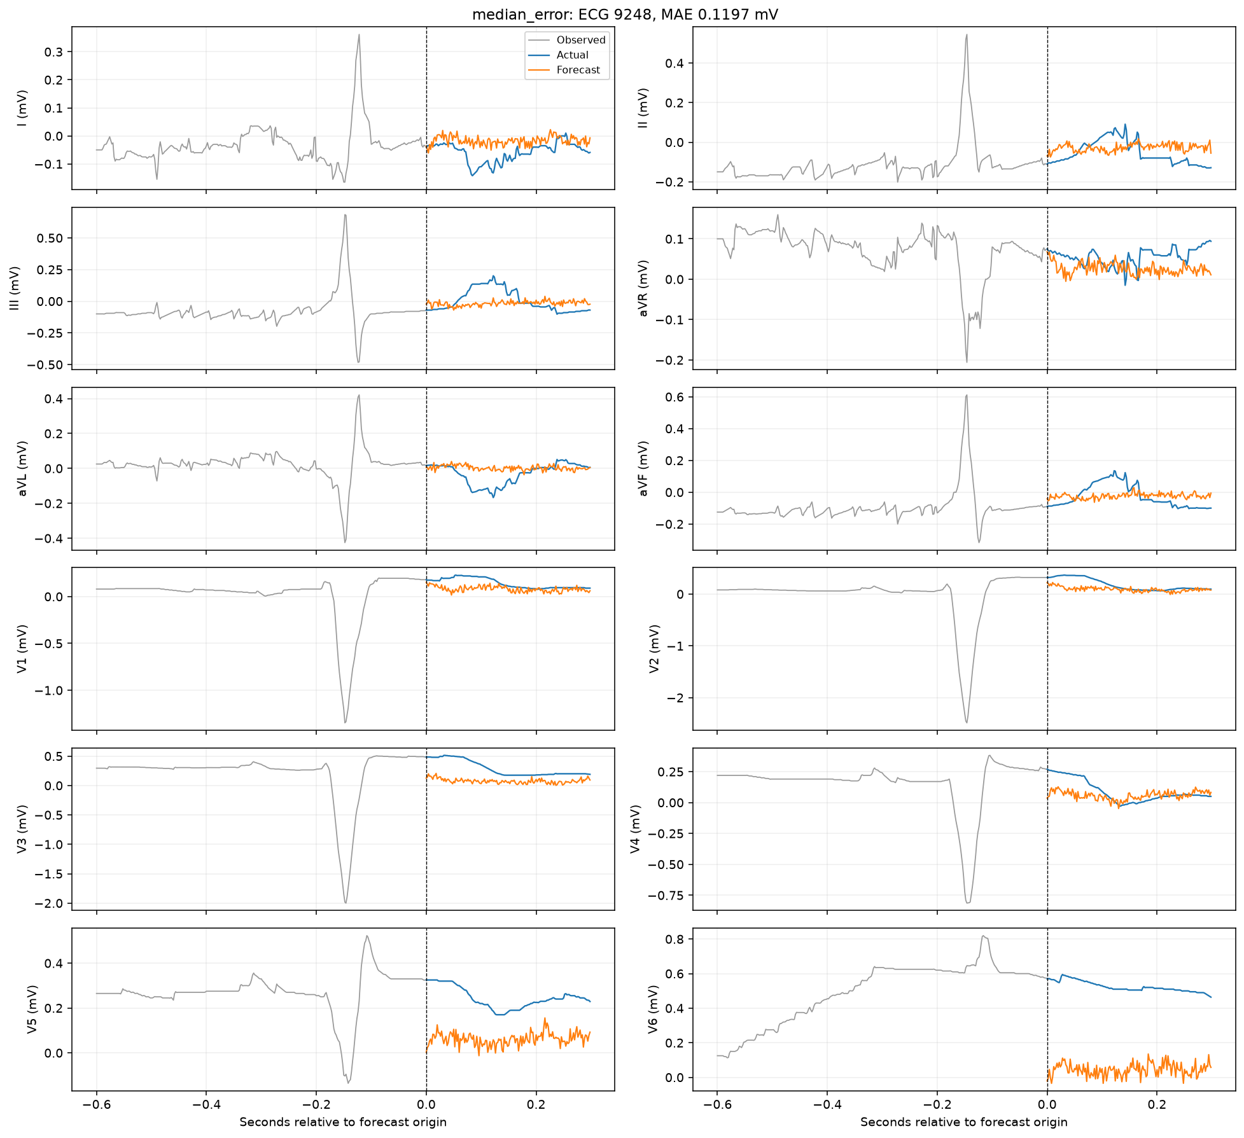
Median-error test forecast
LSTM / demographics
31

Slide 32
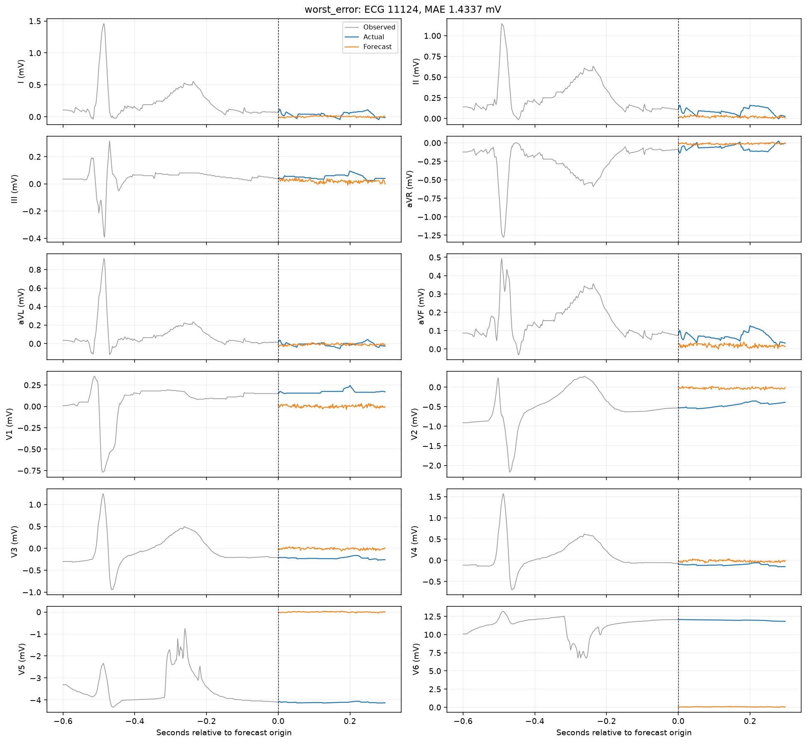
Worst-error test forecast
LSTM / demographics
32

Slide 33
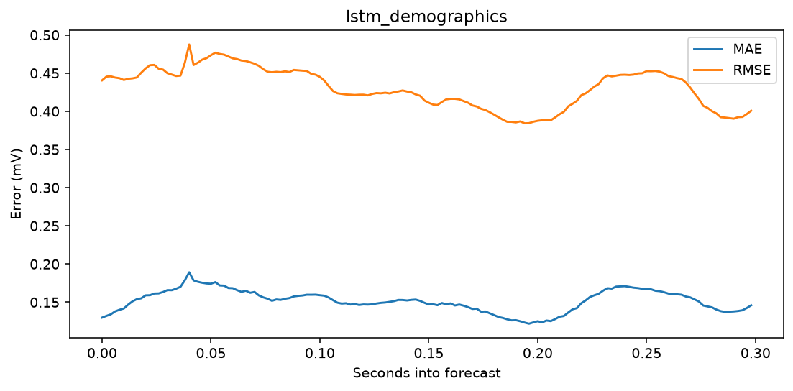
Forecast-horizon error
LSTM / demographics
33

Slide 34
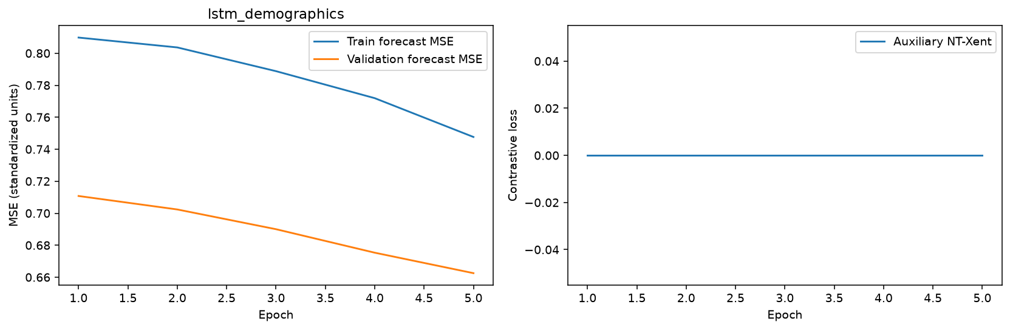
Learning curves
LSTM / demographics
34

Slide 35

Per-lead errors
LSTM / demographics
35

Slide 36
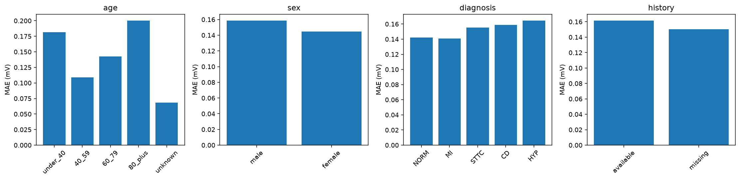
Patient subgroup errors
LSTM / demographics
36

Slide 37
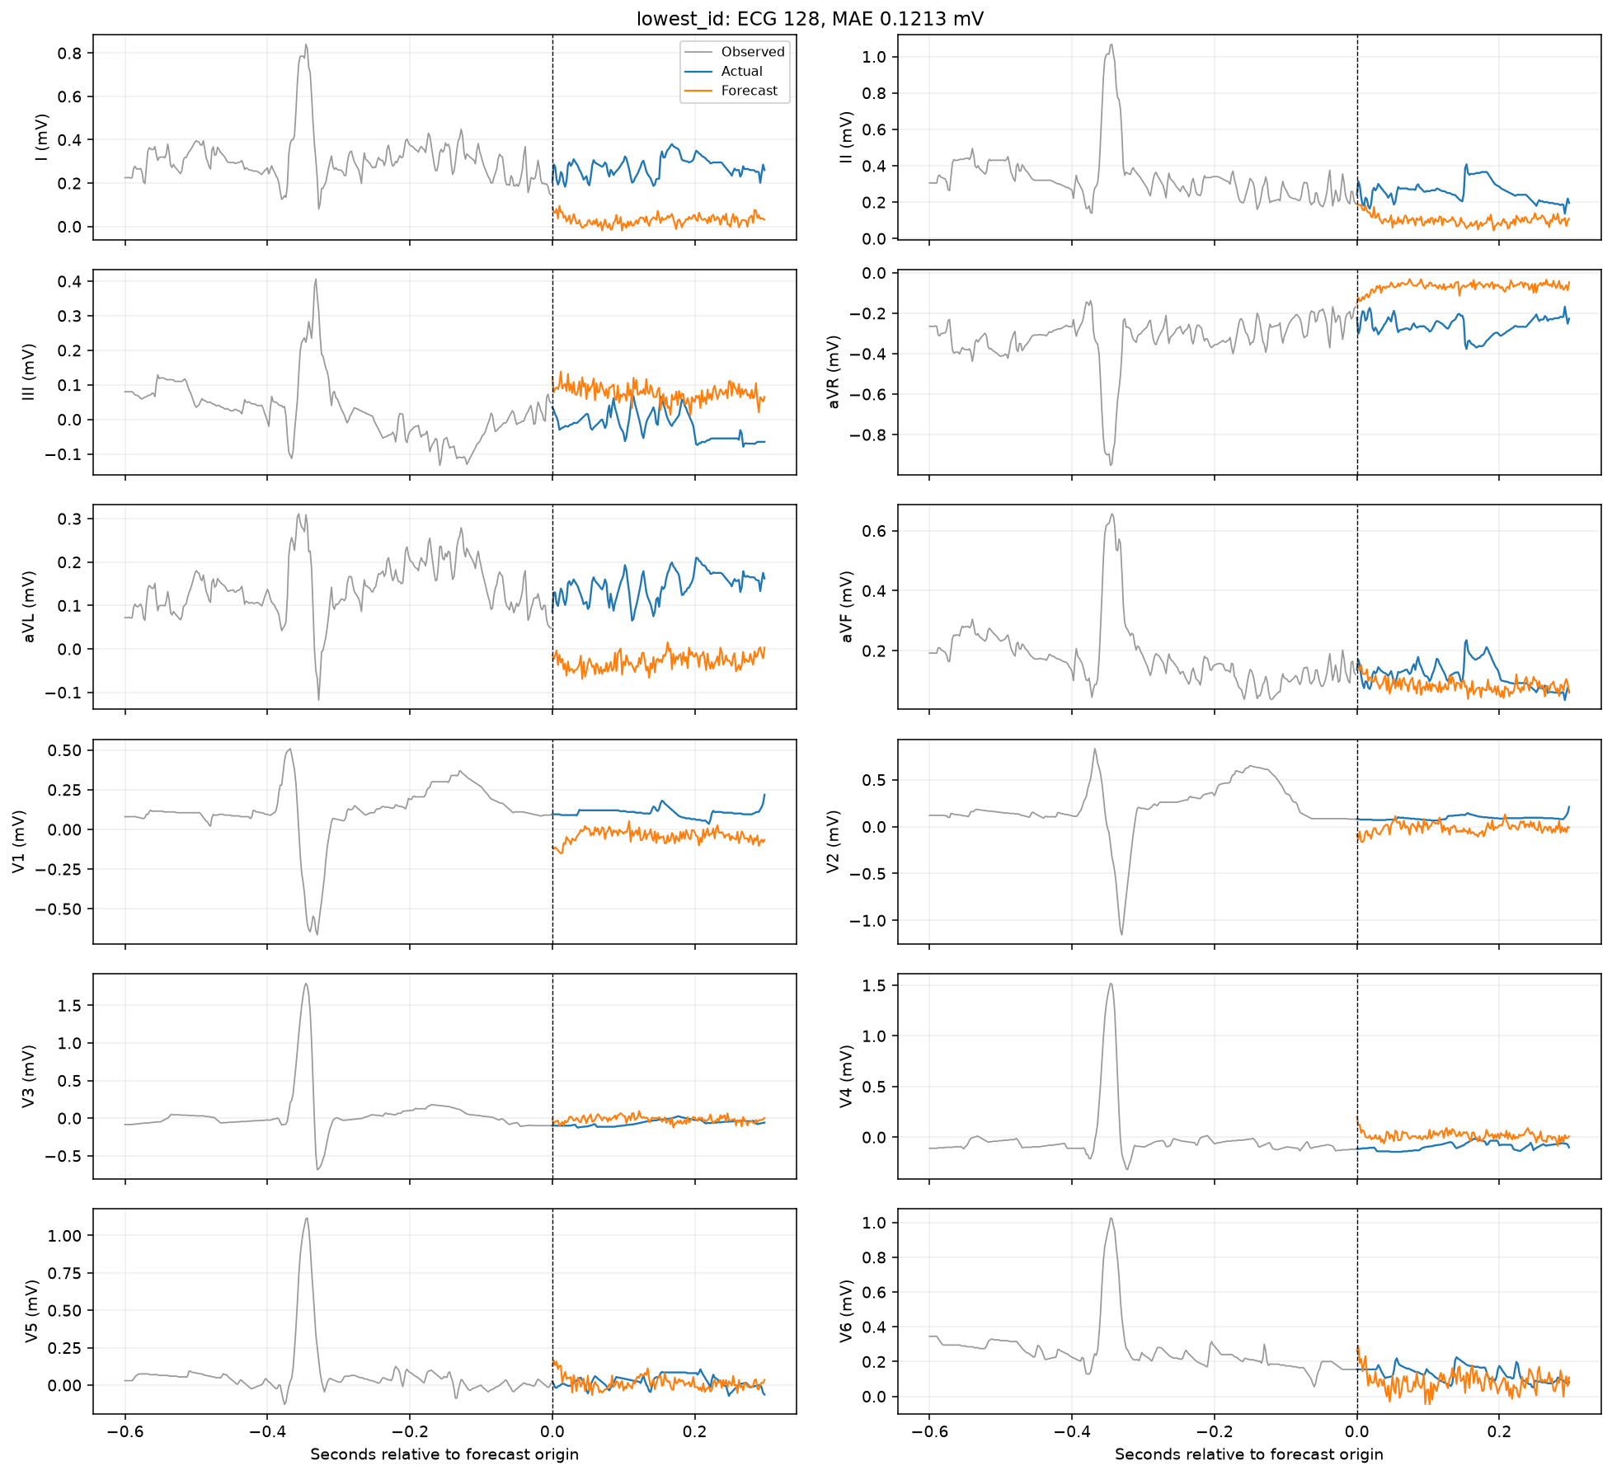
Lowest-ID test forecast
LSTM / ECG only
37

Slide 38
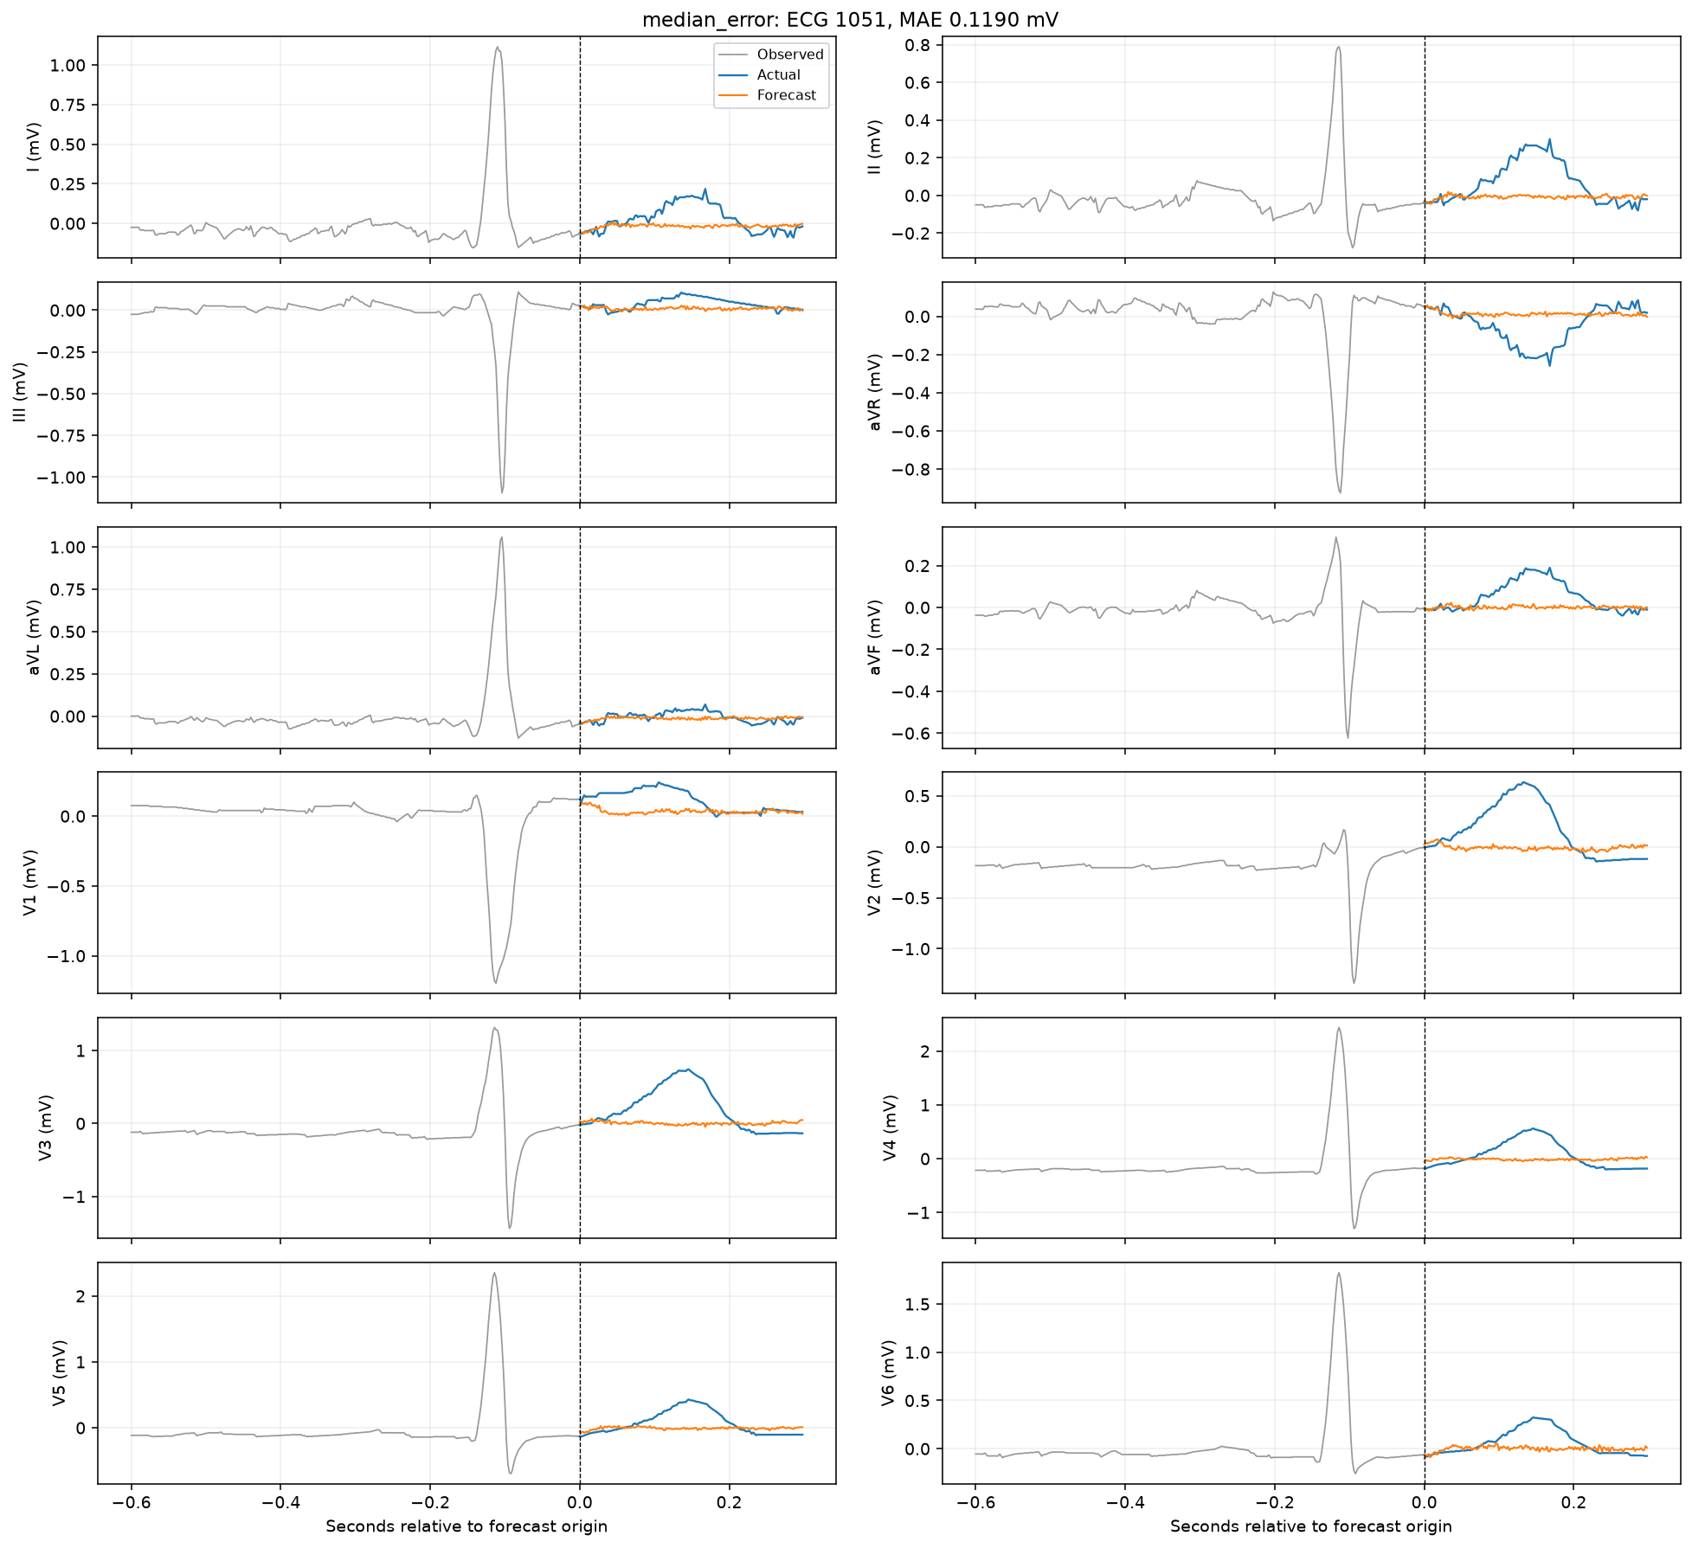
Median-error test forecast
LSTM / ECG only
38

Slide 39
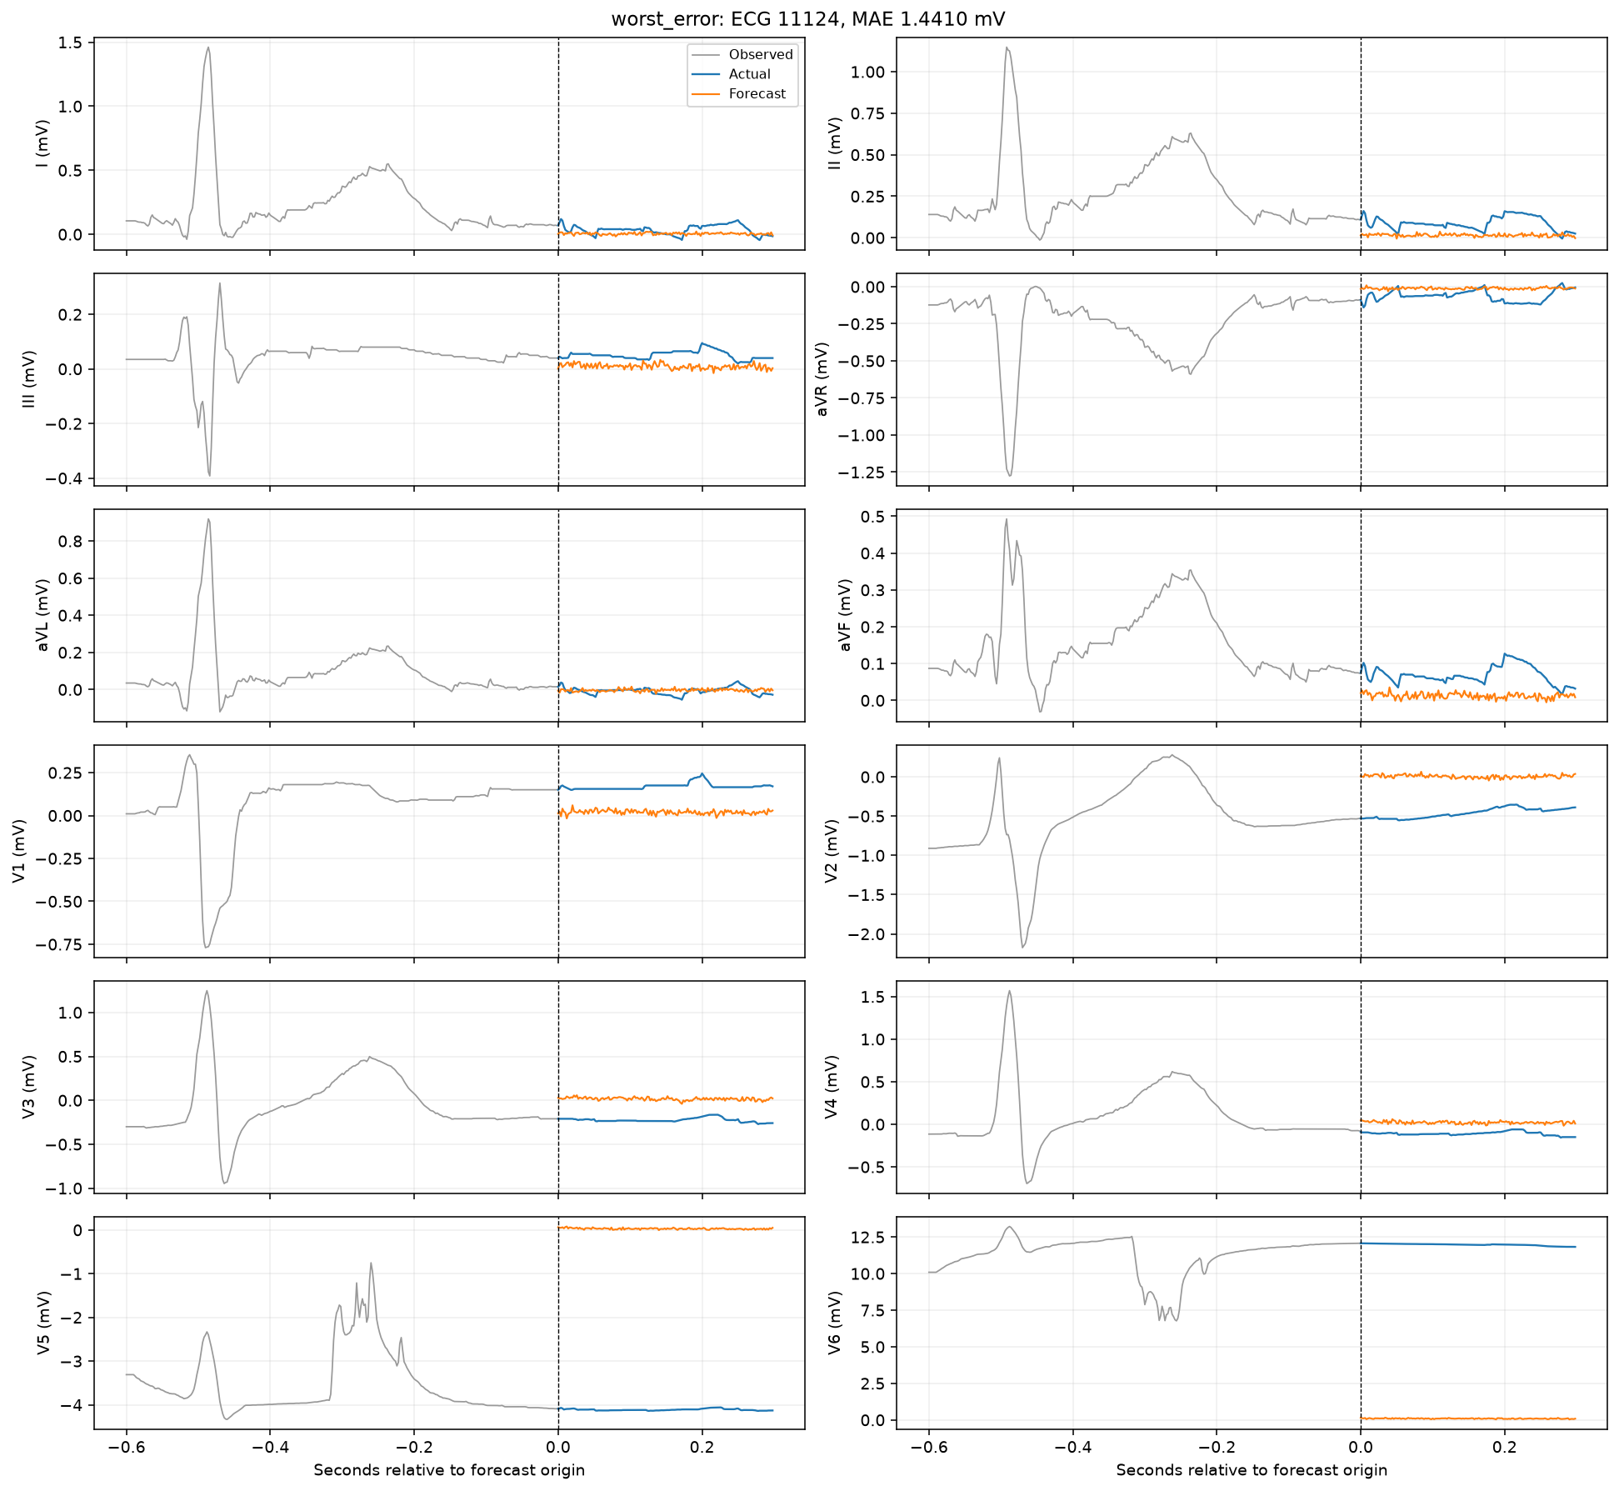
Worst-error test forecast
LSTM / ECG only
39

Slide 40
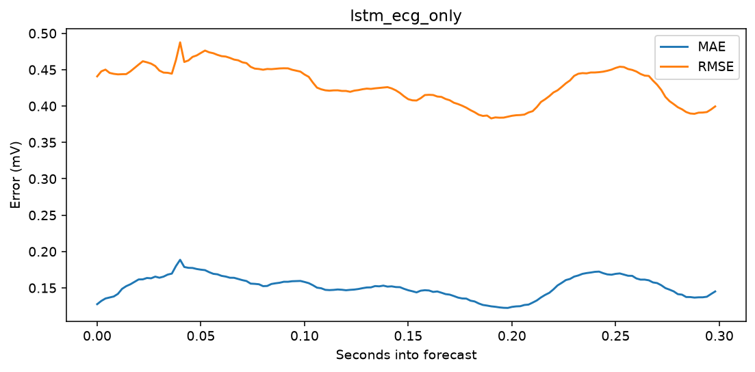
Forecast-horizon error
LSTM / ECG only
40

Slide 41
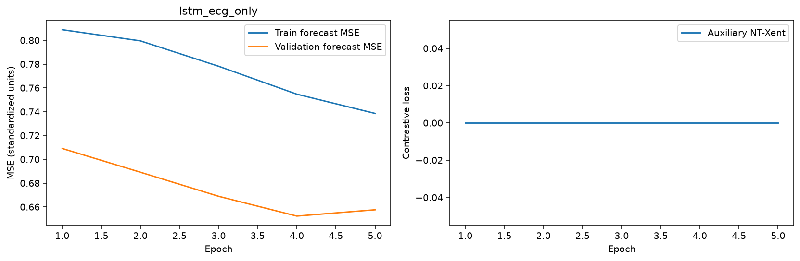
Learning curves
LSTM / ECG only
41

Slide 42
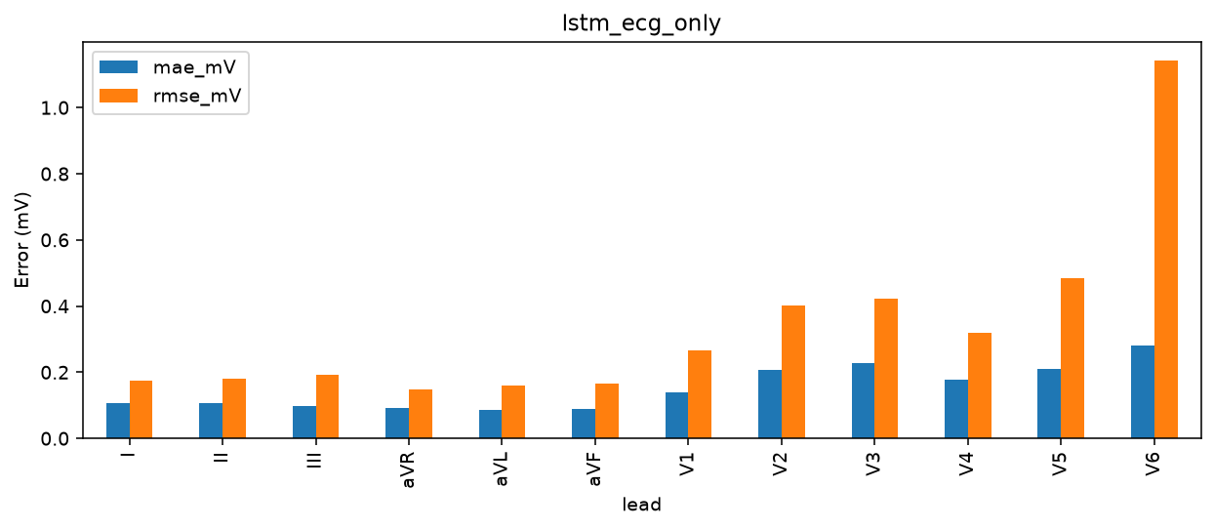
Per-lead errors
LSTM / ECG only
42

Slide 43
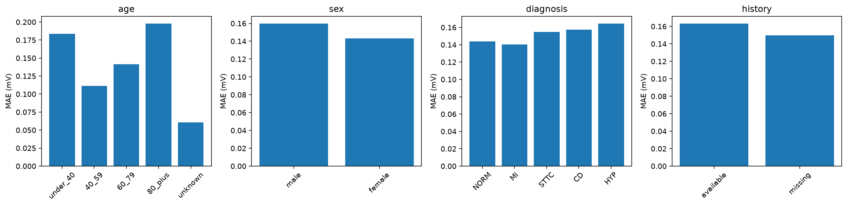
Patient subgroup errors
LSTM / ECG only
43

Slide 44

Lowest-ID test forecast
LSTM / patient history
44

Slide 45
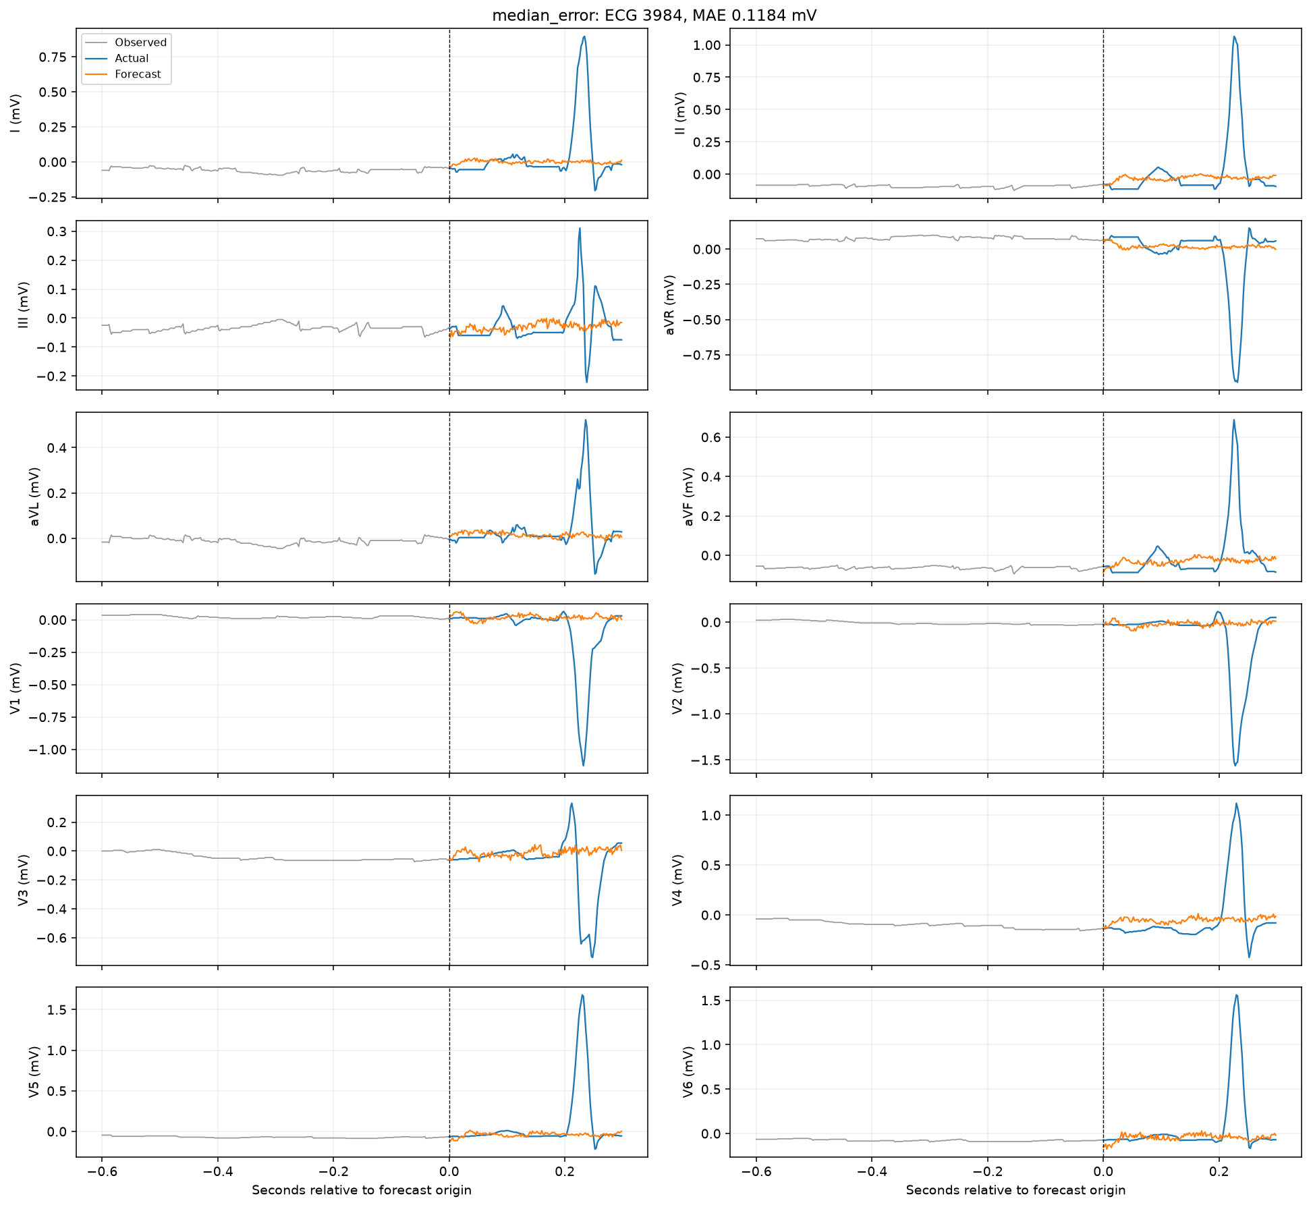
Median-error test forecast
LSTM / patient history
45

Slide 46

Worst-error test forecast
LSTM / patient history
46

Slide 47

Forecast-horizon error
LSTM / patient history
47

Slide 48

Learning curves
LSTM / patient history
48

Slide 49

Per-lead errors
LSTM / patient history
49

Slide 50
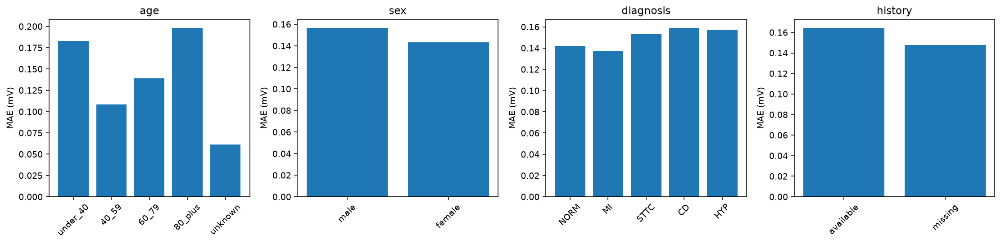
Patient subgroup errors
LSTM / patient history
50

Slide 51
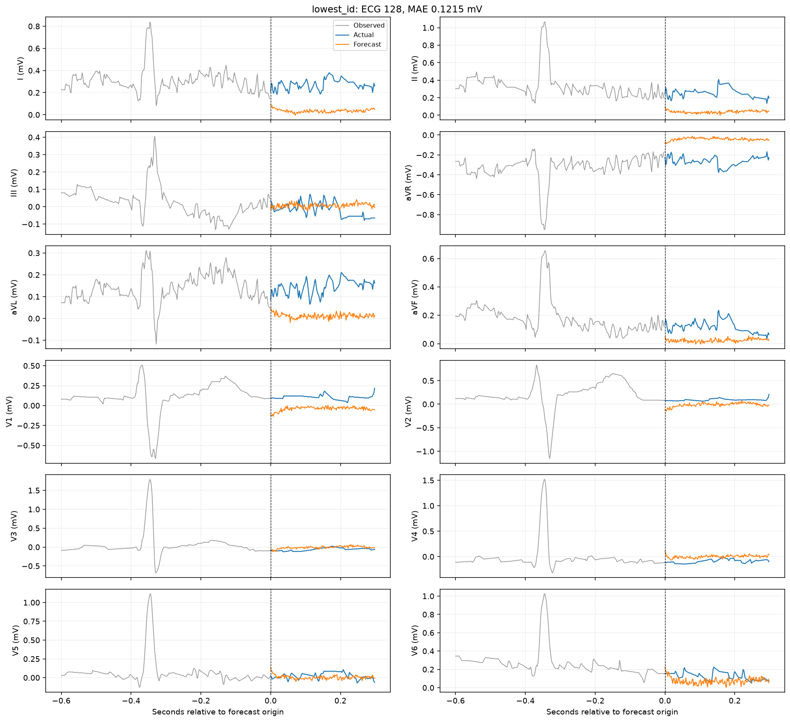
Lowest-ID test forecast
LSTM / patient history + contrastive
51

Slide 52
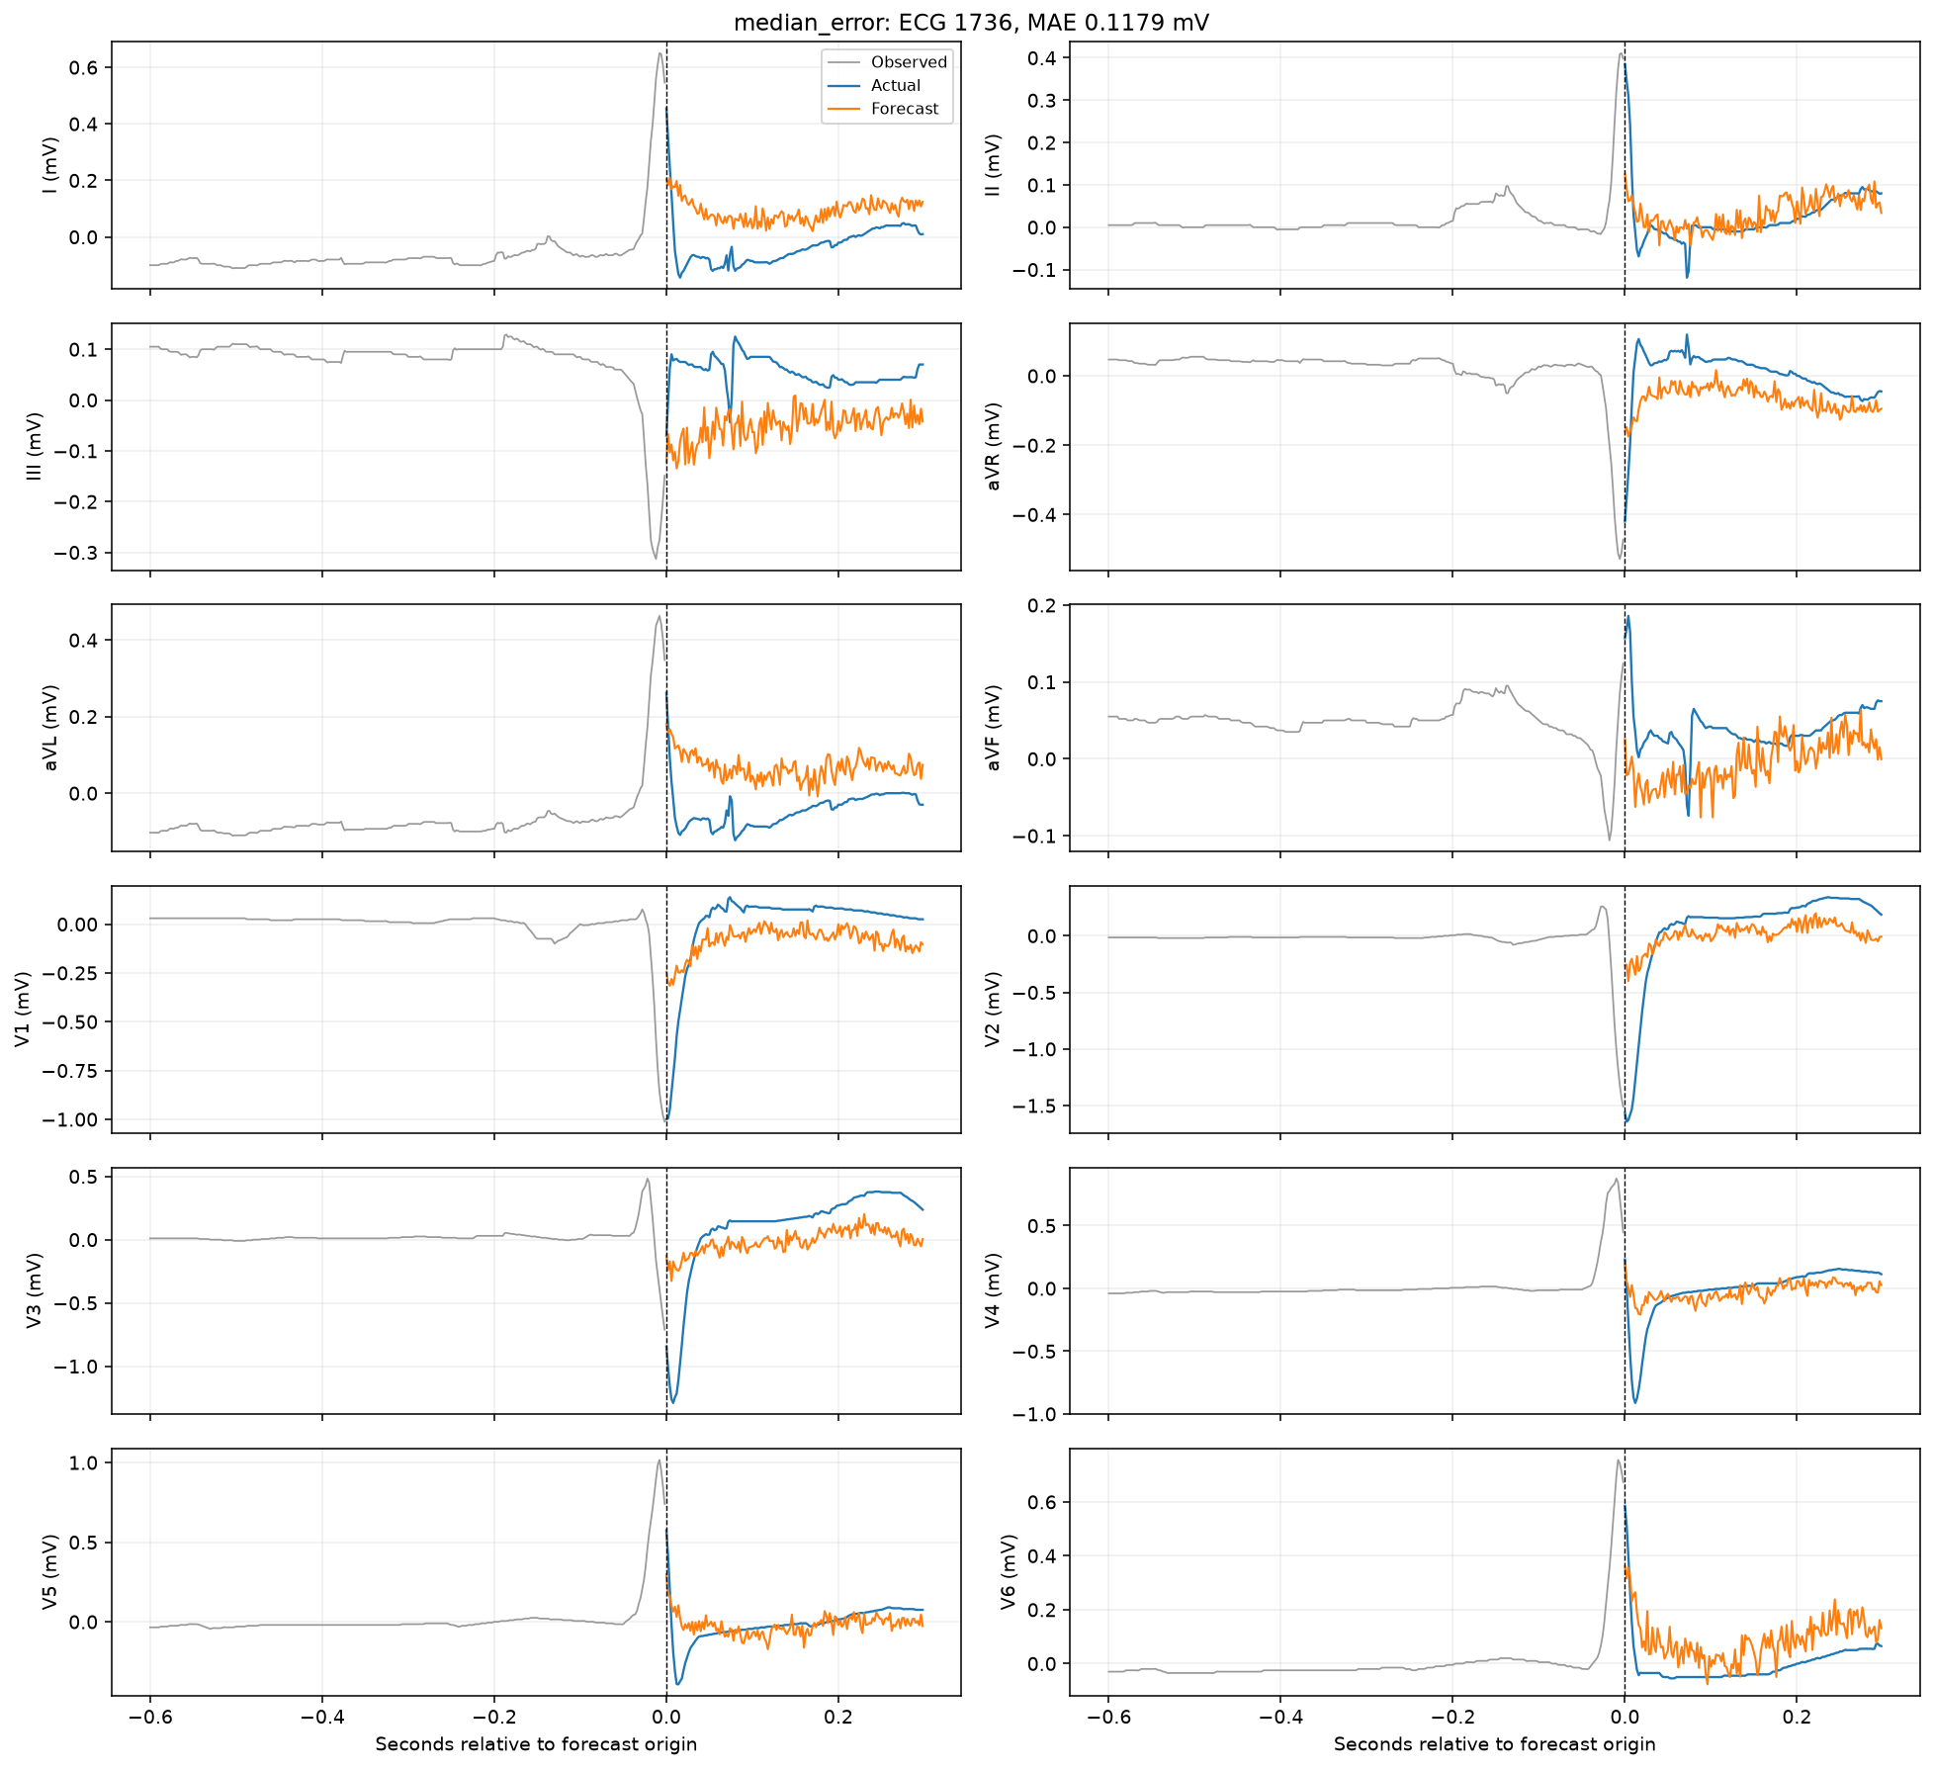
Median-error test forecast
LSTM / patient history + contrastive
52

Slide 53
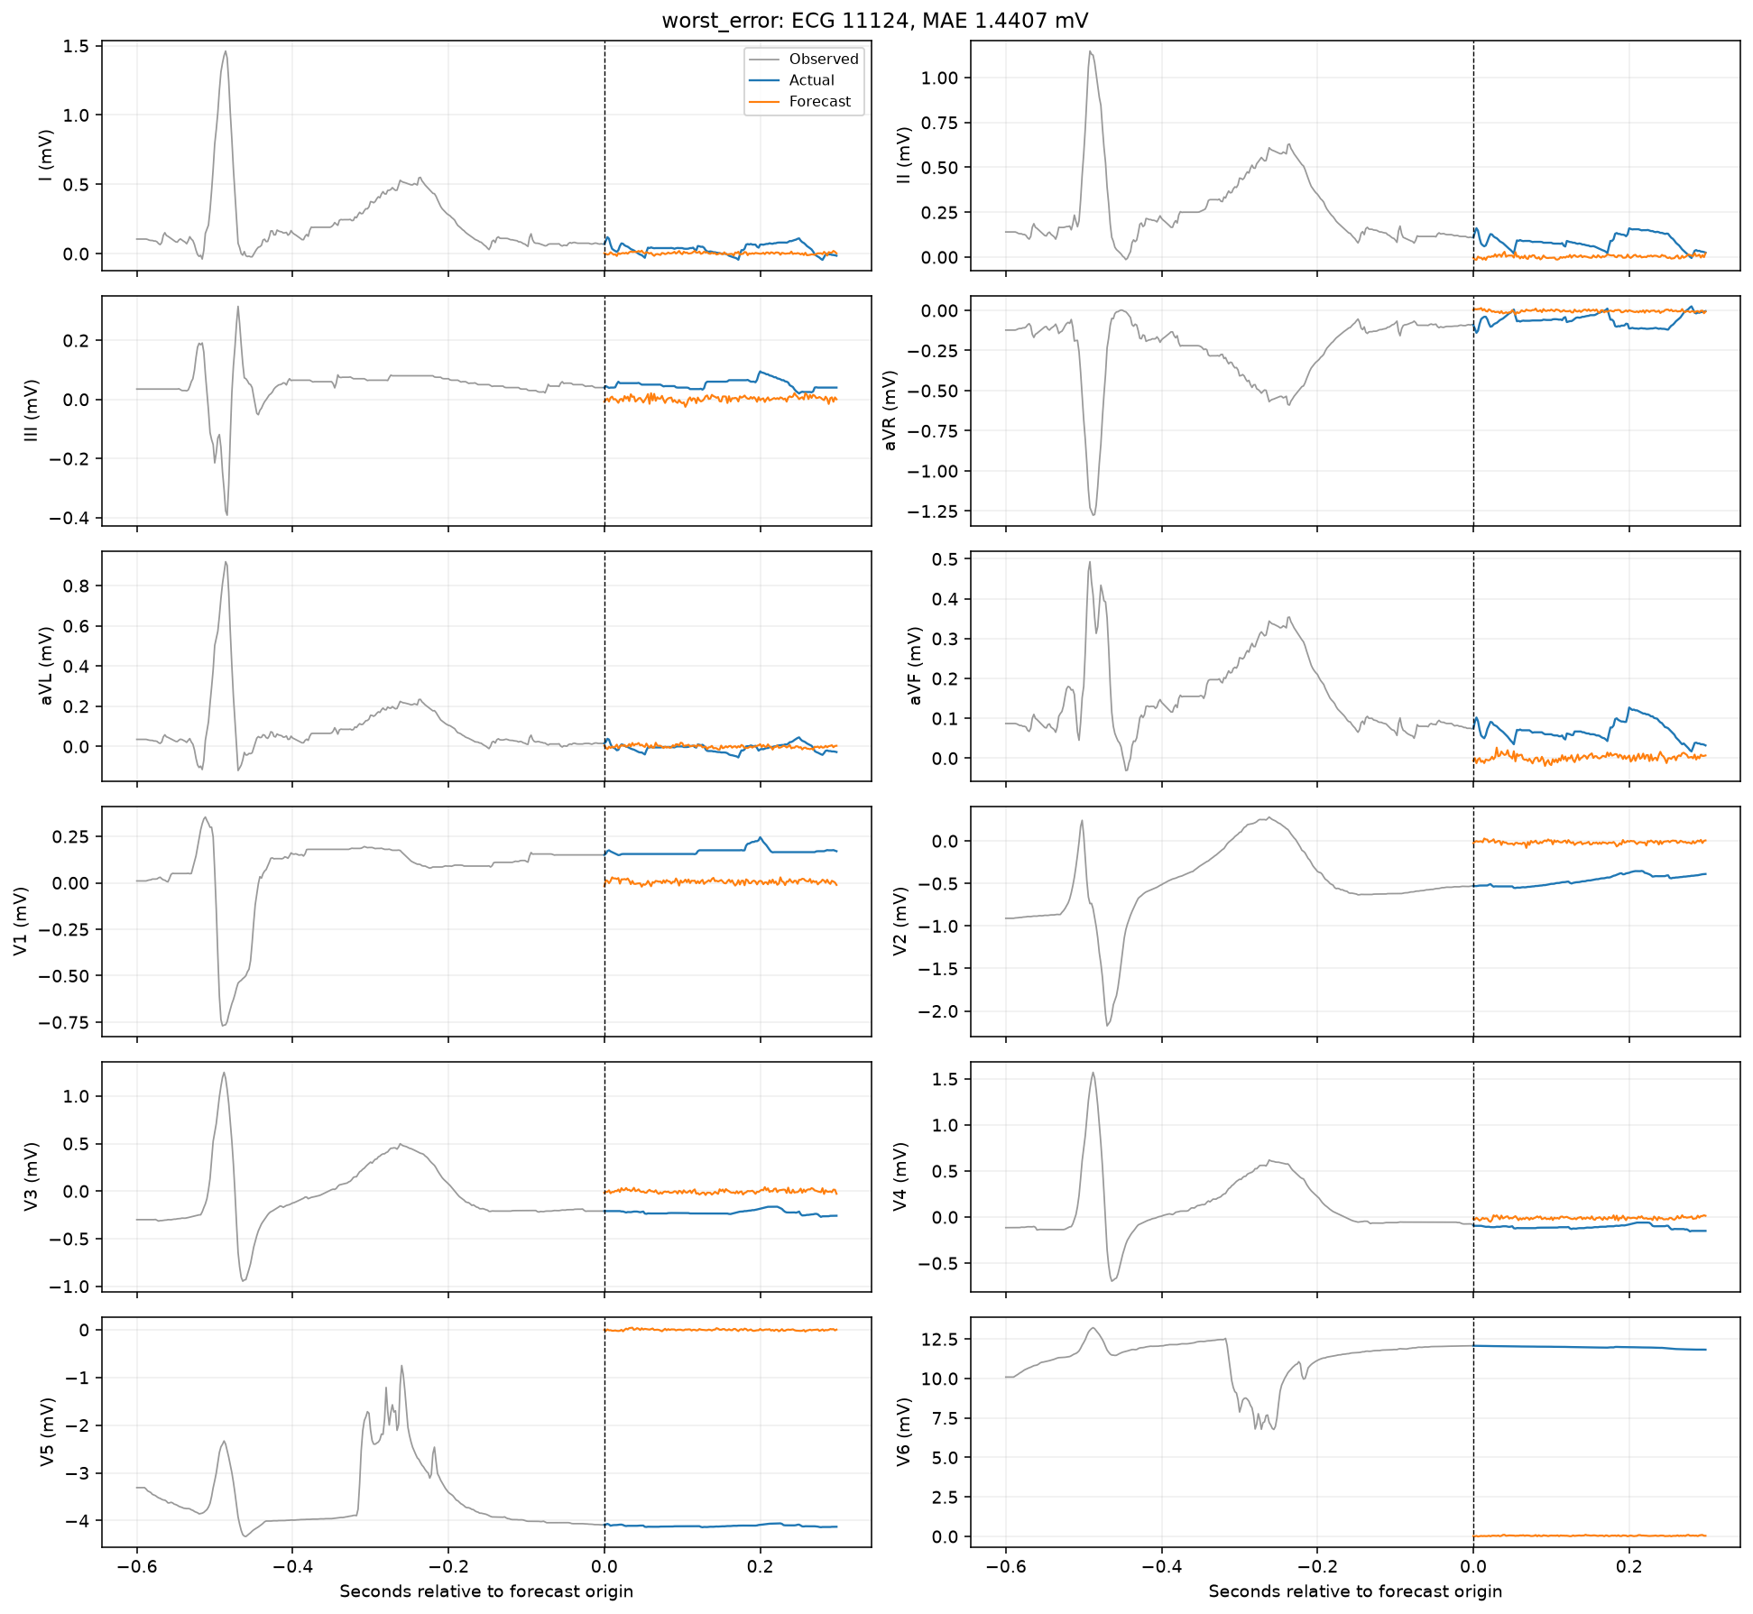
Worst-error test forecast
LSTM / patient history + contrastive
53

Slide 54
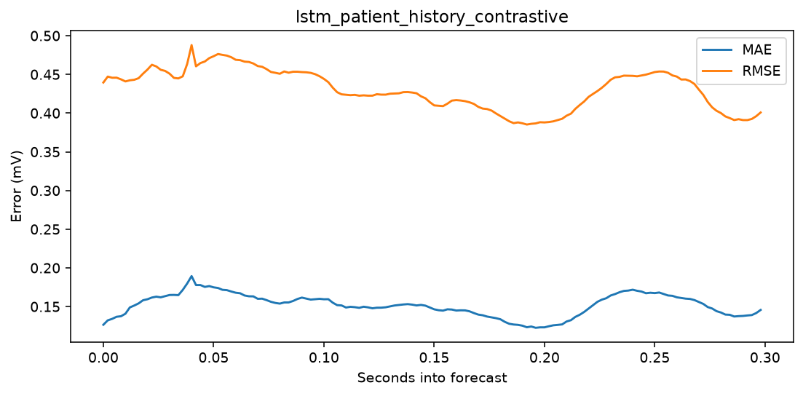
Forecast-horizon error
LSTM / patient history + contrastive
54

Slide 55
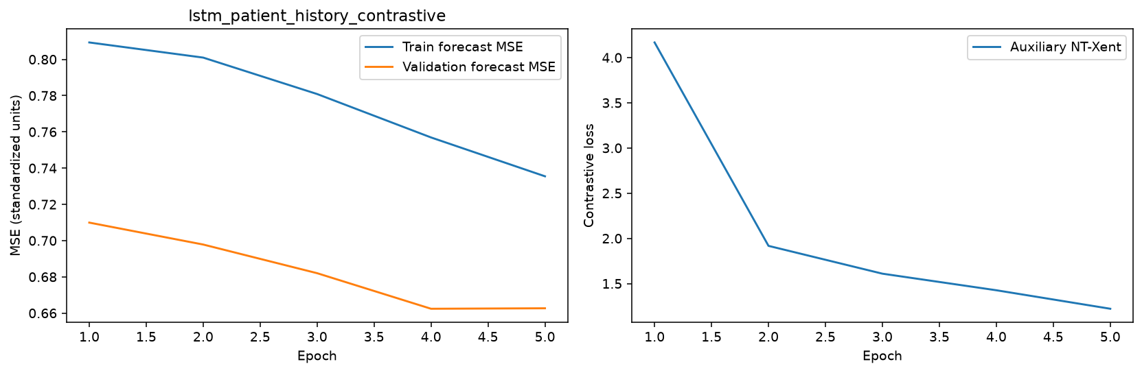
Learning curves
LSTM / patient history + contrastive
55

Slide 56

Per-lead errors
LSTM / patient history + contrastive
56

Slide 57
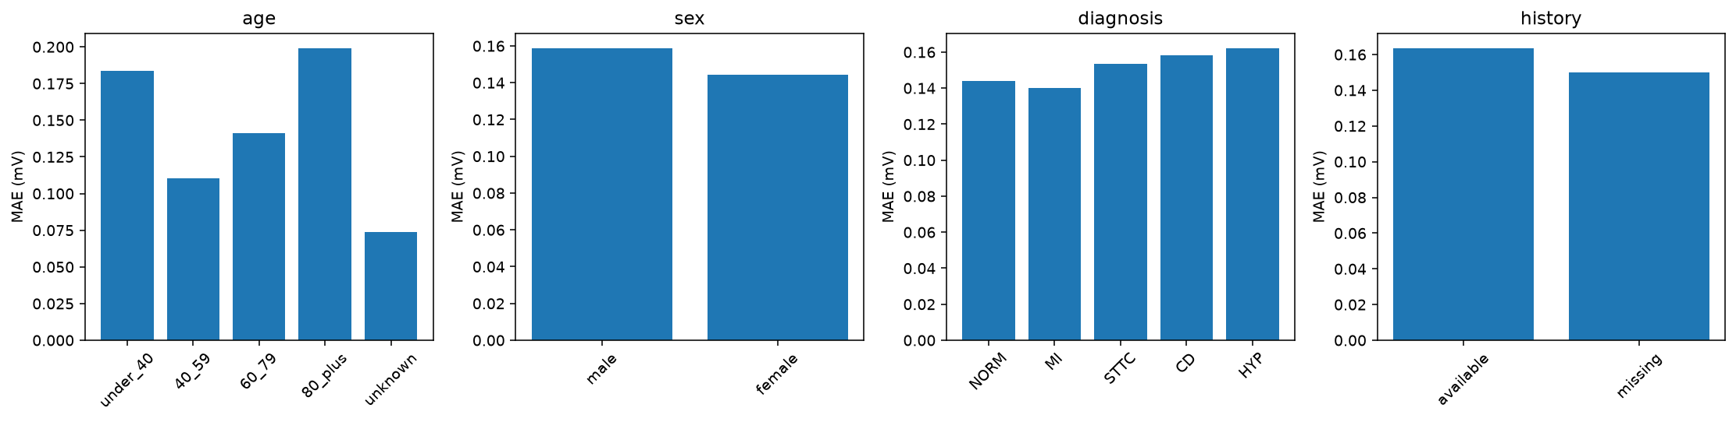
Patient subgroup errors
LSTM / patient history + contrastive
57

Slide 58
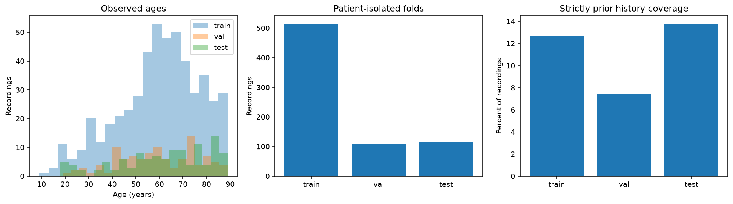
Pilot cohort metadata distributions
PTB-XL small-data pilot
58

Slide 59
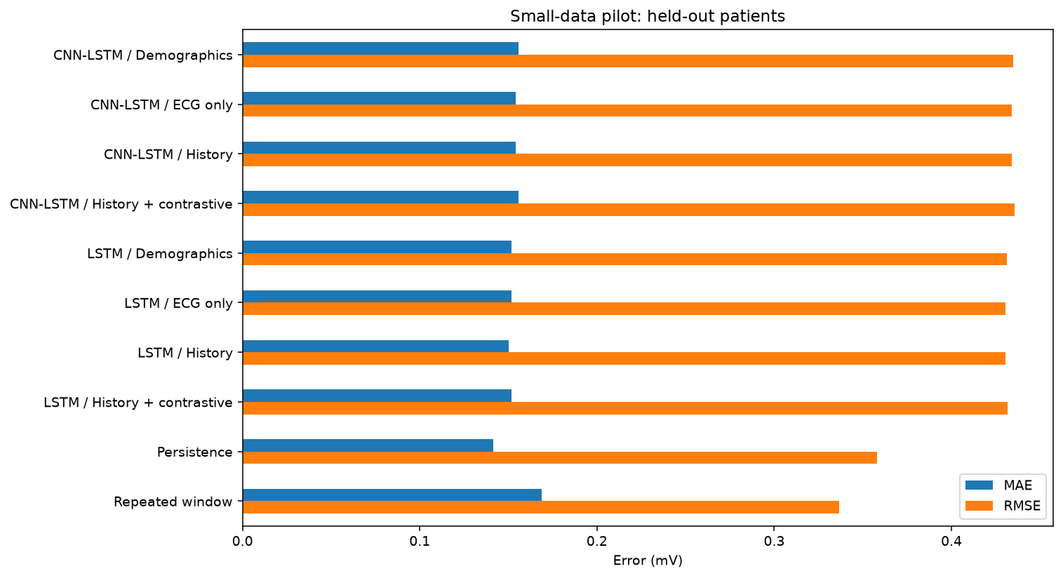
Held-out model comparison
PTB-XL small-data pilot
59

Slide 60
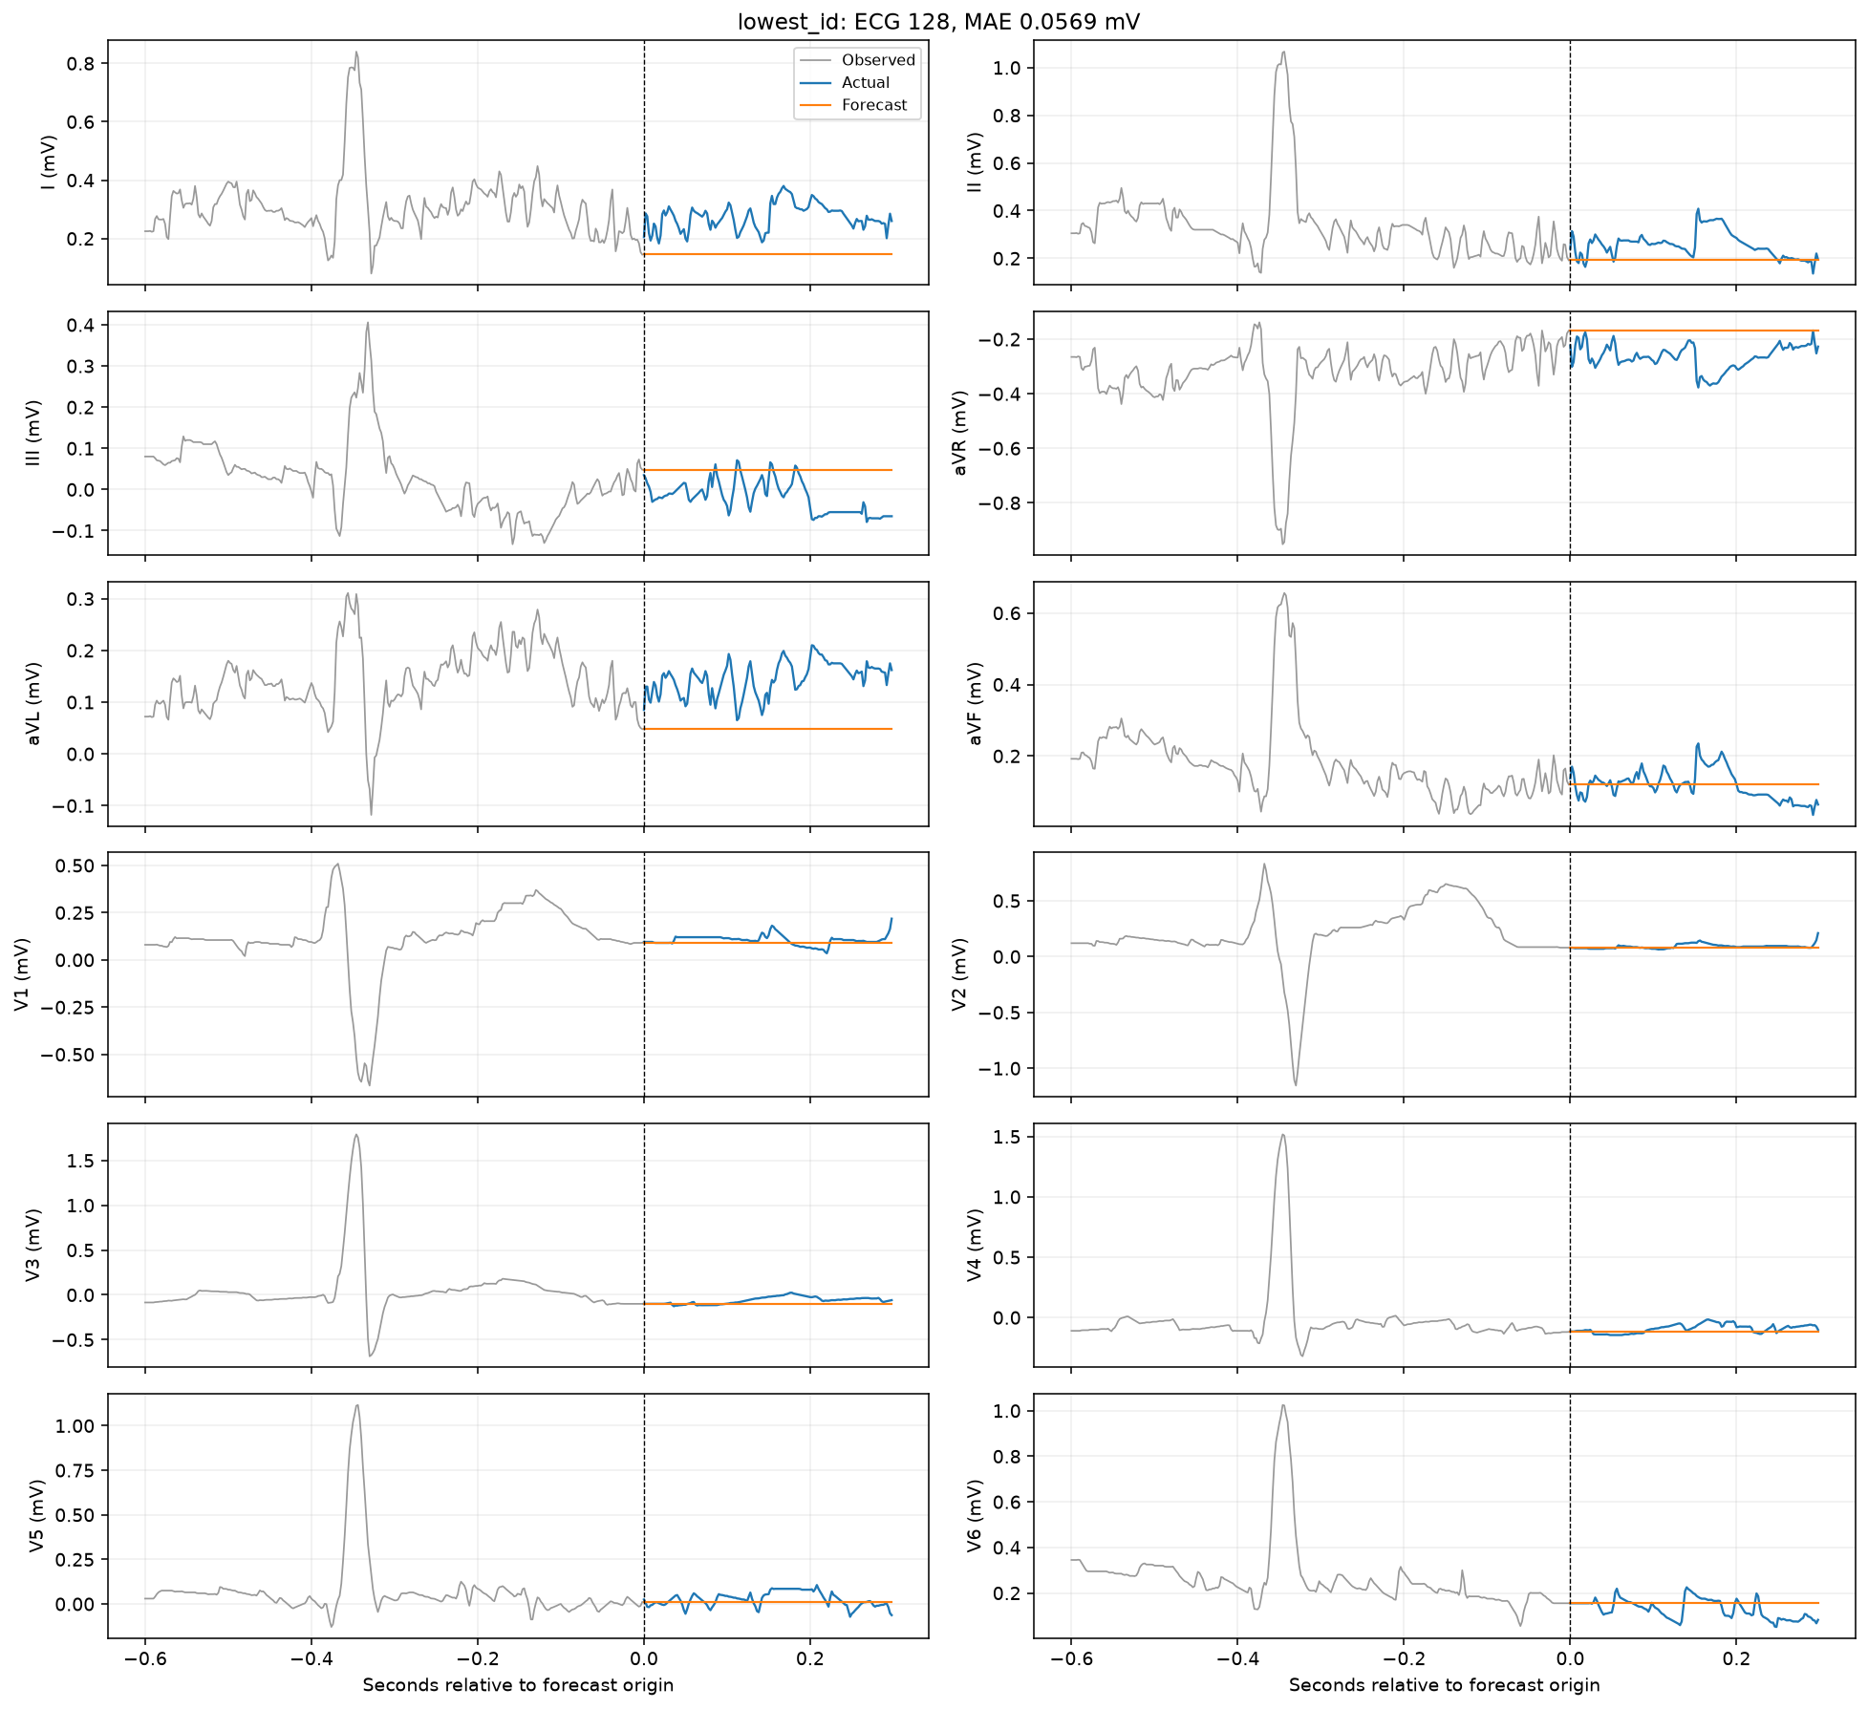
Lowest-ID test forecast
Persistence baseline
60

Slide 61

Median-error test forecast
Persistence baseline
61

Slide 62

Worst-error test forecast
Persistence baseline
62

Slide 63

Forecast-horizon error
Persistence baseline
63

Slide 64

Per-lead errors
Persistence baseline
64

Slide 65

Patient subgroup errors
Persistence baseline
65

Slide 66

Lowest-ID test forecast
Repeated-window baseline
66

Slide 67

Median-error test forecast
Repeated-window baseline
67

Slide 68

Worst-error test forecast
Repeated-window baseline
68

Slide 69

Forecast-horizon error
Repeated-window baseline
69

Slide 70

Per-lead errors
Repeated-window baseline
70

Slide 71

Patient subgroup errors
Repeated-window baseline
71

