Slide 1
Patient-conditioned ECG forecasting
High Integrity Systems Project · TSA Tasks 03
PTB-XL small-data pilot · Winter Semester 2026/27
0.6 s observed · 0.3 s forecast · 12 leads · 70 figures

Slide 2
HIS Project 03 task coverage
Assignment requirements
1
State of the art
Literature comparison and protocol caveats
2
Preprocessing and loaders
Official patient folds; train-only scaling
3-5
LSTM and CNN-LSTM
Architecture, training, metrics and comparison
6
Literature benchmark
Butt et al. values reported without ranking
7-8
Mechanics and mathematics
CNN/LSTM operations and metric equations
9
Agentic AI
Definition and minimum agent components
10-11
Delivery
Report artifacts plus a 25-minute presentation
Source: HIS_Project_03.pdf
02

Slide 3
Forecasting task and active cohort
PTB-XL pilot
Observed window
Forecast window
Task
12 leads × 300 samples
0.6 s at 500 Hz
12 leads × 150 samples
next 0.3 s
Within-record voltage forecasting
in original mV units
TRAINING
VALIDATION
TEST
515 records · 450 patients
108 records · 100 patients
116 records · 100 patients
Prior history exists for 65 training, 8 validation and 16 test records.
Research question: do demographics, prior diagnostic superclasses or contrastive training reduce short-horizon forecast error?
03

Slide 4
Preprocessing and patient isolation
Data integrity
Patient split
PTB-XL official folds 1-8 / 9 / 10 prevent the same patient from crossing train, validation and test.
Waveforms
records500 stays at 500 Hz. Inputs use samples 0:300 and targets use 300:450.
Scaling
Per-lead mean and standard deviation fit on training inputs only. Targets reuse the same transform.
Age and sex
Age outside 0-120 becomes missing. Training median imputes age. Unknown sex uses 0.5 plus a missingness flag.
History
Only strictly earlier timestamps contribute NORM, MI, STTC, CD and HYP indicators. A history mask records availability.
Random window splitting would leak patient identity and inflate validation performance.
04

Slide 5
Dataloader construction
Training, validation and test
TRAIN
VALIDATION
TEST
515 records
450 patients
shuffle = true
batch = 64
augment contrastive views only
108 records
100 patients
shuffle = false
checkpoint on forecast MSE
no augmentation
116 records
100 patients
shuffle = false
original-mV metrics
patient-level bootstrap
Each record contributes one fixed window. The loader returns waveform input, static features, target waveform, patient ID and subgroup labels.
05

Slide 6
LSTM forecast architecture
Model mechanics
ECG input
Two-layer LSTM
Static branch
Forecast head
Prediction
[B, 12, 300]
transpose to
[B, 300, 12]
›
hidden size 128
dropout 0.2
final state [B, 128]
›
0, 4 or 10 features
embedding [B, 32]
›
concat [B, 160]
256 ReLU
1,800 outputs
›
reshape to
[B, 12, 150]
Static context enters after the recurrent encoder, so the LSTM state represents the observed ECG sequence.
06

Slide 7
LSTM gates and backpropagation through time
Model mechanics
zₜ = [hₜ₋₁, xₜ]
Sigmoid gates retain or suppress information in the range [0, 1].
fₜ = σ(Wf zₜ + bf) iₜ = σ(Wi zₜ + bi)
The tanh candidate supplies signed content for the cell state.
gₜ = tanh(Wg zₜ + bg)
cₜ = fₜ ⊙ cₜ₋₁ + iₜ ⊙ gₜ
The direct memory path contains products of forget gates across 300 time steps.
oₜ = σ(Wo zₜ + bo) hₜ = oₜ ⊙ tanh(cₜ)
Gradient clipping at norm 1.0 limits exploding gradients during BPTT.
⊙ denotes elementwise multiplication.
07

Slide 8
Temporal CNN operation
Model mechanics
Y[o,t] = b[o] + Σc Σk W[o,c,k] X[c,t+k−padding]
Channels
Each filter combines all input leads and produces one output feature map.
Kernel
Widths 7, 5 and 3 capture local voltage morphology with shared weights across time.
Padding
Same padding preserves temporal length before the pooling layer.
Pooling
Average pooling by 2 changes 300 raw samples into 150 recurrent feature steps.
Activation
ReLU follows each convolution. The final receptive field spans 16 raw samples or 32 ms.
PyTorch Conv1d computes cross-correlation rather than reversing the kernel.
08

Slide 9
CNN-LSTM forecast architecture
Model mechanics
ECG input
Temporal CNN
LSTM
Static branch
Forecast head
[B, 12, 300]
›
12→32 k7
32→64 k5
pool by 2
64→64 k3
›
transpose to
[B, 150, 64]
final [B, 128]
›
0, 4 or 10 features
embedding [B, 32]
›
256 ReLU
1,800 outputs
[B, 12, 150]
The CNN shortens the recurrent sequence but can lose timing precision around sharp QRS peaks.
09

Slide 10
Training objective and hyperparameters
Experiment design
Forecast loss
Normalized waveform MSE on clean inputs
Batch
64 records
Contrastive loss
0.1 × NT-Xent, temperature 0.1
Gradient clipping
global norm 1.0
Optimizer
AdamW, learning rate 0.001
Checkpoint
minimum validation forecast MSE
Regularization
weight decay 0.0001, dropout 0.2
Budget
maximum 5 epochs, patience 3, seed 42
Eight neural runs use identical folds and optimization settings. Persistence and repeated-window forecasts provide non-trained baselines.
10

Slide 11
Forecast metrics
Mathematical definitions
MAE
(1/N) Σ |ŷᵢ − yᵢ|
mV
Average absolute voltage error
MSE
(1/N) Σ (ŷᵢ − yᵢ)²
mV²
Squared error used for checkpoint selection
RMSE
√MSE
mV
Square root restores the voltage unit
R²
1 − Σ(ŷᵢ−yᵢ)² / Σ(yᵢ−ȳ)²
unitless
Negative values mean worse than the global mean
Pearson
cov(ŷ,y) / (σŷ σy)
unitless
Calculated per lead, then averaged
Patient-macro MAE
(1/P) Σp MAEₚ
mV
Each patient receives equal weight
N spans test records, leads and forecast samples. Reported metrics use inverse-transformed voltages.
11

Slide 12
Held-out test results
Original mV units
Model | MAE | RMSE | R² | Patient-macro MAE
Persistence | 0.141546 | 0.358149 | 0.329855 | 0.129724
Repeated window | 0.168642 | 0.336686 | 0.407766 | 0.161466
LSTM / ECG only | 0.151706 | 0.430543 | 0.031552 | 0.148435
LSTM / demographics | 0.151759 | 0.431238 | 0.028427 | 0.148413
LSTM / history | 0.150113 | 0.430582 | 0.031379 | 0.146684
LSTM / history + contrastive | 0.151782 | 0.431546 | 0.027037 | 0.148438
CNN-LSTM / ECG only | 0.154296 | 0.433948 | 0.016176 | 0.151576
CNN-LSTM / demographics | 0.155650 | 0.434724 | 0.012654 | 0.152838
CNN-LSTM / history | 0.154251 | 0.433902 | 0.016385 | 0.151215
CNN-LSTM / history + contrastive | 0.155719 | 0.435588 | 0.008725 | 0.152772
Lowest observed MAE: persistence. Lowest observed neural MAE: LSTM with patient history.
12

Slide 13
Measured model comparisons
Patient-level uncertainty
Persistence vs best neural
0.141546 vs 0.150113 mV MAE
Persistence produced the lowest record-weighted MAE.
LSTM history vs demographics
−0.001729 mV patient-macro MAE
95% interval [−0.003275, −0.000242].
LSTM contrastive vs history
+0.001754 mV patient-macro MAE
95% interval [+0.000283, +0.003351].
CNN-LSTM vs LSTM, ECG only
+0.003141 mV patient-macro MAE
95% interval [+0.001435, +0.005009].
Intervals use 1,000 patient bootstrap resamples and describe this fitted seed only.
13

Slide 14
Literature comparison
Butt et al. 2025 manuscript
Reported experiments 1-5
Project protocol
Manuscript protocol
MAE: 0.0504-0.0725
RMSE: 0.1135-0.1466
SMAPE: 0.8791-1.0104
500 Hz PTB-XL
official patient folds
train-input z-scores
errors inverted to mV
80/10/10 split
robust TorchNormalizer
patient isolation unclear
lead aggregation unclear
The paper abstract reports RMSE 0.061 and MAE 0.128, which conflicts with its Table 1. Protocol and scaling differences prevent a numerical ranking.
Context source: F. S. Butt et al., Temporal Fusion Transformers for Forecasting ECG Signals, pp. 5-6, Table 1.
14

Slide 15
Agentic AI and a minimal ECG analysis agent
HIS Project 03 task 9
Agentic AI uses a model inside a controlled loop that selects actions, uses tools and checks progress toward a stated goal.
Goal
Example: evaluate one trained checkpoint on the locked test split.
Model
Interprets the request and selects the next permitted operation.
Tools
Read configuration, run evaluation and retrieve saved metrics.
State
Stores the checkpoint, dataset version, completed steps and outputs.
Policy
Restricts tool access, patient data exposure and irreversible actions.
Feedback
Checks schema, metric units, failures and completion conditions.
For clinical data, human review remains the final authority for interpretation and release.
15

Slide 16
Findings and limits
PTB-XL small-data pilot
MEASURED
Persistence achieved the lowest MAE at 0.141546 mV.
MEASURED
LSTM with patient history achieved the lowest neural MAE at 0.150113 mV.
MEASURED
The contrastive objective increased LSTM patient-macro MAE by 0.001754 mV in this run.
LIMIT
Five epochs and one seed do not establish architecture superiority.
LIMIT
Only 16 test records contain prior history, and diagnostic groups overlap.
LIMIT
A 0.6 s context may contain less than one beat, so the task does not measure long-term clinical forecasting.
Next experiment: larger patient cohort, repeated seeds, longer contexts and a predeclared training budget.
16

Slide 17
Figure appendix
70 generated plots across eight neural runs and two baselines
17

Slide 18
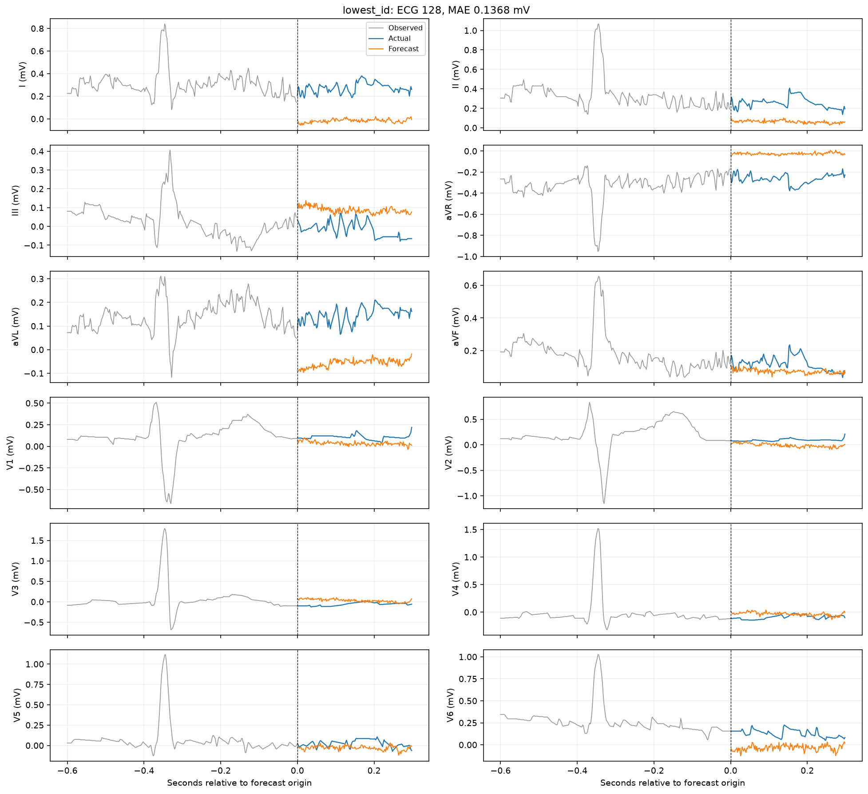
Lowest-ID test forecast
CNN-LSTM / demographics
18

Slide 19
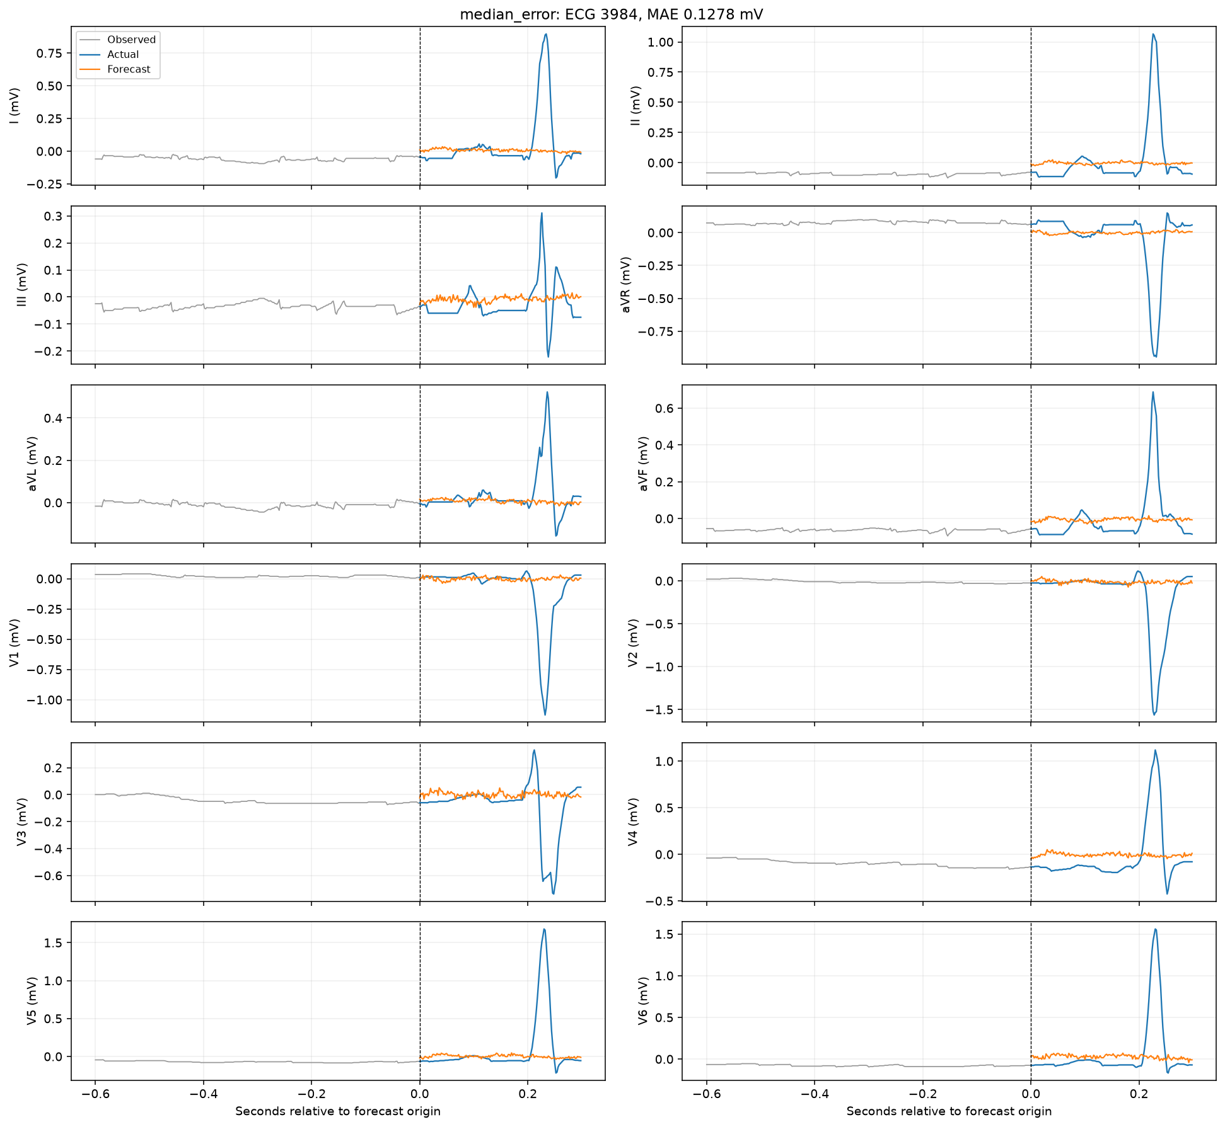
Median-error test forecast
CNN-LSTM / demographics
19

Slide 20
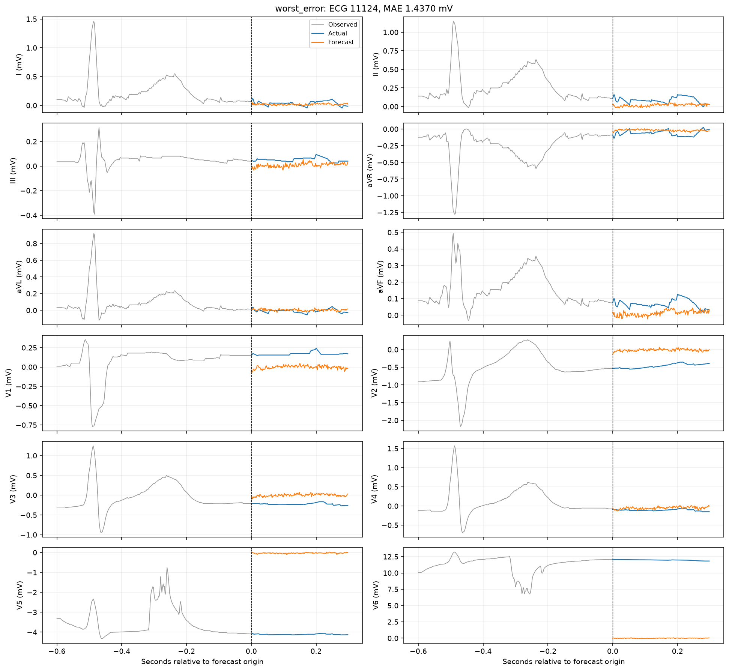
Worst-error test forecast
CNN-LSTM / demographics
20

Slide 21
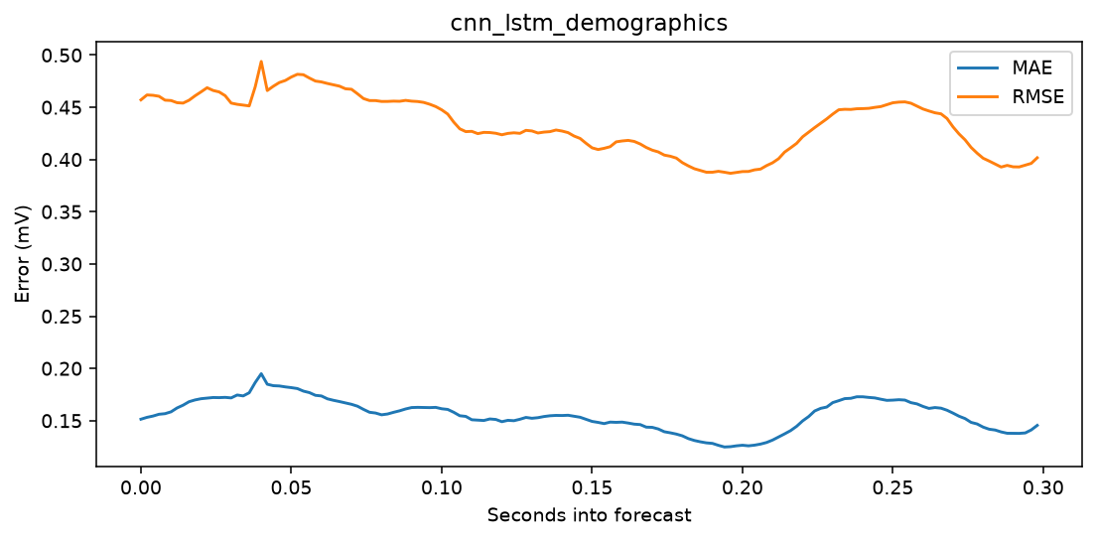
Forecast-horizon error
CNN-LSTM / demographics
21

Slide 22
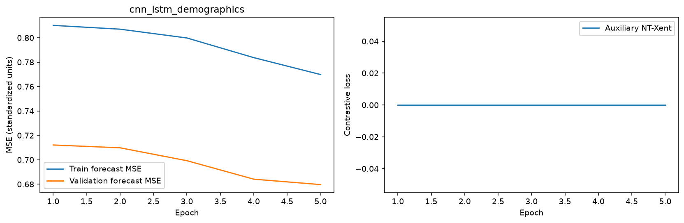
Learning curves
CNN-LSTM / demographics
22

Slide 23
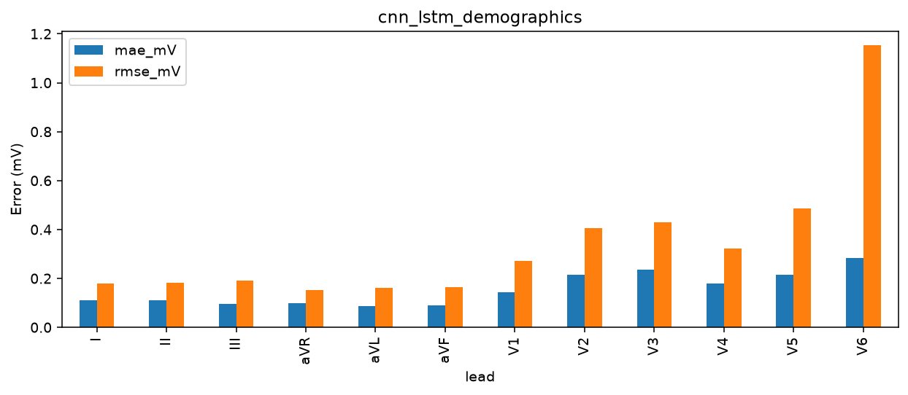
Per-lead errors
CNN-LSTM / demographics
23

Slide 24
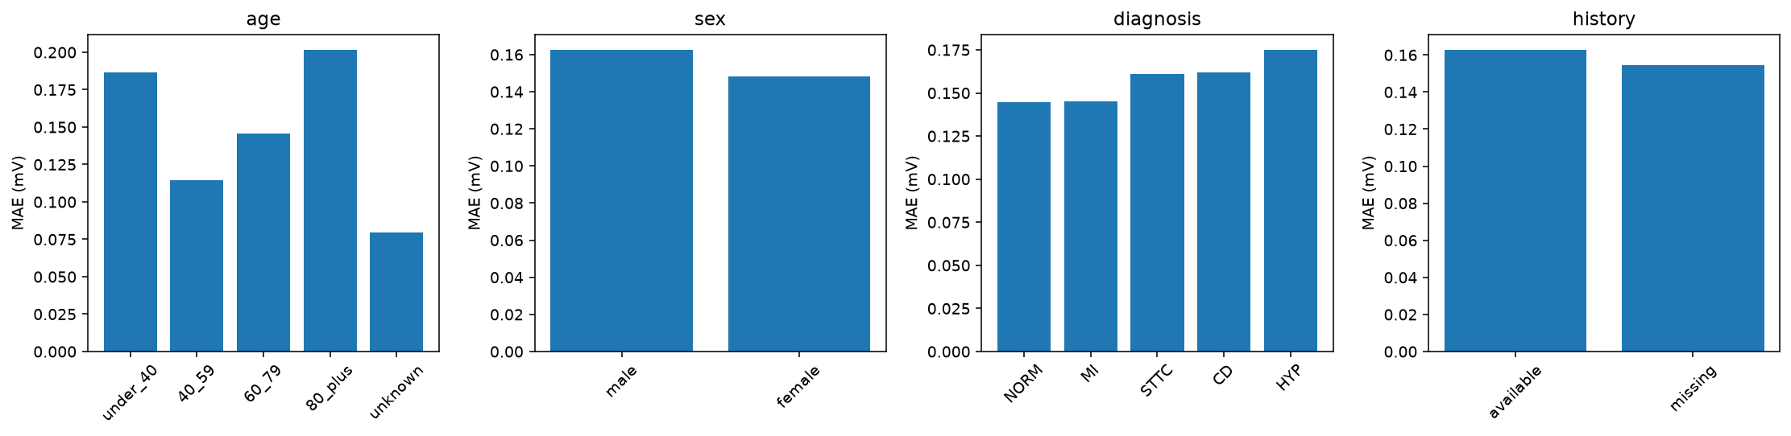
Patient subgroup errors
CNN-LSTM / demographics
24

Slide 25
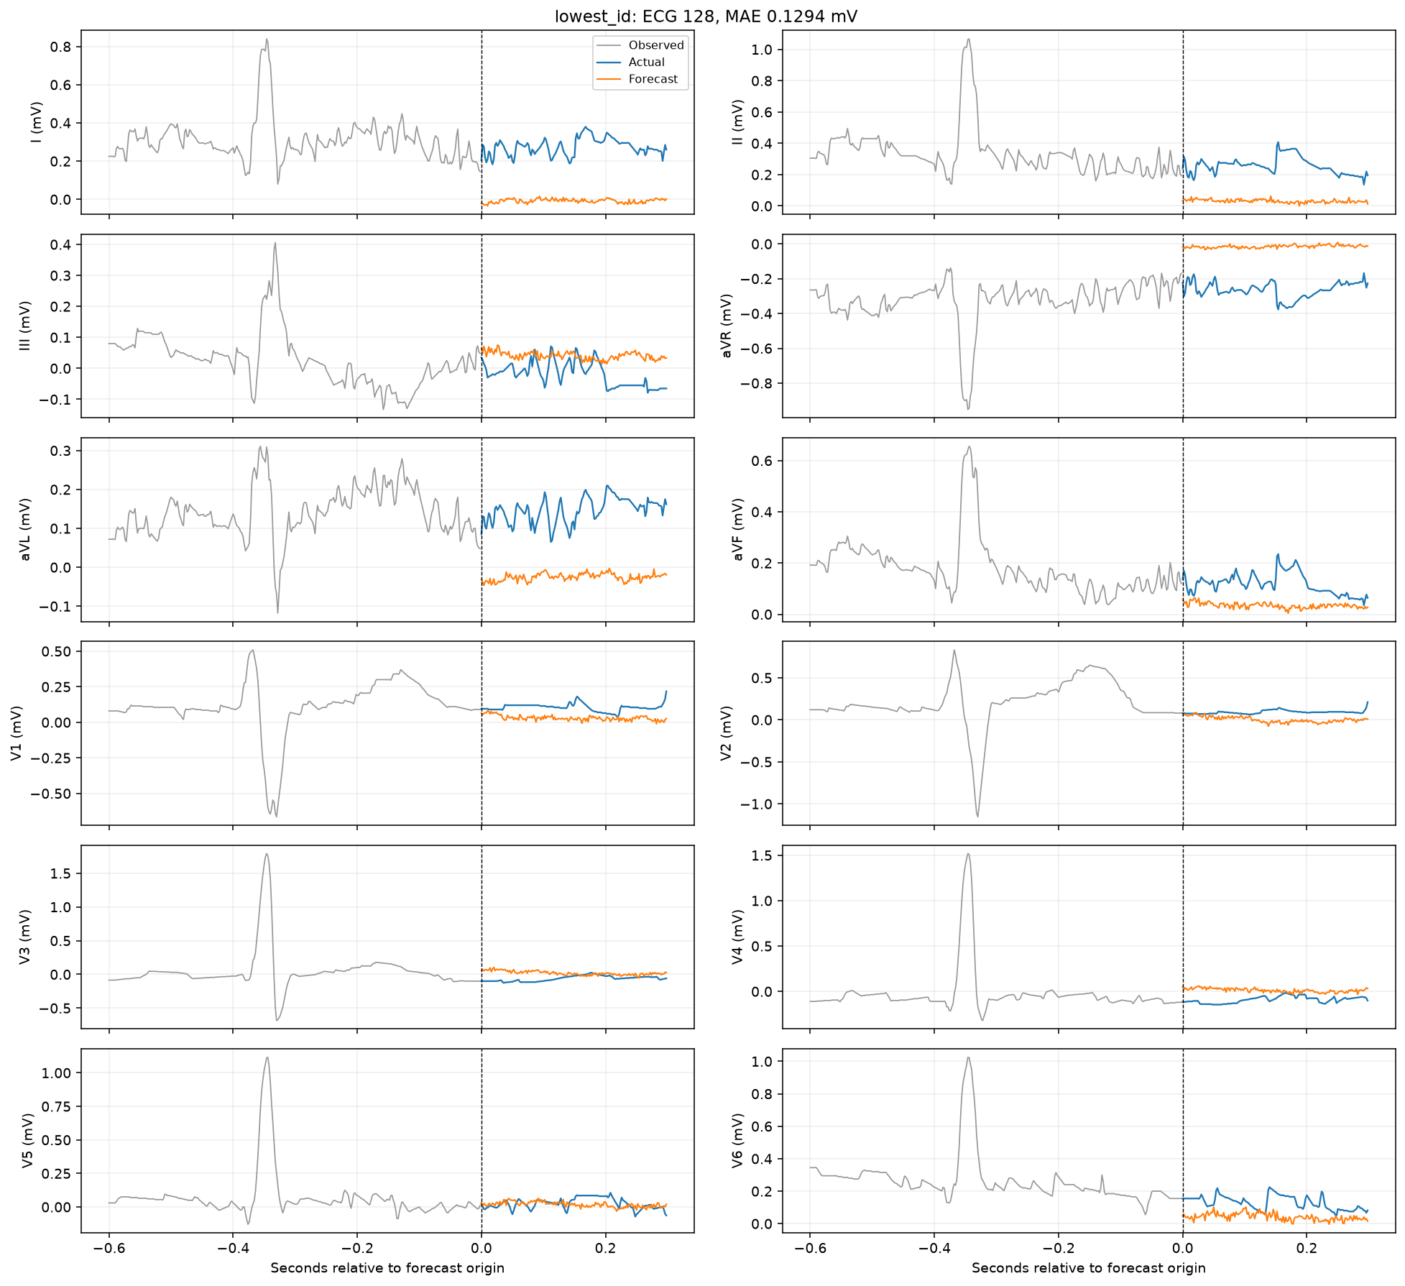
Lowest-ID test forecast
CNN-LSTM / ECG only
25

Slide 26
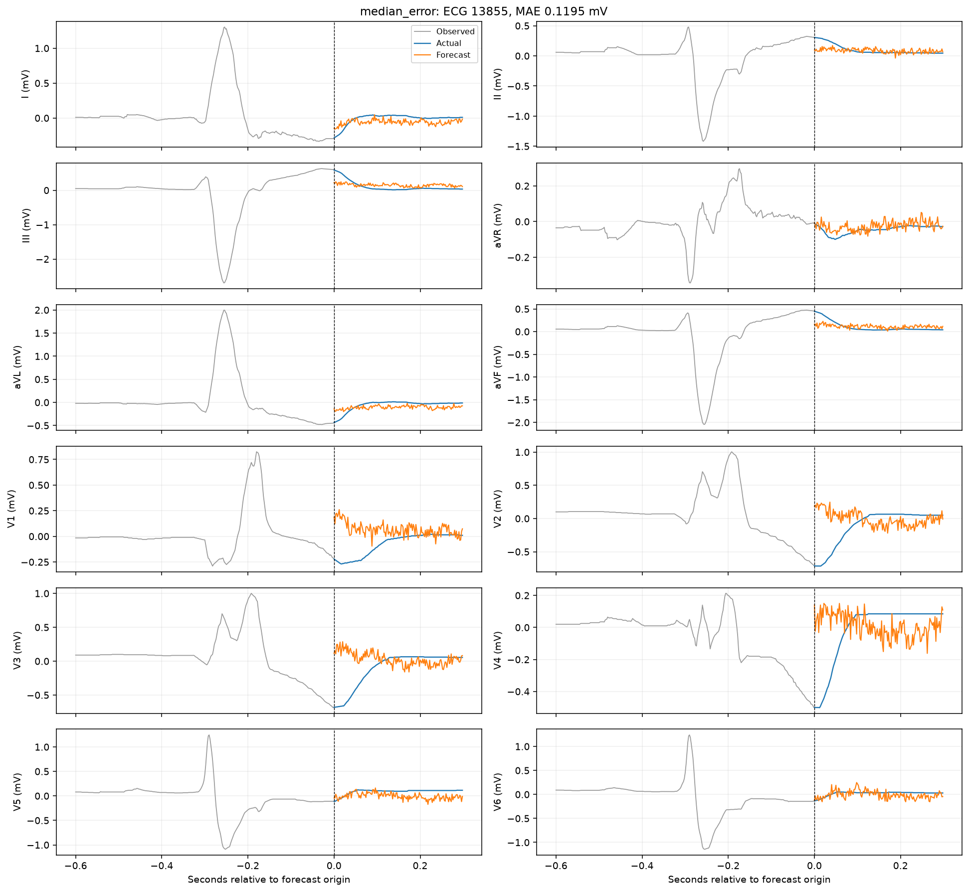
Median-error test forecast
CNN-LSTM / ECG only
26

Slide 27
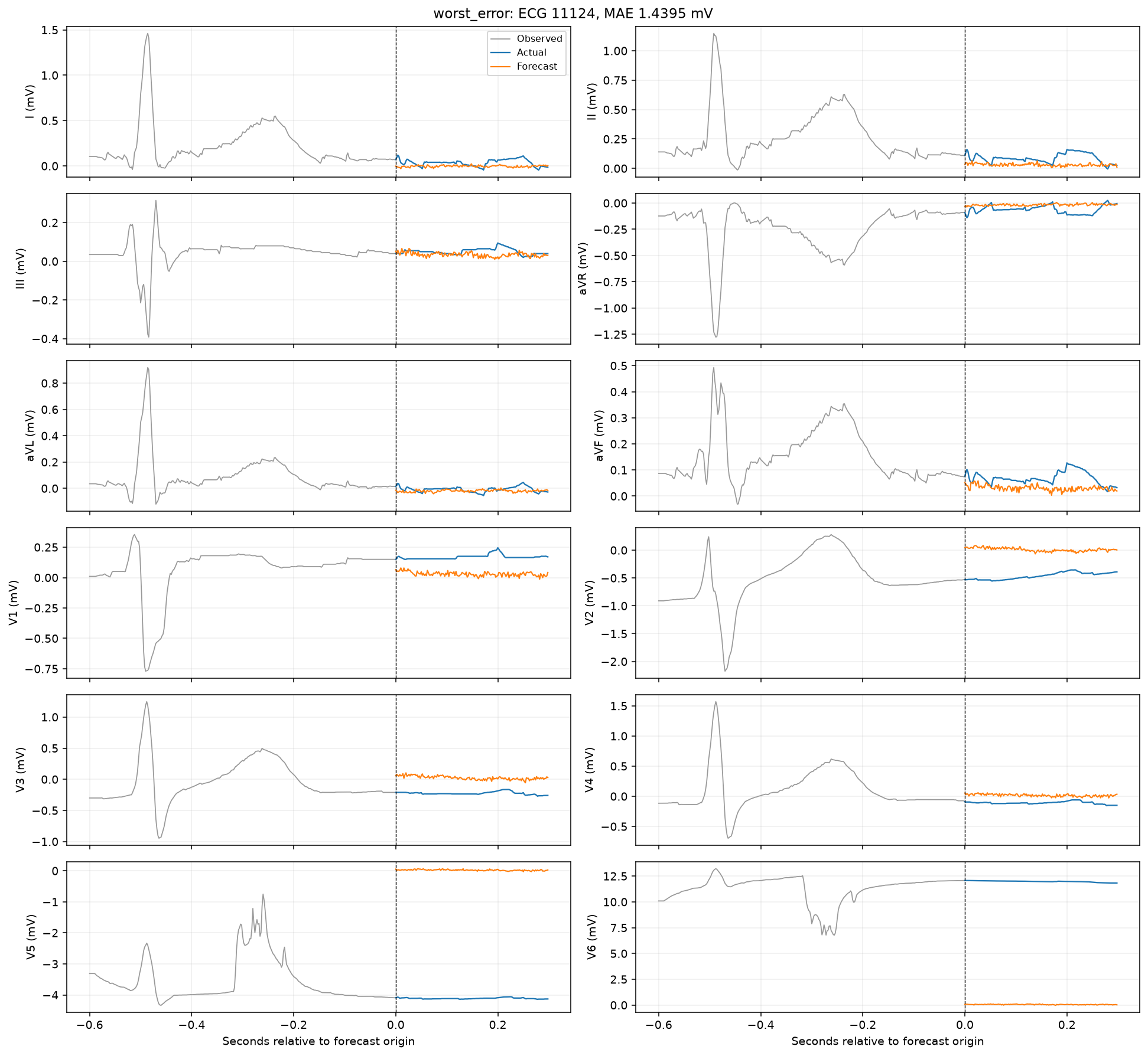
Worst-error test forecast
CNN-LSTM / ECG only
27

Slide 28
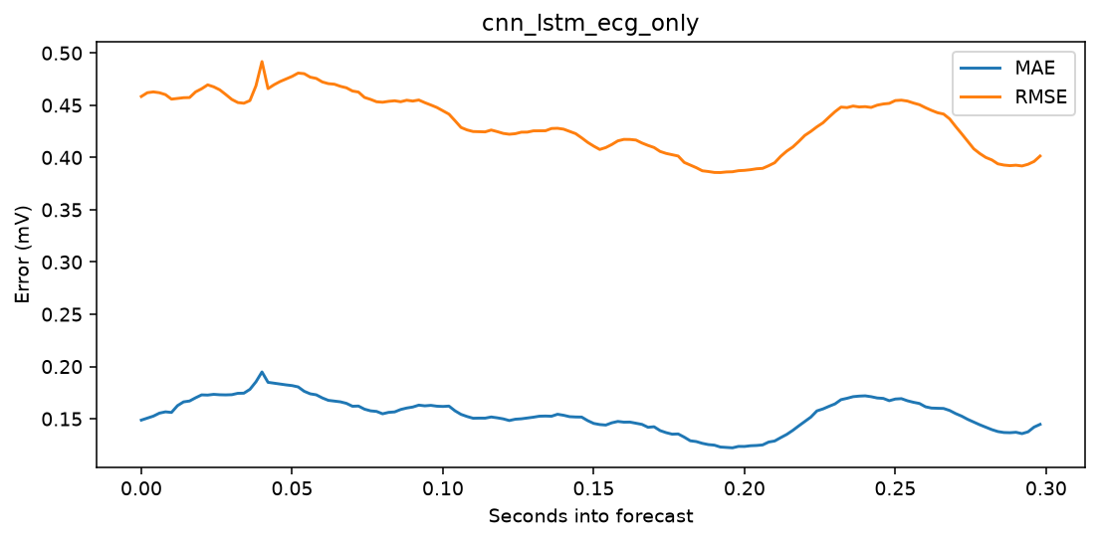
Forecast-horizon error
CNN-LSTM / ECG only
28

Slide 29
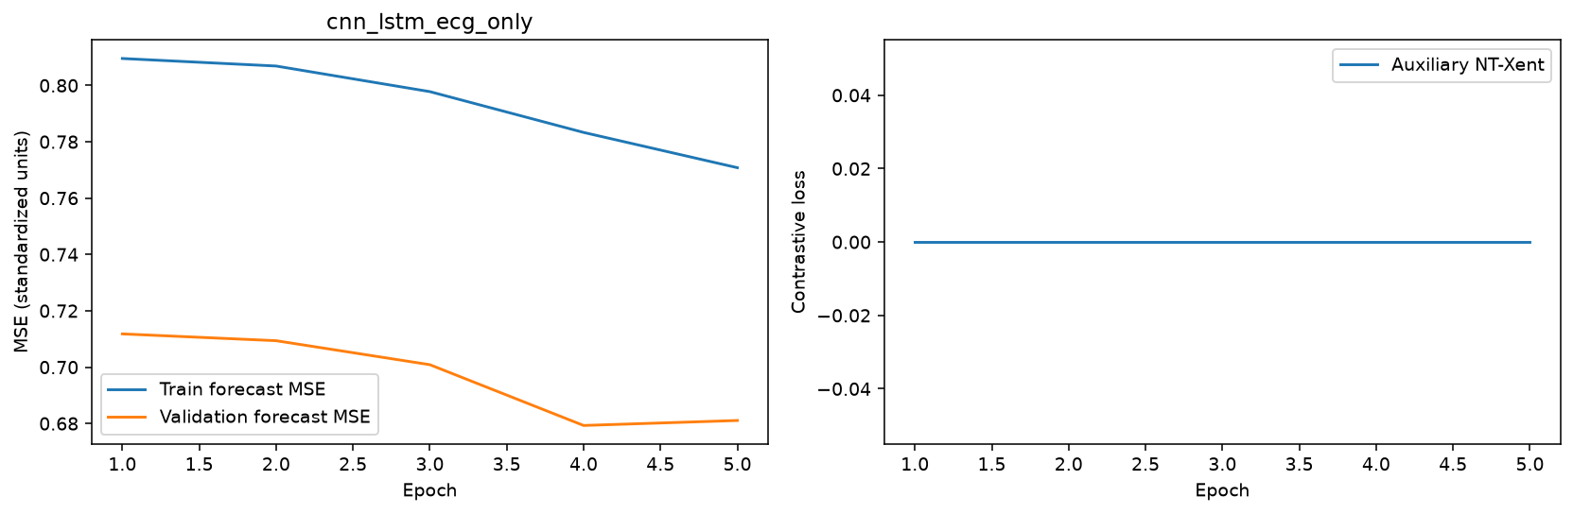
Learning curves
CNN-LSTM / ECG only
29

Slide 30

Per-lead errors
CNN-LSTM / ECG only
30

Slide 31
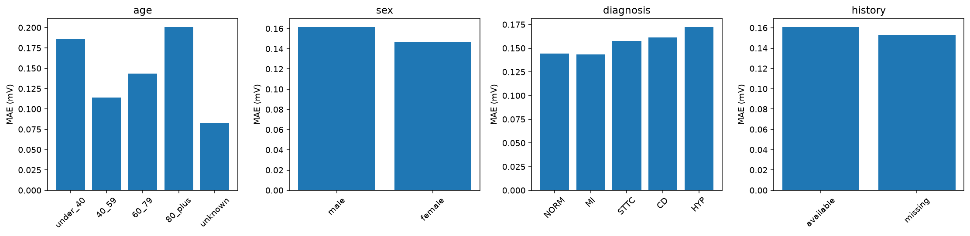
Patient subgroup errors
CNN-LSTM / ECG only
31

Slide 32
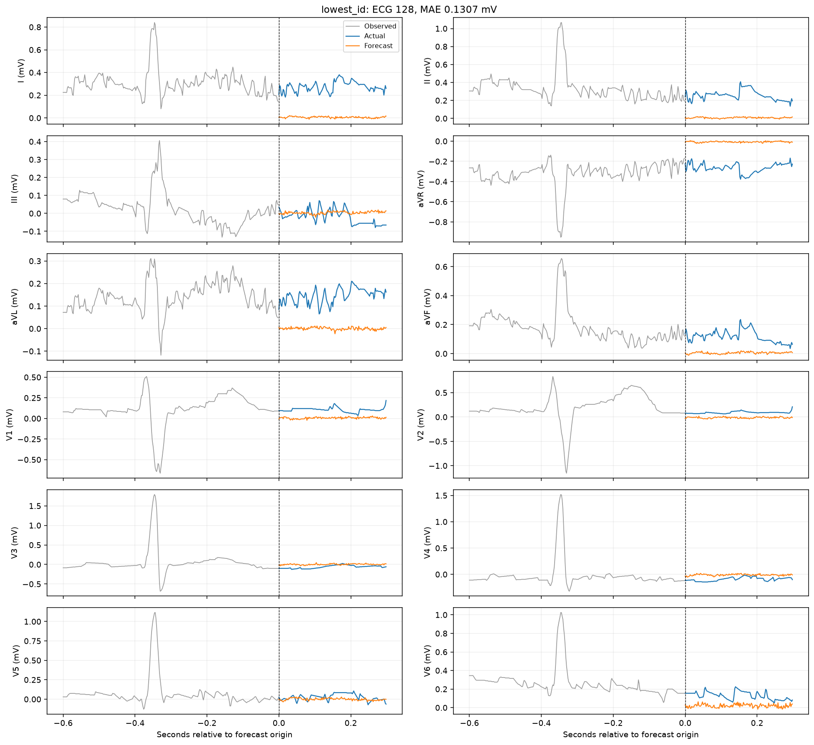
Lowest-ID test forecast
CNN-LSTM / patient history
32

Slide 33
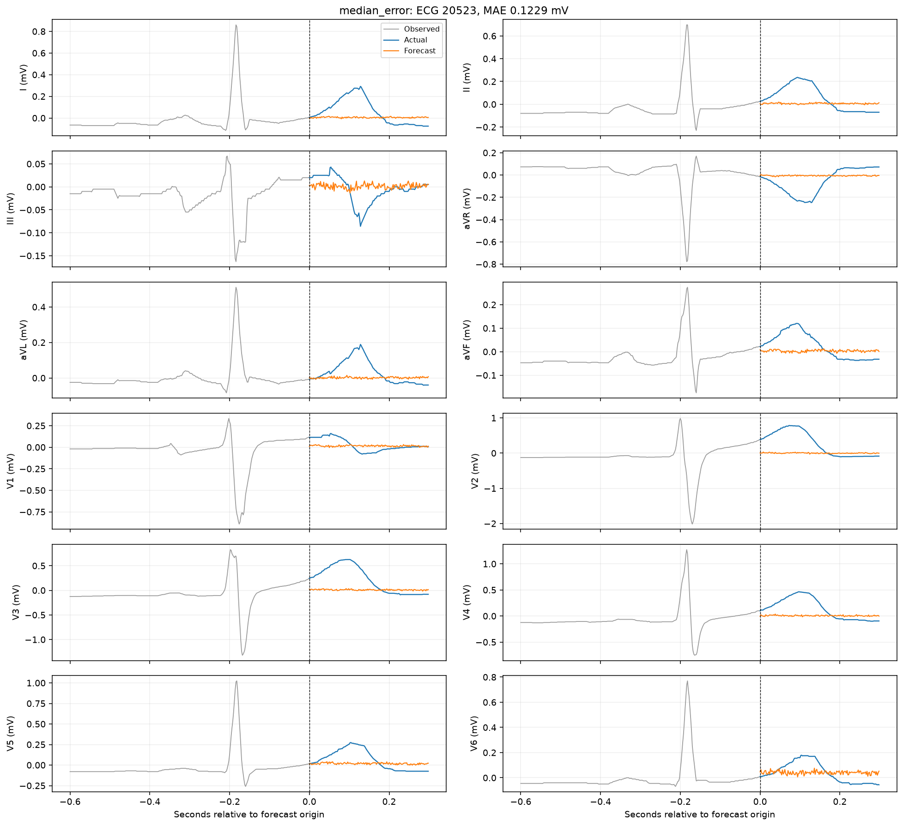
Median-error test forecast
CNN-LSTM / patient history
33

Slide 34
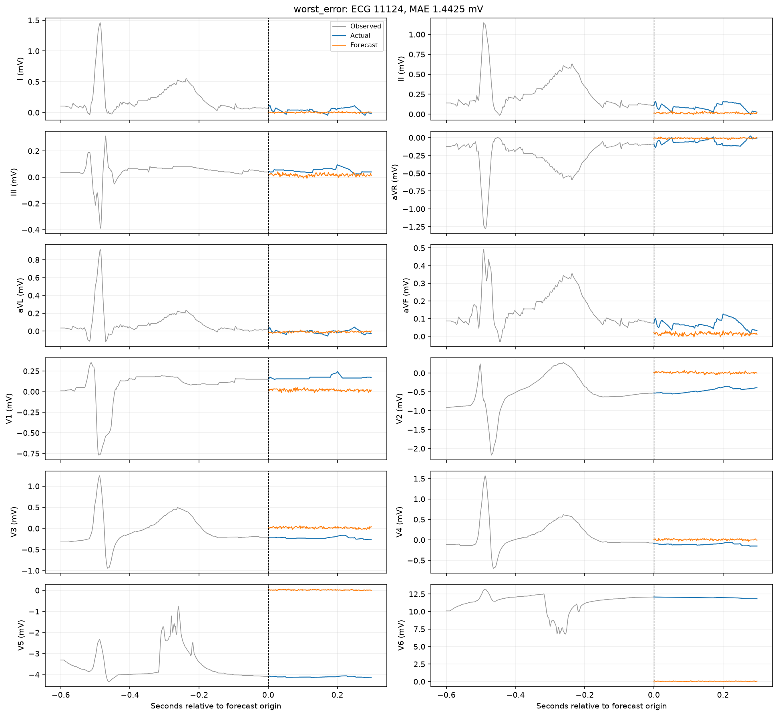
Worst-error test forecast
CNN-LSTM / patient history
34

Slide 35
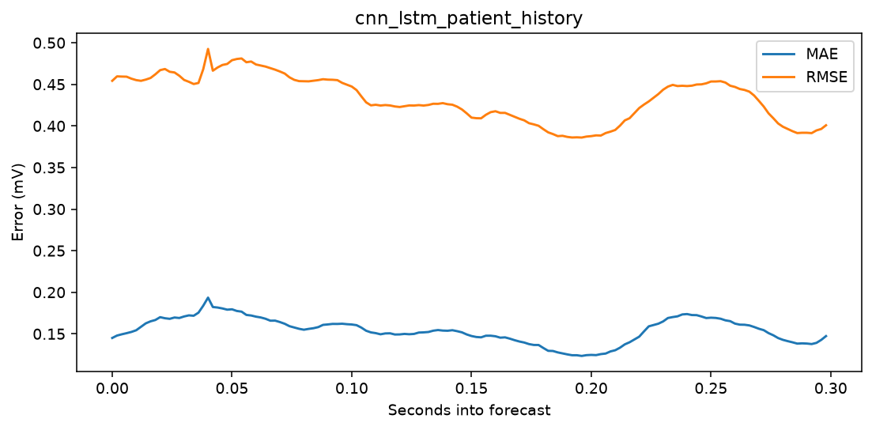
Forecast-horizon error
CNN-LSTM / patient history
35

Slide 36

Learning curves
CNN-LSTM / patient history
36

Slide 37
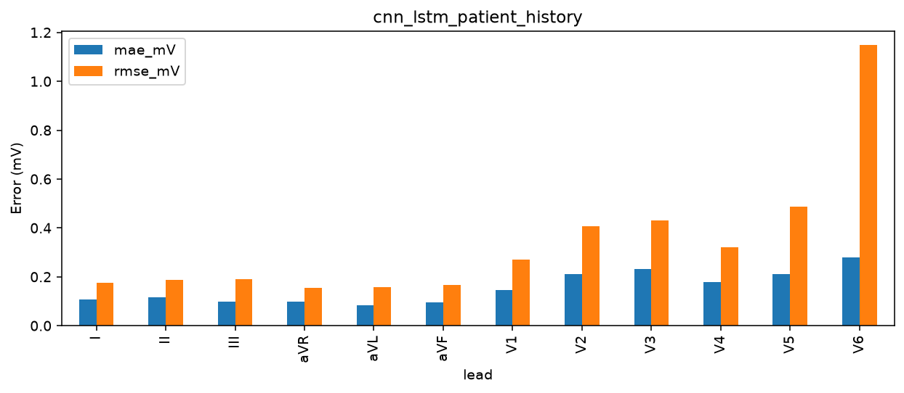
Per-lead errors
CNN-LSTM / patient history
37

Slide 38
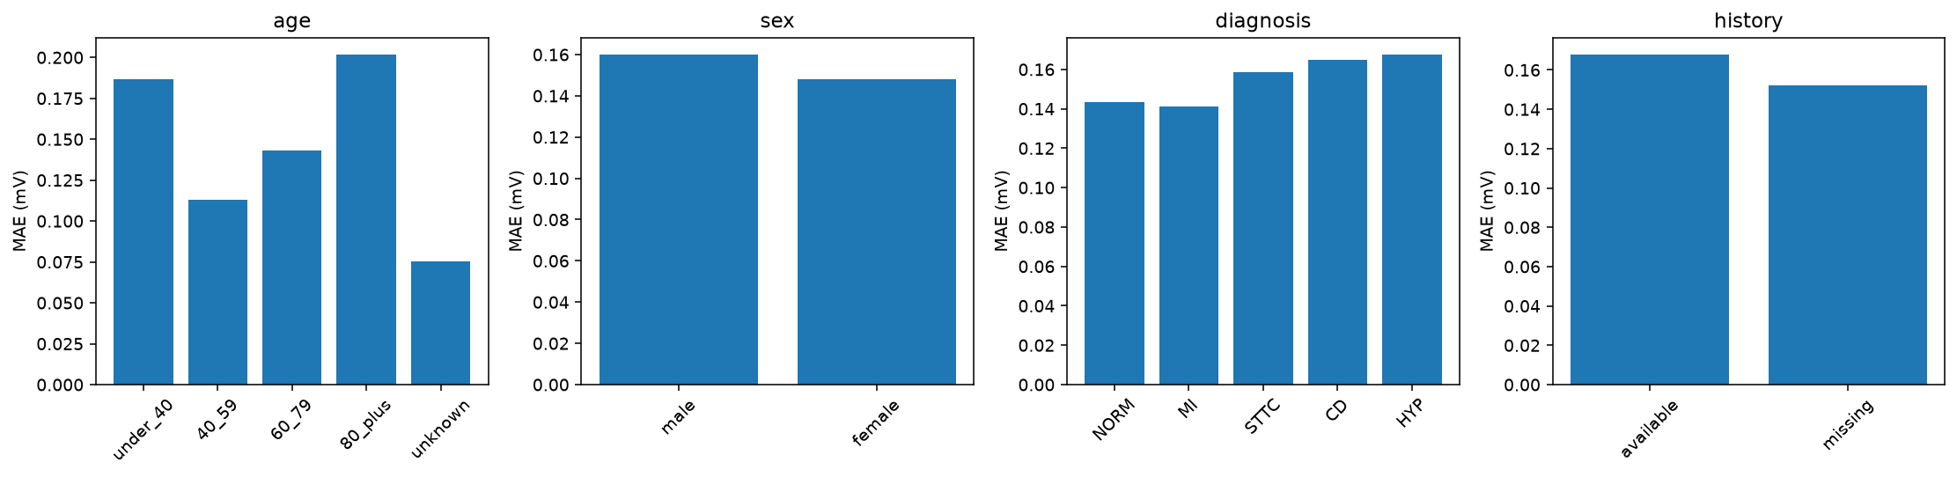
Patient subgroup errors
CNN-LSTM / patient history
38

Slide 39
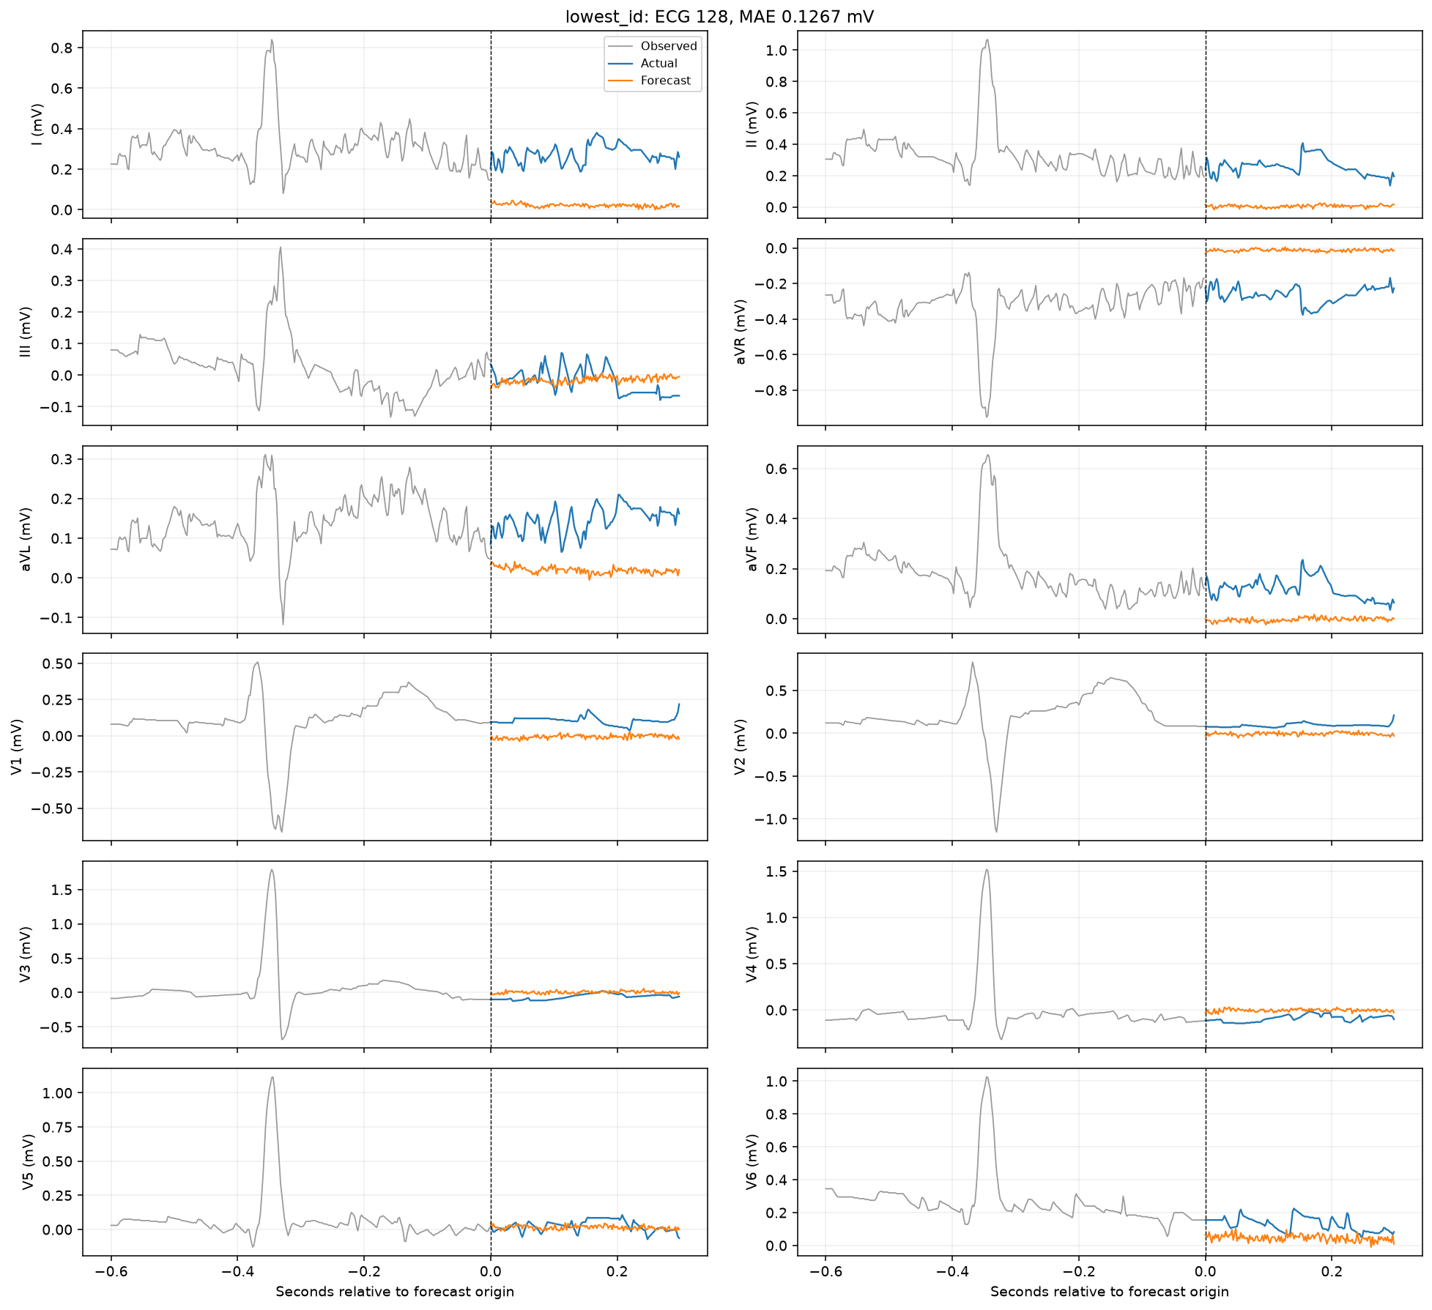
Lowest-ID test forecast
CNN-LSTM / patient history + contrastive
39

Slide 40
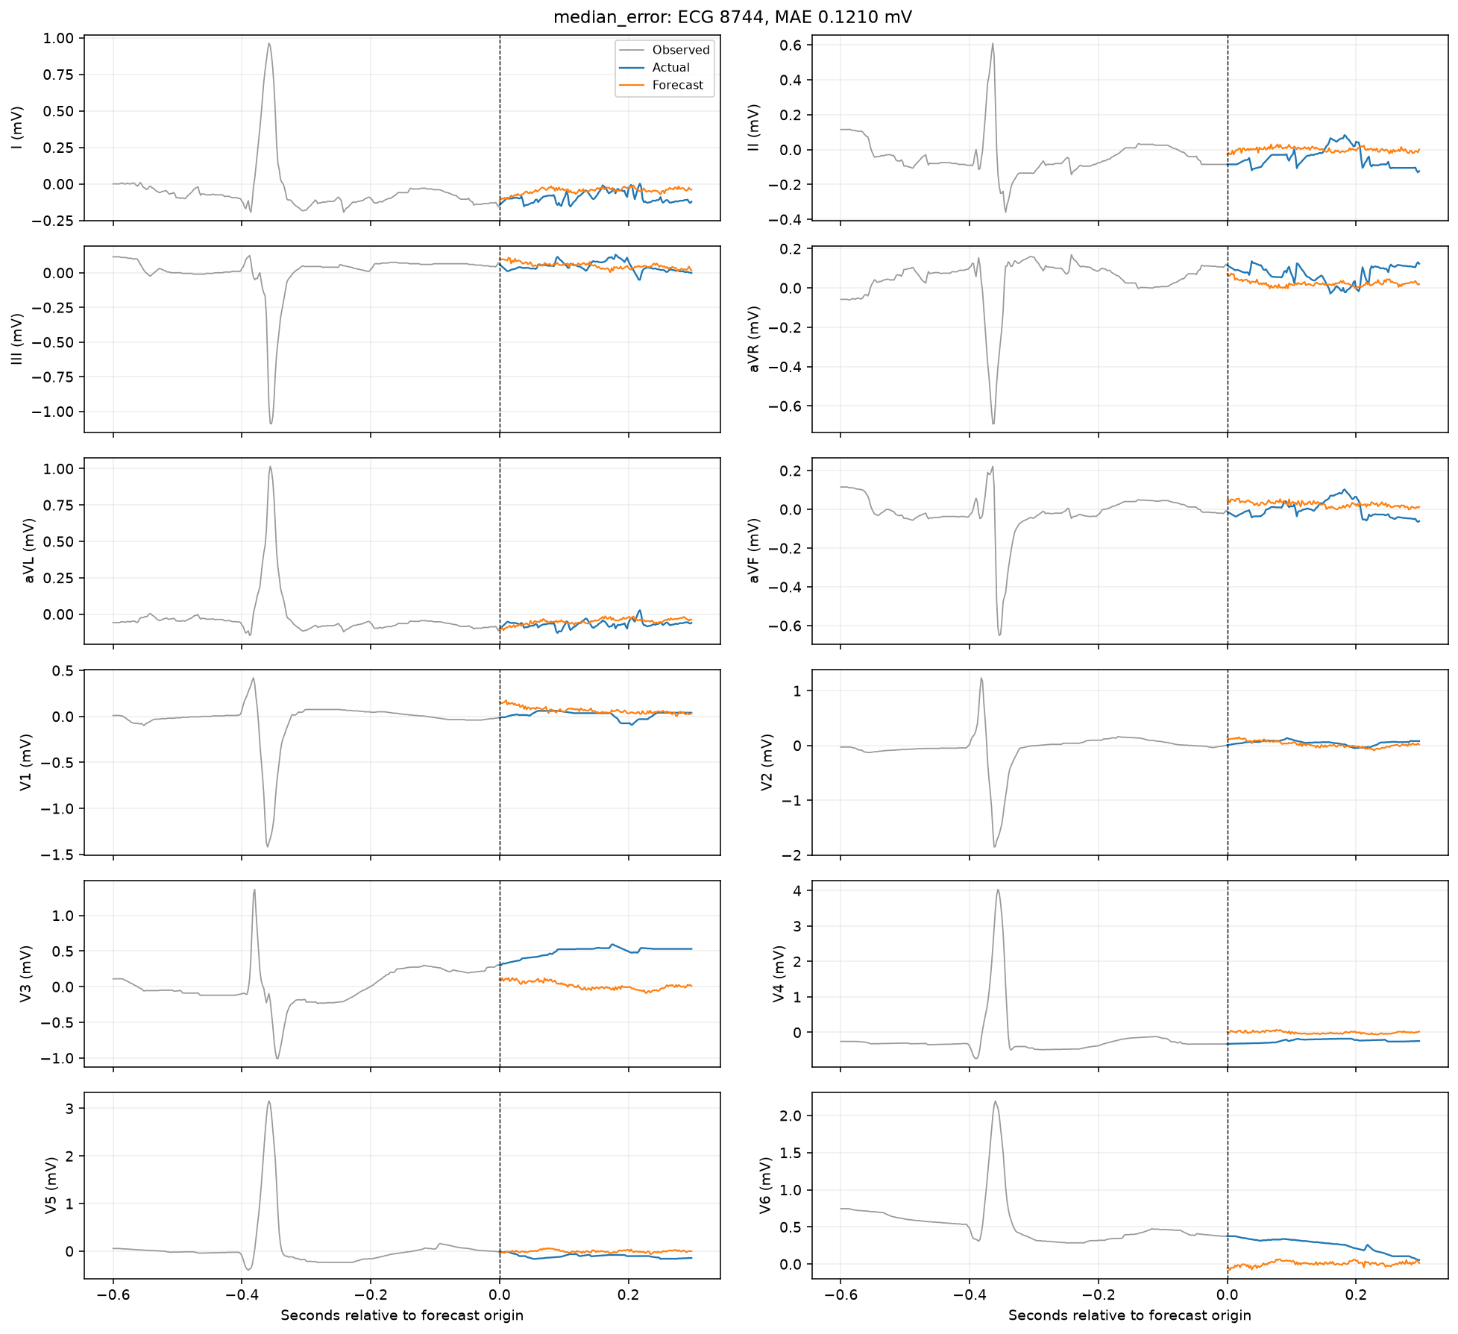
Median-error test forecast
CNN-LSTM / patient history + contrastive
40

Slide 41
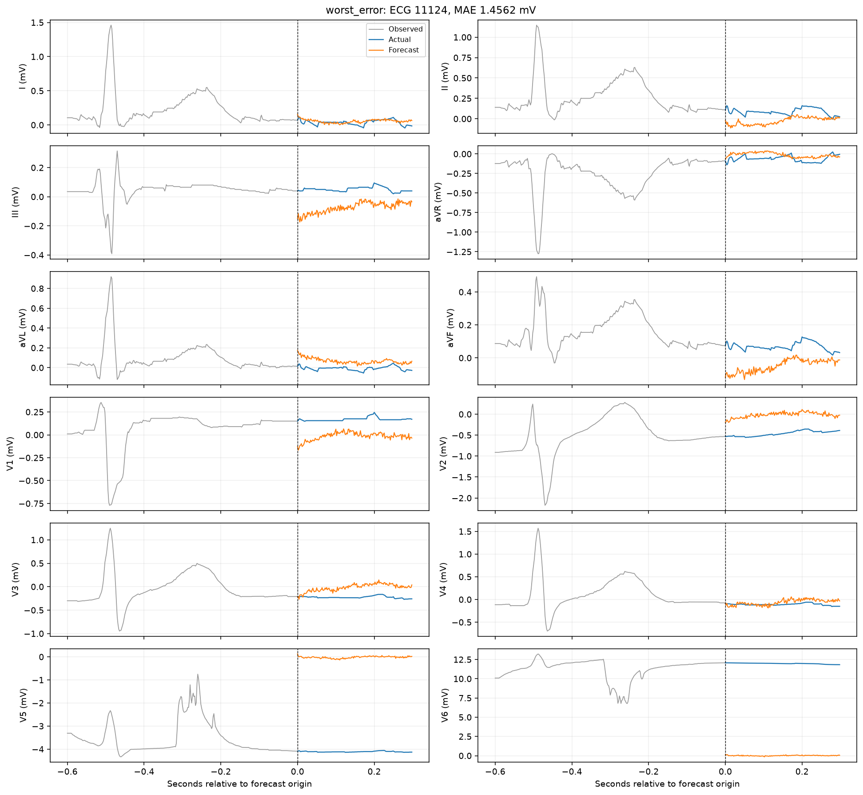
Worst-error test forecast
CNN-LSTM / patient history + contrastive
41

Slide 42
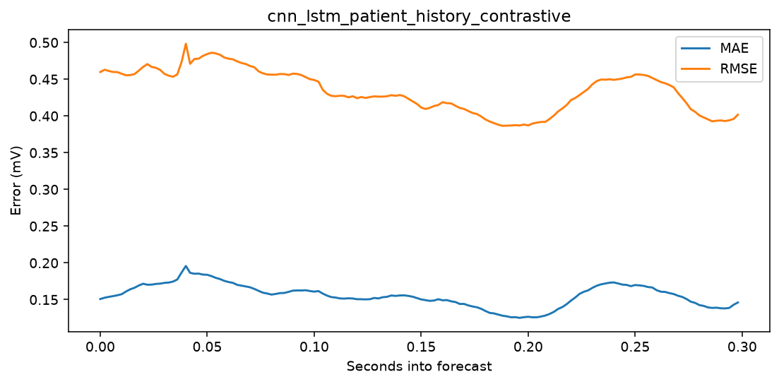
Forecast-horizon error
CNN-LSTM / patient history + contrastive
42

Slide 43
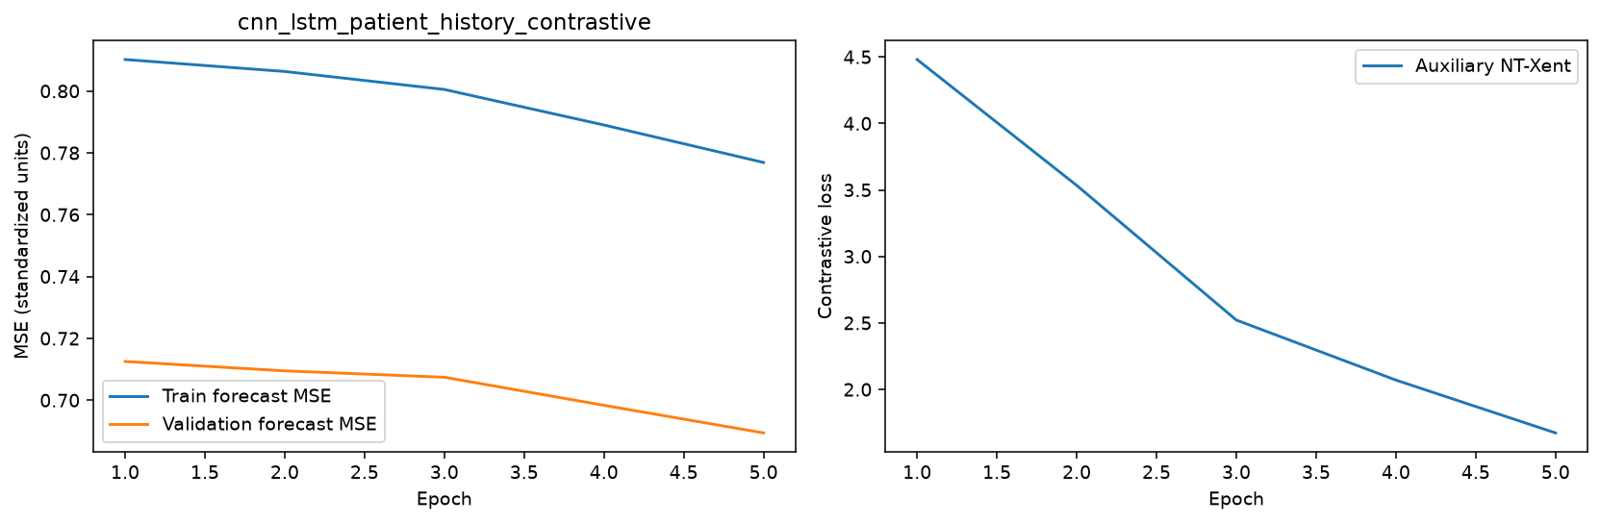
Learning curves
CNN-LSTM / patient history + contrastive
43

Slide 44
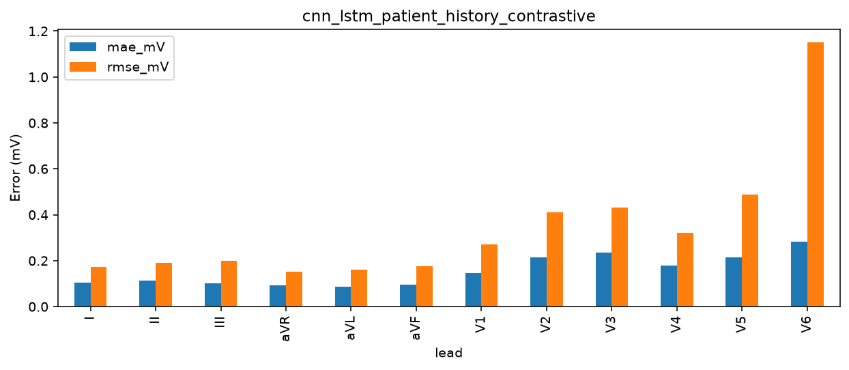
Per-lead errors
CNN-LSTM / patient history + contrastive
44

Slide 45
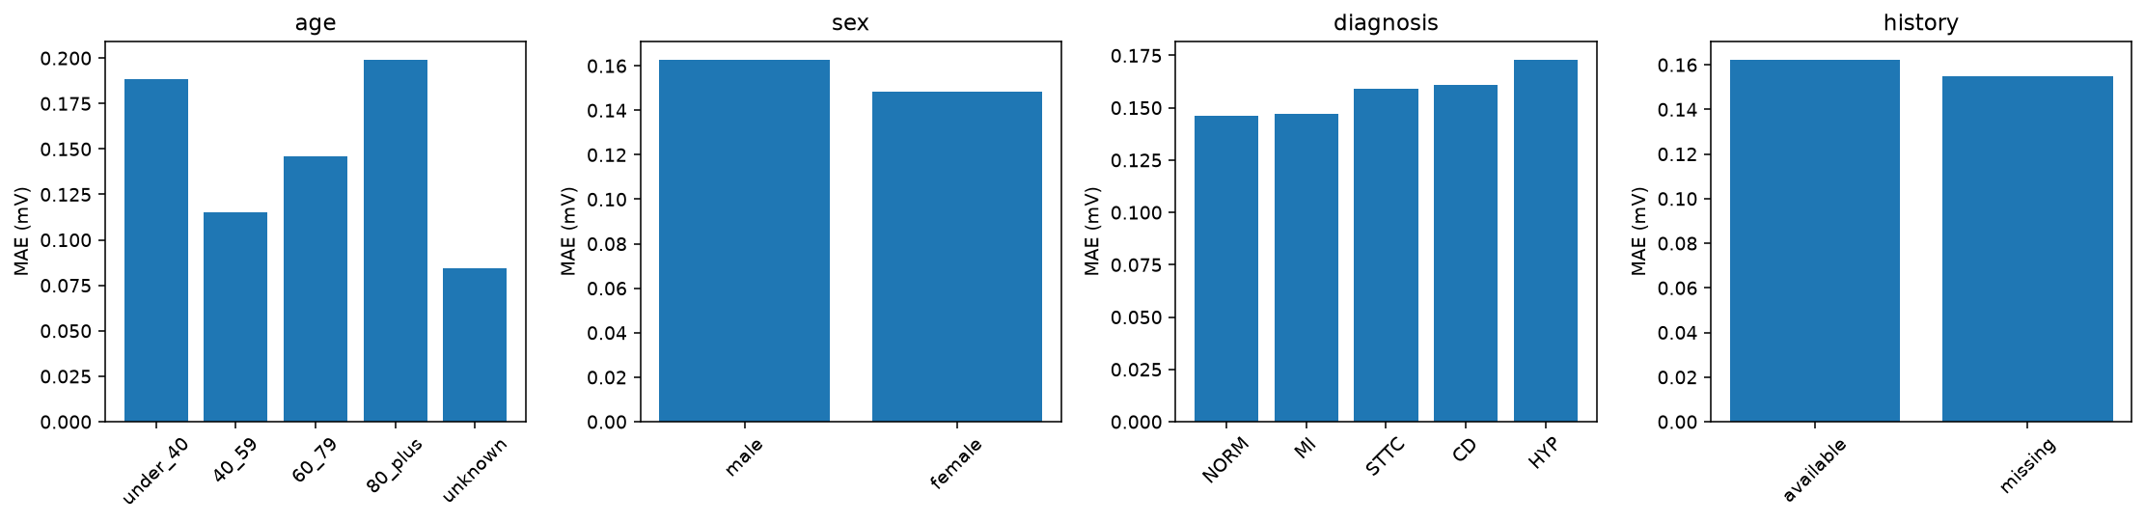
Patient subgroup errors
CNN-LSTM / patient history + contrastive
45

Slide 46
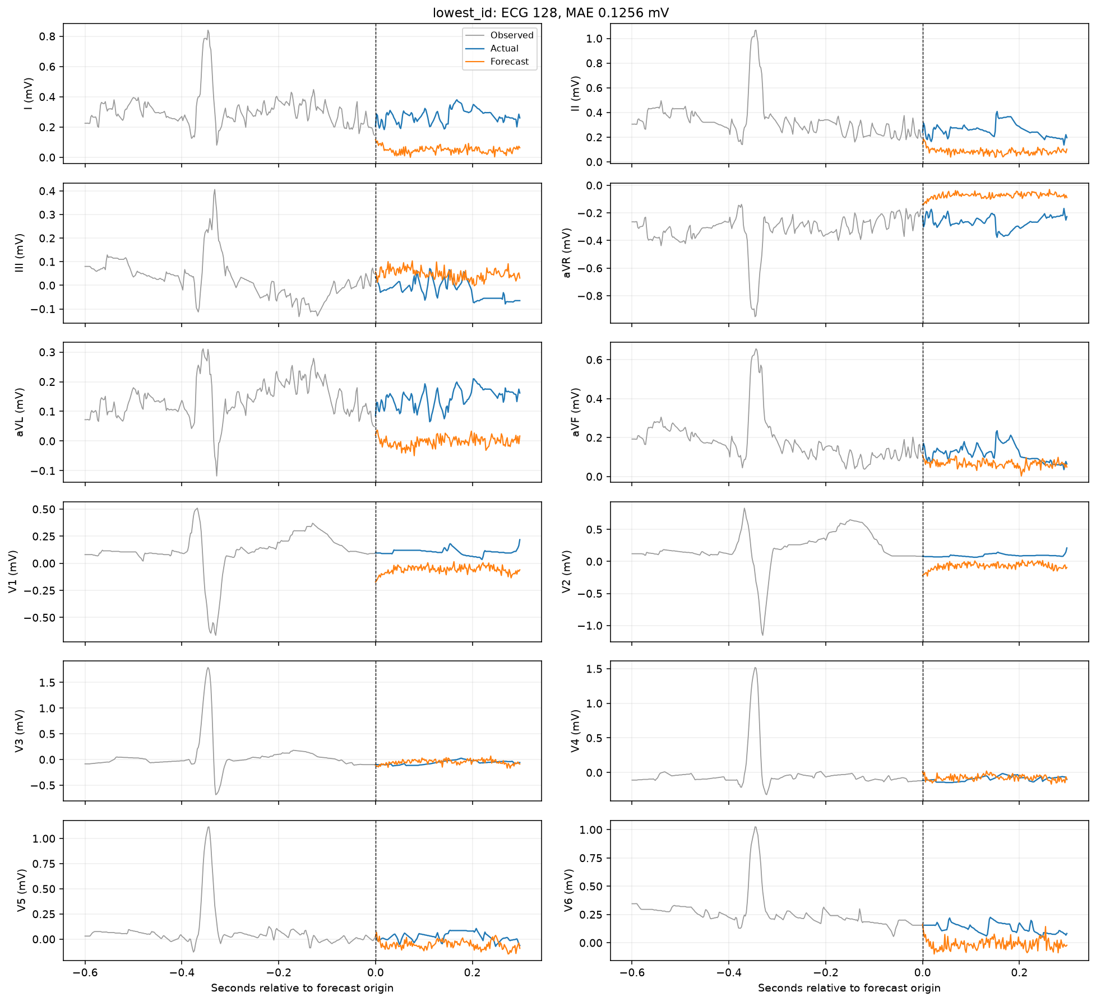
Lowest-ID test forecast
LSTM / demographics
46

Slide 47
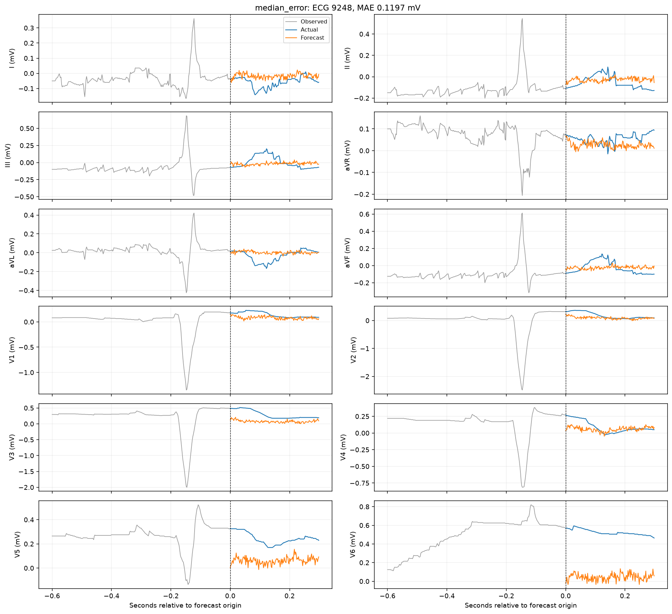
Median-error test forecast
LSTM / demographics
47

Slide 48
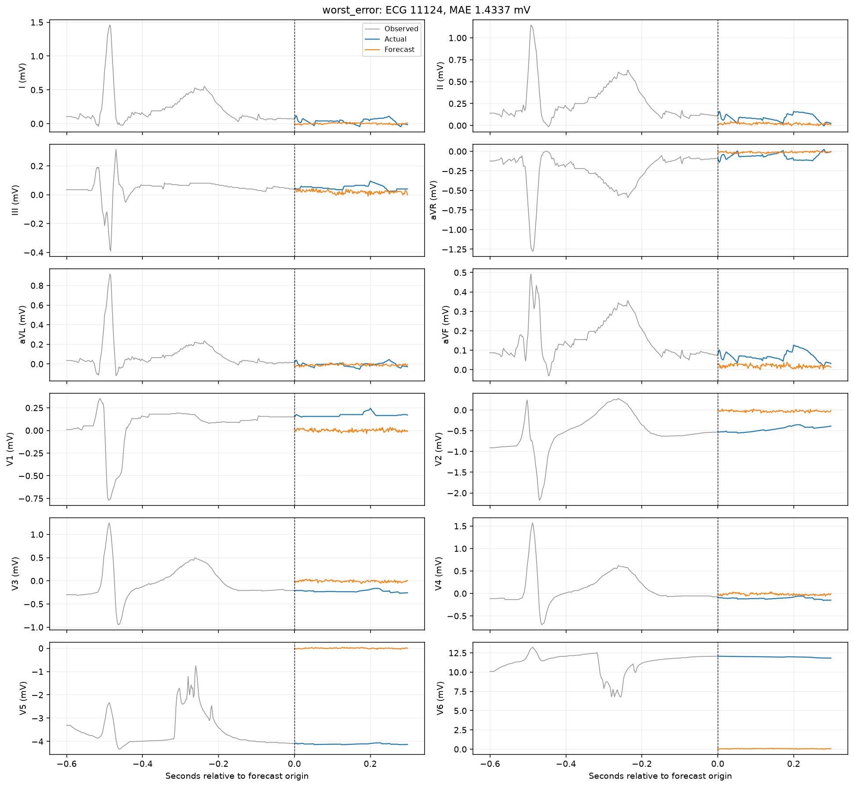
Worst-error test forecast
LSTM / demographics
48

Slide 49
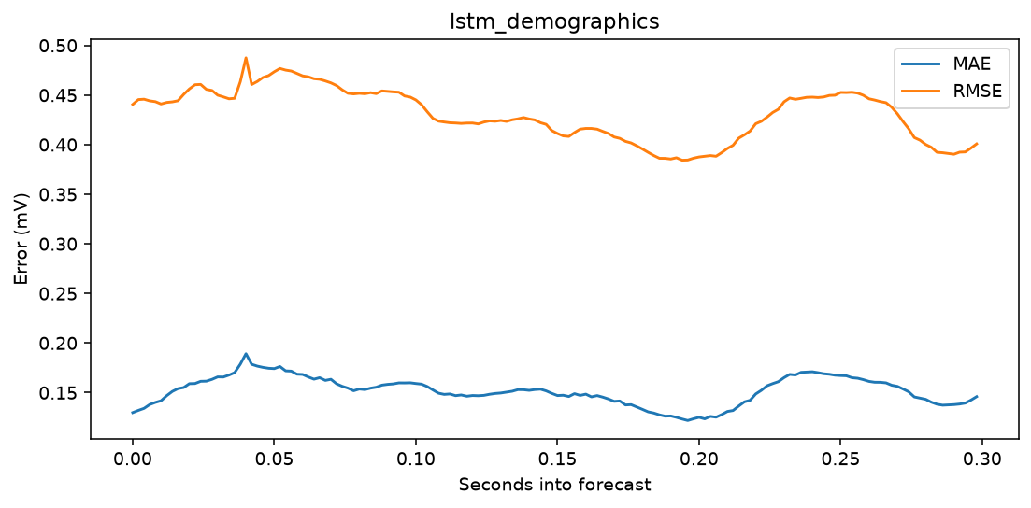
Forecast-horizon error
LSTM / demographics
49

Slide 50
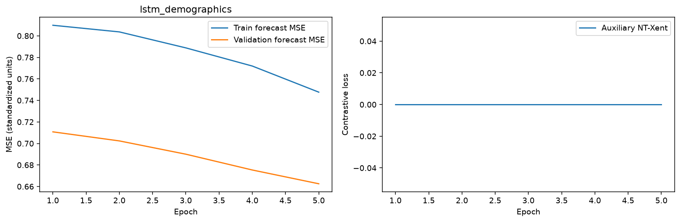
Learning curves
LSTM / demographics
50

Slide 51

Per-lead errors
LSTM / demographics
51

Slide 52
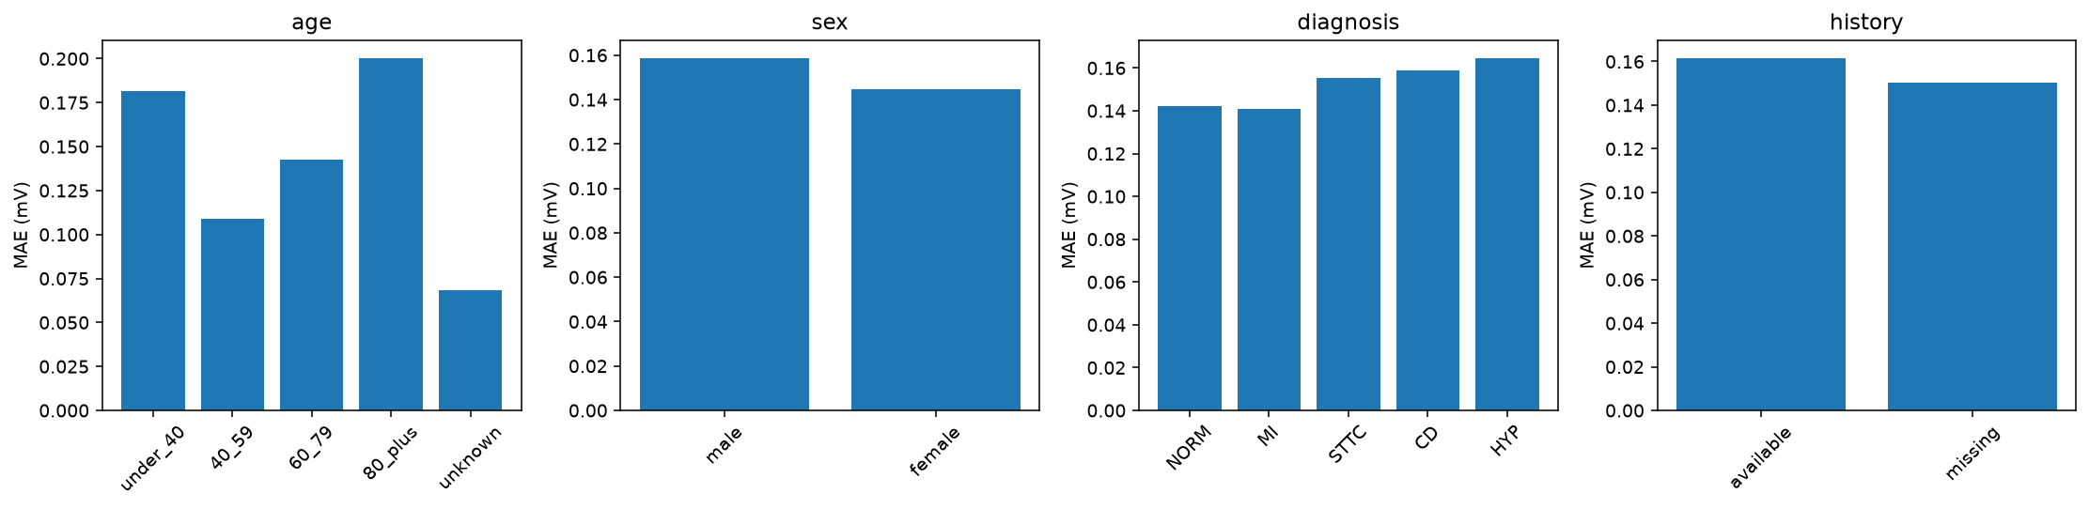
Patient subgroup errors
LSTM / demographics
52

Slide 53
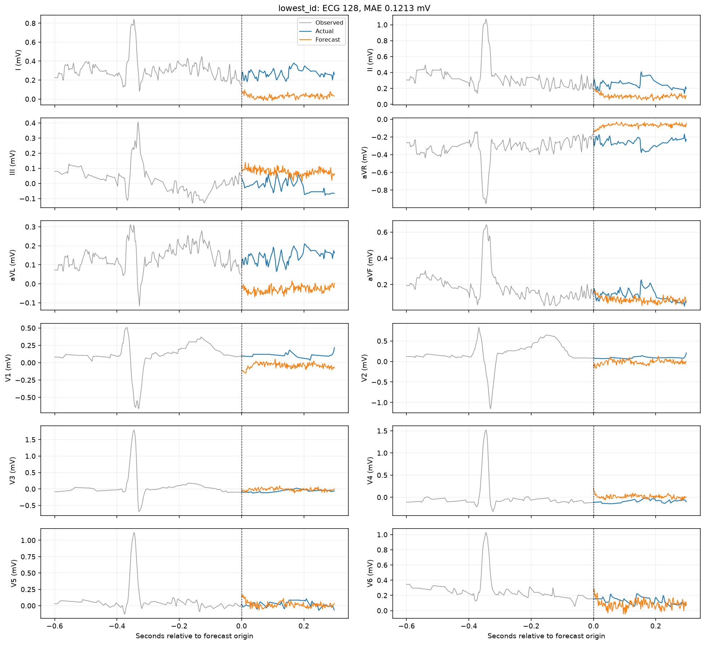
Lowest-ID test forecast
LSTM / ECG only
53

Slide 54
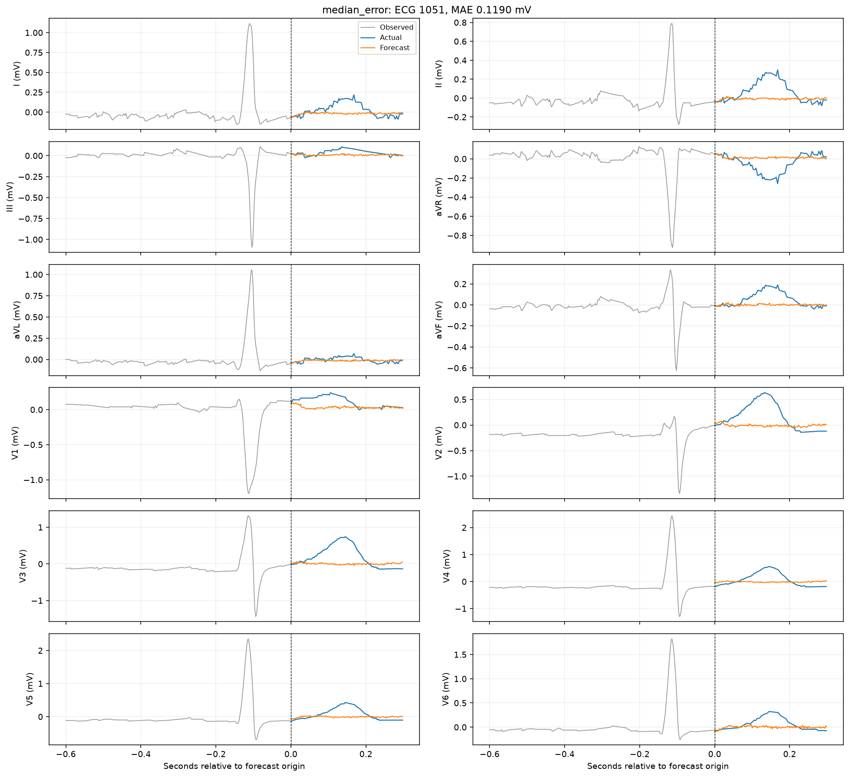
Median-error test forecast
LSTM / ECG only
54

Slide 55
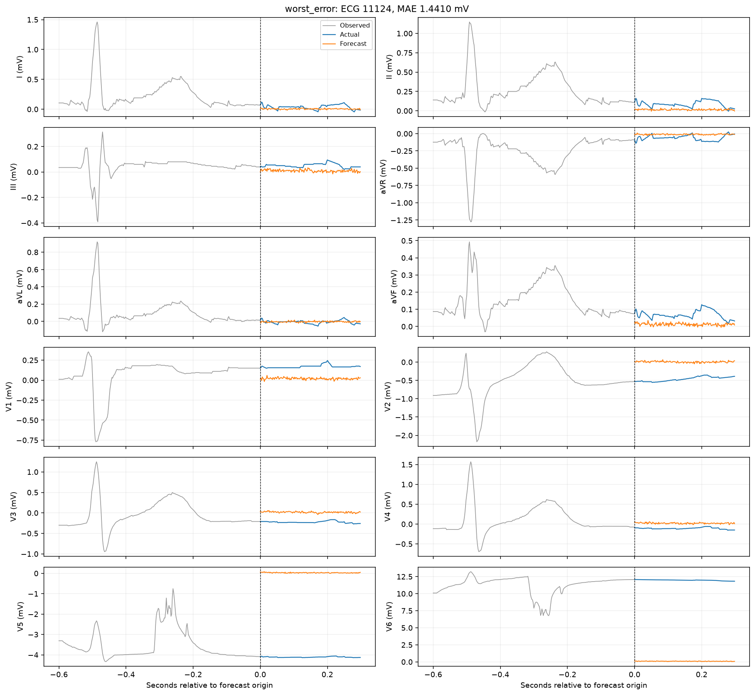
Worst-error test forecast
LSTM / ECG only
55

Slide 56
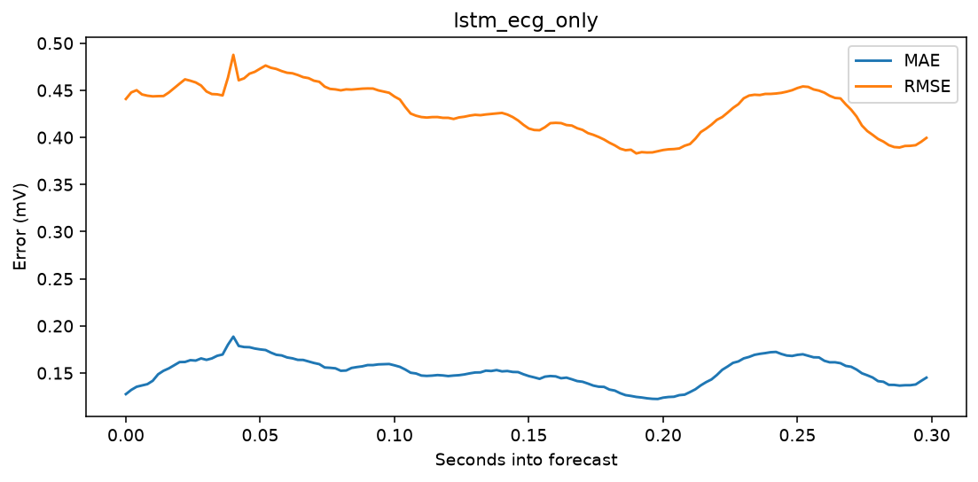
Forecast-horizon error
LSTM / ECG only
56

Slide 57
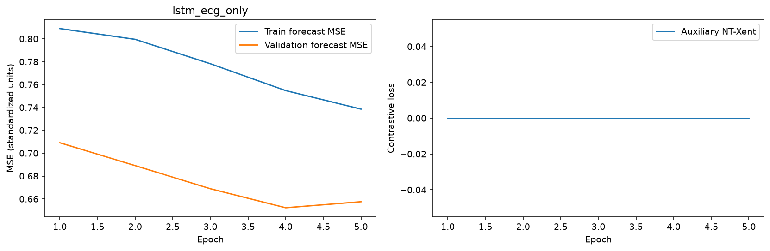
Learning curves
LSTM / ECG only
57

Slide 58
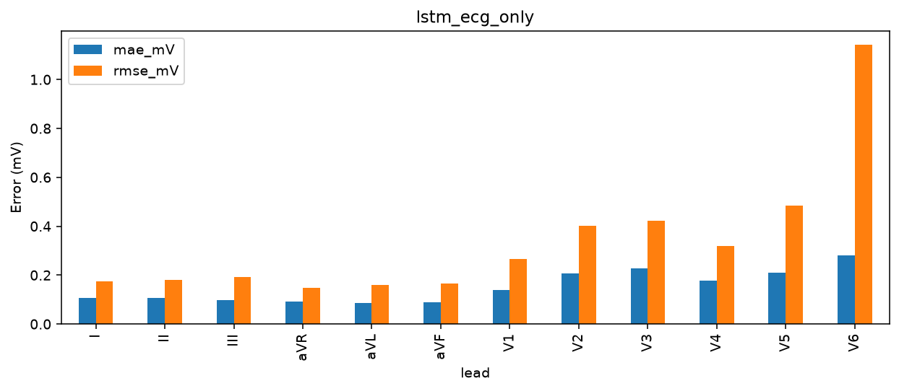
Per-lead errors
LSTM / ECG only
58

Slide 59
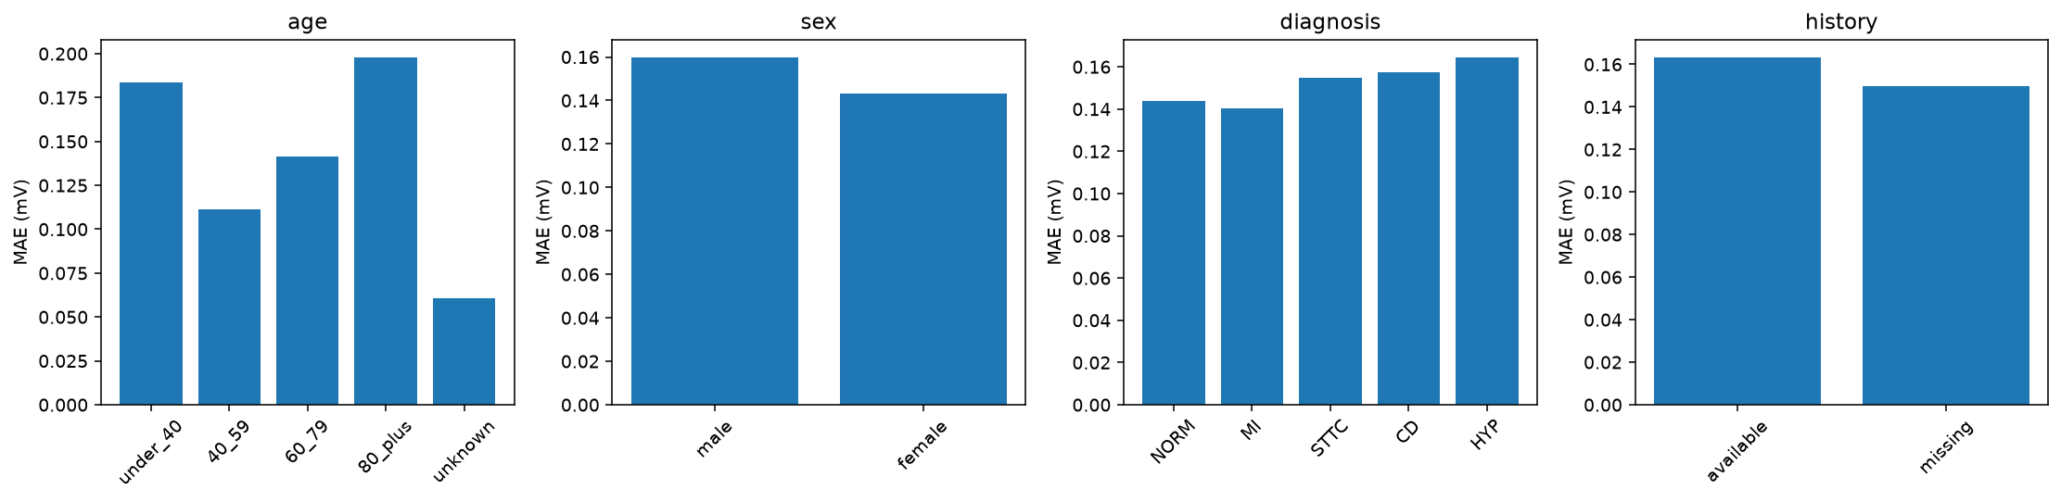
Patient subgroup errors
LSTM / ECG only
59

Slide 60

Lowest-ID test forecast
LSTM / patient history
60

Slide 61
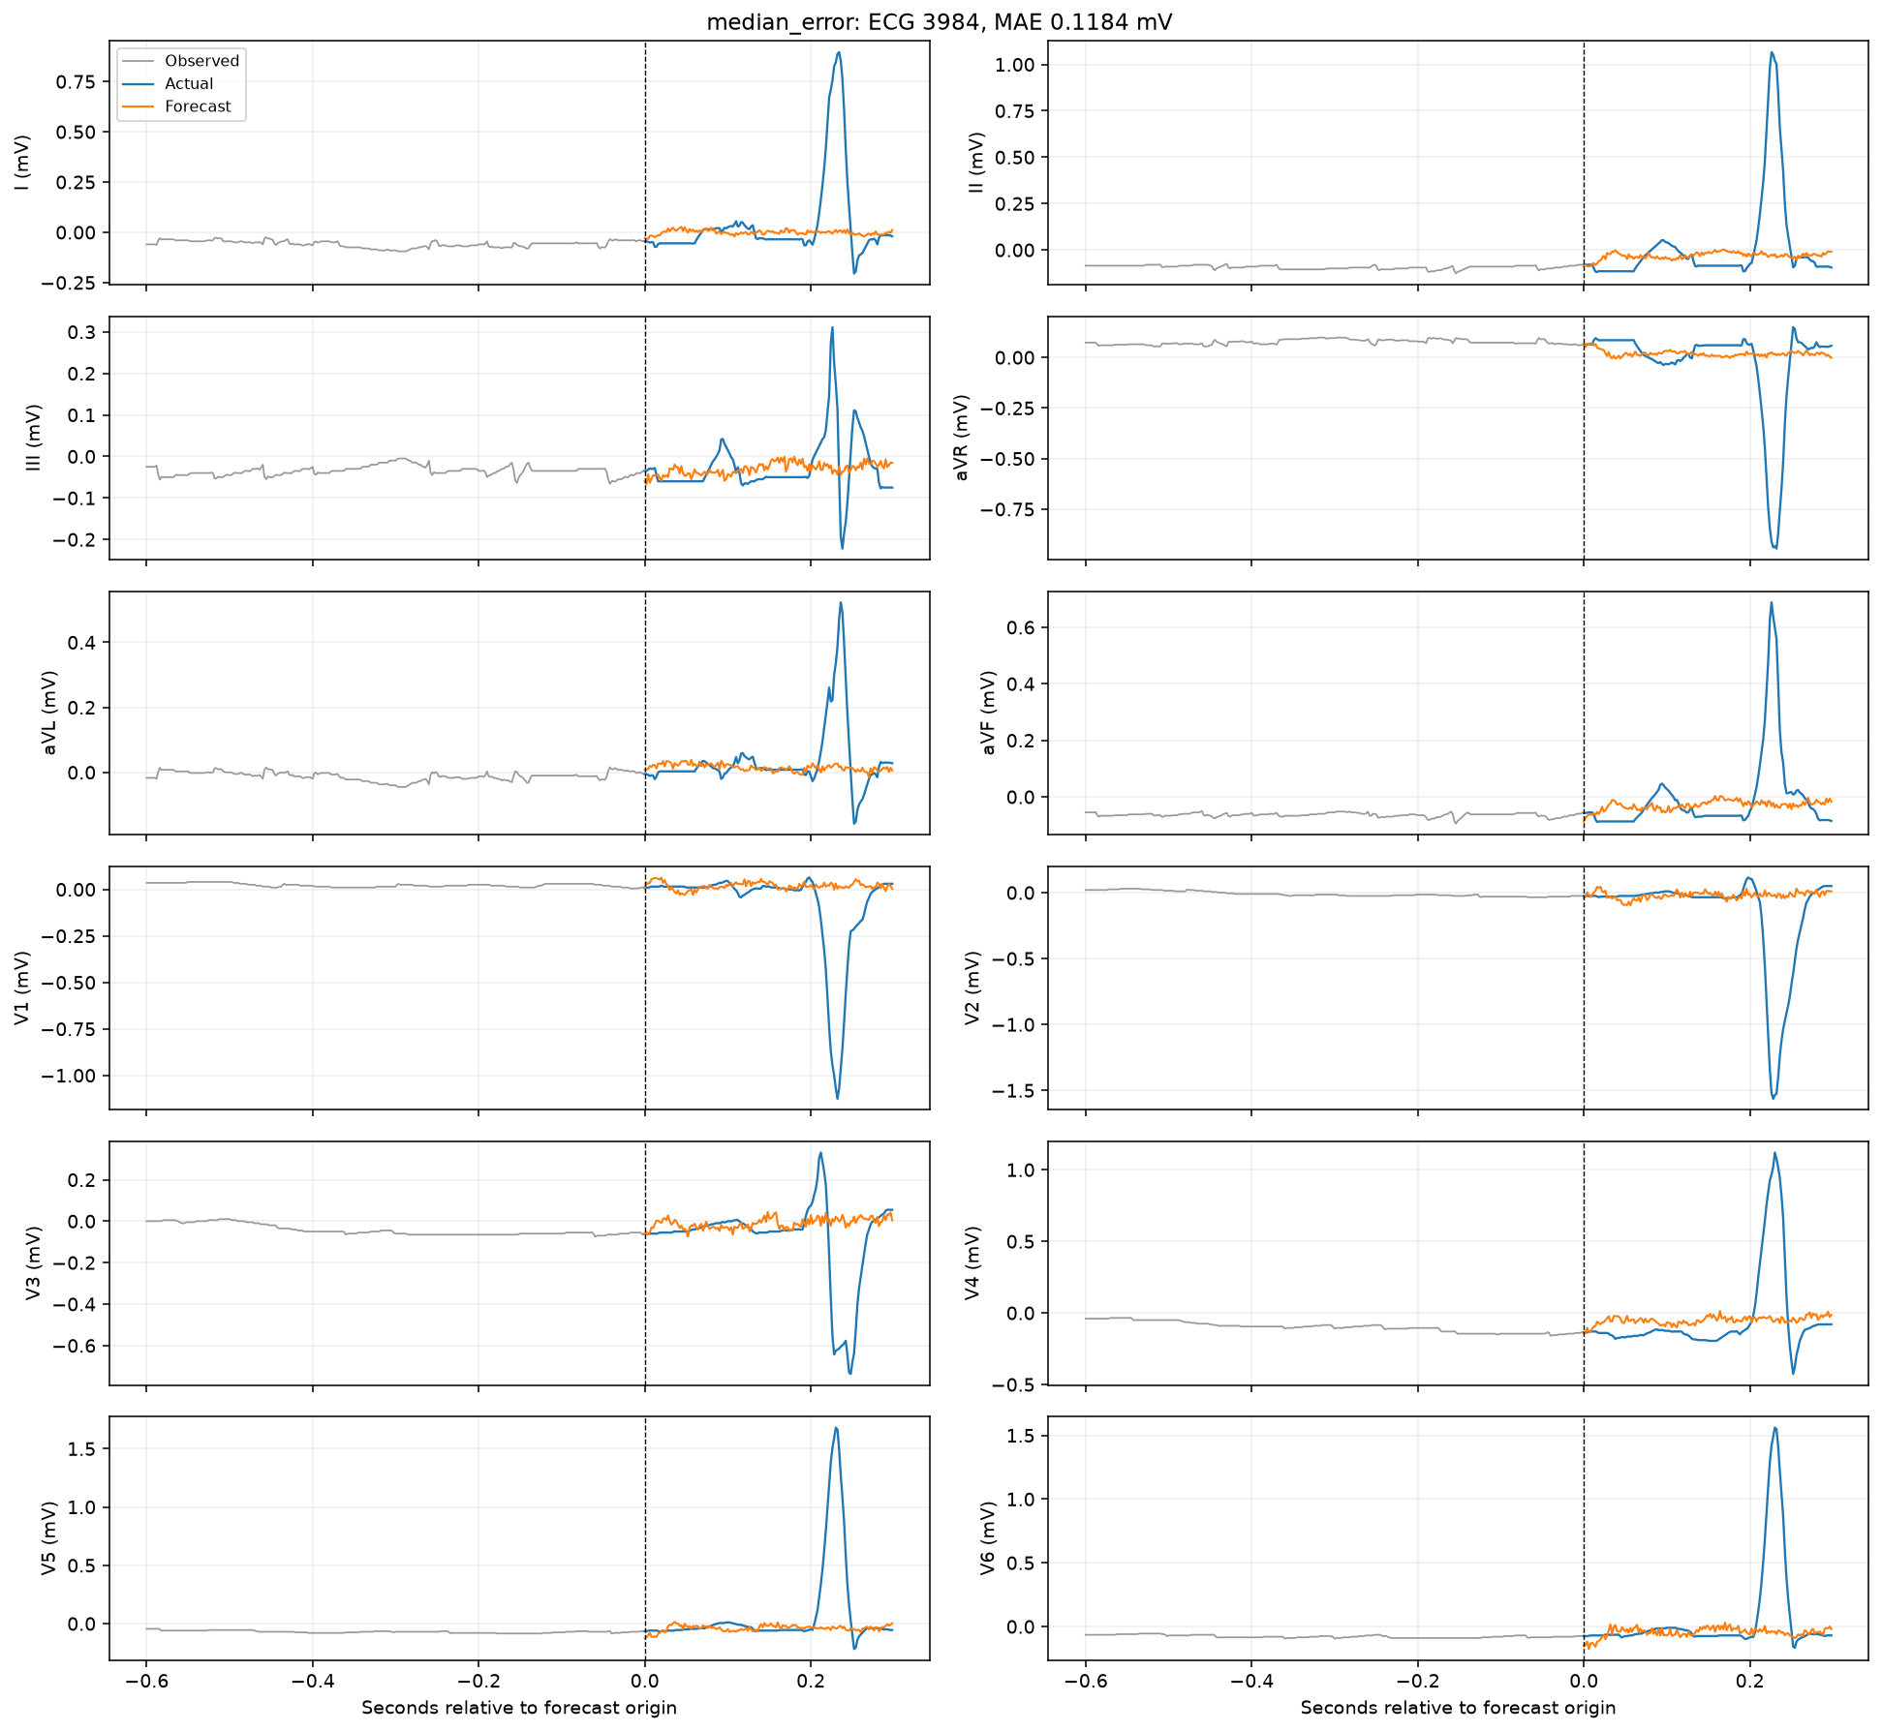
Median-error test forecast
LSTM / patient history
61

Slide 62

Worst-error test forecast
LSTM / patient history
62

Slide 63

Forecast-horizon error
LSTM / patient history
63

Slide 64

Learning curves
LSTM / patient history
64

Slide 65

Per-lead errors
LSTM / patient history
65

Slide 66
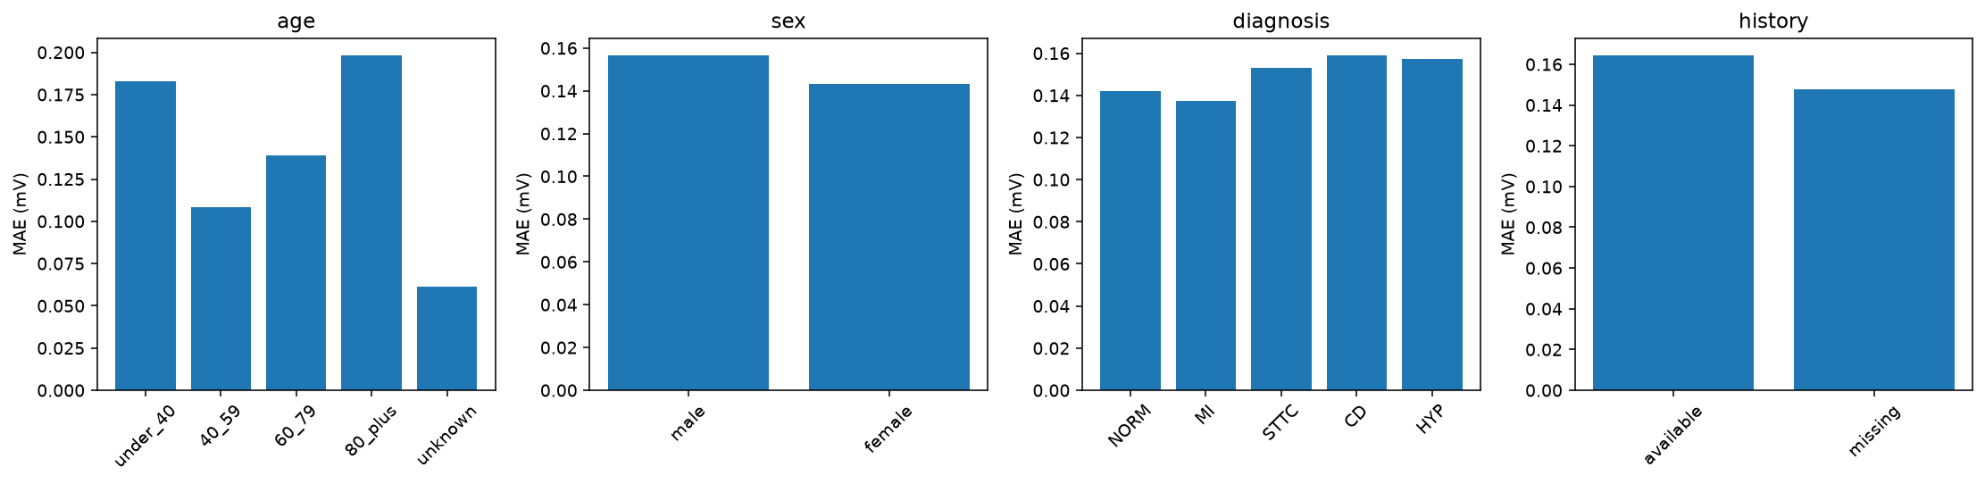
Patient subgroup errors
LSTM / patient history
66

Slide 67
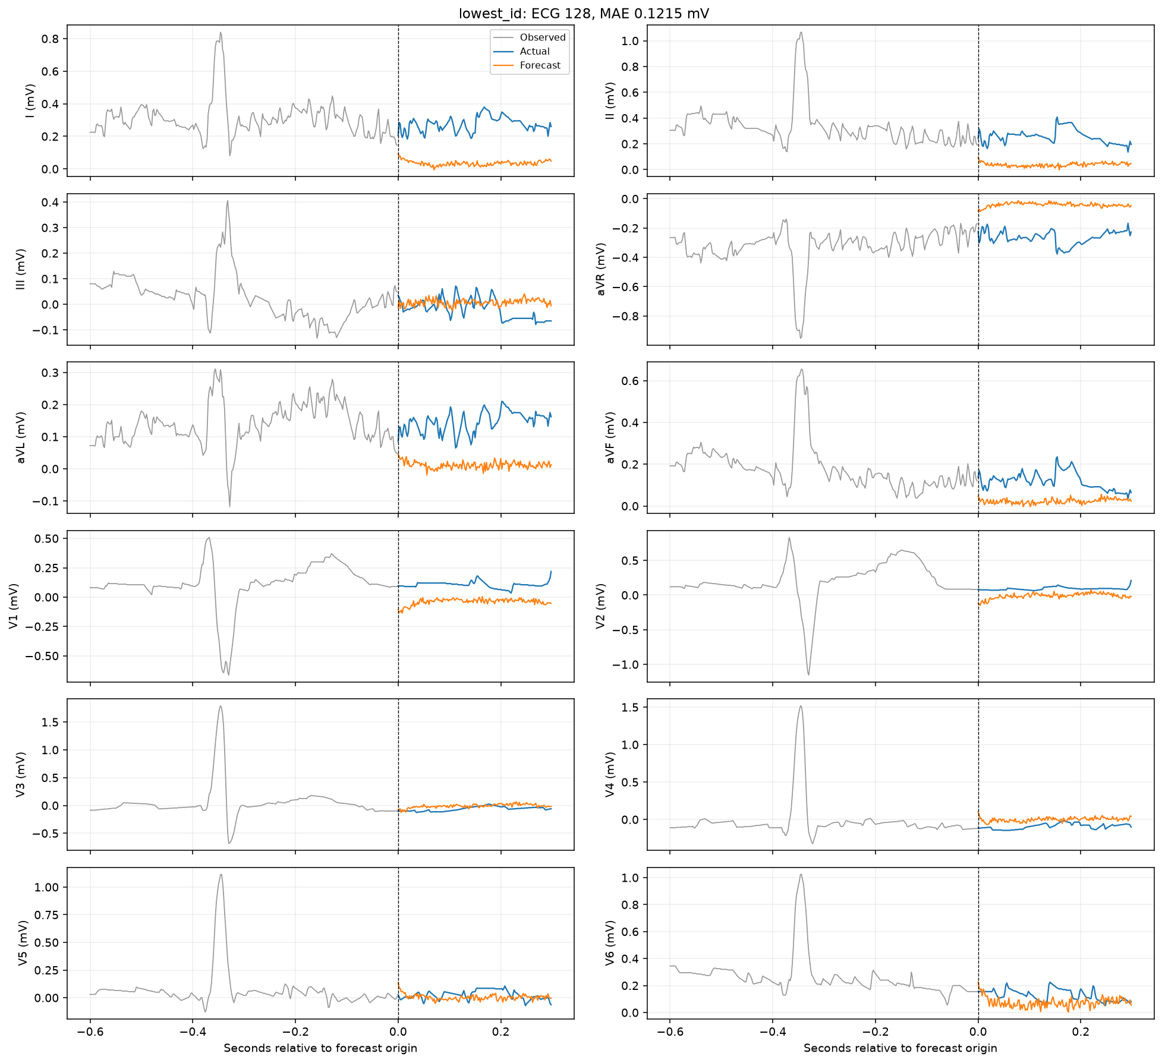
Lowest-ID test forecast
LSTM / patient history + contrastive
67

Slide 68
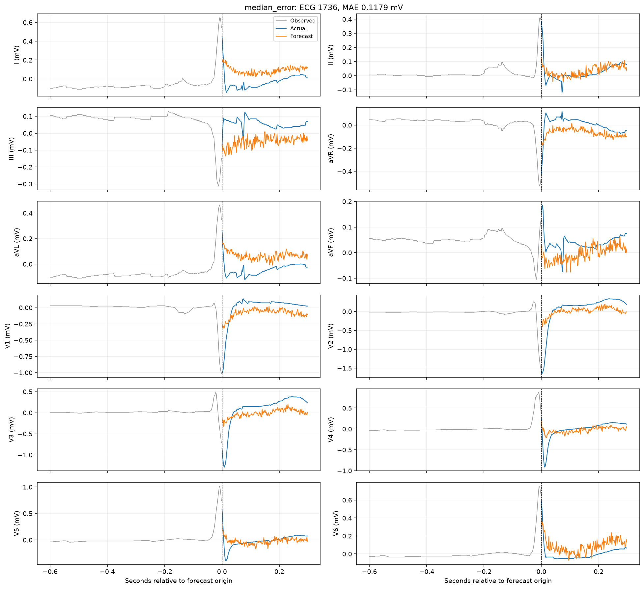
Median-error test forecast
LSTM / patient history + contrastive
68

Slide 69
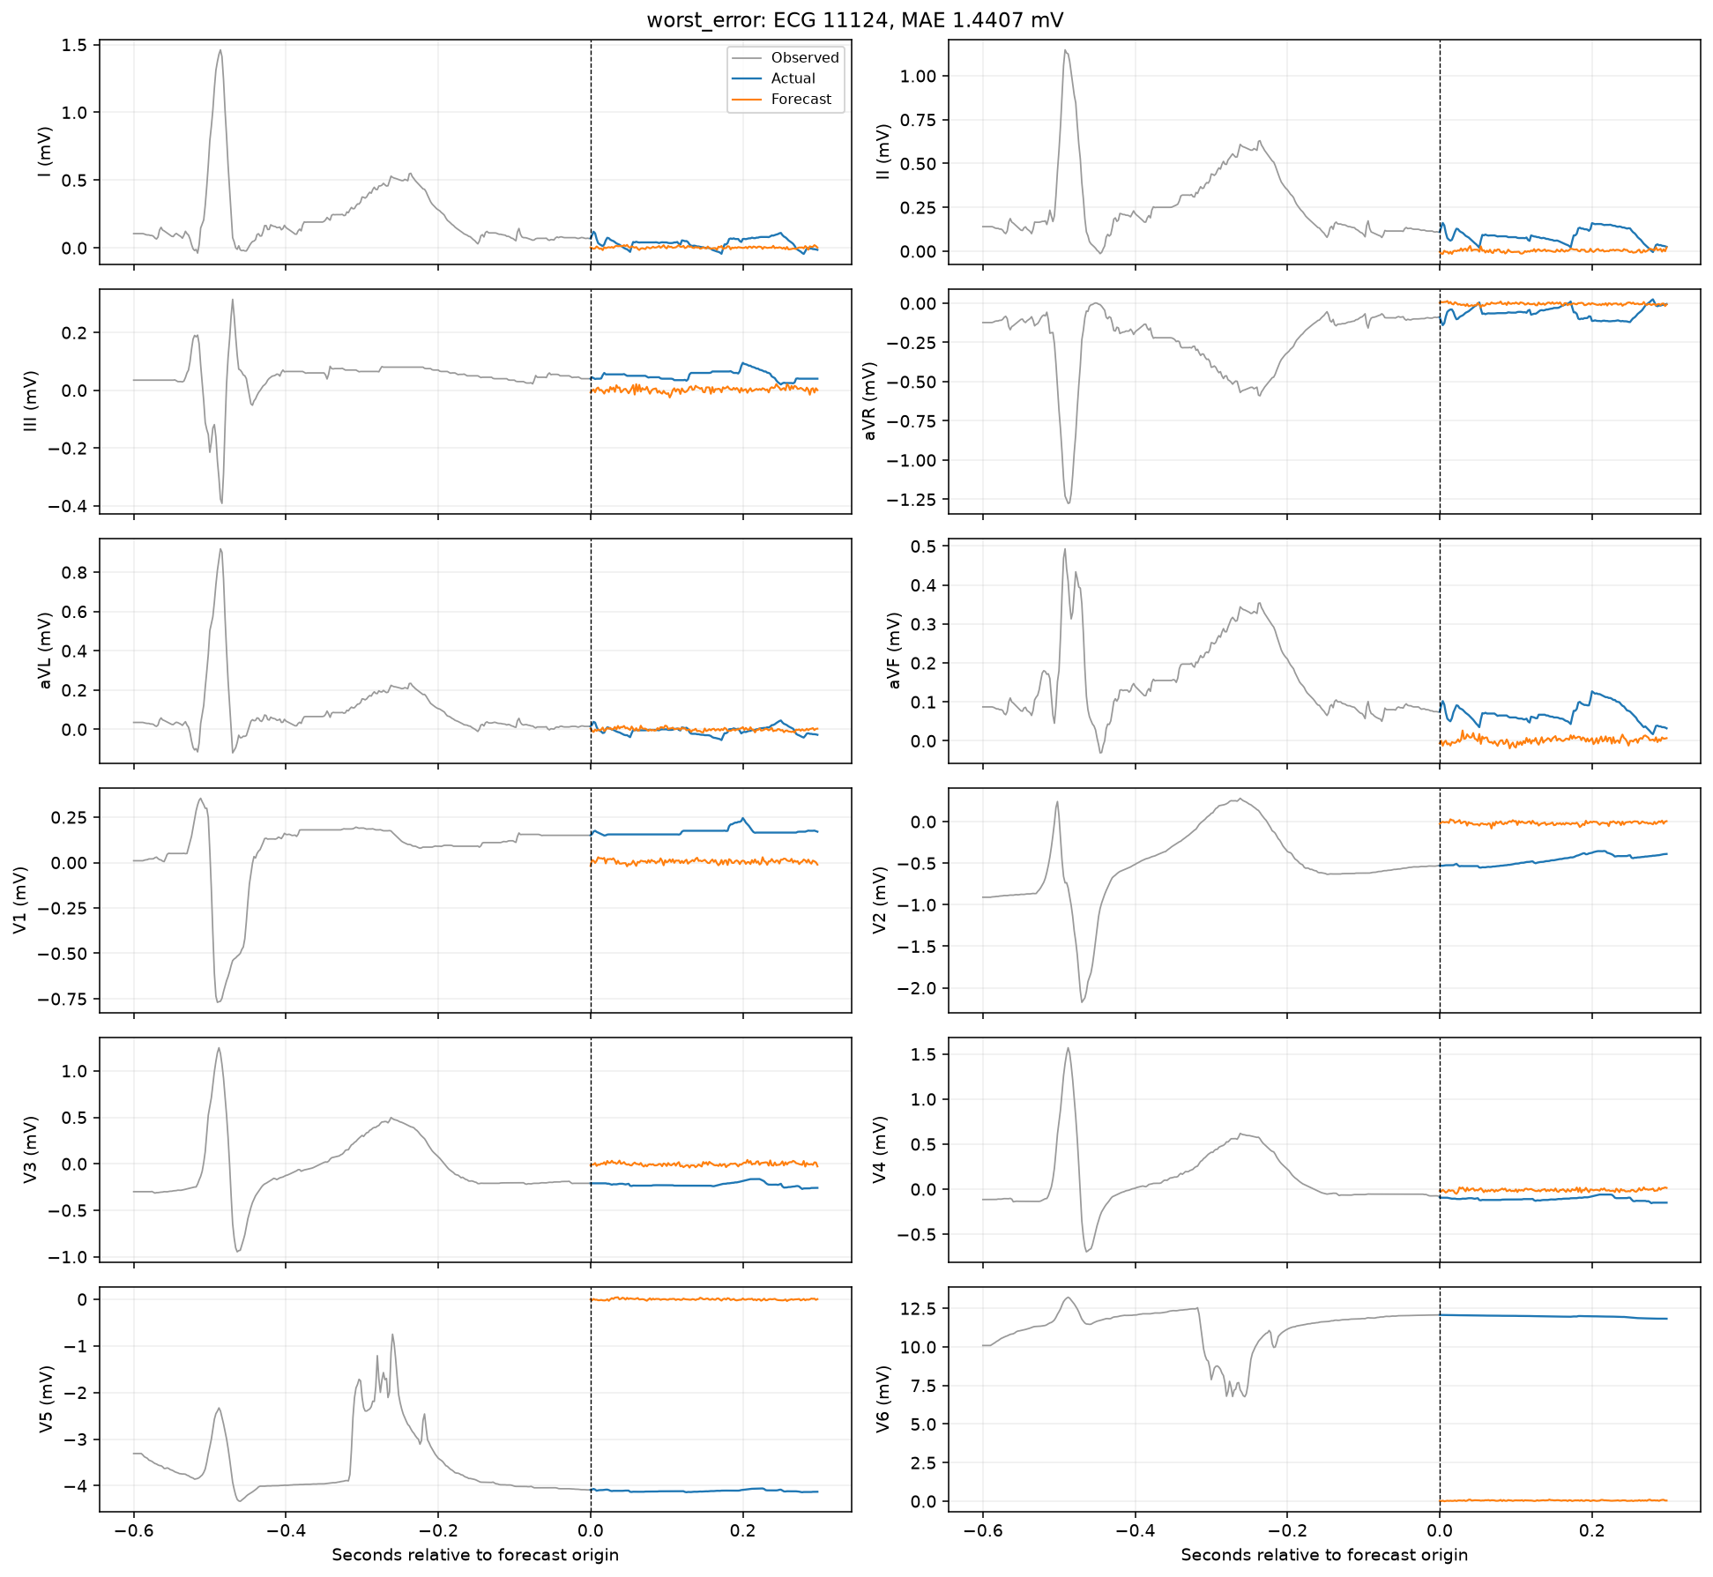
Worst-error test forecast
LSTM / patient history + contrastive
69

Slide 70
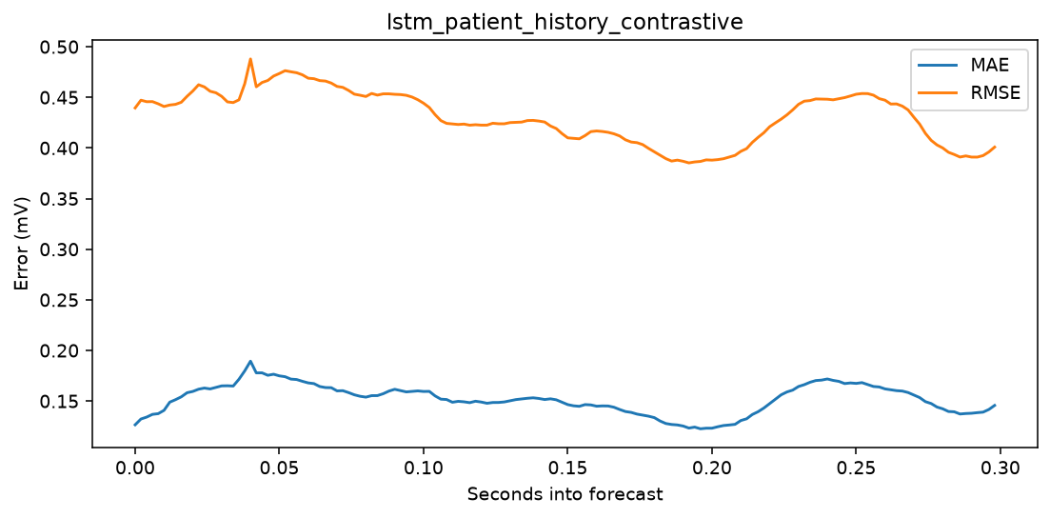
Forecast-horizon error
LSTM / patient history + contrastive
70

Slide 71
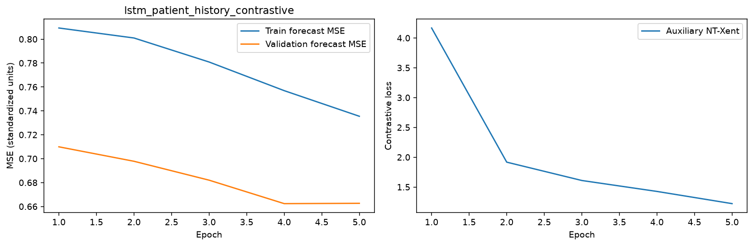
Learning curves
LSTM / patient history + contrastive
71

Slide 72

Per-lead errors
LSTM / patient history + contrastive
72

Slide 73
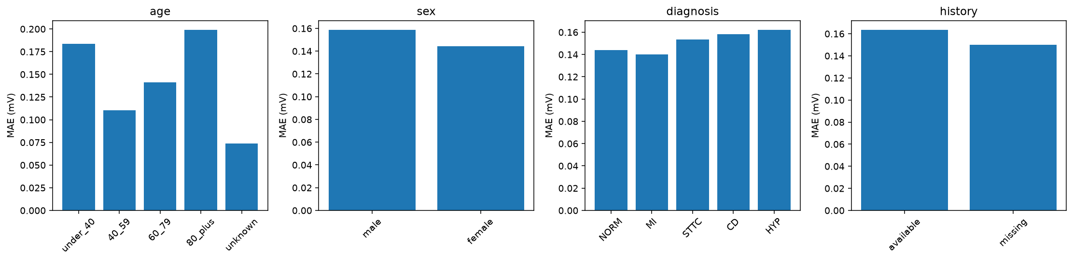
Patient subgroup errors
LSTM / patient history + contrastive
73

Slide 74
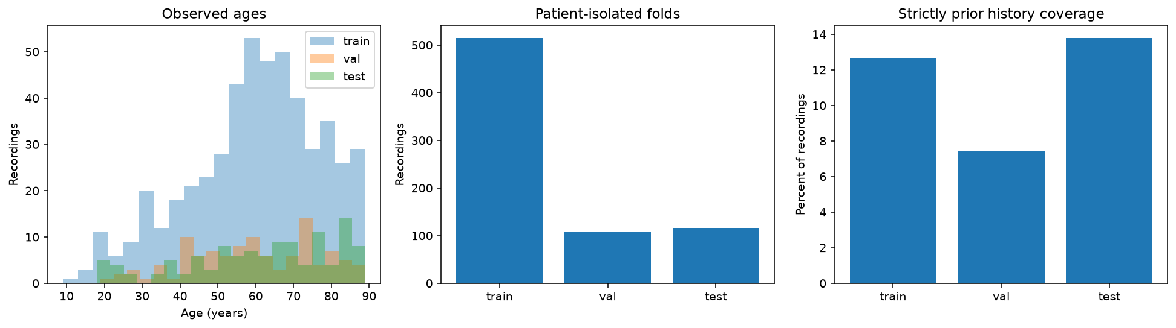
Pilot cohort metadata distributions
PTB-XL small-data pilot
74

Slide 75
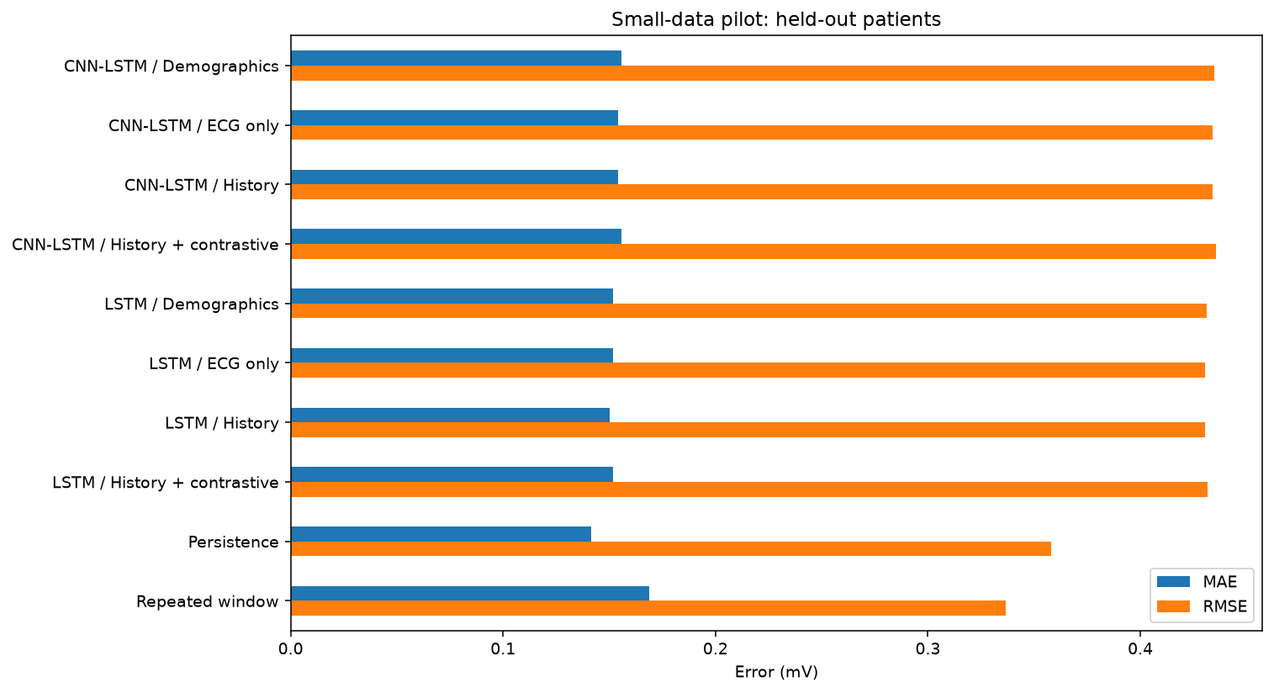
Held-out model comparison
PTB-XL small-data pilot
75

Slide 76
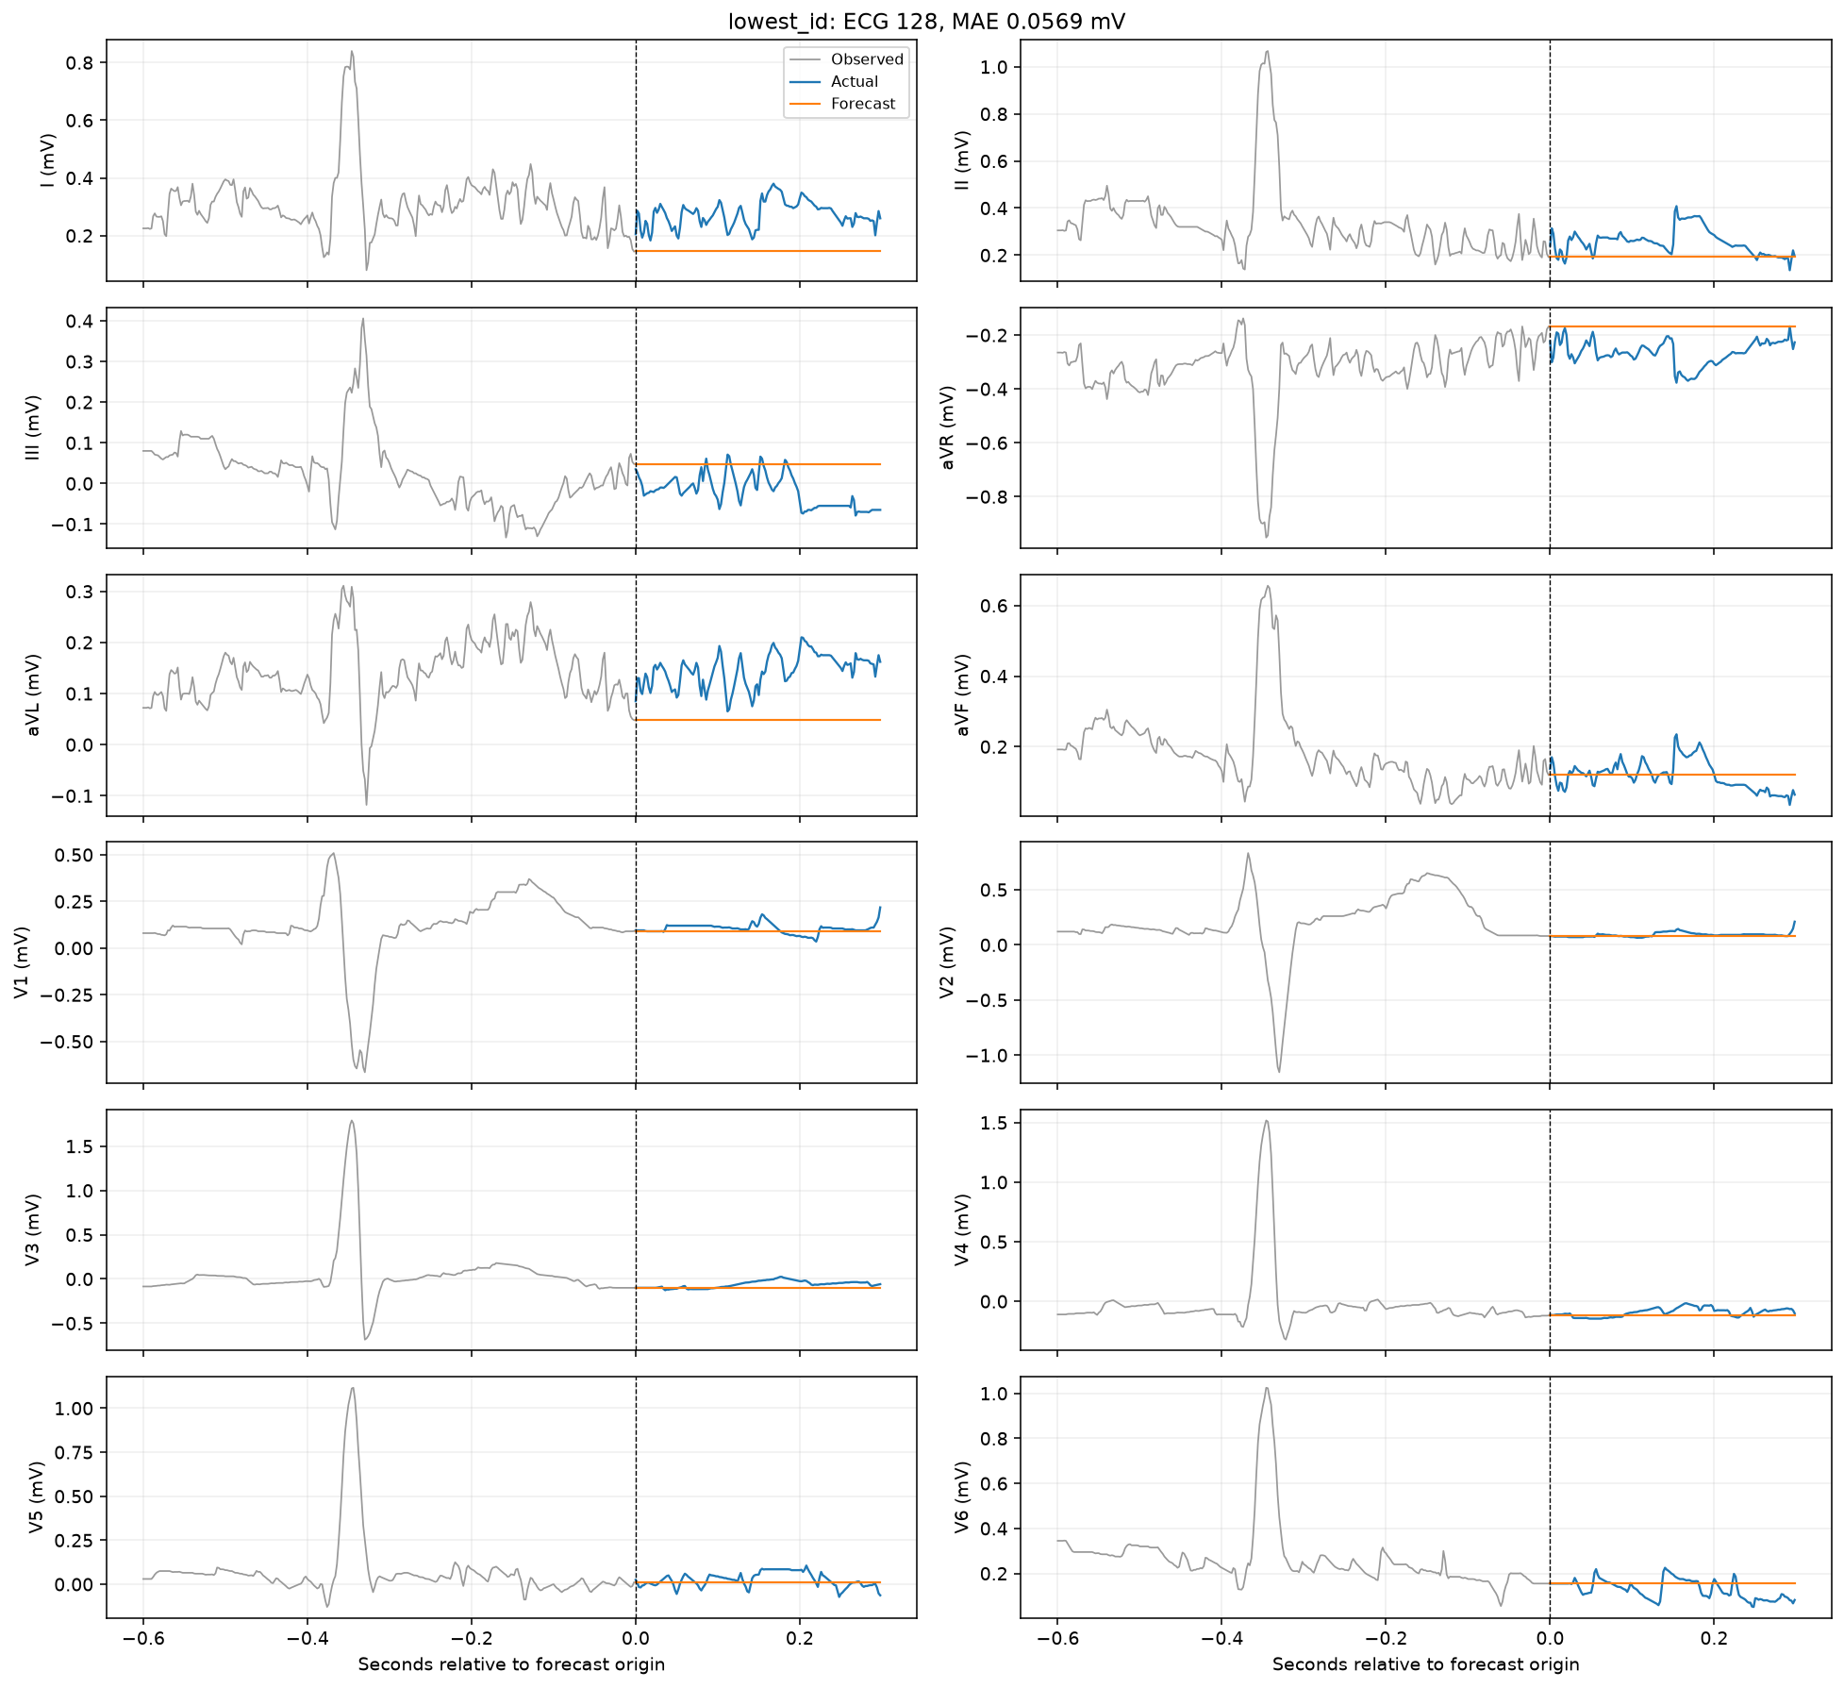
Lowest-ID test forecast
Persistence baseline
76

Slide 77

Median-error test forecast
Persistence baseline
77

Slide 78

Worst-error test forecast
Persistence baseline
78

Slide 79

Forecast-horizon error
Persistence baseline
79

Slide 80

Per-lead errors
Persistence baseline
80

Slide 81

Patient subgroup errors
Persistence baseline
81

Slide 82

Lowest-ID test forecast
Repeated-window baseline
82

Slide 83

Median-error test forecast
Repeated-window baseline
83

Slide 84

Worst-error test forecast
Repeated-window baseline
84

Slide 85

Forecast-horizon error
Repeated-window baseline
85

Slide 86

Per-lead errors
Repeated-window baseline
86

Slide 87

Patient subgroup errors
Repeated-window baseline
87

Slide 88
88
LSTM and CNN-LSTM by conditioning
Held-out test MAE
ECG only
0.151706 vs 0.154296 mV
LSTM lower by 0.002590 mV (1.7%).
Demographics
0.151759 vs 0.155650 mV
LSTM lower by 0.003891 mV (2.6%).
Patient history
0.150113 vs 0.154251 mV
LSTM lower by 0.004139 mV (2.8%).
History + contrastive
0.151782 vs 0.155719 mV
LSTM lower by 0.003937 mV (2.6%).
LSTM produced the lower MAE in every matched variant in this five-epoch pilot.
13

Slide 89
Architecture tradeoff
Pilot efficiency
Best neural MAE
LSTM/history: 0.150113 mV
CNN-LSTM/history: 0.154251 mV.
Mean Pearson correlation
LSTM/history: 0.288765
CNN-LSTM/history: 0.202367.
Parameters
LSTM/history: 733,736
CNN-LSTM/history: 785,736 (+7.1%).
Training time
LSTM/history: 15.7 s
CNN-LSTM/history: 8.8 s (44% faster).
CNN preprocessing shortened training, but LSTM forecast the held-out signals more accurately.
13

