Slide 1


FORMATIVE × COLLEGE BASKETBALL
You're already
a brand.
Personal branding & NIL for college basketball players
A 60-minute working session
Notes:
0:00–0:02 | Open standing, high energy. 'Show of hands — who posted something in the last 24 hours?' Most hands go up. 'Then this isn't about whether you have a brand — you already do. It's about running it on purpose.' Frame: 60 min, mostly hands-on, they leave with a one-page brand brief and a live profile.

Slide 2




THE QUESTION · 0:02–0:06
Who's running your brand —
you, or the algorithm?
It already exists
It's always on
It can be steered
Every post, clip, and caption is a vote for how people see you.
Coaches, brands, and fans are forming an opinion whether you curate it or not.
A brand run on purpose opens doors. One left on autopilot closes them.
Formative · @formativeunites
02
Notes:
0:02–0:06 | Socratic. Ask the question and let it sit; take 2–3 answers. The point: a personal brand is already running — the only choice is whether you take the wheel. Transition: 'Before we steer it, where's the money actually in 2026?'

Slide 3


THE LANDSCAPE · 0:06–0:10
The school check is real —
but it's not the whole game.
Revenue sharing flows to basketball
$20.5M
#2
Since July 2025, schools can pay athletes directly — and men's basketball gets one of the biggest shares of the pool. But it's concentrated on a handful of players, the school controls it, and it ends the day your eligibility does.
School revenue-share pool per school this year
Where men's basketball ranks in rev-share, after football
Your audience is the asset you keep
Most of the roster won't see big school money — and even stars lose it when the ball stops. The brand and audience you build are yours for life.
Formative · @formativeunites
03
Notes:
0:06–0:10 | The reframe that earns attention. Show where the real, durable money is for this athlete — and why the audience they build is the asset they control. Sets up everything next. Factual, not cynical.

Slide 4




THE FRAME · 0:10–0:14
A brand isn't a logo.
It's a business.
Reputation
Audience
Trust
What people say about you when you're not in the room — on and off the field.
The people who choose to follow your story. This is the asset brands pay for.
The reason a fan shows up and a brand signs. Earned slowly, spent instantly.
The Formative thesis: creators — and athletes — are small businesses. You have a product, an audience, and revenue. You just haven't been handed the tools.
Formative · @formativeunites
04
Notes:
0:10–0:14 | Reframe 'brand' away from visuals toward business. Reputation, audience, trust — assets. Land the thesis: athletes are small businesses. The hinge of the session. Transition: 'Let's build yours — starting with you, not your sport.'

Slide 5
DO IT · 0:14–0:19 · EXERCISE 1
Three words that aren't
“basketball.”
On your phone, open Notes.
→ Brief, box 1
Identity
Write three words that describe who you are beyond the game. Not your position. Not your stats. The person.
These three words become the filter for every post you make. If a piece of content doesn't sound like these words, it's not yours.
e.g. relentless · small-town · funny / curious · faith-first · competitor
Formative · @formativeunites
05
Notes:
0:14–0:19 | First hands-on rep. 90 seconds of silence to write, then take 4–5 aloud and react. Nobody picks a sport word — that's the point. This is box 1 of their brief.

Slide 6

THE LENS · 0:19–0:23
Three people are always
in the room.
You — the creator
Brands — who pay
Fans — who follow
Your story, your voice, your audience. The asset everything is built on.
They're buying access to your audience and the trust you've earned with it.
They decide if any of it is real. Lose them and the other two walk.
Agencies sometimes manage an athlete's account — on Formative that's flagged openly, so fans and brands always know who they're talking to.
Formative · @formativeunites
06
Notes:
0:19–0:23 | The Triple-POV lens, athlete-flavored. Every branding decision involves three parties. Brands evaluate you by what fans do — so authenticity is the business model. Transition to picking lanes.

Slide 7



DO IT · 0:23–0:28 · EXERCISE 2
Pick your three lanes.
Your content needs lanes — repeatable themes people follow you for. Pick the three that fit your three words.
The grind
Game day
Off the field
Skills & tips
Faith & family
Hot takes
→ Circle your three in Brief box 2.
Formative · @formativeunites
07
Notes:
0:23–0:28 | Second rep. Six starters, not limits — invite their own lane. Discipline is choosing only three. Lanes must match the three words. Box 2 of the brief.

Slide 8

THE PLAYBOOK · 0:28–0:31
Process beats highlights.
Anyone can post a poster dunk. The brand is built in everything around it.
Show the work
Real over polished
5 a.m. shootarounds and film beat the highlight reel. Effort is relatable; talent isn't.
A phone clip with a real reaction outperforms a produced edit. Fans smell staging.
Consistency wins
Have a point of view
Three posts a week, every week, beats a viral month then silence. Show up like a starter.
A take, a value, a story. Neutral content gets scrolled past. Stand for something.
Formative · @formativeunites
08
Notes:
0:28–0:31 | Short teach block. Brands and fans reward process and authenticity over polish. They need a phone and consistency, not a videographer. Lowers the barrier before they make something.

Slide 9

DO IT · 0:31–0:35 · EXERCISE 3
Audit your last nine posts.
Open your profile. Look at the
last 9. Ask three questions:
Most grids fail the test.
That's normal — and it's good news. It means the easiest growth you have isn't more posts. It's posting on purpose. You don't need a bigger audience to start. You need a clearer signal.
Does it sound like my three words?
Would a brand understand what I'm about?
Is there a pattern — or is it random?
Formative · @formativeunites
09
Notes:
0:31–0:35 | Reflection rep — quieter. Let them scroll against the rubric. Failing the audit is the opportunity, because clarity is free and instant. Don't shame content — frame as untapped upside.

Slide 10

DO IT · 0:35–0:40 · EXERCISE 4
Draft one signature post.
Not nine. One. The post only you could make this week.
Lane
The hook
The moment
Why it's you
Which of your three lanes is it in?
First line that makes someone stop scrolling.
What we see — a clip, a photo, a piece to camera.
The line that ties it to your three words.
→ Sketch it in Brief box 3. This is the first post of your brand, run on purpose.
Formative · @formativeunites
10
Notes:
0:35–0:40 | Biggest 'do' block — 3–4 min. Walk the room. The template kills the blank page: lane, hook, moment, why-it's-you. Coach a hook live. Box 3 of the brief.

Slide 11
THE VALUE · 0:40–0:44
Engagement pays more
than follower count.
10K
5–10%
Niche
An engaged audience this size can earn real brand deals — you don't need millions
Engagement rates brands prize — micro-creators often beat the big accounts
A clear lane + a local market is worth more to a brand than vague reach
What actually drives your value
Trust (do fans act on what you say) · Clarity (can a brand describe you in one line) · Consistency (do you show up) · Fit (does the brand's audience match yours)
Formative · @formativeunites
11
Notes:
0:40–0:44 | Bust the follower-count myth — freeing for an athlete with a few thousand followers. Brands pay for engaged, clearly-defined, trusted audiences. Drivers: trust, clarity, consistency, fit.

Slide 12




PLAY IT SAFE · KNOW YOUR LANE · 0:44–0:46
First, know your lane.
Three things decide what you can earn. Get these right before any deal.
Your division
Your state
Your status
Big school money is a D1 — mostly the power programs — thing. Smaller D1, D2, and D3 share little or none, but every division can do third-party brand deals.
State law still layers on top: what you disclose, which categories are off-limits, how your school can help. It varies by state.
U.S. citizen or international? International (F-1) athletes face a stricter, riskier set of rules — see the next slide.
Find your authority: your school's compliance office is free and exists for exactly this. When in doubt, ask before you sign.
Formative · @formativeunites
12
Notes:
0:44–0:46 | The most important compliance idea: your rules depend on who you are — division, state, status. Don't recite rules; teach the dimensions and point them to the right office. Slow down here — this protects them and Formative.

Slide 13



PLAY IT SAFE · THE LINES YOU DON'T CROSS · 0:46–0:48
Then, the lines you
never cross.
It must be a real deal
Report every deal
Protect your eligibility
Real work only — post, appear, endorse. No-show deals and pay-for-play are out, everywhere.
Deals over $600 get a fair-value check at the clearinghouse. Loop in your compliance office.
A bad deal can cost you your season — it's never worth it. Check first, sign second.
International athletes — read this first
On an F-1 visa, active NIL work done in the U.S. can put your visa at risk. The safe lanes are passive income and work done outside the U.S. — talk to your international student office and an immigration attorney before anything.
Rules vary by division, state, and status, and they change. This is education, not legal advice — confirm with the right office before any deal.
Formative · @formativeunites
13
Notes:
0:46–0:48 | The universal guardrails apply to everyone. Then STOP on the red box: if any athlete in the room is international, active U.S. NIL can cost their visa — send them to the international student office and an immigration attorney before anything. Say clearly: education, not legal advice.

Slide 14

THE GAP · 0:48–0:50
You're running a business
with no system.
12–20 disconnected tools
And brands can't find you
DMs for deals · spreadsheets for tracking · screenshots for proof · a separate app to invoice · another to sign · payment chased over text. Nothing talks to anything.
There's no front door. A brand that wants a Pittsburgh-area college basketball player with your exact audience has no clean way to discover you, vet you, and pay you. So the deal goes to whoever's easiest to find — not whoever's the best fit.
Formative · @formativeunites
14
Notes:
0:48–0:50 | Name the pain they'll feel as they grow: a business across a dozen tools, and brands with no way to find or pay them. This is the problem Formative solves. Make them want the fix.

Slide 15
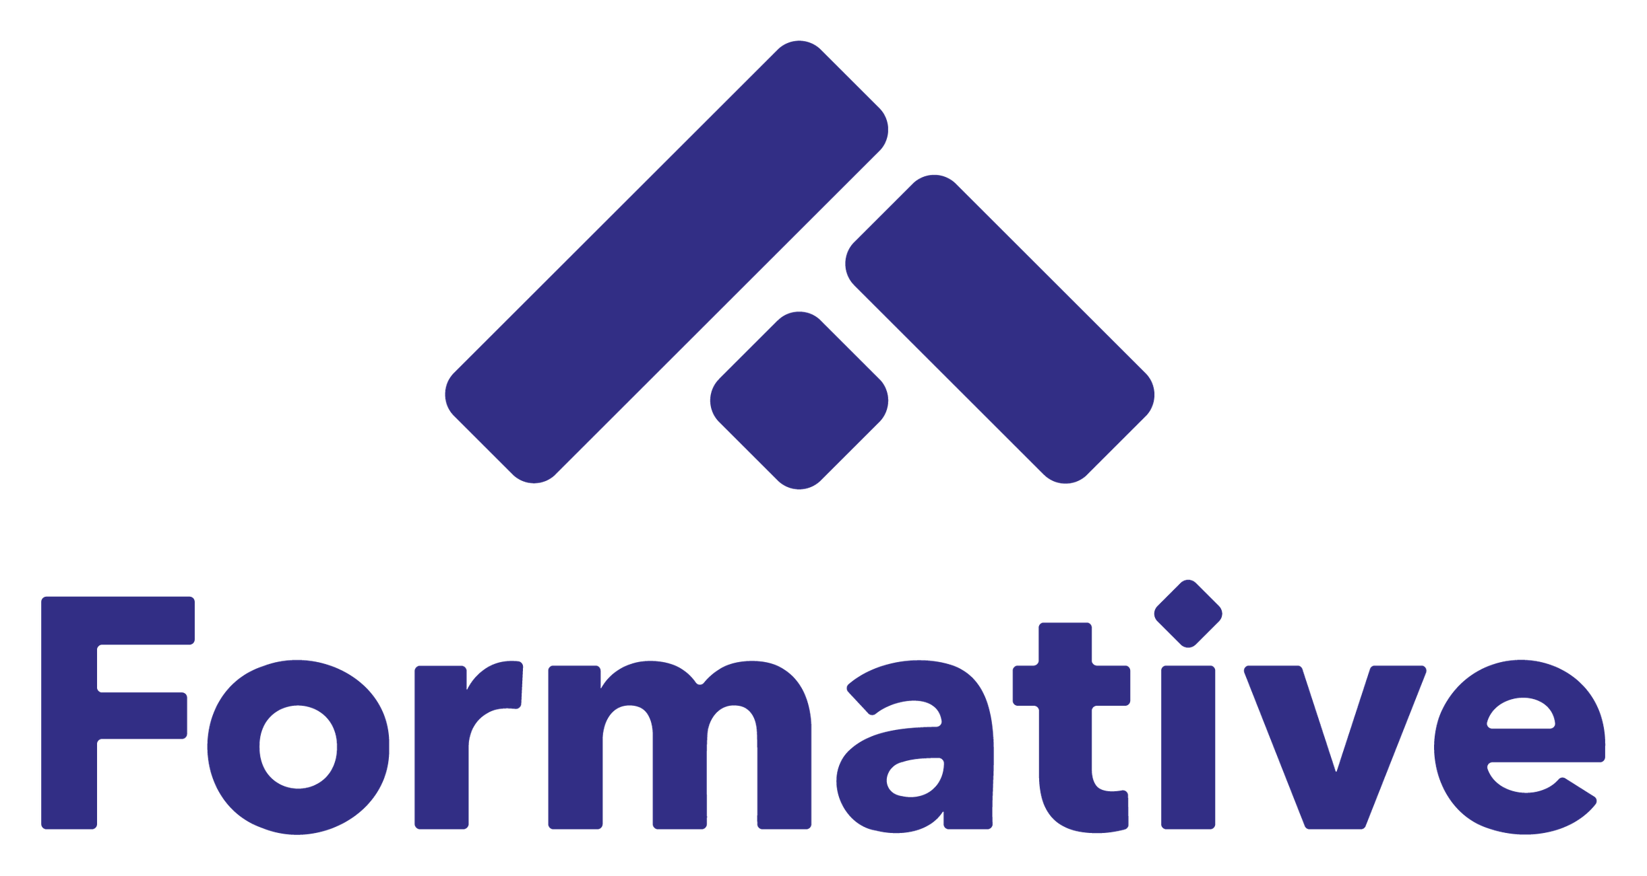
THE FIX · 0:50–0:53
One place where athletes and brands actually connect.
One profile
Smart matching
Deal to payment
Your brand, audience, and lanes in one link brands can find, vet, and trust.
Our matching engine puts you in front of the brands whose audience actually fits yours.
Agree, sign, deliver, get paid — tracked in one flow. No more chasing texts.
Formative · @formativeunites
15
Notes:
0:50–0:53 | The reveal, tight and confident. Formative is the front door and the operating system: one profile, a matching engine, one flow from handshake to payment. Sell the relief of one system replacing twenty. Then move to action.

Slide 16

BUILD IT NOW · 0:53–0:58
Scan, and build your
profile right now.
1
Sign up — claim your handle
2
Add sport, school, position
3
Drop in your three lanes (box 2)
4
Connect your socials
Scan to start
5
You're live — you're discoverable
demo link — swap for your live signup URL
Formative · @formativeunites
16
Notes:
0:53–0:58 | The conversion moment. QR up, walk the room, do it WITH them. Their lanes from box 2 drop straight in. Goal: every athlete leaves live and discoverable. No signal? Hand out the paper brief and capture names.

Slide 17

AFTER TODAY
Then brands come to you.
Your profile is live
Matches roll in
Deals you control
A clean front door working for you 24/7 — even on road trips.
Brands that fit your audience and lanes get surfaced to you automatically.
You pick what fits, do the work, get paid — and keep your audience either way.
Formative · @formativeunites
17
Notes:
0:58 (overlaps) | Quick payoff picture so signing up has an obvious 'why.' Keep it to 30 seconds — momentum into the close.

Slide 18
YOU'VE GOT THIS · 0:58–1:00
You walked in an athlete.
You're leaving a brand.
Box 1 — Identity
Box 2 — Your lanes
Three words that are the filter for everything you post.
The three themes fans will follow you for.
Box 3 — Signature post
Profile — live
The first piece of your brand, run on purpose.
You're discoverable to brands on Formative.
Take the brief with you. Post your signature piece this week.
Formative · @formativeunites
18
Notes:
0:58–1:00 | Land the transformation. Recap the four things now in their hands: identity, lanes, signature post, live profile. One homework: post the signature piece this week. End on belief.

Slide 19


Run your brand.
We'll handle the business.
formative.app · @formativeunites · hello@formative.app
Notes:
1:00 | Close with conviction, QR still up. 'Run your brand — we'll handle the business.' Thank them, point to the QR once more, take questions. Swap the placeholder handle/email/URL for the real Formative contact details before presenting.

