Slide 1
Principal Component Analysis （主成分分析）
Shiping Wang
May, 2019

Slide 2
Contents
  Motivation
  PCA algorithm
  Application
  Conclusion

Slide 3
Philosophy of PCA
Introduced by Pearson (1901) and Hotelling (1933) to describe the variation in a set of multivariate data in terms of a set of uncorrelated variables
We typically have a data matrix of d observations on m correlated variables x₁,x₂,…x_{m}
PCA looks for a transformation of the x_{i} into m new variables y_{i} that are uncorrelated

Slide 4
Reduce dimension
The simple way is to keep one variable and discard all others: not reasonable!
Wheigt all variable equally: not reasonable (unless they have same variance)
Wheigted average based on some citerion.
Which criterion?

Slide 5
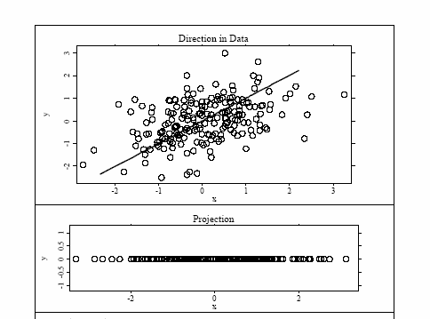
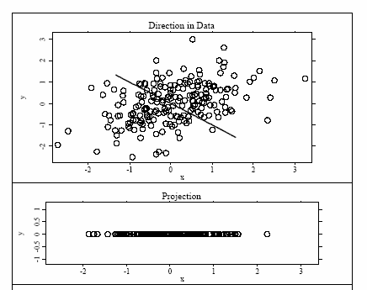
Let us see it on a figure
Good
Better

Slide 6
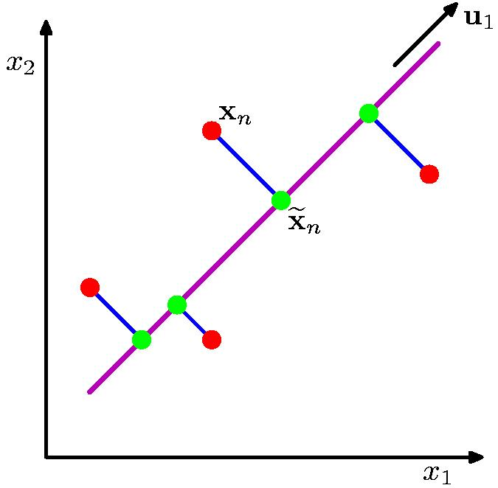
Principle Component Analysis
Orthogonal projection of data onto lower-dimension linear space that
  maximizes variance of projected data (purple line)
  minimizes mean squared distance between data point and projections (sum of blue lines)

Slide 7
Principle Components Analysis
Idea:
  Given data points in a d-dimensional space,
  project into lower dimensional space while preserving as much information as possible
    Eg, find best planar approximation to 3D data
    Eg, find best 12-D approximation to 10⁴-D data
  In particular, choose projection that
  minimizes squared error in reconstructing original data.

Slide 8
The Principal Components
Vectors originating from the center of mass
Principal component #1 points
in the direction of the largest variance.
Each subsequent principal component…
  is orthogonal to the previous ones, and
  points in the directions of the largest variance of the residual subspace

Slide 9
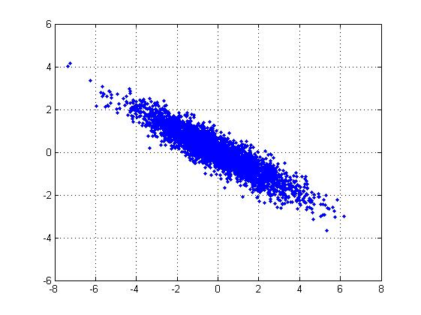
2D Gaussian dataset

Slide 10
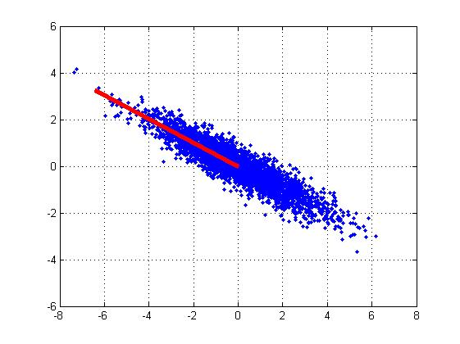
1st PCA axis

Slide 11

2nd PCA axis

Slide 12
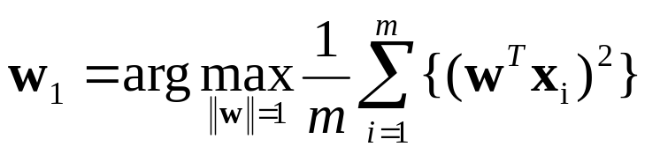
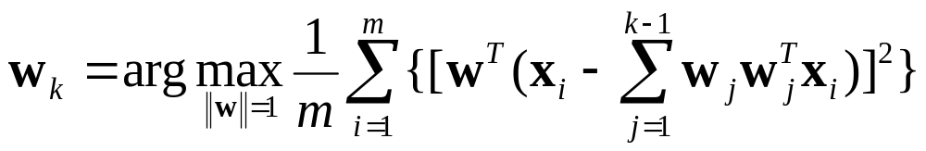
PCA algorithm I (sequential)
Given the centered data {x₁, …, x_{m}}, compute the principal vectors:
1st PCA vector
We maximize the variance of projection of x
k^{th} PCA vector
x’ PCA reconstruction
We maximize the variance of the projection in the residual subspace
w
x
w₁(w₁^{T}x)
w₁
w₂(w₂^{T}x)
x’=w₁(w₁^{T}x)+w₂(w₂^{T}x)
w₂

Slide 13
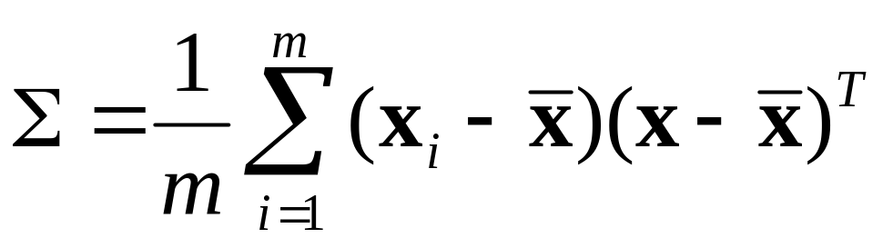
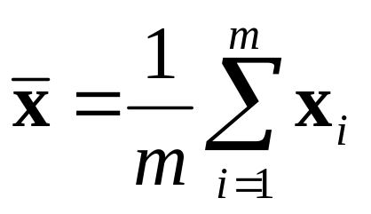
PCA algorithm II
(sample covariance matrix)
Given data {x₁, …, x_{m}}, compute covariance matrix Σ
PCA basis vectors = the eigenvectors of Σ
Larger eigenvalue ⇒ more important eigenvectors
where

Slide 14
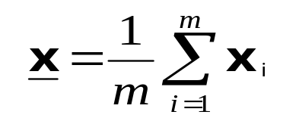
PCA algorithm II
PCA algorithm(X, k): top k eigenvalues/eigenvectors
% X = N × m data matrix,
% … each data point x_{i} = column vector, i=1..m
X ← subtract mean x from each column vector x_{i} in X
Σ ← X X^{T} … covariance matrix of X
{ λ_{i}, u_{i} }_{i=1..N} = eigenvectors/eigenvalues of Σ
... λ₁ ≥ λ₂ ≥ … ≥ λ_{N}
Return { λ_{i}, u_{i} }_{i=1..k}
% top k principle components

Slide 15

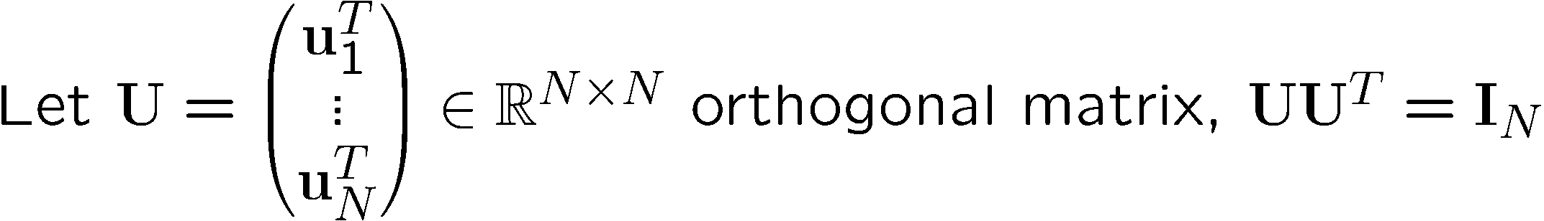
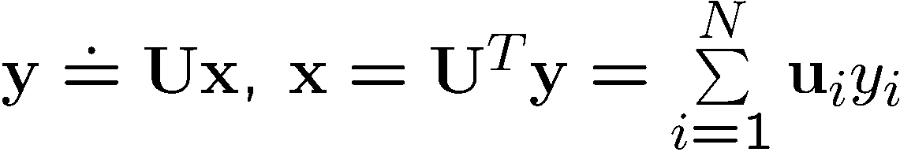
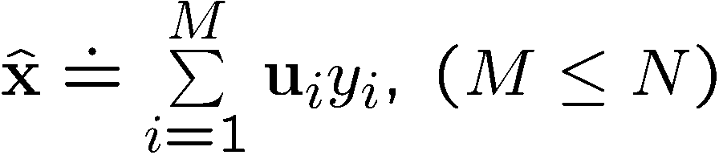


Justification of Algorithm II
GOAL:

Slide 16
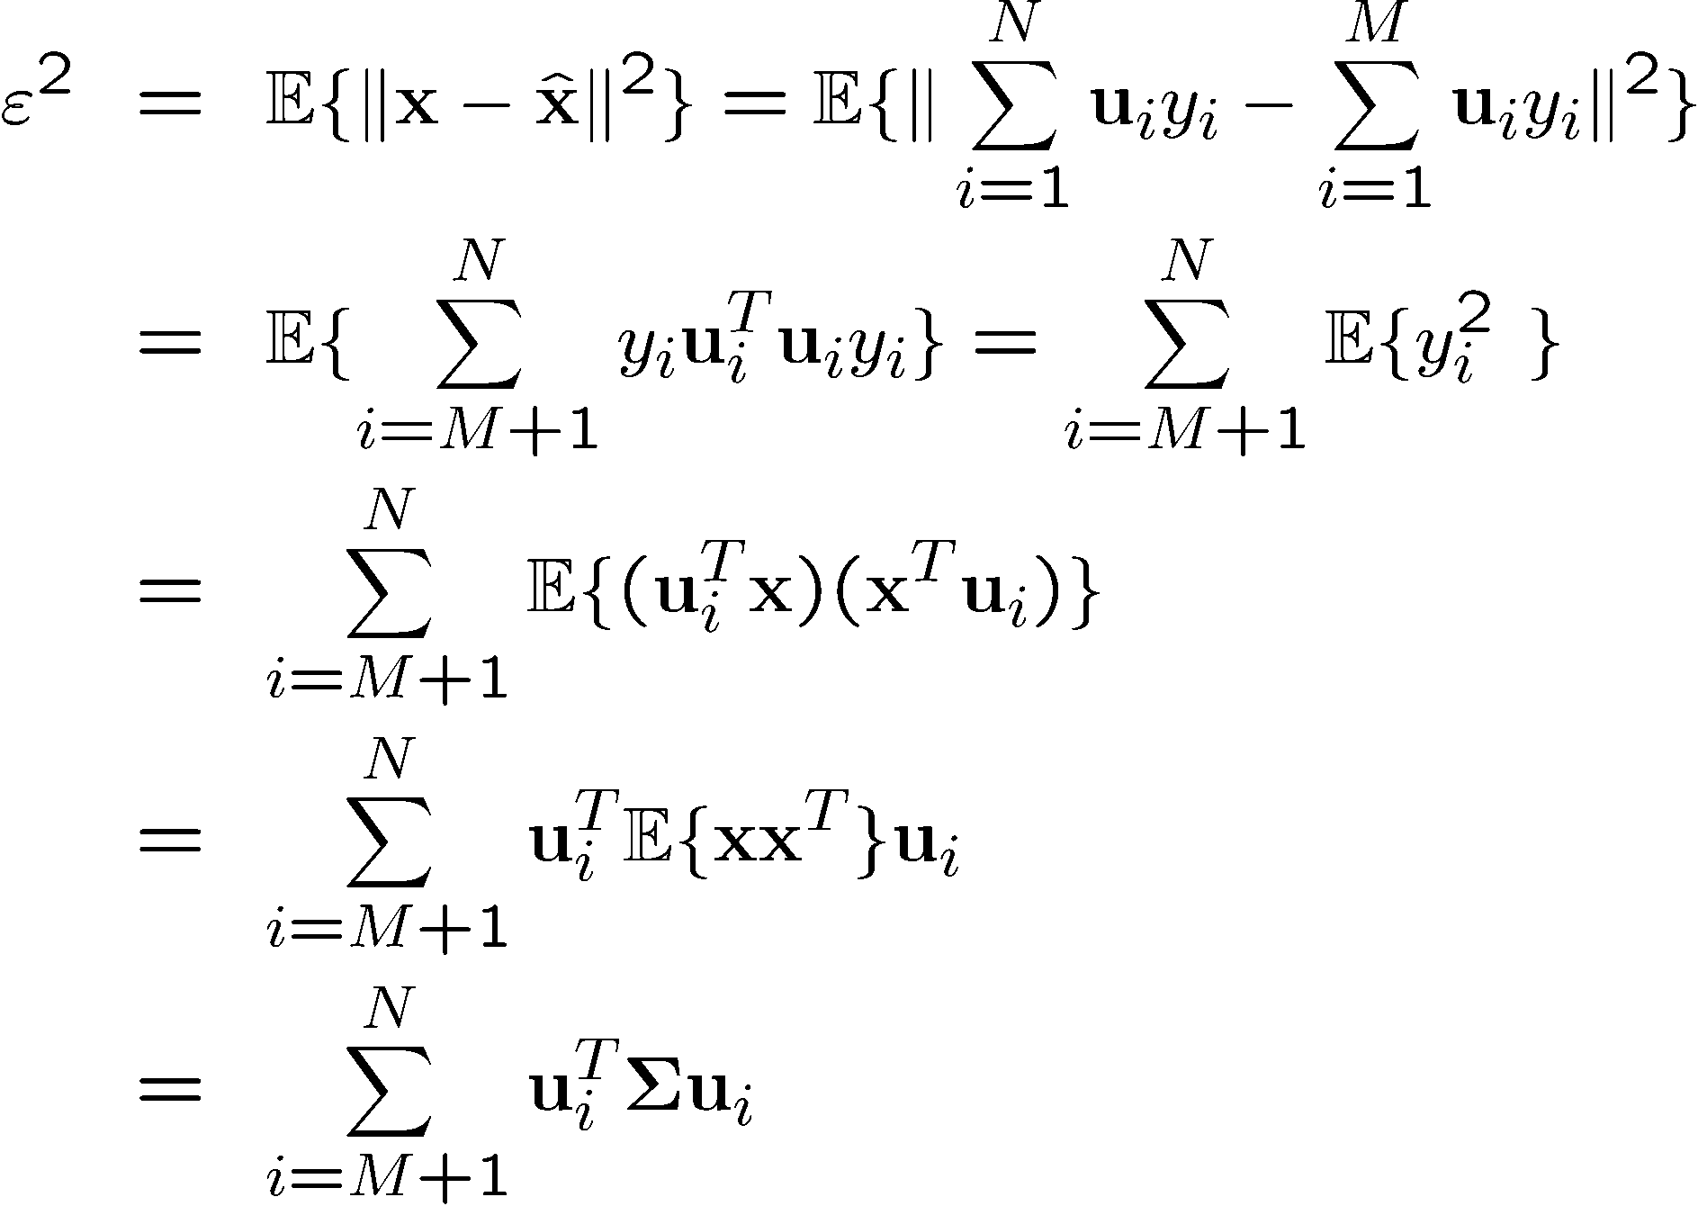
Justification of Algorithm II
x is centered!

Slide 17
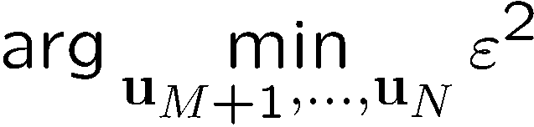
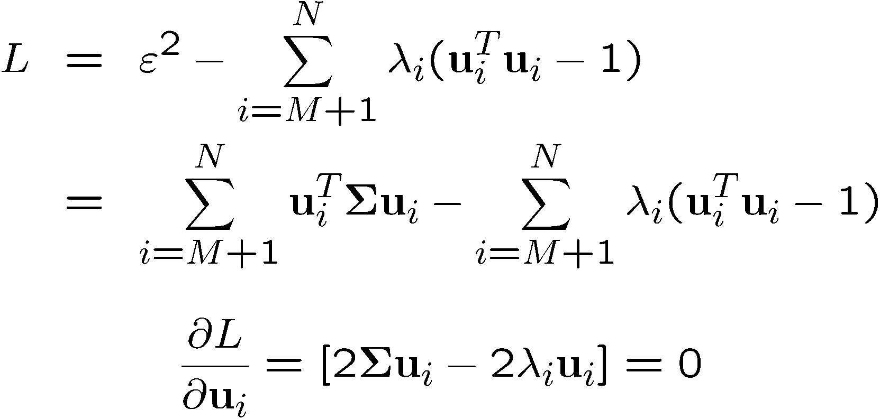
Justification of Algorithm II
GOAL:
Use Lagrange-multipliers for the constraints.

Slide 18
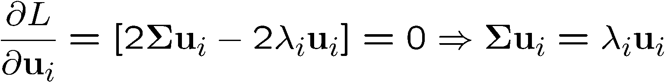
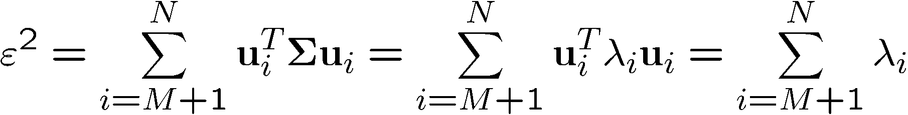
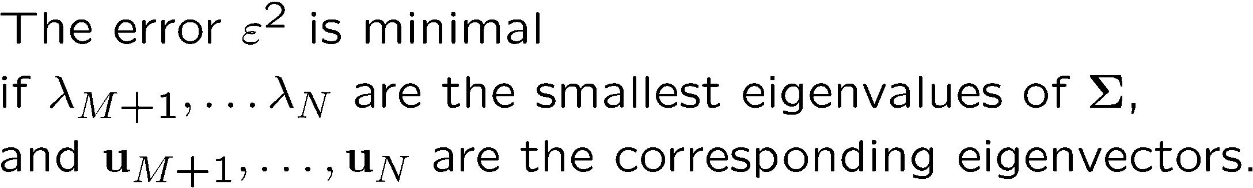
Justification of Algorithm II

Slide 19
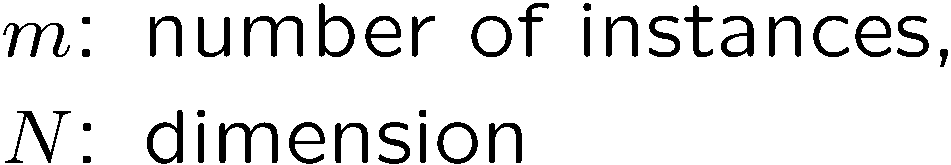
PCA algorithm III
(SVD of the data matrix)
Singular Value Decomposition of the centered data matrix X.
  X_{features × samples} = USV^{T}
X
=
U
S
V^{T}
sig.
significant
noise
noise
significant
noise
samples

Slide 20
PCA algorithm III
Columns of U
  the principal vectors, { u⁽¹⁾, …, u^{(k)} }
  orthogonal and has unit norm – so U^{T}U = I
  Can reconstruct the data using linear combinations of { u⁽¹⁾, …, u^{(k)} }
Matrix S
  Diagonal
  Shows importance of each eigenvector
Columns of V^{T}
  The coefficients for reconstructing the samples

Slide 21


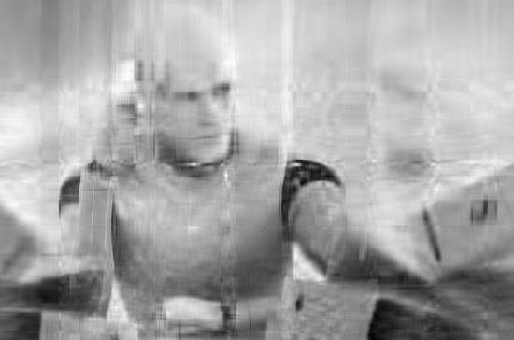
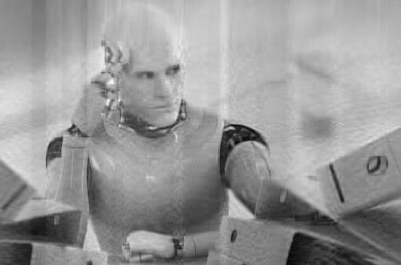
PCA in image compression
Original image (364x550)
364x10+10x550
364x20+20x550
364x40+40x550

Slide 22
PCA Conclusions
PCA
  finds orthonormal basis for data
  Sorts dimensions in order of “importance”
  Discard low significance dimensions
Uses:
  Get compact description
  Ignore noise
  Improve classification (hopefully)
Not magic:
  Doesn’t know class labels
  Can only capture linear variations
One of many tricks to reduce dimensionality!

Slide 23
Project 2
Given data matrix X and label class Y, please use
  PCA to reduce dimensionality
  KNN to classify the reduced data
  Submission deadline: May 21, 2019.

Slide 24
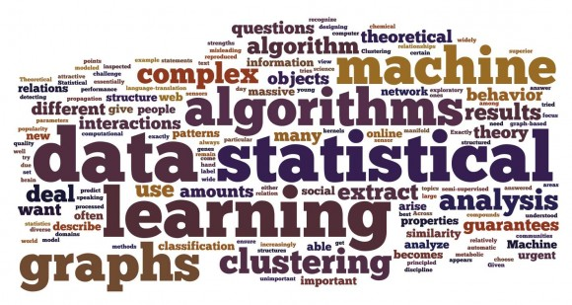
Thanks for the Attention! ☺

