Slide 1
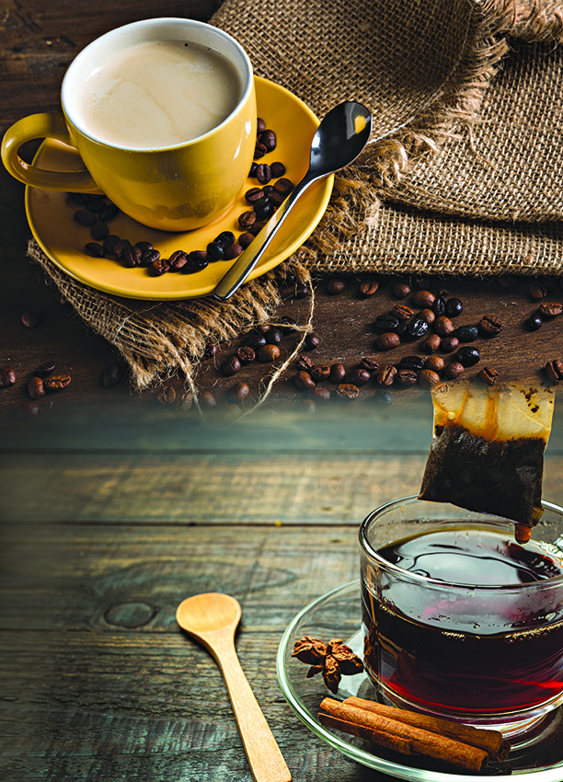

Coffee Sales: An Analysis
Forough Passyar

Slide 2
Revenue of Coffee & Tea
Revenue from Coffee Sales for the months of April, May, and June 2023 was $171,123.
Revenue from Tea Sales for April, May, and June 2023 was $124,139.
Total Sales for Coffee & Tea for April, May, and June 2023 were $295,263.

Slide 3
Revenue by Location
Revenue for Coffee & Tea was highest for the Astoria location, followed by Lower Manhattan, and lastly by Hell’s Kitchen.

Slide 4
Top sellers
Top sellers include:
Regular Lattes
Regular Morning Sunrise Chai
Large Cappuccino
Large Jamaican River Coffee
Large Brazilian Coffee

Slide 5
Best selling sizes
Regular drinks sold at the highest count.
Large sold at the second highest level.
Small drinks sold at the fewest levels.

Slide 6

Summary of Findings
The findings for the months of April, May, and June 2023 suggest that coffee had more revenue than Tea!
Astoria had the best sales followed closely by Hell’s Kitchen and Lower Manhattan!
The top 5 best-selling drinks were as follows:
Regular Lattes
Regular Morning Sunrise Chai
Large Cappuccino
Large Jamaican River Coffee
Large Brazilian Coffee
Regular-sized drinks sold the most!

Slide 7
Recommendations
There are multiple recommendations that I am suggesting to the company. They are as follows:
My first suggestion involves advertising the café, specifically, its coffee through social media channels like Instagram and TikTok.
My second recommendation is to get customer feedback to conclude which kinds of things are functioning well, like at the Astoria location, and how the company could make improvements specifically regarding the Hell’s Kitchen and Lower Manhattan locations!
My third recommendation is to increase the prices of the top 5 selling drinks which were Regular Lattes, Regular Morning Sunrise Chai’s, Large Cappuccinos, the Large Jamaican River Coffee, Large Brazilian Coffees, and all regular-sized drinks. We would increase the price by 5-7% to not deter customers from continuing their favorites while making a profit on drinks we know are top-sellers.

