Slide 1
TEM: Tree-enhanced Embedding Model for Explainable Recommendation
XiangWang1, XiangnanHe1, FuliFeng1, LiqiangNie2, Tat-SengChua1
1 National University of Singapore, 2 Shandong University
In WWW 2018: The 2018 Web Conference, April 23–27, 2018, Lyon, France.
https://doi.org/10.1145/3178876.3186066

Slide 2
OUTLINE
Introduction
Tree-enhanced Embedding Model
Experimental Results
Conclusion

Slide 3
OUTLINE
Introduction
Tree-enhanced Embedding Model
Experimental Results
Conclusion

Slide 4
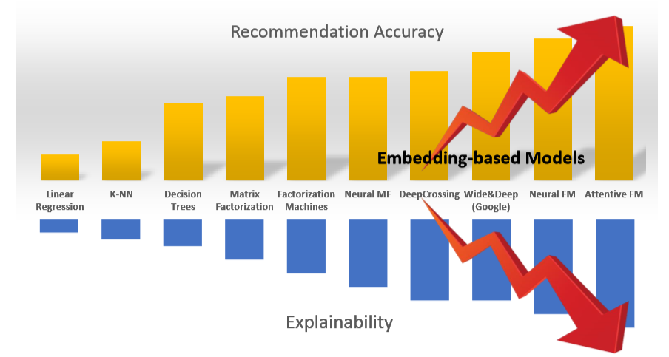
Trade-off of Accuracy & Explainability
Our Goal:
Accurate: achieve the same level or comparable performance as embedding-based methods
Explainable: be transparent in generating a recommendation & can identify the key rules for a prediction

Slide 5
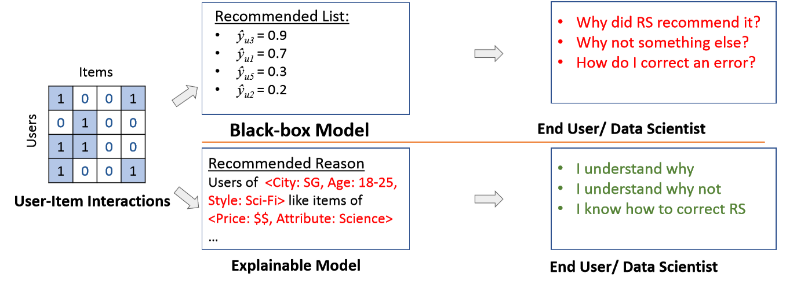
Explainable Recommendation
Transparency, Trust, Explainability, Scrutability

Slide 6
OUTLINE
Introduction
Tree-enhanced Embedding Model
Experimental Results
Conclusion

Slide 7
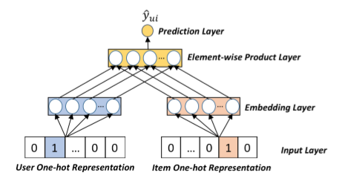
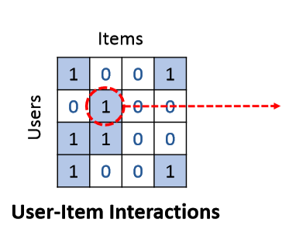

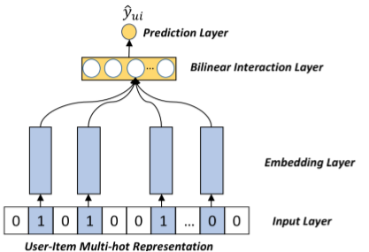

Embedding-based Models
Learn latent factors for each feature (IDs & side Info)
Matrix Factorization (MF)
Input: user ID, item ID Interaction: Inner Product
Factorization Machine (FM)
Input: user ID, item ID, side features ID
Interaction: Element-wise Product
Neural Network Methods
NCF, Deep Crossing, Wide&Deep, DIN, NFM

Slide 8
Cross Features
Cross Feature: combinatorial feature that crosses (or multiplies) multiple individual input features.
Why?
Higher-order feature interactions: e.g., [Age * Occupation *Gender]
Explicit decision rules
For example
Users of <Gender=female & Age=20-25 & Income Level=$8,000>
tend to adopt items of <Color=Pink & Product=Apple>

Slide 9
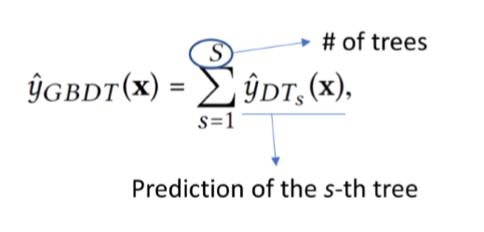
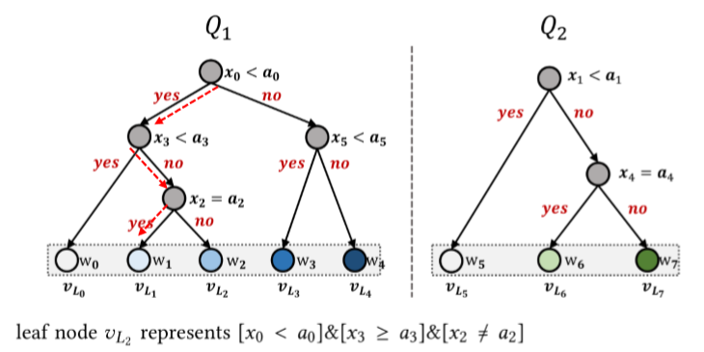
Tree-based Methods
Decision Tree (DT):
Each node splits a feature variable into two decision edges based on a value.
A path from the root to a leaf -> a decision rule (like a cross feature).
The leaf node -> the prediction value.
Forest (ensemble of trees)
Since a single tree may not be expressive enough, a typical way is to build a forest, i.e., an ensemble of additive trees

Slide 10
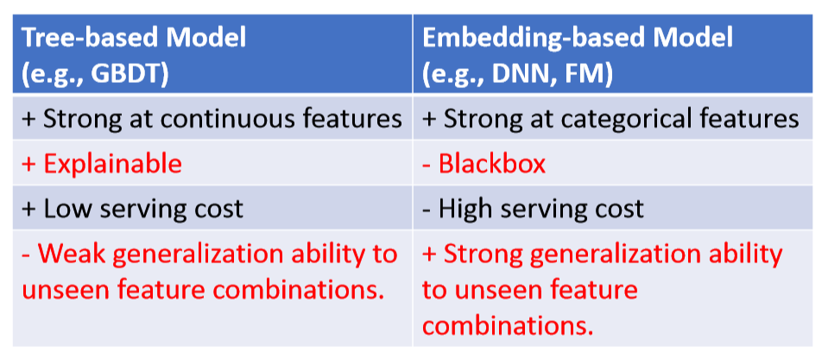
Tree-based vs. Embedding-based Model
Why not combining the strengths of the two types of models?

Slide 11
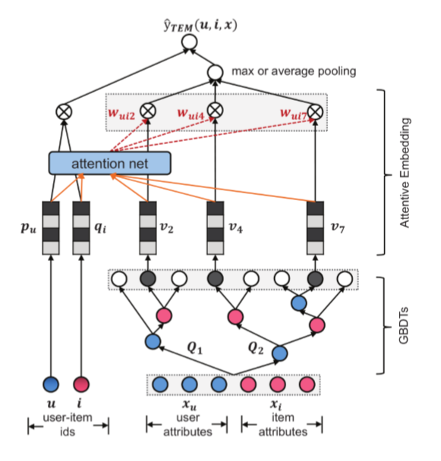
Tree-enhanced Embedding Model
Concrete Reasons: Explicitly discover effective cross features from rich side information of users & items
Explicit Decision Process: Estimate user-item matching score in an explainable way

Slide 12
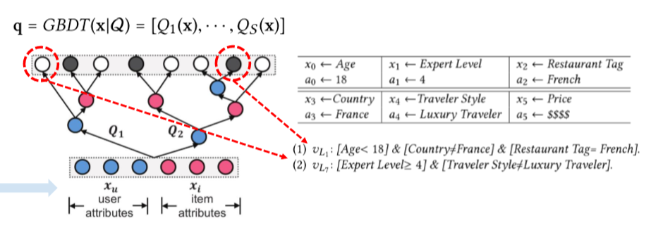
Constructing Cross Features
Traditional Solution: manually cross all values of feature variables
Our Solution: GBDT -> automatically identify useful cross features
We bulid GBDT on user attributes and item attributes.
Explicit Cross Features with easy-to-comprehend semantics！

Slide 13
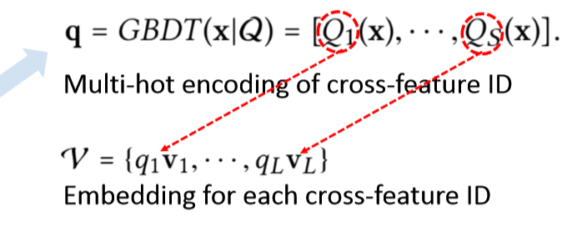
Cross Features Embedding
Primary Consideration: seamlessly integrate cross features with embedding-based CF
Our Solution: embed them into user-item latent space
The correlations among cross features may be captured in the embedding space.

Slide 14
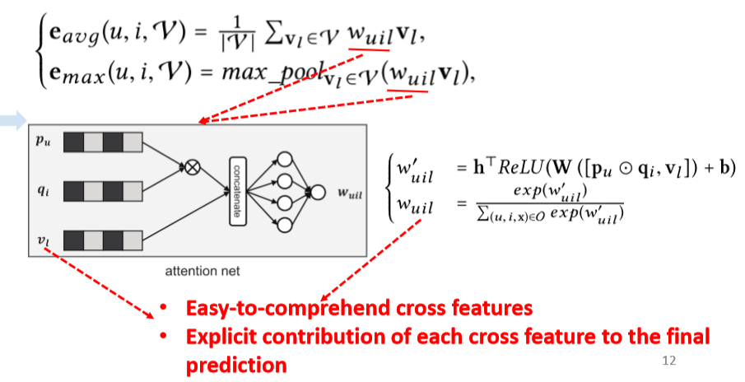
Attention Network
Primary Consideration: different cross features contribute differently for a prediction
Solution: Attention Network

Slide 15
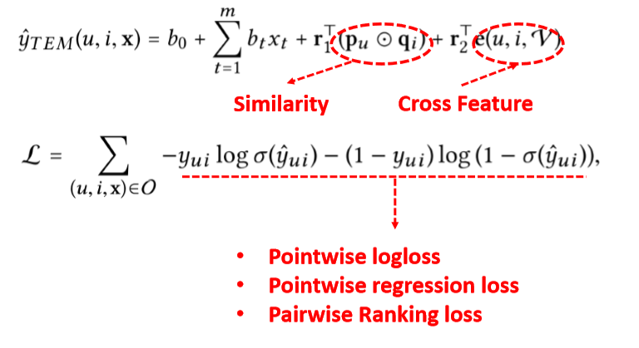
Final Prediction
Primary Consideration: explicit decision process & similarity-based + cross feature-based explanation mechanism
Solution: Simple linear regression

Slide 16
OUTLINE
Introduction
Tree-enhanced Embedding Model
Experimental Results
Conclusion

Slide 17
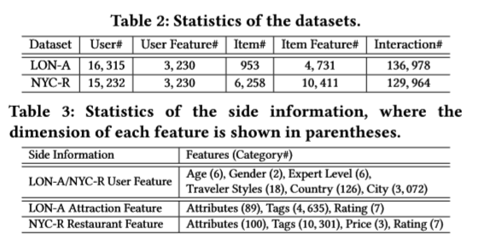
Experimental Settings
Research Questions:
RQ1: Compared with the state-of-the-art recsys methods, can TEM achieve comparable accuracy?
RQ2: Can TEM make the recsys results easy-to-interpret by using cross features and the attention network?
RQ3: how do different hyper-paramaters settings affect TEM?
Tasks: Attraction Recommendation & Restaurant Recommendation
Dataset: TripAdvisor
(https://www.tripadvisor.cn/)

Slide 18
Baselines
XGBoost: the state-of-the-art tree-based model
GBDT+LR [ADKDD’14]: feeding the cross features extracted from GBDT into the logistic regression
GB-CENT [WWW’17]: modeling categorical features with embedding-based model, numerical features with decision trees.
FM: a generic embedding model that implicitly models all the second-order cross features
NFM [SIGIR’17]: the state-of-the-art factorization model under the neural network framework
Evaluation Protocols:
logloss: indicate the generalization ability of each model
ndcg@k: reflect the top-k recommendation performance

Slide 19
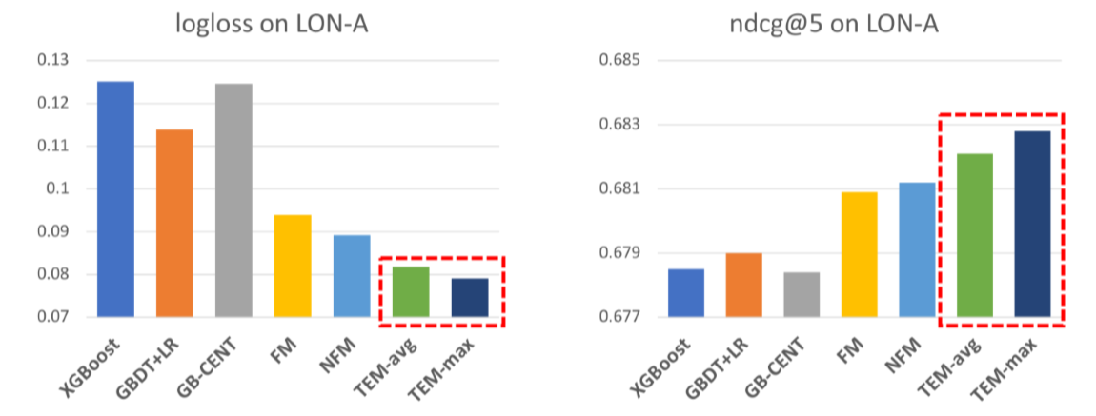
RQ1: Overall Performance Comparison
Observations:
TEM achieves the best performance w.r.t. logloss.
TEM achieves comparable ndcg@5 to NFM
Comparable Expressiveness & Accuracy

Slide 20
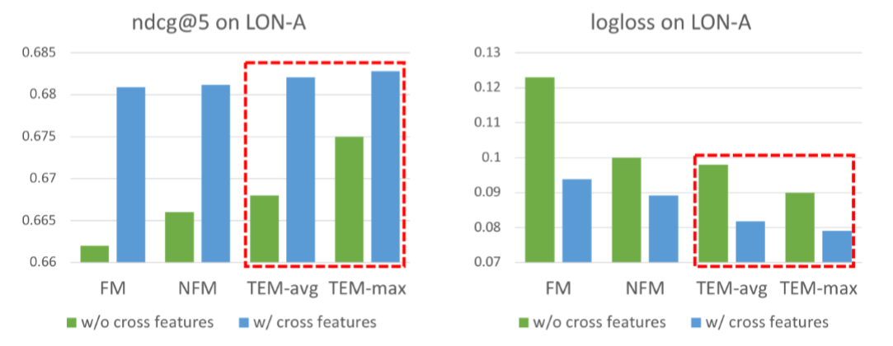
RQ1: Overall Performance Comparison
Without cross feature modeling:
All methods have worse performance
TEM is still better than others, due to the utility of attention network (can learn which features are more important for a user-item prediction).

Slide 21
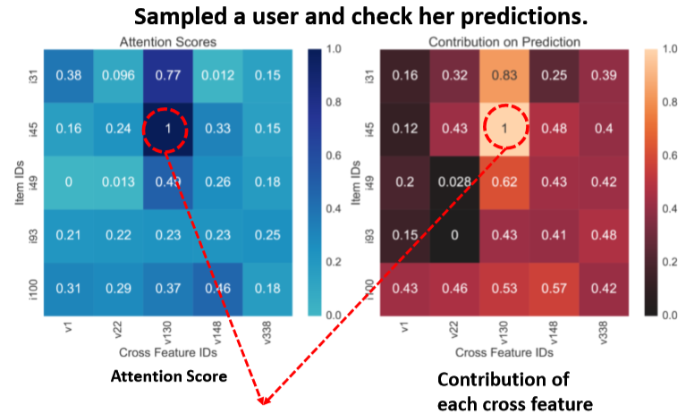
RQ2: Case Study of Explainability
• V130: User Gender=Female] & [User Style=Peace and Quiet Seeker] ⇒ [Item Attribute=Sights & Landmarks] & [Item Tag=Walk Around]
• V148: [User Age=30-40] & [User Country=USA] ⇒ [Item Tag=Top Deck & Canary Wharf]
We attribute the user’s preferences on The View from the Shard to her special interests in the item aspects of Walk Around, Top Deck & Canary Wharf.
TEM can provide more informative explanations based on a user’s preferred cross features.

Slide 22
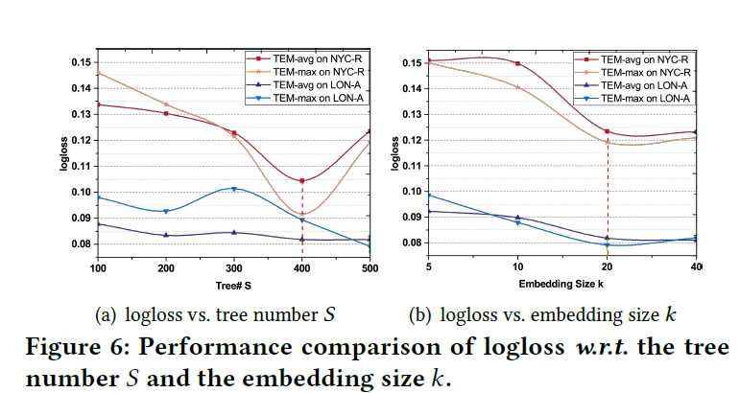
RQ3: Hyper-parameter Studies

Slide 23
OUTLINE
Introduction
Tree-enhanced Embedding Model
Experimental Results
Conclusion

Slide 24
Conclusions
We proposed a tree-enhanced embedding method (TEM), which seamlessly combines the generalization ability of embedding-based models with the explainability of tree-based models.
Owing to the explicit cross features from tree-based part & the easy-to-interpret attention network, the whole prediction process of our solution is transparent & self-explainable.

Slide 25
Future Work:
Jointly learn the tree-based and embedding-based
Relational reasoning over KG (symbolic logics) + Deep Learning
How to evaluate the quality of explanations?

Slide 26
Thanks!

