Slide 1

RE510 SLAM
Occupancy grid map & MCL
Lecture

Slide 2
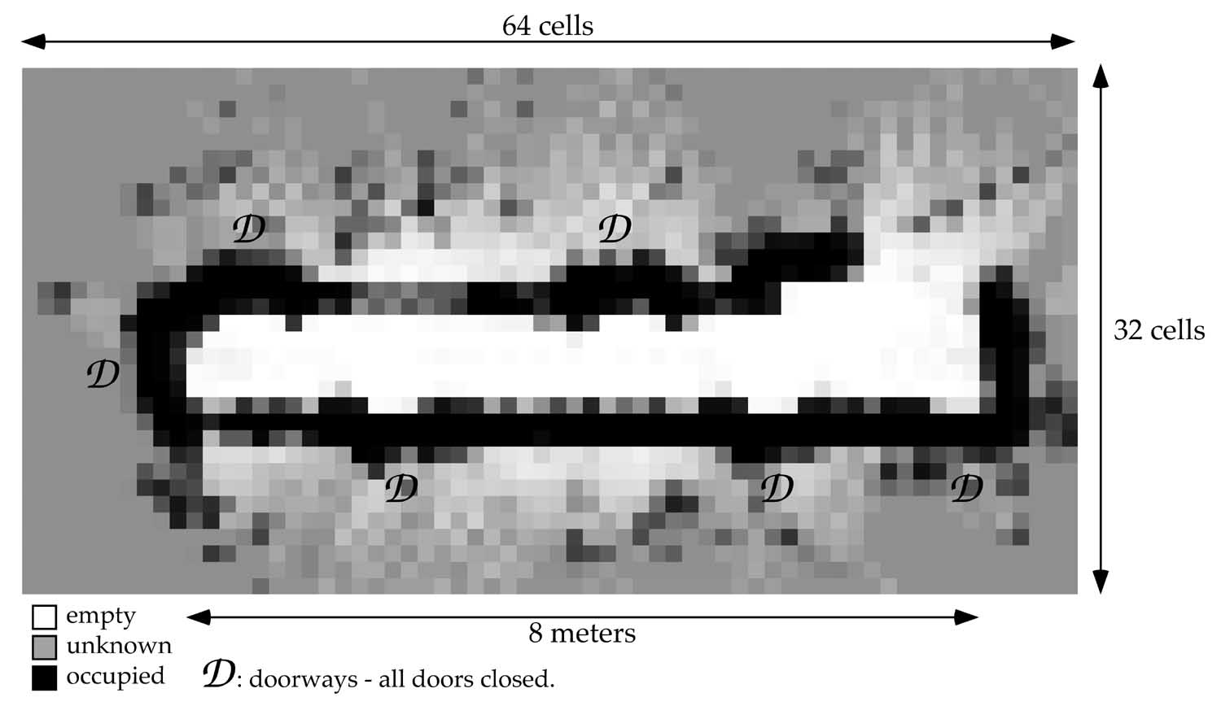
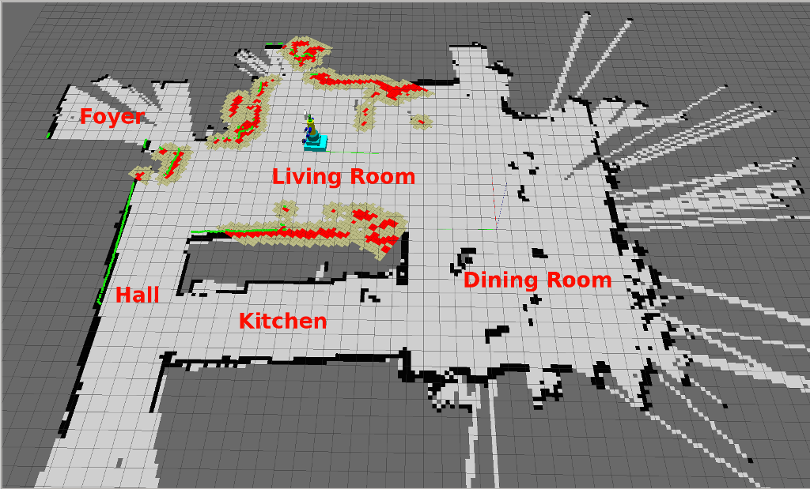
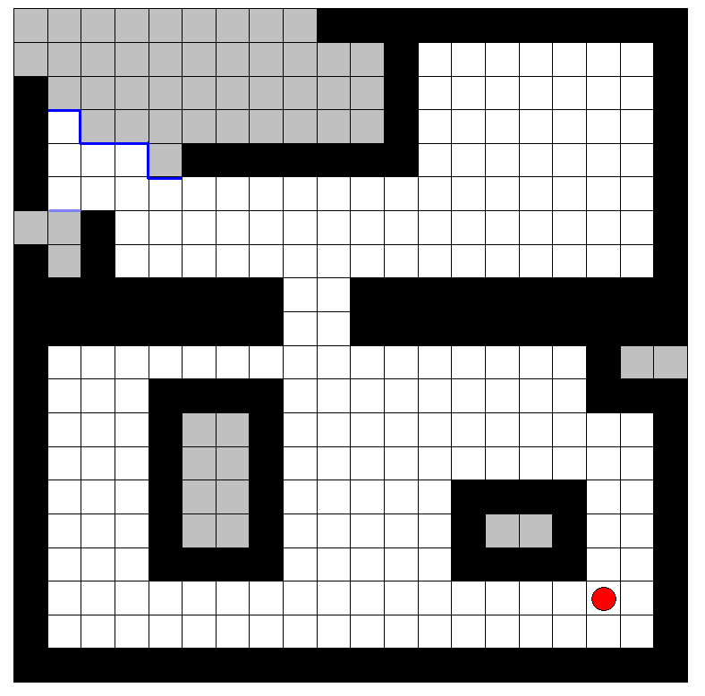
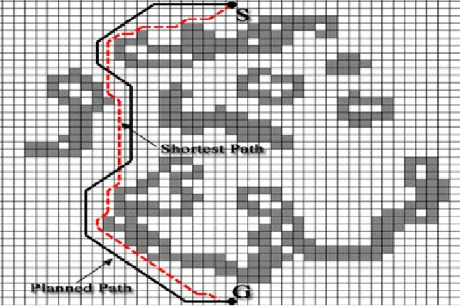
Occupancy grid map

Slide 3
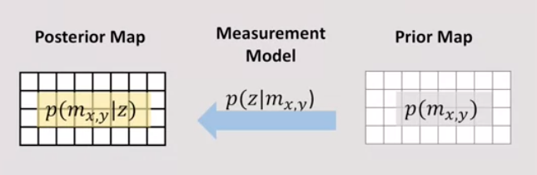
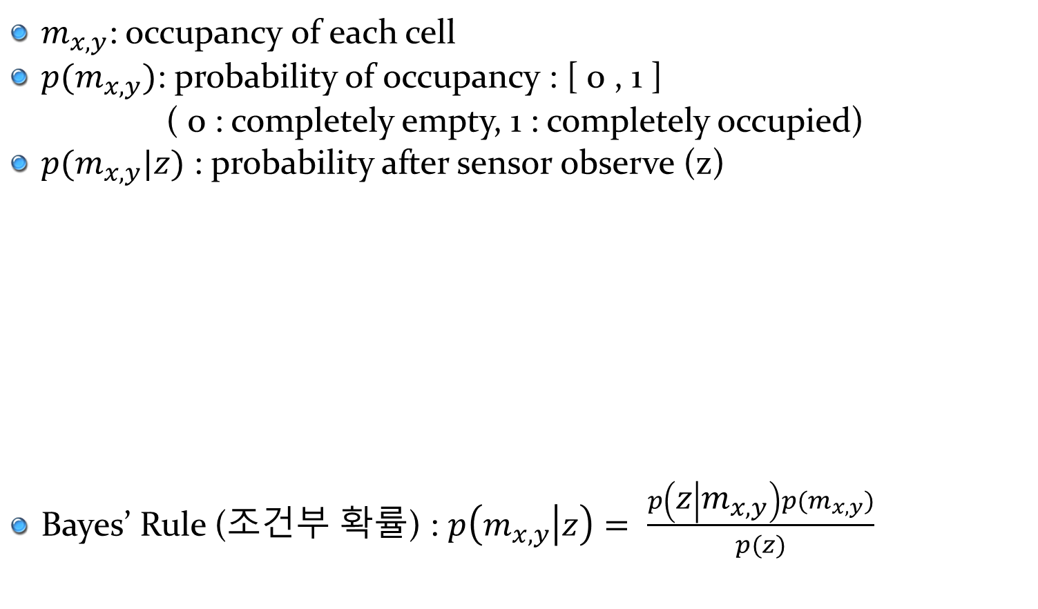
Occupancy Grid Map
$m_{x,y}$: occupancy of each cell
$p(m_{x,y})$: probability of occupancy : [ 0 , 1 ]
( 0 : completely empty, 1 : completely occupied)
$p(m_{x,y}|z)$ : probability after sensor observe (z)
Bayes’ Rule (조건부 확률) : $p\left(m_{x,y} | z\right)= \frac{p\left(z | m_{x,y}\right)p(m_{x,y})}{p(z)}$
Too complex to compute!

Slide 4
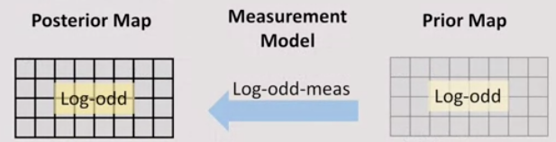
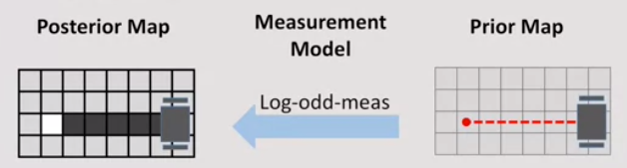
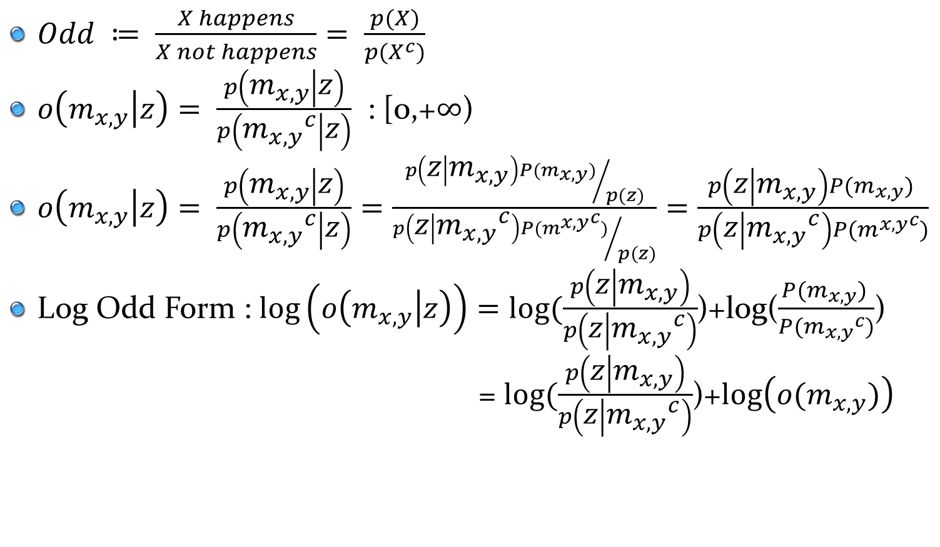
Occupancy Grid Map
$Odd ≔ \frac{X happens}{X not happens}= \frac{p(X)}{p(X^{c})}$
$o\left(m_{x,y} | z\right)= \frac{p\left(m_{x,y} | z\right)}{p\left({m_{x,y}}^{c} | z\right)}$ : [0,+$∞$)
$o\left(m_{x,y} | z\right)= \frac{p\left(m_{x,y} | z\right)}{p\left({m_{x,y}}^{c} | z\right)}=\frac{{p\left(z | m_{x,y}\right)P(m_{x,y})}/{p(z)}}{{p\left(z | {m_{x,y}}^{c}\right)P({m^{x,y}}^{c})}/{p(z)}}=\frac{p\left(z | m_{x,y}\right)P(m_{x,y}) }{p\left(z | {m_{x,y}}^{c}\right)P({m^{x,y}}^{c})}$
Log Odd Form : $log\left(o\left(m_{x,y} | z\right)\right)=log⁡(\frac{p\left(z | m_{x,y}\right)}{p\left(z | {m_{x,y}}^{c}\right)}$)+log($\frac{P(m_{x,y}) }{P({m_{x,y}}^{c})}$)
= $log⁡(\frac{p\left(z | m_{x,y}\right)}{p\left(z | {m_{x,y}}^{c}\right)}$)+$log\left(o(m_{x,y})\right)$
Measure
prior

Slide 5
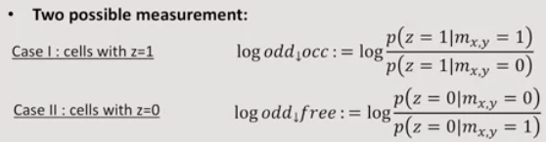
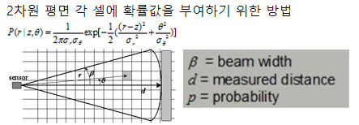
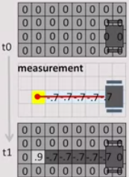


Occupancy Grid Map
$log⁡(\frac{p\left(z | m_{x,y}\right)}{p\left(z | {m_{x,y}}^{c}\right)}$) : measurement term
(laser passed : negative, laser hit : positive)
Commonly use constant measurement model like
Hard!

Slide 6
Particle Filter, Monte Carlo Localization
This lecture based on :
http://ais.informatik.uni-freiburg.de/teaching/ws12/practicalB/02-mcl.pdf

Slide 7
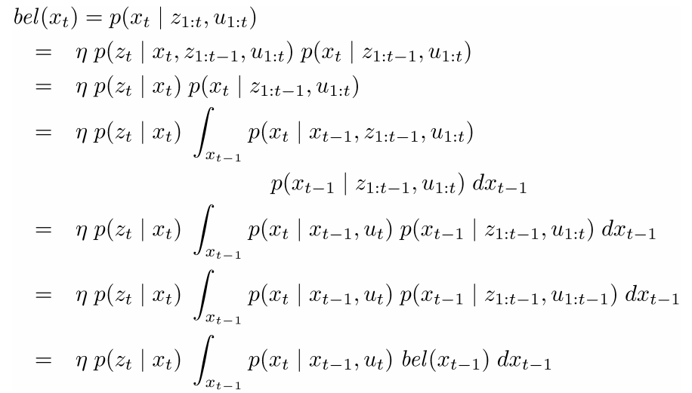

Monte Carlo Localization
State Estimation
Estimate the state x of a system using given observations z and controls u.
Bayes Filter $bel\left(x_{t}\right)=p\left(x_{t} | z_{1:t},u_{1:t}\right)= ηp(z_{t}|x_{t})\int_{x_{t−1}}{p\left(x_{t} | x_{t−1},u_{t}\right)bel\left(x_{t−1}\right) dx_{t−1}}$
Derivation :

Slide 8
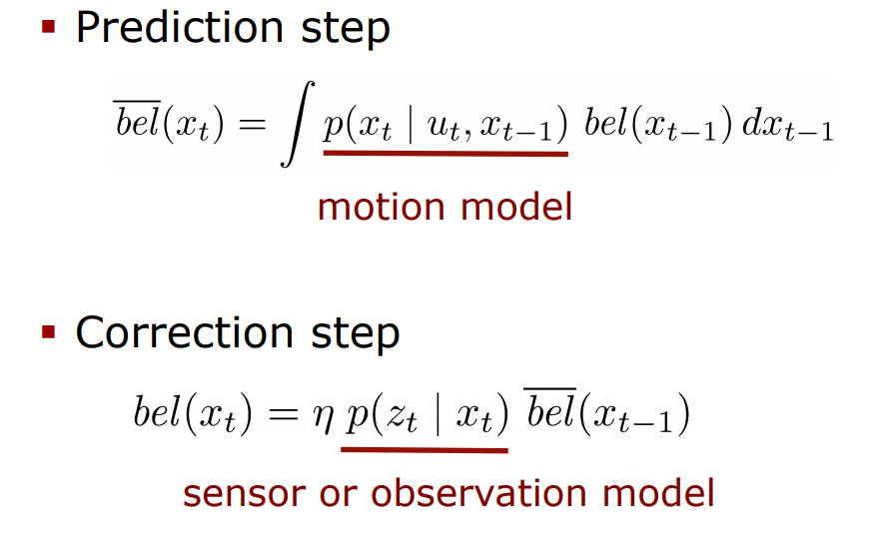
Monte Carlo Localization
State Estimation
Bayes filter = Prediction step + correction step

Slide 9
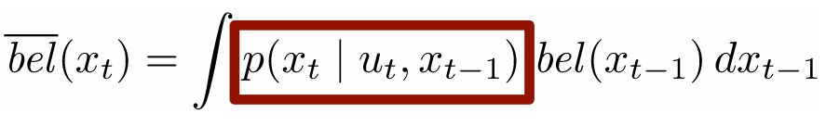
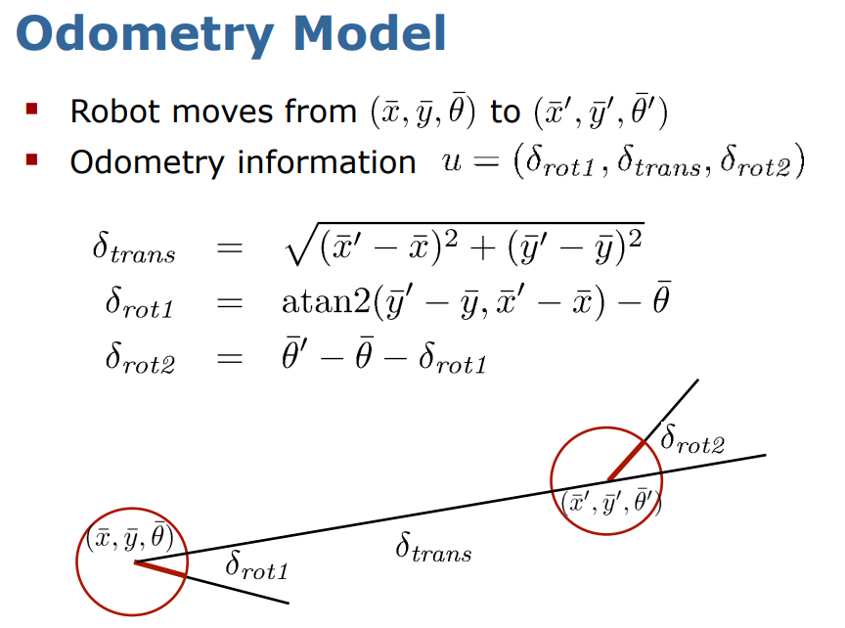
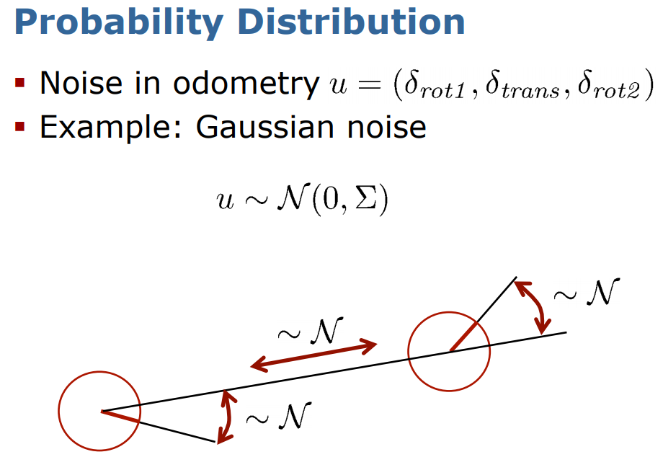
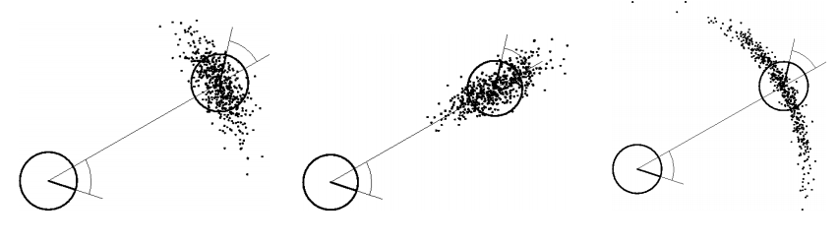
Monte Carlo Localization
Motion Model

Slide 10
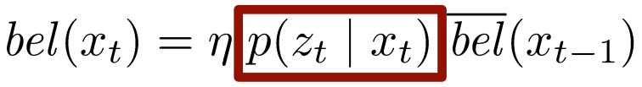
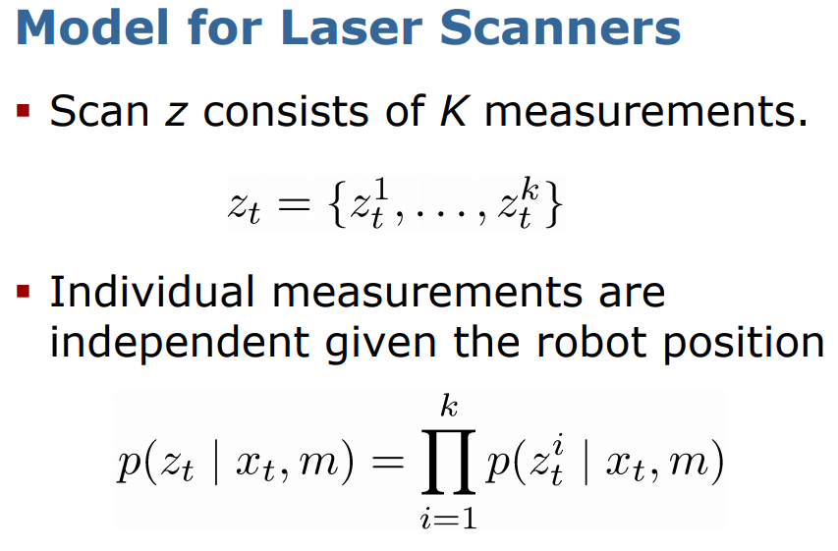
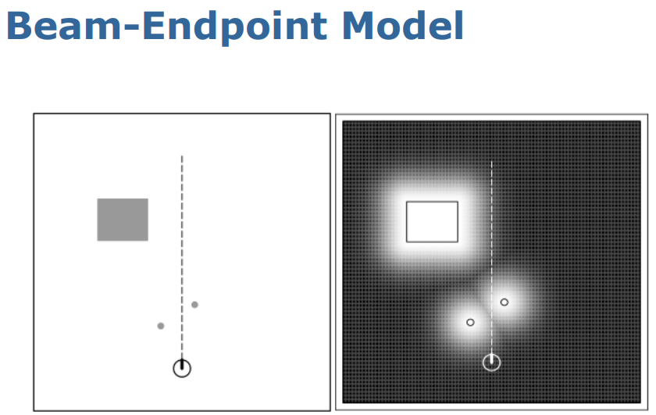
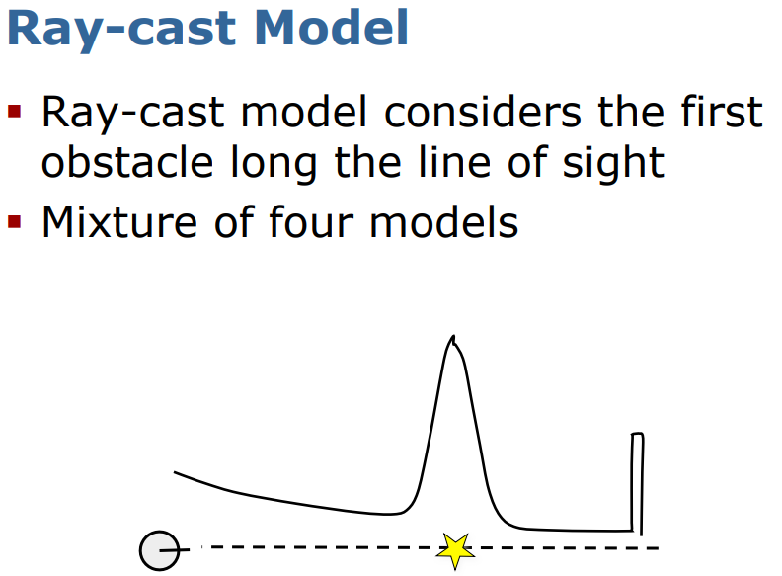
Monte Carlo Localization
Sensor Model

Slide 11
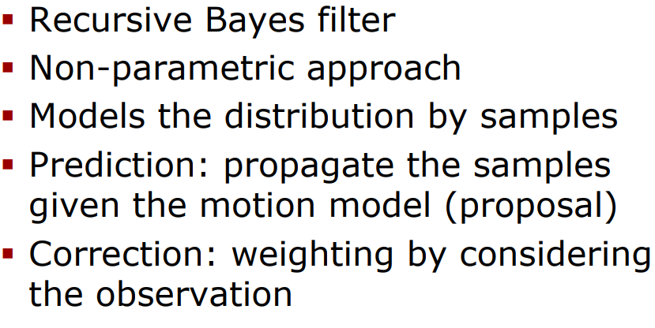
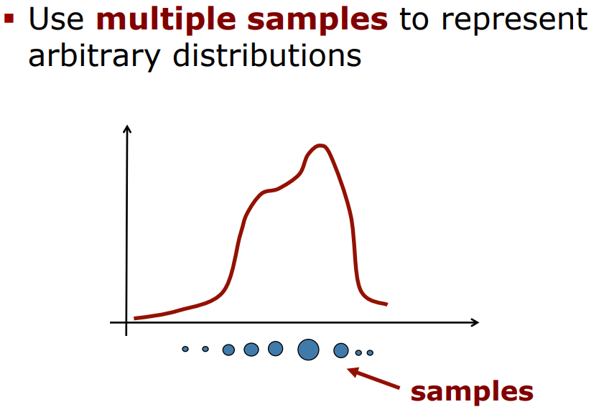
Monte Carlo Localization
Particle Filter

Slide 12
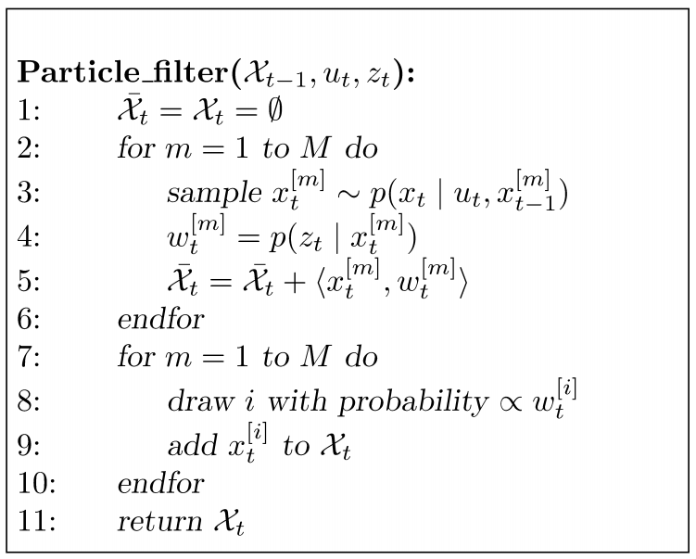
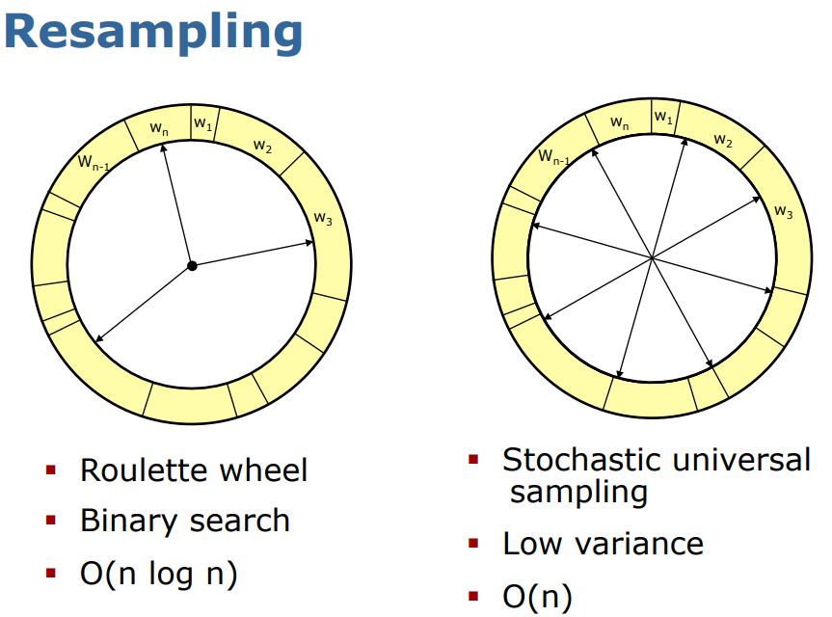
Monte Carlo Localization
Particle Filter
Motion update
Weighting
Resampling

Slide 13
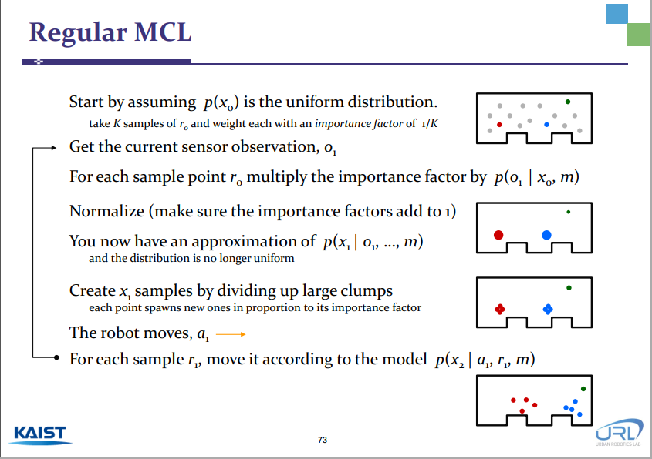

Slide 14
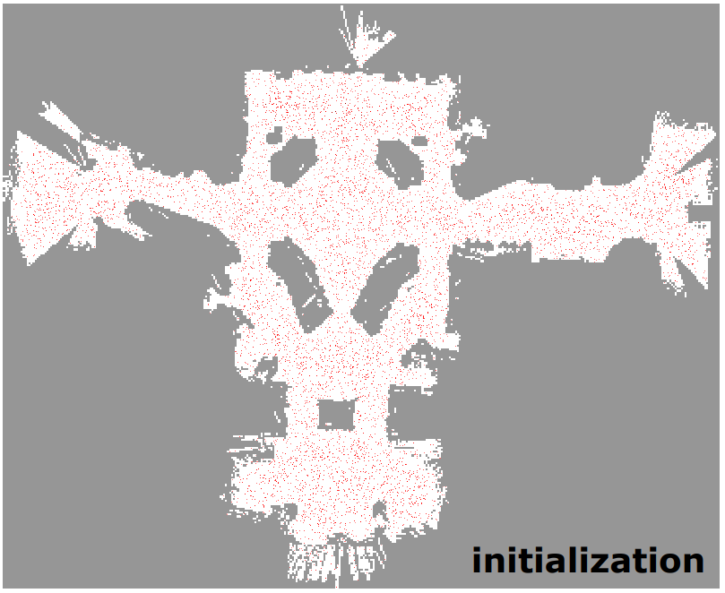
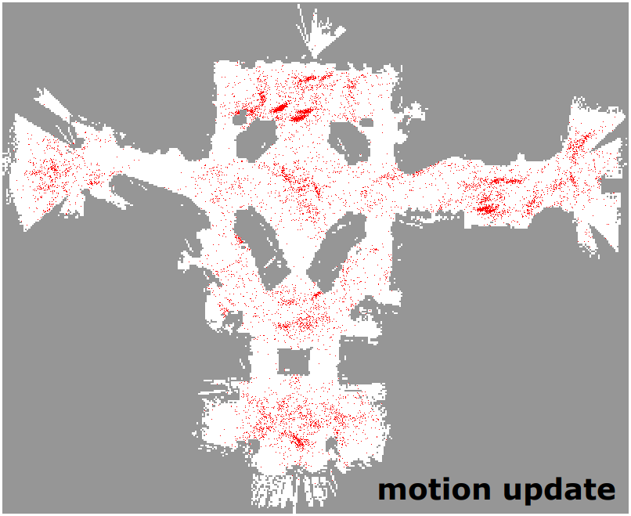
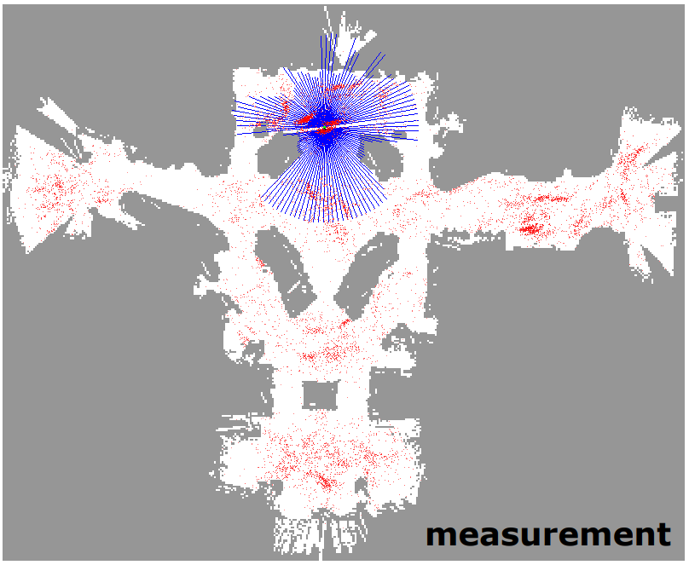
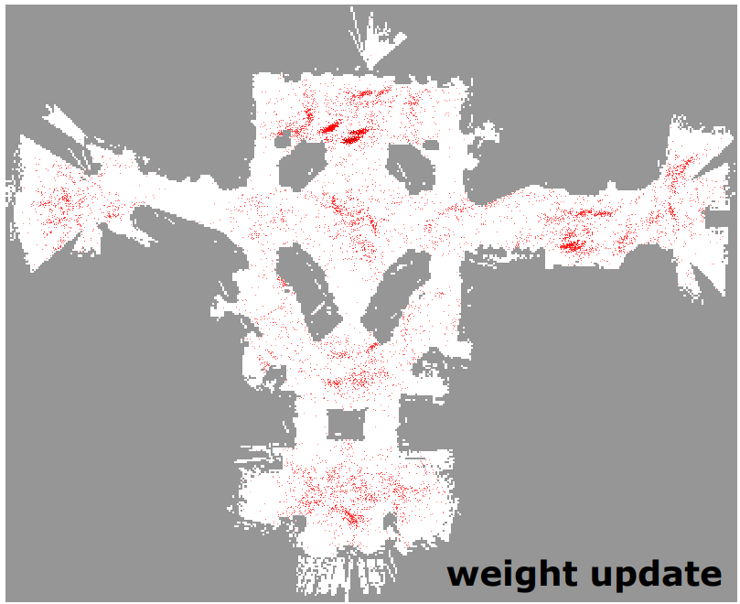
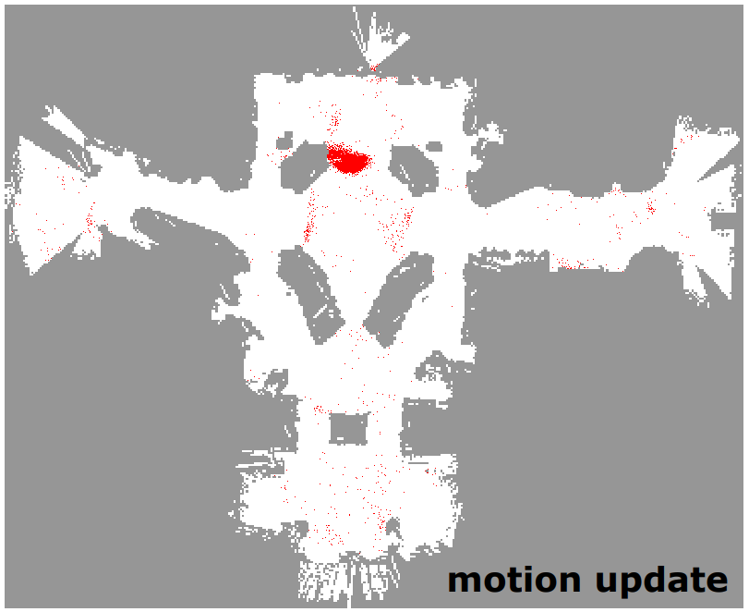

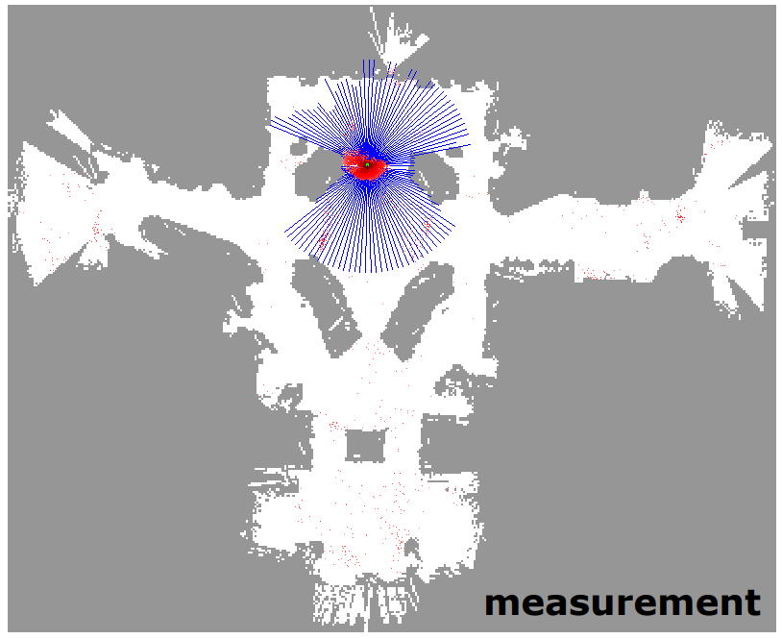
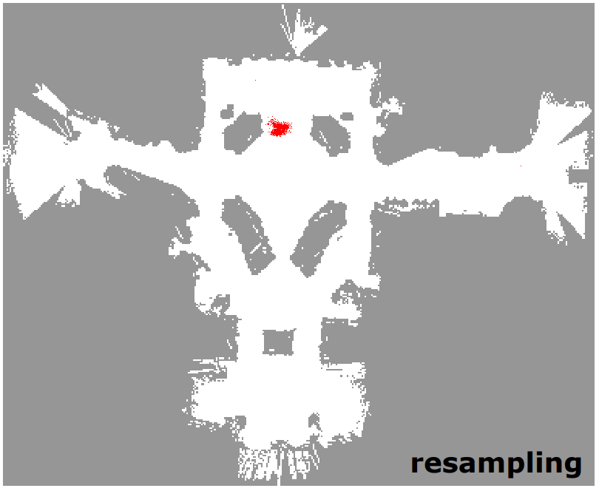
Monte Carlo Localization
Particle Filter

Slide 15
