Slide 1
DATA SCIENCE Model Evaluation Metrics

Slide 2
EVALUATION METRICS
Regression:
Root Mean Squared Error
Classification:
Confusion Matrix
ROC Curve (and AUC)

Slide 3
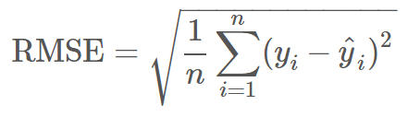
Root Mean Squared Error
Used for regression problems
Square root of the mean of the squared errors
Easily interpretable (in the “y” units)
“Punishes” larger errors

Slide 4
Root Mean Squared Error
Example #1
Example #2

Slide 5
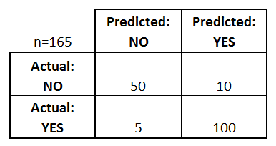
Confusion Matrix
Confusion Matrix: table to describe the performance of a classifier
How many classes are there?
How many patients?
How many times is disease predicted?
How many patients actually have the disease?
Example: Test for presence of disease
NO = negative test = False = 0
YES = positive test = True = 1

Slide 6
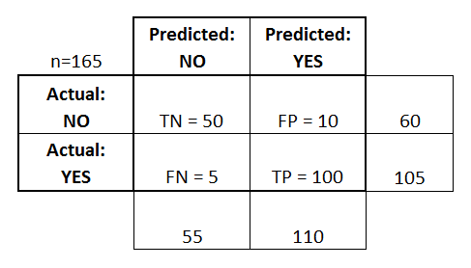
Confusion Matrix
Basic Terminology:
True Positives (TP)
True Negatives (TN)
False Positives (FP)
False Negatives (FN)
Accuracy:
Overall, how often is it correct?
(TP + TN) / total = 150/165 = 0.91
Misclassification Rate (Error Rate):
Overall, how often is it wrong?
(FP + FN) / total = 15/165 = 0.09

Slide 7
Confusion Matrix
Sensitivity:
When actual value is positive, how often is prediction correct?
TP / actual yes = 100/105 = 0.95
“True Positive Rate” or “Recall”
False Positive Rate:
When actual value is negative, how often is prediction wrong?
FP / actual no = 10/60 = 0.17
Specificity:
When actual value is negative, how often is prediction correct?
TN / actual no = 50/60 = 0.83

Slide 8
ROC Curve / AUC
Every email is assigned a “spamminess” score by our classification algorithm. To actually make our predictions, we choose a numeric cutoff for classifying as spam.
An ROC Curve will help us to visualize how well our classifier is doing without having to choose a cutoff!
Email Number | Score | True Label
5 | 0.99 | Spam
8 | 0.82 | Spam
2 | 0.60 | Spam
1 | 0.60 | Ham
7 | 0.48 | Spam
3 | 0.22 | Ham
4 | 0.10 | Ham
6 | 0.02 | Ham

Slide 9
ROC CURVE / AUC
The ROC plots the True Positive Rate (TRP) on the y-axis against the False Positive Rate (FPR) on the x-axis.
TPR: When actual value is spam, how often is prediction correct?
FPR: When actual value is ham, how often is prediction wrong?
Email Number | Score | True Label
5 | 0.99 | Spam
8 | 0.82 | Spam
2 | 0.60 | Spam
1 | 0.60 | Ham
7 | 0.48 | Spam
3 | 0.22 | Ham
4 | 0.10 | Ham
6 | 0.02 | Ham

Slide 10
ROC Curve / AUC
TPR: When actual value is spam, how often is prediction correct?
FPR: When actual value is ham, how often is prediction wrong?
Email Number | Score | True Label
5 | 0.99 | Spam
8 | 0.82 | Spam
2 | 0.60 | Spam
1 | 0.60 | Ham
7 | 0.48 | Spam
3 | 0.22 | Ham
4 | 0.10 | Ham
6 | 0.02 | Ham
Cutoff | TPR (y) | FPR (x) | Cutoff | TPR (y) | FPR (x)
0 |  |  | 0.50
0.05 |  |  | 0.65
0.15 |  |  | 0.85
0.25 |  |  | 1

Slide 11
ROC Curve / AUC
TPR: When actual value is spam, how often is prediction correct?
FPR: When actual value is ham, how often is prediction wrong?
Email Number | Score | True Label
5 | 0.99 | Spam
8 | 0.82 | Spam
2 | 0.60 | Spam
1 | 0.60 | Ham
7 | 0.48 | Spam
3 | 0.22 | Ham
4 | 0.10 | Ham
6 | 0.02 | Ham
Cutoff | TPR (y) | FPR (x) | Cutoff | TPR (y) | FPR (x)
0 | 1 | 1 | 0.50 | 0.75 | 0.25
0.05 | 1 | 0.75 | 0.65 | 0.5 | 0
0.15 | 1 | 0.5 | 0.85 | 0.25 | 0
0.25 | 1 | 0.25 | 1 | 0 | 0

Slide 12
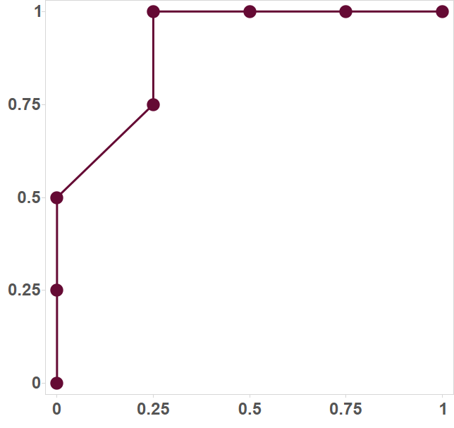
ROC CURVE / AUC
ROC Curve
Email Number | Score | True Label
5 | 0.99 | Spam
8 | 0.82 | Spam
2 | 0.60 | Spam
1 | 0.60 | Ham
7 | 0.48 | Spam
3 | 0.22 | Ham
4 | 0.10 | Ham
6 | 0.02 | Ham
TPR
FPR

Slide 13
ROC Curve / AUC
Q: Would the ROC Curve (and AUC) change if the scores changed but the ordering remained the same?
A: Not at all! The ROC Curve is only sensitive to rank ordering and does not require calibrated scores.
Email Number | Score | True Label
5 | 0.99 | Spam
8 | 0.98 | Spam
2 | 0.97 | Spam
1 | 0.97 | Ham
7 | 0.96 | Spam
3 | 0.95 | Ham
4 | 0.94 | Ham
6 | 0.93 | Ham

