Slide 1
DATA SCIENCE Class 2: machine learning AND KNN

Slide 2
I. what is machine learning? iI. Supervised Learning III. Unsupervised Learning IV. Classification with K-Nearest Neighbors
agenda

Slide 3
I. What is machine learning?
MACHINE LEARNING AND KNN

Slide 4
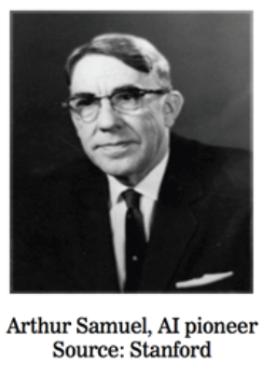
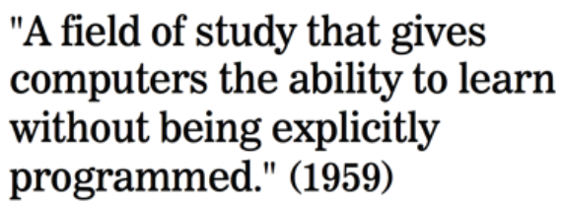
What is machine learning?

Slide 5

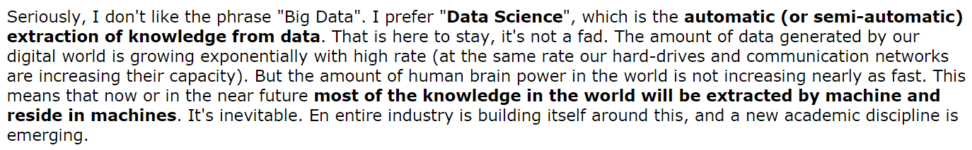
What is machine learning?
Source: http://www.reddit.com/r/MachineLearning/comments/25lnbt/ama_yann_lecun

Slide 6
What is Machine Learning?
There are two main categories of machine learning:
Supervised learning (aka “predictive modeling”)
Predict an outcome based on data
Example: predict whether an email is spam or “ham”
Goal is “generalization”
Unsupervised learning
Extracting structure from data
Example: create segments of voters
Goal is “representation”

Slide 7
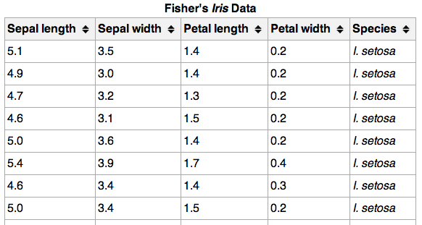
Machine Learning Terminology
}
150 observations
(n = 150)
{
Feature matrix “X” has n rows and p columns
Response “y” is a vector with length n
{
response
4 features (p = 4)

Slide 8
Machine Learning Terminology
Observations are also known as: samples, examples, instances, records
Features are also known as: predictors, independent variables, inputs, regressors, covariates, attributes
Response is also known as: outcome, label, target, dependent variable
Note: Unsupervised learning does not have a response, and does not require labeled data!

Slide 9
II. Supervised Learning
MACHINE LEARNING AND KNN

Slide 10
Categories of Supervised Learning
There are two categories of supervised learning:
Regression
Response is continuous
Examples: price, blood pressure
Classification
Response is categorical (values in a finite, unordered set)
Examples: spam/ham, digit 0-9, cancer class of tissue sample

Slide 11
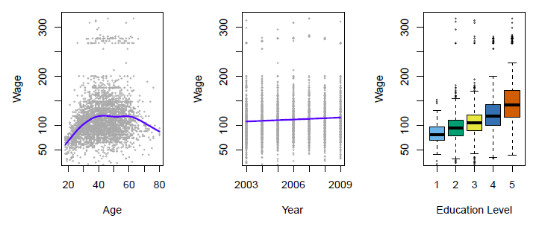
Regression Example
Predict salary using demographic data
Income survey data for males from the central Atlantic region of the USA in 2009
Source: https://class.stanford.edu/c4x/HumanitiesScience/StatLearning/asset/introduction.pdf

Slide 12
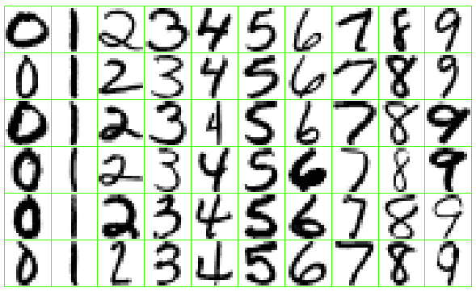
Classification Example
Identify the numbers in a handwritten zip code
Source: https://class.stanford.edu/c4x/HumanitiesScience/StatLearning/asset/introduction.pdf

Slide 13
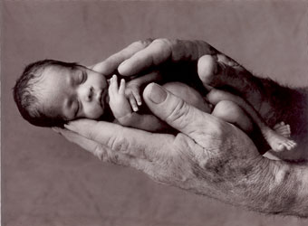
Regression or Classification?
Problem: Children born prematurely are at high risk of developing infections, many of which are not detected until after the baby is sick
Goal: Detect subtle patterns in the data that predicts infection before it occurs
Data: 16 vital signs such as heart rate, respiration rate, blood pressure, etc…
Impact: Model is able to predict the onset of infection 24 hours before the traditional symptoms of infection appear
Image: http://www.babycaretips4u.com/wp-content/uploads/2014/03/premature-baby.jpg
Case Study: http://www.amazon.com/Big-Data-Revolution-Transform-Think/dp/0544002695

Slide 14
III. UNSupervised Learning
MACHINE LEARNING AND KNN

Slide 15
Supervised Vs. Unsupervised Learning
Supervised learning has clear objectives:
Accurately predict unseen test cases
Understand which features affect the response, and how
You can evaluate how well you are doing!
Unsupervised learning has fuzzy objectives:
Find groups of observations that behave similarly
Find features that behave similarly
It’s difficult to evaluate how well you are doing!

Slide 16
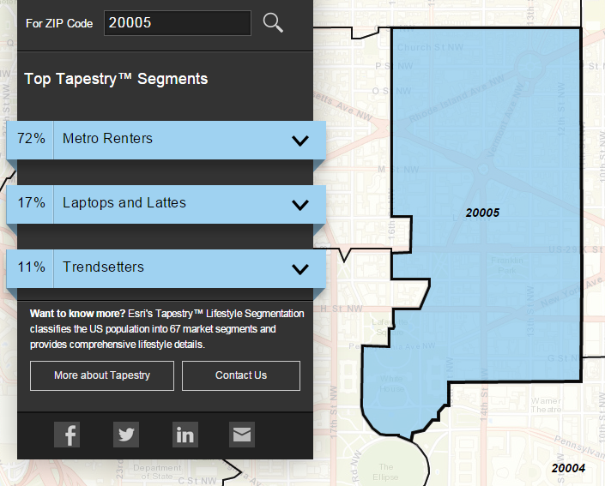
Clustering Example
Classify US residential neighborhoods into 67 unique segments based on demographic and socioeconomic characteristics
Metro Renters:
Young, mobile, educated, or still in school, we live alone or with a roommate in rented apartments or condos in the center of the city. Long hours and hard work don’t deter us; we’re willing to take risks to get to the top of our professions… We buy groceries at Whole Foods and Trader Joe’s and shop for clothes at Banana Republic, Nordstrom, and Gap. We practice yoga, go skiing, and attend Pilates sessions.
Source: http://www.esri.com/landing-pages/tapestry/

Slide 17
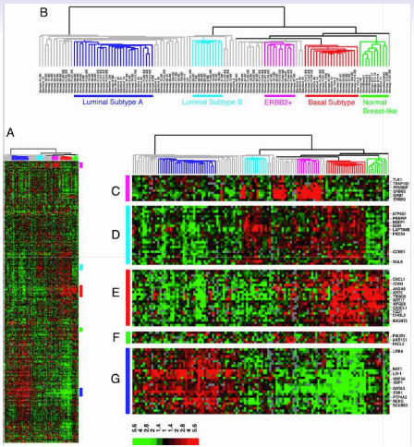
Clustering Example
Classify a tissue sample into one of several cancer classes, based on gene expression data
Each column is a woman with breast cancer (n=88)
Each row is a gene (p=8000)
Color represents level of gene expression
Goal: Locate subcategories of breast cancer showing different gene expressions
Technique: Hierarchical clustering applied to the columns, resulting in six sub-groups of patients
Source: https://class.stanford.edu/c4x/HumanitiesScience/StatLearning/asset/introduction.pdf

Slide 18
IV. Classification with K-Nearest Neighbors
MACHINE LEARNING AND KNN

Slide 19

Types of Machine Learning problems
continuous categorical
supervised regression classification
unsupervised dimension clustering
reduction

Slide 20
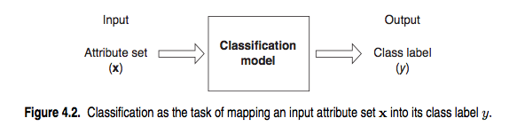
Classification problems
Q: How does a classification problem work?
A: Features in, predicted response out.
Source: http://www-users.cs.umn.edu/~kumar/dmbook/ch4.pdf

Slide 21
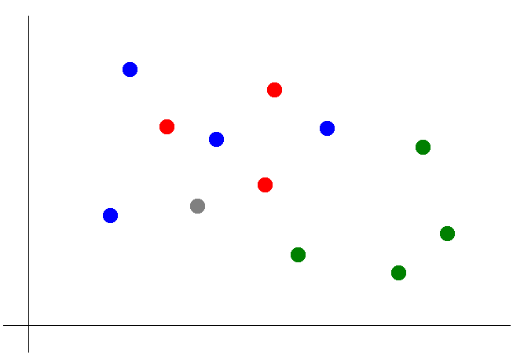

Classification with KNN
Suppose we want to predict the color of the gray dot.
QUESTION:
What are the features? What is the response?

Slide 22
Classification with KNN
Suppose we want to predict the color of the gray dot.
1) Pick a value for k.
k = 3

Slide 23
Classification with KNN
Suppose we want to predict the color of the gray dot.
1) Pick a value for k.
2) Find colors of k nearest neighbors.
k = 3

Slide 24
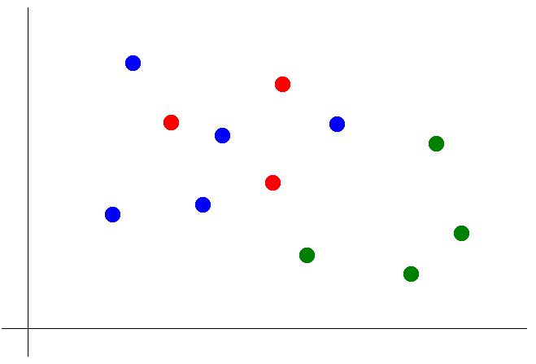
Classification with KNN
Suppose we want to predict the color of the gray dot.
1) Pick a value for k.
2) Find colors of k nearest neighbors.
3) Assign the most common color
to the gray dot.
NOTE:
Our definition of “nearest” implicitly uses the Euclidean distance function.

Slide 25
Classification with KNN
Advantages of KNN:
Simple to understand and explain
Model training is fast
Can be used for classification and regression!
Disadvantages of KNN:
Prediction phase can be slow when n is large
Sensitive to irrelevant features
Accuracy is generally not competitive with the best supervised learning methods

