Slide 1
B-Edit Overview
Reduces technical complexity to let you focus on functionality
Forrest Bentley

Slide 2
Overview
History
Written 1992 (Honeywell Tex, System 90’s)
Original OS/2
Ported to DOS/Windows 1997
Recompiled/Enhanced 64-Bit 2013
Description
Interpreter written in C
1 code-base that runs on many platforms
Strong string manipulation language
Strengths
Editing/Creating Text Files
Code Generation/Maintenance
Prototyping
Current Desktop Environments
Interactive DOS
Batch DOS
Windows GUI

Slide 3
Architecture
Startup
BEDIT call Beditcode.bed
B-Edit
Interpreter
(C executable)

Slide 4
Architecture
B-Edit
Language
Startup
BEDIT call Beditcode.bed
B-Edit
Interpreter
(C executable)
B-Edit
Code
(.bed)

Slide 5
Architecture
System
Commands
B-Edit
Language
Input
Text
Files
B-Edit
Interpreter
(C executable)
B-Edit
Code
(.bed)

Slide 6
Architecture
System
Commands
B-Edit
Language
Input
Text
Files
B-Edit
Interpreter
(C executable)
B-Edit
Code
(.bed)
Output
Text
Files

Slide 7
Architecture
System
Commands
B-Edit
Language
Input
Text
Files
B-Edit
Interpreter
(C executable)
B-Edit
Code
(.bed)
Output
Text
Files
Debug
Log

Slide 8
Sample B-Edit Code
string Restart = 'n'
Int Version = ‘1.1’
//************************************************************************
//* Main Processing
//************************************************************************
!a100_main
call !b100_init
call !b200_proc
call !b300_wrap
exit
//************************************************************************
//* Initialization
//************************************************************************
!b100_init
print:”Version:@Version@”
return

Slide 9
BEDITWIN: Windows GUI Version
B-Edit
Language
System
Commands
Input
Text
Files
B-Edit
Code
(.bed)
BEDITWIN
Interpreter
(C executable)
Window(s)
Definition
(.WIN)
Output
Text
Files
Menu
Definition
(.MNU)
Debug
Log

Slide 10
BEDITWIN Sample Code
//***********************************
//* Window Menu Actions
//***********************************
string Test2_System_MSOBJ = "call !a100_Test2_System_MSOBJ"
//***********************************
//* Window Button Actions
//*******************************
string Test2_System_Cancel_PBOBJ = "call !b100_Test2_System_Cancel_PBOBJ"
//****************************************
//* Test2_System_MSOBJ Processing
//****************************************
!a100_Test2_System_MSOBJ
window pointer wait
window open Test2_System_WIN shade
window center Test2_System_WIN
window clear Test2_System_WIN
window unshade Test2_System_WIN
window pointer arrow
return

Slide 11
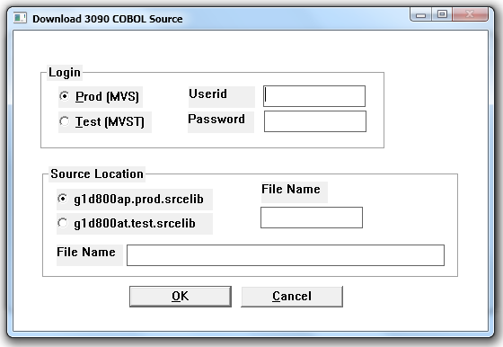
BEDITWIN Architecture
Startup
BEDIT call Builder.bed
Window Name
Builder_3090_WIN
BEDITWIN.EXE
BEDITWIN Script
Builder.BED
C Source
Windows.h
CreateWindow
window open Builder_3090_WIN
WindowProc for
Builder_3090_WIN
Message
WM_PUSHBUTTON
Builder_3090_OK_PBOBJ
Button Name
Builder_3090_OK_PBOBJ
string Builder_3090_OK_PBOBJ
= “call !b100_Builder_3090_OK_PBOBJ
Window
Commands
!b100_Builder_3090_OK_PBOBJ
Window Commands

Slide 12
B-Edit Examples
B-Edit Analysis System (Windows)
Code Checker (Java, C, HTML, Javascript, etc…) (Batch/Windows)
3090 Code Checker (COBOL, ADSO) (Batch/Windows)
Convert CICS code to DC-COBOL (Batch)
SCABBA Remediation
Cross Site Scripting (Batch)
URL Jumping (Batch)
JSDoc Checker (Batch)
HTML Tag Unique Identifier (Batch)
Automation Status Analyzer (Windows)
Remote Property Maintenance (Windows)
Personal Task Tracker (Windows)

Slide 13
B-Edit Future
Language Enhancements
Convert to Java
HTML/CSS/JS Interaction
Oracle Access
Mainframe Access
Utilities
Dragon/ViaVoice/Speakonia Integration
Browser Compatibility Fix
Mainframe JCL Viewer
Mainframe Job Inspect Code -> BPEL -> BPM Tool
Code Development/Maintenance English Dialog
B-Edit, Java, C, etc…

Slide 14


