Slide 1
GECA Technology Viewer
Forrest Bentley

Slide 2
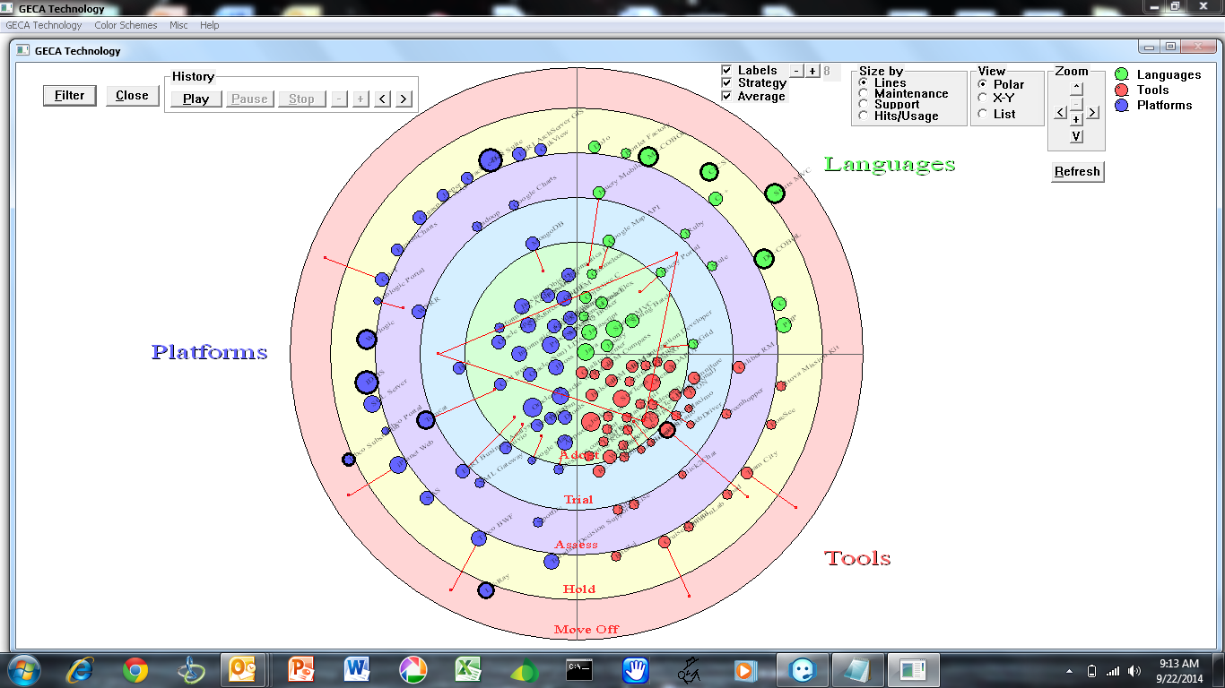
GECA Technologies - All

Slide 3
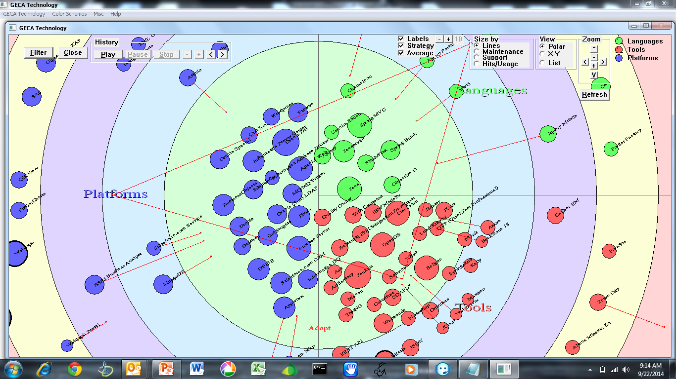
GECA Technologies – Zoom/Translate

Slide 4
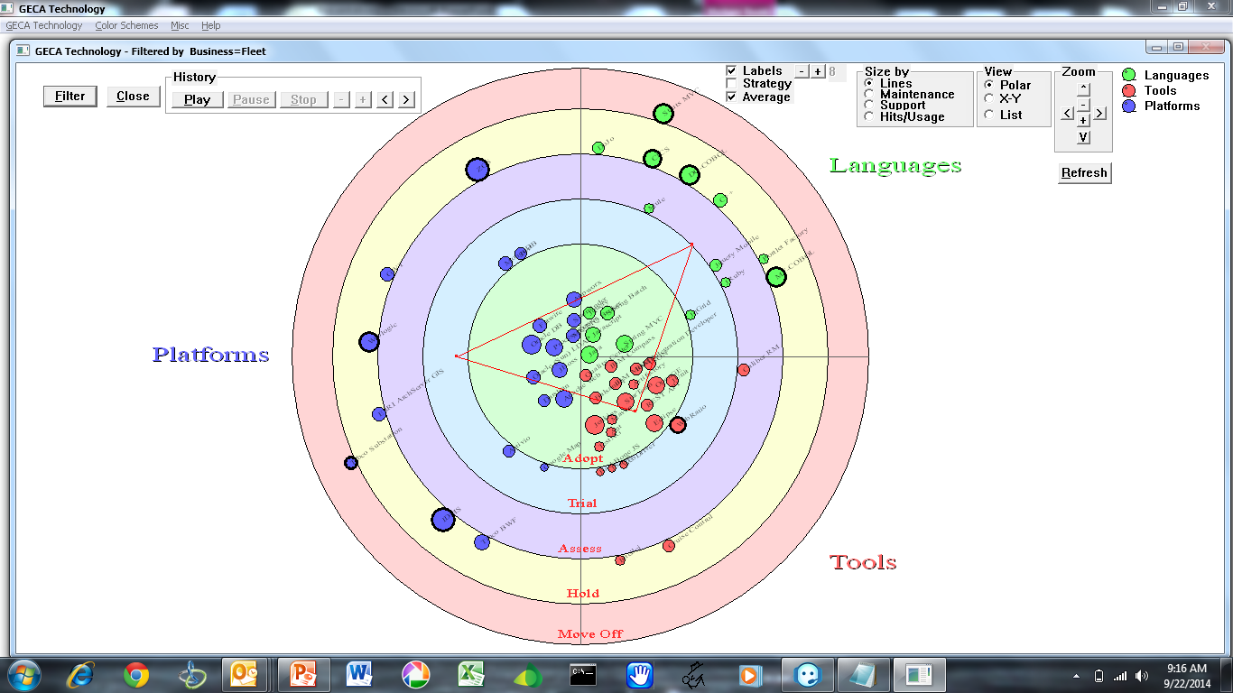
GECA Technologies – View for a Business

Slide 5
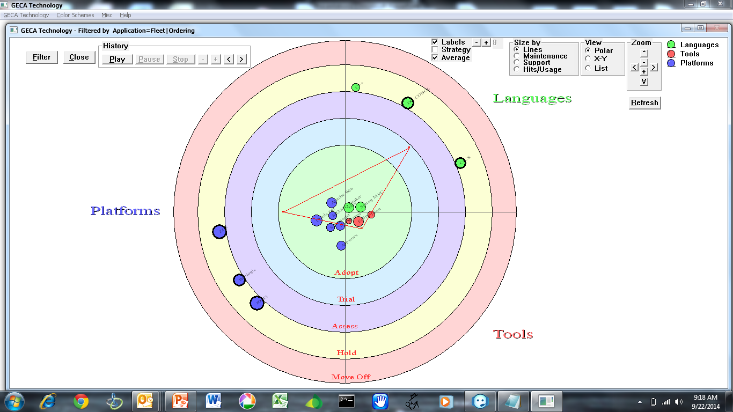
GECA Technologies – View for an Application

Slide 6
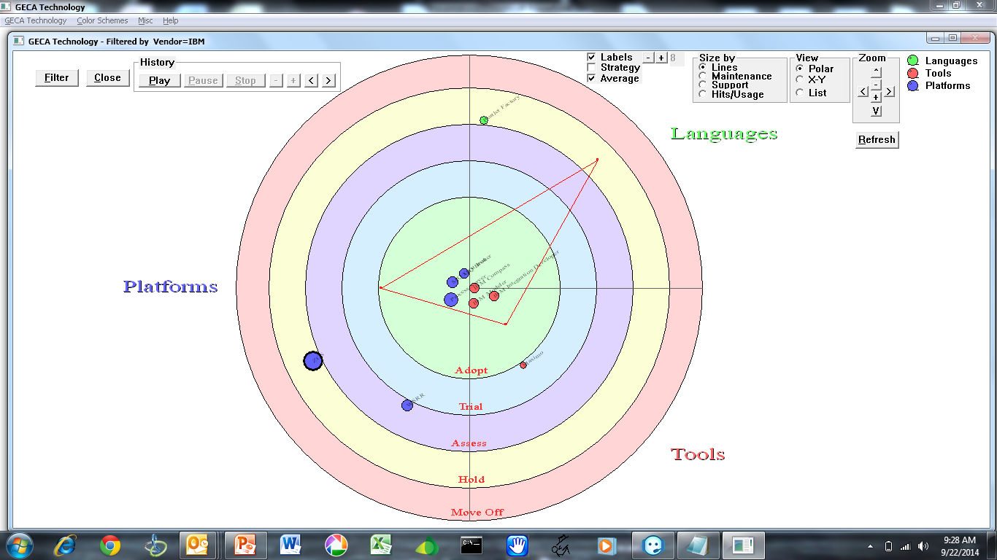
GECA Technologies – View for a Vendor

Slide 7
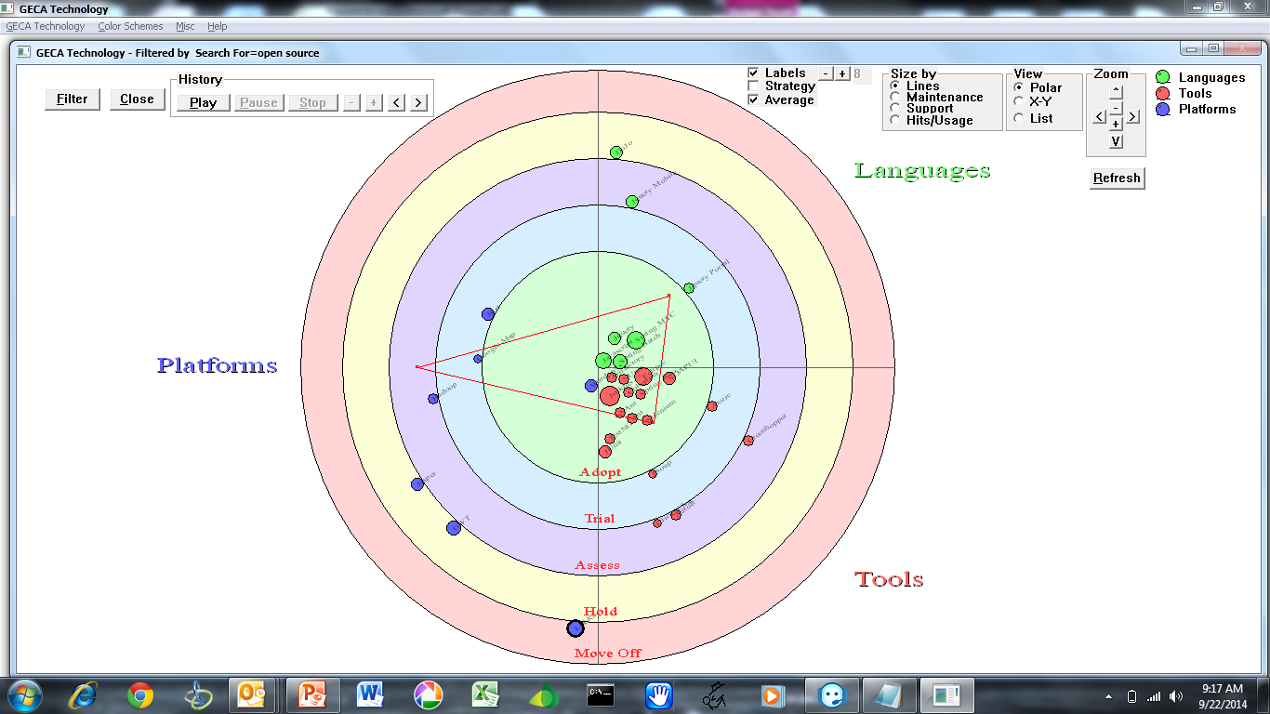
GECA Technologies – View by text e.g. “Open Source”

Slide 8
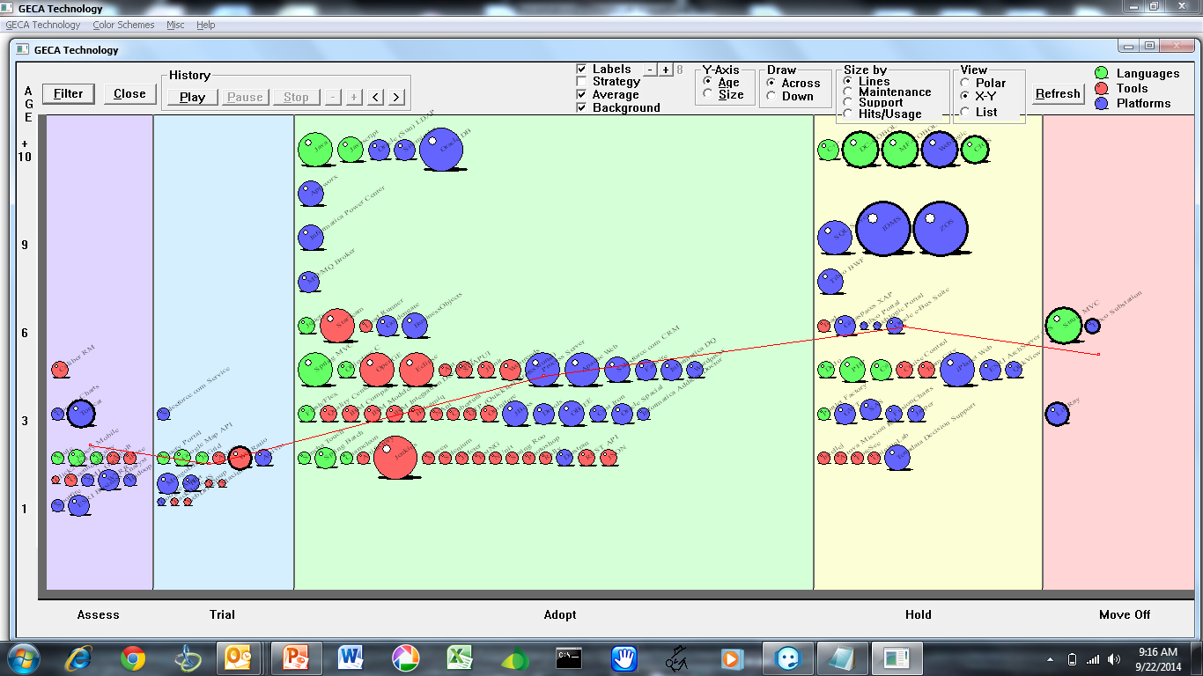
GECA Technologies – X/Y View

Slide 9
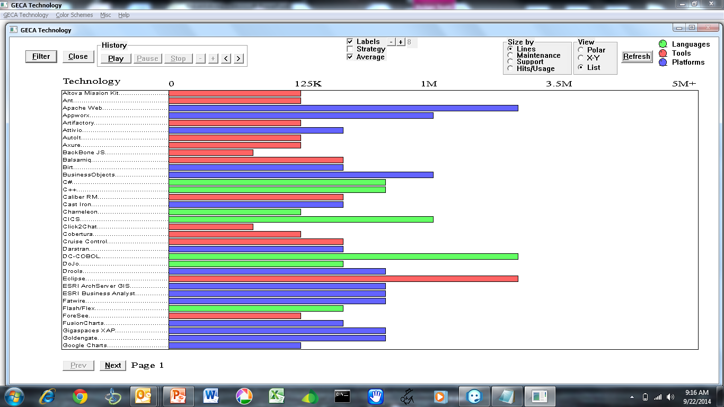
GECA Technologies – List View

Slide 10
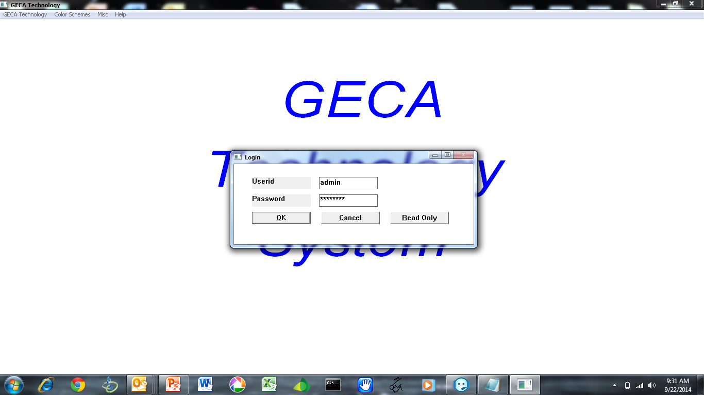
GECA Technologies – Login

Slide 11
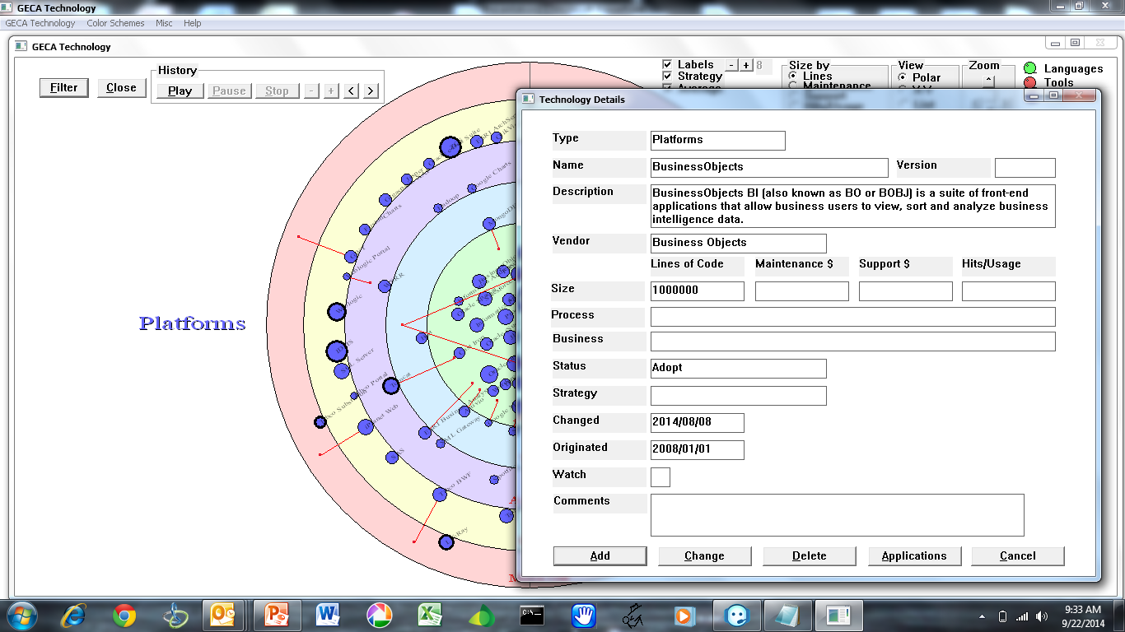
GECA Technologies – Data Maintenance

Slide 12
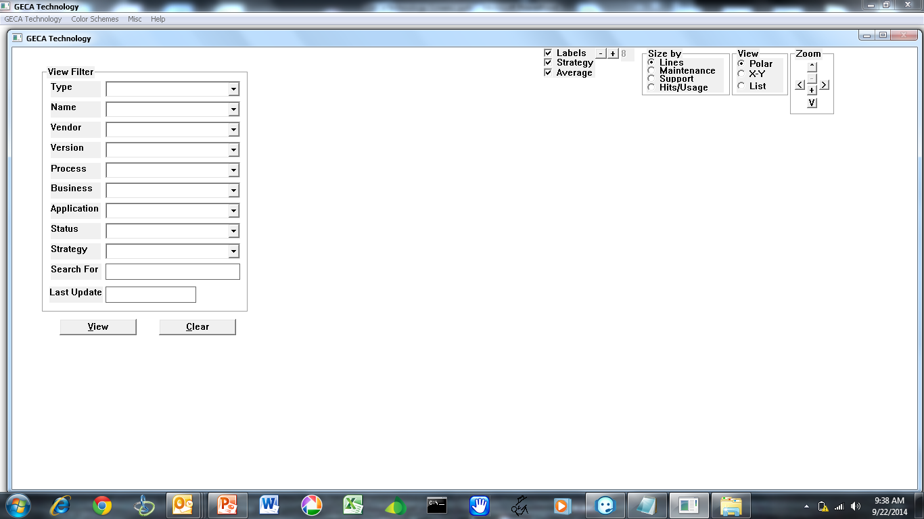
GECA Technologies – Selection Filters

