Slide 1
Asterisms and Constellations
by
Lee Erickson

Slide 2
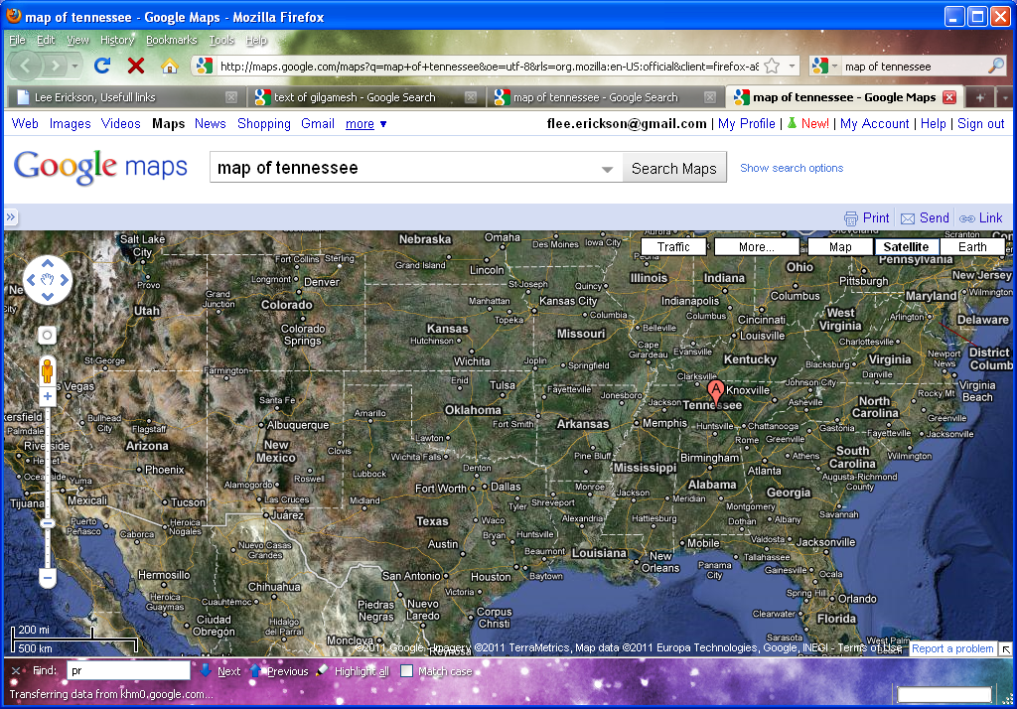
Constlations are Boundaries
Like the state lines

Slide 3
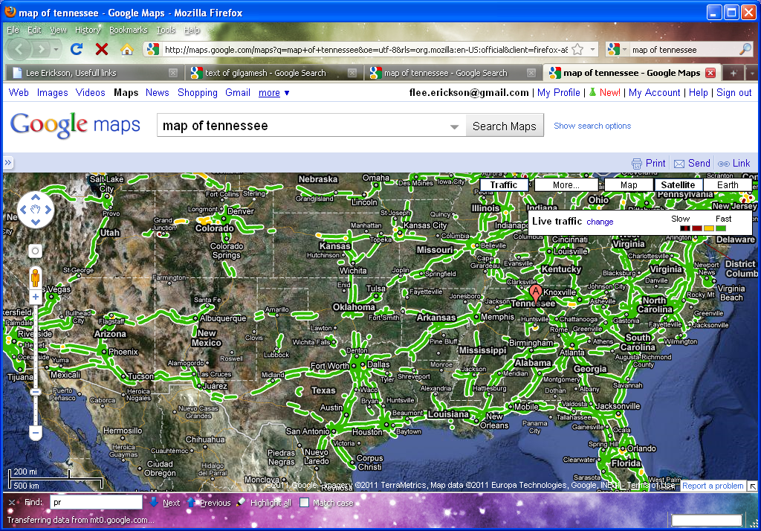
Asterisms “Connect the Dots”
Like the highways

Slide 4
Planetarium Software
Simulate the experience of visiting a planetarium.
Many free ones available.
The good, you are in control.
The bad, you are in control.

Slide 5
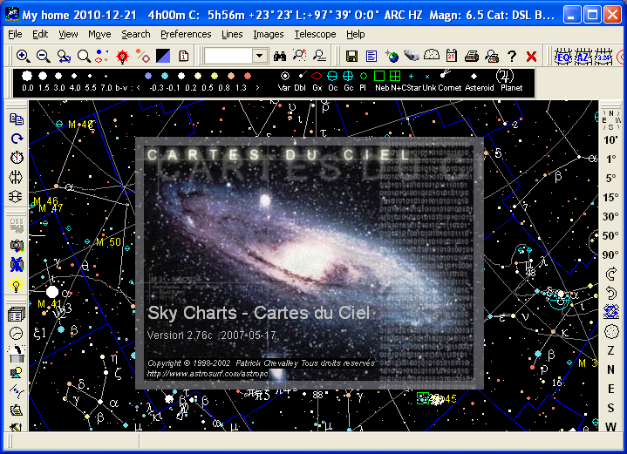
Cartes du Ciel

Slide 6
Cartes du Ceil
Also known as: Sky Chartshttp://www.ap-i.net/skychart/start
Same author provides: Virtual Moon Atlas

Slide 7
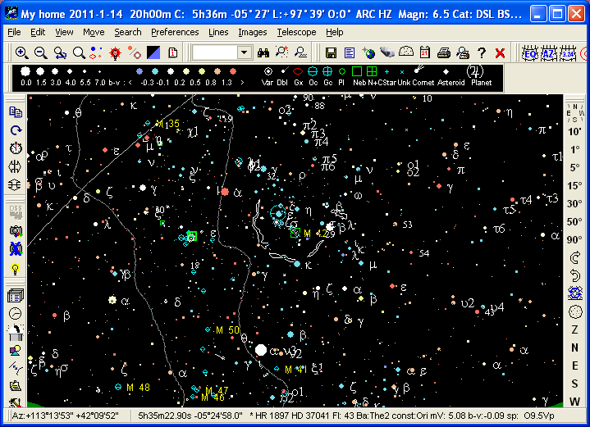
Just the Sky

Slide 8
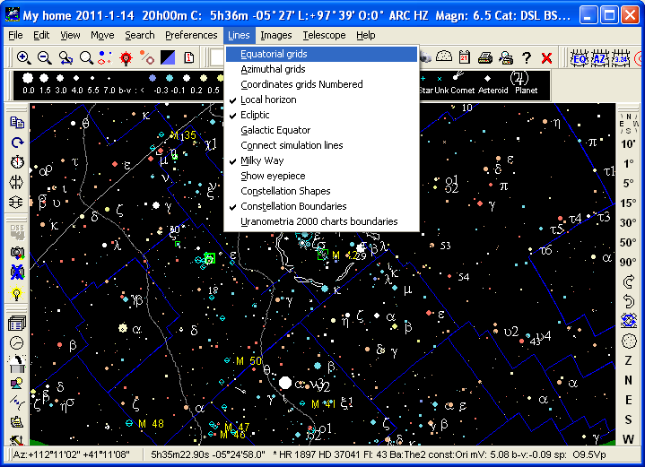
Add the Boundaries

Slide 9
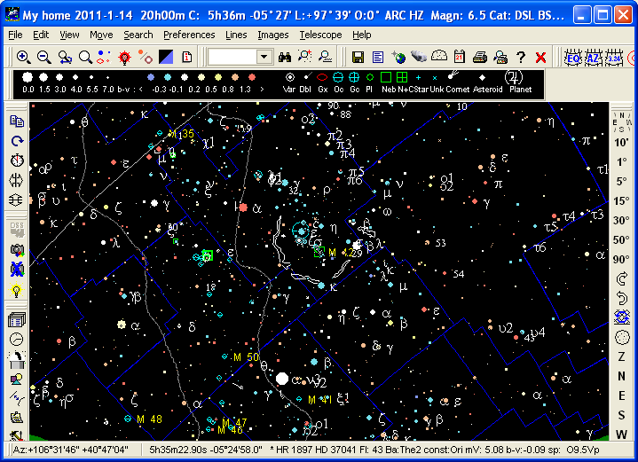
How Does This Help?

Slide 10
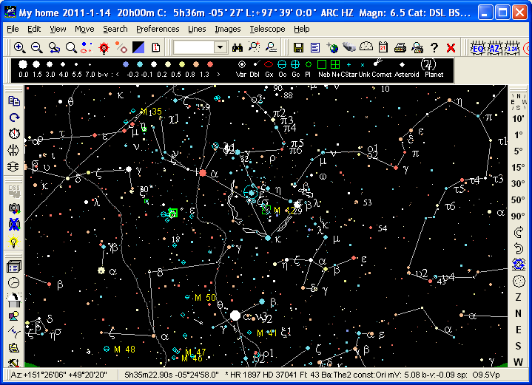
Add the Asterisms

Slide 11
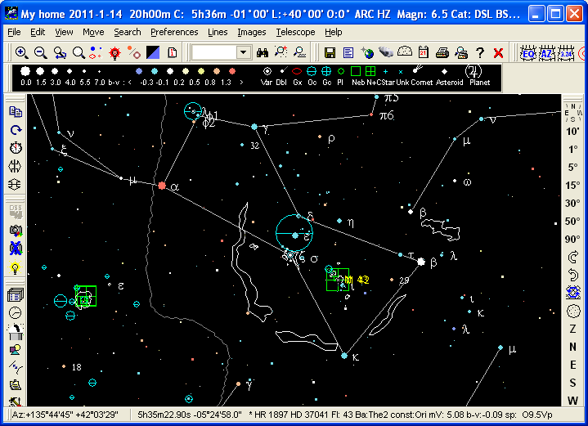
Prominent Now: Orion

Slide 12
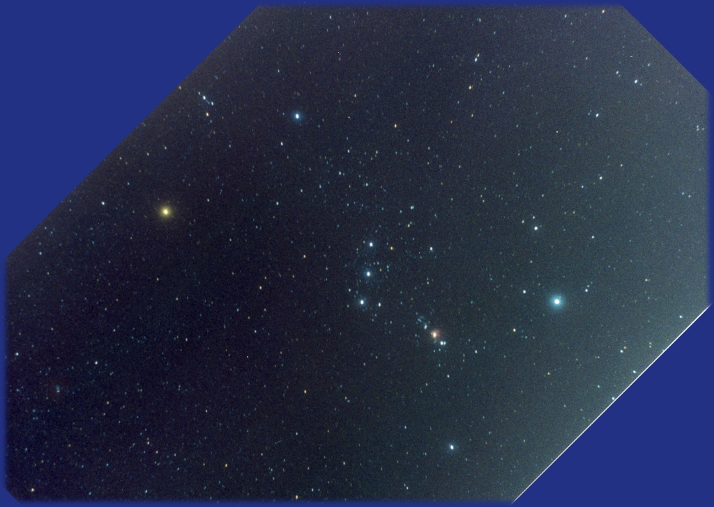
Prominent Now: Orion

Slide 13
Prominent Now: Orion
35 MM Camera on Barn Door
Probably 10 minuet exposure
ASA 800
F2.0 Lens 55mm focal length.
East Tennessee Sky

Slide 14
Where is Barnard's Loop?

Slide 15
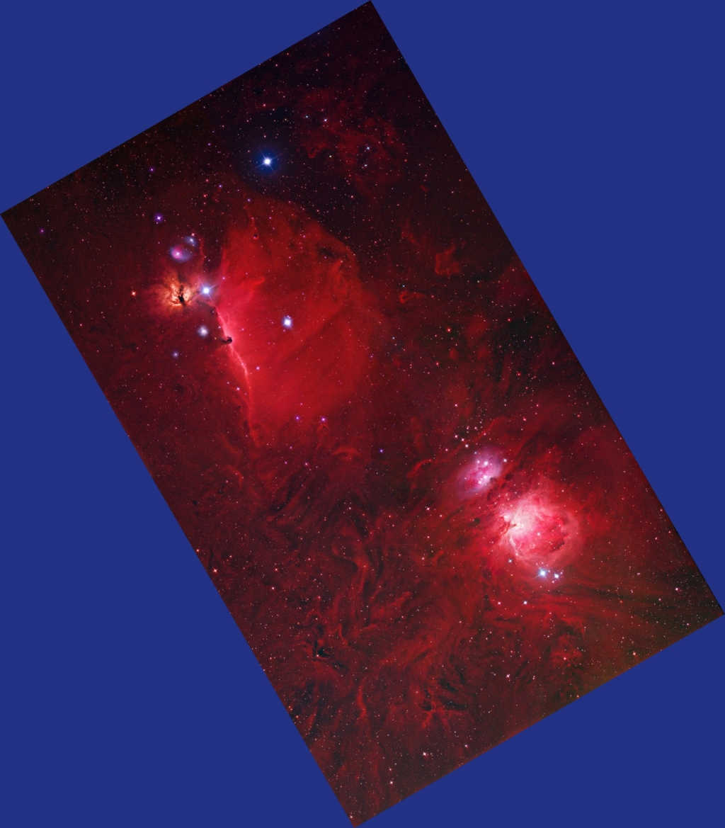
M42 and Horse Head

Slide 16
M42 and Horse Head

Slide 17
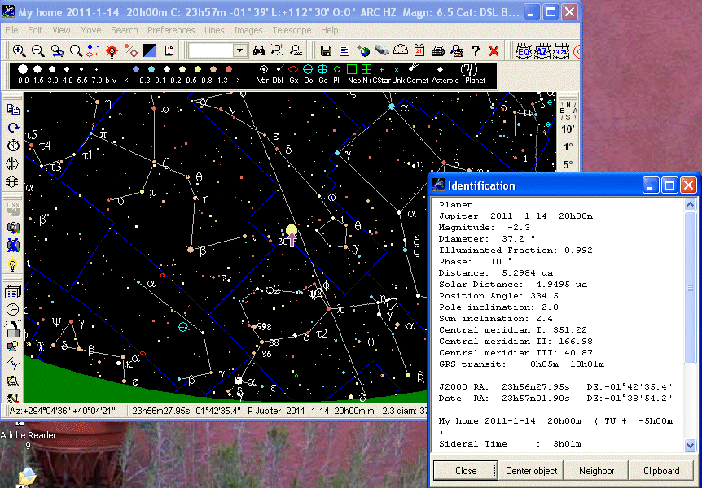
Prominent Now: Jupiter
Jupiter is in Pisces

Slide 18
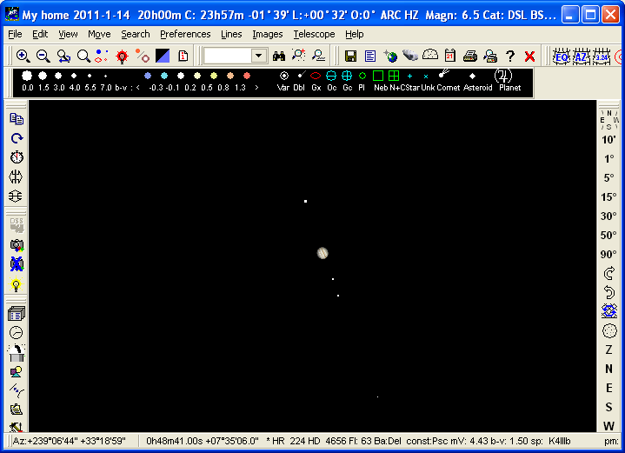
Prominent Now: Jupiter
Jupiter with 4 moons
Ganymede
Io
Europa
Callisto

Slide 19
Review
Asterism versus Constellation

Slide 20
Asterism “Connect the Dots”
Like highways
Constellations are boundaries
Like state lines

