Slide 1
Asterisms and Constellations
by
Lee Erickson

Slide 2
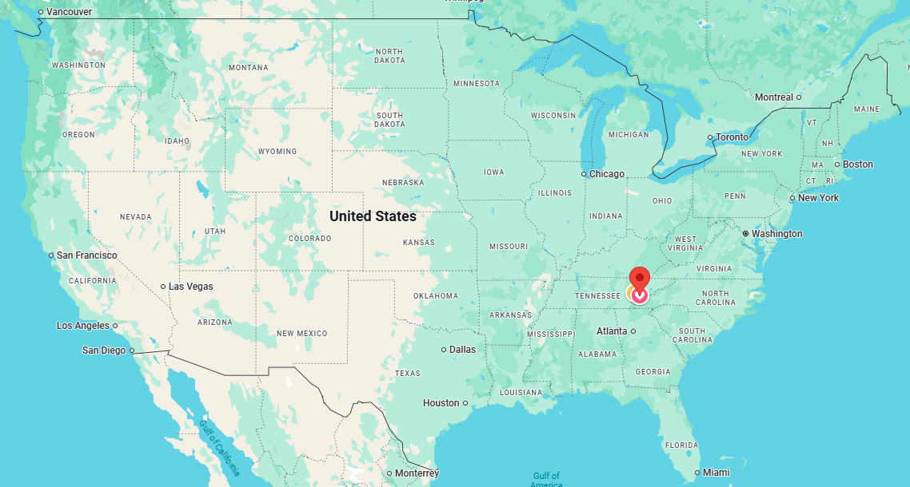
Constellations are Boundaries
Like the state lines

Slide 3
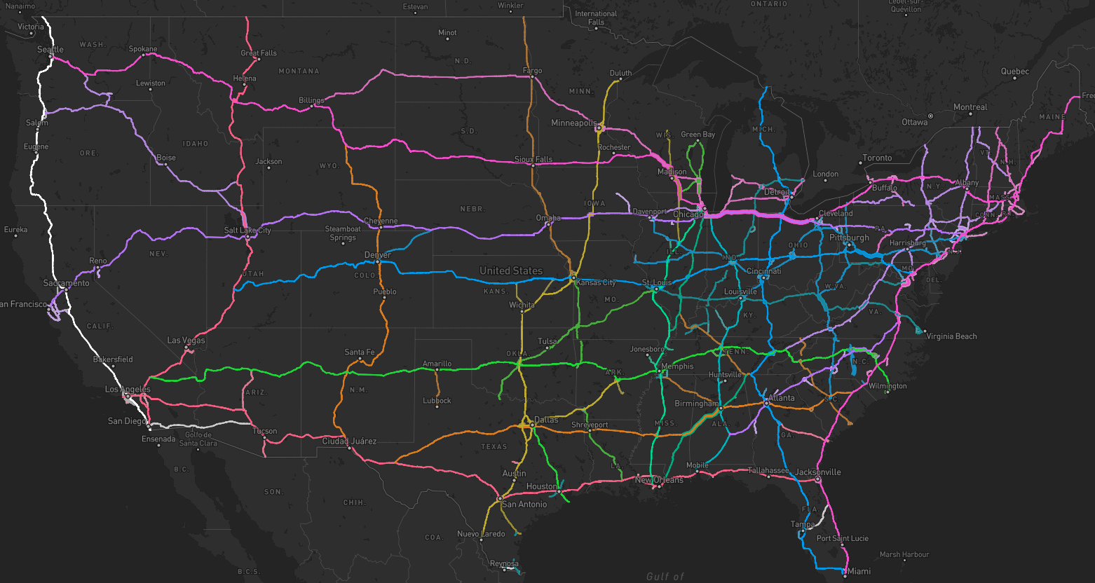
Asterisms “Connect the Dots”
Like the highways connect cities with in states.

Slide 4
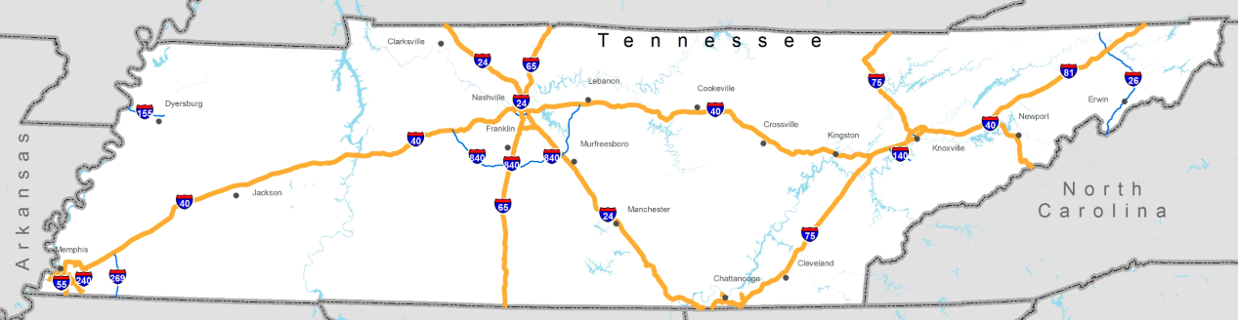
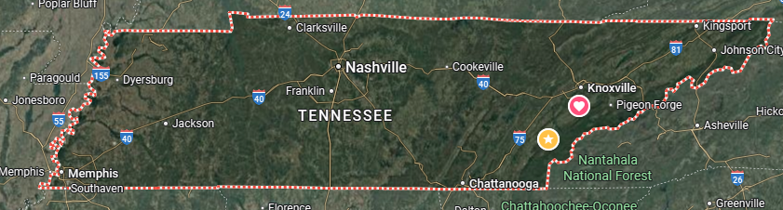
Asterism “Connect the Dots”
Like highways
Constellations are boundaries
Like state lines

Slide 5
Planetarium Software
Simulate the experience of visiting a planetarium.
Many free ones available.
The good, you are in control.
The bad, you are in control.
You can visualize unofficial asterisms
You can visualize official constellations

Slide 6
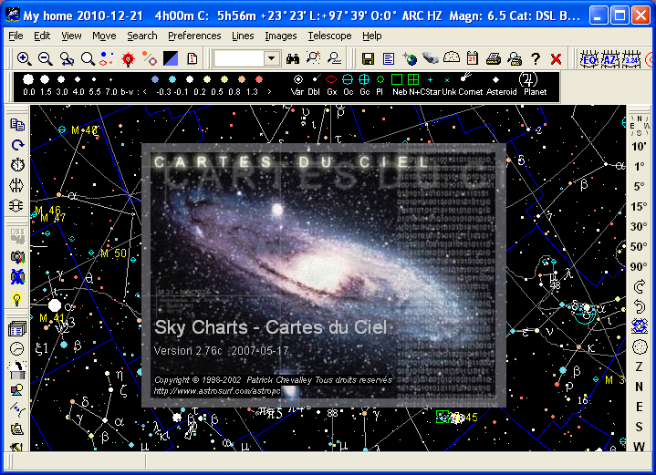
Cartes du Ciel

Slide 7
Cartes du Ceil
Also known as: Sky Chartshttp://www.ap-i.net/skychart/start
Same author provides: Virtual Moon Atlas

Slide 8
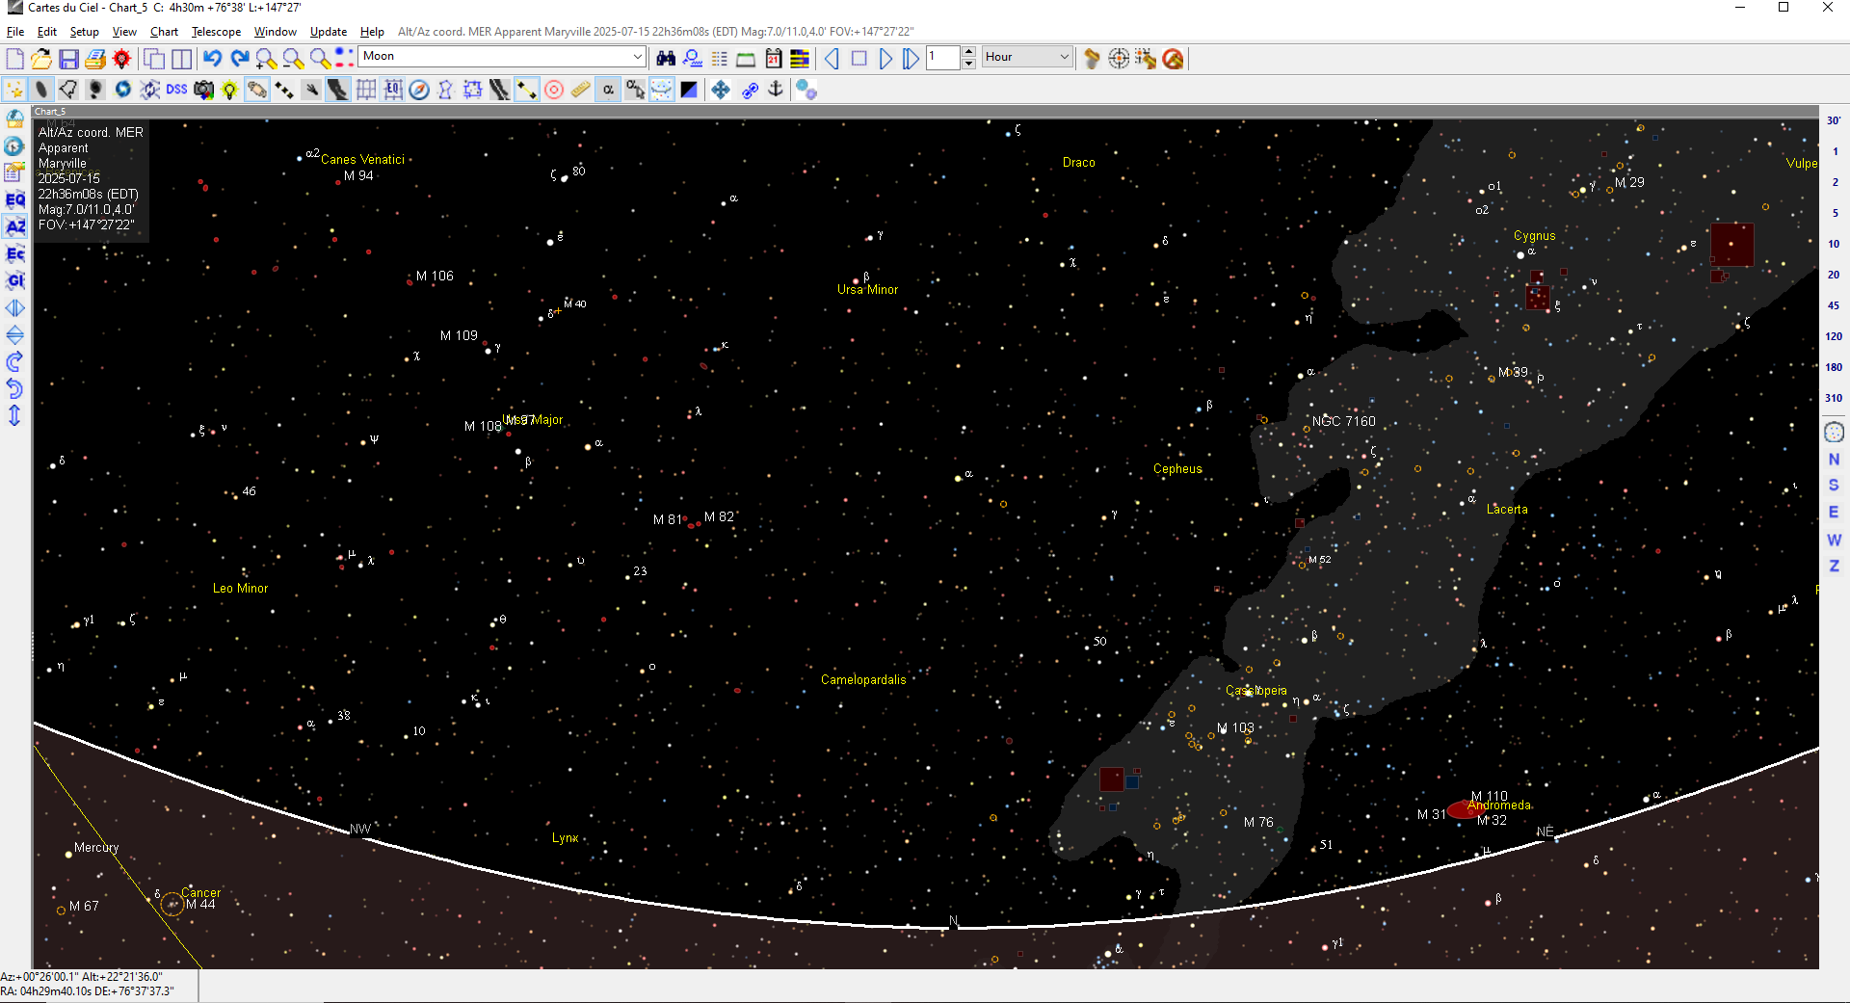
Just the Sky
Facing north from latitude 35.5N

Slide 9
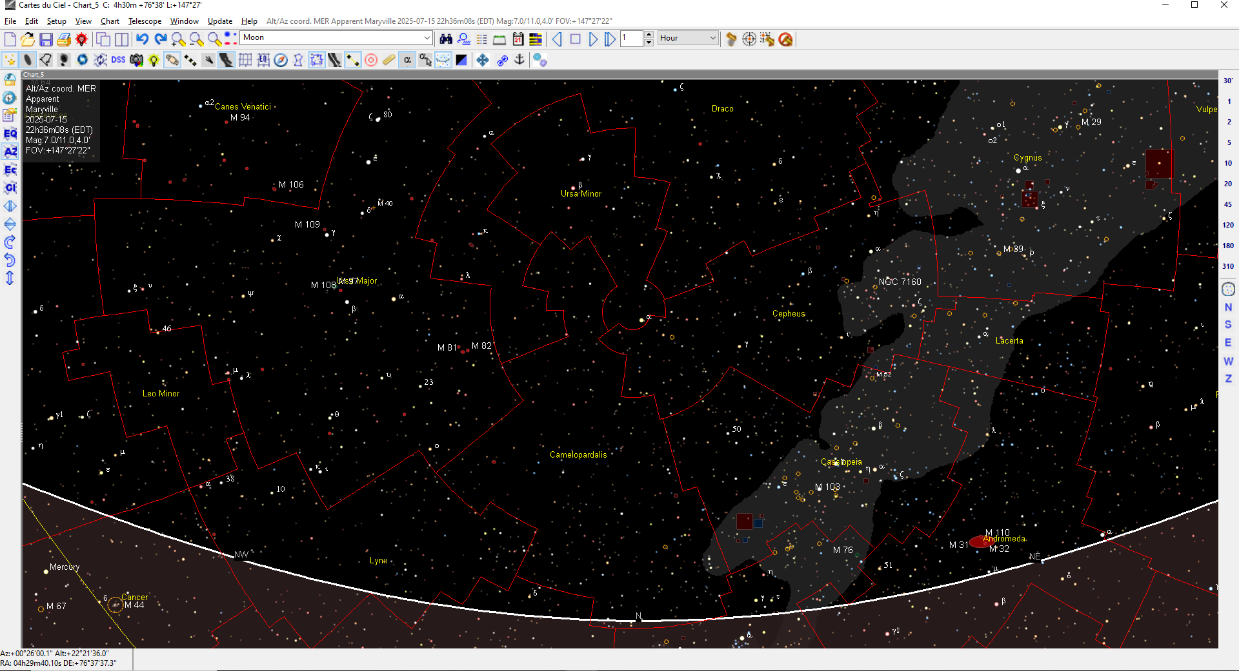
Add the Boundaries, the Constellations
The red north-South and East West line segments only.

Slide 10
How Does This Help?

Slide 11
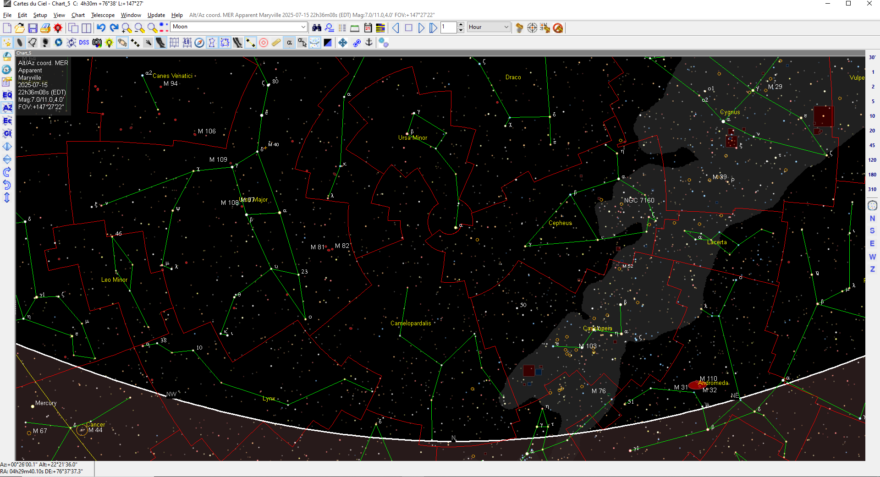
Add the Asterisms
The green connect the dot patterns.
Note the big and little bears!

Slide 12
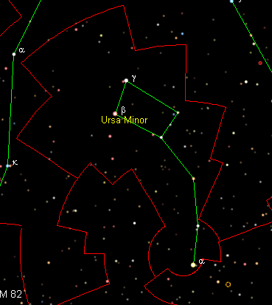
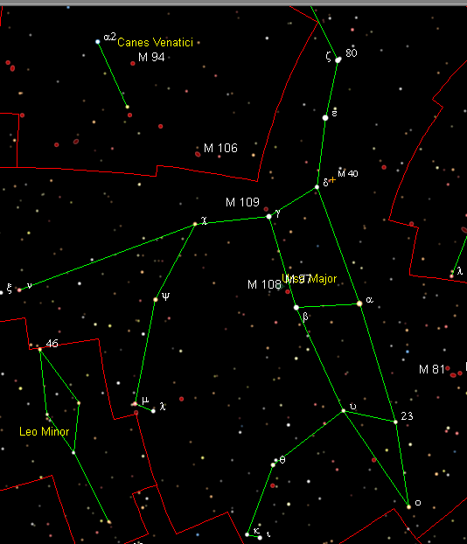
Add the Asterisms
The green connect the dot patterns.
Note the big and little bears!

Slide 13
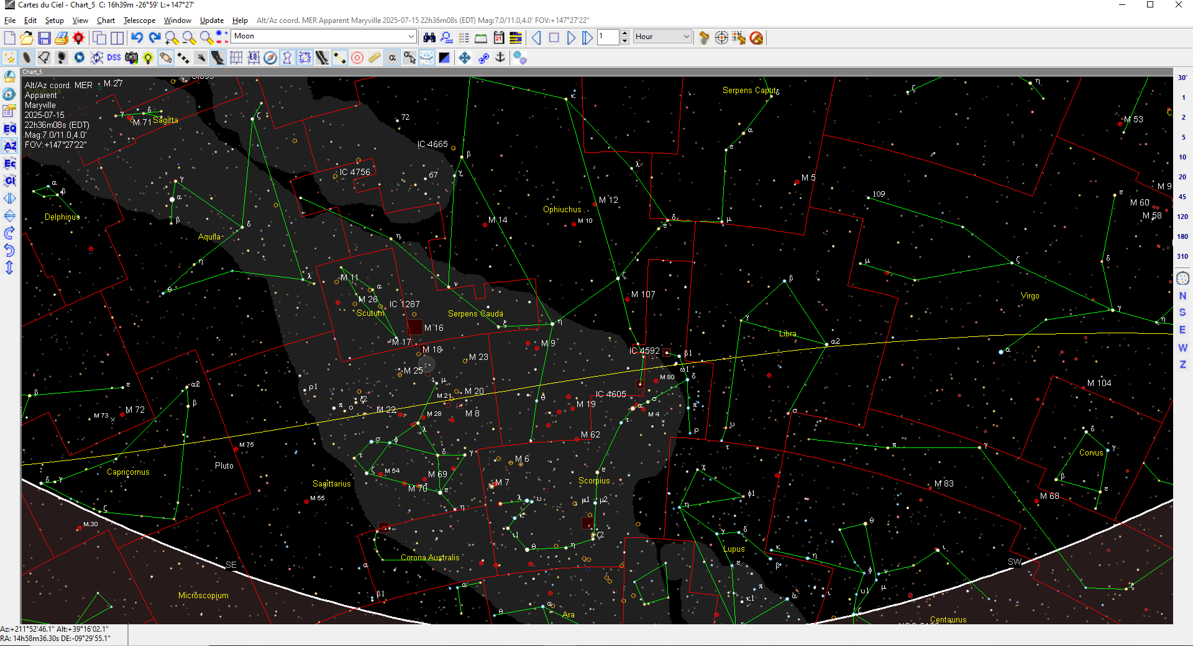
Prominent in Summer: Scorpio
Facing South and adding is one more line, Yellow Ecliptic.

Slide 14
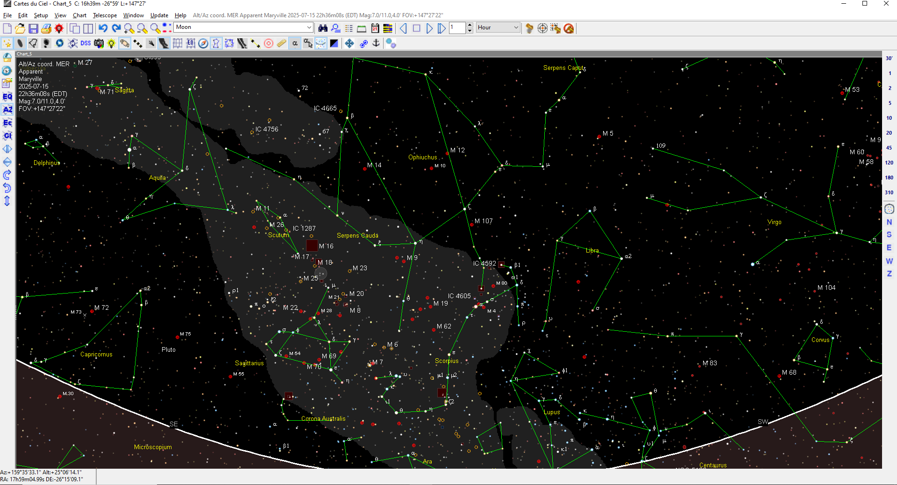
Prominent in Summer: Scorpio
Just the asterisms.
Notice the names: Virgo, Libra, Scorpio, Sagittarius and Capricornus

Slide 15
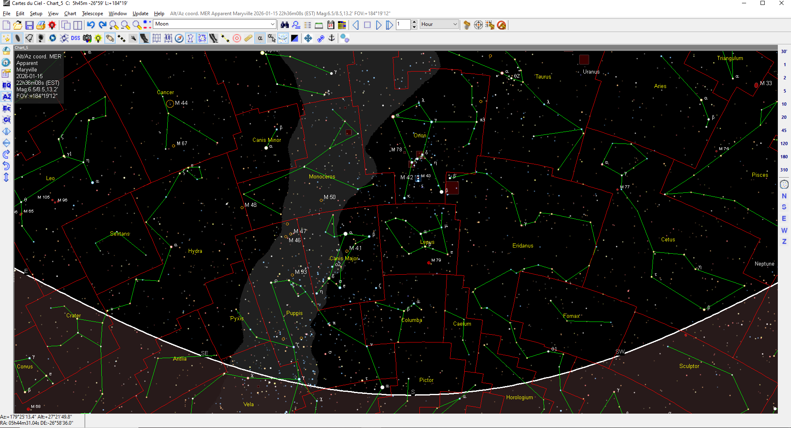
Prominent in Winter: Orion

Slide 16
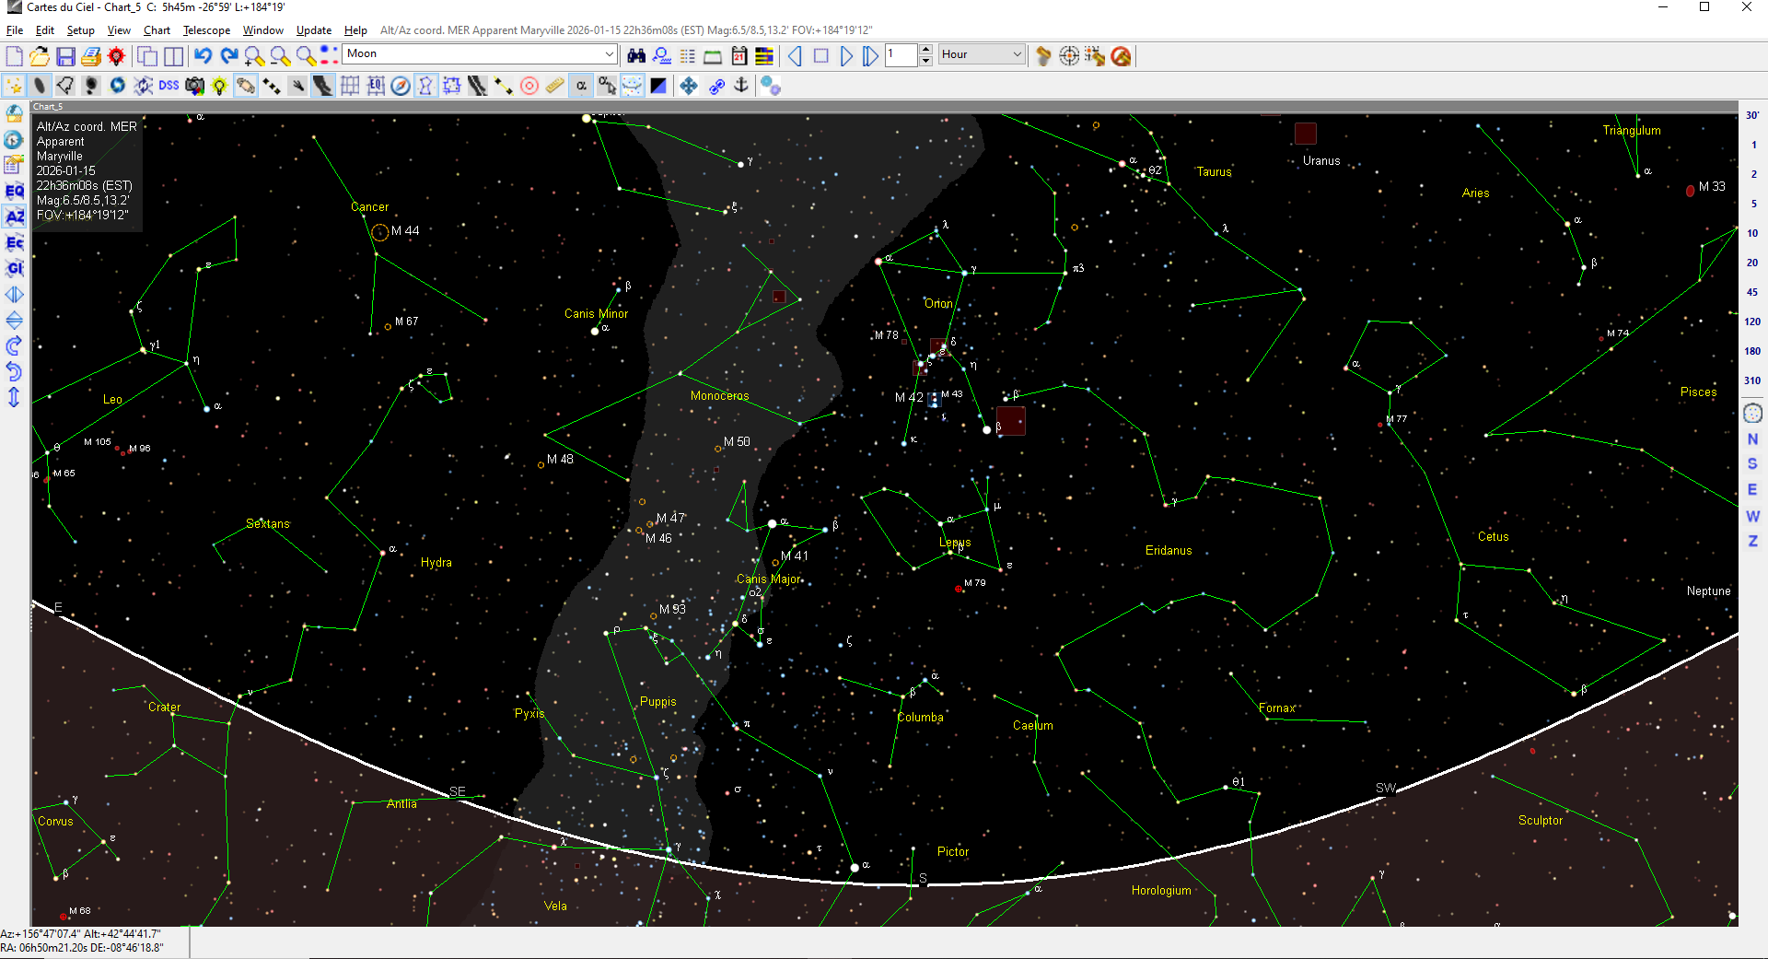
Prominent in Winter: Orion
Just the asterisms.
Notice the names: Aries Taurus, (Gemini), Cancer and Leo

Slide 17
Review
Asterism versus Constellation

Slide 18
Asterism “Connect the Dots”
Like highways
Constellations are boundaries
Like state lines

