Slide 1
November Sky at night
Notes from the
Smoky Mountain Astronomical Society
aka the SMAS
Notes:
Viewing Total Solar Eclipse of 2017

Slide 2
Remember the Zodiac?
Aries
Taurus
Gemini
Cancer
Leo
Virgo
Libra
Scorpio
(Ophiuchus)
Sagittarius
Capricorn
Aquarius
Pisces
Notes:
An eclipse is a general term for when something covers the view to something else. You can find a Bonnie Tyler song with another application of eclipse.
These can happened in the sky and that is what we will be talking about.
There are several kinds of eclipses. They are named inconsistently Sometimes they are named for the object doing the blocking and some times the object blocked.
We will talk about a few types to with emphasis on the August 21, 2017 total solar eclipse.

Slide 3
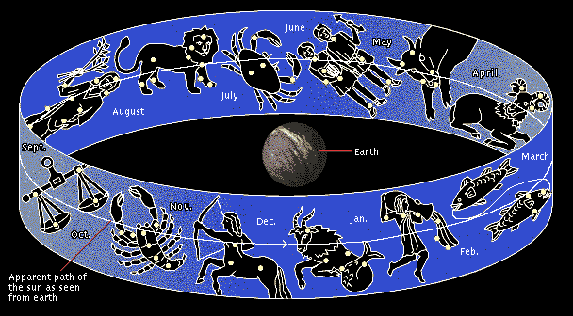
How Do We Remember the Zodiac?
The Ramble Twins Crab Liverish;Scaly Scorpions Are Good Water Fish.
Aries
Taurus
Gemini
Cancer
Leo
Virgo
Libra
Scorpio
(Ophiuchus)
Sagittarius
Capricorn
Aquarius
Pisces
Notes:
An eclipse is a general term for when something covers the view to something else. You can find a Bonnie Tyler song with another application of eclipse.
These can happened in the sky and that is what we will be talking about.
There are several kinds of eclipses. They are named inconsistently Sometimes they are named for the object doing the blocking and some times the object blocked.
We will talk about a few types to with emphasis on the August 21, 2017 total solar eclipse.

Slide 4
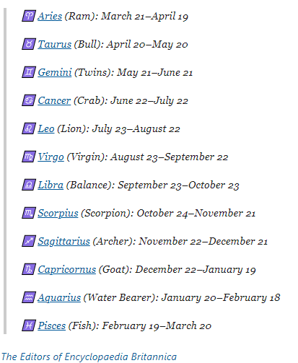
Dates of the Zodiac?
The Ramble Twins Crab Liverish;Scaly Scorpions Are Good Water Fish.
Notes:
An eclipse is a general term for when something covers the view to something else. You can find a Bonnie Tyler song with another application of eclipse.
These can happened in the sky and that is what we will be talking about.
There are several kinds of eclipses. They are named inconsistently Sometimes they are named for the object doing the blocking and some times the object blocked.
We will talk about a few types to with emphasis on the August 21, 2017 total solar eclipse.

Slide 5
November Sun is in Zodiac Where?
The Ramble Twins Crab Liverish;Scaly Scorpions Are Good Water Fish.
Notes:
An eclipse is a general term for when something covers the view to something else. You can find a Bonnie Tyler song with another application of eclipse.
These can happened in the sky and that is what we will be talking about.
There are several kinds of eclipses. They are named inconsistently Sometimes they are named for the object doing the blocking and some times the object blocked.
We will talk about a few types to with emphasis on the August 21, 2017 total solar eclipse.

Slide 6
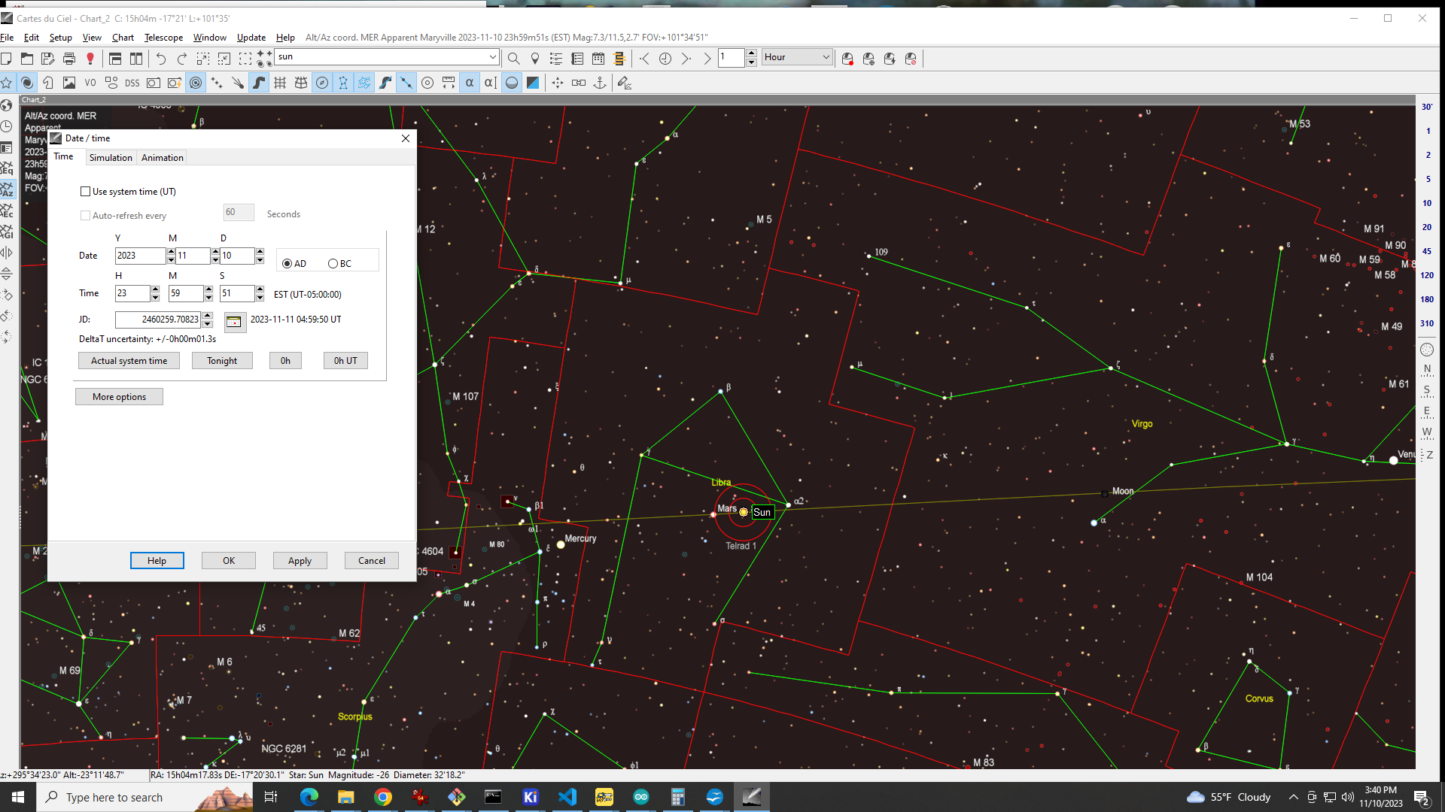
2023 Dates of the Zodiac!
Sun is in Libra
The Ramble Twins Crab Liverish;Scaly Scorpions Are Good Water Fish.
Notes:
An eclipse is a general term for when something covers the view to something else. You can find a Bonnie Tyler song with another application of eclipse.
These can happened in the sky and that is what we will be talking about.
There are several kinds of eclipses. They are named inconsistently Sometimes they are named for the object doing the blocking and some times the object blocked.
We will talk about a few types to with emphasis on the August 21, 2017 total solar eclipse.

Slide 7
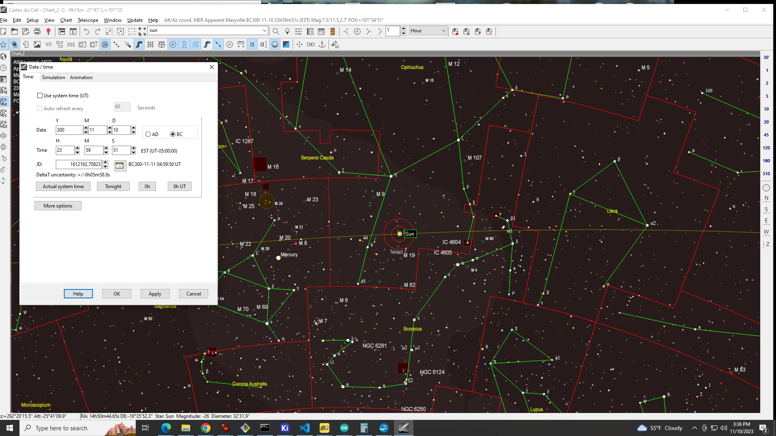
300 BCE Dates of the Zodiac!
Sun is above Scorpius
The Ramble Twins Crab Liverish;Scaly Scorpions Are Good Water Fish.
Notes:
An eclipse is a general term for when something covers the view to something else. You can find a Bonnie Tyler song with another application of eclipse.
These can happened in the sky and that is what we will be talking about.
There are several kinds of eclipses. They are named inconsistently Sometimes they are named for the object doing the blocking and some times the object blocked.
We will talk about a few types to with emphasis on the August 21, 2017 total solar eclipse.

Slide 8
Reflect Just How Bad Astrology Is.
Not only can Astrologers not predict the future
they CAN NOT predict the present!
The Ramble Twins Crab Liverish;Scaly Scorpions Are Good Water Fish.
Notes:
An eclipse is a general term for when something covers the view to something else. You can find a Bonnie Tyler song with another application of eclipse.
These can happened in the sky and that is what we will be talking about.
There are several kinds of eclipses. They are named inconsistently Sometimes they are named for the object doing the blocking and some times the object blocked.
We will talk about a few types to with emphasis on the August 21, 2017 total solar eclipse.

Slide 9
Sun in Libra, What is Night Sky?
At Sunset? At Midnight?
The Ramble Twins Crab Liverish;Scaly Scorpions Are Good Water Fish.
Aries
Taurus
Gemini
Cancer
Leo
Virgo
Libra
Scorpio
(Ophiuchus)
Sagittarius
Capricorn
Aquarius
Pisces
Notes:
An eclipse is a general term for when something covers the view to something else. You can find a Bonnie Tyler song with another application of eclipse.
These can happened in the sky and that is what we will be talking about.
There are several kinds of eclipses. They are named inconsistently Sometimes they are named for the object doing the blocking and some times the object blocked.
We will talk about a few types to with emphasis on the August 21, 2017 total solar eclipse.

Slide 10
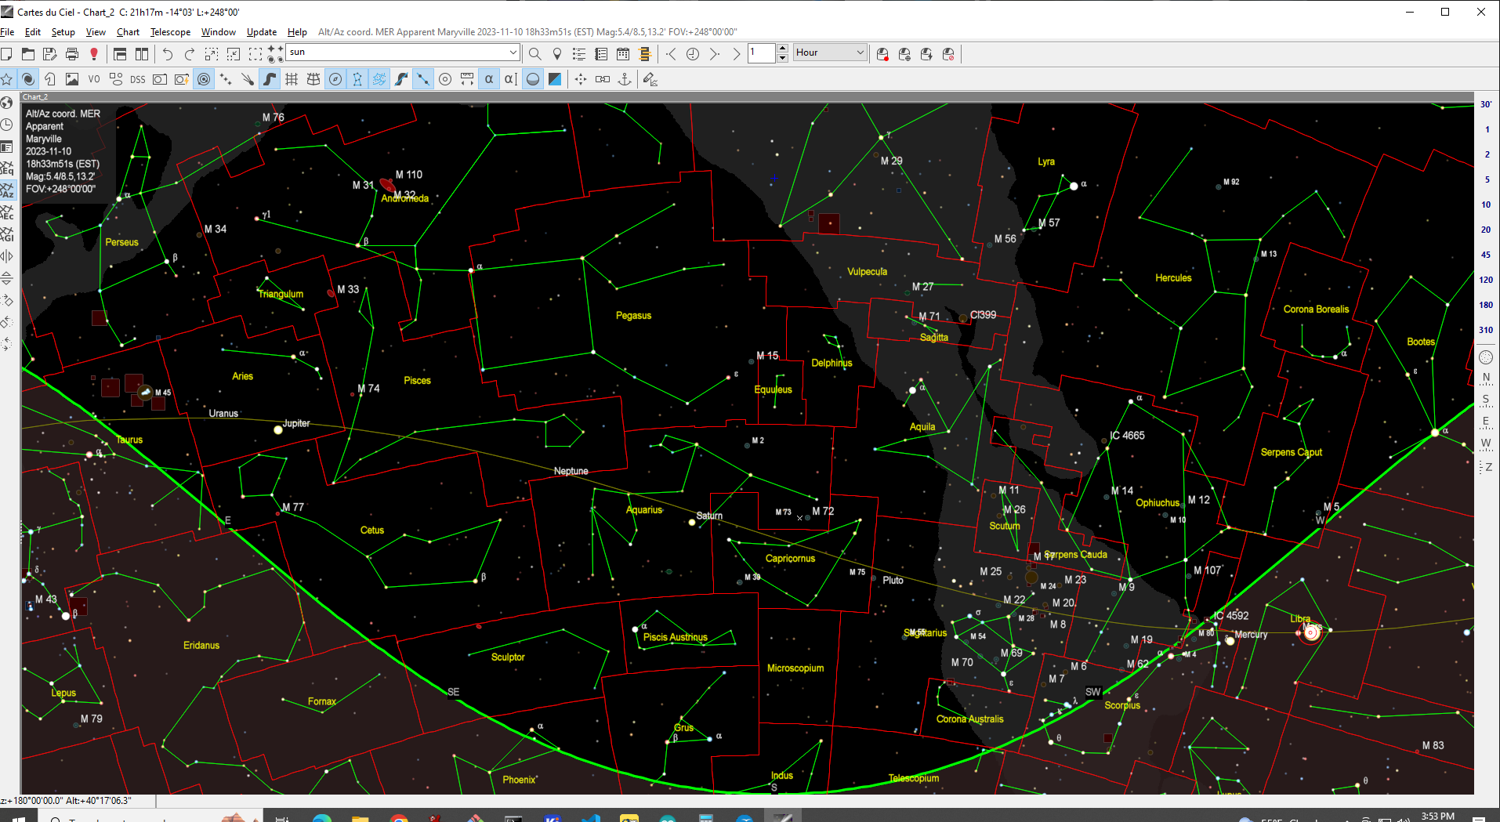
At Sunset
Capricornus and Aquarius are to the south with Saturn.
Further East is Pisces, Even Further is Aries with Jupiter.
Aries
Taurus
Gemini
Cancer
Leo
Virgo
Libra
Scorpio
(Ophiuchus)
Sagittarius
Capricorn
Aquarius
Pisces
Notes:
An eclipse is a general term for when something covers the view to something else. You can find a Bonnie Tyler song with another application of eclipse.
These can happened in the sky and that is what we will be talking about.
There are several kinds of eclipses. They are named inconsistently Sometimes they are named for the object doing the blocking and some times the object blocked.
We will talk about a few types to with emphasis on the August 21, 2017 total solar eclipse.

Slide 11
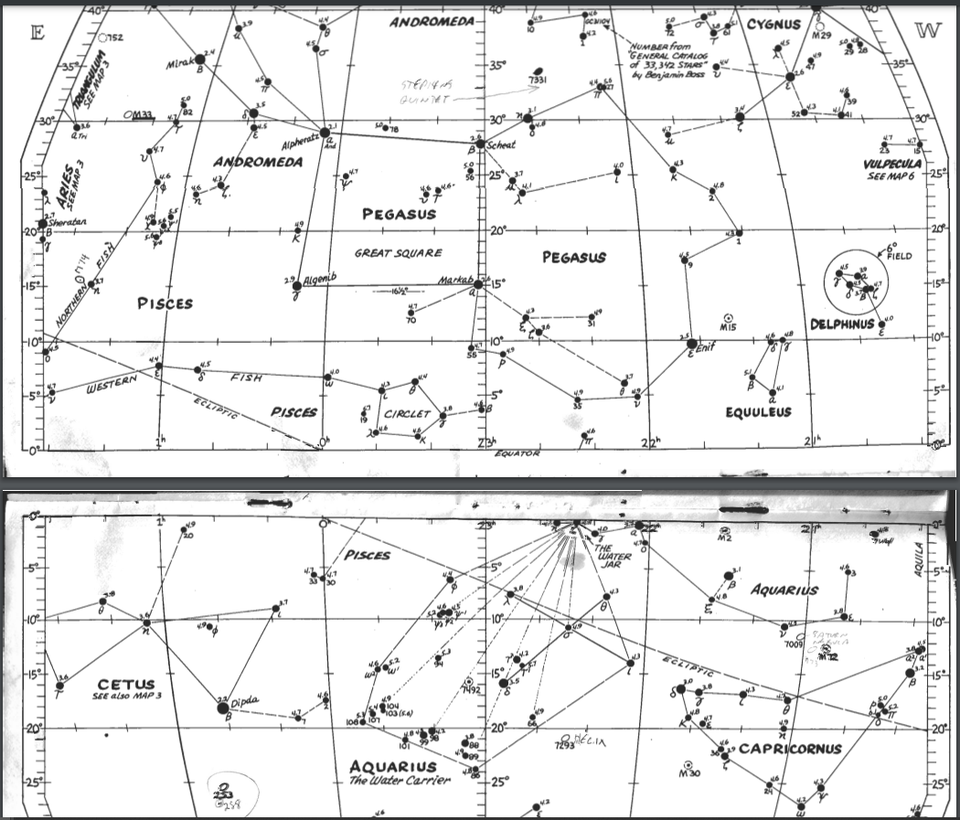
Edmond Mag 5 Atlas
https://www.texasastro.org/SIG/PDF/Mag5StarAtlas.pdf
Pegasus
Great square of
Aquarius
South west, busy with faint stars
Pisces
Western fish is south, Northern fish is east
Notes:
An eclipse is a general term for when something covers the view to something else. You can find a Bonnie Tyler song with another application of eclipse.
These can happened in the sky and that is what we will be talking about.
There are several kinds of eclipses. They are named inconsistently Sometimes they are named for the object doing the blocking and some times the object blocked.
We will talk about a few types to with emphasis on the August 21, 2017 total solar eclipse.

Slide 12
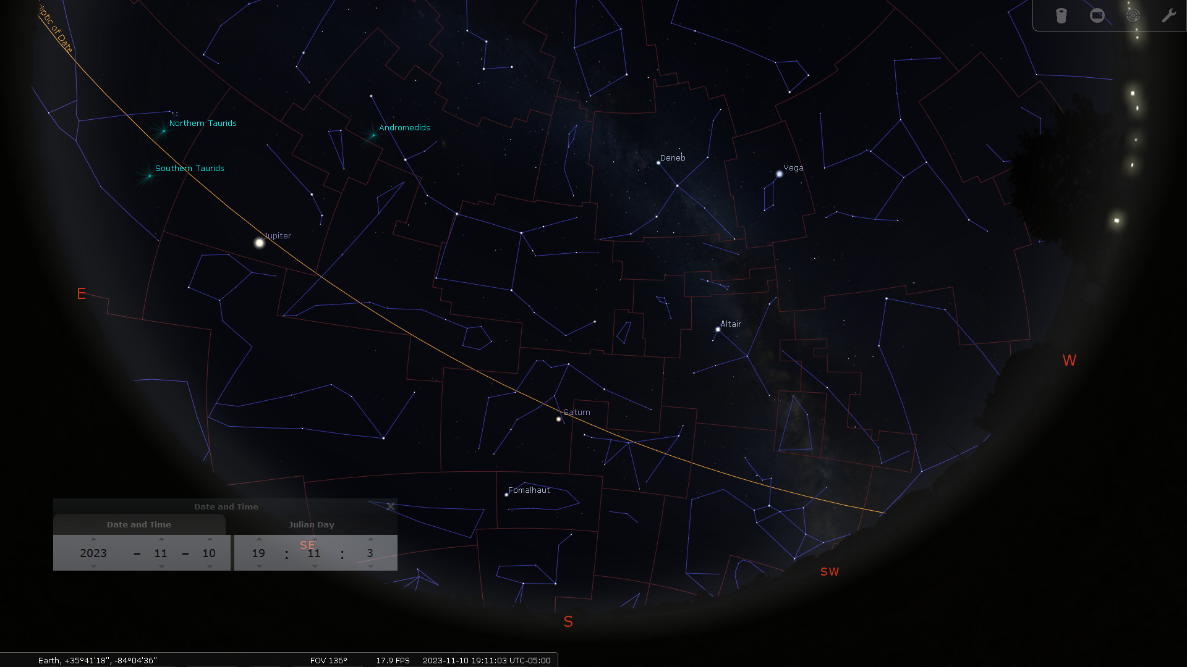
Stellarium
Free at: https://stellarium.org/
Pegasus
Great square of
Aquarius
South west, busy with faint stars
Pisces
Western fish is south, Northern fish is east
Notes:
An eclipse is a general term for when something covers the view to something else. You can find a Bonnie Tyler song with another application of eclipse.
These can happened in the sky and that is what we will be talking about.
There are several kinds of eclipses. They are named inconsistently Sometimes they are named for the object doing the blocking and some times the object blocked.
We will talk about a few types to with emphasis on the August 21, 2017 total solar eclipse.

Slide 13
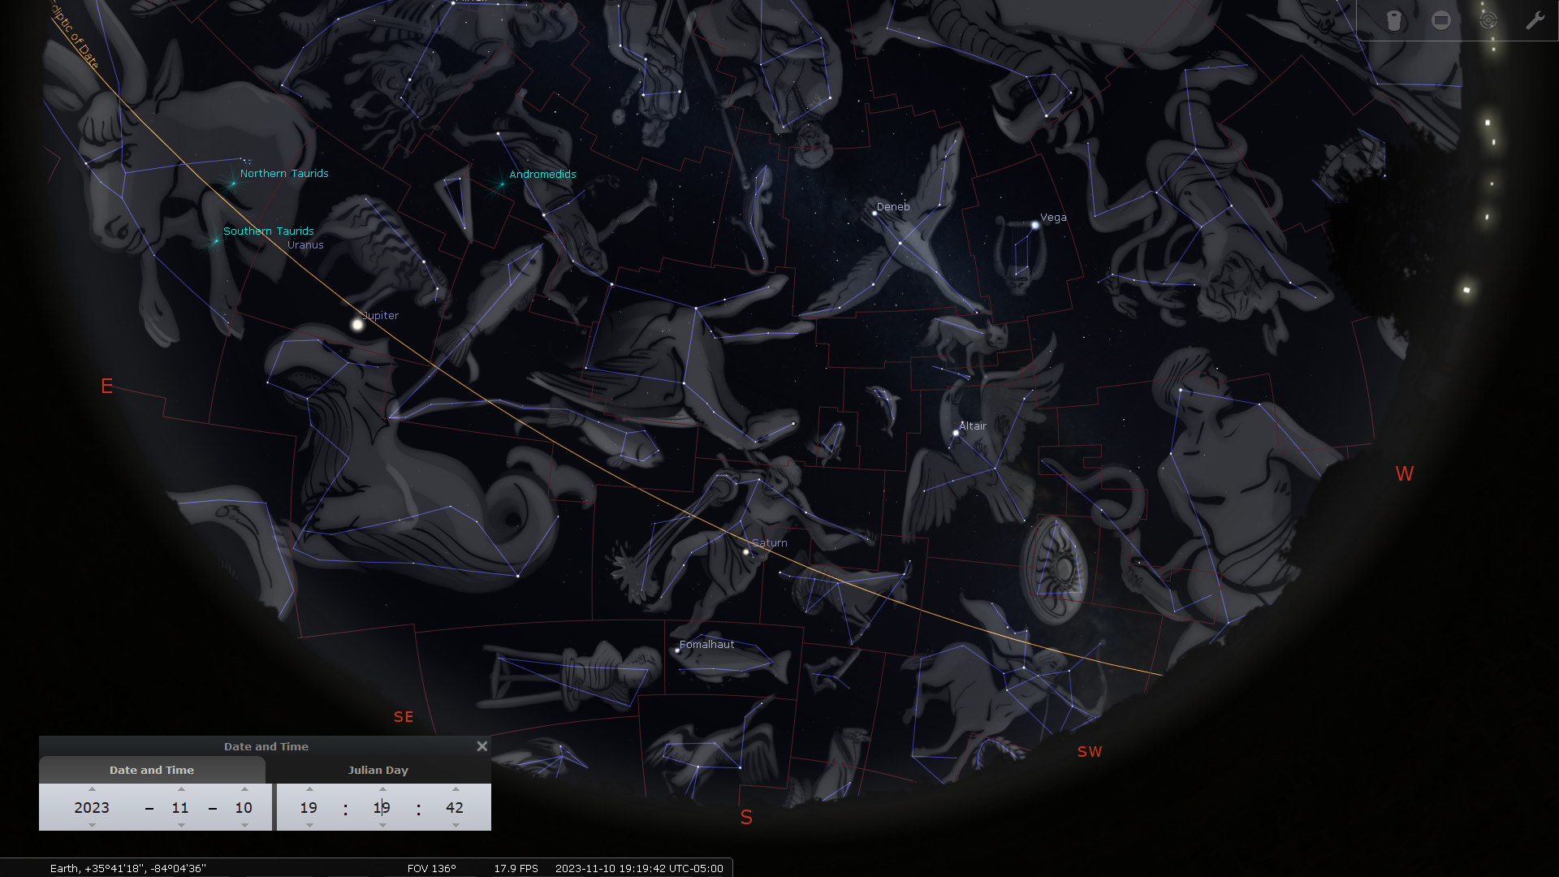
Stellarium
With Art Work!
Pegasus
Great square of
Aquarius
South west, busy with faint stars
Pisces
Western fish is south, Northern fish is east
Notes:
An eclipse is a general term for when something covers the view to something else. You can find a Bonnie Tyler song with another application of eclipse.
These can happened in the sky and that is what we will be talking about.
There are several kinds of eclipses. They are named inconsistently Sometimes they are named for the object doing the blocking and some times the object blocked.
We will talk about a few types to with emphasis on the August 21, 2017 total solar eclipse.

Slide 14
How Do We Remember the Zodiac?
The Ramble Twins Crab Liverish;Scaly Scorpions Are Good Water Fish.
Aries
Taurus
Gemini
Cancer
Leo
Virgo
Libra
Scorpio
(Ophiuchus)
Sagittarius
Capricorn
Aquarius
Pisces
Notes:
An eclipse is a general term for when something covers the view to something else. You can find a Bonnie Tyler song with another application of eclipse.
These can happened in the sky and that is what we will be talking about.
There are several kinds of eclipses. They are named inconsistently Sometimes they are named for the object doing the blocking and some times the object blocked.
We will talk about a few types to with emphasis on the August 21, 2017 total solar eclipse.

Slide 15
Review
Flying horse is upside down and facing west.
Aquarius is under the flying horse a bit west.
Western Pisces is under flying horse
Norther Pisces is east of flying horse.
Notes:
Review.
Everyone together lets read this.
Any questions?
Have I confused anyone?

