Slide 1
SMAS Photos M31
What is in those photos
by
Lee Erickson

Slide 2
Globular Cluster Photos
Members Early SeeStar Photos
Peggy Burkman,
Tim Cox,
Gene Johnson,
and others

Slide 3
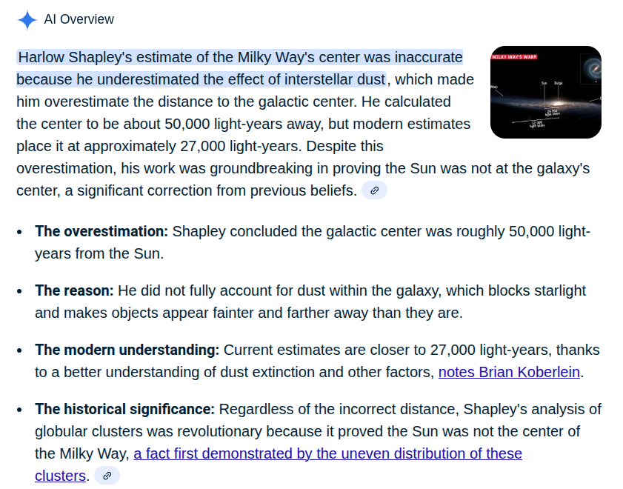
Shapley Estimates Size
IIRC, Asimov says first OVER estimate of size of “Universe”

Slide 4
Review
SMAS members have captured
Dust Lanes
OB Association
Globular Clusters?

