Slide 1
Drilling Machine SOP

Slide 2
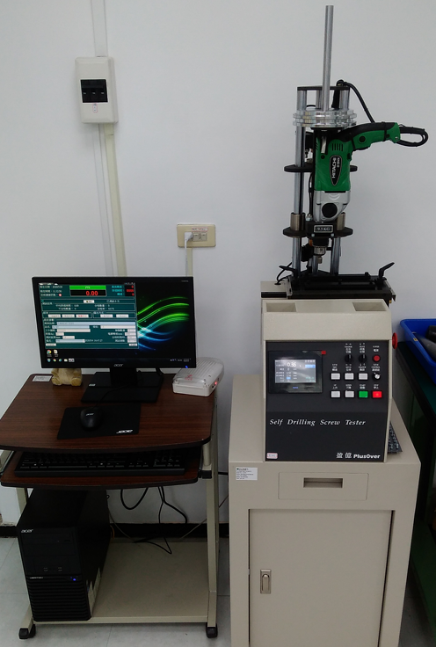
鑽尾機之外觀
B
粗略分辨，鑽尾機為以下幾個部分所組成
A: 遙控控制用電腦
B: 電控板手與測試座
C: 手動控制面板
D: 機台內部電路設備
D部分非實驗室操作員的作業範圍，後續僅針對B、C部分編寫操作文件
C
A
D

Slide 3
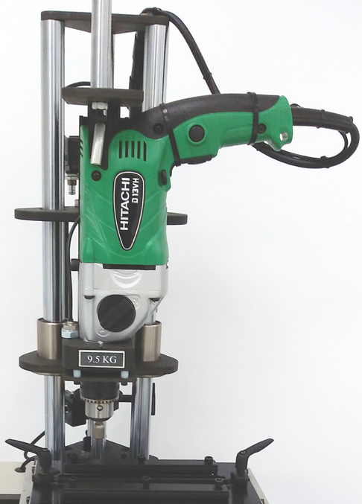
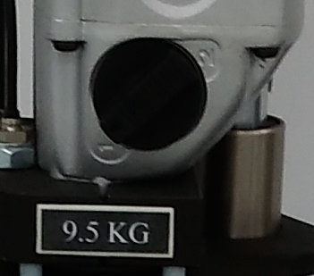
1. 確認機台設置
確認螺絲尺寸與表面處理之種類，此據將影響荷重、轉速與測試時間設定值
W為放置砝碼之載座。 根據下頁table，確認確認螺絲尺寸與相對應之軸向荷重Axial Loading 因為機台本身已有重量，進行配重時要一併算入 故，配重計算公式為 Axial Loading = W + A 放置砝碼時，因單位換算之緣故無法做到十分精準，故僅取最接近的數值
G為調整轉速開關，僅有1800 RPM與2500 RPM兩種選項。 根據下頁table，確認螺絲尺寸與相對應之轉速，機台標示1為1800 RPM，2為2500 RPM
W
G
A

Slide 4
1. 確認機台設置 SAE J78
According to SAE J78, machine must be setup with following table:
Nominal Size | Plate Thickness* Unit: inch |  | Axial Loading** Unit: lb |  |  | Drilling Time*** Unit: sec
 | Max | Min | A | B | C
4 | 0.068 | 0.062 | 25 | 30 | 40 | 2
6 | 0.068 | 0.062 | 30 | 35 | 45 | 2.5
8 | 0.068 | 0.062 | 30 | 35 | 45 | 3
10 | 0.068 | 0.062 | 35 | 40 | 50 | 3.5
12 | 0.068 | 0.062 | 45 | 50 | 60 | 4
1/4 | 0.068 | 0.062 | 45 | 50 | 60 | 5
*: Test plates shall be low carbon, cold rolled steel having a hardness of Rockwell B60-85. **: Axial loads are varied to offset the detrimental effects on drilling capability created by finishes applied to screws in accordance with the following: A — Axial loads tabulated shall apply to plain, oiled, and commercial phosphate coating and cadmium and zinc platings up to 0.0003 in thickness. B — Axial loads tabulated shall apply special electroplated finishes exceeding 0.0003 in thickness and to special coatings, such as thread sealing hot melts, etc. C — Axial loads tabulated shall apply to chromium finish. ***: Tool speed shall be 2500 rpm for screw sizes No. 4 through No. 10. Tool speed of 1800 rpm is recommended for screw sizes No. 12 and 1/4; however, 2500 rpm may be used provided care is exercised to minimize influence of high heat buildup due to surface speed.

Slide 5
1. 機台設置 by IFI-504
According to IFI 504, machine must be setup with following table:
Nominal Size | Plate Thickness* Unit: inch |  | Axial Loading** Unit: lb |  |  | Drilling Time*** Unit: sec
 | Max | Min | A | B | C
4 | 0.068 | 0.062 | 25 | 30 | 40 | 2
6 | 0.068 | 0.062 | 30 | 35 | 45 | 2.5
8 | 0.068 | 0.062 | 30 | 35 | 45 | 3
10 | 0.068 | 0.062 | 35 | 40 | 50 | 3.5
12 | 0.068 | 0.062 | 45 | 50 | 60 | 4
1/4 | 0.068 | 0.062 | 45 | 50 | 60 | 5
*: Test plates shall be low carbon, cold rolled steel having a hardness of Rockwell B60-85. **: Axial loads are varied to offset the detrimental effects on drilling capability created by finishes applied to screws in accordance with the following: A — Axial loads tabulated shall apply to plain, oiled, and commercial phosphate coating and cadmium and zinc platings up to 0.0003 in thickness. B — Axial loads tabulated shall apply special electroplated finishes exceeding 0.0003 in thickness and to special coatings, such as thread sealing hot melts, etc. C — Axial loads tabulated shall apply to chromium finish. ***: Tool speed shall be 2500 rpm for screw sizes No. 4 through No. 10. Tool speed of 1800 rpm is recommended for screw sizes No. 12 and 1/4; however, 2500 rpm may be used provided care is exercised to minimize influence of high heat buildup due to surface speed.

Slide 6
1. 機台設置 by IFI-113
According to IFI 113, machine must be setup with following table:
Nominal Size | Plate Thickness* Unit: inch |  | Axial Loading** Unit: lb |  |  | Drilling Time*** Unit: sec
 | Max | Min | A | B | C
4 | 0.068 | 0.062 | 25 | 30 | 40 | 2
6 | 0.068 | 0.062 | 30 | 35 | 45 | 2.5
8 | 0.068 | 0.062 | 30 | 35 | 45 | 3
10 | 0.068 | 0.062 | 35 | 40 | 50 | 3.5
12 | 0.068 | 0.062 | 45 | 50 | 60 | 4
1/4 | 0.068 | 0.062 | 45 | 50 | 60 | 5
*: Test plates shall be low carbon, cold rolled steel having a hardness of Rockwell B60-85. **: Axial loads are varied to offset the detrimental effects on drilling capability created by finishes applied to screws in accordance with the following: A — Axial loads tabulated shall apply to plain, oiled, and commercial phosphate coating and cadmium and zinc platings up to 0.0003 in thickness. B — Axial loads tabulated shall apply special electroplated finishes exceeding 0.0003 in thickness and to special coatings, such as thread sealing hot melts, etc. C — Axial loads tabulated shall apply to chromium finish. ***: Tool speed shall be 2500 rpm for screw sizes No. 4 through No. 10. Tool speed of 1800 rpm is recommended for screw sizes No. 12 and 1/4; however, 2500 rpm may be used provided care is exercised to minimize influence of high heat buildup due to surface speed.

