Slide 1
Label Approval Process
© 2015 Endries International, Inc., a Wolseley Industrial Group company

Slide 2
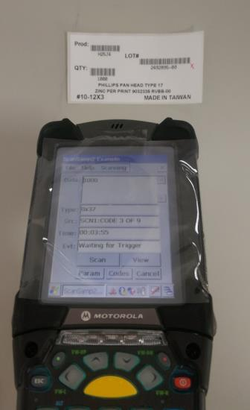
Label Approval Process
Length
1. Label has to meet Endries requirement on dimension.
Length: 4”~6”
Width: 2”~4”
2. B has to meet A, and C has to be CODE 3 of 9.
3. Prod, QTY and LOT# must be successfully scanned on every label.
4. 3 pieces have to be scanned at least.
Width
A
B
C

Slide 3
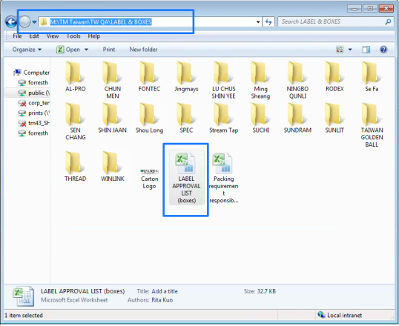
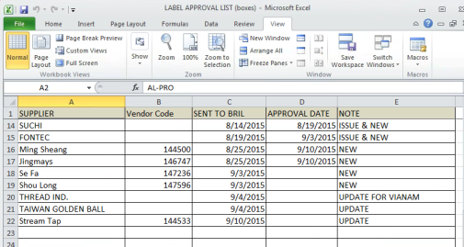
Label Approval Process
1. QA team members scan labels on suppliers who are responsible on.
2. QA team members notice suppliers that labels are approved.
3. All approvals are stored and managed in Taiwan folder at M driver.

