Slide 1
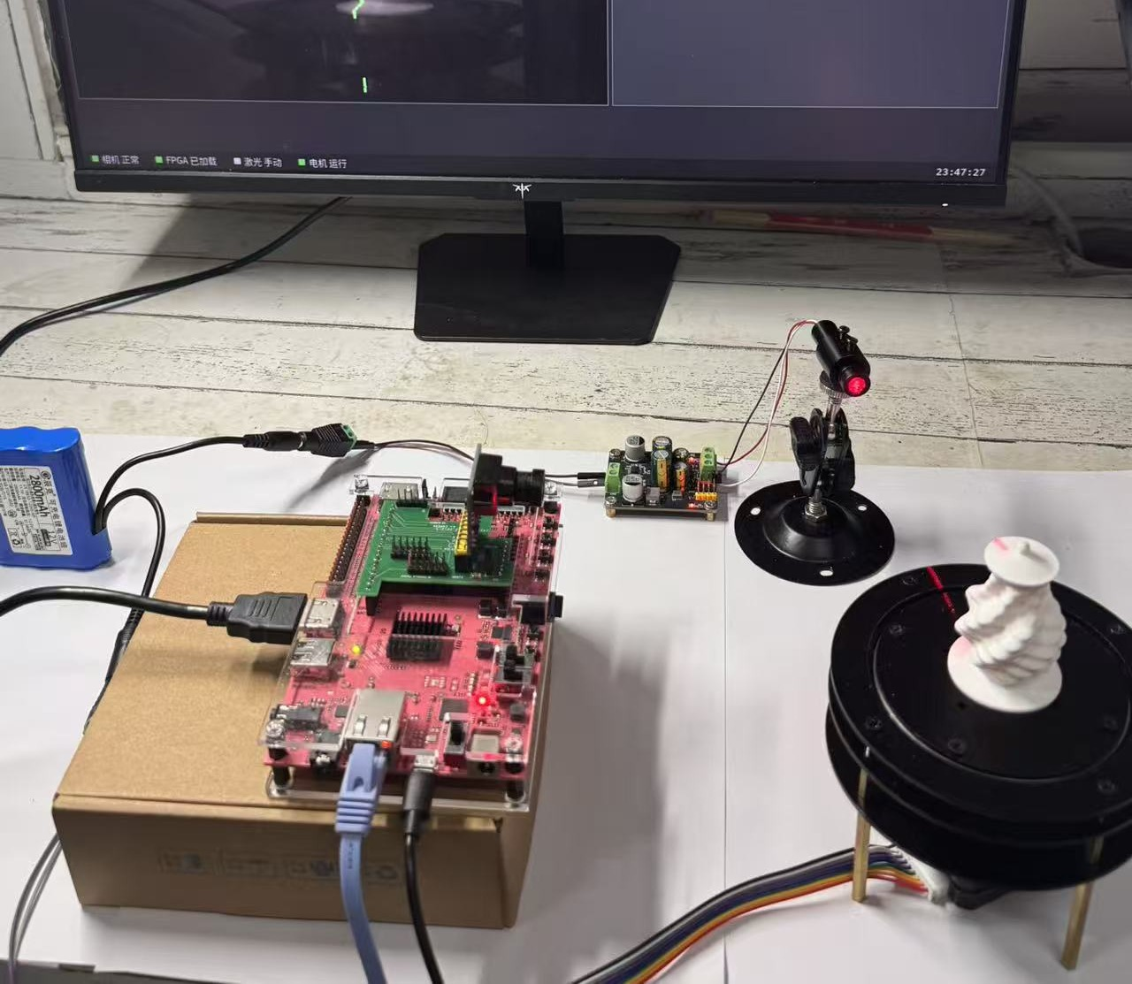

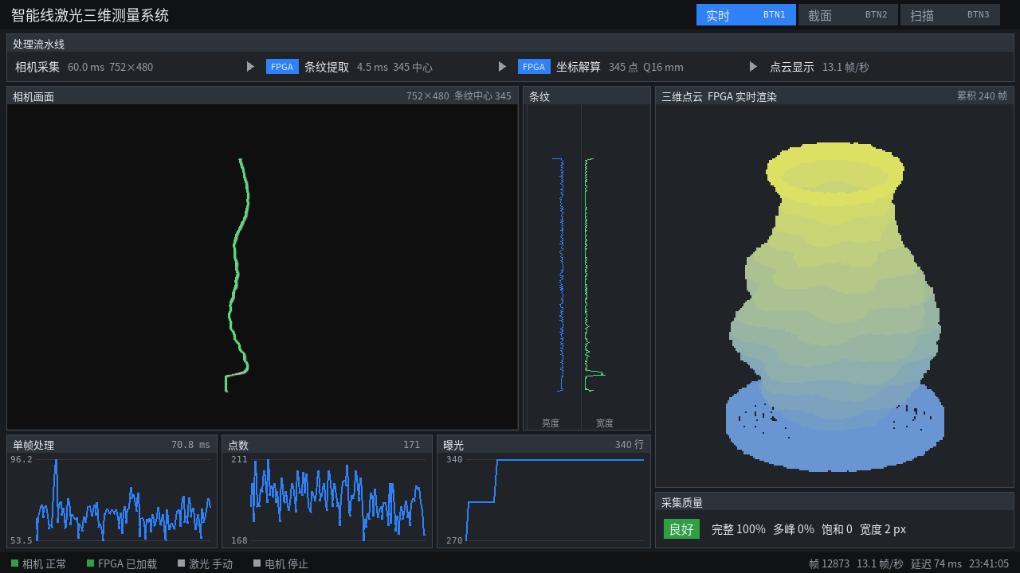
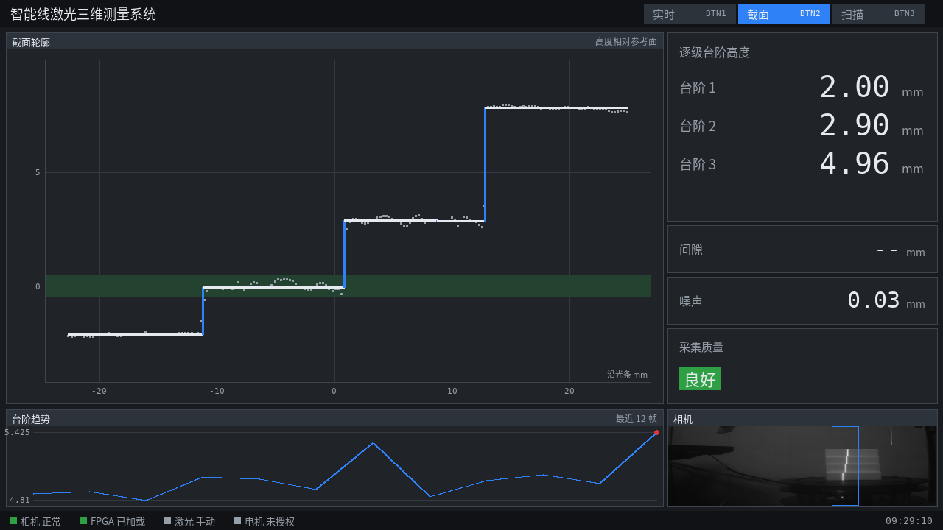
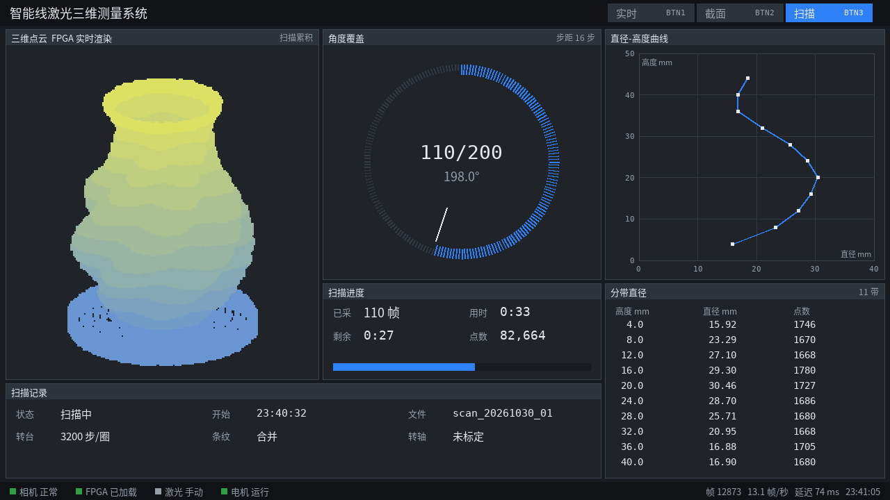
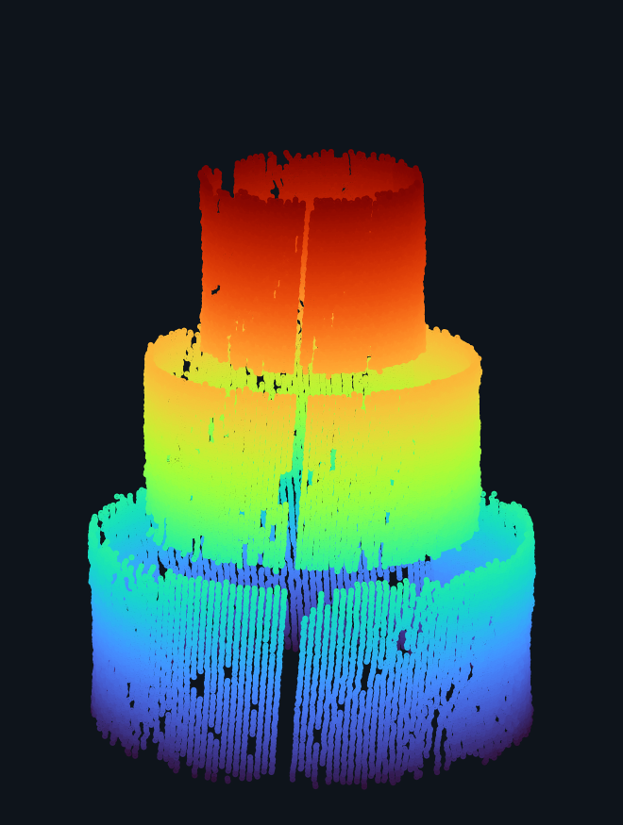
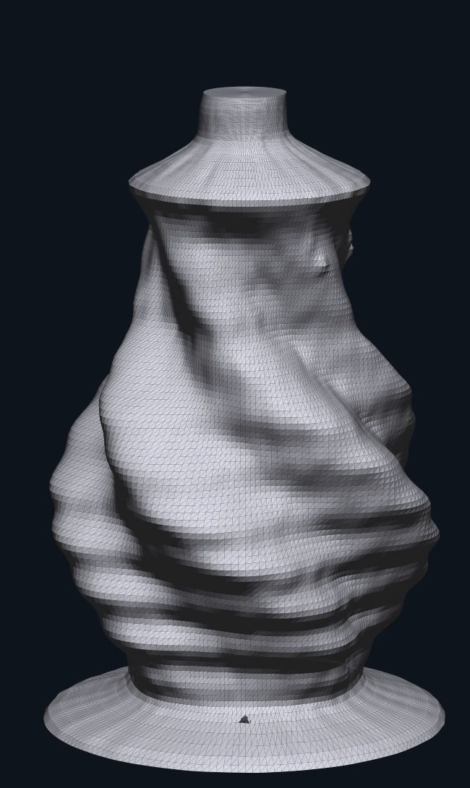
智能线激光
三维测量系统
PYNQ-Z2 单板运行
752 × 480 灰度输入
作品简介
面向台阶、阶梯轴和3D打印件的非接触轮廓与尺寸检测。单块PYNQ-Z2完成条纹提取、三维重建与HDMI显示，支持板载按键操作，并完整保存原图、观测和XYZ数据。
板上实测：PYNQ-Z2
创
新
设
计
测
PL图像处理能力
BTN1 实时
26.5
帧 / 秒
试
逐帧处理，无错误包
激光中心
定点三维坐标
实时点云
同帧质量状态
条纹中心误差中位数
0.02 像素
结
已知中心位置的合成条纹
一圈扫描：200视角 / 约2.5分钟 / 约6.6万个点
果
测量项目 | 实测结果
台阶标准值 | 2 / 3 / 5 mm
台阶实测值 | 2.00 / 2.90 / 4.96 mm
阶梯圆柱直径偏差 | −0.32 to −0.10 mm
花瓶颈部直径偏差 | −0.27 to +0.05 mm
BTN2 截面
台阶高度
间隙提示
参考面与噪声
测量变化趋势
直径偏差为扫描值减卡尺读数。
阶梯圆柱结果用于标定复核。
FPGA实现资源
LUT 73.5% FF 47.8%
BRAM 78.9% DSP 60.9%
BTN3 扫描
WNS +0.230 ns 片上功耗约2.37 W
角度进度
点云累积
结果导出
原图 / XYZ保存
阶梯圆柱实测点云
花瓶点云重建表面
Notes:
Revision: compact content within the official template. Native UI images are archived software renders, not a new board run. Step nominal heights are 2/3/5 mm; displayed values 2.00/2.90/4.96 mm from section_page.png. PL 26.5 frames/s is camera image processing, separate from the 200-view scan example. Resource, timing and measurement numbers retained from the design report. No school, team or member identity added. Sources: report/design_report.pdf pp.1,23,24; docs/media/readme_media_sources.json. Two result thumbnails show scan data, not the STL model.

Slide 2
Intelligent Line-Laser
3D Measurement System
Single-board operation
752 × 480 grayscale input
INTRODUCTION
Non-contact inspection of stepped parts, shafts and 3D prints. One PYNQ-Z2 extracts stripes, reconstructs 3D and drives HDMI. On-board buttons control operation; raw frames and XYZ are saved for review.
On-board test: PYNQ-Z2
C
R
E
A
T
I
V
E
D
E
S
I
G
N
R
PL image processing
BTN1 LIVE
E
26.5
frames/s
S
Frame-by-frame processing, zero packet errors
Laser centres
Fixed-point XYZ
Live cloud
Per-frame quality
U
Median stripe-centre error
0.02 px
L
Synthetic stripes with known centre positions
T
360° scan: 200 views / ≈2.5 min / ≈66k points
S
Measurement | Result
Steps, nominal | 2 / 3 / 5 mm
Steps, measured | 2.00 / 2.90 / 4.96 mm
Cylinder diameter error | −0.32 to −0.10 mm
Vase neck error | −0.27 to +0.05 mm
BTN2 SECTION
Step heights
Gap indication
Reference / noise
Measurement trend
Signed diameter errors against caliper readings.
Cylinder results are calibration rechecks.
Implemented FPGA resources
LUT 73.5% FF 47.8%
BRAM 78.9% DSP 60.9%
BTN3 SCAN
WNS +0.230 ns On-chip power ≈2.37 W
Angle progress
Cloud accumulation
Data export
Raw / XYZ files
Cylinder scan cloud
Vase scan mesh
Notes:
Revision: compact content within the official template. Native UI images are archived software renders, not a new board run. Step nominal heights are 2/3/5 mm; displayed values 2.00/2.90/4.96 mm from section_page.png. PL 26.5 frames/s is camera image processing, separate from the 200-view scan example. Resource, timing and measurement numbers retained from the design report. No school, team or member identity added. Sources: report/design_report.pdf pp.1,23,24; docs/media/readme_media_sources.json. Two result thumbnails show scan data, not the STL model.

