Slide 1
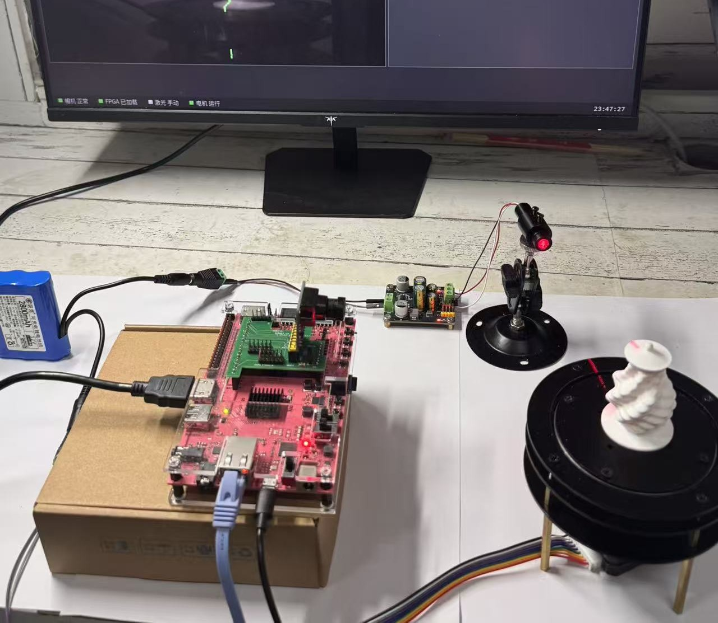

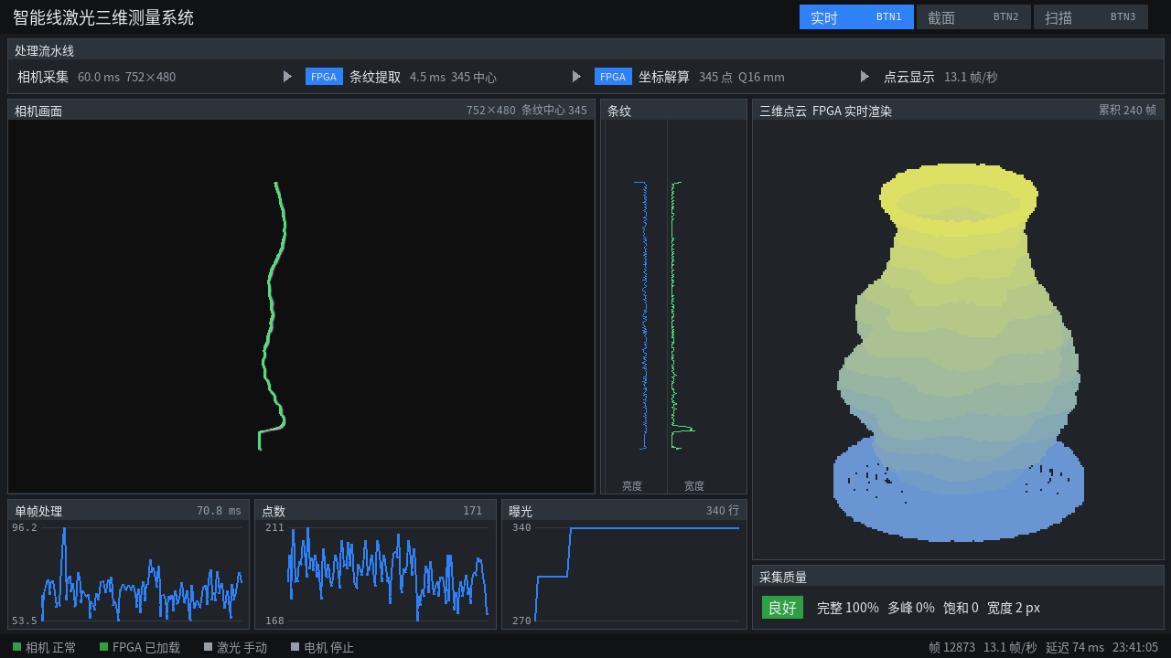
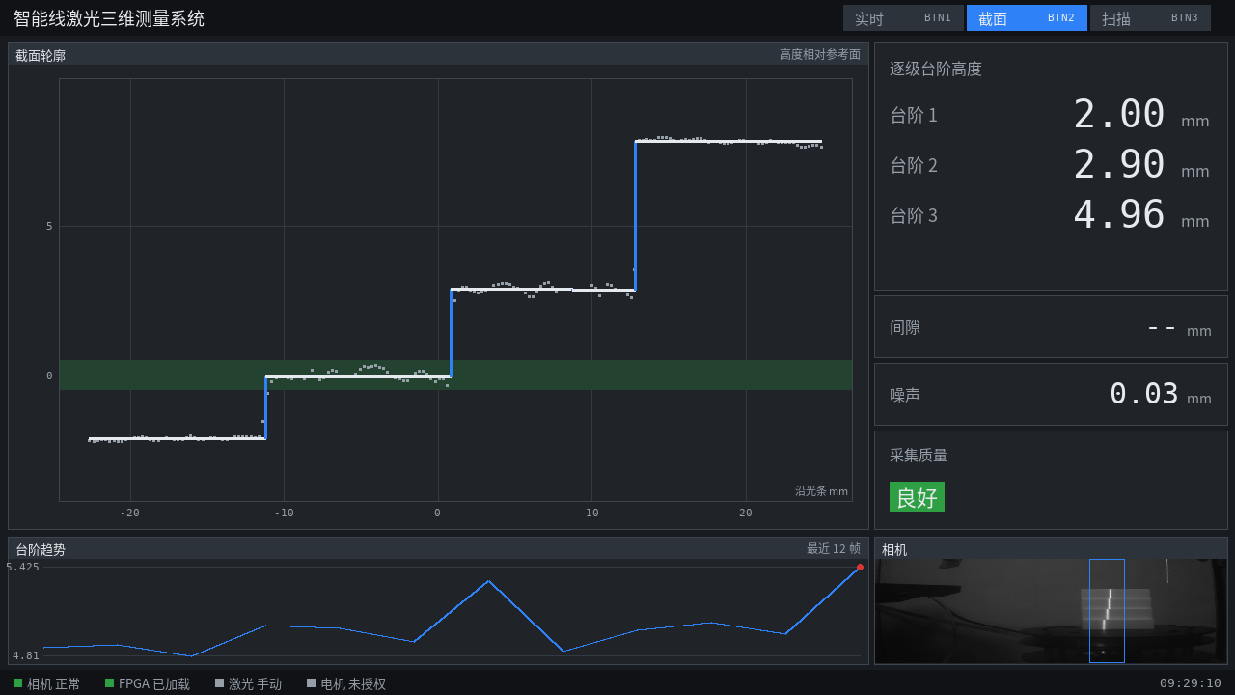
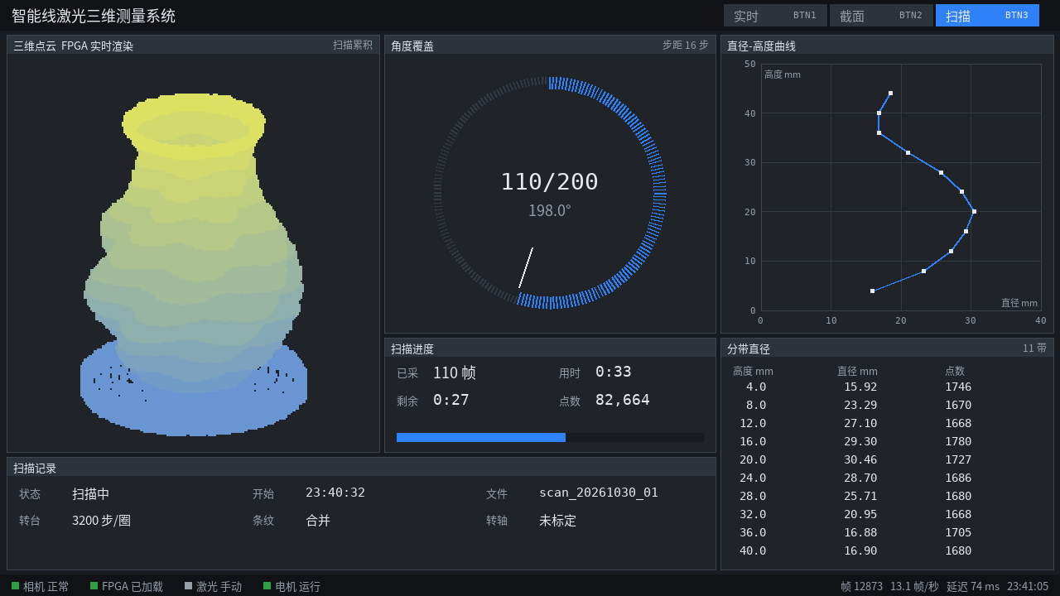
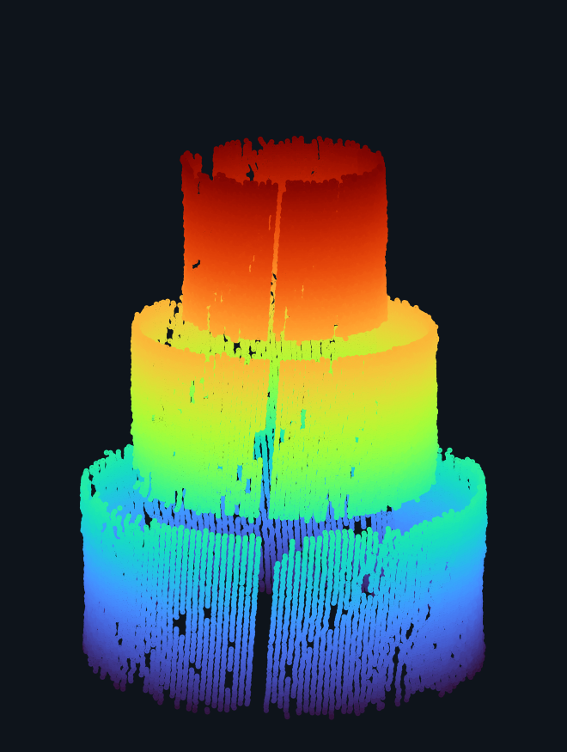
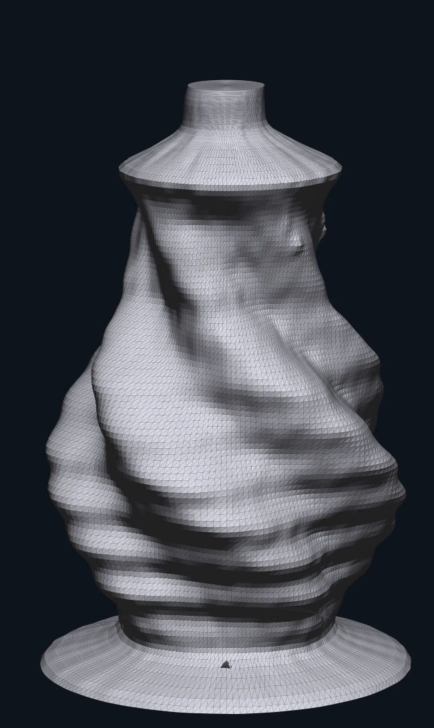
Intelligent Line-Laser
3D Measurement System
Single-board operation
752 × 480 grayscale input
INTRODUCTION
Pixel-to-3D hardware pipeline
Data
Control / status
Non-contact profile and dimension inspection of small parts. Pixel extraction, 3D geometry and HDMI point-cloud rendering run on one PYNQ-Z2.
MT9V034 Camera
On-board test: PYNQ-Z2
752 × 480 grayscale
PL / Programmable Logic
100 MHz
C
R
E
A
T
I
V
E
D
E
S
I
G
N
R
PL image processing
BTN1 LIVE
Camera Capture / CDC FIFO
E
26.5
frames/s
Frame identity and pixel stream
S
Frame-by-frame processing, zero packet errors
Laser centres
Fixed-point XYZ
Live cloud
Shared Window / Hessian
U
Median stripe-centre error
0.02 px
Shared filter and derivative features
L
Synthetic stripes with known centre positions
T
360° scan: 200 views / ≈2.5 min / ≈66k points
Direction Lane 0
Direction Lane 1
S
Measurement | Result
Steps, nominal | 2 / 3 / 5 mm
Steps, measured | 2.00 / 2.90 / 4.96 mm
Cylinder diameter error | −0.32 to −0.10 mm
Vase neck error | −0.27 to +0.05 mm
Direction / refinement
Direction / refinement
BTN2 SECTION
Stripe Extraction / Branch Linking
Q12 centres and quality flags
Step heights
Gap indication
Noise and trend
Fixed-point Geometry Engine
Undistort · triangulate · rotate
Signed diameter errors against caliper readings.
Cylinder results are calibration rechecks.
Measure / Section
Voxel Renderer
AXI-Lite result registers
Point buffer / projection
Implemented FPGA resources
LUT 73.5% FF 47.8%
BRAM 78.9% DSP 60.9%
BTN3 SCAN
DMA / DDR3
Video / HDMI Output
Raw · PFO3 · XYZ packets
VDMA + PL cloud overlay
WNS +0.230 ns On-chip power ≈2.37 W
Angle progress
Cloud accumulation
Result export
GP0
Result readback
PS / ARM Cortex-A9
Scan control, stitching and assessment
HDMI pages, storage and export
Motion Guard / Turntable BTN0 scan · BTN1–3 pages
Cylinder scan cloud
Vase scan mesh
Notes:
Revision: compact content within the official template. Native UI images are archived software renders, not a new board run. Step nominal heights are 2/3/5 mm; displayed values 2.00/2.90/4.96 mm from section_page.png. PL 26.5 frames/s is camera image processing, separate from the 200-view scan example. Resource, timing and measurement numbers retained from the design report. No school, team or member identity added. Sources: report/design_report.pdf pp.1,23,24; docs/media/readme_media_sources.json. Two result thumbnails show scan data, not the STL model.

